Slide 1
Section 10.2
Arithmetic Sequences and Series

Slide 2
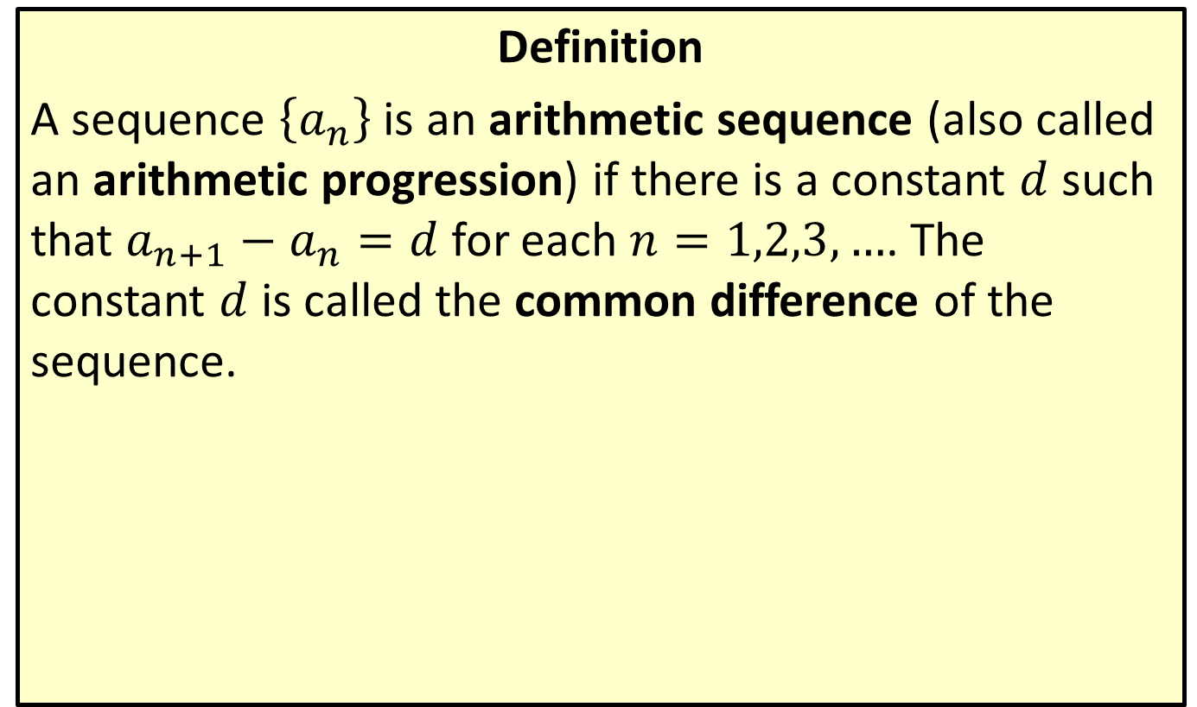
Arithmetic Sequences
Definition
A sequence $\left\{a_{n}\right\}$ is an arithmetic sequence (also called an arithmetic progression) if there is a constant $d$ such that $a_{n+1}−a_{n}=d$ for each $n=1,2,3,…$. The constant $d$ is called the common difference of the sequence.

Slide 3
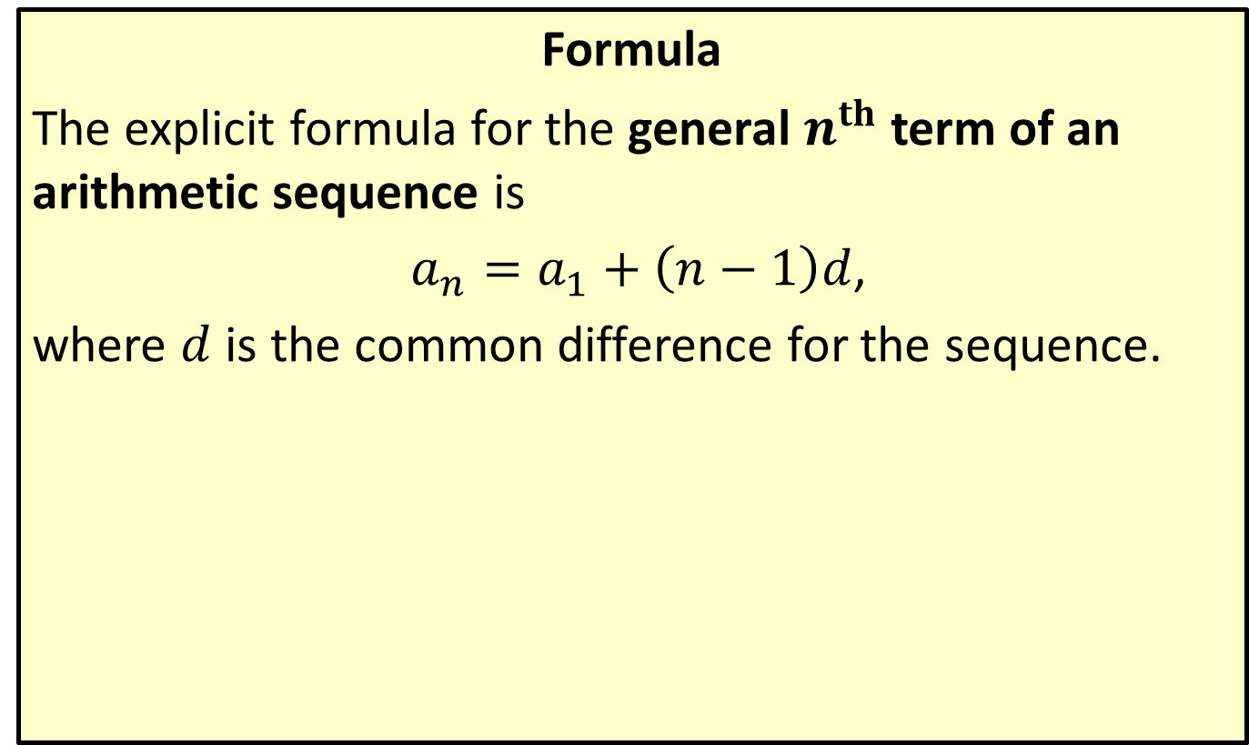
General Term of an Arithmetic Sequence
Formula
The explicit formula for the general $n^{th}$ term of an arithmetic sequence is
$a_{n}=a_{1}+\left(n−1\right)d$,
where $d$ is the common difference for the sequence.

Slide 4

Example 1: General Term of an Arithmetic Sequence
Find the formula for the general $n$^{th} term of each arithmetic sequence.
​$−3, 2, 7, 12,…$
​$a_{1}=\frac{1}{3}$ and $a_{4}=\frac{11}{6}$
​$a_{7}=−8$ and $d=−3$

Slide 5
Note:
An arithmetic sequence can be defined by two terms, or by one term and the common difference.

Slide 6
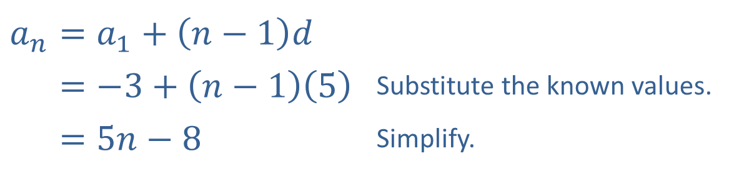
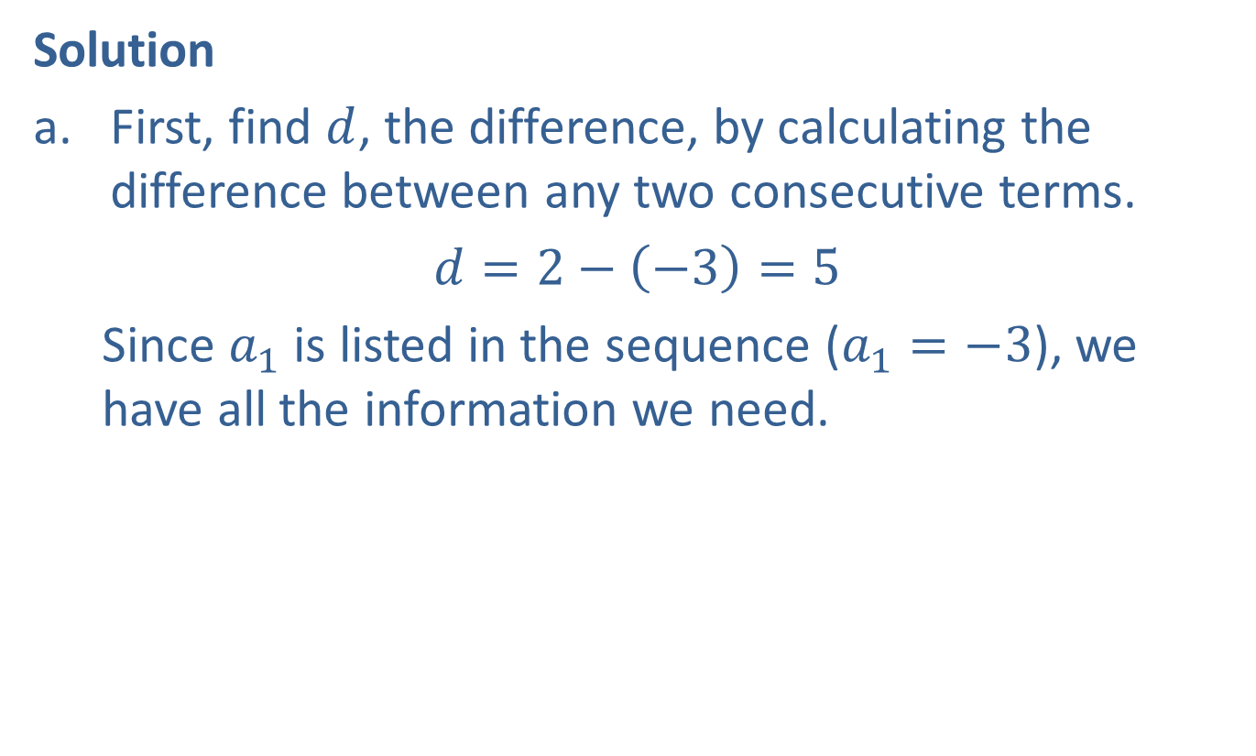
Example 1: General Term of an Arithmetic Sequence (cont.)
Solution
​First, find $d$, the difference, by calculating the difference between any two consecutive terms.
​$d=2−\left(−3\right)=5$
  Since $a_{1}$ is listed in the sequence ($a_{1}=−3$), we have all the information we need.
​
​$a_{n}=a_{1}+\left(n−1\right)d$
​𝑎𝑛=−3+𝑛−15 | Substitute the known values.
​𝑎𝑛=5𝑛−8 | Simplify.

Slide 7
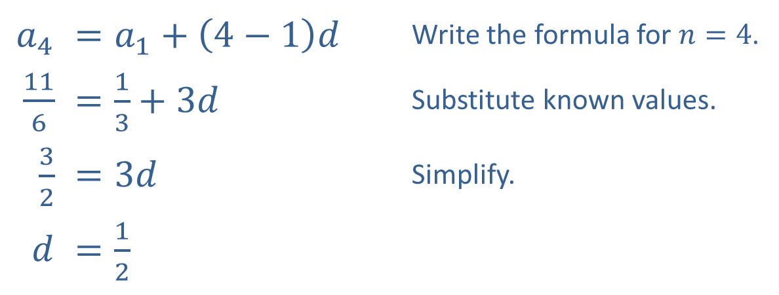

Example 1: General Term of an Arithmetic Sequence (cont.)
​Here, two nonconsecutive terms are given. Since
$a_{1}=\frac{1}{3}$, we can use the formula for the $n$^{th} term to find $d$.
​
​$a_{4}$ | ​$=a_{1}+\left(4−1\right)d$ | Write the formula for $n=4$.
​$\frac{11}{6}$ | ​$=\frac{1}{3}+3d$ | Substitute known values.
​$\frac{3}{2}$ | ​$=3d$ | Simplify.
$d$ | ​$=\frac{1}{2}$

Slide 8
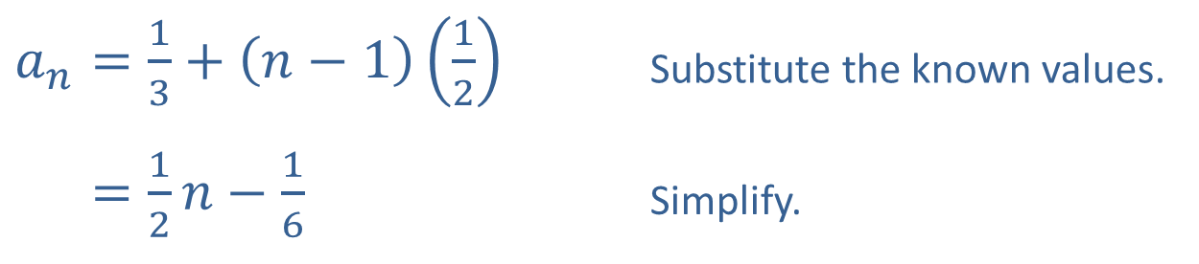

Example 1: General Term of an Arithmetic Sequence (cont.)
​Now, substitute back in to the formula to find the general $n$^{th} term.
​
​$a_{n}=\frac{1}{3}+\left(n−1\right)\left(\frac{1}{2}\right)$ | Substitute the known values.
​𝑎𝑛=12𝑛−16 | Simplify.

Slide 9
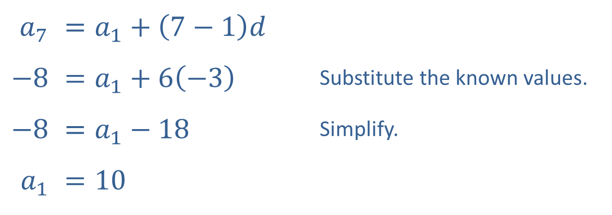

Example 1: General Term of an Arithmetic Sequence (cont.)
​Similarly, we have enough information to use the formula to find $a_{1}$.
​
​$a_{7}$ | ​$=a_{1}+\left(7−1\right)d$
​$−8$ | ​$=a_{1}+6\left(−3\right)$ | Substitute the known values.
​$−8$ | ​$=a_{1}−18$ | Simplify.
​$a_{1}$ | ​$=10$

Slide 10

Example 1: General Term of an Arithmetic Sequence (cont.)
​Substitute back in to the formula to find $a_{n}$.
𝑎𝑛=10+𝑛−1−3𝑎𝑛=−3𝑛+13

Slide 11
Example 2: Modeling Population Growth
A demographer models the population growth of a small town as an arithmetic progression. He knows that the population in 2012 was 12,790 and that in 2015 the population was 13,150. He wants to treat the population in 2010 as the first term of the arithmetic progression. What is the sought-after formula?

Slide 12
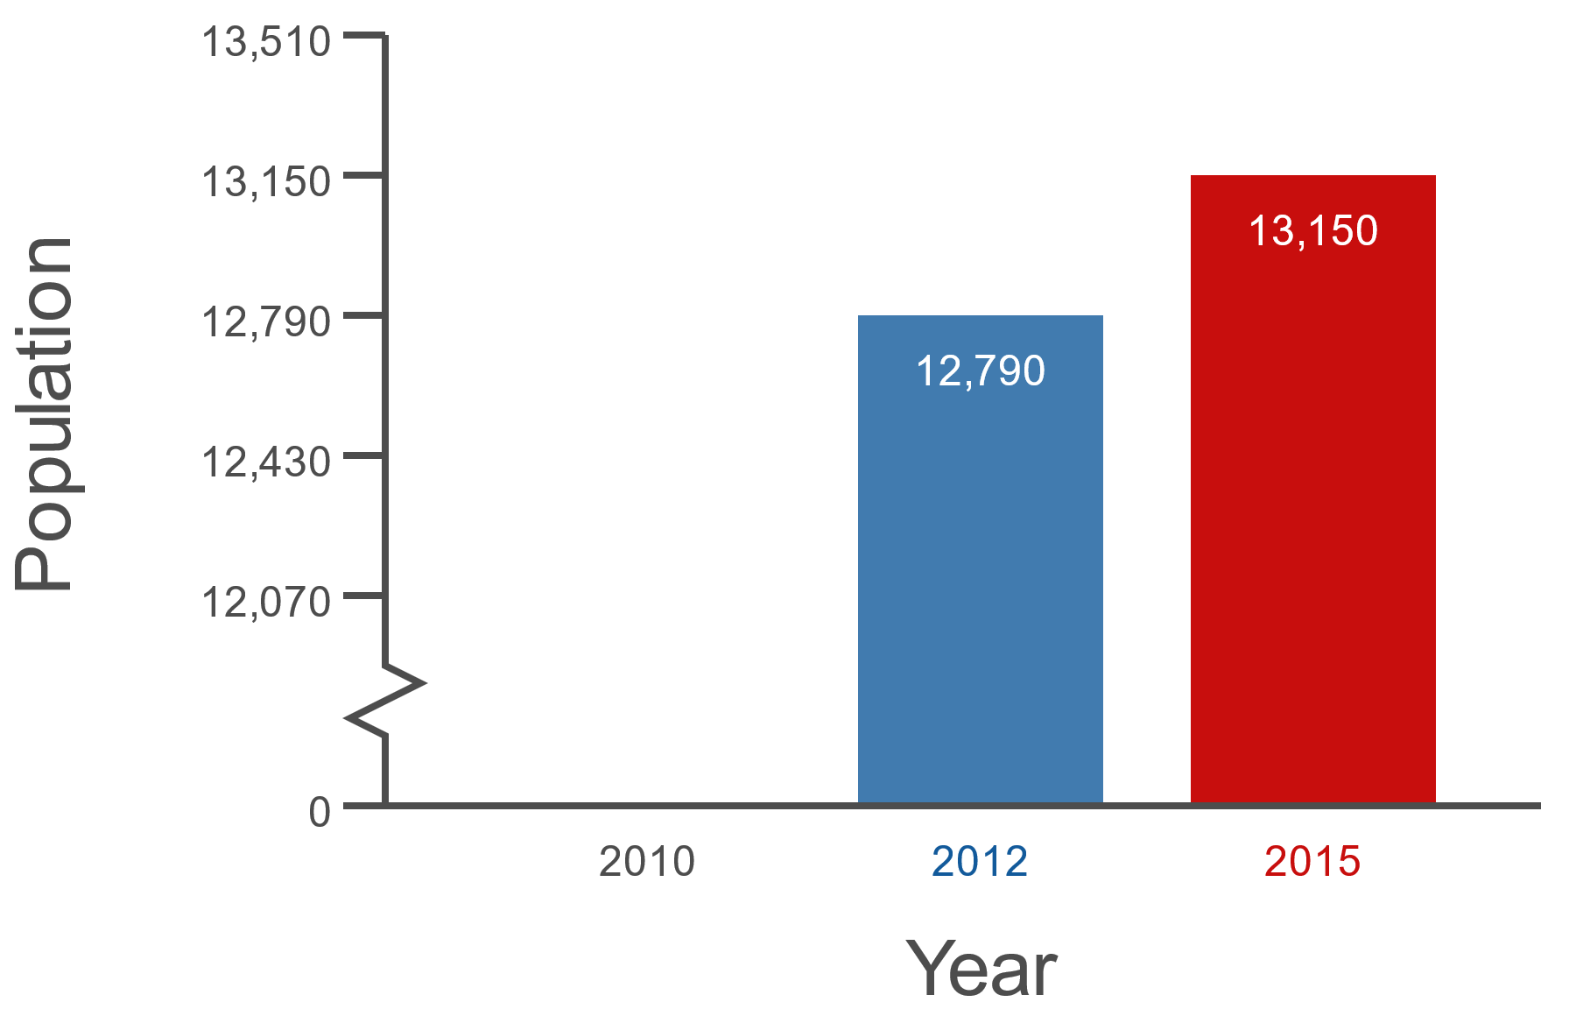
Example 2: Modeling Population Growth (cont.)
Figure 1

Slide 13
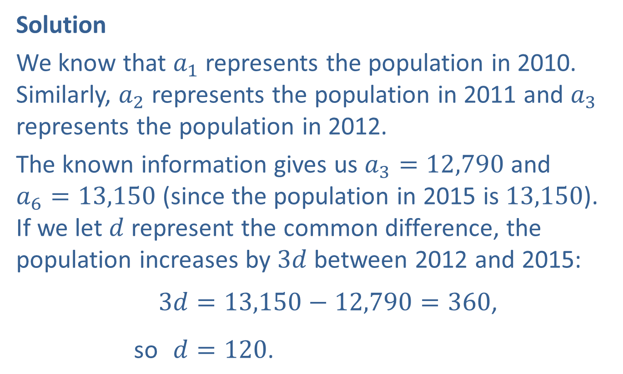
Example 2: Modeling Population Growth (cont.)
Solution
We know that $a_{1}$ represents the population in 2010. Similarly, $a_{2}$ represents the population in 2011 and $a_{3}$ represents the population in 2012.
The known information gives us $a_{3}=12,790$ and
$a_{6}=13,150$ (since the population in 2015 is 13,150). If we let $d$ represent the common difference, the population increases by $3d$ between 2012 and 2015:
so3𝑑=13,150−12,790=360,so1𝑑=120.

Slide 14
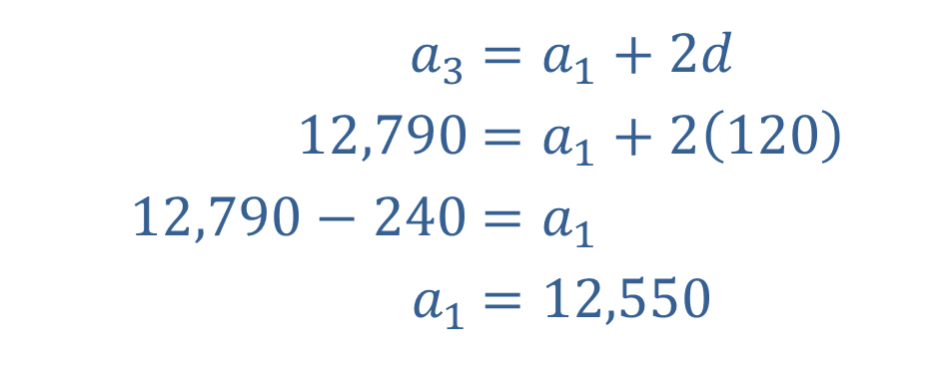

Example 2: Modeling Population Growth (cont.)
Now, we can use the fact that $a_{3}=12,790$ to determine $a_{1}$.
​
​$a_{3}$ | ​$=a_{1}+2d$
​$12,790$ | ​$=a_{1}+2\left(120\right)$
​$12,790−240$ | ​$=a_{1}$
​$a_{1}$ | ​$=12,550$

Slide 15
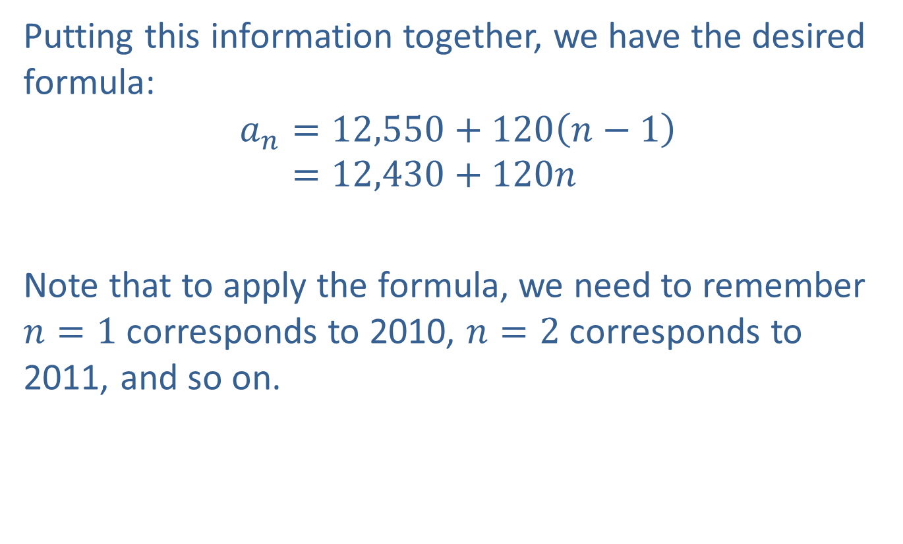
Example 2: Modeling Population Growth (cont.)
Putting this information together, we have the desired formula:
𝑎𝑛=12,550+120𝑛−1𝑎𝑛=12,430+120𝑛
Note that to apply the formula, we need to remember $n=1$ corresponds to 2010, $n=2$ corresponds to 2011, and so on.

Slide 16
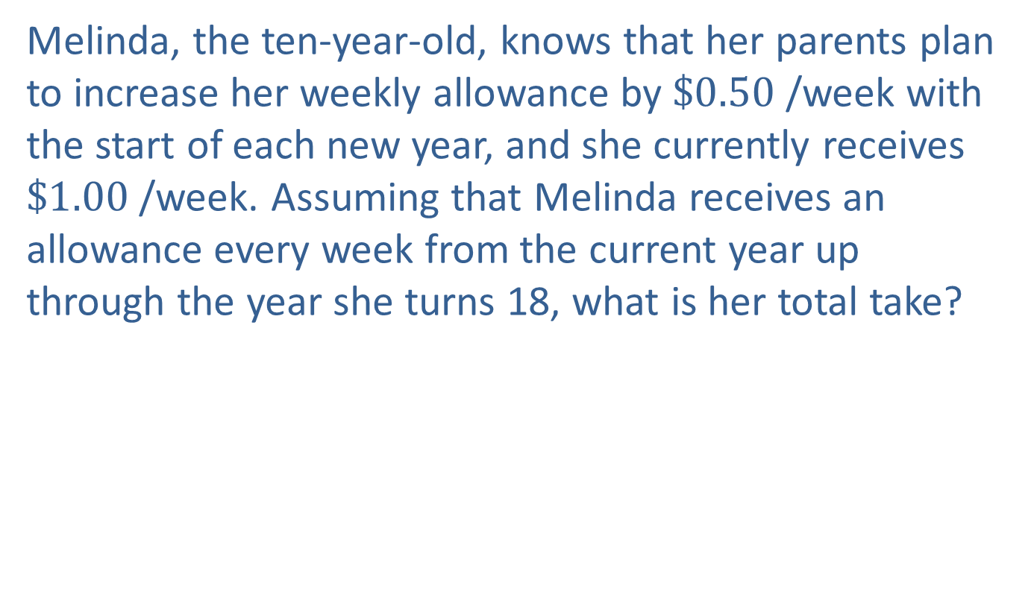
Example 3: Partial Sums of Arithmetic Sequences
Melinda, the ten-year-old, knows that her parents plan to increase her weekly allowance by $\$0.50$ /week with the start of each new year, and she currently receives $\$1.00$ /week. Assuming that Melinda receives an allowance every week from the current year up through the year she turns 18, what is her total take?

Slide 17
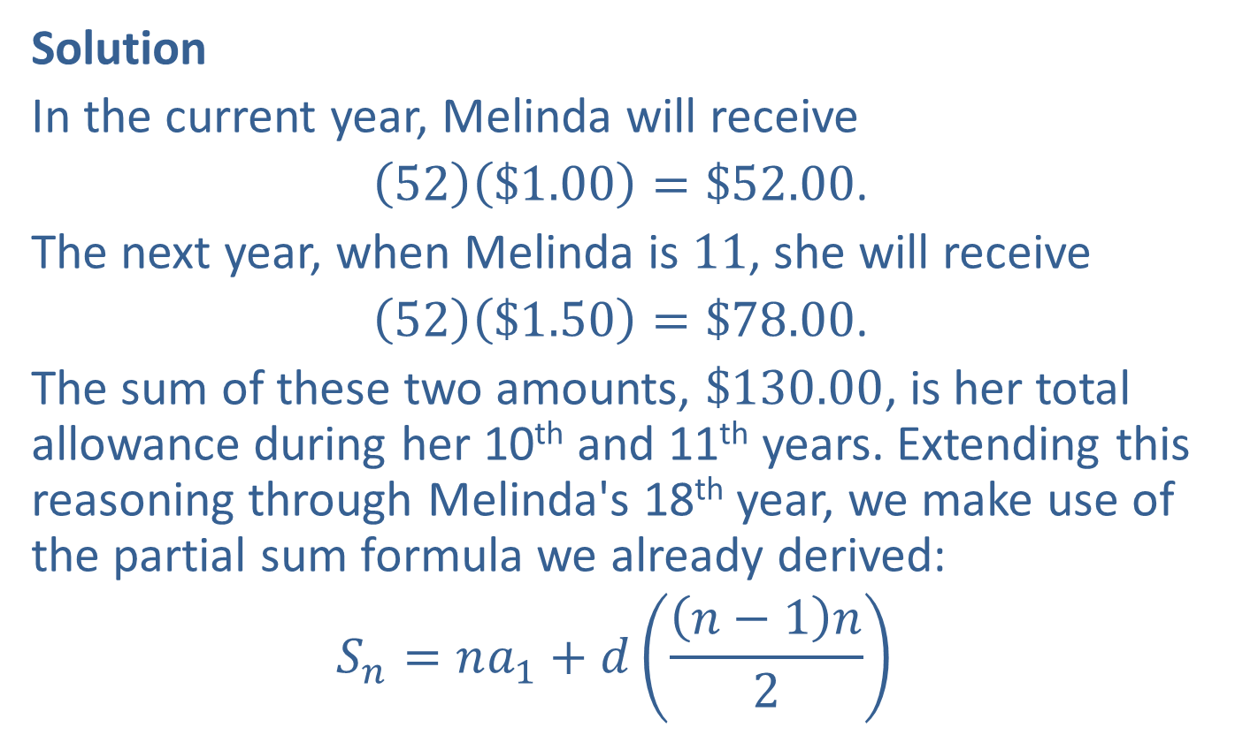
Example 3: Partial Sums of Arithmetic Sequences (cont.)
Solution
In the current year, Melinda will receive
$\left(52\right)\left(\$1.00\right)=\$52.00$.
The next year, when Melinda is 11, she will receive
$\left(52\right)\left(\$1.50\right)=\$78.00$.
The sum of these two amounts, $\$130.00$, is her total allowance during her 10th and 11th years. Extending this reasoning through Melinda's 18th year, we make use of the partial sum formula we already derived:
$$S_{n}=na_{1}+d\left(\frac{\left(n−1\right)n}{2}\right)$$

Slide 18

Example 3: Partial Sums of Arithmetic Sequences (cont.)
We know that $a_{1}=52$ since her total allowance during the first year is $\$52.00$. Since her weekly allowance increases $\$0.50$ every year, Melinda's yearly allowance increases by $52\left(\$0.50\right)=\$26.00$ each year, so
$d=26$.

Slide 19
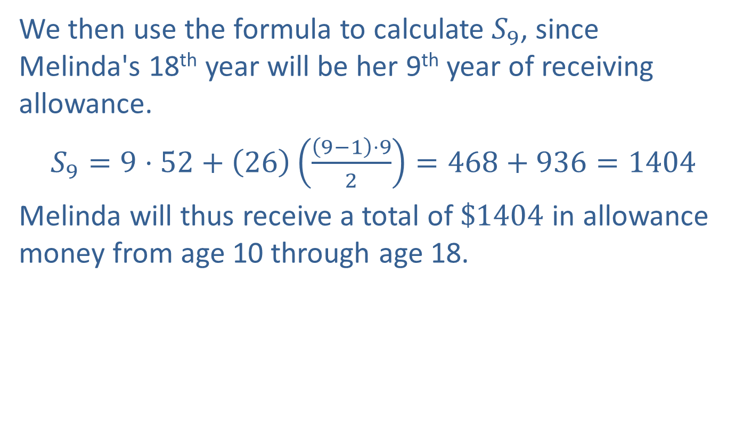
Example 3: Partial Sums of Arithmetic Sequences (cont.)
We then use the formula to calculate $S_{9}$, since Melinda's 18th year will be her 9th year of receiving allowance.
$S_{9}=9⋅52+\left(26\right)\left(\frac{\left(9−1\right)⋅9}{2}\right)=468+936=1404$
Melinda will thus receive a total of $\$1404$ in allowance money from age 10 through age 18.

Slide 20
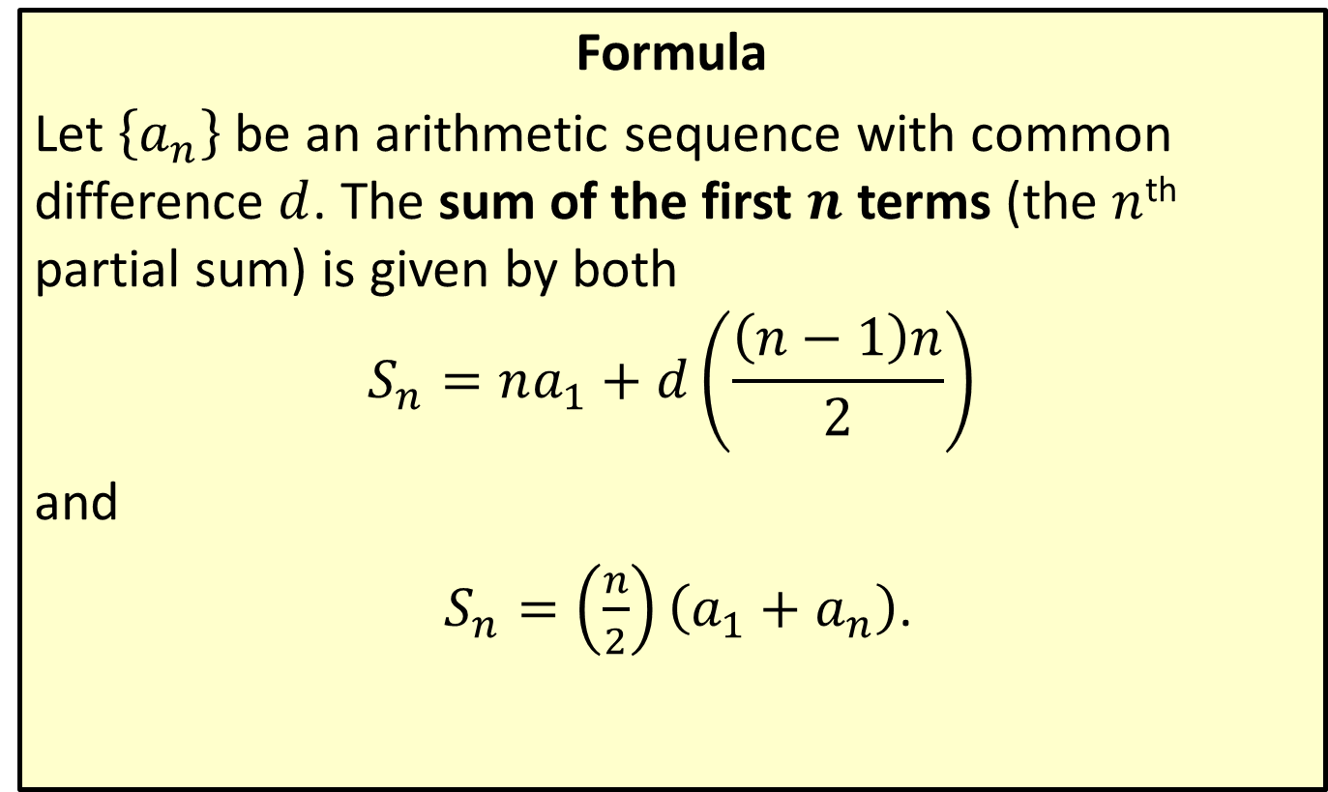
Partial Sums of Arithmetic Sequences
Formula
Let $\left\{a_{n}\right\}$ be an arithmetic sequence with common difference $d$. The sum of the first $n$ terms (the $n$^{th} partial sum) is given by both
$$S_{n}=na_{1}+d\left(\frac{\left(n−1\right)n}{2}\right)$$
and
$S_{n}=\left(\frac{n}{2}\right)\left(a_{1}+a_{n}\right)$.

Slide 21
Example 4: Partial Sums of Arithmetic Sequences
Determine the sum of the first 100 positive odd integers.

Slide 22
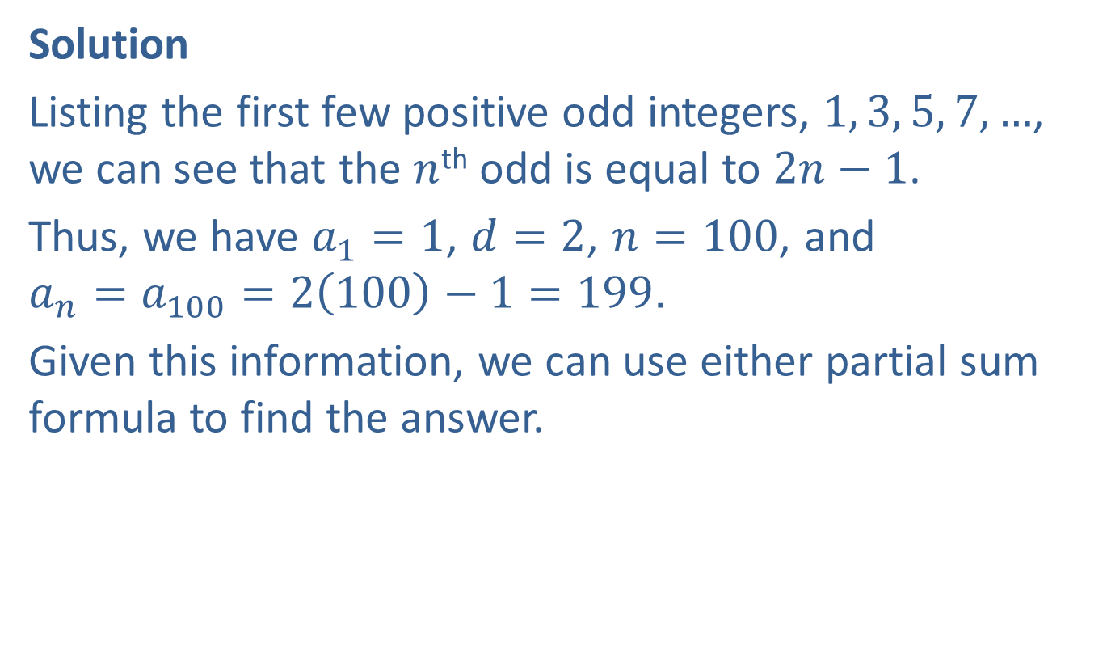
Example 4: Partial Sums of Arithmetic Sequences (cont.)
Solution
Listing the first few positive odd integers, $1, 3, 5, 7,…$, we can see that the $n$^{th} odd is equal to $2n−1$.
Thus, we have $a_{1}=1$, $d=2$, $n=100$, and
$a_{n}=a_{100}=2\left(100\right)−1=199$.
Given this information, we can use either partial sum formula to find the answer.

Slide 23
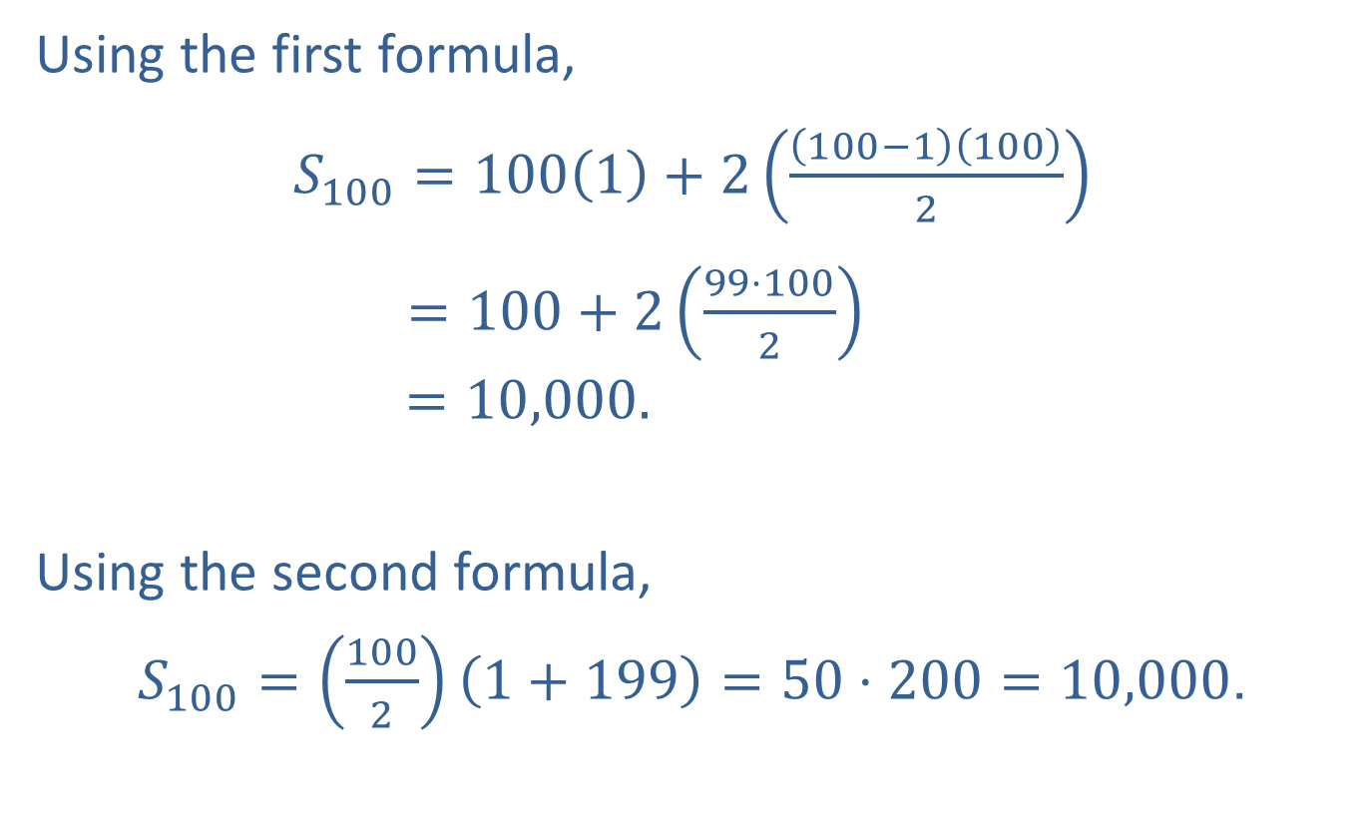
Example 4: Partial Sums of Arithmetic Sequences (cont.)
Using the first formula,
$S_{100}=100\left(1\right)+2\left(\frac{\left(100−1\right)\left(100\right)}{2}\right)$
$=100+2\left(\frac{99⋅100}{2}\right)$
$$=10,000.$$
Using the second formula,
$S_{100}=\left(\frac{100}{2}\right)\left(1+199\right)=50⋅200=10,000$.

