Slide 1
Section 10.3
Geometric Sequences and Series

Slide 2
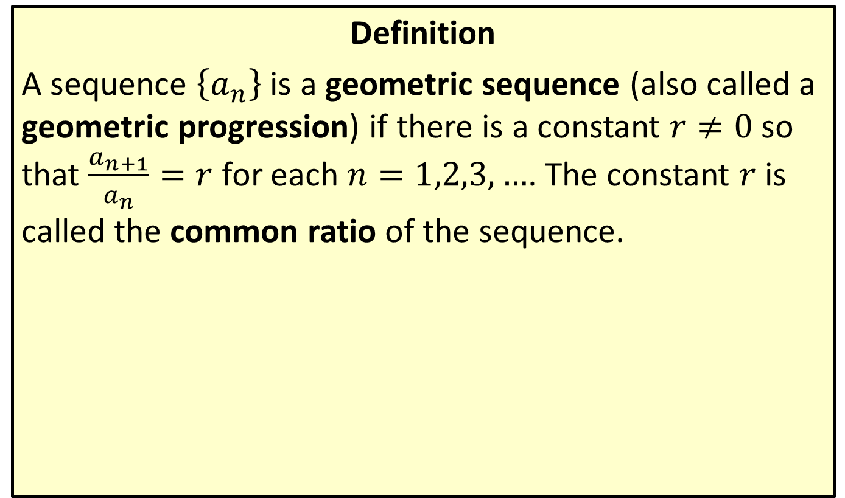
Geometric Sequences
Definition
A sequence $\left\{a_{n}\right\}$ is a geometric sequence (also called a geometric progression) if there is a constant $r≠0$ so that $\frac{a_{n+1}}{a_{n}}=r$ for each $n=1,2,3,…$. The constant $r$ is called the common ratio of the sequence.

Slide 3
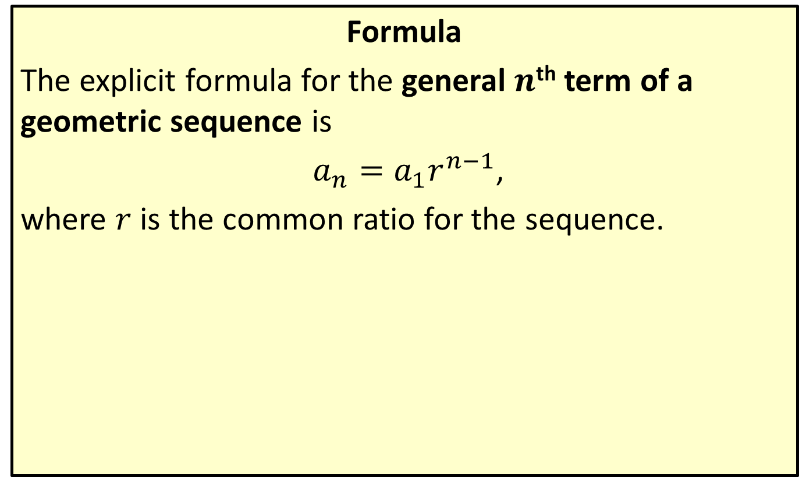
General Term of a Geometric Sequence
Formula
The explicit formula for the general $n$^{th} term of a geometric sequence is
$a_{n}=a_{1}r^{n−1}$,
where $r$ is the common ratio for the sequence.

Slide 4

Example 1: General Term of a Geometric Sequence
Find the formula for the general $n$^{th} term of each geometric sequence.
​ $\frac{1}{3},\frac{1}{9},\frac{1}{27},…$
​$3,−6,12,…$
​$a_{4}=\frac{5}{16}$ and $r=\frac{1}{2}$

Slide 5
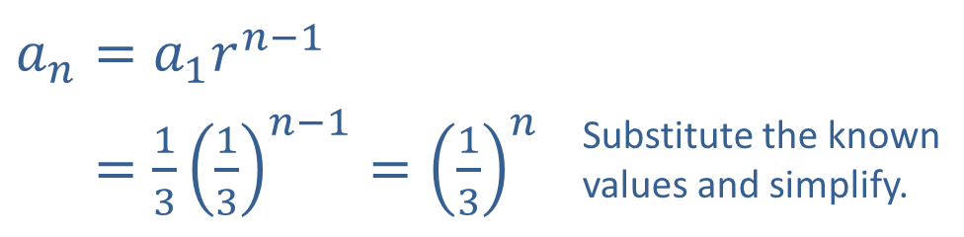
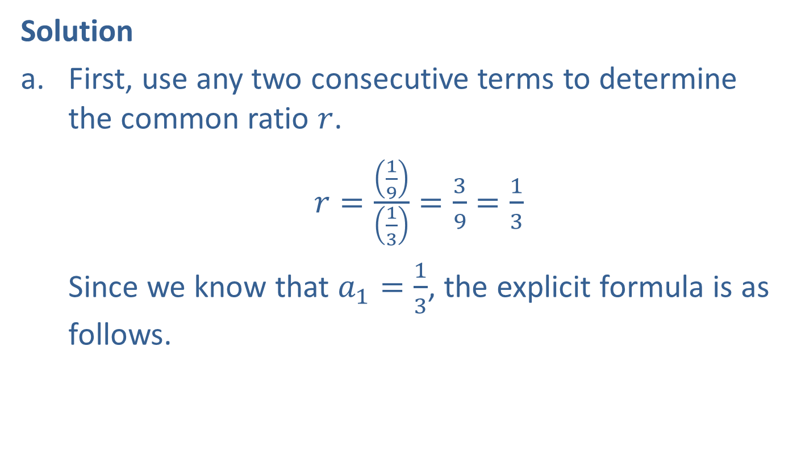
Example 1: General Term of a Geometric Sequence (cont.)
Solution
​First, use any two consecutive terms to determine the common ratio $r$.
​$r=\frac{\left(\frac{1}{9}\right)}{\left(\frac{1}{3}\right)}=\frac{3}{9}=\frac{1}{3}$
​Since we know that $a_{1}=\frac{1}{3}$, the explicit formula is as follows.
​$a_{n}=a_{1}r^{n−1}$
​𝑎𝑛=1313𝑛−1=13𝑛 | Substitute the known values and simplify.

Slide 6
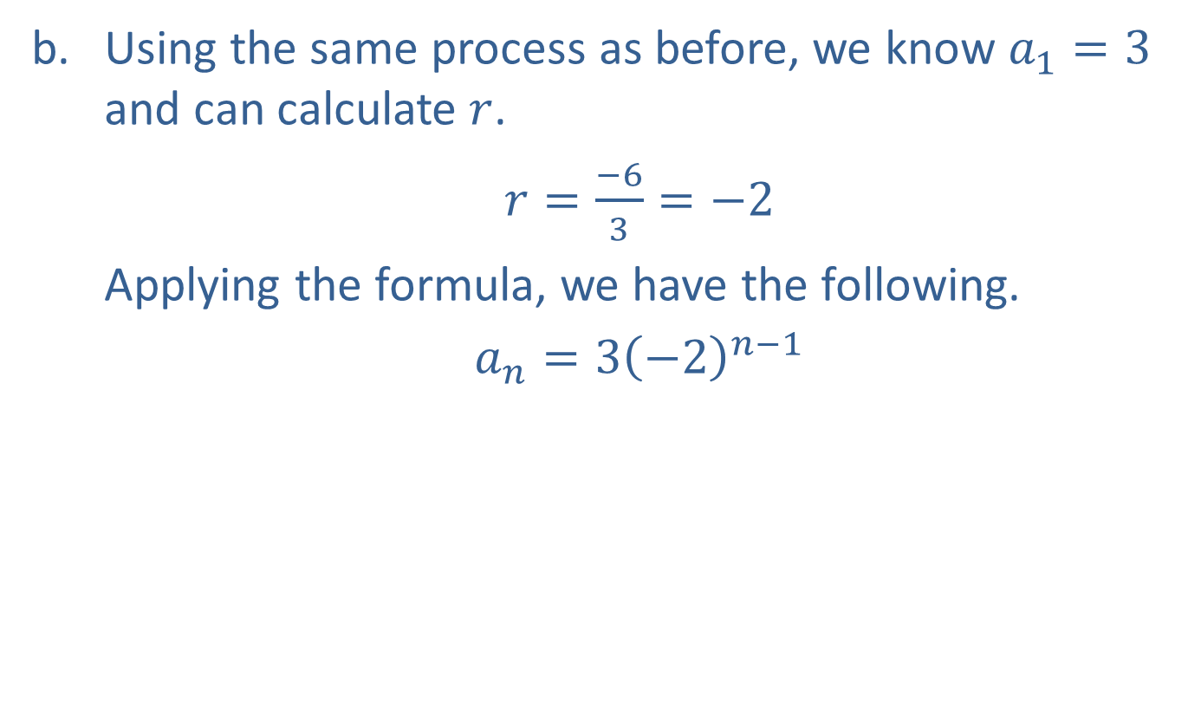
Example 1: General Term of a Geometric Sequence (cont.)
​Using the same process as before, we know $a_{1}=3$ and can calculate $r$.
​$r=\frac{−6}{3}=−2$
​Applying the formula, we have the following.
​$a_{n}=3{\left(−2\right)}^{n−1}$

Slide 7
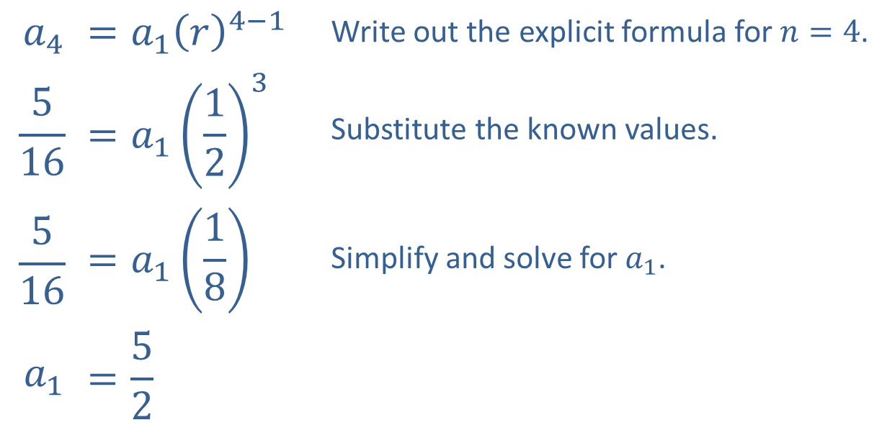

Example 1: General Term of a Geometric Sequence (cont.)
​Here we are given $r$ and another term. We can use the formula to find $a_{1}$.
​
$$a_{4}$$ | $$=a_{1}{\left(r\right)}^{4−1}$$ | Write out the explicit formula for $n=4$.
$$\frac{5}{16}$$ | $$=a_{1}{\left(\frac{1}{2}\right)}^{3}$$ | Substitute the known values.
$$\frac{5}{16}$$ | $$=a_{1}\left(\frac{1}{8}\right)$$ | Simplify and solve for $a_{1}$.
$$a_{1}$$ | $$=\frac{5}{2}$$

Slide 8

Example 1: General Term of a Geometric Sequence (cont.)
​We then substitute $a_{1}$ and $r$ to find the explicit formula.
$$a_{n}=\frac{5}{2}{\left(\frac{1}{2}\right)}^{n−1}$$

Slide 9

Example 2: General Term of a Geometric Sequence
Given that the second term of a geometric sequence is $−6$ and the fifth term is 162, what is the fourth term?

Slide 10
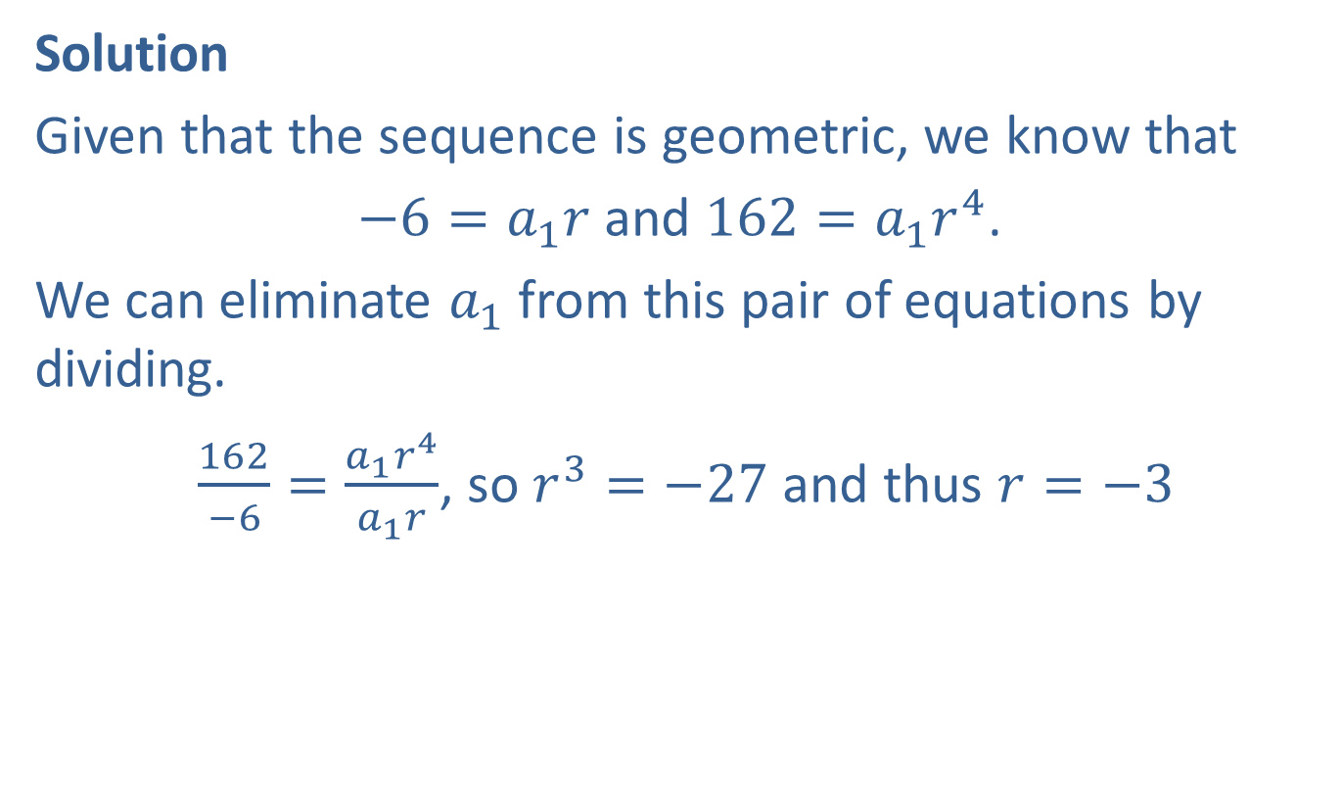
Example 2: General Term of a Geometric Sequence (cont.)
Solution
Given that the sequence is geometric, we know that
$−6=a_{1}r$ and $162=a_{1}r^{4}$.
We can eliminate $a_{1}$ from this pair of equations by dividing.
$\frac{162}{−6}=\frac{a_{1}r^{4}}{a_{1}r}$, so $r^{3}=−27$ and thus $r=−3$

Slide 11
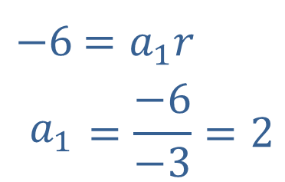
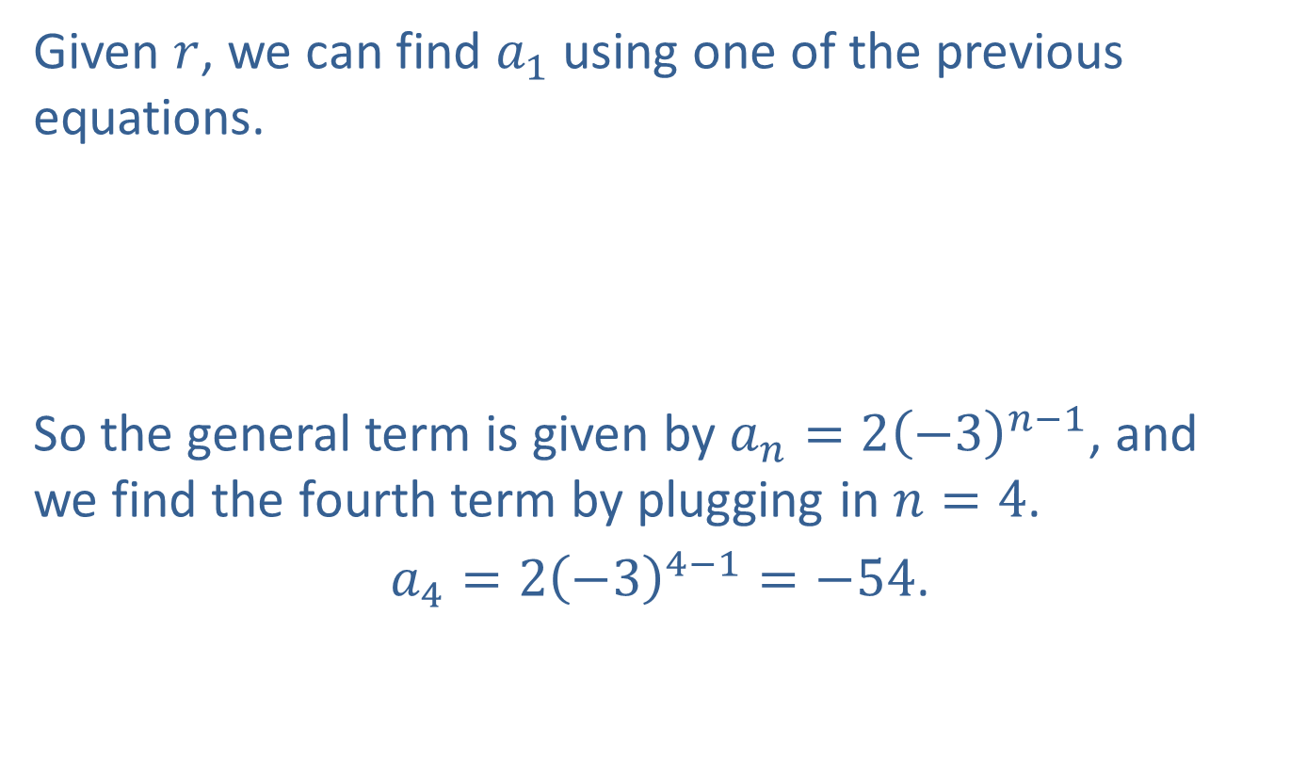
Example 2: General Term of a Geometric Sequence (cont.)
Given $r$, we can find $a_{1}$ using one of the previous equations.
​
So the general term is given by $a_{n}=2{\left(−3\right)}^{n−1}$, and we find the fourth term by plugging in $n=4$.
$a_{4}=2{\left(−3\right)}^{4−1}=−54$.
​$−6$ | ​$=a_{1}r$
​$a_{1}$ | $$=\frac{−6}{−3}=2$$

Slide 12
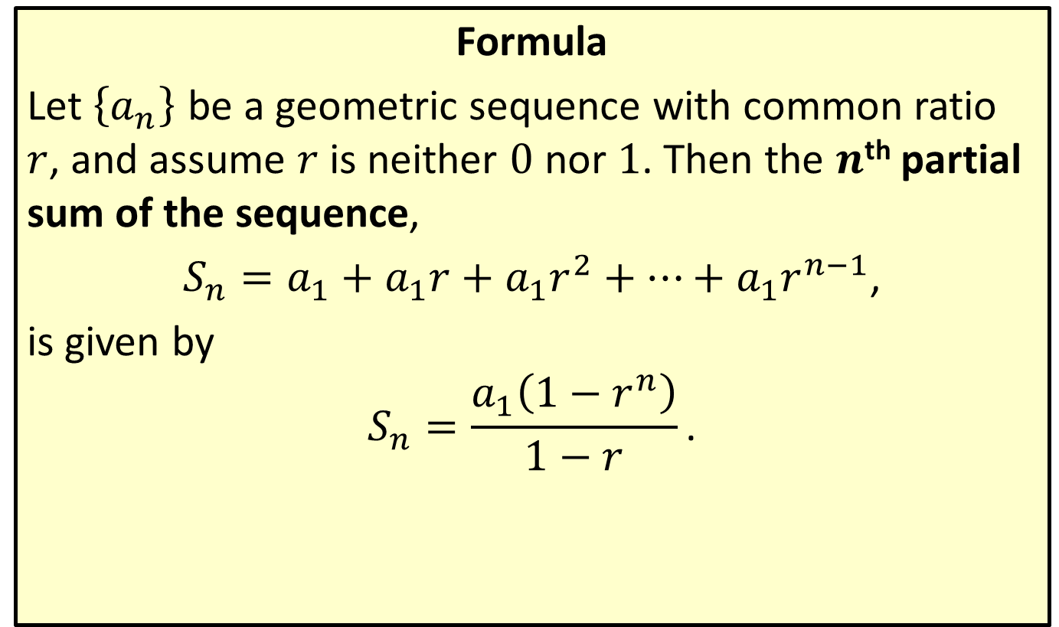
Partial Sum of a Geometric Sequence
Formula
Let $\left\{a_{n}\right\}$ be a geometric sequence with common ratio $r$, and assume $r$ is neither 0 nor 1. Then the $n$^{th} partial sum of the sequence,
$S_{n}=a_{1}+a_{1}r+a_{1}r^{2}+…+a_{1}r^{n−1}$,
is given by
$$S_{n}=\frac{a_{1}\left(1−r^{n}\right)}{1−r}\text{.}$$

Slide 13
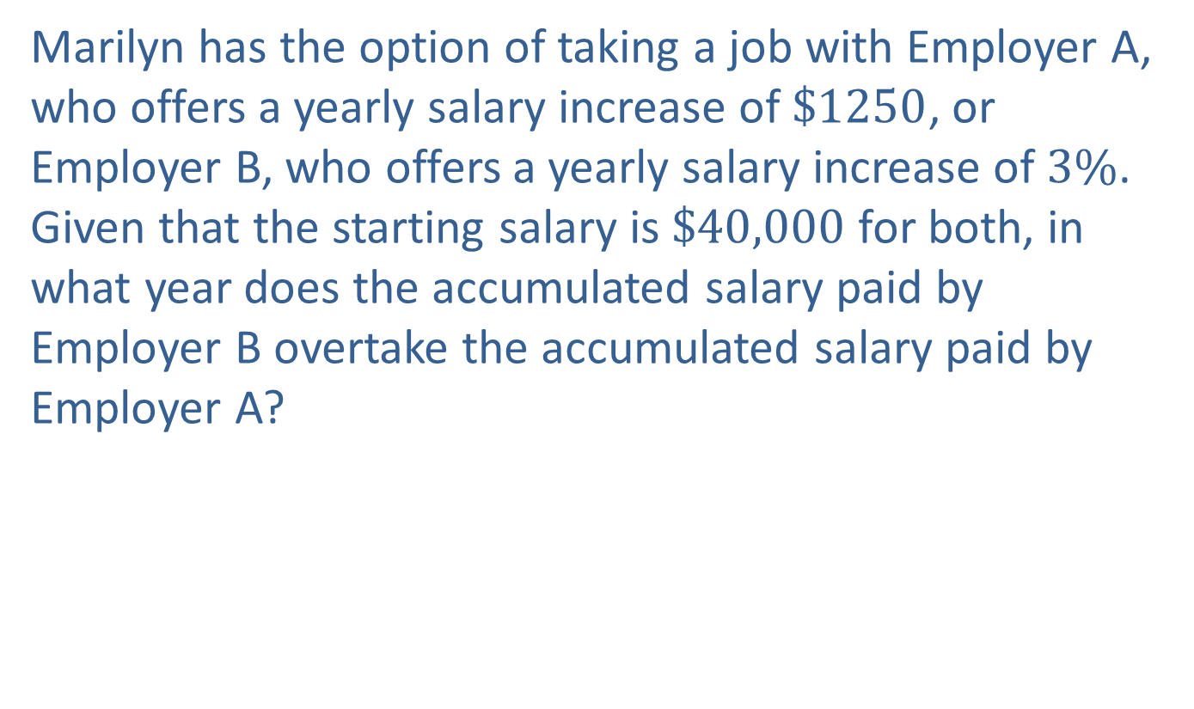
Example 3: Comparing Salary Offers
Marilyn has the option of taking a job with Employer A, who offers a yearly salary increase of $\$1250$, or Employer B, who offers a yearly salary increase of $3\%$. Given that the starting salary is $\$40,000$ for both, in what year does the accumulated salary paid by Employer B overtake the accumulated salary paid by Employer A?

Slide 14
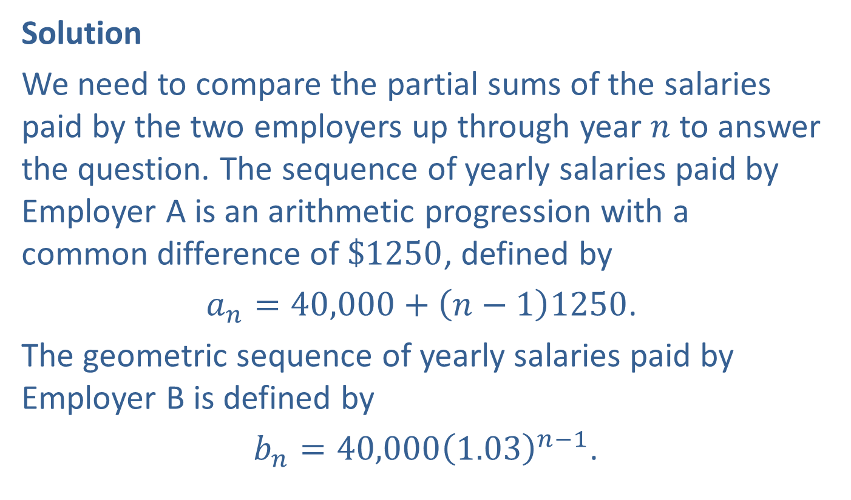
Example 3: Comparing Salary Offers (cont.)
Solution
We need to compare the partial sums of the salaries paid by the two employers up through year $n$ to answer the question. The sequence of yearly salaries paid by Employer A is an arithmetic progression with a common difference of $\$1250$, defined by
$a_{n}=40,000+\left(n−1\right)1250$.
The geometric sequence of yearly salaries paid by Employer B is defined by
$b_{n}=40,000{\left(1.03\right)}^{n−1}$.

Slide 15
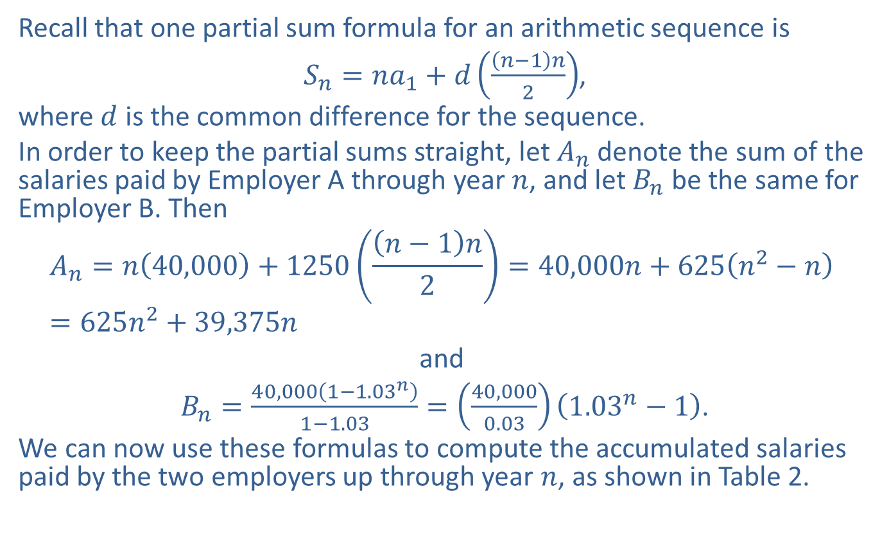
Example 3: Comparing Salary Offers (cont.)
Recall that one partial sum formula for an arithmetic sequence is
$S_{n}=na_{1}+d\left(\frac{\left(n−1\right)n}{2}\right)$,
where $d$ is the common difference for the sequence.
In order to keep the partial sums straight, let $A_{n}$ denote the sum of the salaries paid by Employer A through year $n$, and let $B_{n}$ be the same for Employer B. Then
$$A_{n}=n\left(40,000\right)+1250\left(\frac{\left(n−1\right)n}{2}\right)=40,000n+625\left(n^{2}−n\right)=625n^{2}+39,375n$$
and
$B_{n}=\frac{40,000\left(1−{1.03}^{n}\right)}{1−1.03}=\left(\frac{40,000}{0.03}\right)\left({1.03}^{n}−1\right)$.
We can now use these formulas to compute the accumulated salaries paid by the two employers up through year $n$, as shown in Table 2.

Slide 16
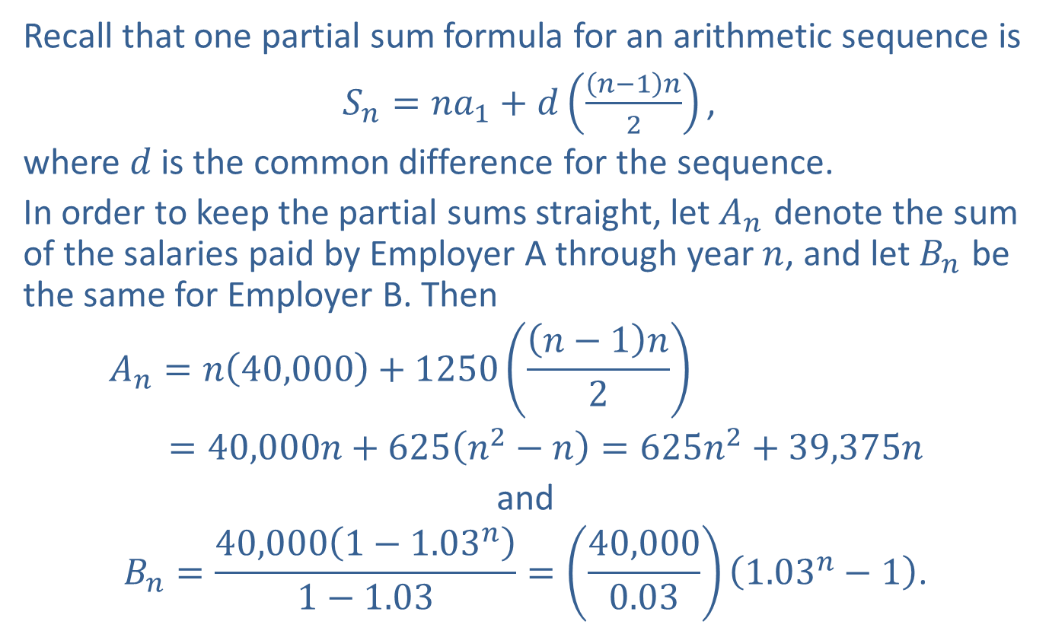
Example 3: Comparing Salary Offers (cont.)
Recall that one partial sum formula for an arithmetic sequence is
$S_{n}=na_{1}+d\left(\frac{\left(n−1\right)n}{2}\right)\text{,}$
where $d$ is the common difference for the sequence.
In order to keep the partial sums straight, let $A_{n}$ denote the sum of the salaries paid by Employer A through year $n$, and let $B_{n}$ be the same for Employer B. Then
$$A_{n}=n\left(40,000\right)+1250\left(\frac{\left(n−1\right)n}{2}\right)$$
$=40,000n+625\left(n^{2}−n\right)=625n^{2}+39,375n$
and
$$B_{n}=\frac{40,000\left(1−{1.03}^{n}\right)}{1−1.03}=\left(\frac{40,000}{0.03}\right)\left({1.03}^{n}−1\right)\text{.}$$

Slide 17
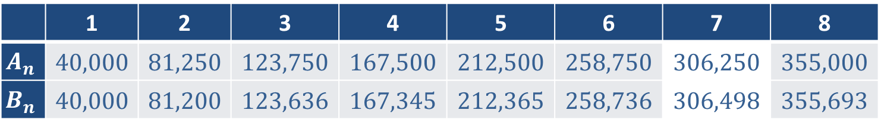
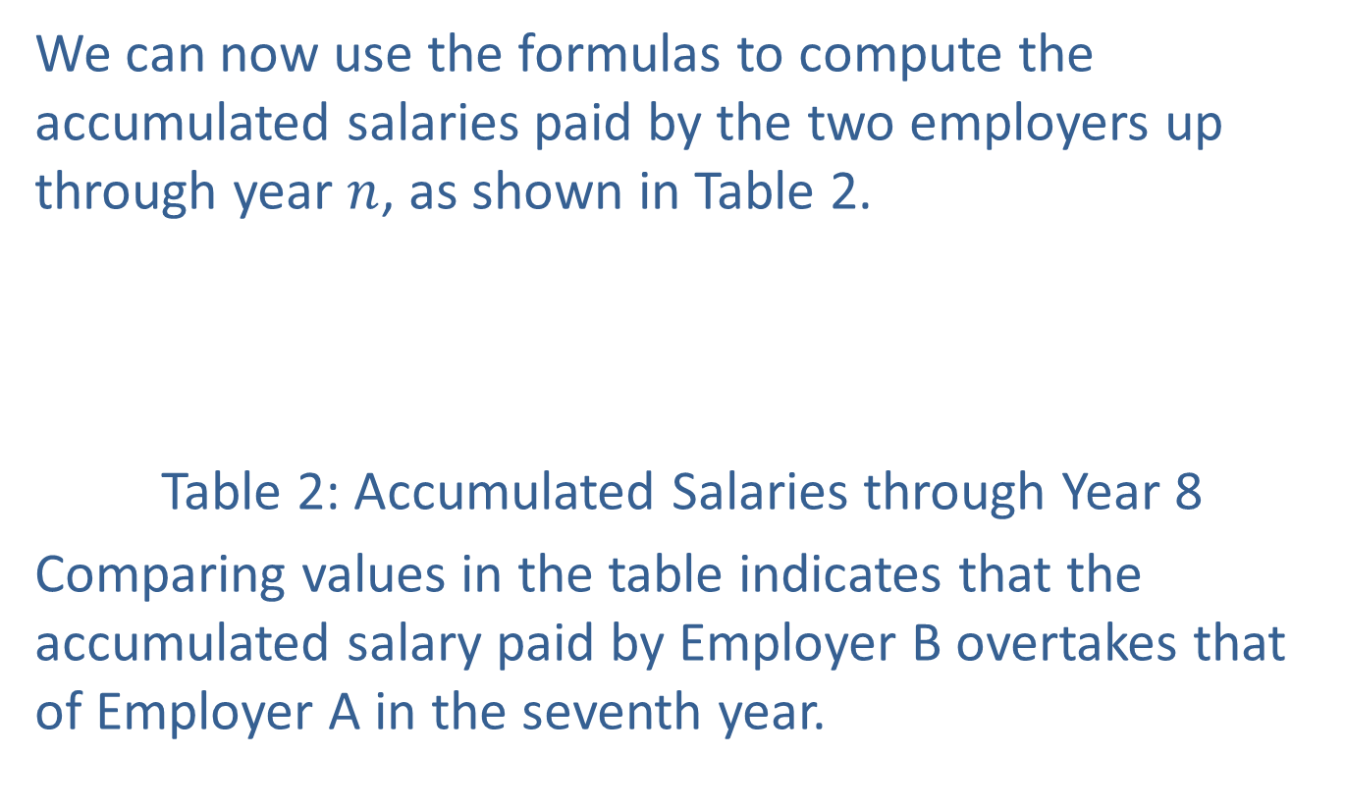
Example 3: Comparing Salary Offers (cont.)
We can now use the formulas to compute the accumulated salaries paid by the two employers up through year $n$, as shown in Table 2.
Table 2: Accumulated Salaries through Year 8
Comparing values in the table indicates that the accumulated salary paid by Employer B overtakes that of Employer A in the seventh year.
 | 1 | 2 | 3 | 4 | 5 | 6 | 7 | 8
$$A_{n}$$ | 40,000 | 81,250 | 123,750 | 167,500 | 212,500 | 258,750 | 306,250 | 355,000
$$B_{n}$$ | 40,000 | 81,200 | 123,636 | 167,345 | 212,365 | 258,736 | 306,498 | 355,693

Slide 18

Example 4: Partial Sum of a Geometric Sequence
Evaluate
$$\sum_{i=2}^{7}{5{\left(−\frac{1}{2}\right)}^{i}}\text{.}$$

Slide 19
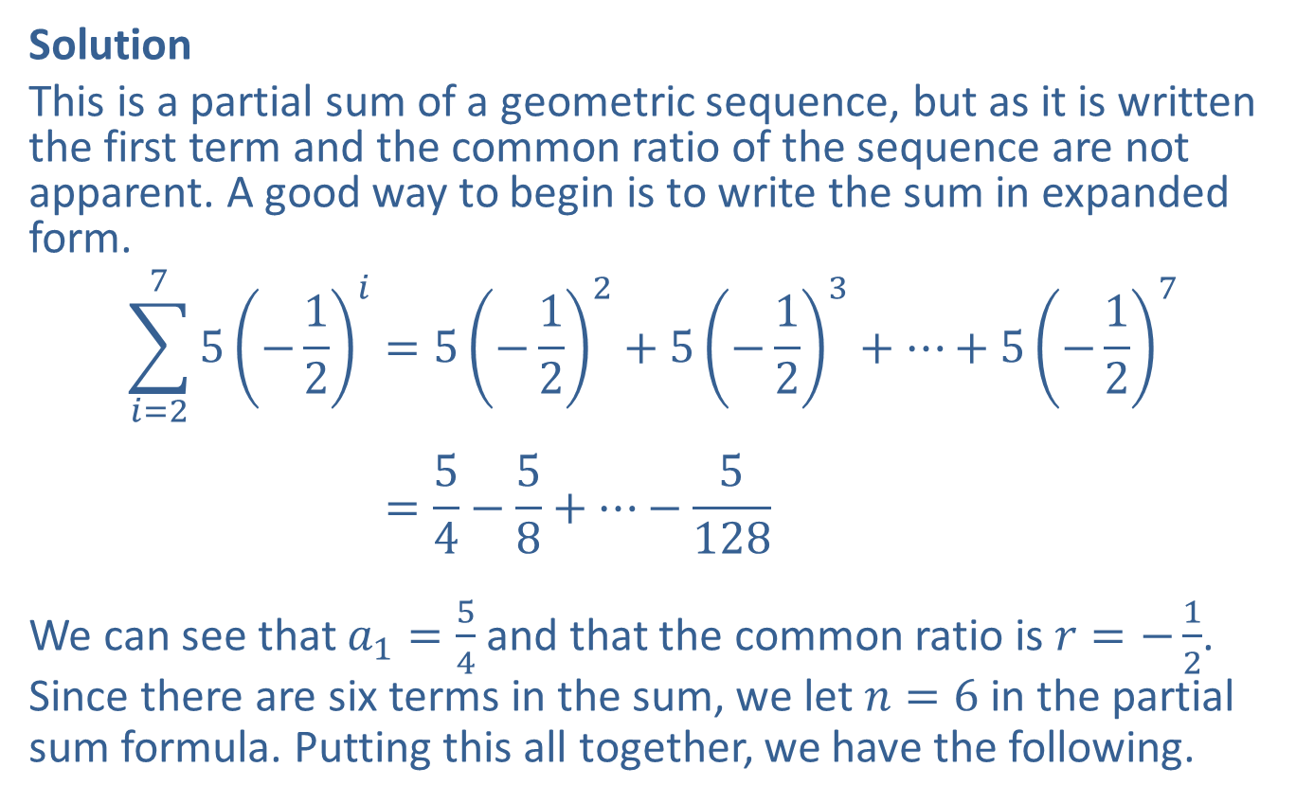
Example 4: Partial Sum of a Geometric Sequence (cont.)
Solution
This is a partial sum of a geometric sequence, but as it is written the first term and the common ratio of the sequence are not apparent. A good way to begin is to write the sum in expanded form.
𝑖=275−12𝑖=5−122+5−123+…+5−127𝑖=275−12𝑖=54−58+…−5128
We can see that $a_{1}=\frac{5}{4}$ and that the common ratio is $r=−\frac{1}{2}$. Since there are six terms in the sum, we let $n=6$ in the partial sum formula. Putting this all together, we have the following.

Slide 20
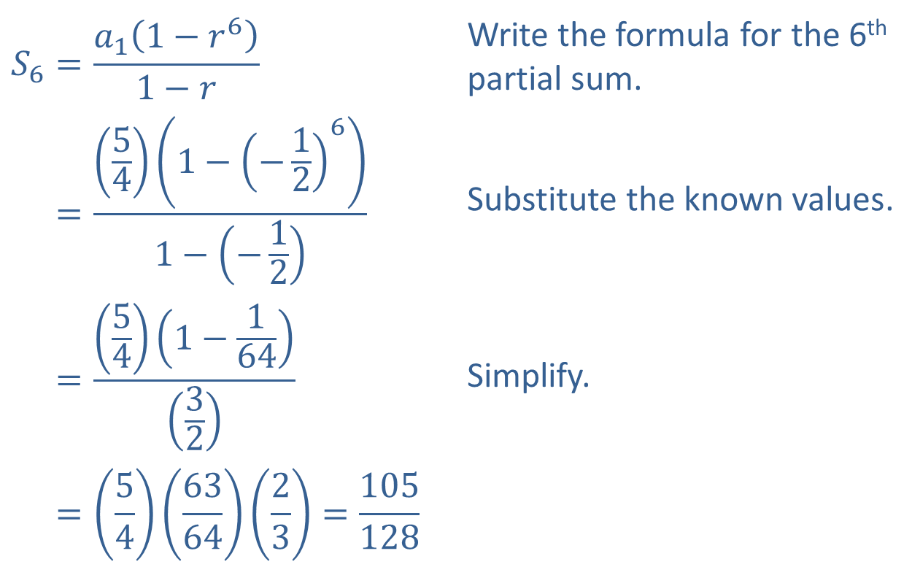
Example 4: Partial Sum of a Geometric Sequence (cont.)
$$S_{6}=\frac{a_{1}\left(1−r^{6}\right)}{1−r}$$ | Write the formula for the 6th partial sum.
𝑆6=541−−1261−−12 | Substitute the known values.
𝑆6=541−16432 | Simplify.
𝑆6=54636423=105128

Slide 21
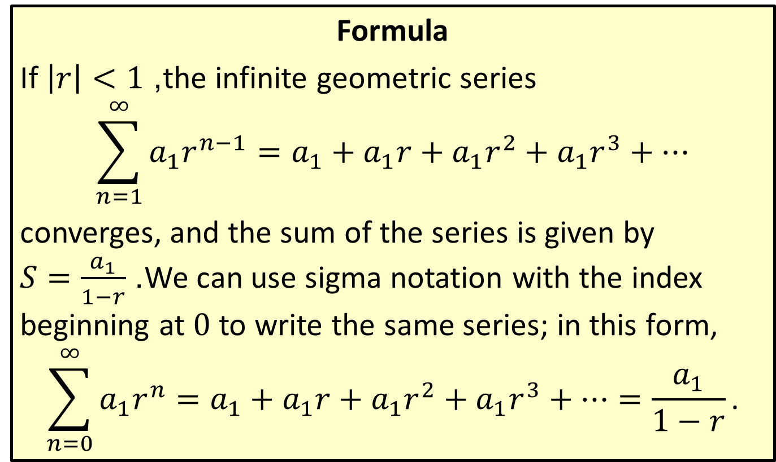
Sum of an Infinite Geometric Series
Formula
If $\left|r\right|<1$, the infinite geometric series
$$\sum_{n=1}^{∞}{a_{1}r^{n−1}}=a_{1}+a_{1}r+a_{1}r^{2}+a_{1}r^{3}+…$$
converges, and the sum of the series is given by
$S=\frac{a_{1}}{1−r}$. We can use sigma notation with the index beginning at 0 to write the same series; in this form,
$$\sum_{n=0}^{∞}{a_{1}r^{n}}=a_{1}+a_{1}r+a_{1}r^{2}+a_{1}r^{3}+…=\frac{a_{1}}{1−r}\text{.}$$

Slide 22

Example 5: Infinite Geometric Series
Find the sums of the following series.
​
​
$$\sum_{n=1}^{∞}{5{\left(−\frac{1}{2}\right)}^{n−1}}$$
$$\sum_{n=1}^{∞}{3{\left(\frac{1}{10}\right)}^{n}}$$

Slide 23
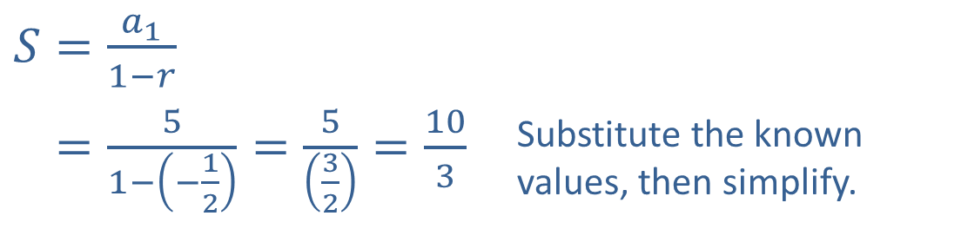
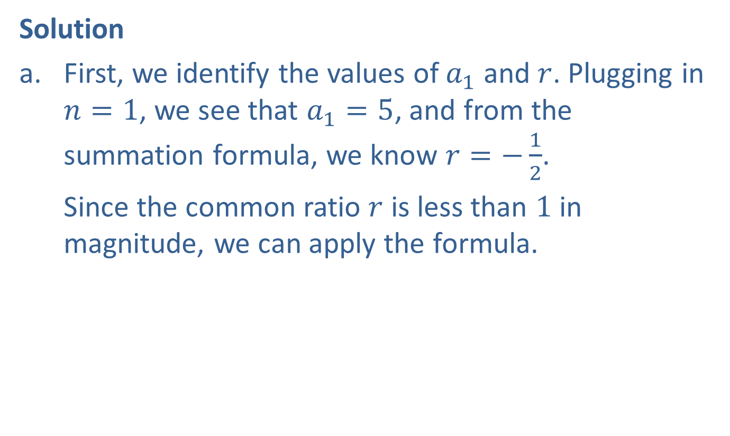
Example 5: Infinite Geometric Series (cont.)
Solution
​First, we identify the values of $a_{1}$ and $r$. Plugging in $n=1$, we see that $a_{1}=5$, and from the summation formula, we know $r=−\frac{1}{2}$.
​Since the common ratio $r$ is less than 1 in magnitude, we can apply the formula.​
​$S=\frac{a_{1}}{1−r}$
​𝑆=51−−12=532=103 | Substitute the known values, then simplify.

Slide 24
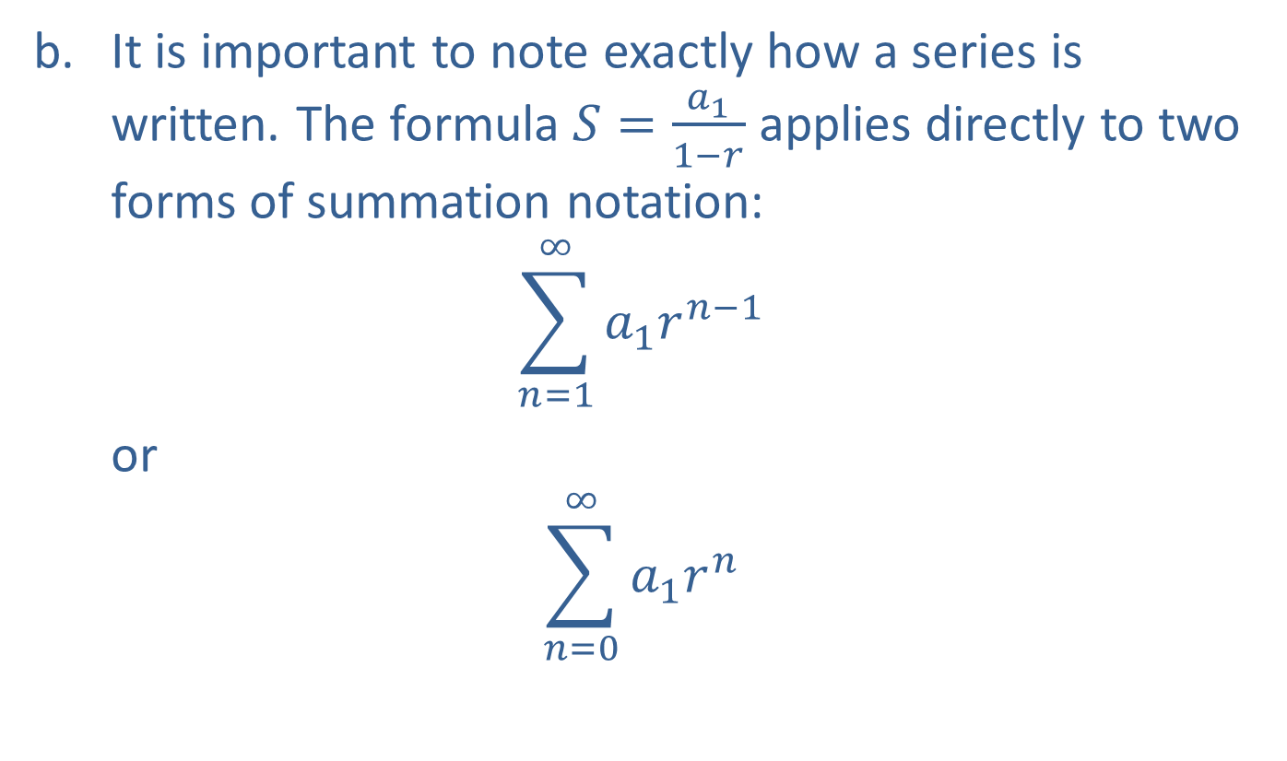
Example 5: Infinite Geometric Series (cont.)
​It is important to note exactly how a series is written. The formula $S=\frac{a_{1}}{1−r}$ applies directly to two forms of summation notation:
$$\sum_{n=1}^{∞}{a_{1}r^{n−1}}$$
or
$$\sum_{n=0}^{∞}{a_{1}r^{n}}$$

Slide 25
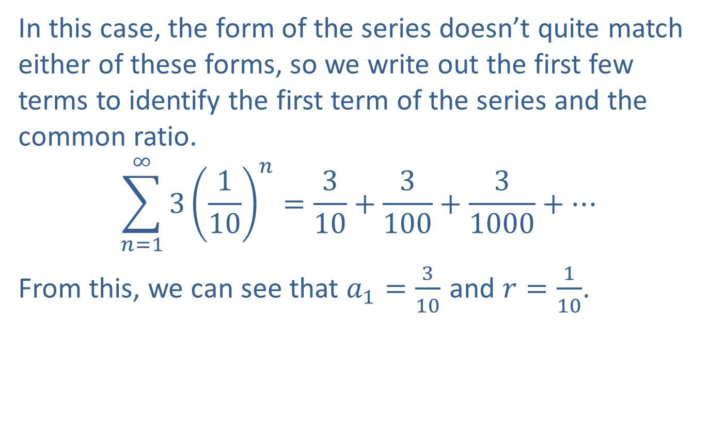
Example 5: Infinite Geometric Series (cont.)
​In this case, the form of the series doesn’t quite match either of these forms, so we write out the first few terms to identify the first term of the series and the common ratio.
$$\sum_{n=1}^{∞}{3{\left(\frac{1}{10}\right)}^{n}}=\frac{3}{10}+\frac{3}{100}+\frac{3}{1000}+…$$
From this, we can see that $a_{1}=\frac{3}{10}$ and $r=\frac{1}{10}$.

Slide 26
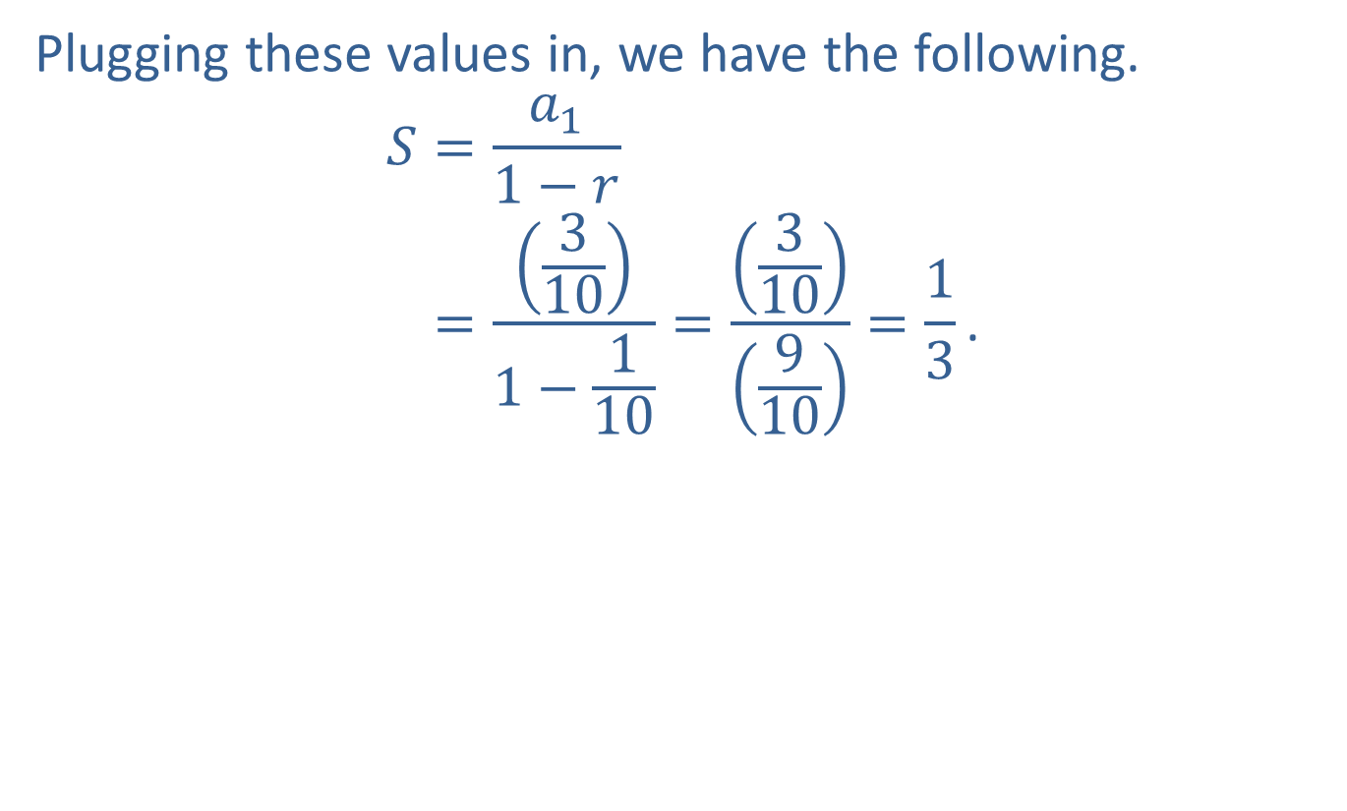
Example 5: Infinite Geometric Series (cont.)
​Plugging these values in, we have the following.
𝑆=𝑎11−𝑟𝑆=3101−110=310910=13.

