Slide 1
Section 10.6
Probability

Slide 2
Terminology of Probability
Definition
An experiment is any activity that results in well-defined outcomes. In a given problem, we are usually concerned with finding the probability that one or more of the outcomes will occur, and we use the word event to refer to a set of outcomes.
The set of all possible outcomes of a given experiment is called the sample space of the experiment. This means that in the language of sets, an event is any subset of the sample space, including the empty set and the entire sample space.

Slide 3
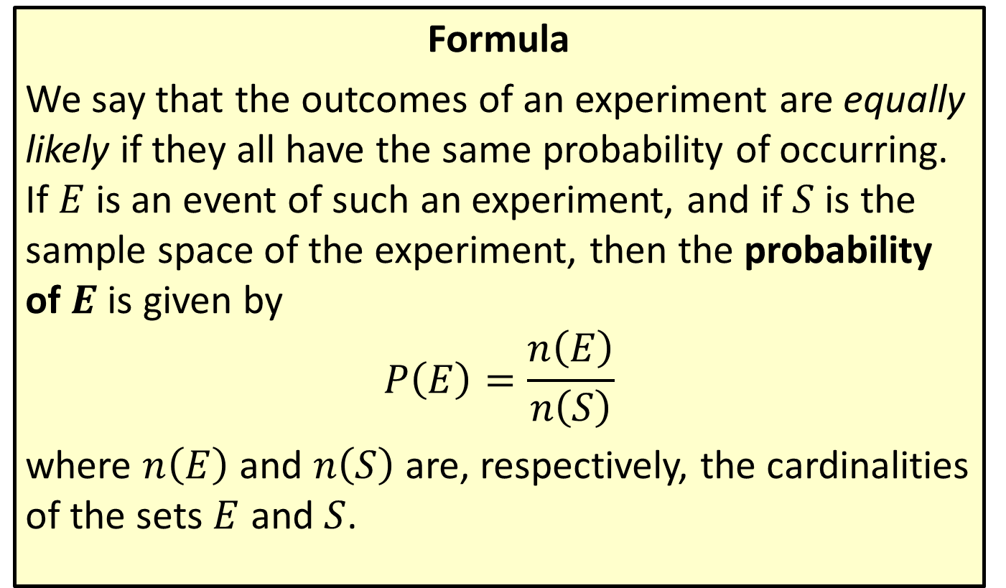
Probabilities When Outcomes Are Equally Likely
Formula
We say that the outcomes of an experiment are equally likely if they all have the same probability of occurring. If $E$ is an event of such an experiment, and if $S$ is the sample space of the experiment, then the probability of $E$ is given by
$$P\left(E\right)=\frac{n\left(E\right)}{n\left(S\right)}$$
where $n⁡\left(E\right)$ and $n⁡\left(S\right)$ are, respectively, the cardinalities of the sets $E$ and $S$.

Slide 4
CAUTION!
This formula has two important restrictions. First, it only applies in equally likely situations, so we can’t use it to analyze weighted coins, crooked roulette tables, tampered decks of cards, and so on. Secondly, and more subtly, it assumes that the size of the sample space is finite (otherwise, the formula makes no sense), so we can’t use it to analyze experiments based on, say, choosing a real number at random.

Slide 5
Example 1: Probabilities When Outcomes Are Equally Likely
A (fair) die is rolled once. Find the probability that the number rolled is
​prime,
​divisible by 5,
​7.

Slide 6
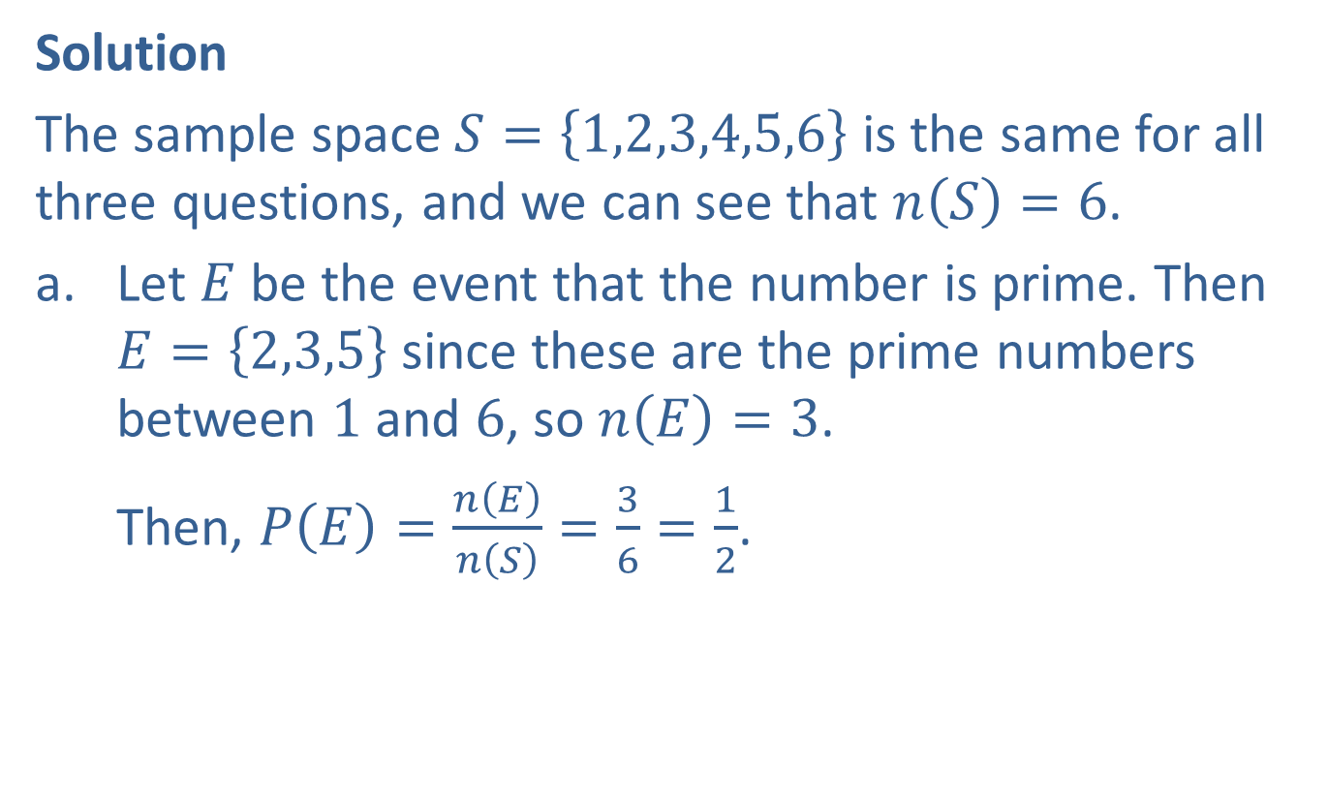
Example 1: Probabilities When Outcomes Are Equally Likely (cont.)
Solution
The sample space $S=\left\{1,2,3,4,5,6\right\}$ is the same for all three questions, and we can see that $n\left(S\right)=6$.
​Let $E$ be the event that the number is prime. Then $E=\left\{2,3,5\right\}$ since these are the prime numbers between 1 and 6, so $n\left(E\right)=3$.
​Then, $P\left(E\right)=\frac{n\left(E\right)}{n\left(S\right)}=\frac{3}{6}=\frac{1}{2}$.

Slide 7
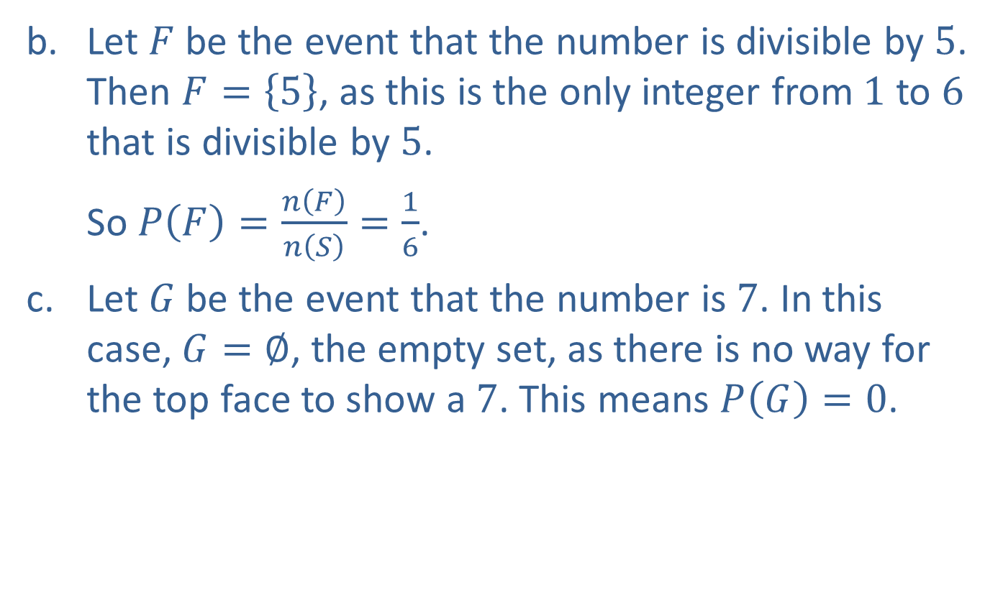
Example 1: Probabilities When Outcomes Are Equally Likely (cont.)
​Let $F$ be the event that the number is divisible by 5. Then $F=\left\{5\right\}$, as this is the only integer from 1 to 6 that is divisible by 5.
So $P\left(F\right)=\frac{n\left(F\right)}{n\left(S\right)}=\frac{1}{6}$.
​Let $G$ be the event that the number is 7. In this case, $G=∅$, the empty set, as there is no way for the top face to show a 7. This means $P\left(G\right)=0$.

Slide 8
Example 2: Computing Probabilities
A pair of dice is rolled, and the sum of the top faces noted. What is the probability that the sum is
​2,
​5,
​7 or 11?

Slide 9
Example 2: Computing Probabilities (cont.)
Solution
The size of the sample space is the same for all three questions, so it makes sense to determine this first. In order to use the one probability formula we have, we need to make sure that all outcomes of the sample space are equally likely.

Slide 10
Example 2: Computing Probabilities (cont.)
For this reason, we do not want to define the sample space to be all integers between 2 and 12. This is because these sums are not all equally likely. For instance, there is only one way for the sum to be 2: both top faces must show a 1. But there are two ways for the sum to be 3: one die (call it die A) shows a 1 and the other (die B) shows a 2, or else die A shows a 2 and die B shows a 1. Similarly, there are three ways for the sum of the top faces to be 4.
In order to define the sample space properly, we create a table of ordered pairs. In Table 1, the first number in each pair corresponds to the number showing on die A and the second number corresponds to the number showing on die B.

Slide 11
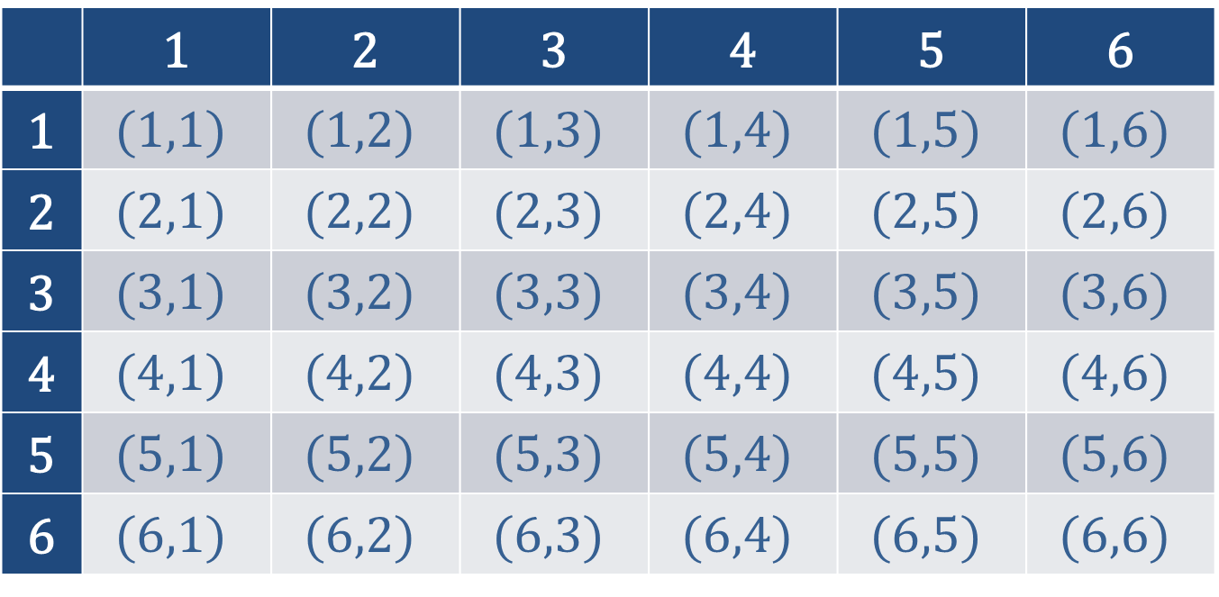
Example 2: Computing Probabilities (cont.)
 | 1 | 2 | 3 | 4 | 5 | 6
1 | $$(1,1)$$ | $$(1,2)$$ | $$(1,3)$$ | $$(1,4)$$ | $$(1,5)$$ | $$(1,6)$$
2 | $$(2,1)$$ | $$(2,2)$$ | $$(2,3)$$ | $$(2,4)$$ | $$(2,5)$$ | $$(2,6)$$
3 | $$(3,1)$$ | $$(3,2)$$ | $$(3,3)$$ | $$(3,4)$$ | $$(3,5)$$ | $$(3,6)$$
4 | $$(4,1)$$ | $$(4,2)$$ | $$(4,3)$$ | $$(4,4)$$ | $$(4,5)$$ | $$(4,6)$$
5 | $$(5,1)$$ | $$(5,2)$$ | $$(5,3)$$ | $$(5,4)$$ | $$(5,5)$$ | $$(5,6)$$
6 | $$(6,1)$$ | $$(6,2)$$ | $$(6,3)$$ | $$(6,4)$$ | $$(6,5)$$ | $$(6,6)$$
Table 1: Sample Space for Rolling a Pair of Dice

Slide 12
Example 2: Computing Probabilities (cont.)
Each of these ordered pairs is equally likely to come up, as any of the numbers 1 through 6 are equally likely for the first slot (die A) and similarly for the second slot (die B). Referring to the positions in the ordered pairs as “slots” points to a quick way of determining the size of the sample space. Since there are 6 choices for each slot, the Multiplication Principle of Counting tells us there are 36 possible outcomes of this experiment.

Slide 13
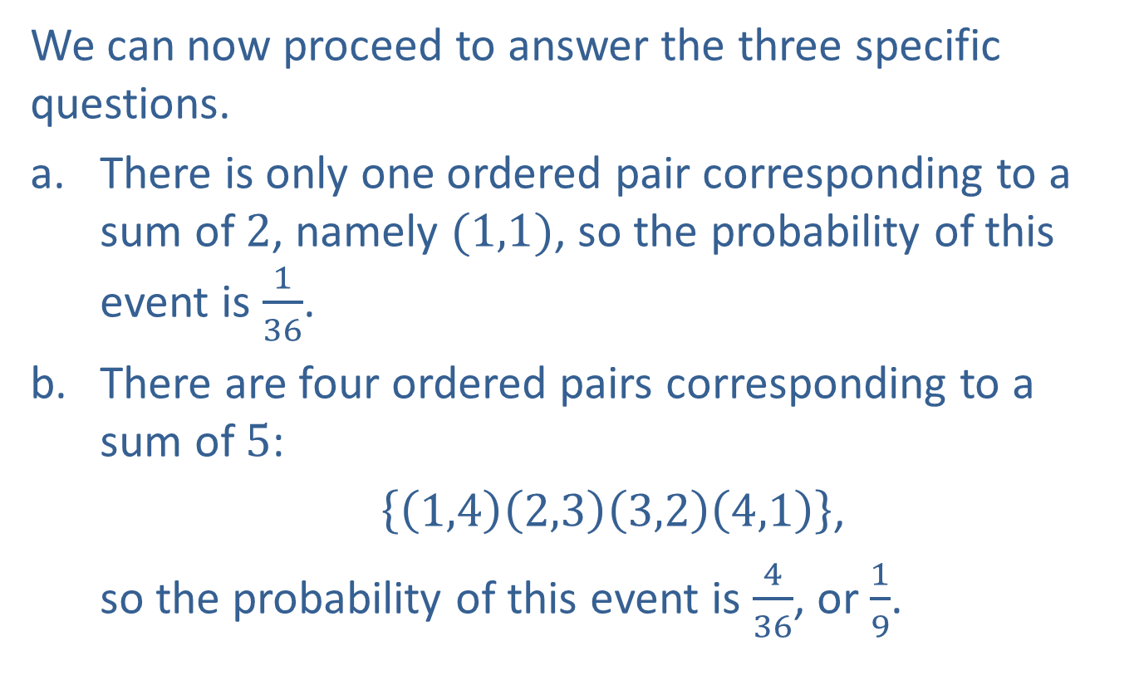
Example 2: Computing Probabilities (cont.)
We can now proceed to answer the three specific questions.
​There is only one ordered pair corresponding to a sum of 2, namely $(1,1)$, so the probability of this event is $\frac{1}{36}$.
​There are four ordered pairs corresponding to a sum of 5:
$\left\{\left(1,4\right)\left(2,3\right)\left(3,2\right)\left(4,1\right)\right\}$,
​so the probability of this event is $\frac{4}{36}$, or $\frac{1}{9}$.

Slide 14
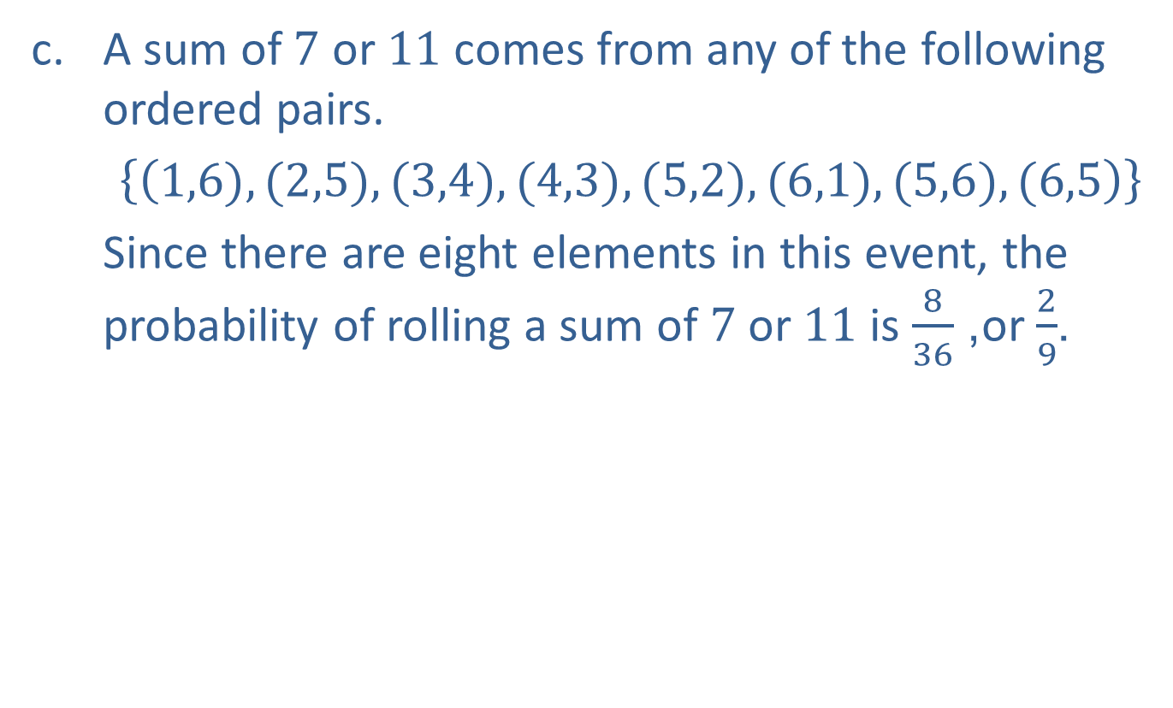
Example 2: Computing Probabilities (cont.)
​A sum of 7 or 11 comes from any of the following ordered pairs.
​$\left\{\left(1,6),(2,5),(3,4),(4,3),(5,2),(6,1),(5,6),(6,5\right)\right\}$
​Since there are eight elements in this event, the probability of rolling a sum of 7 or 11 is $\frac{8}{36}$, or $\frac{2}{9}$.

Slide 15
Example 3: Computing Probabilities
Suppose you are taking a 10-question True-False test, and you are completely unprepared for it. If you decide to guess on each question, what is the probability of getting 8 or more questions right?

Slide 16
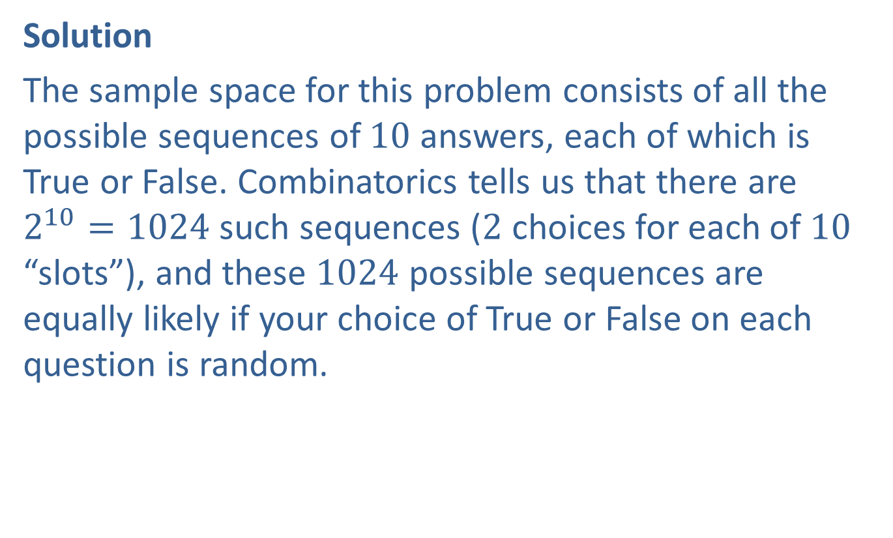
Example 3: Computing Probabilities (cont.)
Solution
The sample space for this problem consists of all the possible sequences of 10 answers, each of which is True or False. Combinatorics tells us that there are $2^{10}=1024$ such sequences (2 choices for each of 10 “slots”), and these 1024 possible sequences are equally likely if your choice of True or False on each question is random.

Slide 17
Example 3: Computing Probabilities (cont.)
The probability of getting 8 or more questions right can be broken up into three possibilities; getting 8 right, 9 right, or all 10 right.
There is only one sequence of 10 answers that are all correct. There are more ways of correctly answering exactly 9 questions, and we can use another tool from combinatorics to find out exactly how many ways.

Slide 18
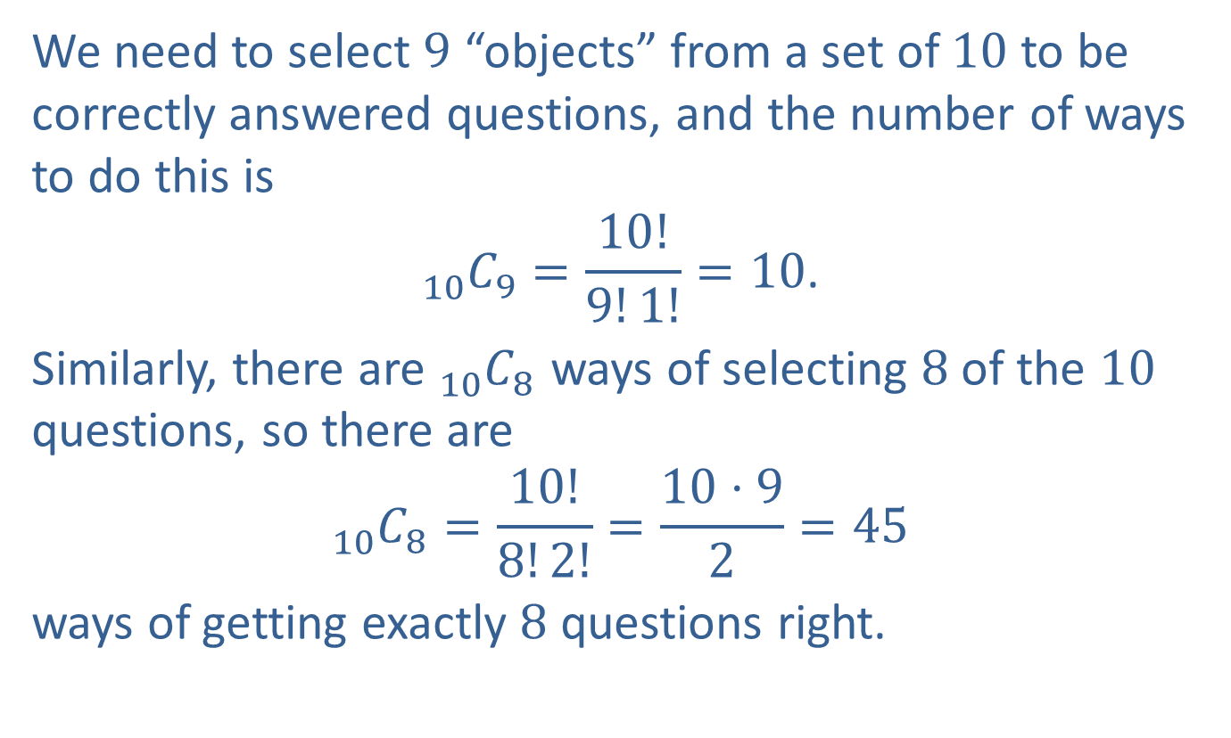
Example 3: Computing Probabilities (cont.)
We need to select 9 “objects” from a set of 10 to be correctly answered questions, and the number of ways to do this is
$${}_{10}^{ }{C_{9}}=\frac{10!}{9!1!}=10\text{.}$$
Similarly, there are ${}_{10}^{ }{C_{8}}$ ways of selecting 8 of the 10 questions, so there are
$${}_{10}^{ }{C_{8}}=\frac{10!}{8!2!}=\frac{10⋅9}{2}=45$$
ways of getting exactly 8 questions right.

Slide 19
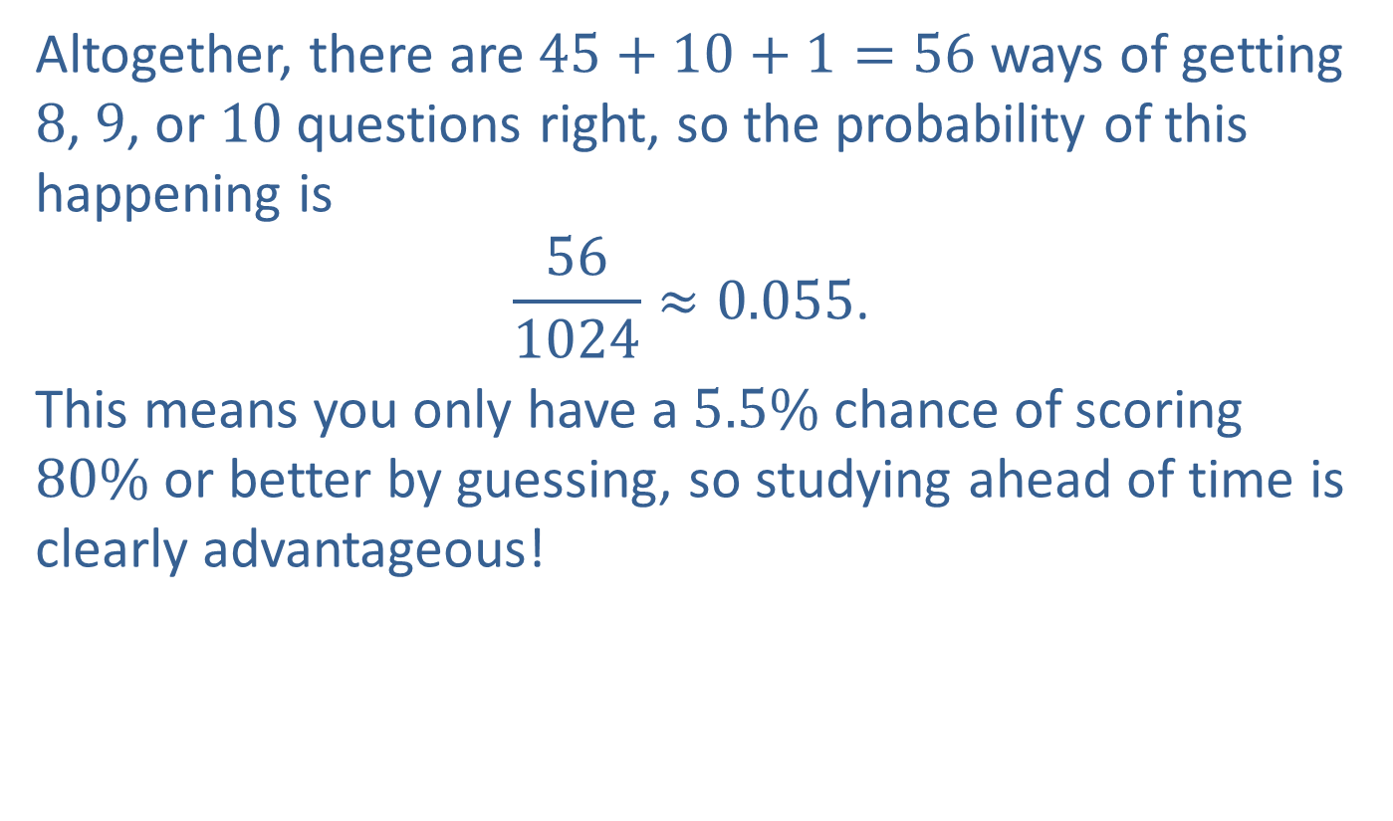
Example 3: Computing Probabilities (cont.)
Altogether, there are $45+10+1=56$ ways of getting 8, 9, or 10 questions right, so the probability of this happening is
$$\frac{56}{1024}≈0.055\text{.}$$
This means you only have a $5.5\%$ chance of scoring $80\%$ or better by guessing, so studying ahead of time is clearly advantageous!

Slide 20
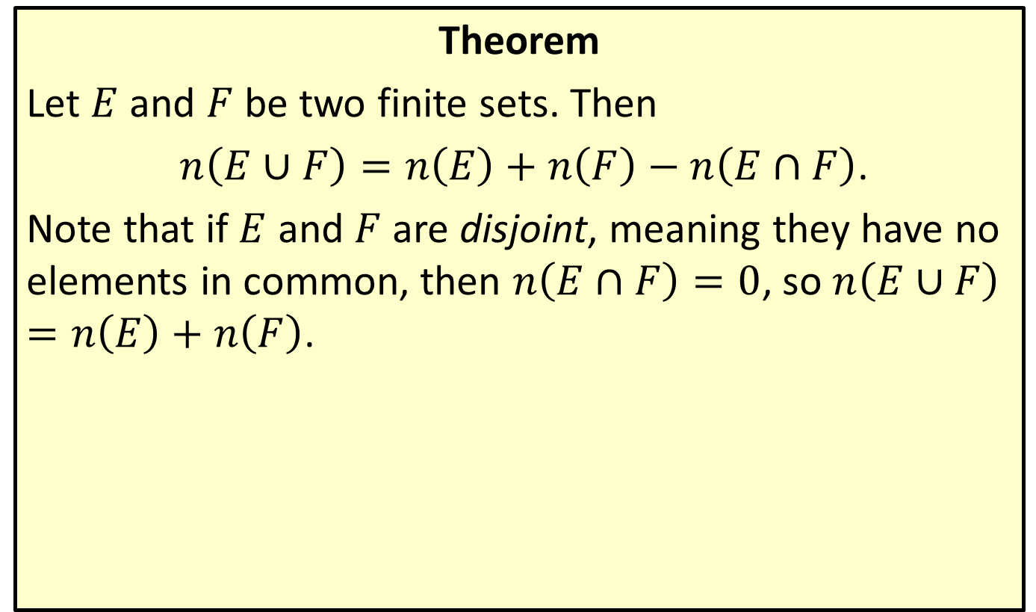
Cardinality of a Union of Sets
Theorem
Let $E$ and $F$ be two finite sets. Then
$n\left(E∪F\right)=n\left(E\right)+n\left(F\right)−n\left(E∩F\right)$.
Note that if $E$ and $F$ are disjoint, meaning they have no elements in common, then $n\left(E∩F\right)=0$, so $n\left(E∪F\right)=n\left(E\right)+n\left(F\right)$.

Slide 21
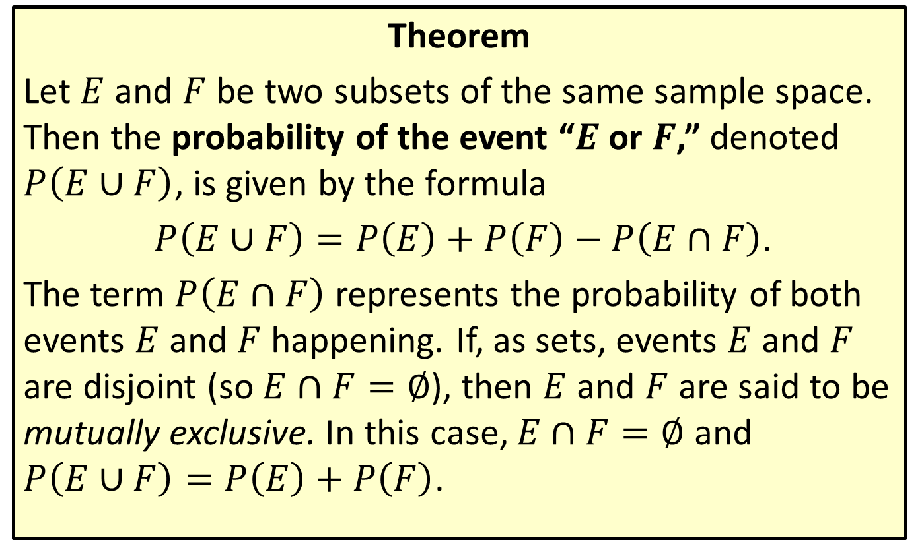
Probability of a Union of Two Events
Theorem
Let $E$ and $F$ be two subsets of the same sample space. Then the probability of the event “$E$ or $F$,” denoted $P⁡\left(E∪F\right)$, is given by the formula
$P\left(E∪F\right)=P\left(E\right)+P\left(F\right)−P\left(E∩F\right)$.
The term $P⁡\left(E∩F\right)$ represents the probability of both events $E$ and $F$ happening. If, as sets, events $E$ and $F$ are disjoint (so $E∩F=∅$), then $E$ and $F$ are said to be mutually exclusive. In this case, $E∩F=∅$ and $P\left(E∪F\right)=P\left(E\right)+P\left(F\right)$.

Slide 22
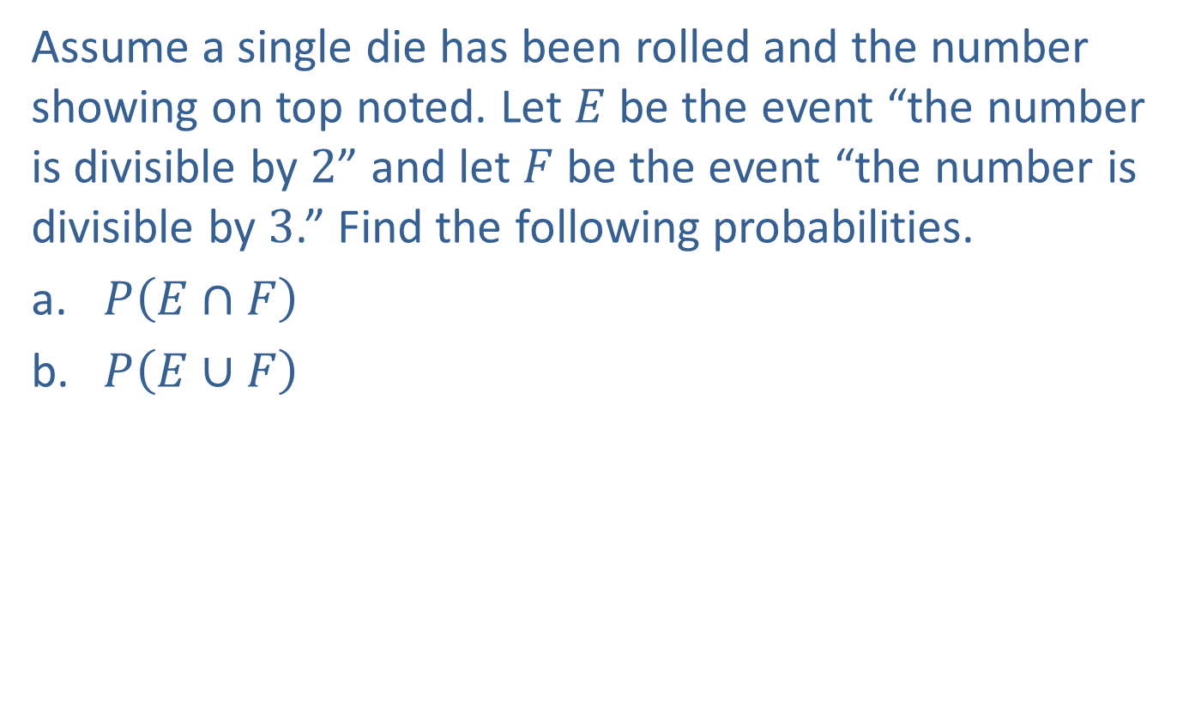
Example 4: Probability of a Union of Two Events
Assume a single die has been rolled and the number showing on top noted. Let $E$ be the event “the number is divisible by 2” and let $F$ be the event “the number is divisible by 3.” Find the following probabilities.
​$P⁡\left(E∩F\right)$
​$P⁡\left(E∪F\right)$

Slide 23
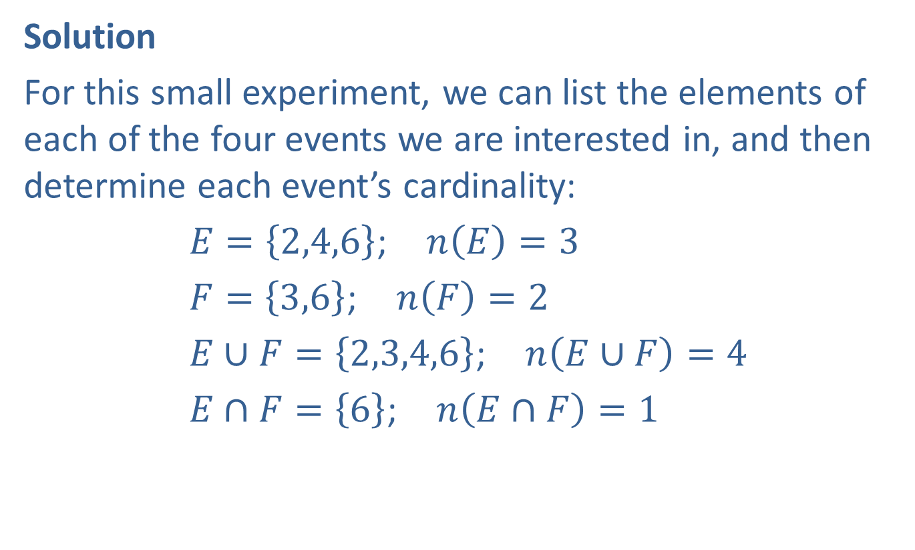
Example 4: Probability of a Union of Two Events (cont.)
Solution
For this small experiment, we can list the elements of each of the four events we are interested in, and then determine each event’s cardinality:
$E=\left\{2,4,6\right\}$; $n\left(E\right)=3$
$F=\left\{3,6\right\}$; $n\left(F\right)=2$
$E∪F=\left\{2,3,4,6\right\}$; $n\left(E∪F\right)=4$
$E∩F=\left\{6\right\}$; $n\left(E∩F\right)=1$

Slide 24
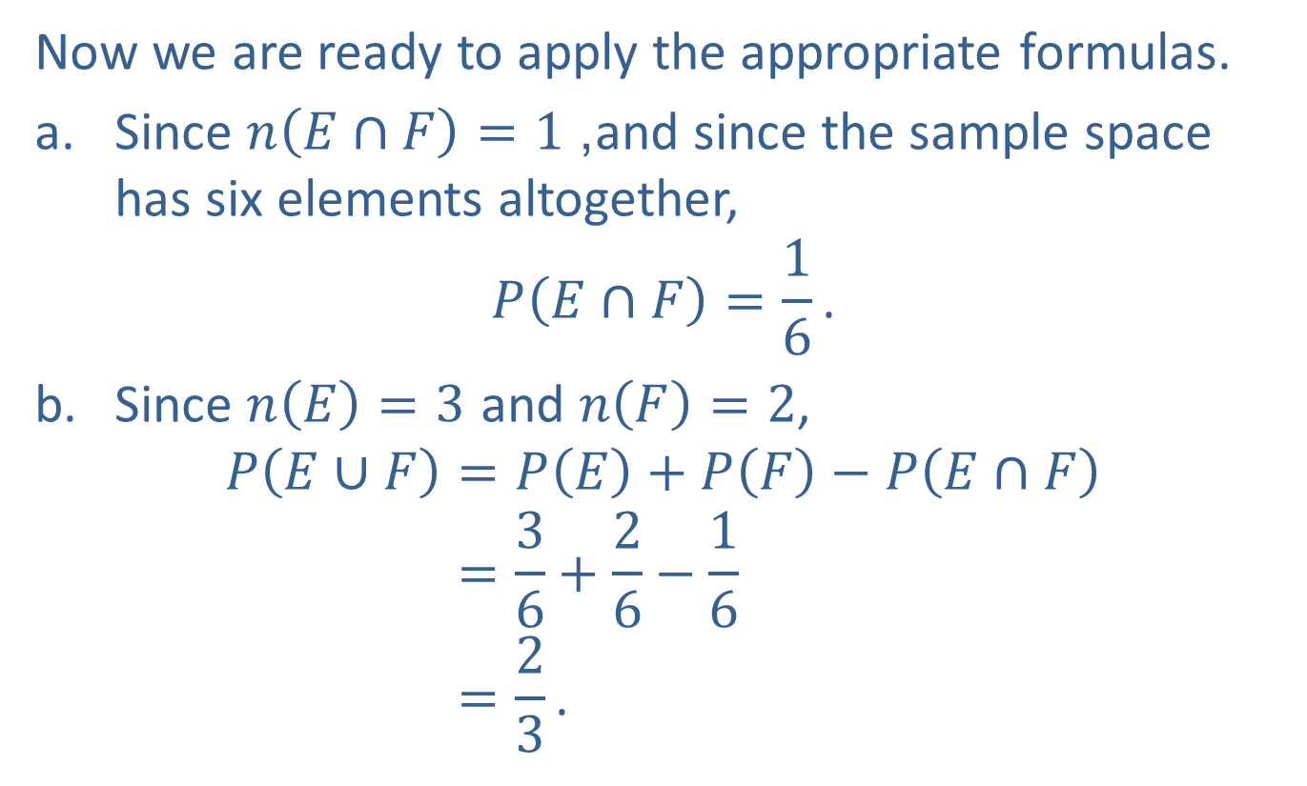
Example 4: Probability of a Union of Two Events (cont.)
Now we are ready to apply the appropriate formulas.
​Since $n\left(E∩F\right)=1$, and since the sample space has six elements altogether,
$$P\left(E∩F\right)=\frac{1}{6}\text{.}$$
​Since $n\left(E\right)=3$ and $n\left(F\right)=2$,
𝑃𝐸∪𝐹=𝑃𝐸+𝑃𝐹−𝑃𝐸∩𝐹𝑃𝐸∪𝐹=36+26−16𝑃𝐸∪𝐹=23.

Slide 25
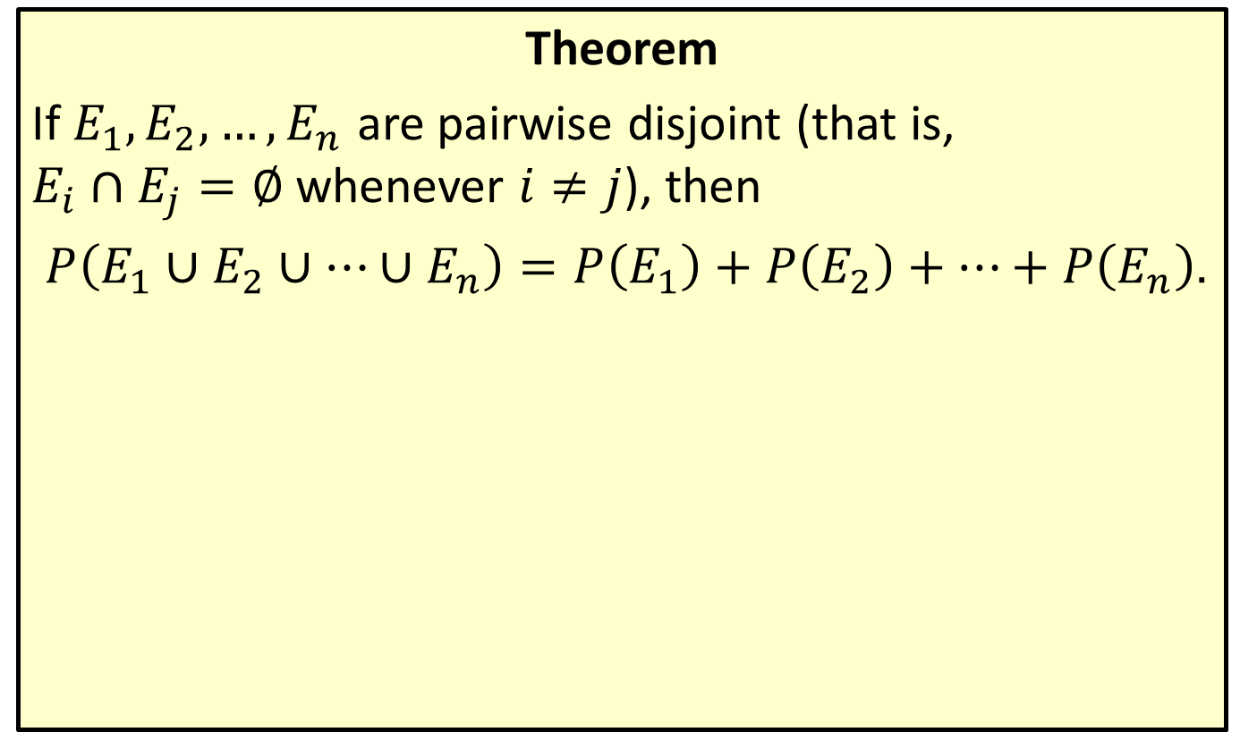
Unions of Mutually Exclusive Events
Theorem
If $E_{1},E_{2},…,E_{n}$ are pairwise disjoint (that is, $E_{i}∩E_{j}=∅$ whenever $i≠j$), then
$P\left(E_{1}∪E_{2}∪…∪E_{n}\right)=P\left(E_{1}\right)+P\left(E_{2}\right)+…+P\left(E_{n}\right)$.

Slide 26
Example 5: Unions of Mutually Exclusive Events
Suppose Jim has chosen a PIN of 8736 for his bank’s ATM, and that all PINs at the bank consist of four digits from 0 to 9. Using the ATM one day, he senses someone looking over his shoulder as he enters the first two digits, and he decides to cancel the operation and leave. The next day Jim discovers his ATM card is missing. In the worst-case scenario, a stranger now has Jim’s ATM card and the first two digits of his PIN. As he calls the bank to cancel the card, he wonders what the chances are the unknown someone can guess the remaining digits in the three tries the ATM allows. What is the probability of this event?

Slide 27
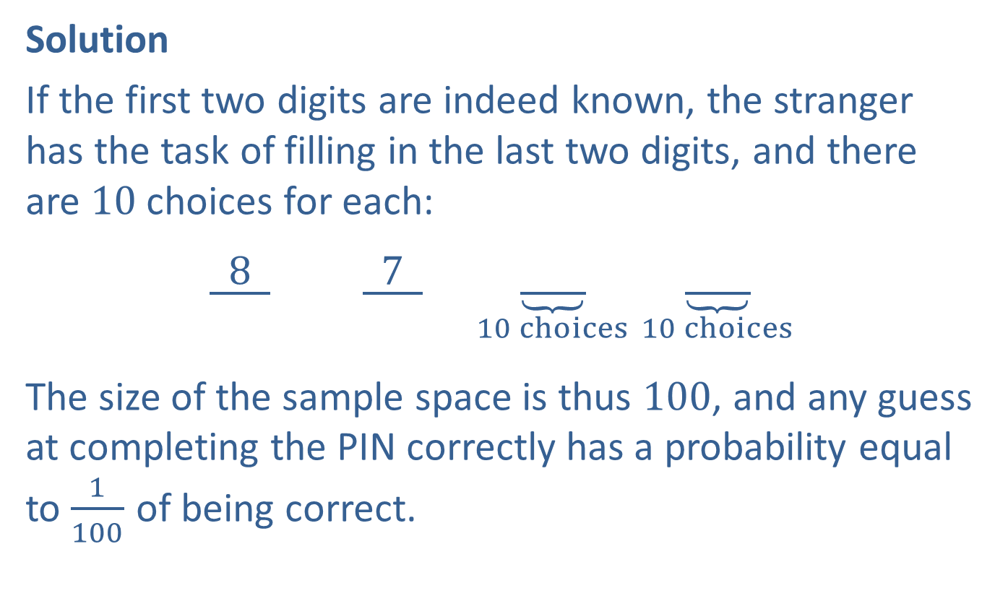
Example 5: Unions of Mutually Exclusive Events (cont.)
Solution
If the first two digits are indeed known, the stranger has the task of filling in the last two digits, and there are 10 choices for each:
$\underline{ 8 } \underline{ 7 }$ $\underset{10 choices}{\underbrace{\underline{ }}}$ $\underset{10 choices}{\underbrace{\underline{ }}}$
The size of the sample space is thus 100, and any guess at completing the PIN correctly has a probability equal to $\frac{1}{100}$ of being correct.

Slide 28
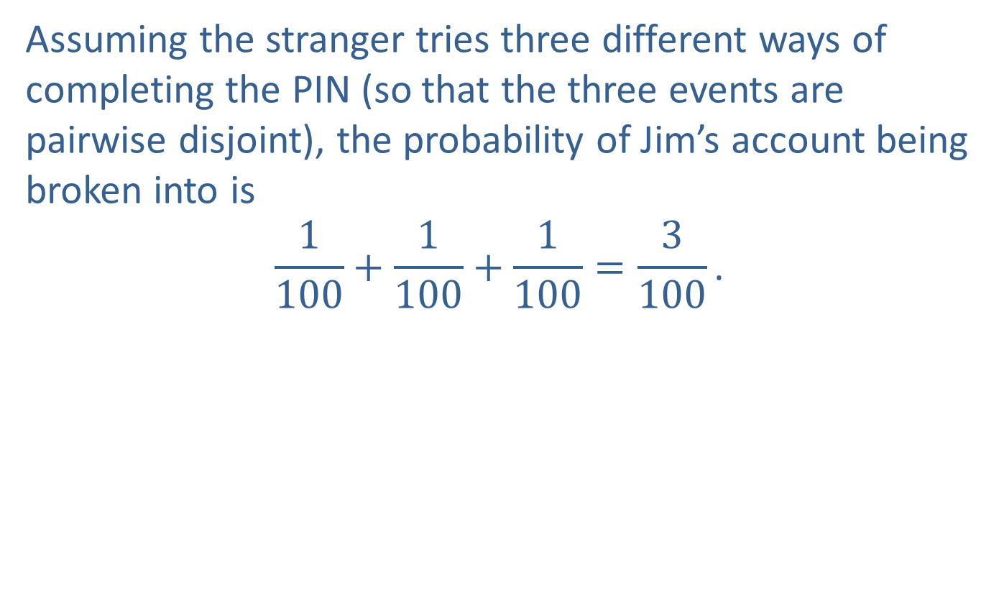
Example 5: Unions of Mutually Exclusive Events (cont.)
Assuming the stranger tries three different ways of completing the PIN (so that the three events are pairwise disjoint), the probability of Jim’s account being broken into is
$$\frac{1}{100}+\frac{1}{100}+\frac{1}{100}=\frac{3}{100}\text{.}$$

Slide 29
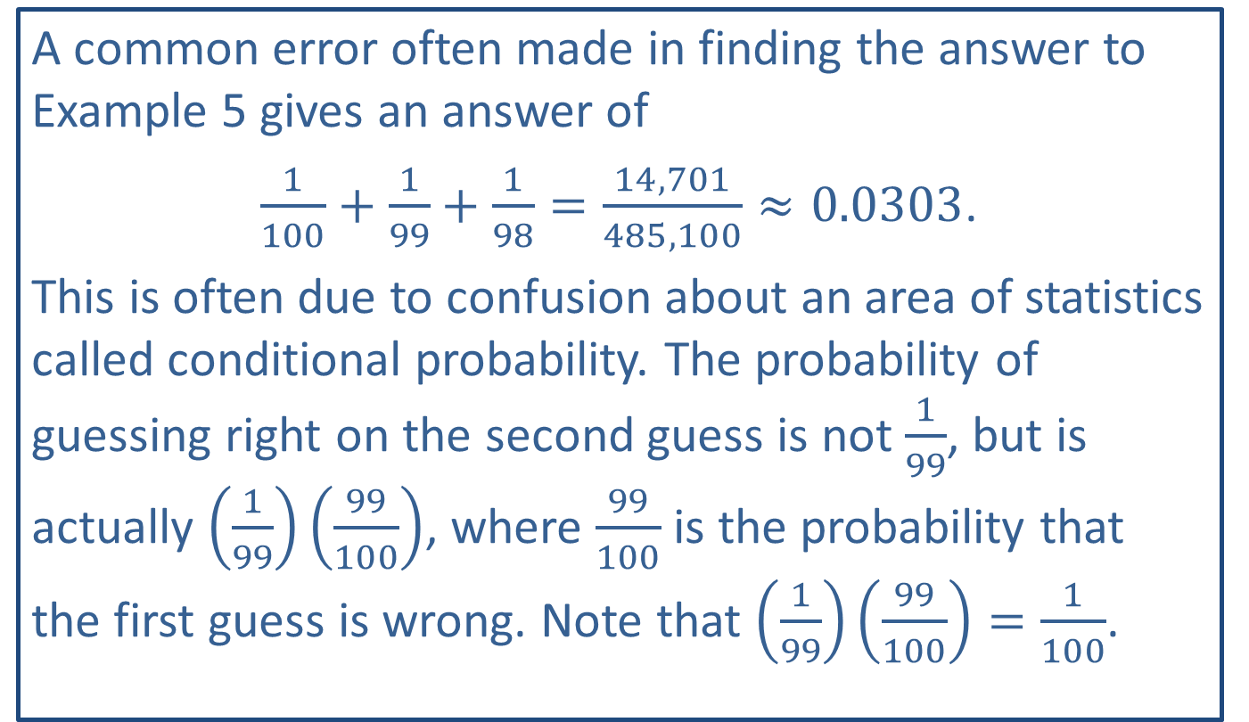
CAUTION!
A common error often made in finding the answer to Example 5 gives an answer of
$\frac{1}{100}+\frac{1}{99}+\frac{1}{98}=\frac{14,701}{485,100}≈0.0303$.
This is often due to confusion about an area of statistics called conditional probability. The probability of guessing right on the second guess is not $\frac{1}{99}$, but is actually $\left(\frac{1}{99}\right)\left(\frac{99}{100}\right)$, where $\frac{99}{100}$ is the probability that the first guess is wrong. Note that $\left(\frac{1}{99}\right)\left(\frac{99}{100}\right)=\frac{1}{100}$.

Slide 30
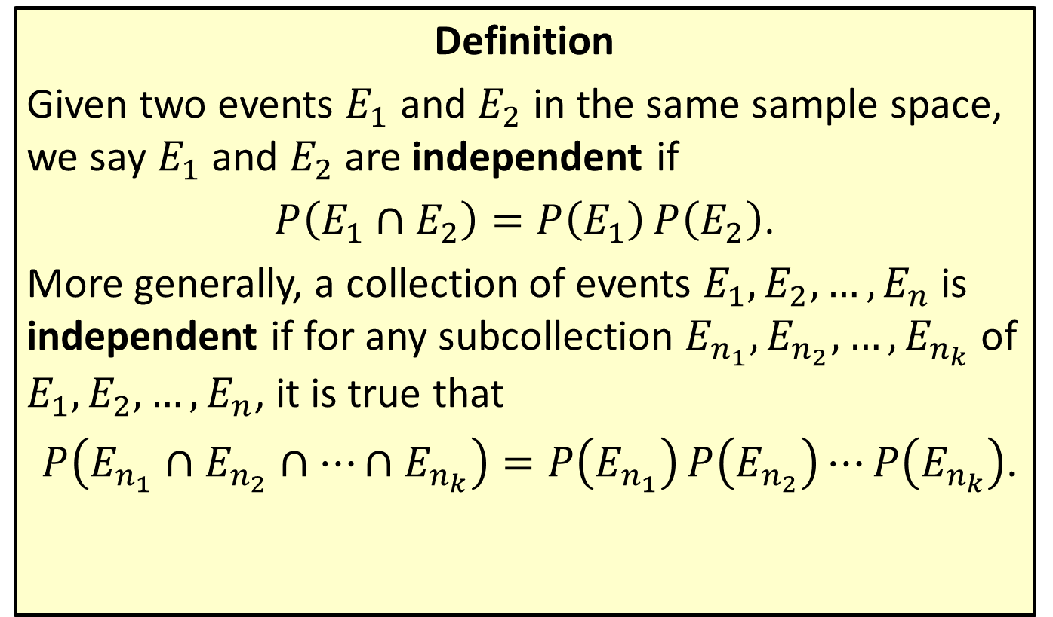
Independent Events
Definition
Given two events $E_{1}$ and $E_{2}$ in the same sample space, we say $E_{1}$ and $E_{2}$ are independent if
$P\left(E_{1}∩E_{2}\right)=P\left(E_{1}\right)P\left(E_{2}\right)$.
More generally, a collection of events $E_{1},E_{2},…,E_{n}$ is independent if for any subcollection $E_{n_{1}},E_{n_{2}},…,E_{n_{k}}$ of $E_{1},E_{2},…,E_{n}$, it is true that
$P\left(E_{n_{1}}∩E_{n_{2}}∩…∩E_{n_{k}}\right)=P\left(E_{n_{1}}\right)P\left(E_{n_{2}}\right)⋯P\left(E_{n_{k}}\right)$.

Slide 31
Example 6: Independent Events
If a coin is flipped three times, what is the probability of it coming up tails all three times?

Slide 32
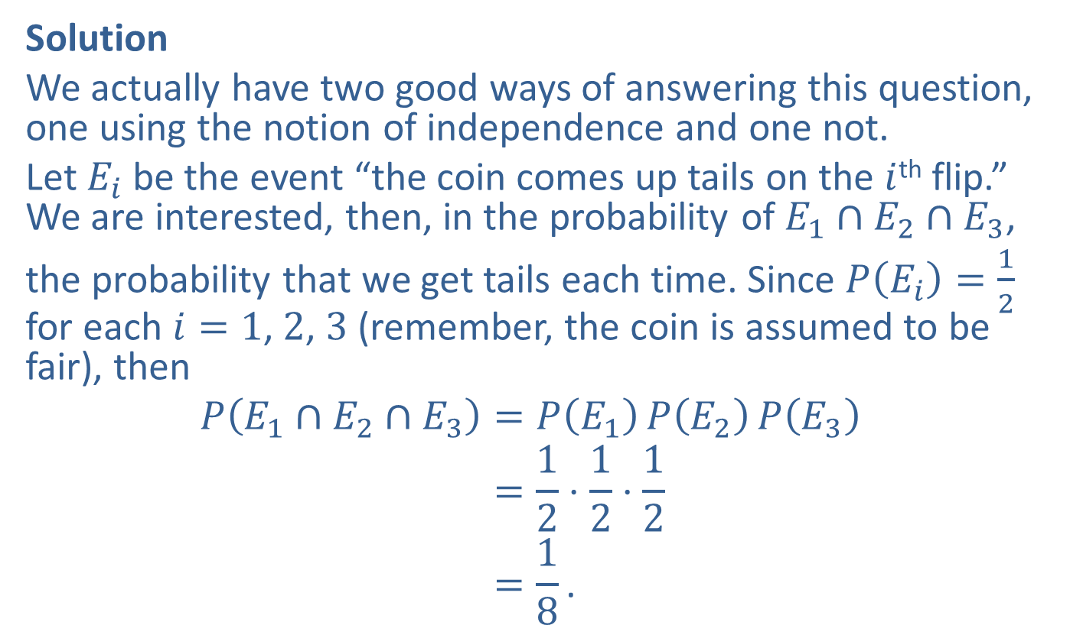
Example 6: Independent Events (cont.)
Solution
We actually have two good ways of answering this question, one using the notion of independence and one not.
Let $E_{i}$ be the event “the coin comes up tails on the $i$^{th} flip.” We are interested, then, in the probability of $E_{1}∩E_{2}∩E_{3}$,
the probability that we get tails each time. Since $P\left(E_{i}\right)=\frac{1}{2}$ for each $i=1$, 2, 3 (remember, the coin is assumed to be fair), then
𝑃𝐸1∩𝐸2∩𝐸3=𝑃𝐸1𝑃𝐸2𝑃𝐸3𝑃𝐸1∩𝐸2∩𝐸3=12⋅12⋅12𝑃𝐸1∩𝐸2∩𝐸3=18.

Slide 33
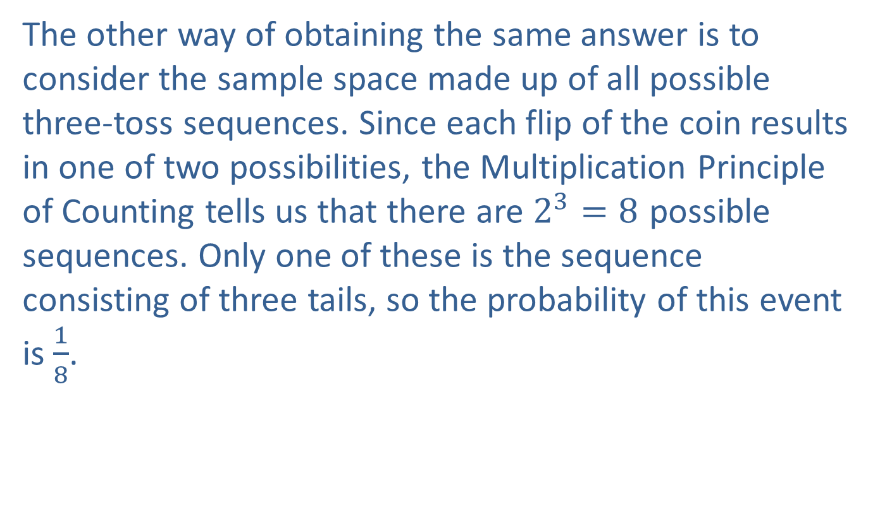
Example 6: Independent Events (cont.)
The other way of obtaining the same answer is to consider the sample space made up of all possible three-toss sequences. Since each flip of the coin results in one of two possibilities, the Multiplication Principle of Counting tells us that there are $2^{3}=8$ possible sequences. Only one of these is the sequence consisting of three tails, so the probability of this event is $\frac{1}{8}$.

