Slide 1
Section 3.1
The Cartesian Coordinate System

Slide 2
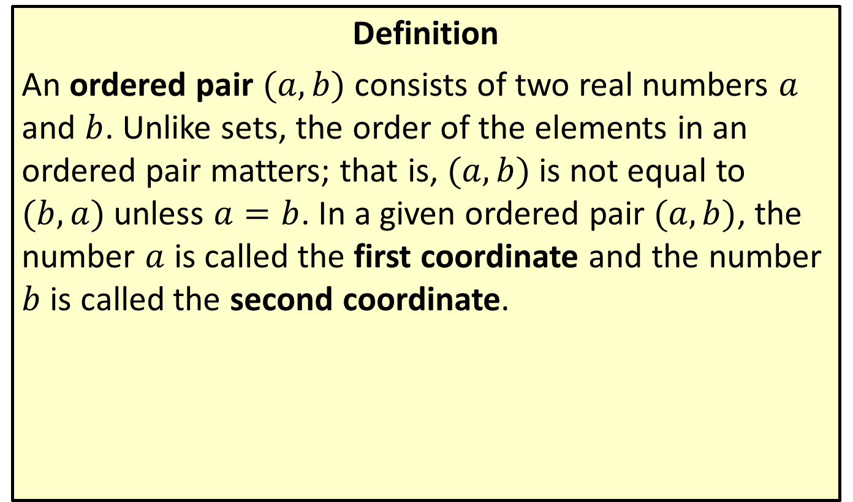
Ordered Pairs
Definition
An ordered pair $(a,b)$ consists of two real numbers $a$ and $b$. Unlike sets, the order of the elements in an ordered pair matters; that is, $(a,b)$ is not equal to $(b,a)$ unless $a=b$. In a given ordered pair $(a,b)$, the number $a$ is called the first coordinate and the number $b$ is called the second coordinate.

Slide 3
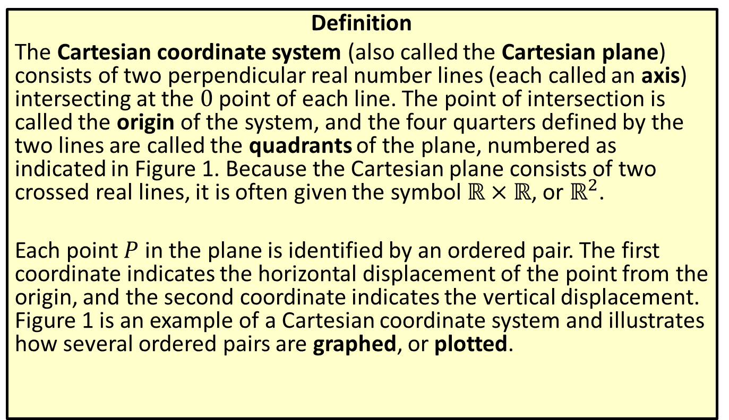
The Cartesian Coordinate System
Definition
The Cartesian coordinate system (also called the Cartesian plane) consists of two perpendicular real number lines (each called an axis) intersecting at the 0 point of each line. The point of intersection is called the origin of the system, and the four quarters defined by the two lines are called the quadrants of the plane, numbered as indicated in Figure 1. Because the Cartesian plane consists of two crossed real lines, it is often given the symbol $ℝ×ℝ$, or $ℝ^{2}$.
Each point $P$ in the plane is identified by an ordered pair. The first coordinate indicates the horizontal displacement of the point from the origin, and the second coordinate indicates the vertical displacement. Figure 1 is an example of a Cartesian coordinate system and illustrates how several ordered pairs are graphed, or plotted.

Slide 4
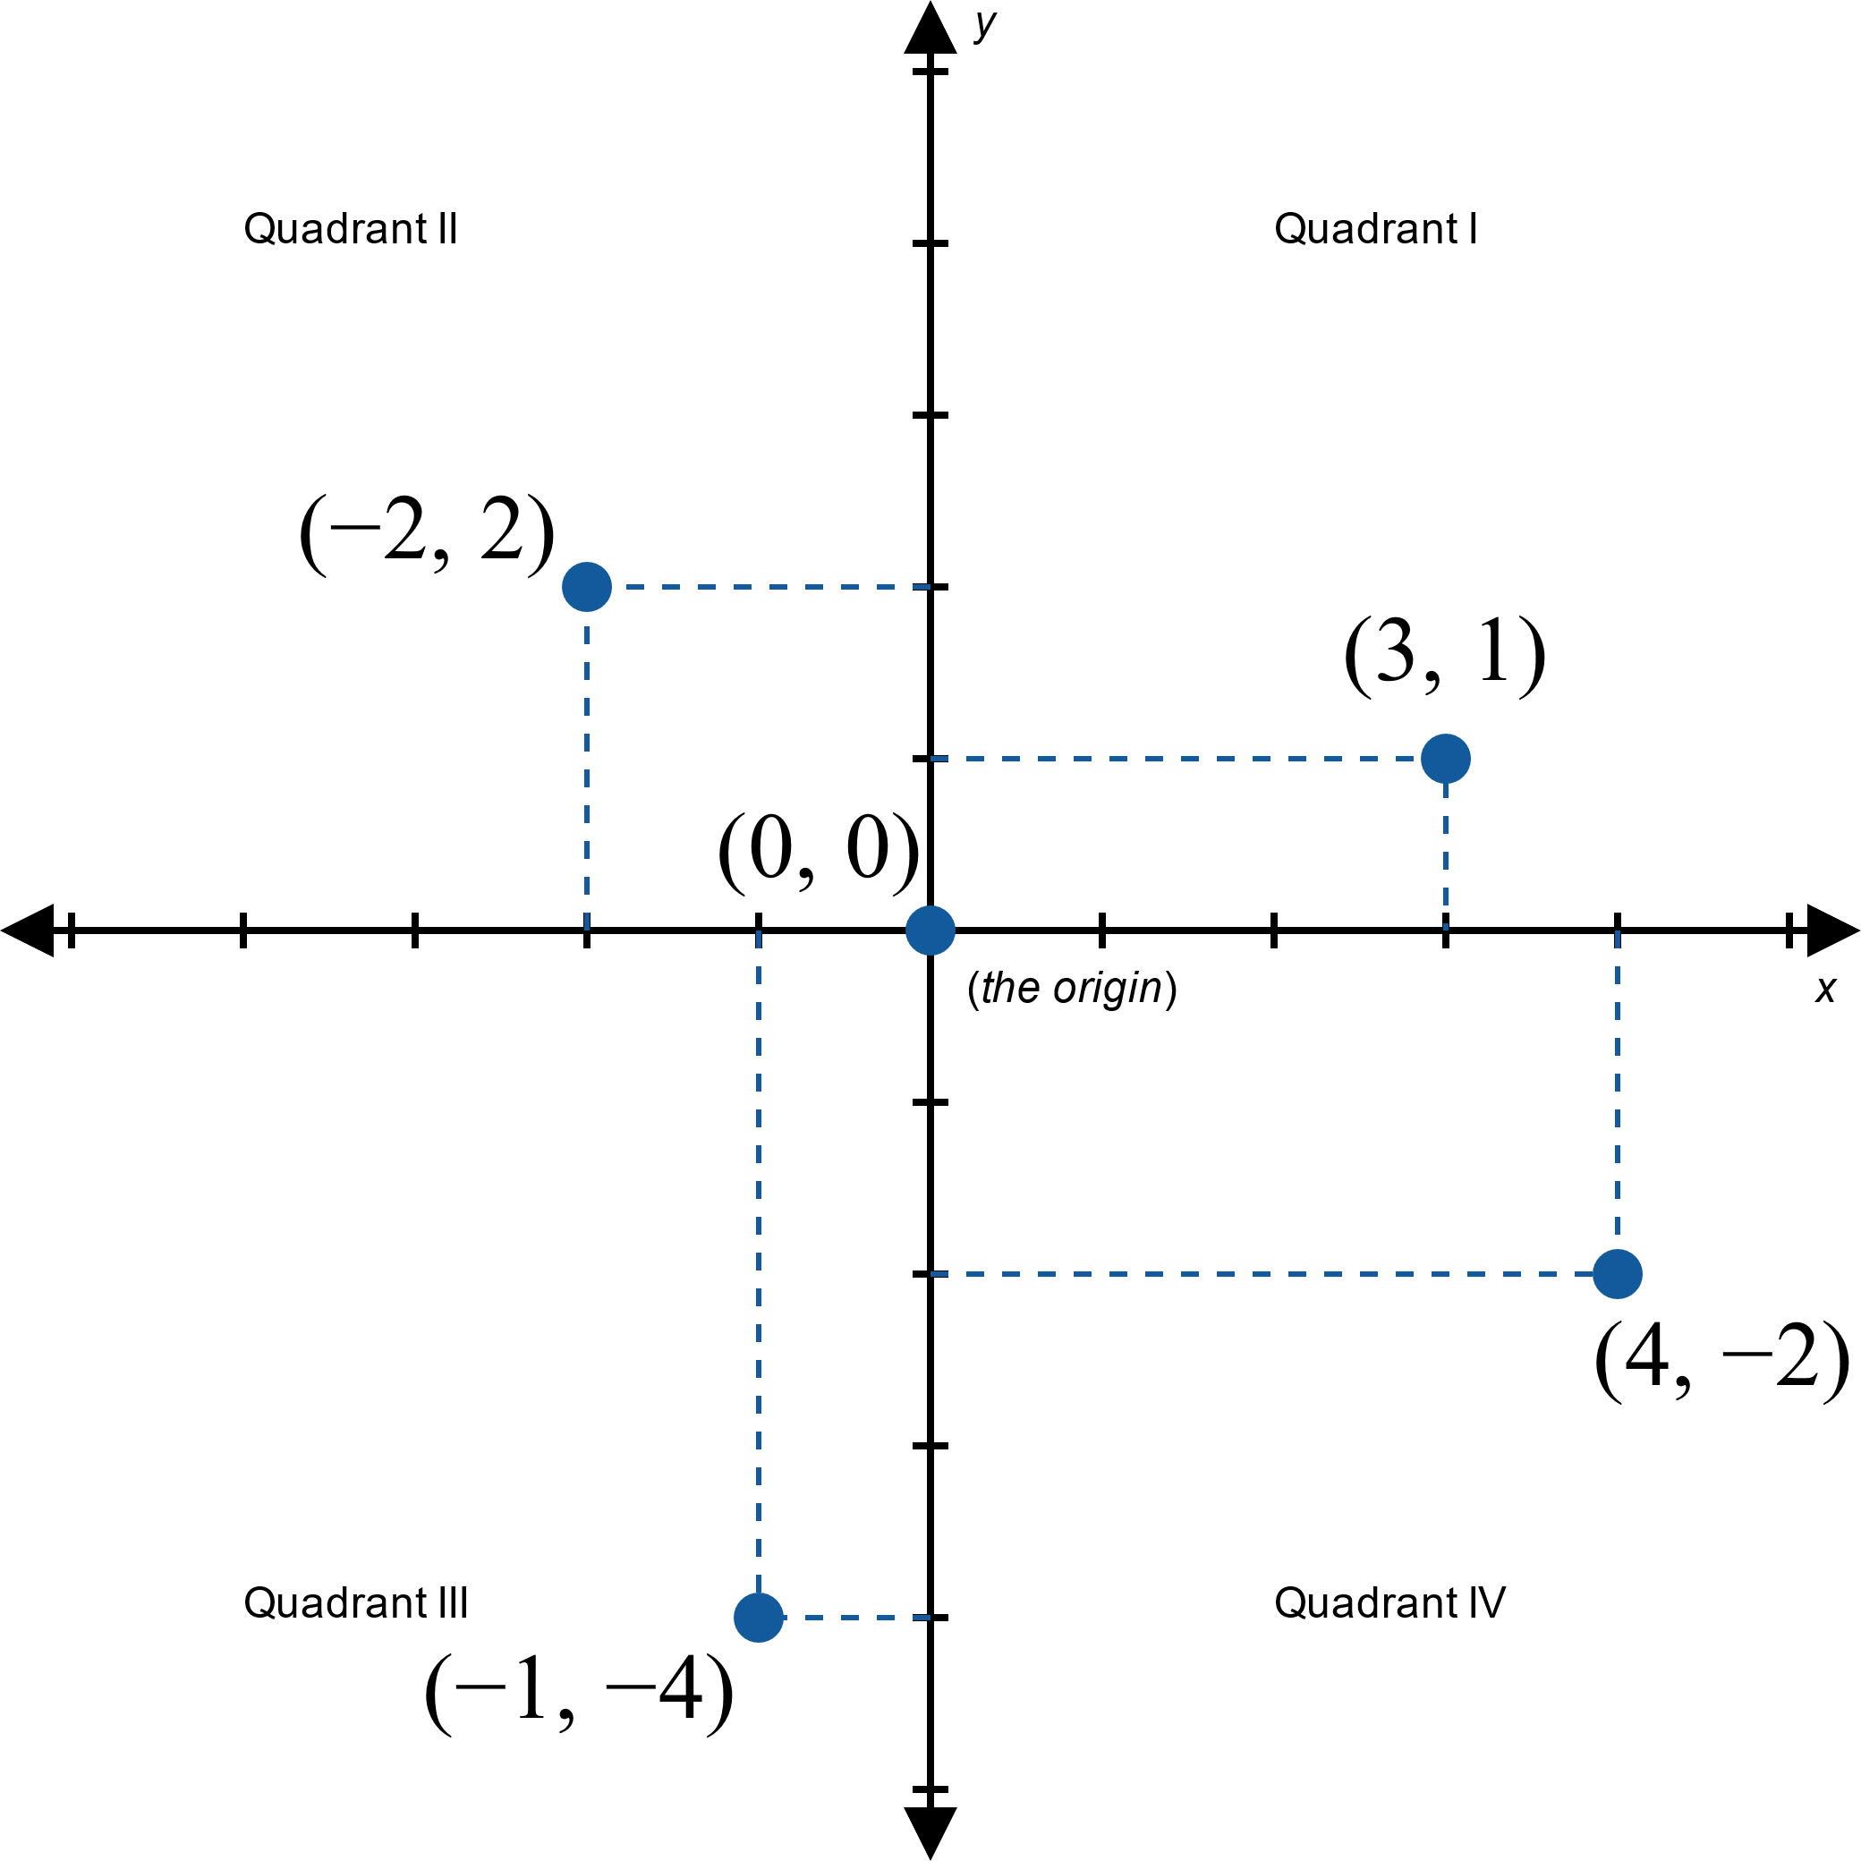
Figure 1: The Cartesian Plane

Slide 5
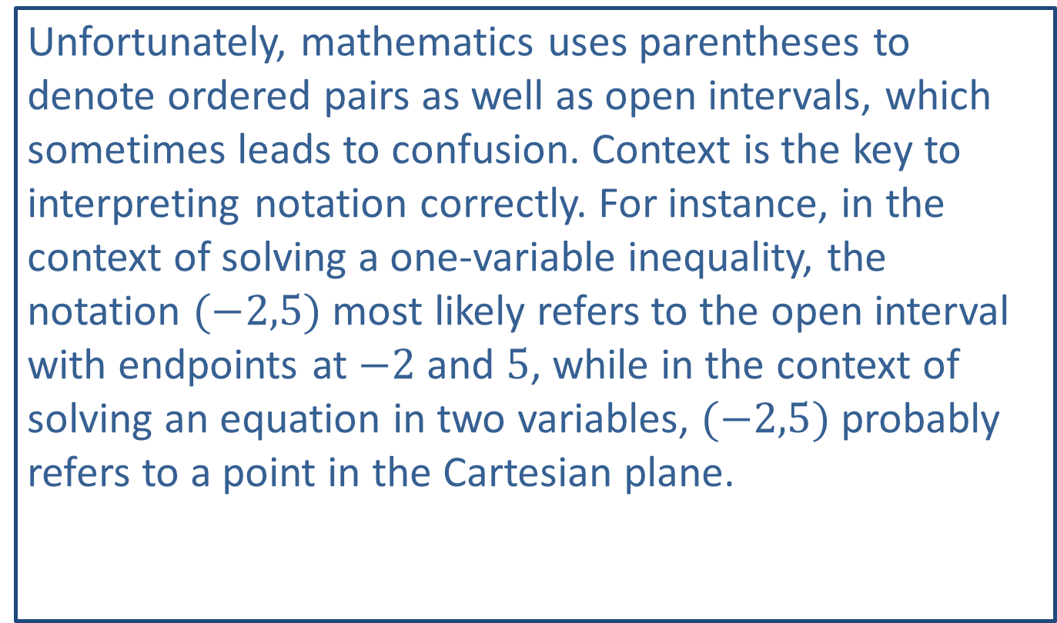
CAUTION!
Unfortunately, mathematics uses parentheses to denote ordered pairs as well as open intervals, which sometimes leads to confusion. Context is the key to interpreting notation correctly. For instance, in the context of solving a one-variable inequality, the notation $(−2,5)$ most likely refers to the open interval with endpoints at $−2$ and 5, while in the context of solving an equation in two variables, $(−2,5)$ probably refers to a point in the Cartesian plane.

Slide 6
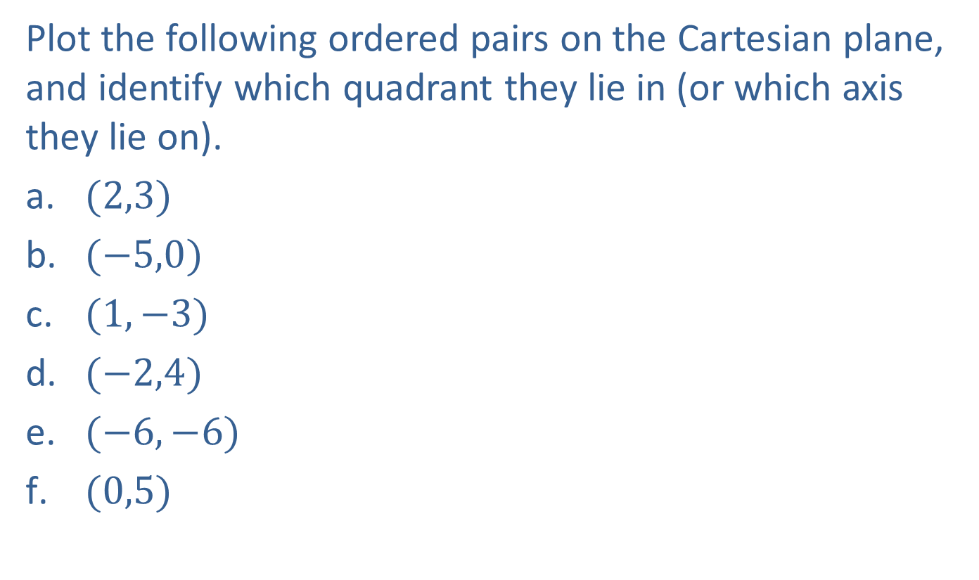
Example 1: Plotting Points in the Cartesian Coordinate System
Plot the following ordered pairs on the Cartesian plane, and identify which quadrant they lie in (or which axis they lie on).
​$(2,3)$
​$(−5,0)$
​$(1,−3)$
​$(−2,4)$
​$(−6,−6)$
​$(0,5)$

Slide 7
Note:
There is no required method when plotting points, but it is helpful to establish a set pattern that you follow. For example, you may always count the horizontal value first, then the vertical displacement.

Slide 8
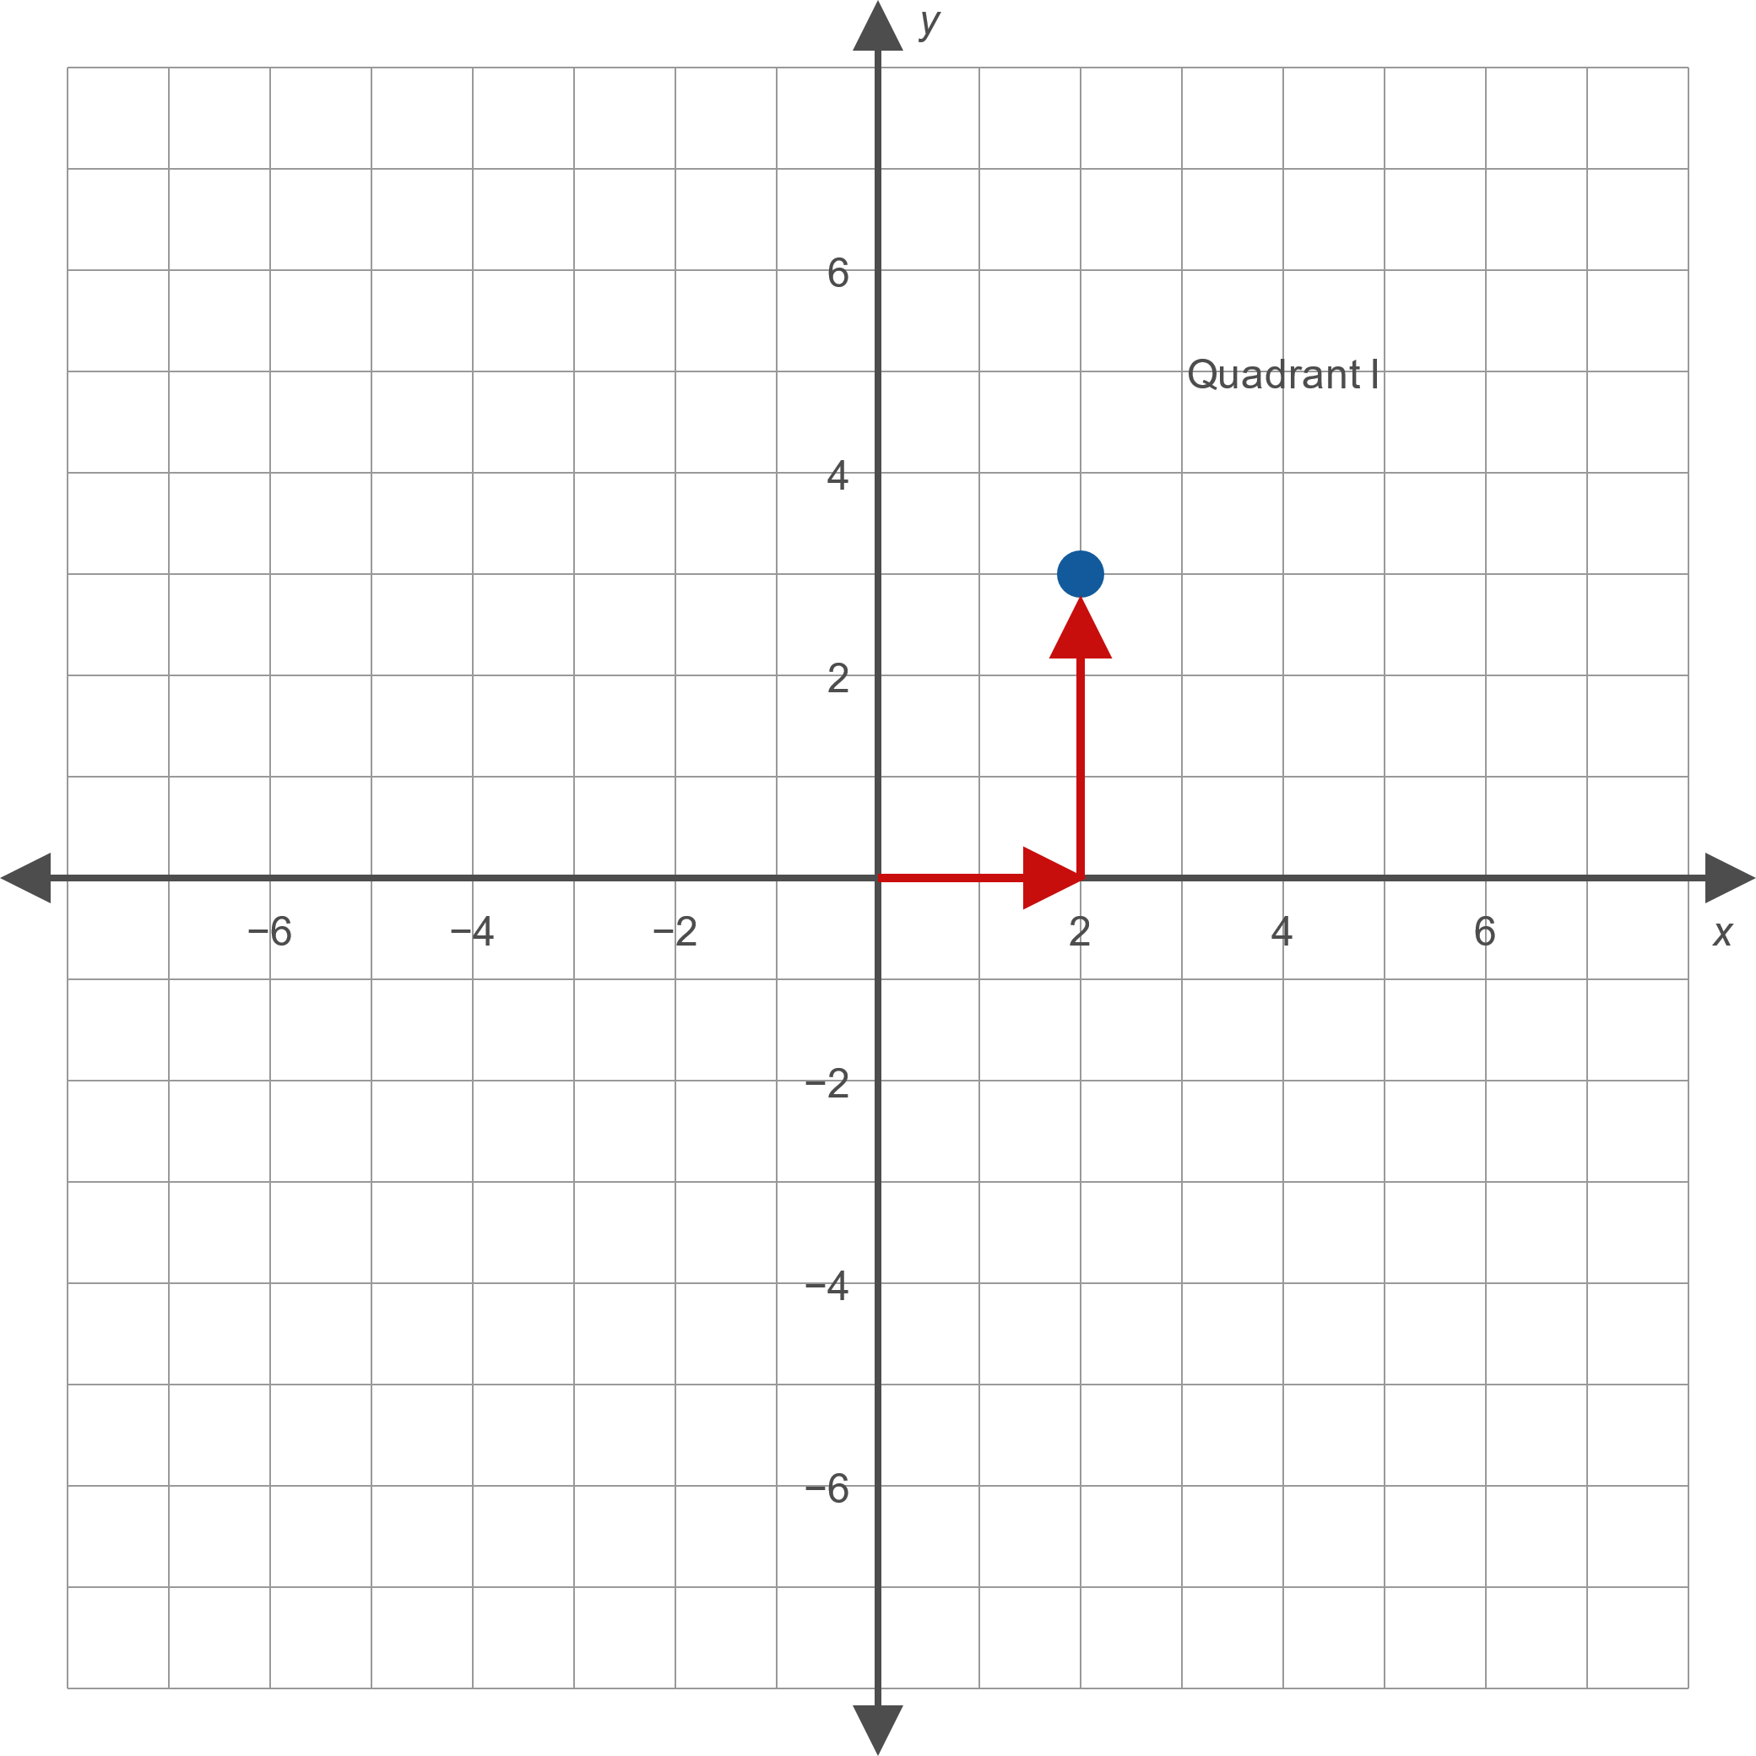

Example 1: Plotting Points in the Cartesian Coordinate System (cont.)
Solution
​

Slide 9
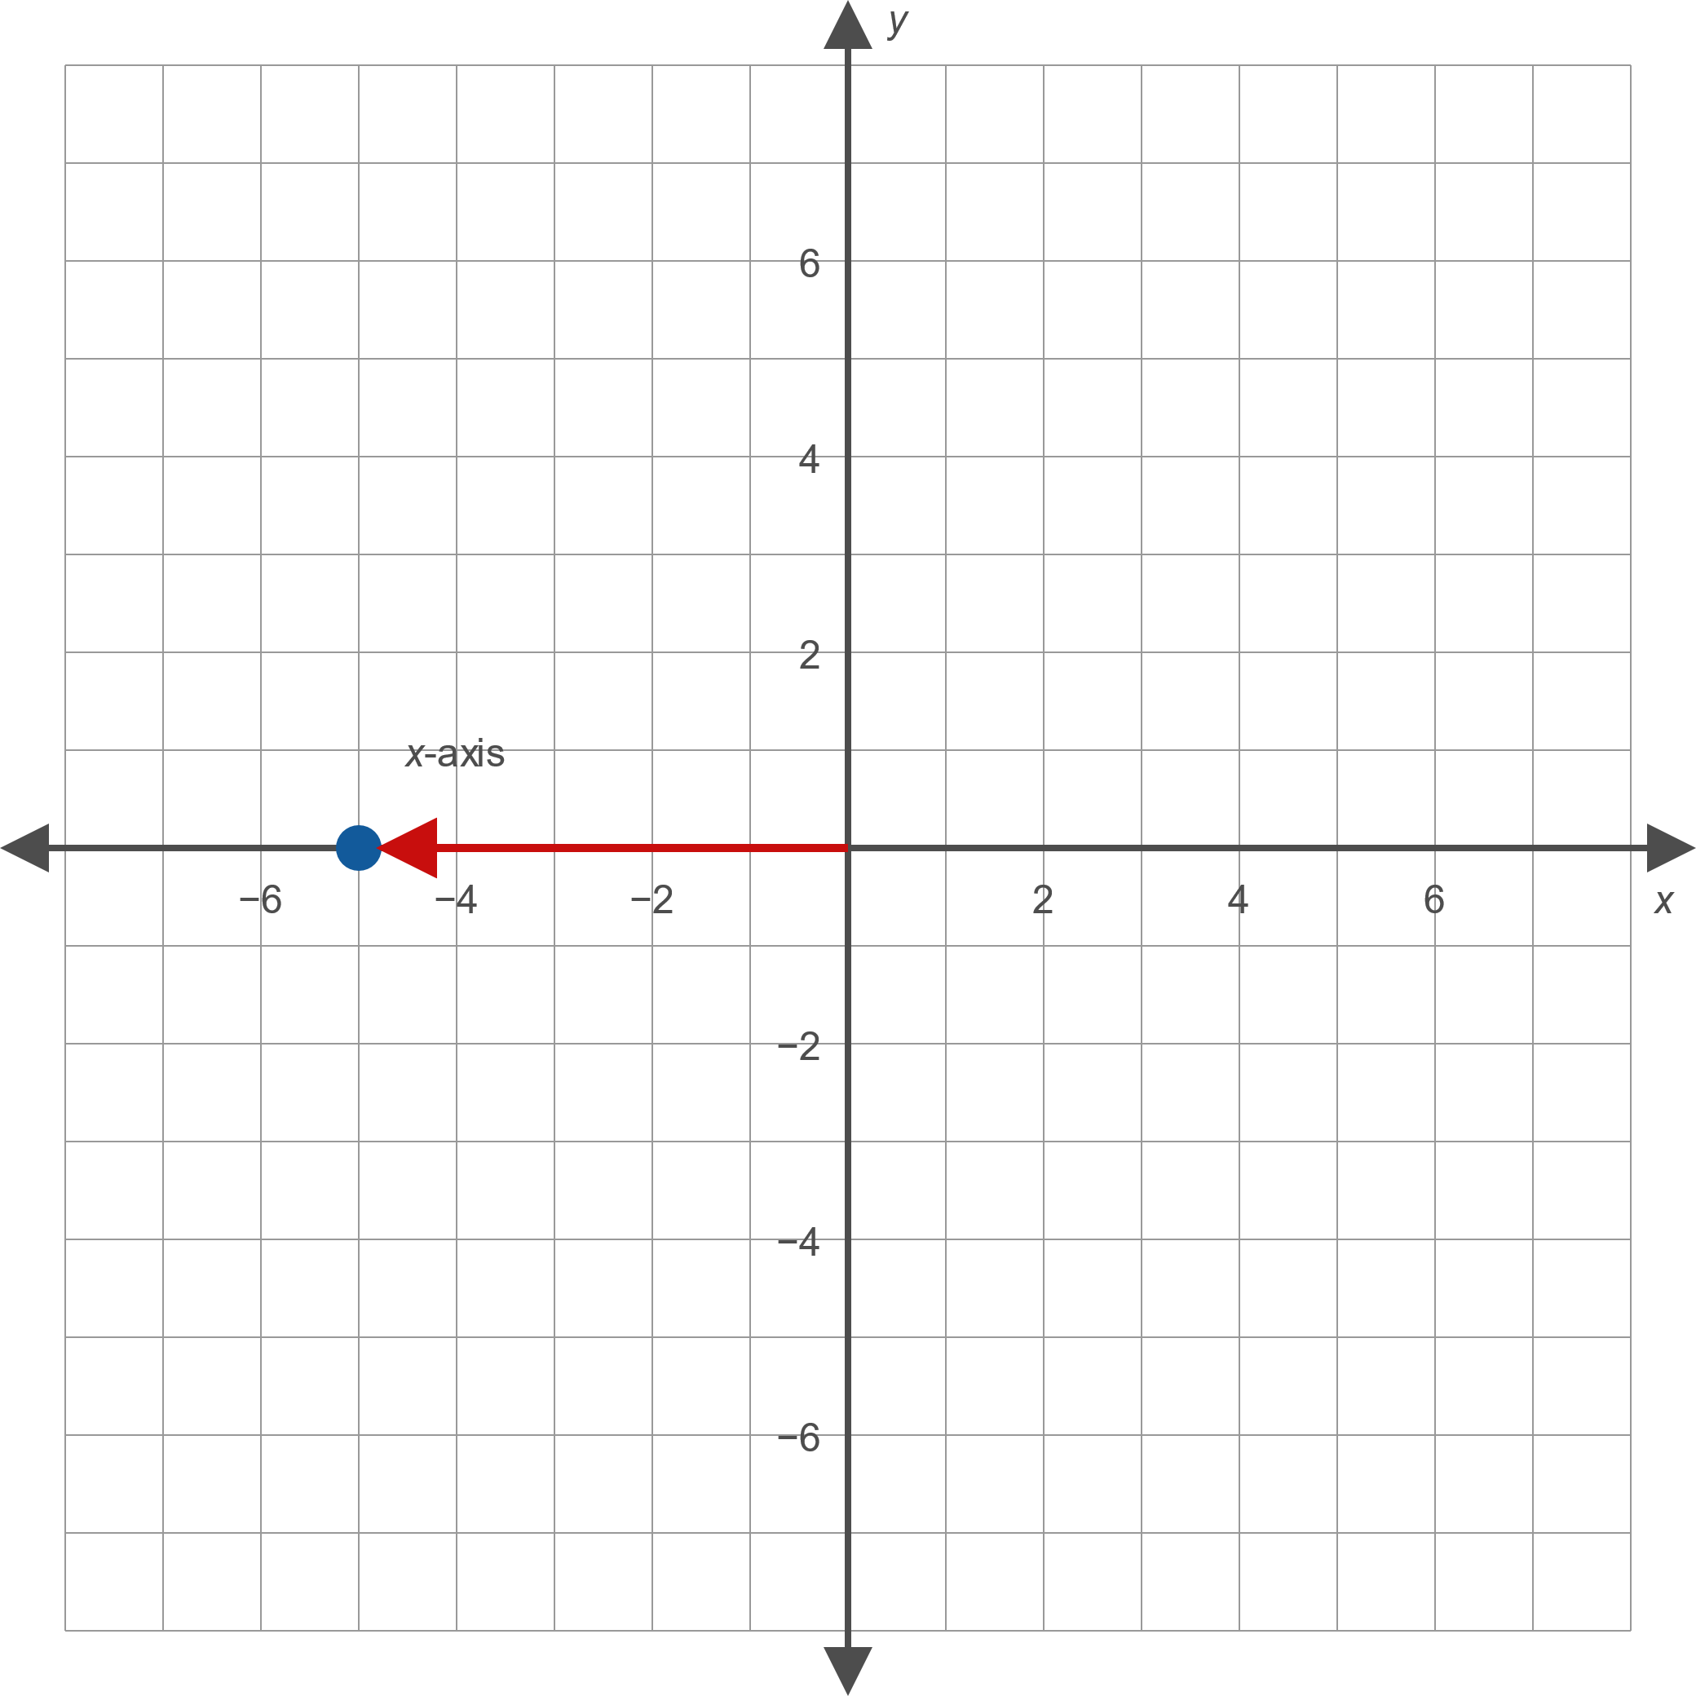

Example 1: Plotting Points in the Cartesian Coordinate System (cont.)
​

Slide 10
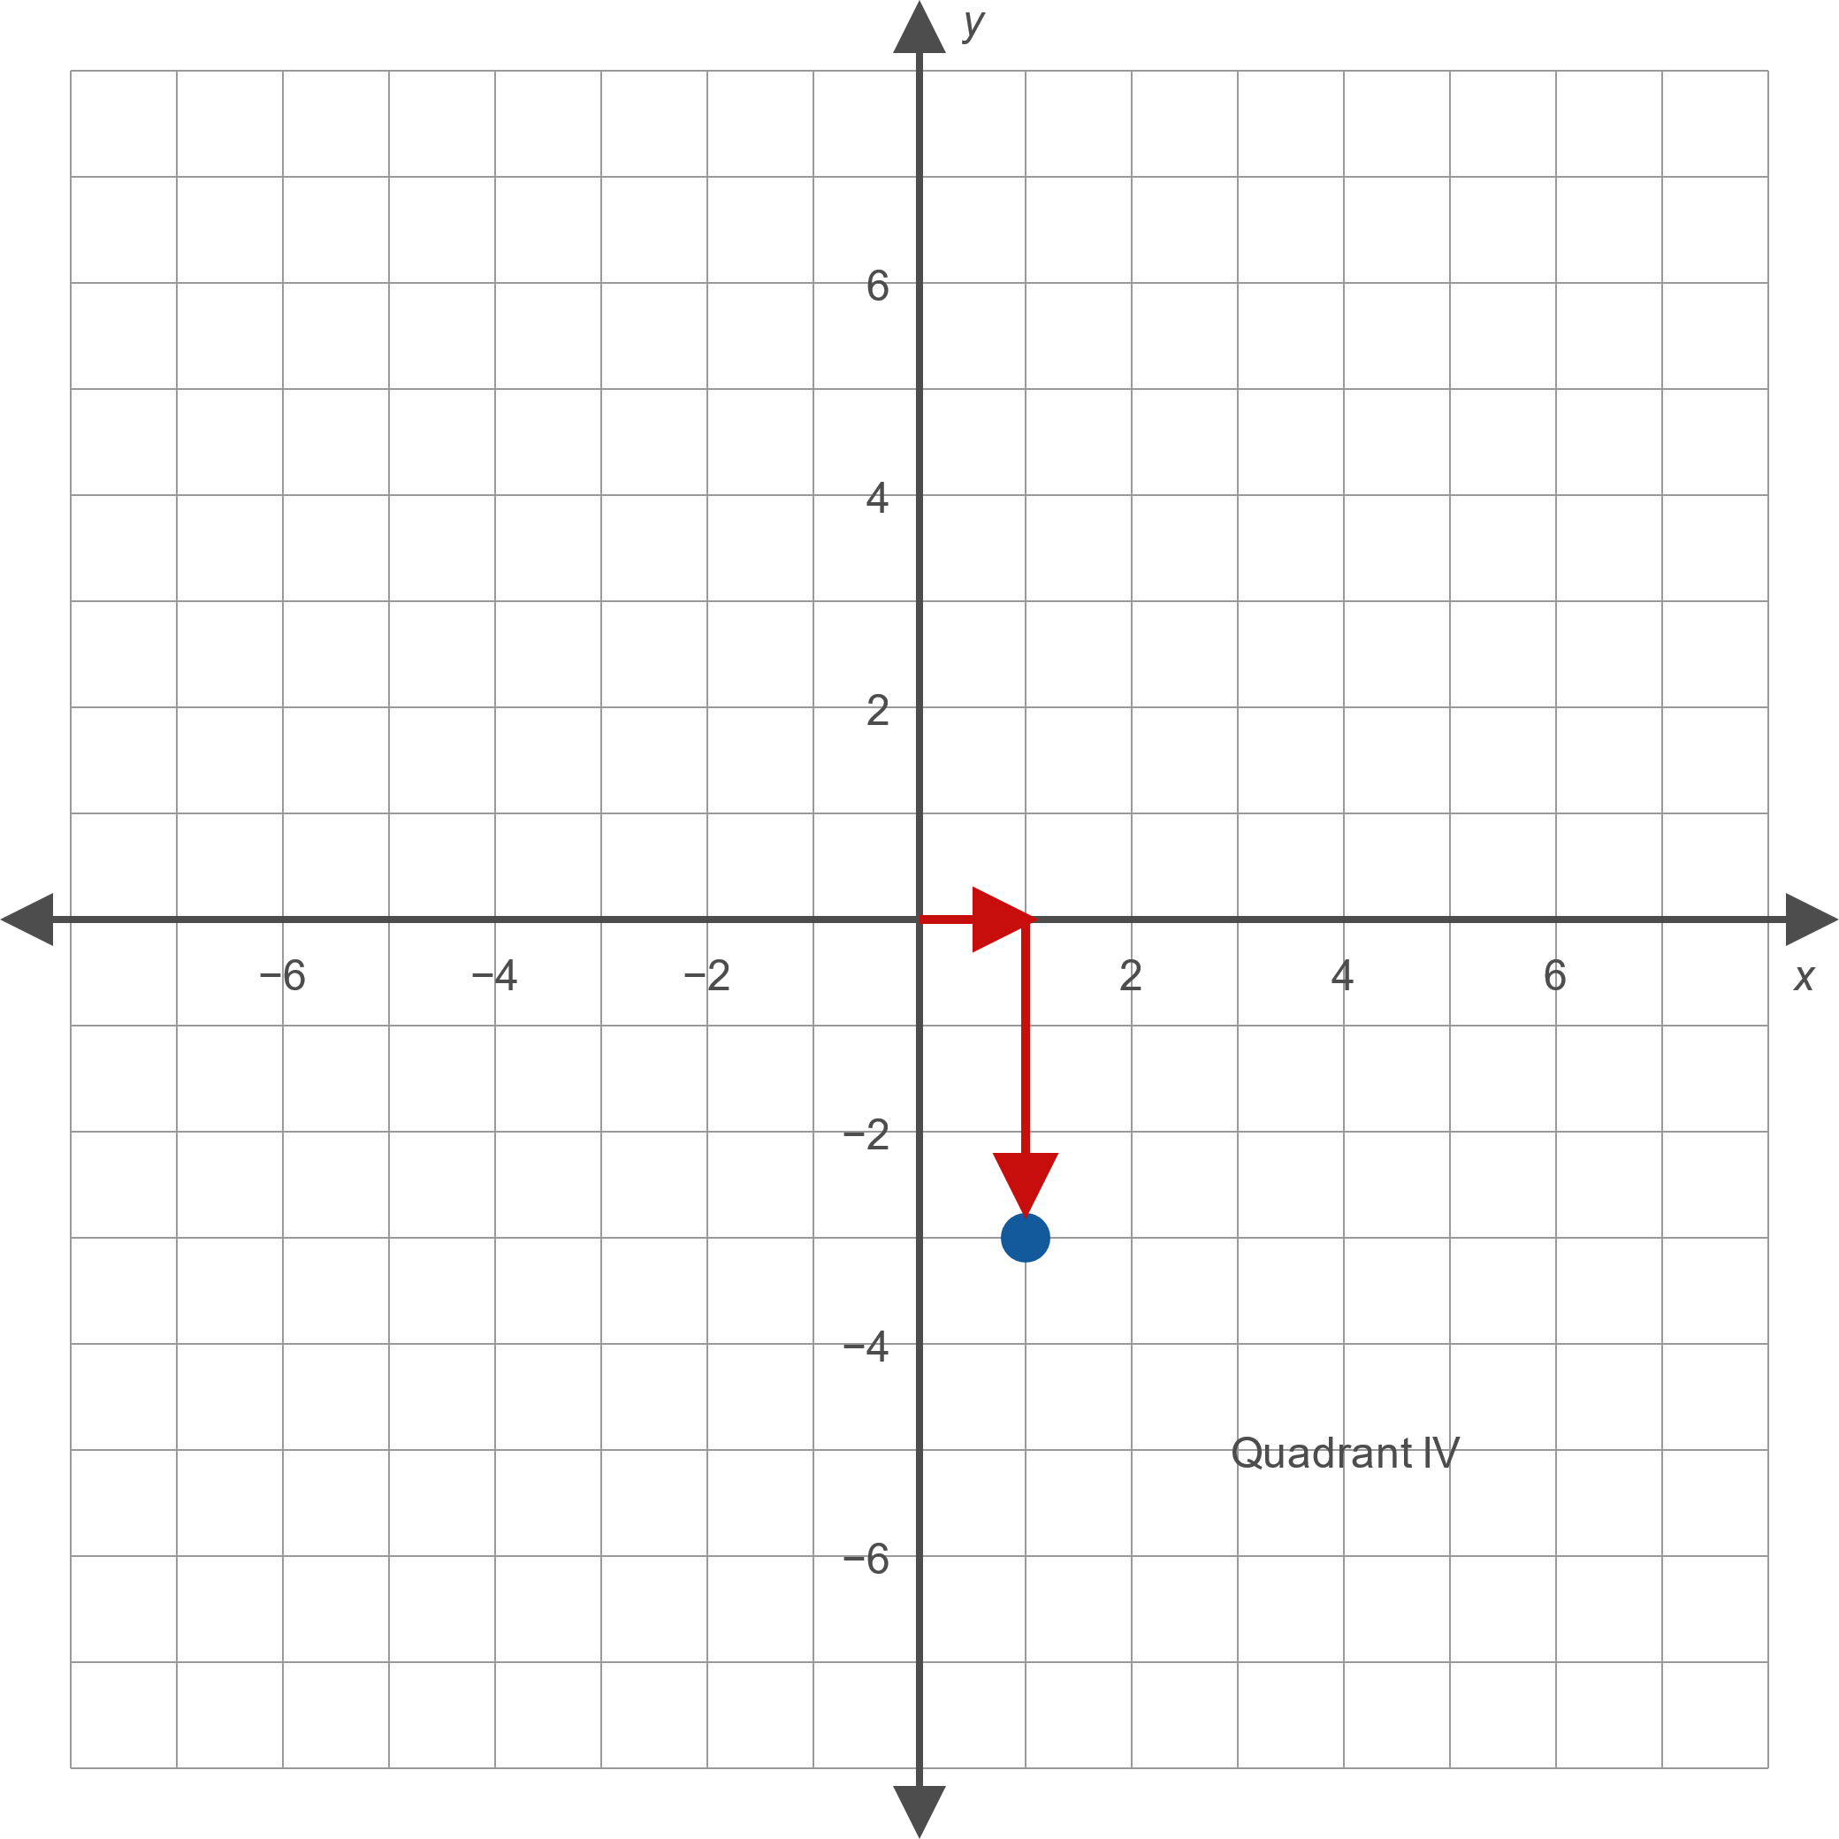

Example 1: Plotting Points in the Cartesian Coordinate System (cont.)
​

Slide 11
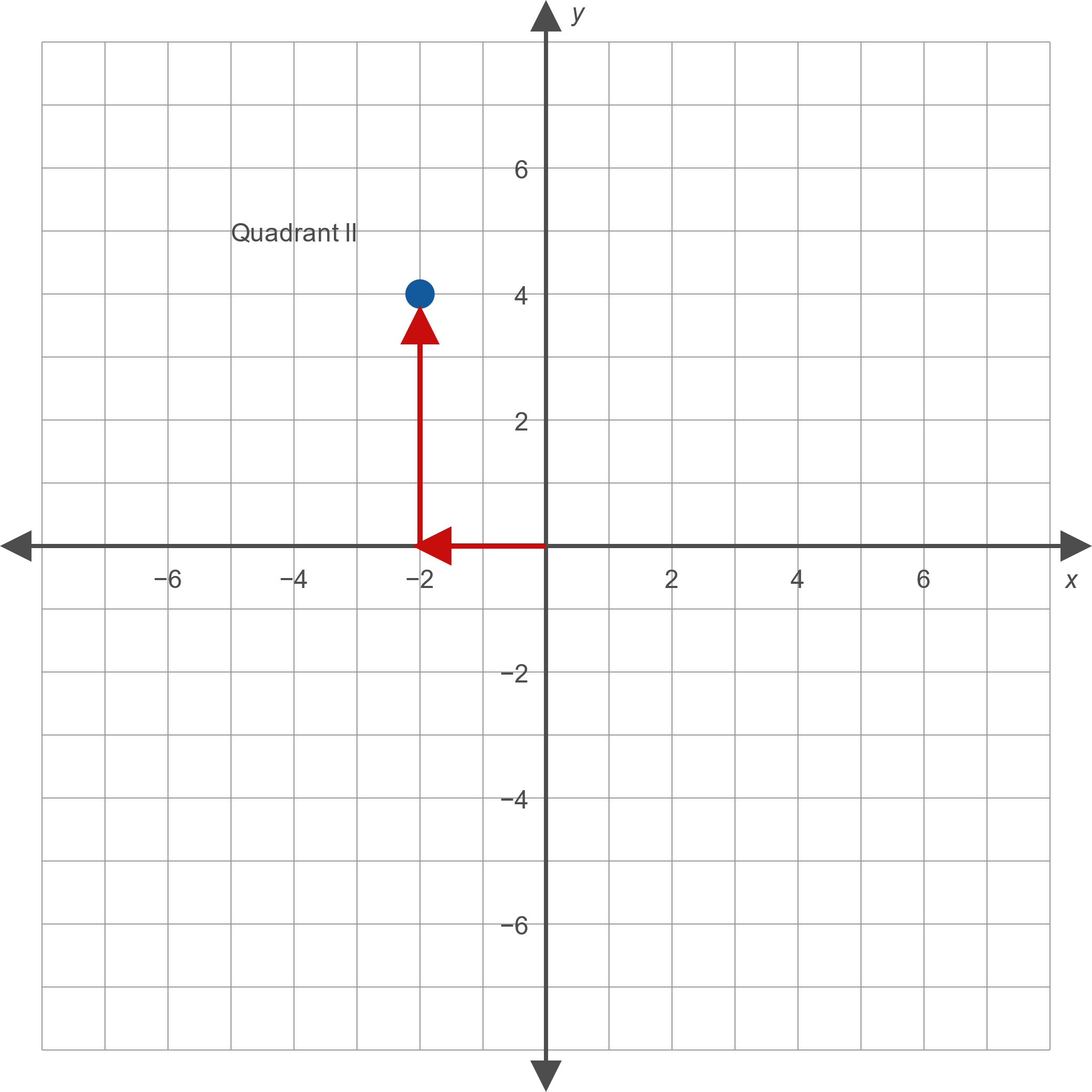

Example 1: Plotting Points in the Cartesian Coordinate System (cont.)
​

Slide 12
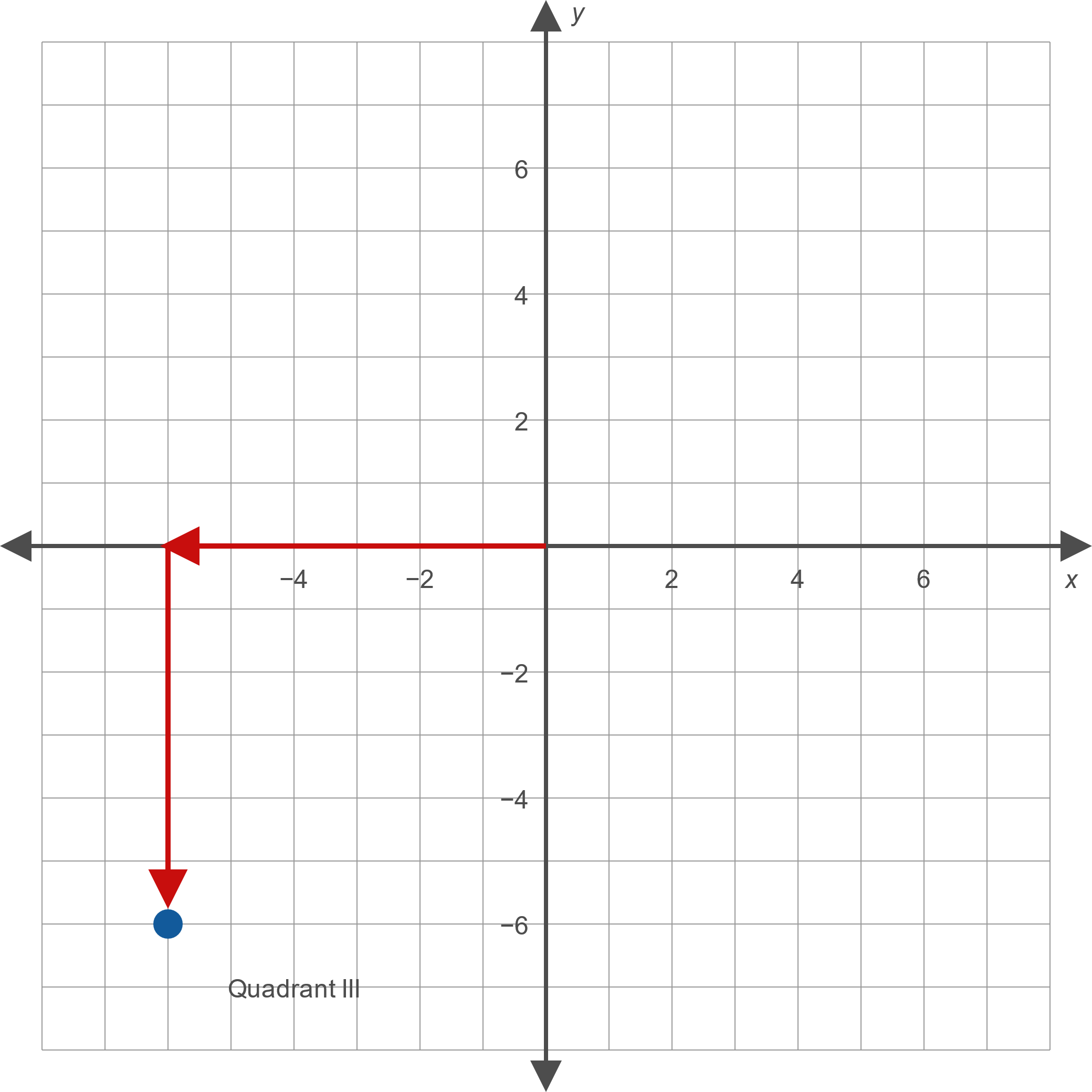
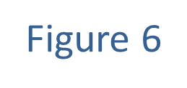
Example 1: Plotting Points in the Cartesian Coordinate System (cont.)
​

Slide 13
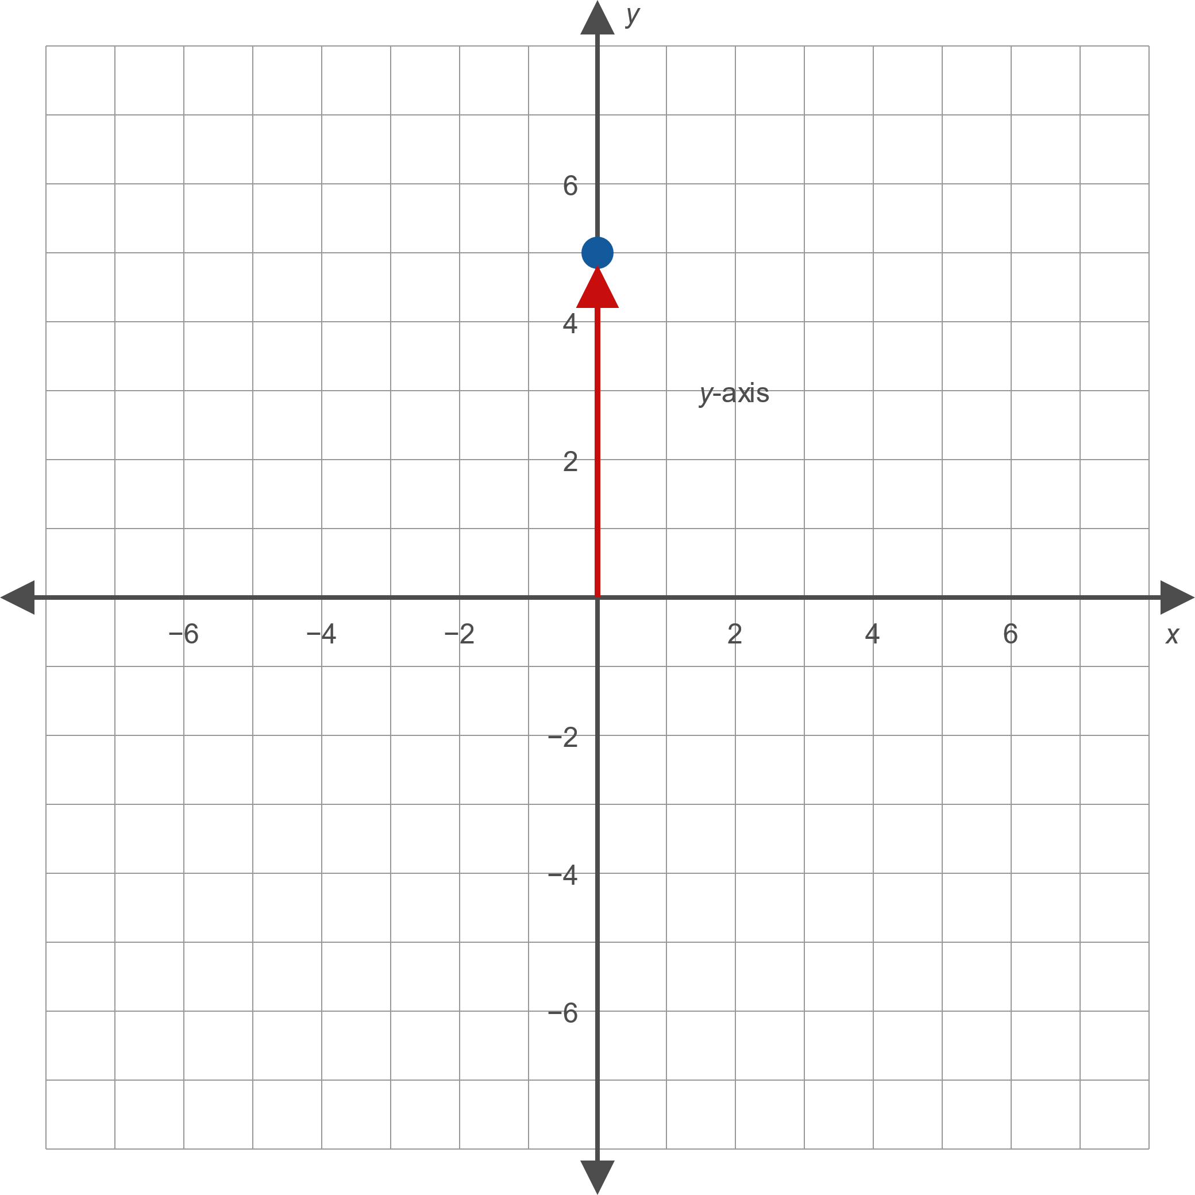

Example 1: Plotting Points in the Cartesian Coordinate System (cont.)
​

Slide 14

Example 2: Graphing Equations in Two Variables
Sketch graphs of the following equations by plotting points.
​$2x−5y=10$
​$x^{2}+y^{2}−6x=0$
​$y=x^{2}−2x$

Slide 15
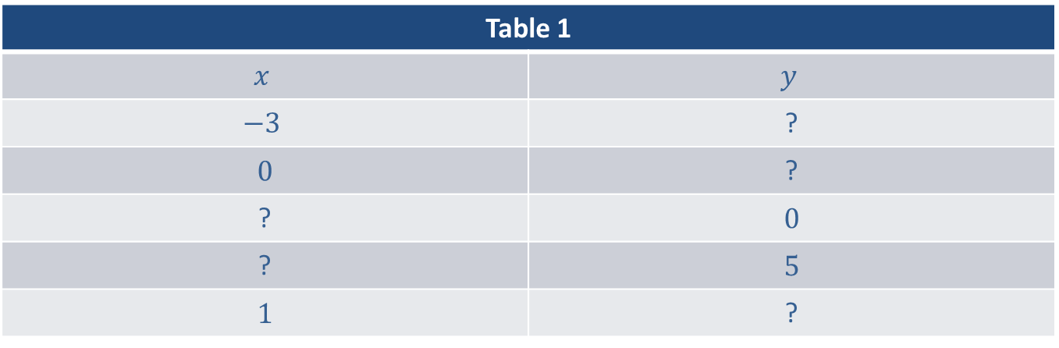
Example 2: Graphing Equations in Two Variables (cont.)
Solution
​In each row in Table 1, we select a value for one of the two variables.
​

Slide 16
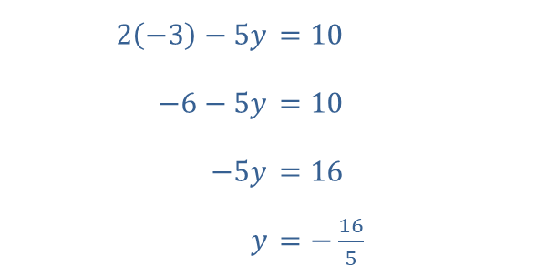
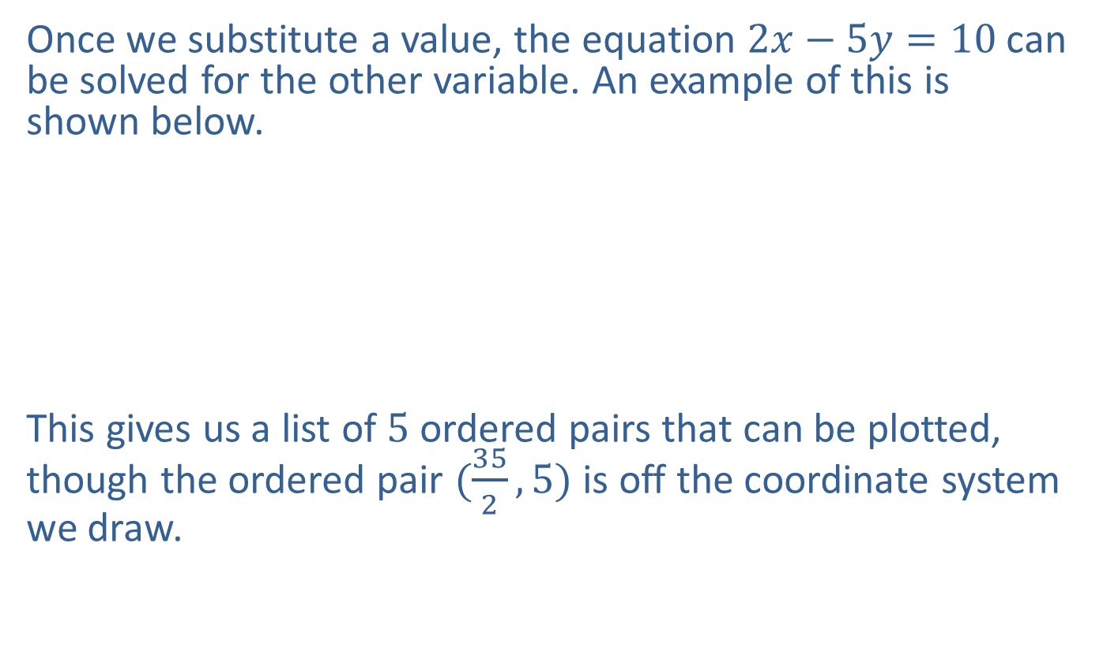
Example 2: Graphing Equations in Two Variables (cont.)
​Once we substitute a value, the equation $2x−5y=10$ can be solved for the other variable. An example of this is shown below.
​
​
This gives us a list of 5 ordered pairs that can be plotted, though the ordered pair $(\frac{35}{2},5)$ is off the coordinate system we draw.
​

Slide 17
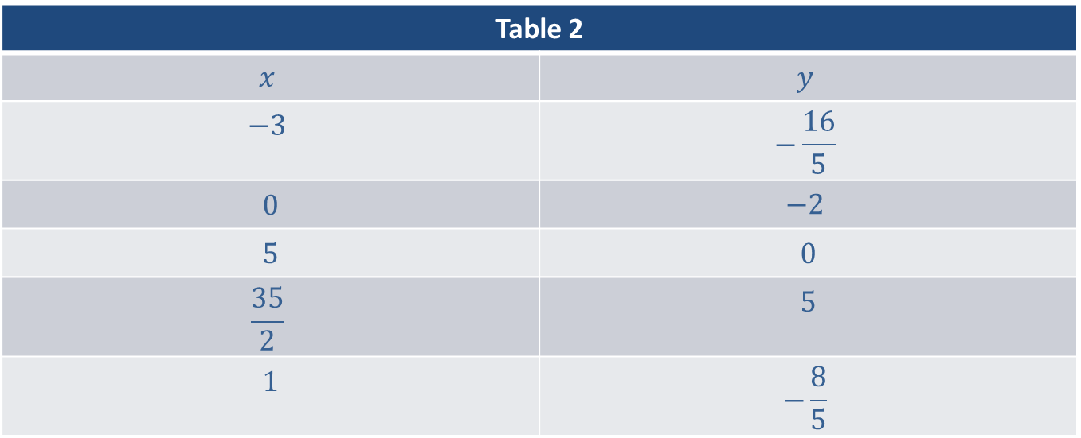
Example 2: Graphing Equations in Two Variables (cont.)
Table 2
$$x$$ | $$y$$
$$−3$$ | $$−\frac{16}{5}$$
0 | $$−2$$
5 | 0
$$\frac{35}{2}$$ | 5
1 | $$−\frac{8}{5}$$

Slide 18
Example 2: Graphing Equations in Two Variables (cont.)
​The four ordered pairs appear to lie on a straight line, and this is indeed the case. To gain more confidence in this fact, we could continue to plot more solutions of the equation, and we would find they all lie along the line that has been drawn through the four plotted ordered pairs. The infinite number of solutions of the equation are depicted by the line drawn through the plotted points.
​

Slide 19
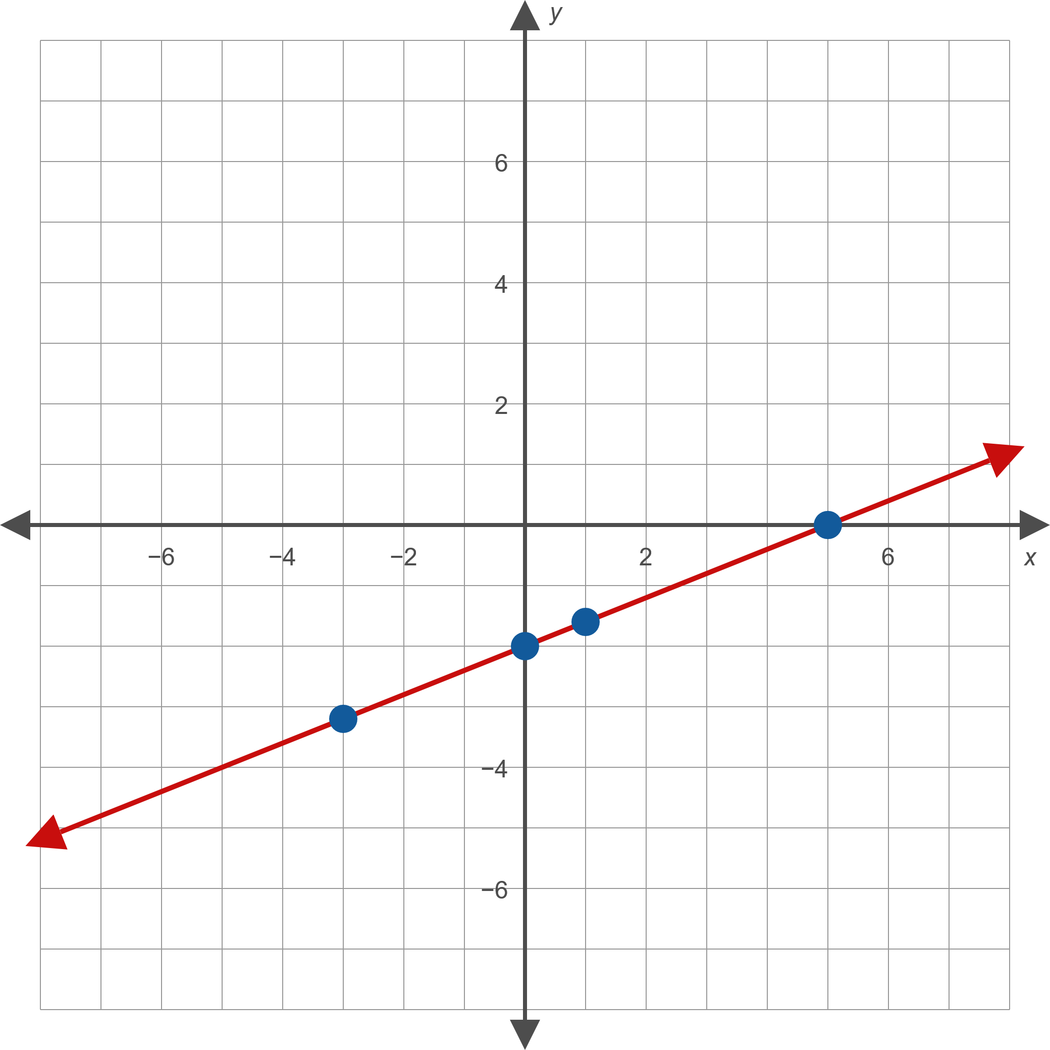

Example 2: Graphing Equations in Two Variables (cont.)

Slide 20
Note:
Rather than solving a new equation each time you substitute a value, it is more efficient to solve the equation for one variable before making substitutions. This method is shown in Example 2b.

Slide 21
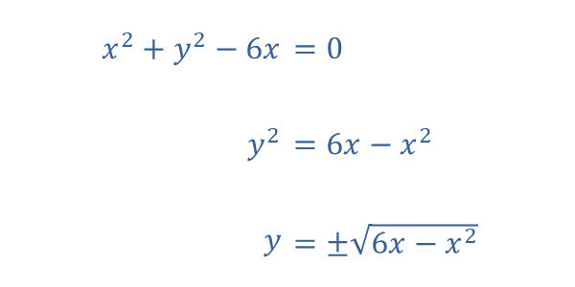

Example 2: Graphing Equations in Two Variables (cont.)
​For this example, we solve the original equation for $y$, then substitute several values for $x$ to generate a series of $y$-values.
​

Slide 22
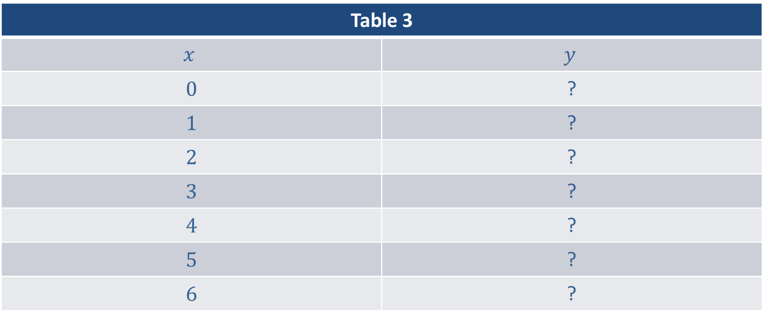
Example 2: Graphing Equations in Two Variables (cont.)
​Again, we plot enough solutions to feel confident in sketching the entire solution set.
​

Slide 23
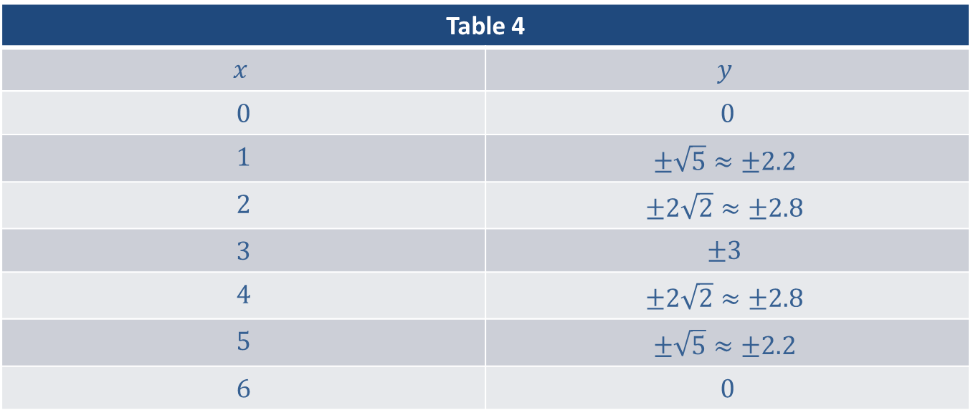
Example 2: Graphing Equations in Two Variables (cont.)
Table 4
$$x$$ | $$y$$
0 | 0
1 | $$±\sqrt{5}≈±2.2$$
2 | $$±2\sqrt{2}≈±2.8$$
3 | $$±3$$
4 | $$±2\sqrt{2}≈±2.8$$
5 | $$±\sqrt{5}≈±2.2$$
6 | 0

Slide 24
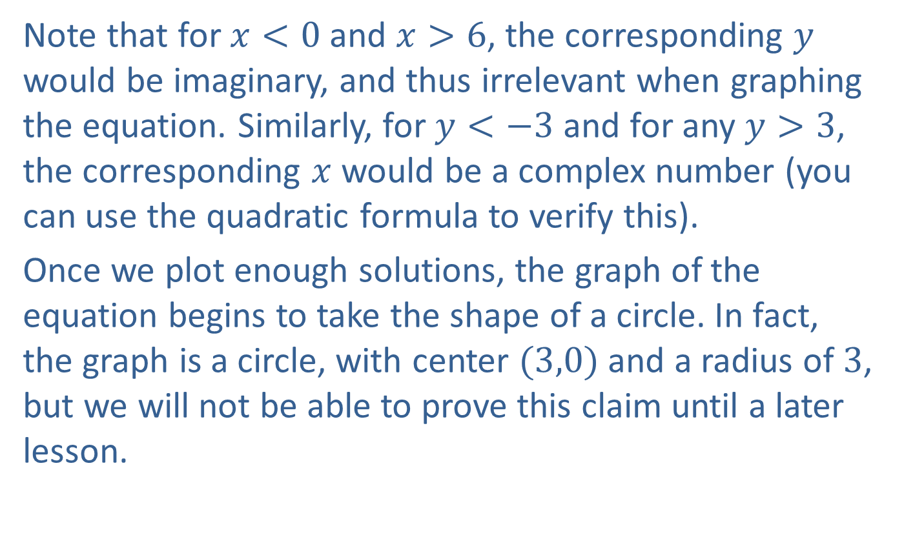
Example 2: Graphing Equations in Two Variables (cont.)
​Note that for $x<0$ and $x>6$, the corresponding $y$ would be imaginary, and thus irrelevant when graphing the equation. Similarly, for $y<−3$ and for any $y>3$, the corresponding $x$ would be a complex number (you can use the quadratic formula to verify this).
​Once we plot enough solutions, the graph of the equation begins to take the shape of a circle. In fact, the graph is a circle, with center $(3,0)$ and a radius of 3, but we will not be able to prove this claim until a later lesson.
​

Slide 25
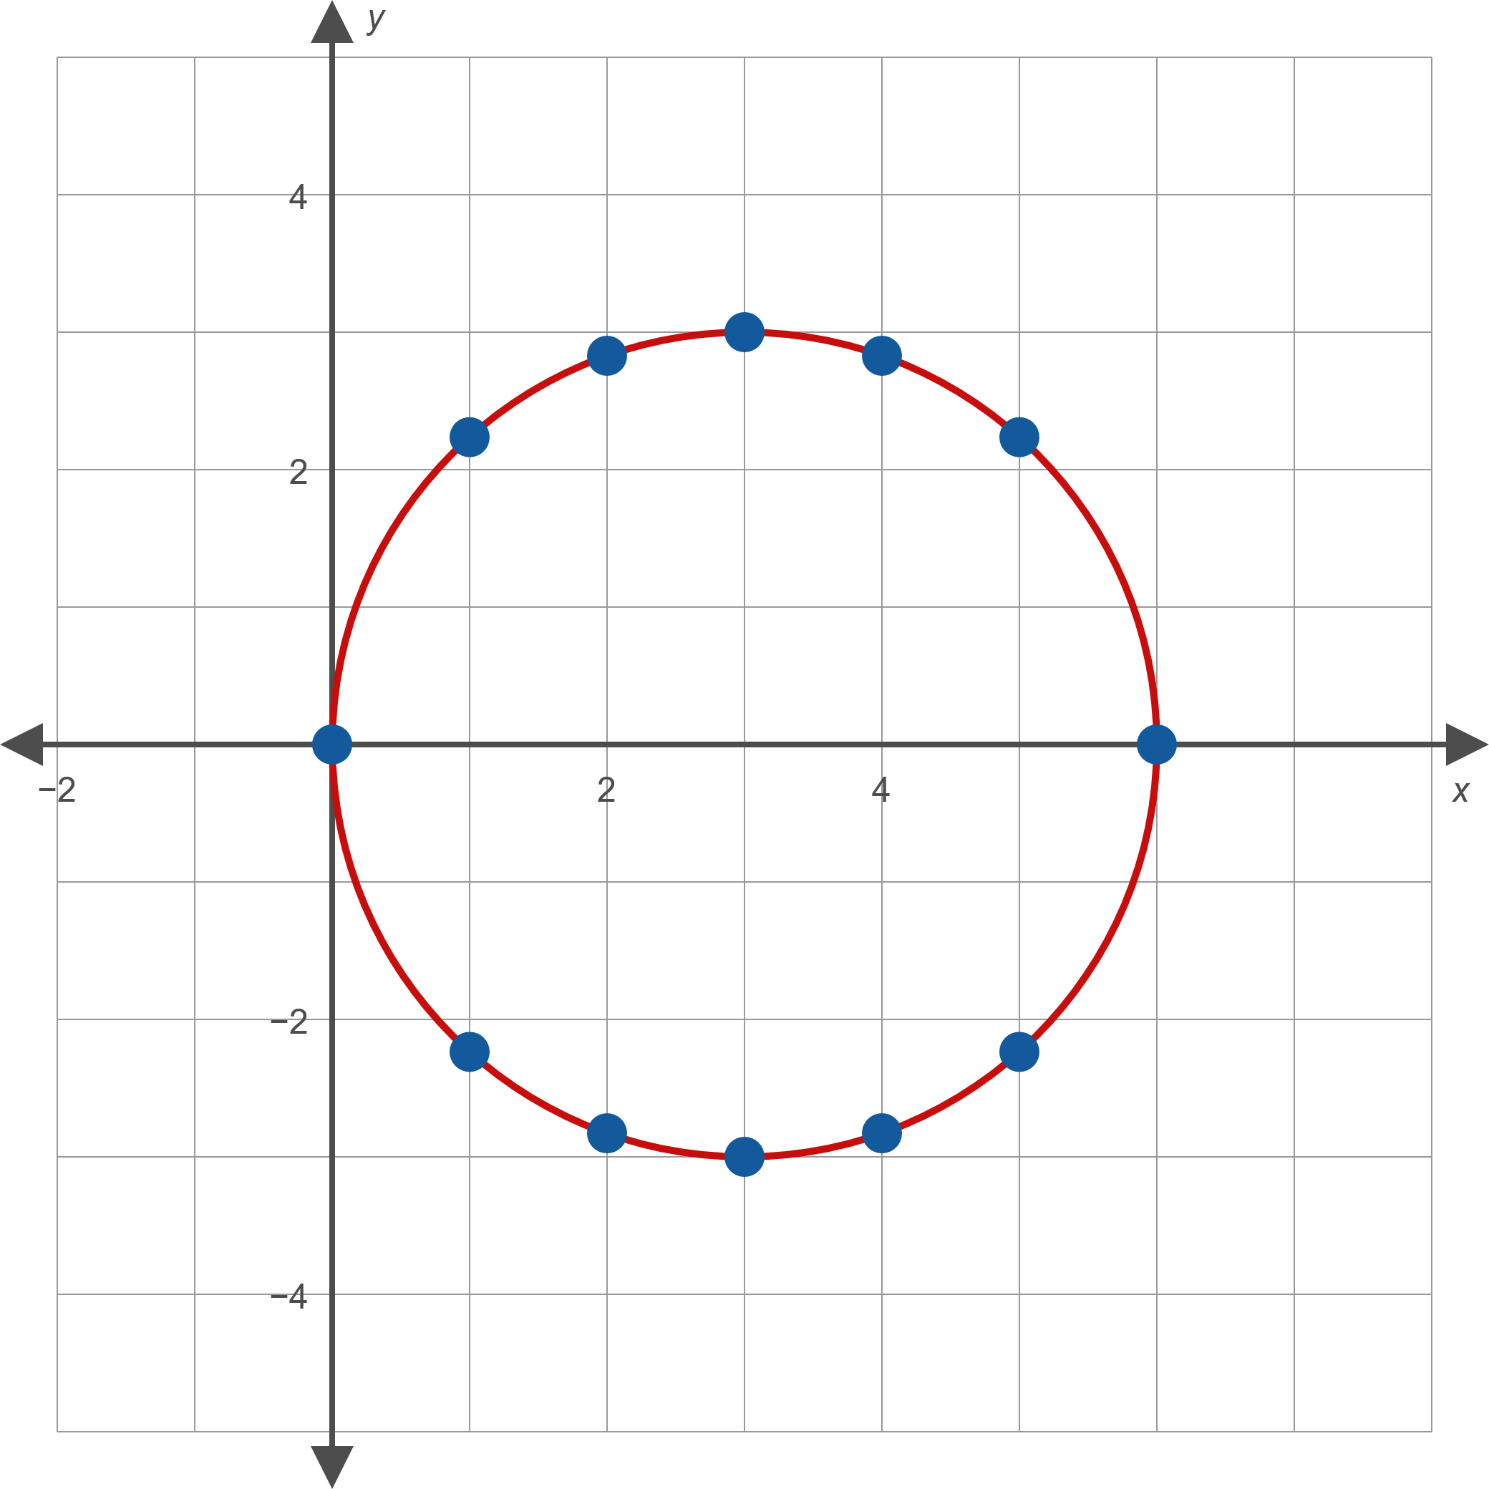
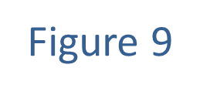
Example 2: Graphing Equations in Two Variables (cont.)

Slide 26

Example 2: Graphing Equations in Two Variables (cont.)
​Since this equation is already solved for $y$ we use a table of $x$-values and substitute them in the given equation. Again, enough points should be plotted to give some idea of the nature of the entire solution set of the equation.
​

Slide 27
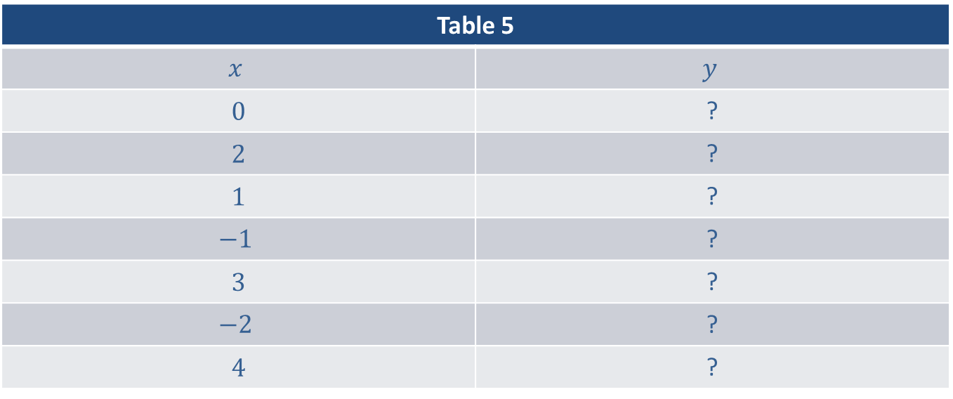
Example 2: Graphing Equations in Two Variables (cont.)
Table 5
$$x$$ | $$y$$
0 | ?
2 | ?
1 | ?
$$−1$$ | ?
3 | ?
$$−2$$ | ?
4 | ?

Slide 28
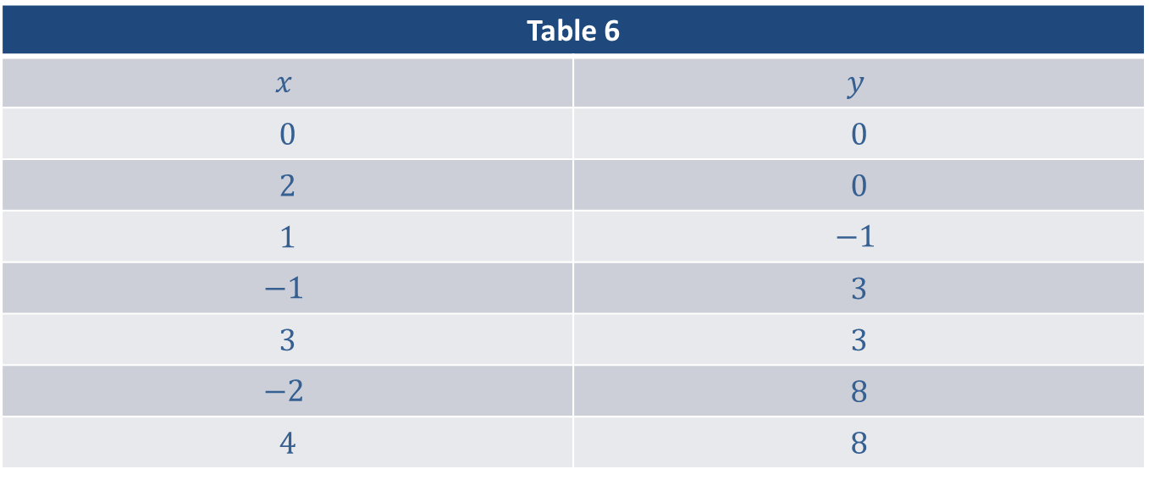
Example 2: Graphing Equations in Two Variables (cont.)
Table 6
$$x$$ | $$y$$
0 | 0
2 | 0
1 | $$−1$$
$$−1$$ | 3
3 | 3
$$−2$$ | 8
4 | 8

Slide 29

Example 2: Graphing Equations in Two Variables (cont.)
​The graph of $y=x^{2}−2x$ is a shape known as a parabola. We will encounter these shapes again in a later lesson, and we will be able, at that time, to prove that our rough sketch in Figure 10 is indeed the graph of the solution set of$y=x^{2}−2x$.
​

Slide 30
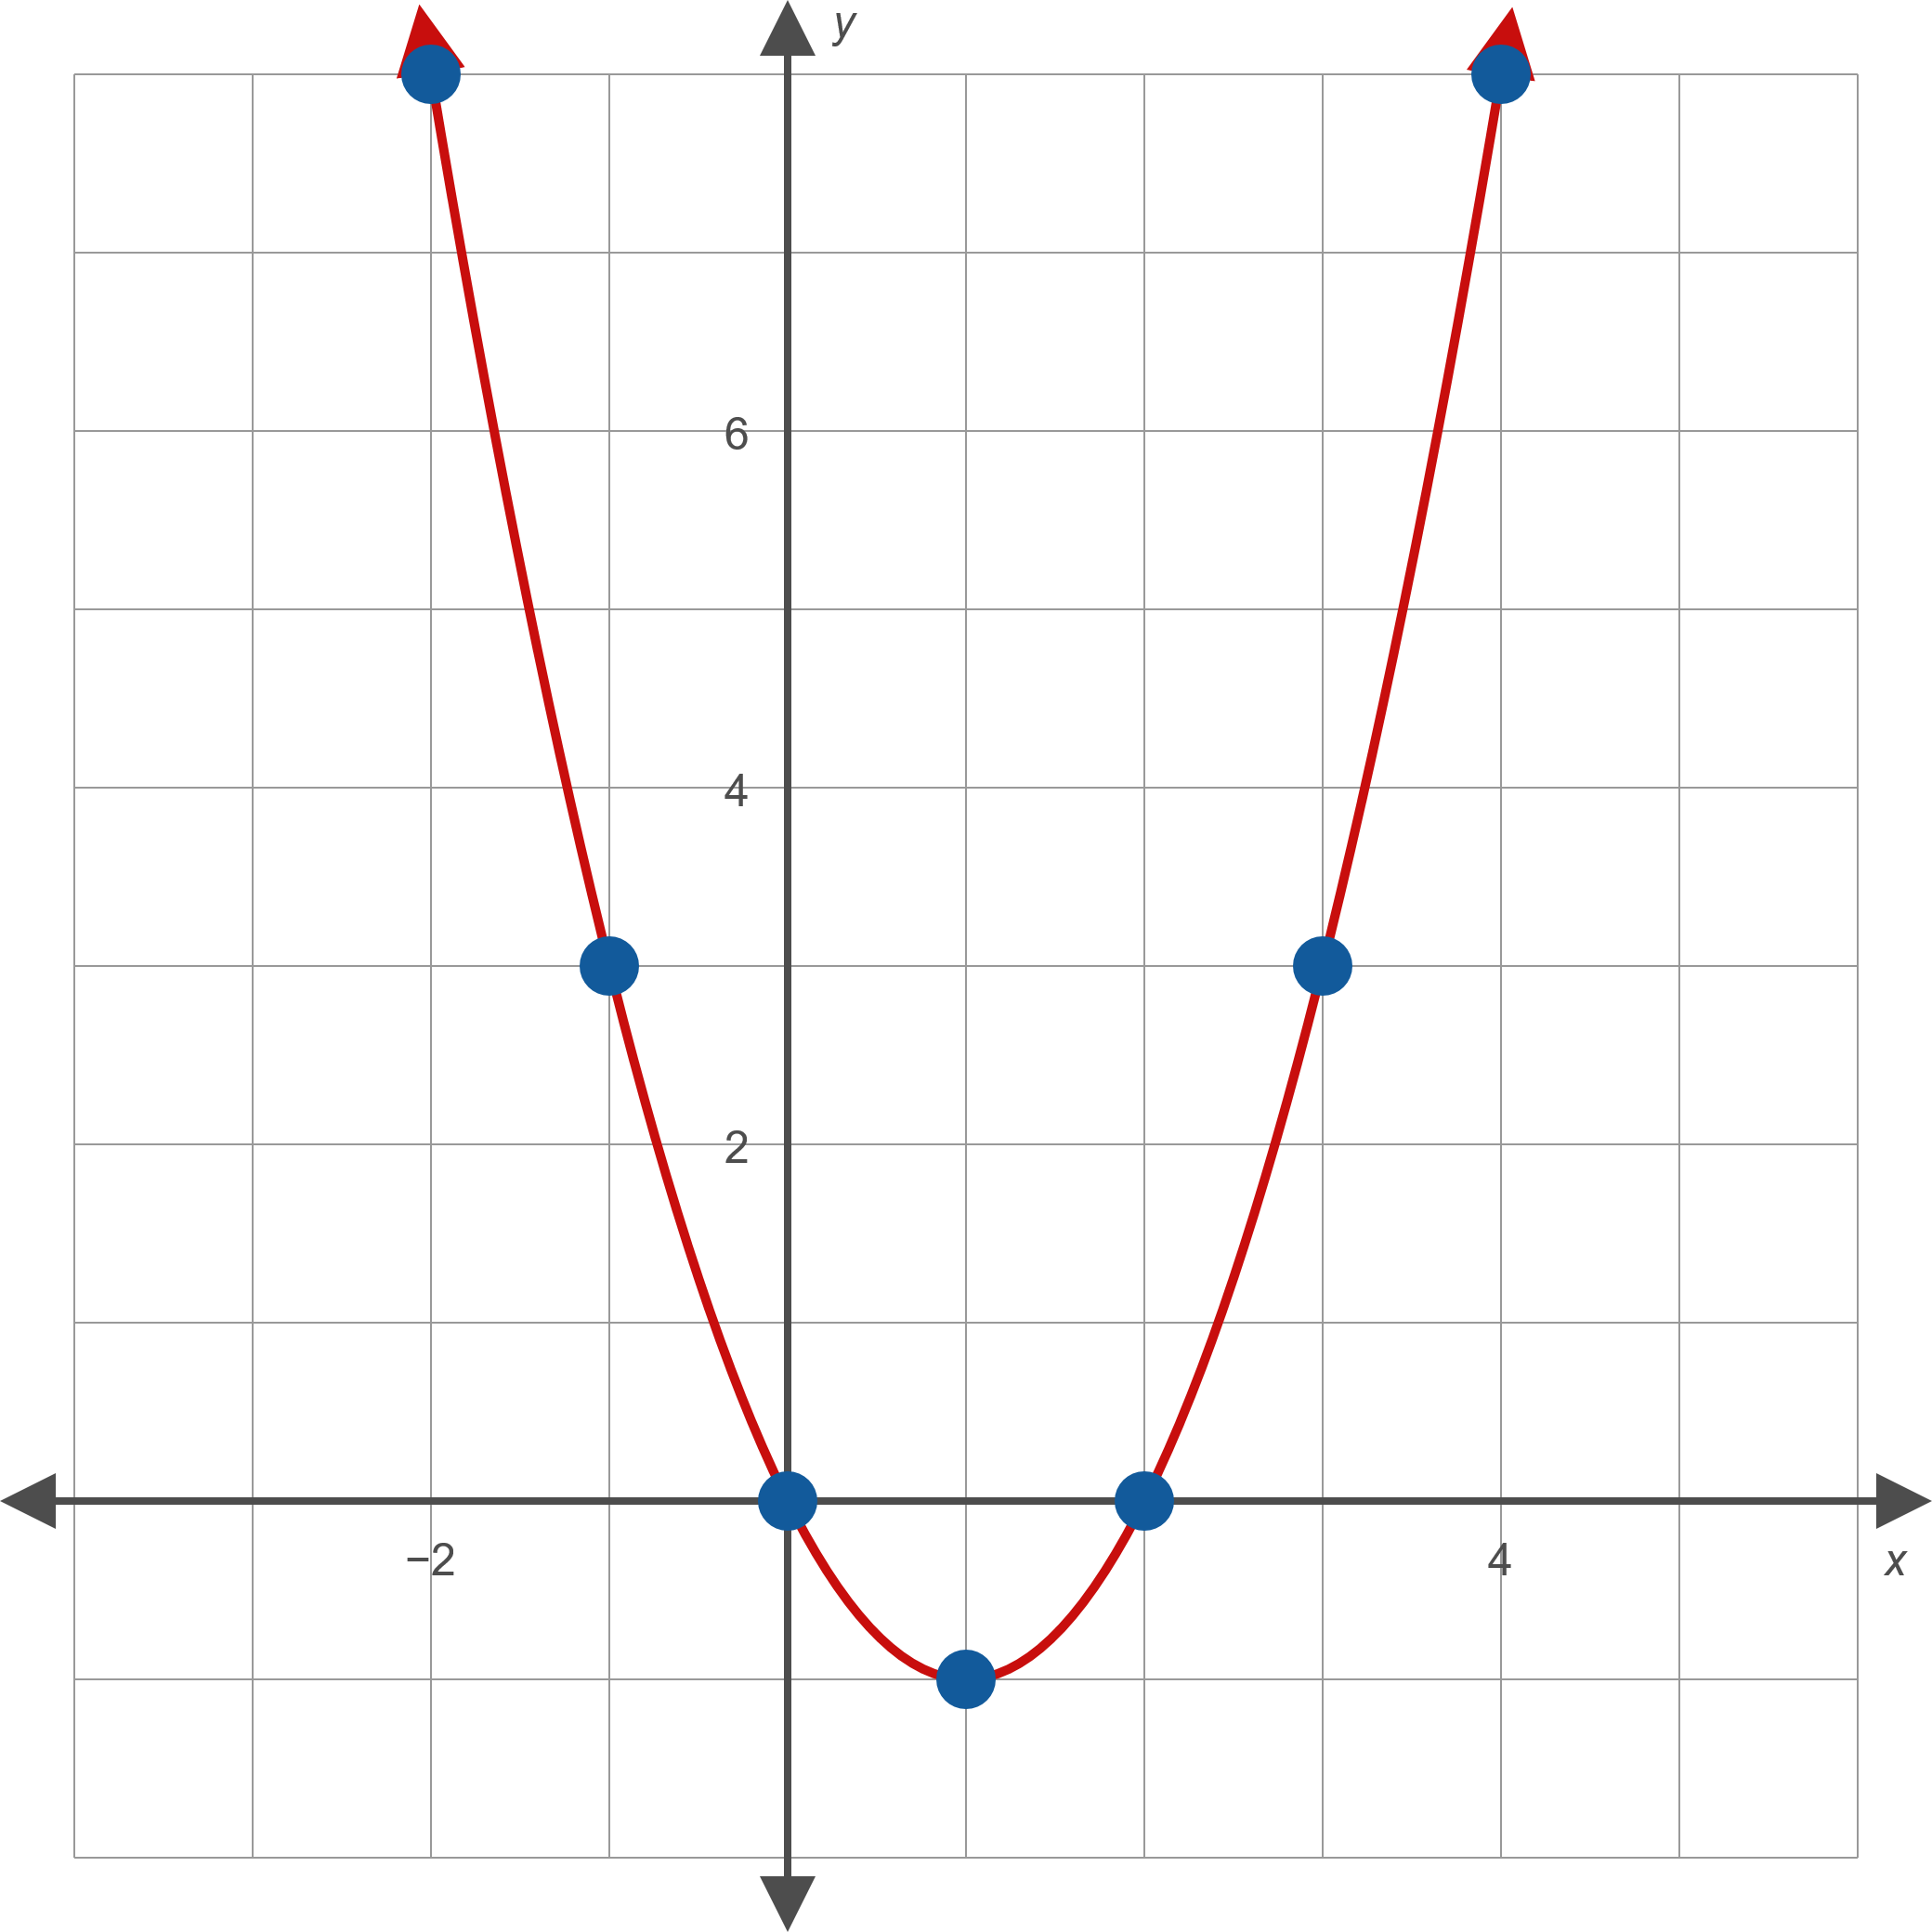
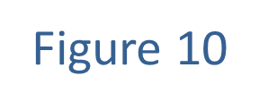
Example 2: Graphing Equations in Two Variables (cont.)

Slide 31
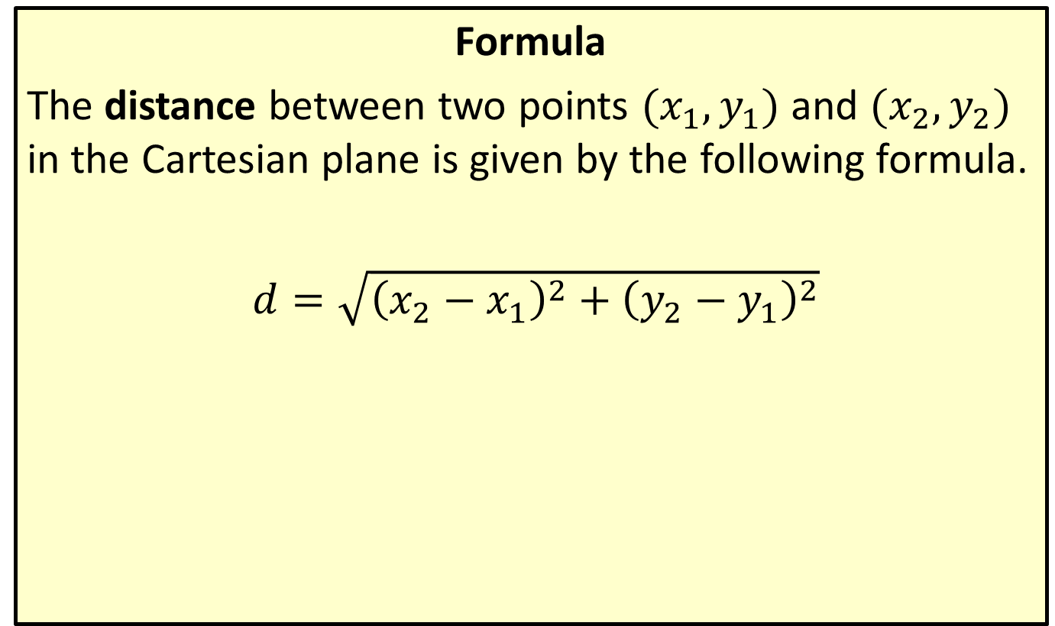
Distance Formula
Formula
The distance between two points $(x_{1},y_{1})$ and $(x_{2},y_{2})$ in the Cartesian plane is given by the following formula.
$d=\sqrt{{\left(x_{2}−x_{1}\right)}^{2}+{\left(y_{2}−y_{1}\right)}^{2}}$

Slide 32

Example 3: Using the Distance Formula
Calculate the distance between the following pairs of points.
​$(−4,−2)$ and $(−7,2)$
​$(5,1)$ and $(−1,3)$

Slide 33
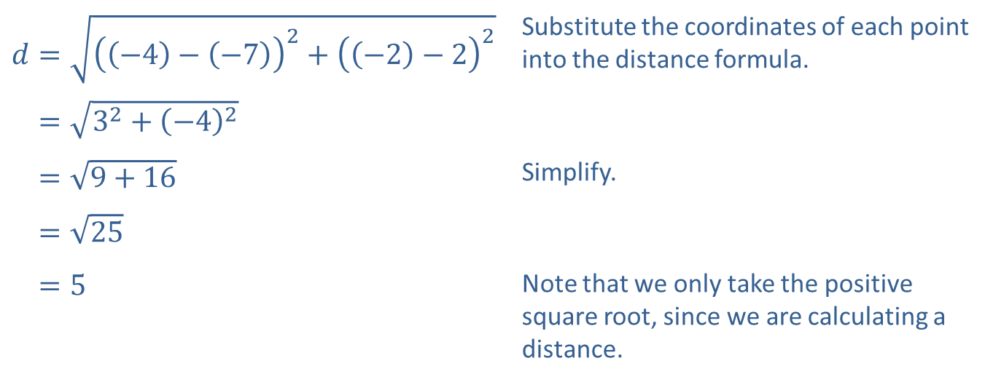
Example 3: Using the Distance Formula (cont.)
Solution
​
​$d=\sqrt{{\left(\left(−4\right)−\left(−7\right)\right)}^{2}+{\left(\left(−2\right)−2\right)}^{2}}$ | Substitute the coordinates of each point into the distance formula.
​𝑑=32+−42
​𝑑=9+16 | Simplify.
​𝑑=25
​𝑑=5 | Note that we only take the positive square root, since we are calculating a distance.

Slide 34
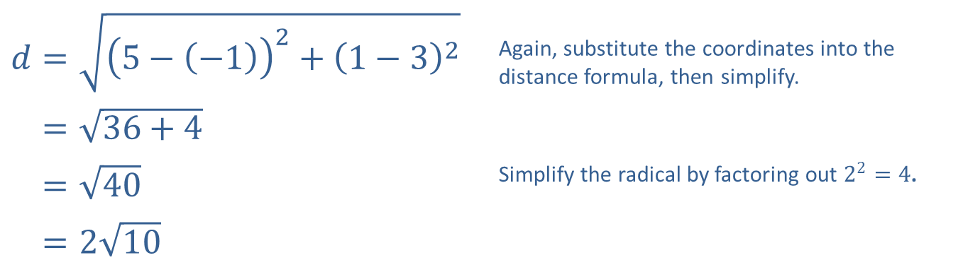
Example 3: Using the Distance Formula (cont.)
​$d=\sqrt{{\left(5−\left(−1\right)\right)}^{2}+{\left(1−3\right)}^{2}}$ | Again, substitute the coordinates into the distance formula, then simplify.
​𝑑=36+4
​𝑑=40 | Simplify the radical by factoring out $2^{2}=4$.
​𝑑=210
​

Slide 35
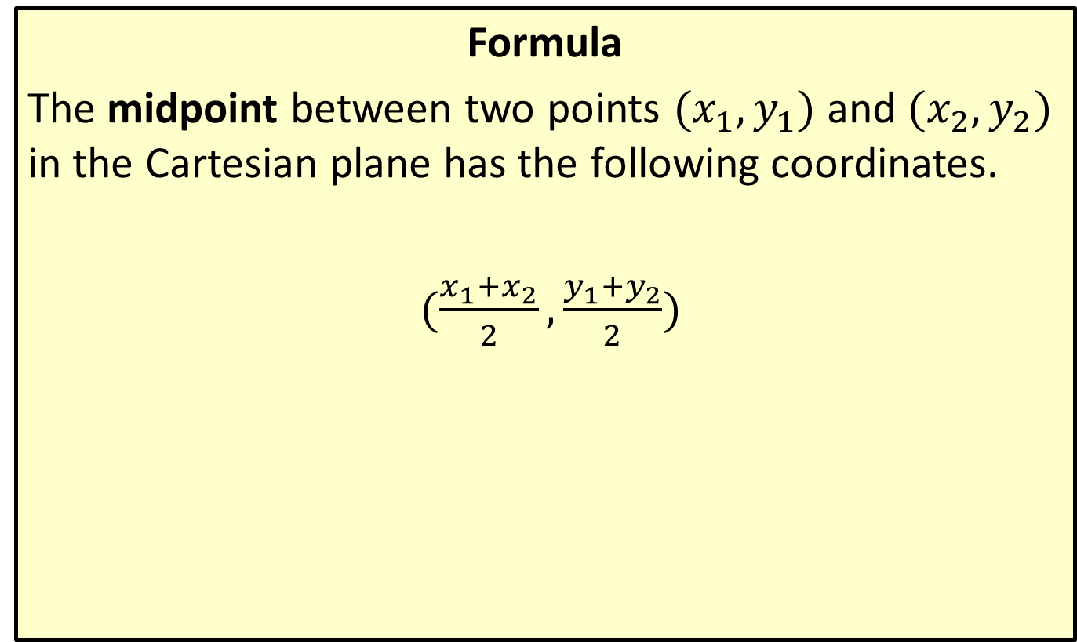
Midpoint Formula
Formula
The midpoint between two points $(x_{1},y_{1})$ and $(x_{2},y_{2})$ in the Cartesian plane has the following coordinates.
$(\frac{x_{1}+x_{2}}{2},\frac{y_{1}+y_{2}}{2})$

Slide 36

Example 4: Using the Midpoint Formula
Calculate the midpoint of the line connecting each pair of points.
​$(5,1)$ and $(−1,3)$
​$(3,0)$ and $(−6,11)$

Slide 37
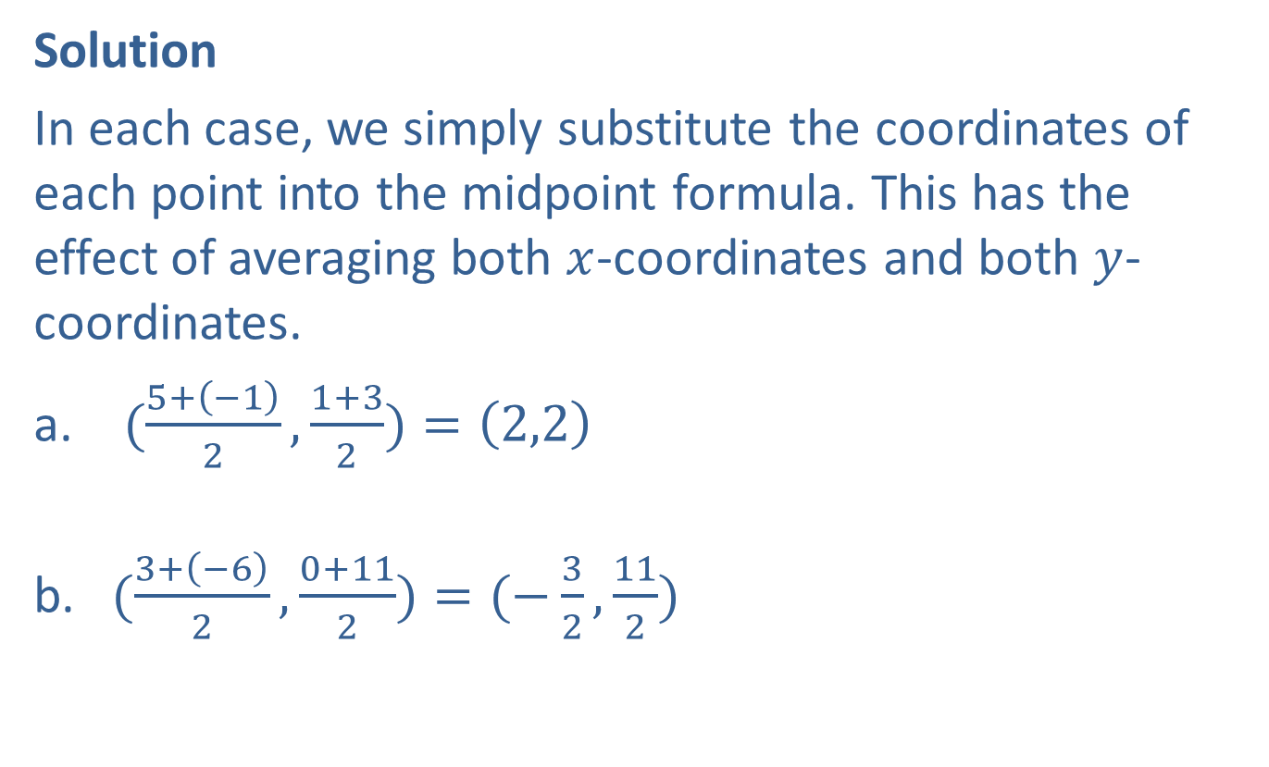
Example 4: Using the Midpoint Formula (cont.)
Solution
In each case, we simply substitute the coordinates of each point into the midpoint formula. This has the effect of averaging both $x$-coordinates and both $y$-coordinates.
​ $(\frac{5+\left(−1\right)}{2},\frac{1+3}{2})=\left(2,2\right)$
​
​$(\frac{3+\left(−6\right)}{2},\frac{0+11}{2})=(−\frac{3}{2},\frac{11}{2})$

