Slide 1
Section 3.2
Circles

Slide 2
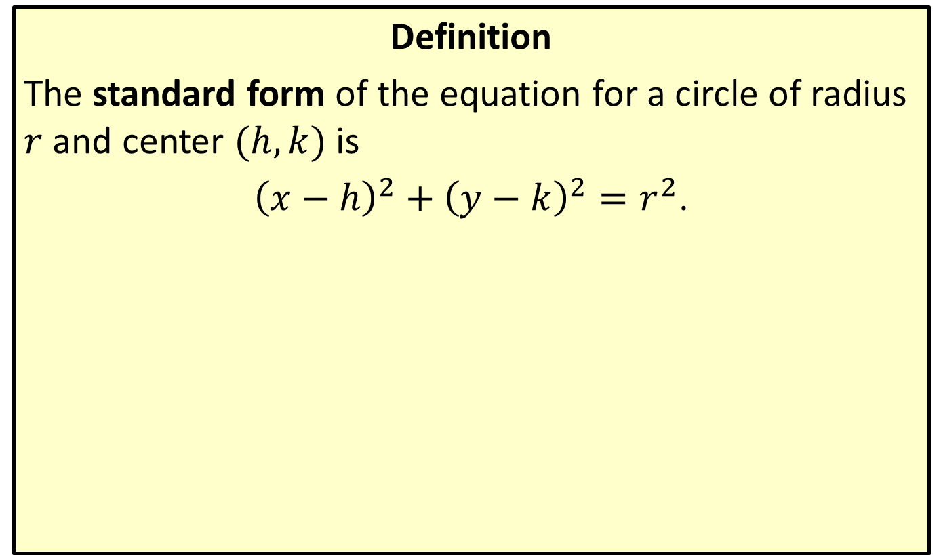
Standard Form of a Circle
Definition
The standard form of the equation for a circle of radius $r$ and center $(h,k)$ is
${\left(x−h\right)}^{2}+{\left(y−k\right)}^{2}=r^{2}$.

Slide 3

Example 1: Standard Form of a Circle
Find the standard form of the equation for the circle with radius 3 and center $(−2,7)$.

Slide 4
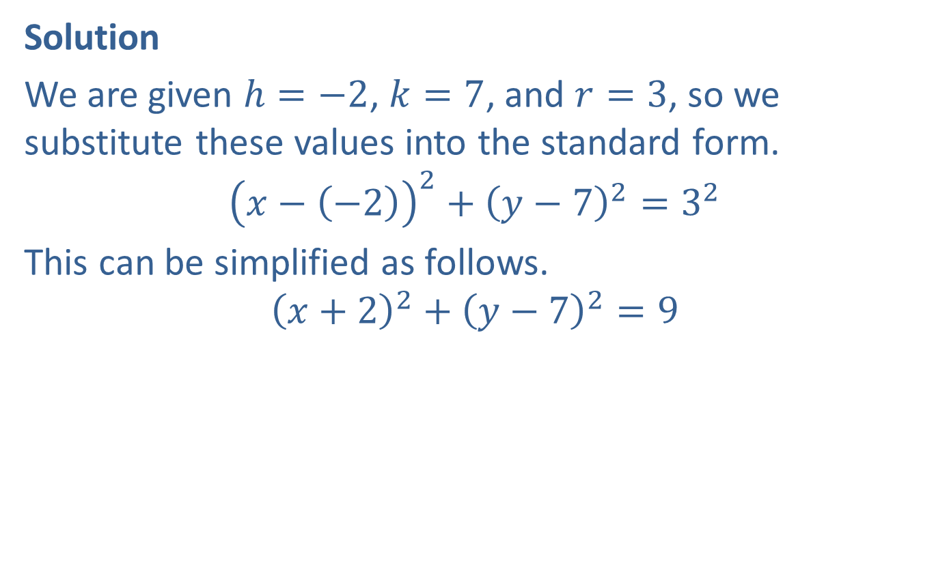
Example 1: Standard Form of a Circle (cont.)
Solution
We are given $h=−2$, $k=7$, and $r=3$, so we substitute these values into the standard form.
$${\left(x−\left(−2\right)\right)}^{2}+{\left(y−7\right)}^{2}=3^{2}$$
This can be simplified as follows.
$${\left(x+2\right)}^{2}+{\left(y−7\right)}^{2}=9$$

Slide 5

Example 2: Standard Form of a Circle
Find the standard form of the equation for the circle with a diameter whose endpoints are $(−4,−1)$ and $(2,5)$.

Slide 6
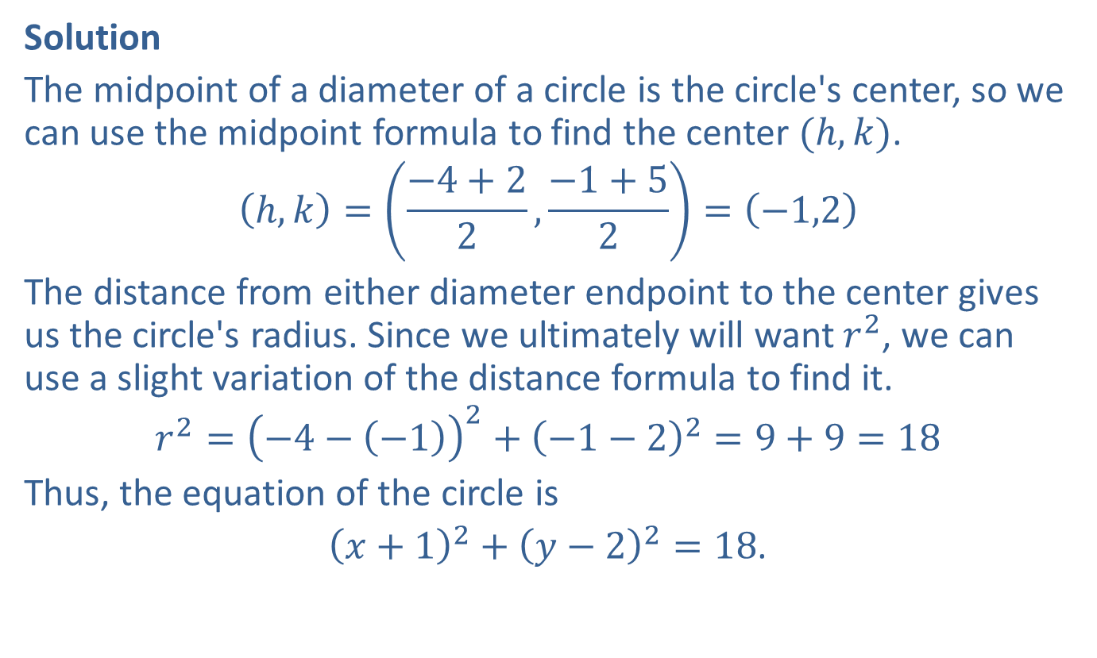
Example 2: Standard Form of a Circle (cont.)
Solution
The midpoint of a diameter of a circle is the circle's center, so we can use the midpoint formula to find the center $(h,k)$.
$$\left(h,k\right)=\left(\frac{−4+2}{2},\frac{−1+5}{2}\right)=\left(−1,2\right)$$
The distance from either diameter endpoint to the center gives us the circle's radius. Since we ultimately will want $r^{2}$, we can use a slight variation of the distance formula to find it.
$$r^{2}={\left(−4−\left(−1\right)\right)}^{2}+{\left(−1−2\right)}^{2}=9+9=18$$
Thus, the equation of the circle is
${\left(x+1\right)}^{2}+{\left(y−2\right)}^{2}=18$.

Slide 7
Example 3: Standard Form of a Circle
Find the standard form of the equation for the circle shown in Figure 2.

Slide 8
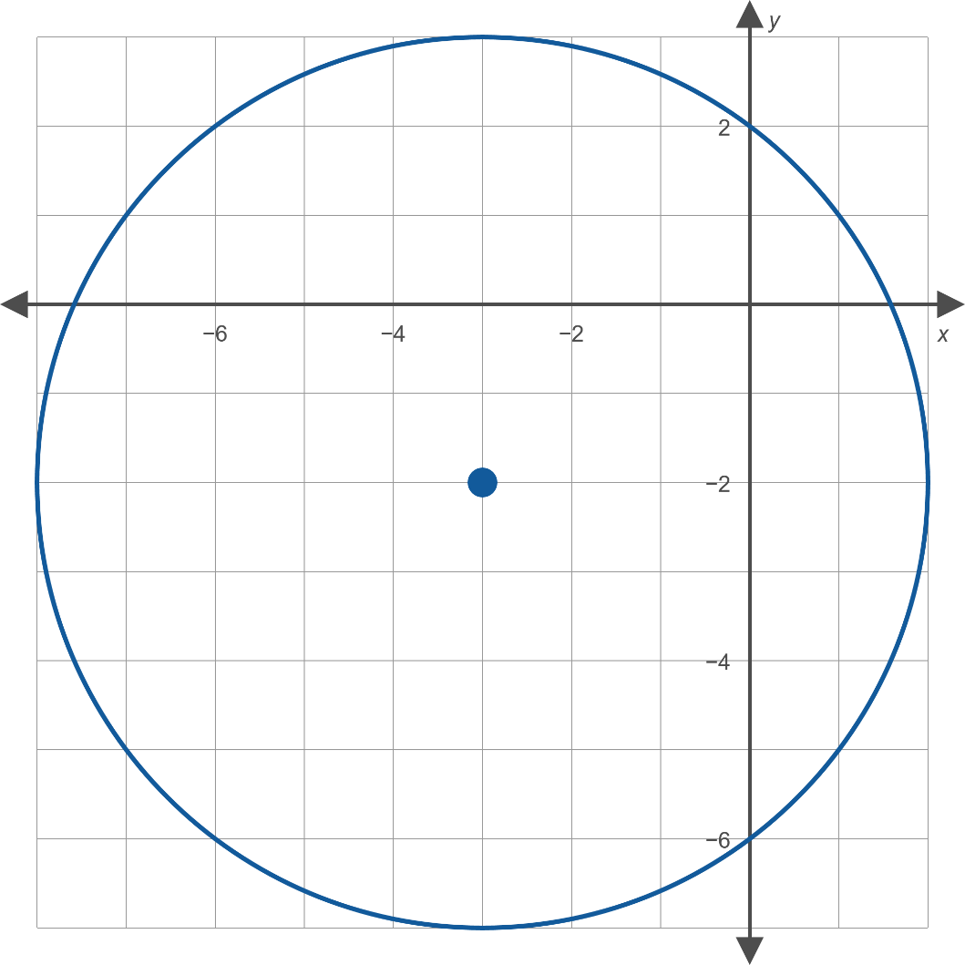
Example 3: Standard Form of a Circle (cont.)
Figure 2

Slide 9
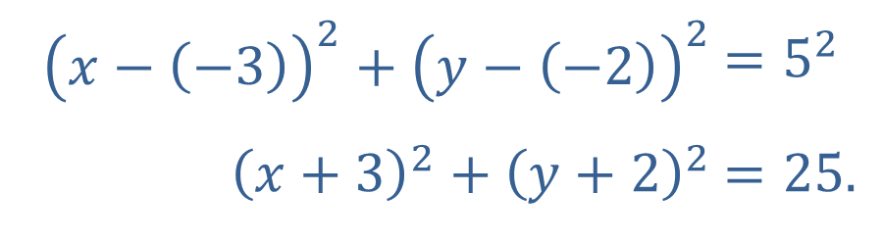
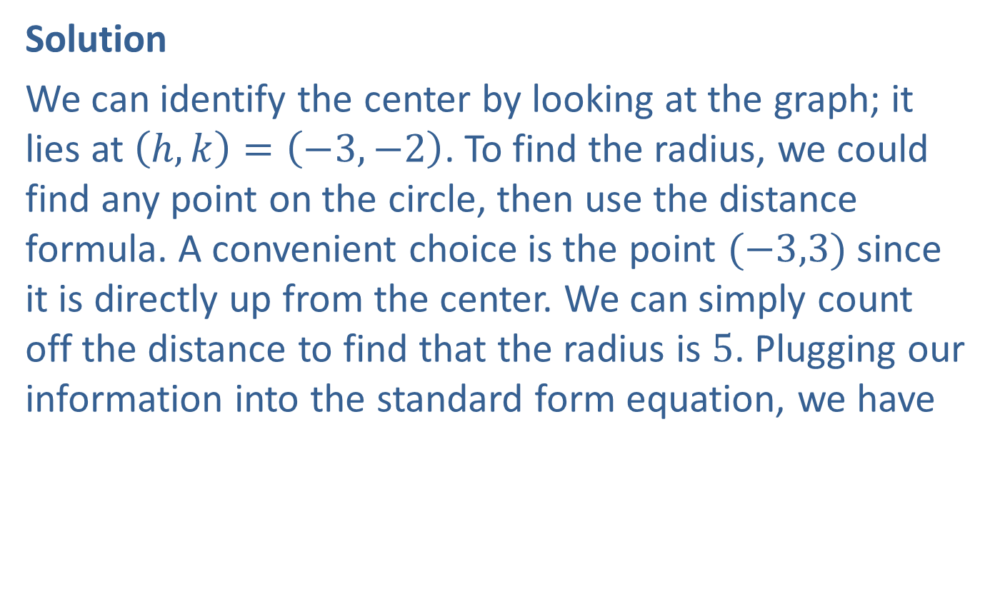
Example 3: Standard Form of a Circle (cont.)
Solution
We can identify the center by looking at the graph; it lies at $\left(h,k\right)=\left(−3,−2\right)$. To find the radius, we could find any point on the circle, then use the distance formula. A convenient choice is the point $(−3,3)$ since it is directly up from the center. We can simply count off the distance to find that the radius is $5$. Plugging our information into the standard form equation, we have
​
​${\left(x−\left(−3\right)\right)}^{2}+{\left(y−\left(−2\right)\right)}^{2}$ | ​$=5^{2}$
​${\left(x+3\right)}^{2}+{\left(y+2\right)}^{2}$ | ​$=25\text{.}$

Slide 10

Example 4: Graphing Circles
Sketch the graph of the circle defined by
${\left(x−2\right)}^{2}+{\left(y+3\right)}^{2}=4$.

Slide 11
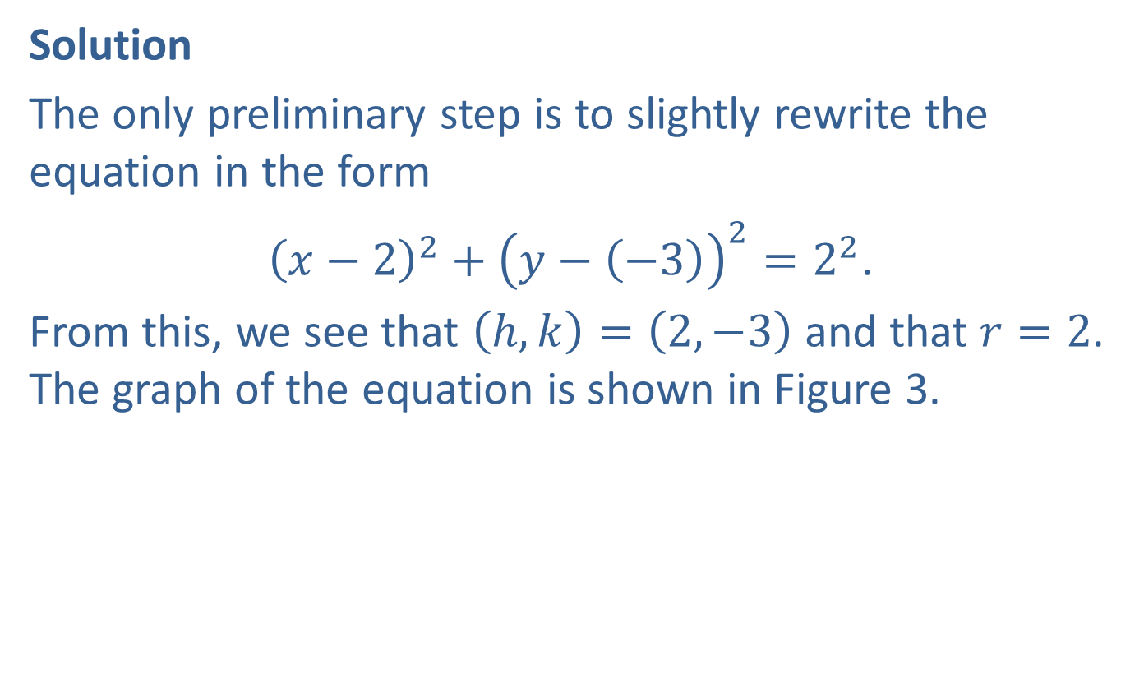
Example 4: Graphing Circles (cont.)
Solution
The only preliminary step is to slightly rewrite the equation in the form
${\left(x−2\right)}^{2}+{\left(y−\left(−3\right)\right)}^{2}=2^{2}$.
From this, we see that $\left(h,k\right)=\left(2,−3\right)$ and that $r=2$. The graph of the equation is shown in Figure 3.

Slide 12
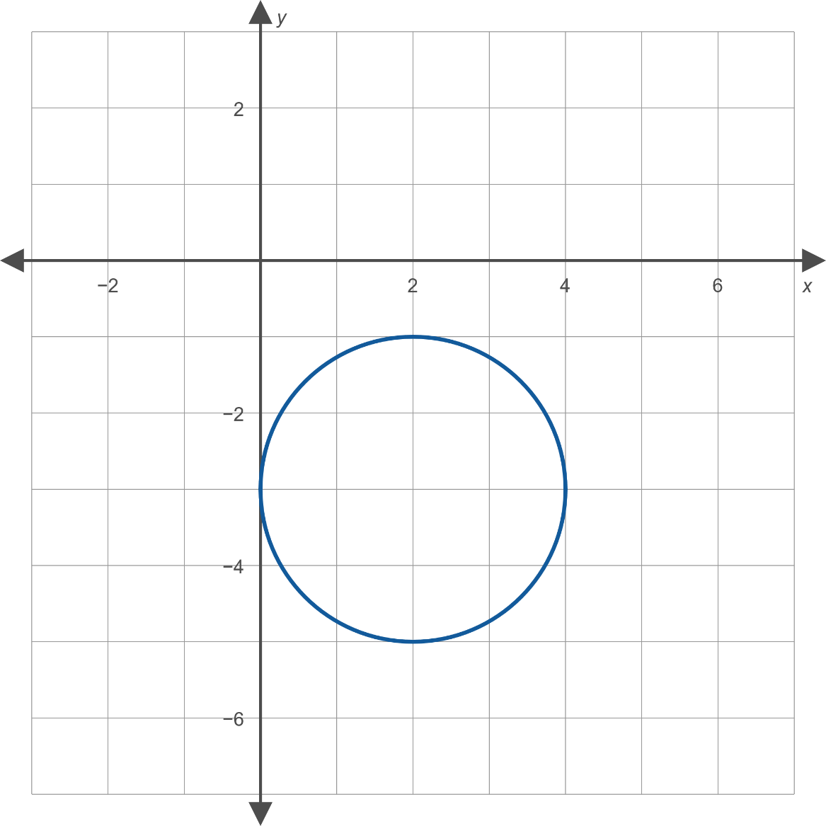
Example 4: Graphing Circles (cont.)
Figure 3

Slide 13

Example 5: Graphing Circles and Completing the Square
Sketch the graph of the equation
$x^{2}+y^{2}+8x−2y=−1$.

Slide 14

Example 5: Graphing Circles and Completing the Square (cont.)
Solution
We need to complete the square in the variable $x$ and the variable $y$, and we do so as follows.

Slide 15
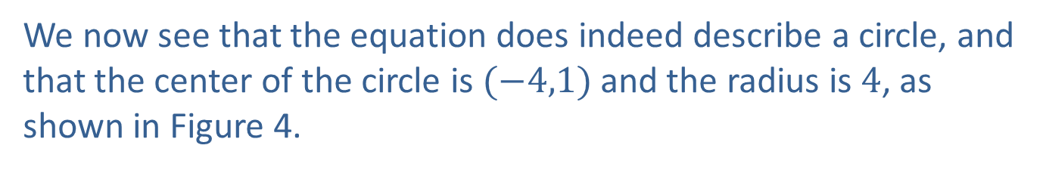
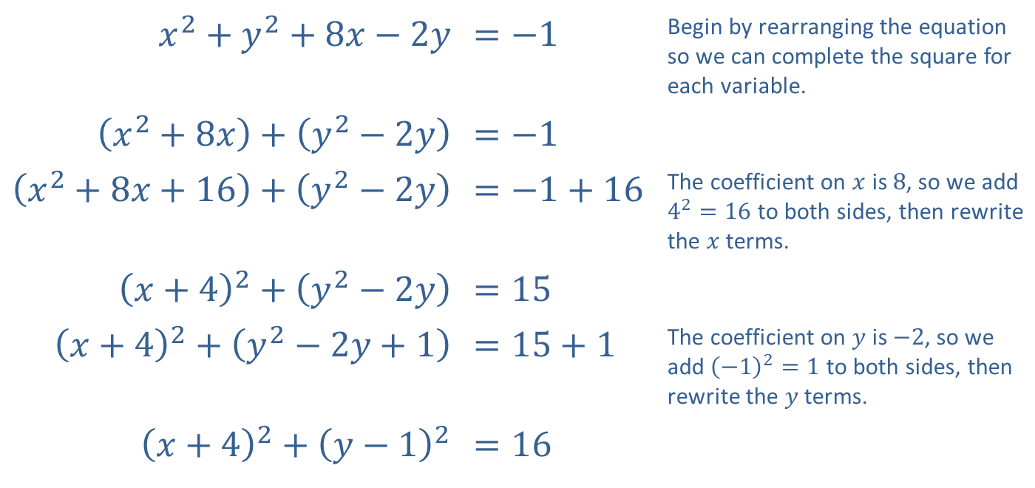
Example 5: Graphing Circles and Completing the Square (cont.)
​$x^{2}+y^{2}+8x−2y$ | ​$=−1$ | Begin by rearranging the equation so we can complete the square for each variable.
​$\left(x^{2}+8x\right)+\left(y^{2}−2y\right)$ | ​$=−1$
​$\left(x^{2}+8x+16\right)+\left(y^{2}−2y\right)$ | ​$=−1+16$ | The coefficient on $x$ is 8, so we add $4^{2}=16$ to both sides, then rewrite the $x$ terms.
​${\left(x+4\right)}^{2}+\left(y^{2}−2y\right)$ | ​$=15$
​${\left(x+4\right)}^{2}+\left(y^{2}−2y+1\right)$ | ​$=15+1$ | The coefficient on $y$ is $−2$, so we add ${\left(−1\right)}^{2}=1$ to both sides, then rewrite the $y$ terms.
​${\left(x+4\right)}^{2}+{\left(y−1\right)}^{2}$ | ​$=16$
We now see that the equation does indeed describe a circle, and that the center of the circle is $(−4,1)$ and the radius is 4, as shown in Figure 4.

Slide 16
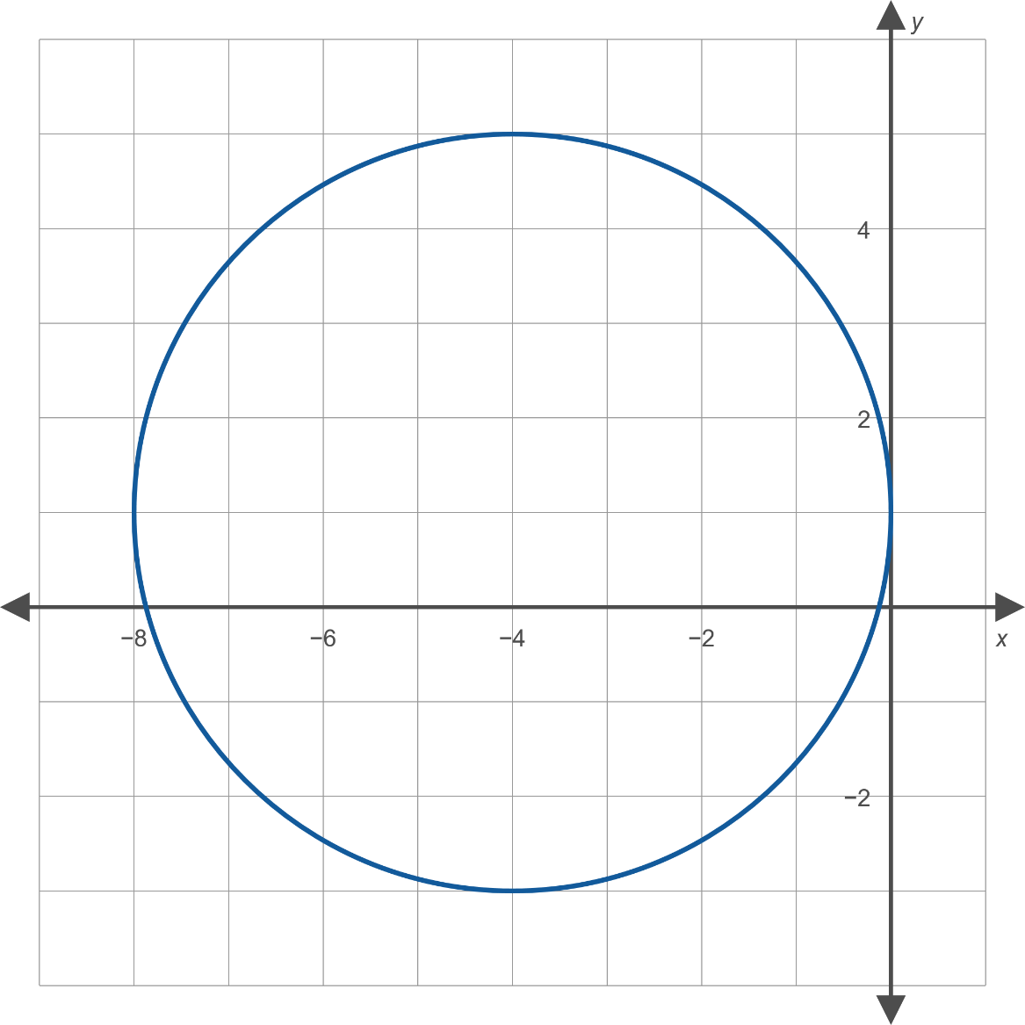
Example 5: Graphing Circles and Completing the Square (cont.)
Figure 4

