Slide 1
Section 3.5
Parallel and Perpendicular Lines

Slide 2
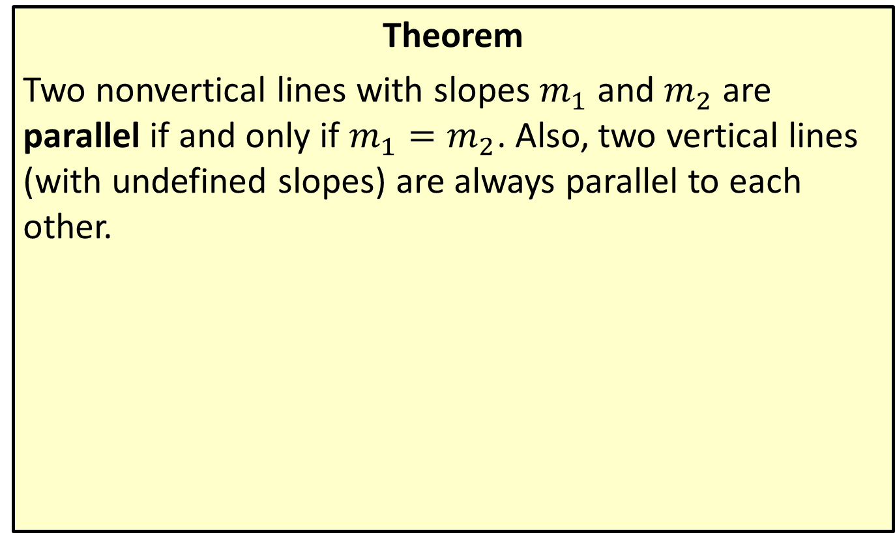
Slopes of Parallel Lines
Theorem
Two nonvertical lines with slopes $m_{1}$ and $m_{2}$ are parallel if and only if $m_{1}=m_{2}$. Also, two vertical lines (with undefined slopes) are always parallel to each other.

Slide 3

Example 1: Finding Equations of Parallel Lines
Find equations for two lines parallel to each of the given lines.
​$y=−\frac{2}{3}x+4$
​$10x−2y=14$

Slide 4
Note:
When given a line in standard form, it is usually easiest to find its slope by rewriting it in slope-intercept form than to find two points on the line and calculate the slope directly.

Slide 5
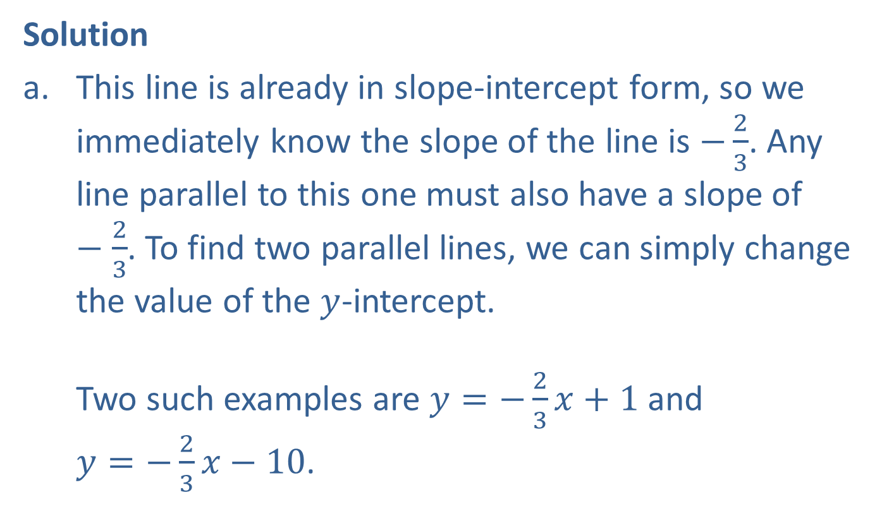
Example 1: Finding Equations of Parallel Lines (cont.)
Solution
​This line is already in slope-intercept form, so we immediately know the slope of the line is $−\frac{2}{3}$. Any line parallel to this one must also have a slope of $−\frac{2}{3}$. To find two parallel lines, we can simply change the value of the $y$-intercept. ​Two such examples are $y=−\frac{2}{3}x+1$ and $y=−\frac{2}{3}x−10$.

Slide 6
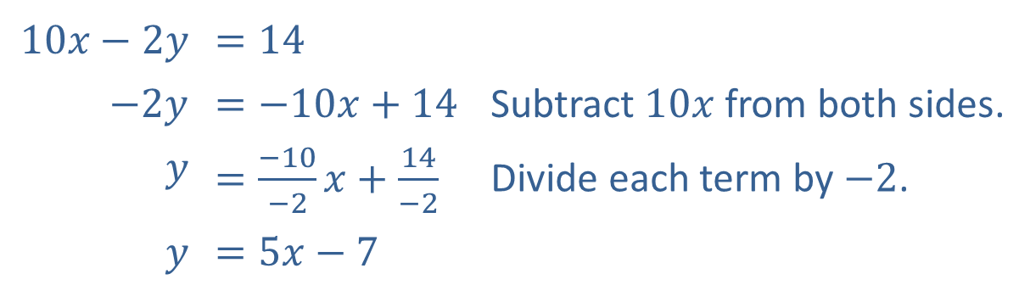
Example 1: Finding Equations of Parallel Lines (cont.)
​This line is in standard form. Our first step is to rewrite it in slope-intercept form.​
​$10x−2y$ | ​$=14$
​$−2y$ | ​$=−10x+14$ | Subtract $10x$ from both sides.
$$y$$ | ​$=\frac{−10}{−2}x+\frac{14}{−2}$ | Divide each term by $−2$.
$$y$$ | ​$=5x−7$

Slide 7

Example 1: Finding Equations of Parallel Lines (cont.)
​Again, once the line is in slope-intercept form, we can change the $y$-intercept to find two lines parallel to the original line.
​Two such examples are $y=5x$ and $y=5x+8$.

Slide 8

Example 2: Finding Equations of Parallel Lines
Find the equation, in slope-intercept form, for the line that is parallel to the line $3x+5y=23$ and which passes through the point $(−2,1)$.

Slide 9
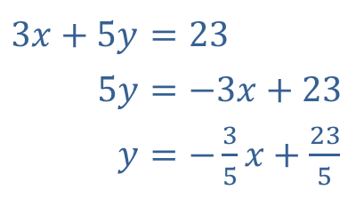
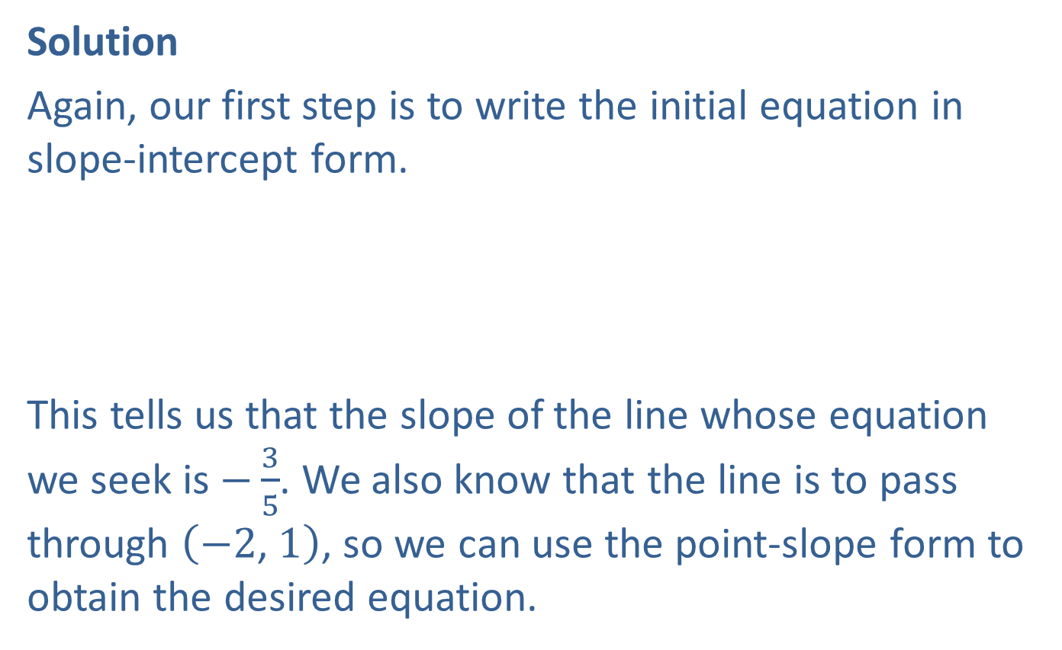
Example 2: Finding Equations of Parallel Lines (cont.)
Solution
Again, our first step is to write the initial equation in slope-intercept form.
​
This tells us that the slope of the line whose equation we seek is $−\frac{3}{5}$. We also know that the line is to pass through $\left(−2\text{, }1\right)$, so we can use the point-slope form to obtain the desired equation.
​$3x+5y$ | ​$=23$
​$5y$ | ​$=−3x+23$
​$y$ | ​$=−\frac{3}{5}x+\frac{23}{5}$

Slide 10
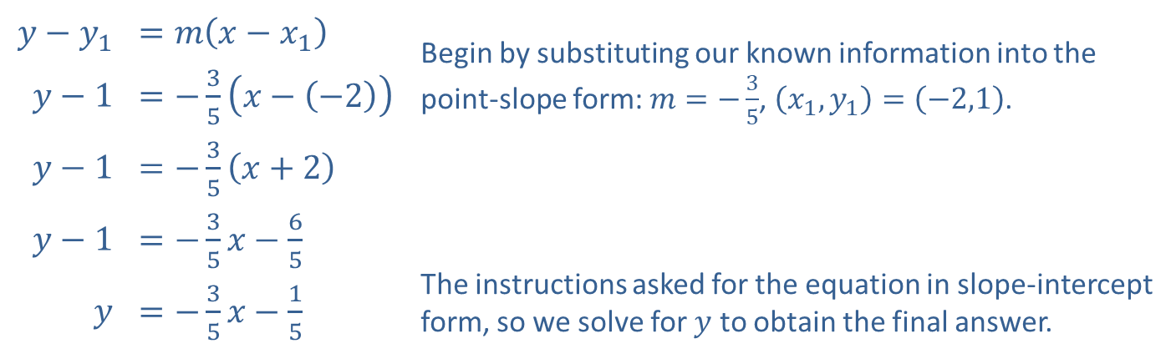
Example 2: Finding Equations of Parallel Lines (cont.)
​$y−y_{1}$ | ​$=m\left(x−x_{1}\right)$ | Begin by substituting our known information into the point-slope form: $m=−\frac{3}{5}$, $\left(x_{1},y_{1}\right)=\left(−2,1\right)$.
​$y−1$ | ​$=−\frac{3}{5}\left(x−\left(−2\right)\right)$
​$y−1$ | ​$=−\frac{3}{5}\left(x+2\right)$
​$y−1$ | ​$=−\frac{3}{5}x−\frac{6}{5}$ | The instructions asked for the equation in slope-intercept form, so we solve for $y$ to obtain the final answer.
$$y$$ | ​$=−\frac{3}{5}x−\frac{1}{5}$

Slide 11
Example 3: Identifying a Quadrilateral
Determine if the quadrilateral (four-sided figure) in Figure 2 is a parallelogram (a quadrilateral in which both pairs of opposite sides are parallel).

Slide 12
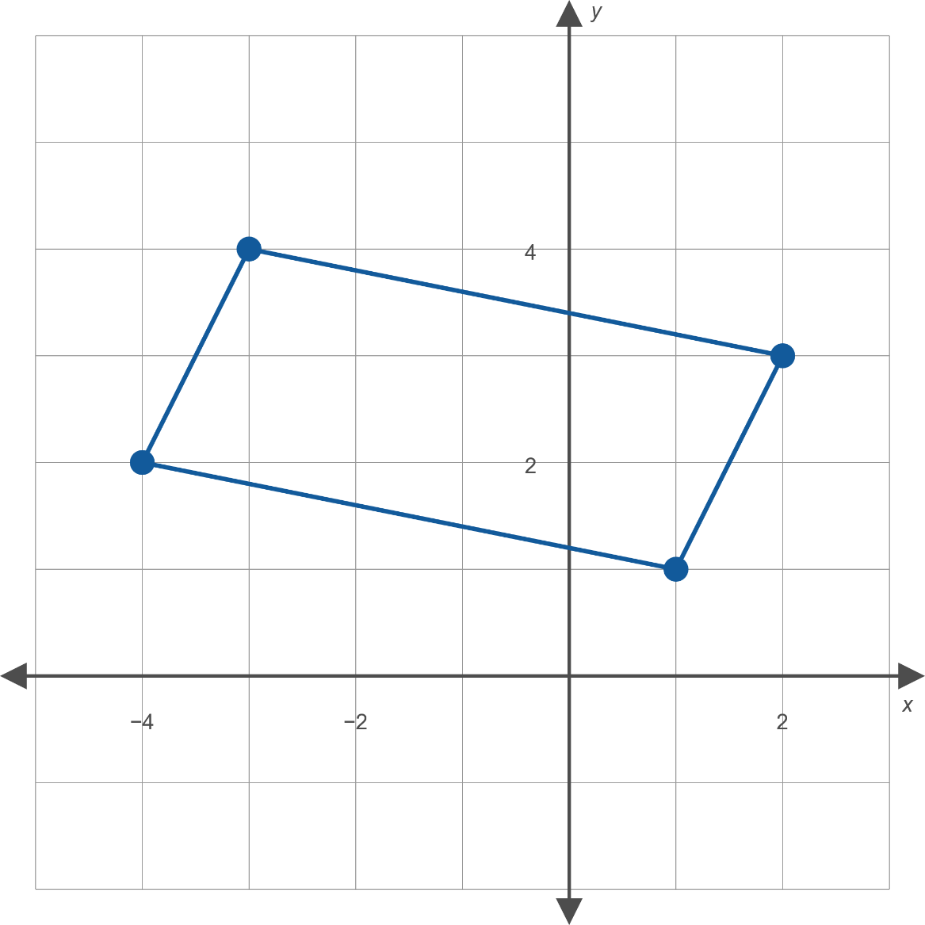
Example 3: Identifying a Quadrilateral (cont.)
Figure 2

Slide 13
Example 3: Identifying a Quadrilateral (cont.)
Solution
The four vertices are plotted in Figure 2, and the sides of the quadrilateral drawn. The figure is a parallelogram if the left and right sides are parallel and the top and bottom sides are parallel.

Slide 14
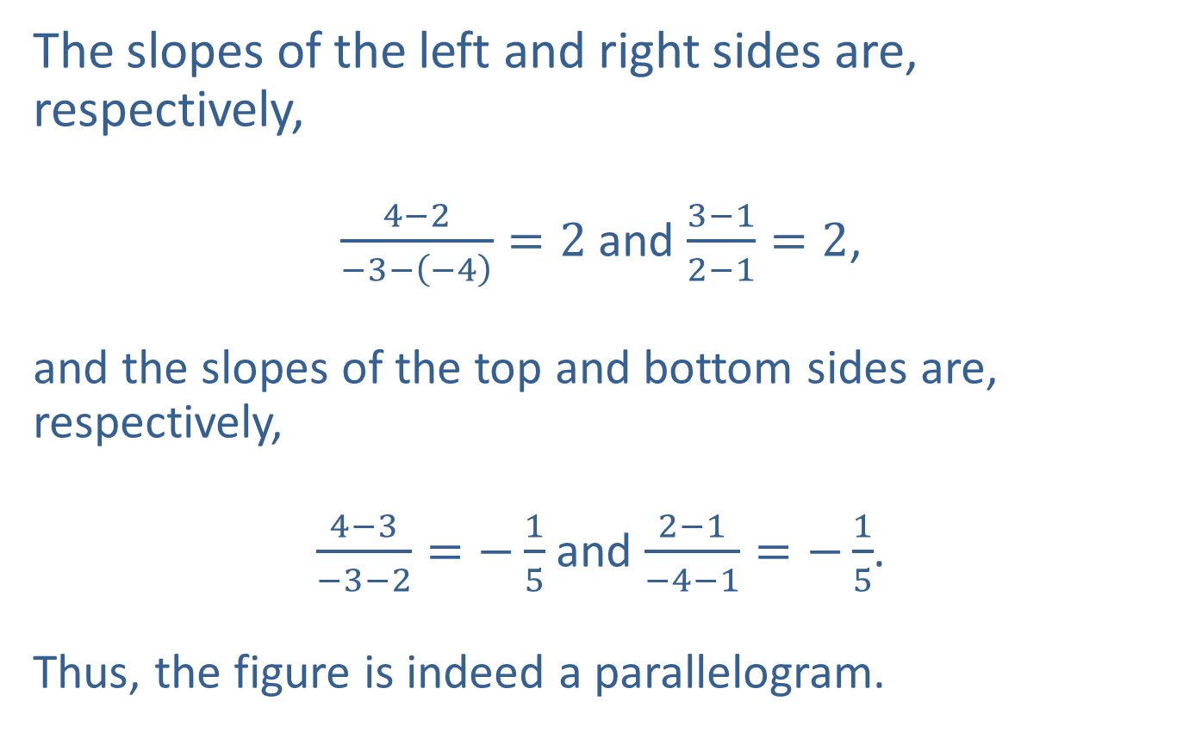
Example 3: Identifying a Quadrilateral (cont.)
The slopes of the left and right sides are, respectively,
$\frac{4−2}{−3−\left(−4\right)}=2$ and $\frac{3−1}{2−1}=2$,
and the slopes of the top and bottom sides are, respectively,
$\frac{4−3}{−3−2}=−\frac{1}{5}$ and $\frac{2−1}{−4−1}=−\frac{1}{5}$.
Thus, the figure is indeed a parallelogram.

Slide 15
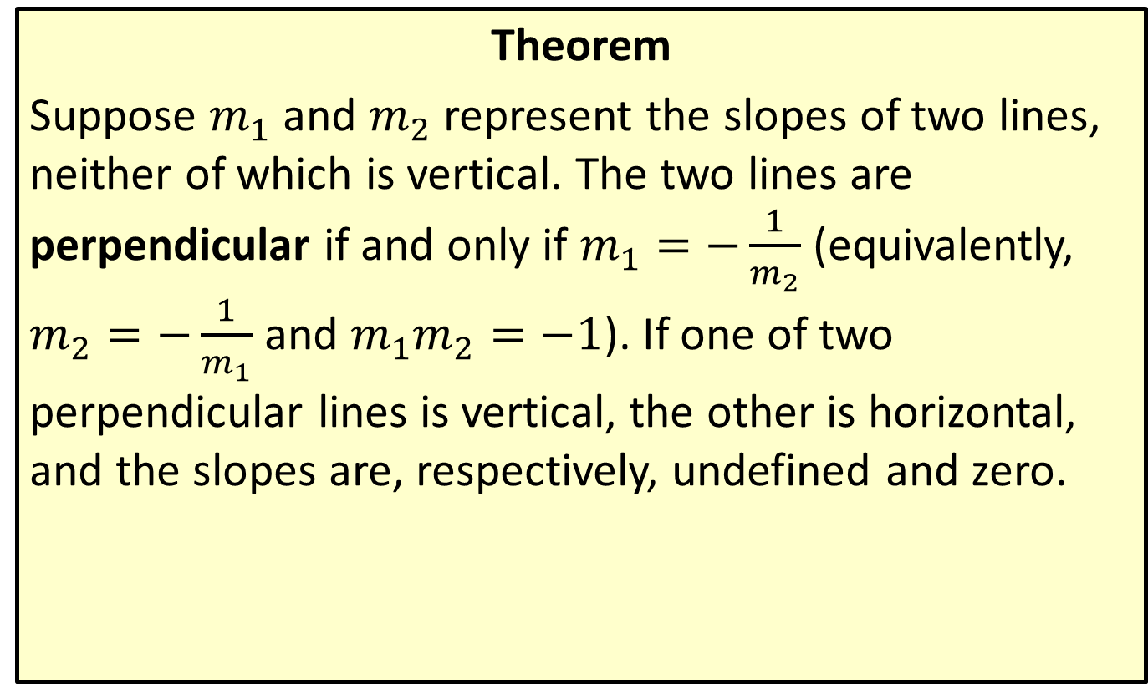
Slopes of Perpendicular Lines
Theorem
Suppose $m_{1}$ and $m_{2}$ represent the slopes of two lines, neither of which is vertical. The two lines are perpendicular if and only if $m_{1}=−\frac{1}{m_{2}}$ (equivalently, $m_{2}=−\frac{1}{m_{1}}$ and $m_{1}m_{2}=−1$). If one of two perpendicular lines is vertical, the other is horizontal, and the slopes are, respectively, undefined and zero.

Slide 16
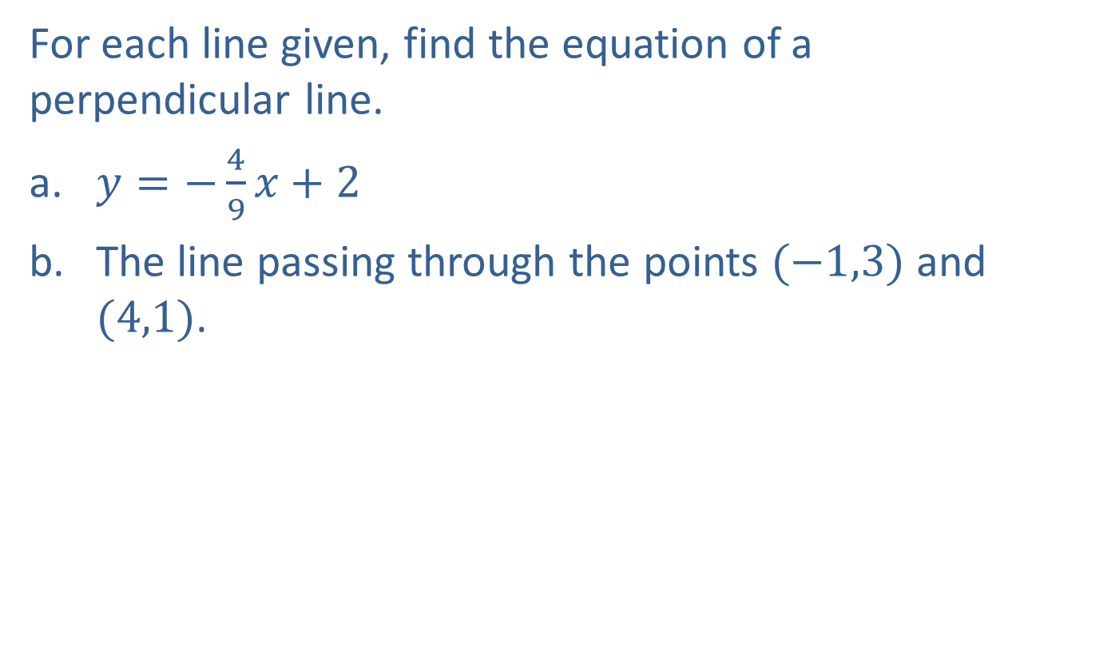
Example 4: Finding Equations of Perpendicular Lines
For each line given, find the equation of a perpendicular line.
​$y=−\frac{4}{9}x+2$
​The line passing through the points $(−1,3)$ and $(4,1)$.

Slide 17
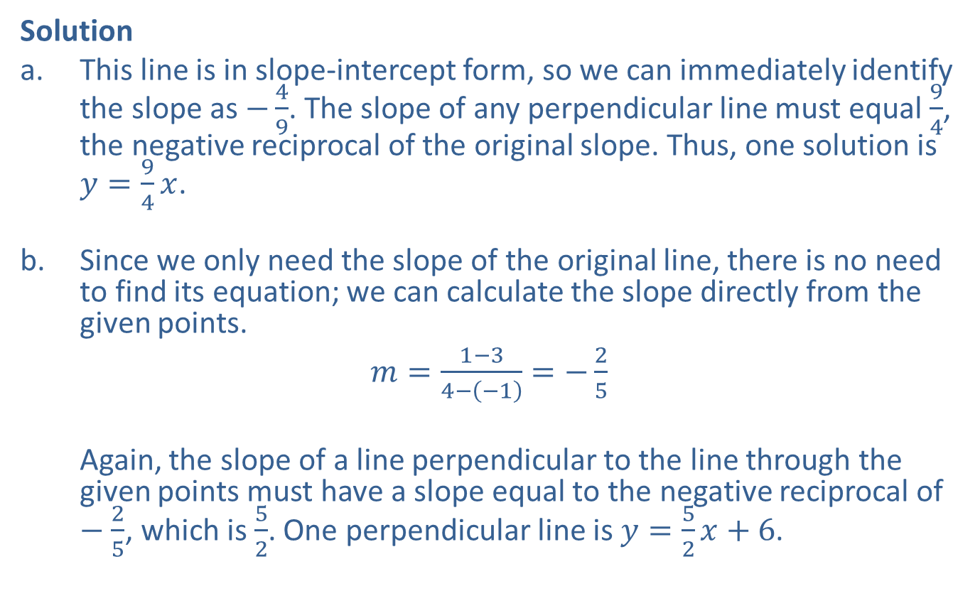
Example 4: Finding Equations of Perpendicular Lines (cont.)
Solution
​This line is in slope-intercept form, so we can immediately identify the slope as $−\frac{4}{9}$. The slope of any perpendicular line must equal $\frac{9}{4}$, the negative reciprocal of the original slope. Thus, one solution is $y=\frac{9}{4}x$.
​Since we only need the slope of the original line, there is no need to find its equation; we can calculate the slope directly from the given points.
​$m=\frac{1−3}{4−\left(−1\right)}=−\frac{2}{5}$
​
Again, the slope of a line perpendicular to the line through the given points must have a slope equal to the negative reciprocal of $−\frac{2}{5}$, which is $\frac{5}{2}$. One perpendicular line is $y=\frac{5}{2}x+6$.

Slide 18

Example 5: Finding Equations of Perpendicular Lines
Find the equation, in standard form, of the line that passes through the point $(−3,13)$ and is perpendicular to the line $y=−7$.

Slide 19
Note:
Remember that if you encounter a horizontal or vertical line, you cannot use the slope formulas to find a perpendicular line.

Slide 20
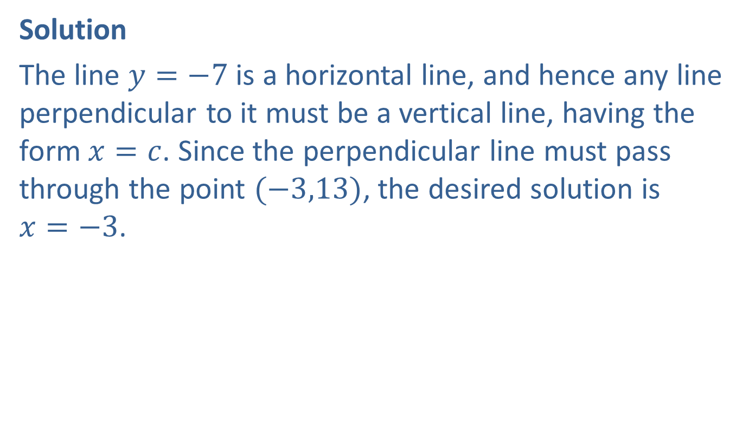
Example 5: Finding Equations of Perpendicular Lines (cont.)
Solution
The line $y=−7$ is a horizontal line, and hence any line perpendicular to it must be a vertical line, having the form $x=c$. Since the perpendicular line must pass through the point $(−3,13)$, the desired solution is $x=−3$.

Slide 21
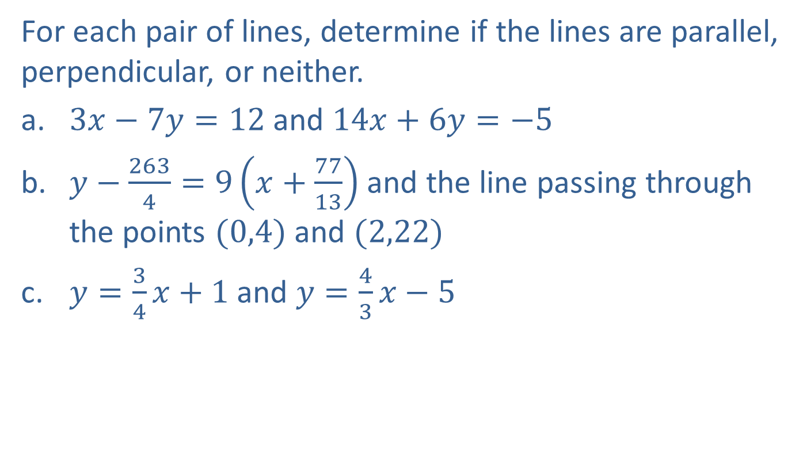
Example 6: Identifying Parallel and Perpendicular Lines
For each pair of lines, determine if the lines are parallel, perpendicular, or neither.
​$3x−7y=12$ and $14x+6y=−5$
​$y−\frac{263}{4}=9\left(x+\frac{77}{13}\right)$ and the line passing through the points $(0,4)$ and $(2,22)$
​$y=\frac{3}{4}x+1$ and $y=\frac{4}{3}x−5$

Slide 22
Note:
A pair of lines cannot be both parallel and perpendicular.

Slide 23
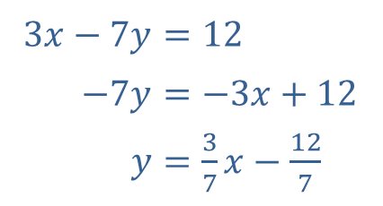
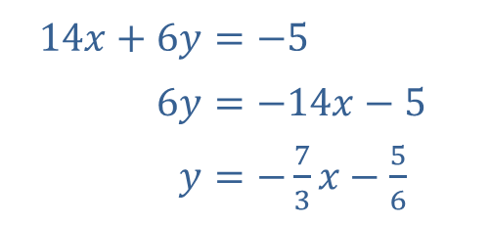
Example 6: Identifying Parallel and Perpendicular Lines (cont.)
Solution
​Both equations are in standard form, so our first step is to rewrite them in slope-intercept form to identify the slopes.
​
​
Are the lines parallel?
​No, the slopes are not equal.
​Are the lines perpendicular?
​Yes, the slopes are negative reciprocals of each other.
​Thus, the lines are perpendicular.
​$3x−7y$ | ​$=12$
​$−7y$ | ​$=−3x+12$
​$y$ | ​$=\frac{3}{7}x−\frac{12}{7}$
​$14x+6y$ | ​$=−5$
​$6y$ | ​$=−14x−5$
​$y$ | ​$=−\frac{7}{3}x−\frac{5}{6}$

Slide 24
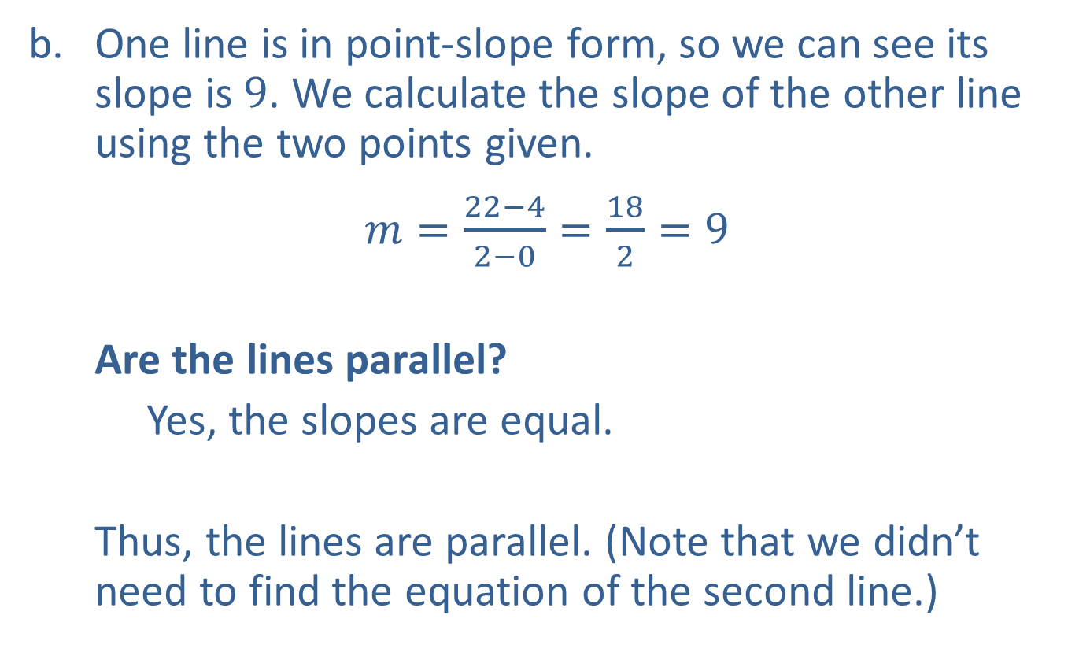
Example 6: Identifying Parallel and Perpendicular Lines (cont.)
​One line is in point-slope form, so we can see its slope is 9. We calculate the slope of the other line using the two points given.
​$m=\frac{22−4}{2−0}=\frac{18}{2}=9$
​
Are the lines parallel?
​Yes, the slopes are equal.
​
Thus, the lines are parallel. (Note that we didn’t need to find the equation of the second line.)

Slide 25
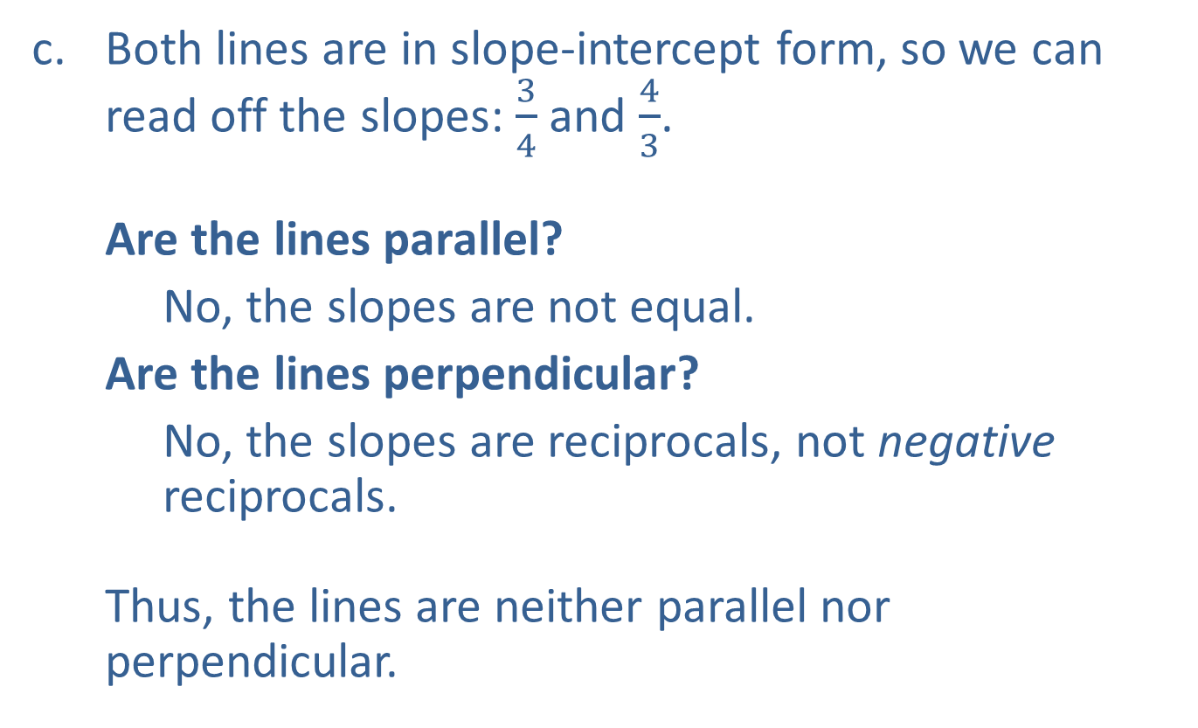
Example 6: Identifying Parallel and Perpendicular Lines (cont.)
​Both lines are in slope-intercept form, so we can read off the slopes: $\frac{3}{4}$ and $\frac{4}{3}$.
​Are the lines parallel?
​ No, the slopes are not equal.
​Are the lines perpendicular?
​No, the slopes are reciprocals, not negative reciprocals.
​
Thus, the lines are neither parallel nor perpendicular.

