Slide 1
Section 4.2
Linear Functions

Slide 2
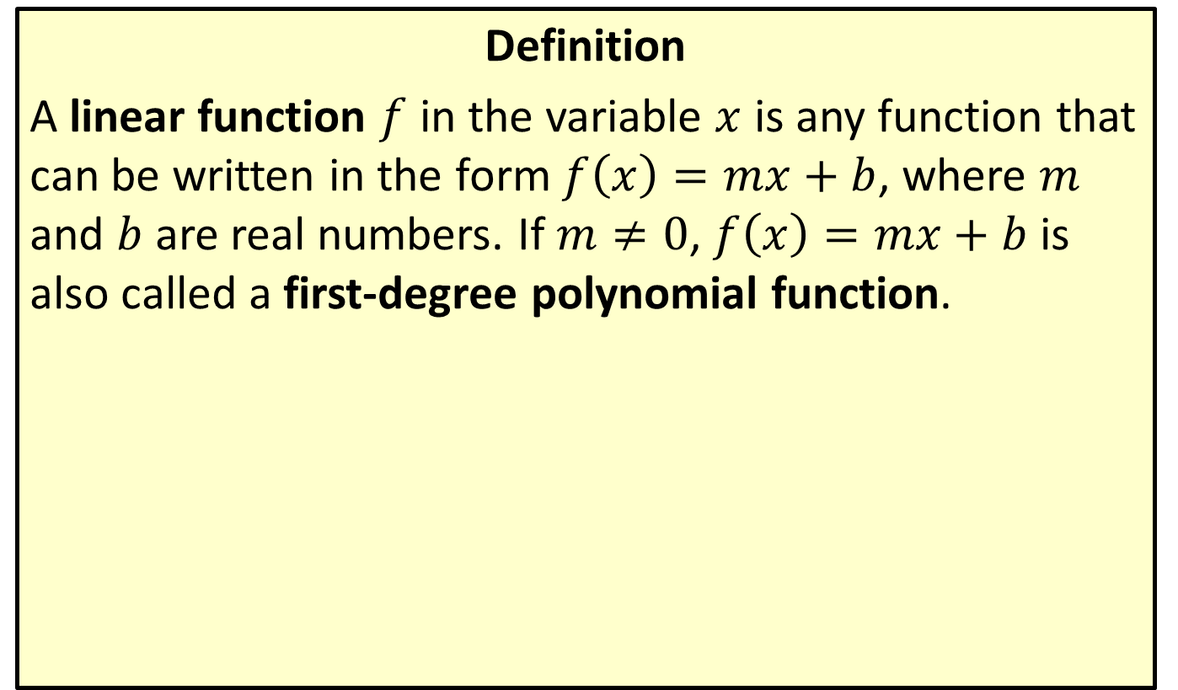
Linear Functions
Definition
A linear function $f$ in the variable $x$ is any function that can be written in the form $f\left(x\right)=mx+b$, where $m$ and $b$ are real numbers. If $m≠0$, $f\left(x\right)=mx+b$ is also called a first-degree polynomial function.

Slide 3
Note:
A function cannot represent a vertical line (since it fails the vertical line test). Vertical lines can represent the graphs of equations, but not functions.

Slide 4

Example 1: Graphing Linear Functions
Graph the following linear functions.
​$f\left(x\right)=3x+2$
​$g\left(x\right)=3$

Slide 5
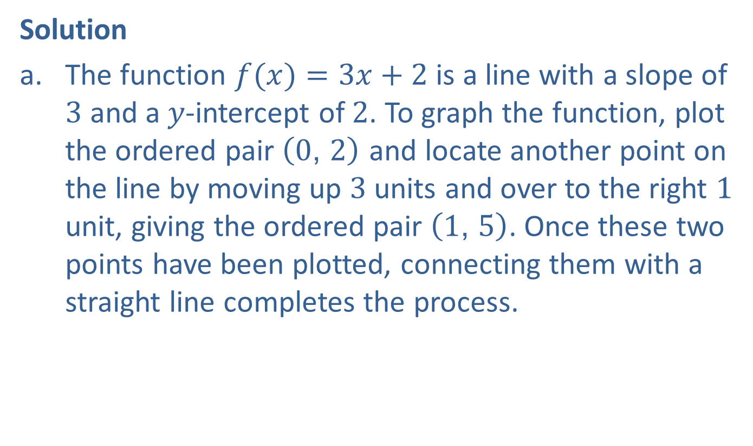
Example 1: Graphing Linear Functions (cont.)
Solution
The function $f(x)=3x+2$ is a line with a slope of 3 and a$y$-intercept of 2. To graph the function, plot the ordered pair $\left(0\text{, }2\right)$ and locate another point on the line by moving up 3 units and over to the right 1 unit, giving the ordered pair $\left(1\text{, }5\right)$. Once these two points have been plotted, connecting them with a straight line completes the process.

Slide 6
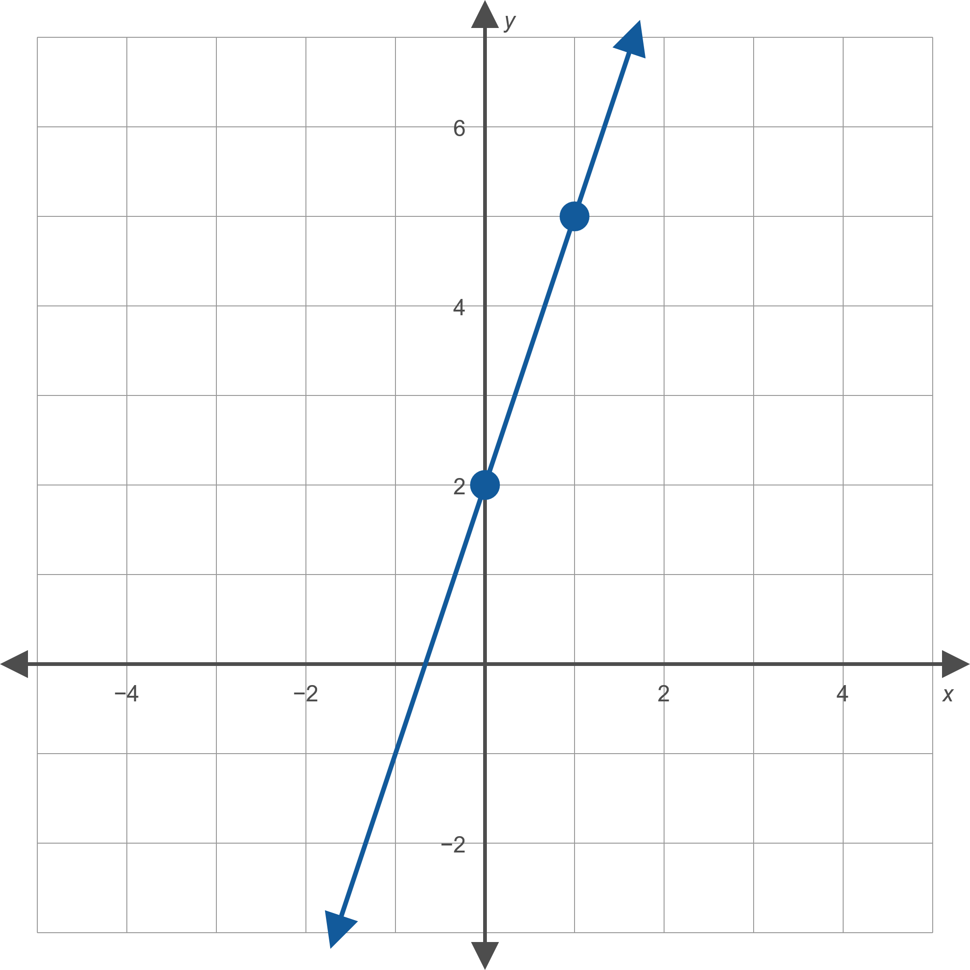

Example 1: Graphing Linear Functions (cont.)
​

Slide 7
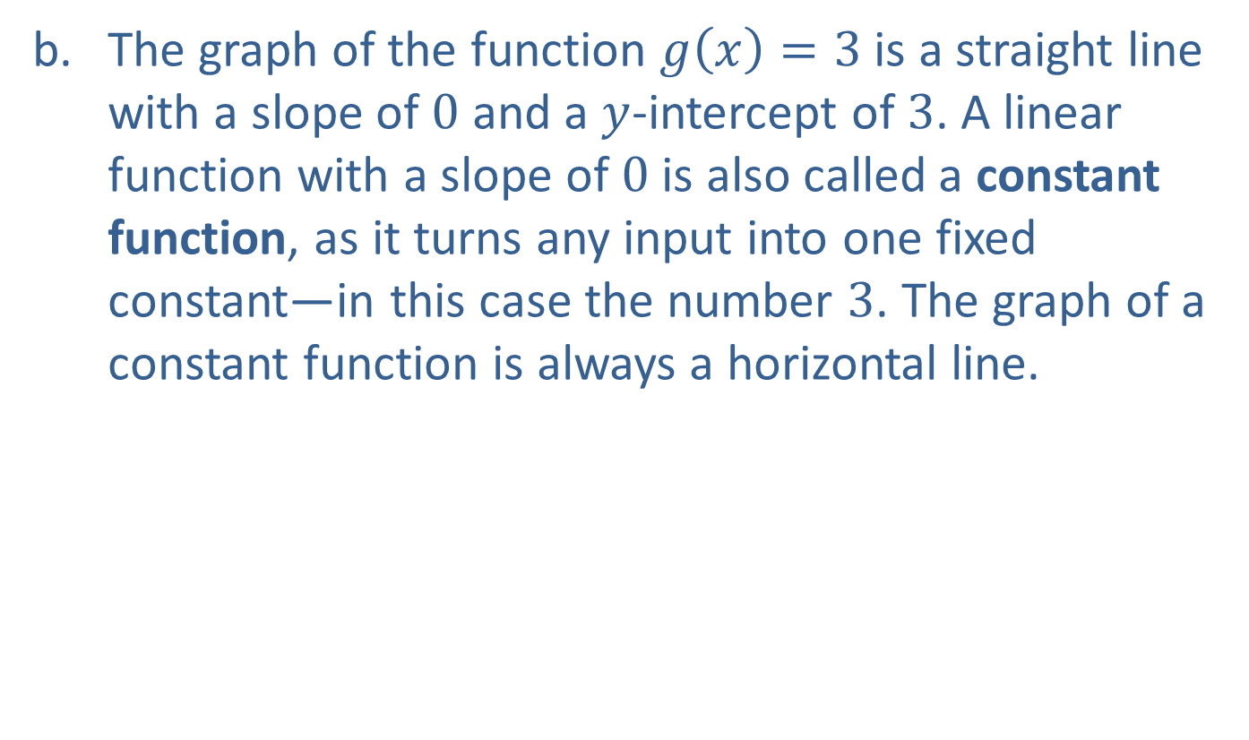
Example 1: Graphing Linear Functions (cont.)
The graph of the function $g\left(x\right)=3$ is a straight line with a slope of 0 and a $y$-intercept of 3. A linear function with a slope of 0 is also called a constant function, as it turns any input into one fixed constant—in this case the number 3. The graph of a constant function is always a horizontal line.
​

Slide 8
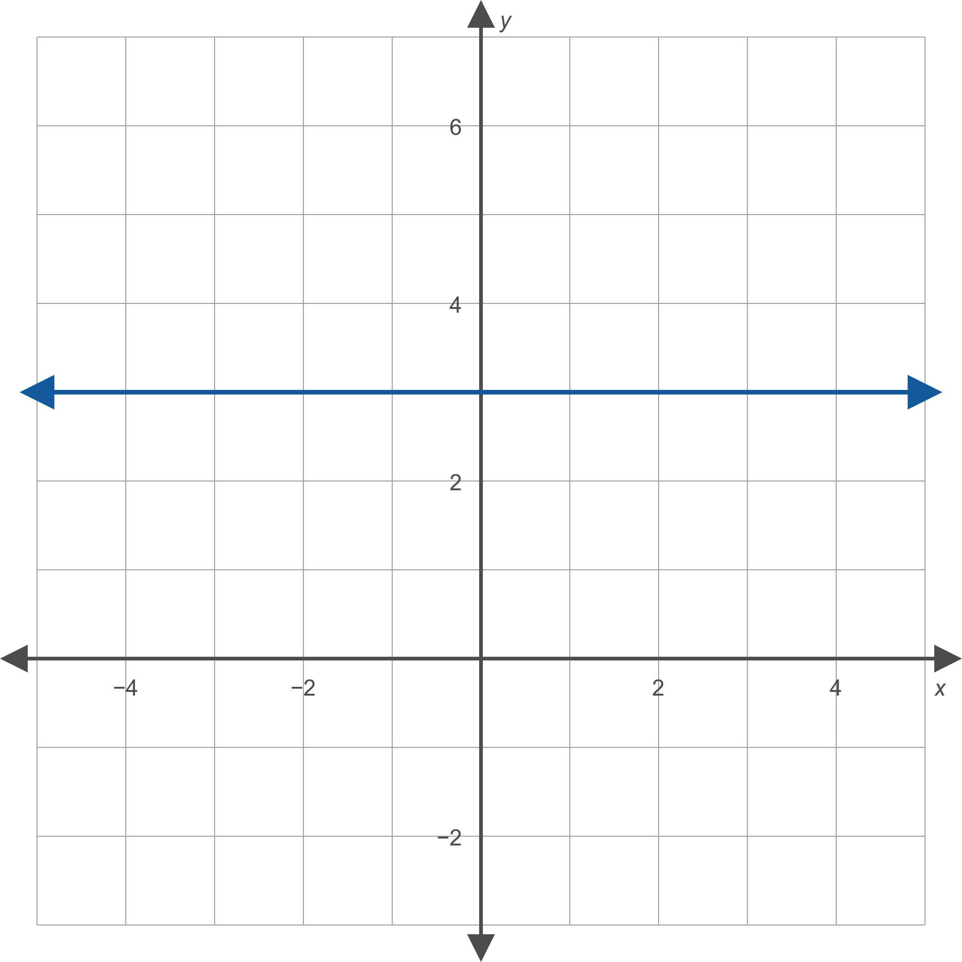
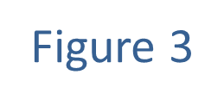
Example 1: Graphing Linear Functions (cont.)

Slide 9
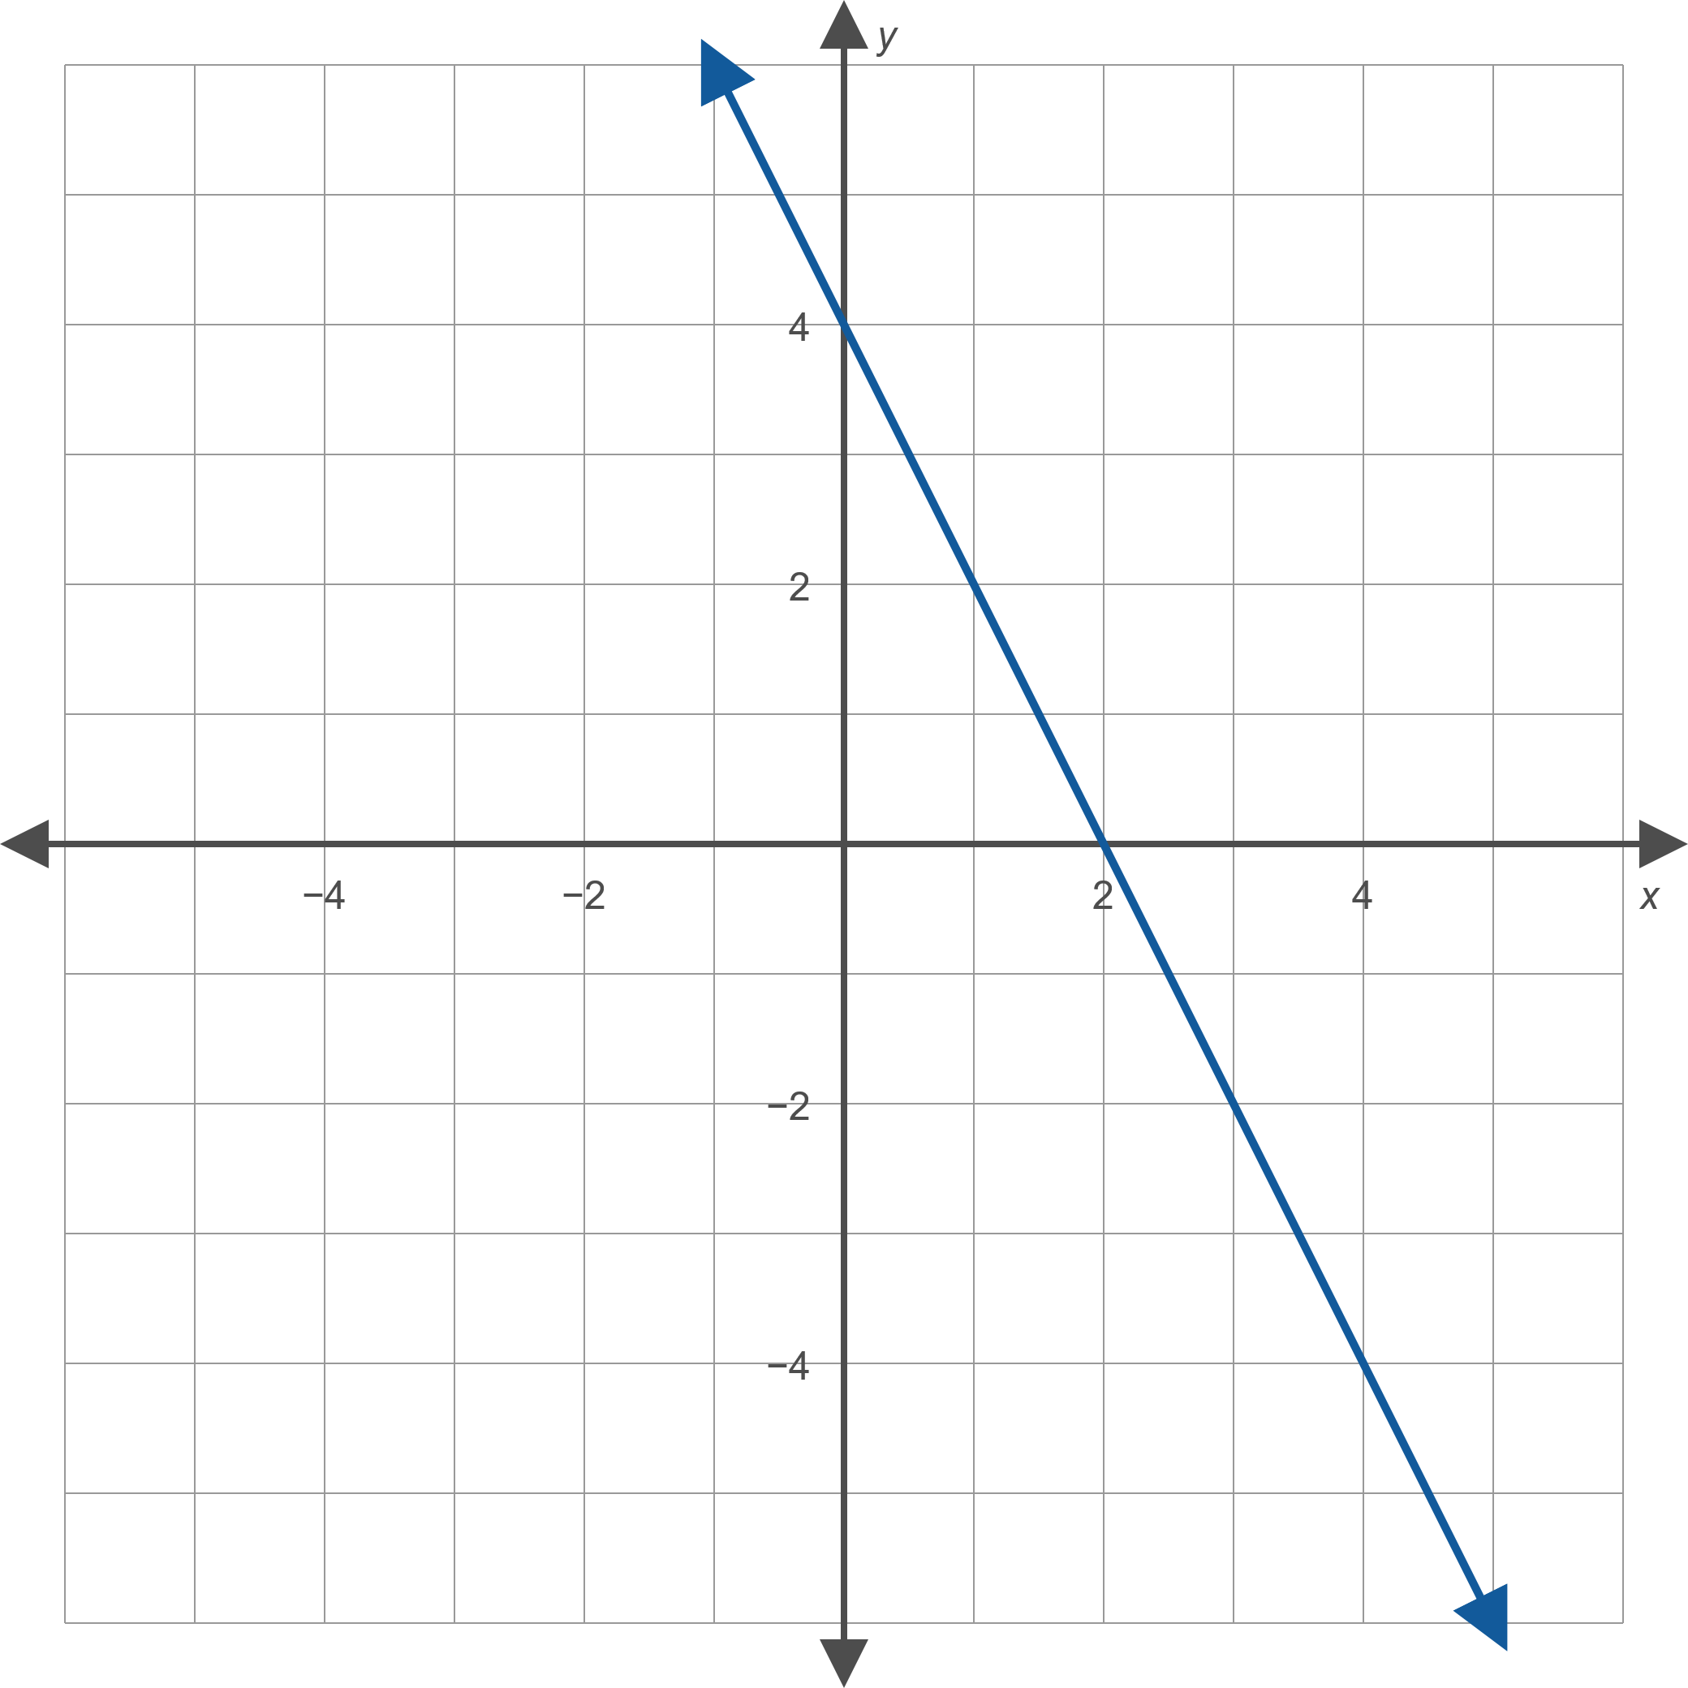
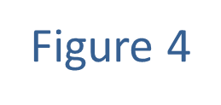
Example 2: Finding a Linear Function Given its Graph
Find a formula for the linear function whose graph is given.

Slide 10
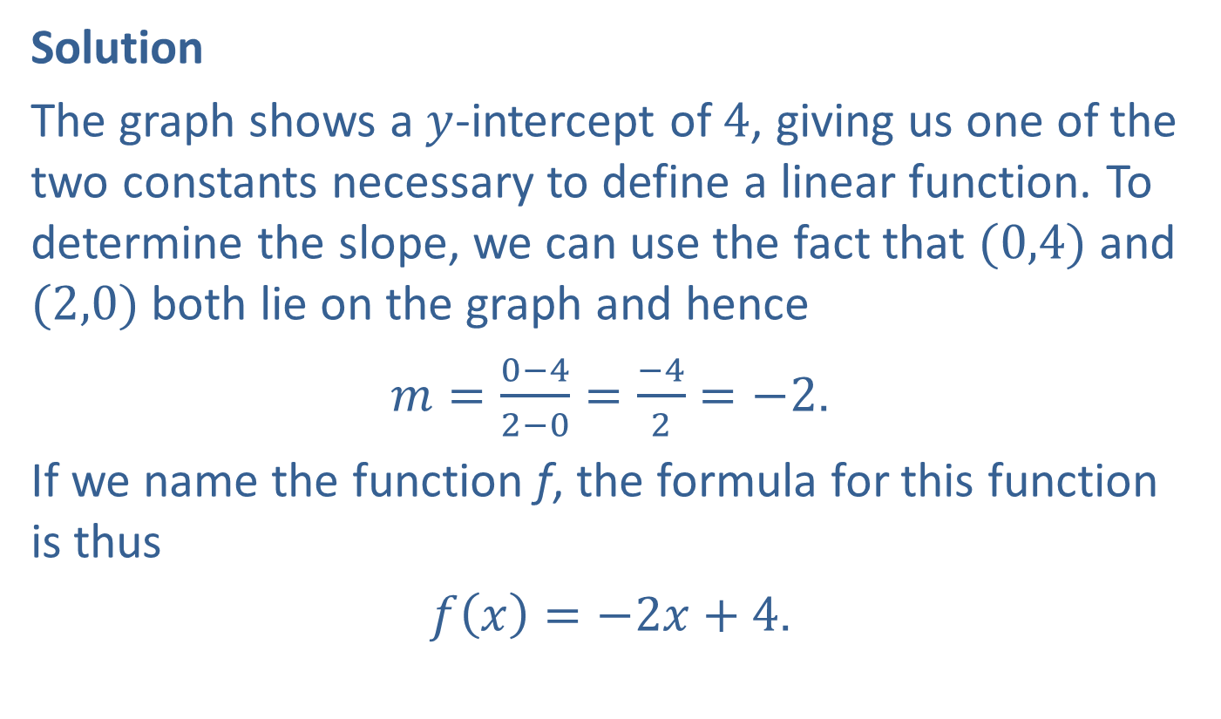
Example 2: Finding a Linear Function Given its Graph (cont.)
Solution
The graph shows a $y$-intercept of 4, giving us one of the two constants necessary to define a linear function. To determine the slope, we can use the fact that $(0,4)$ and $(2,0)$ both lie on the graph and hence
$m=\frac{0−4}{2−0}=\frac{−4}{2}=−2$.
If we name the function f, the formula for this function is thus
$f\left(x\right)=−2x+4$.

Slide 11

Example 3: Finding the Line of Best Fit and Correlation Coefficient
Given the points graphed in Figure 7,
​use linear regression to find and graph the line of best fit, and
​find the Pearson correlation coefficient $r$.

Slide 12
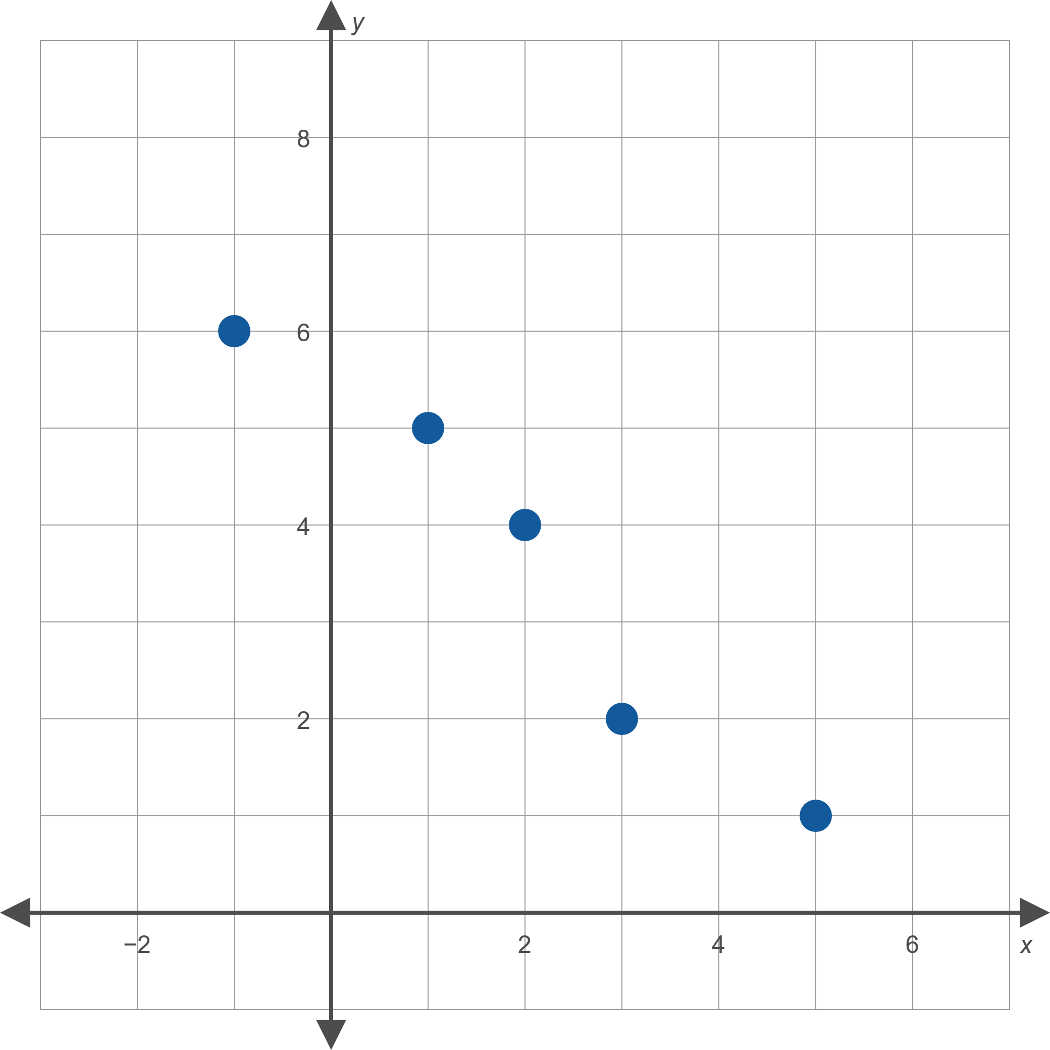
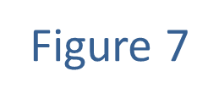
Example 3: Finding the Line of Best Fit and Correlation Coefficient (cont.)

Slide 13
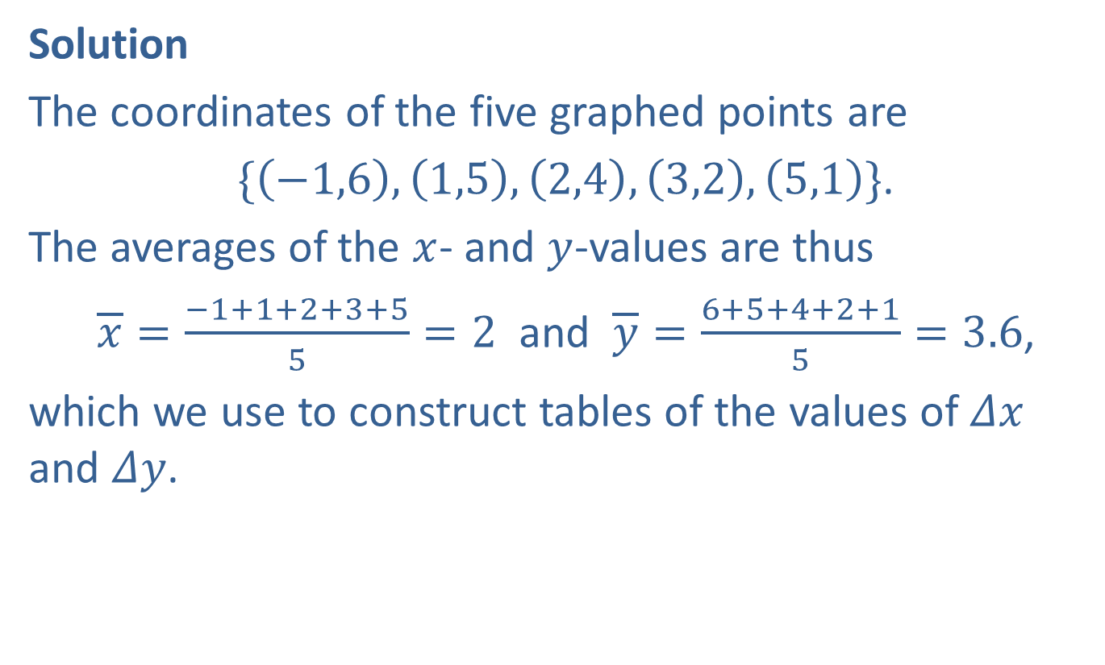
Example 3: Finding the Line of Best Fit and Correlation Coefficient (cont.)
Solution
The coordinates of the five graphed points are
$\{\left(−1,6\right),\left(1,5\right),\left(2,4\right),\left(3,2\right),\left(5,1\right)\}$.
The averages of the $x$- and $y$-values are thus
$\overline{x}=\frac{−1+1+2+3+5}{5}=2$ and $\overline{y}=\frac{6+5+4+2+1}{5}=3.6$,
which we use to construct tables of the values of $Δx$ and $Δy$.

Slide 14
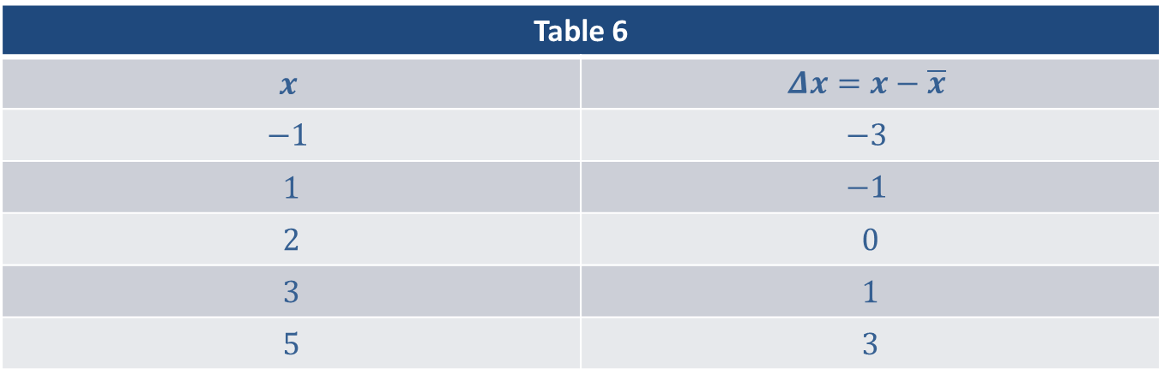
Example 3: Finding the Line of Best Fit and Correlation Coefficient (cont.)
Table 6
$$x$$ | $$Δx=x−\overline{x}$$
$$−1$$ | $$−3$$
1 | $$−1$$
2 | 0
3 | 1
5 | 3

Slide 15
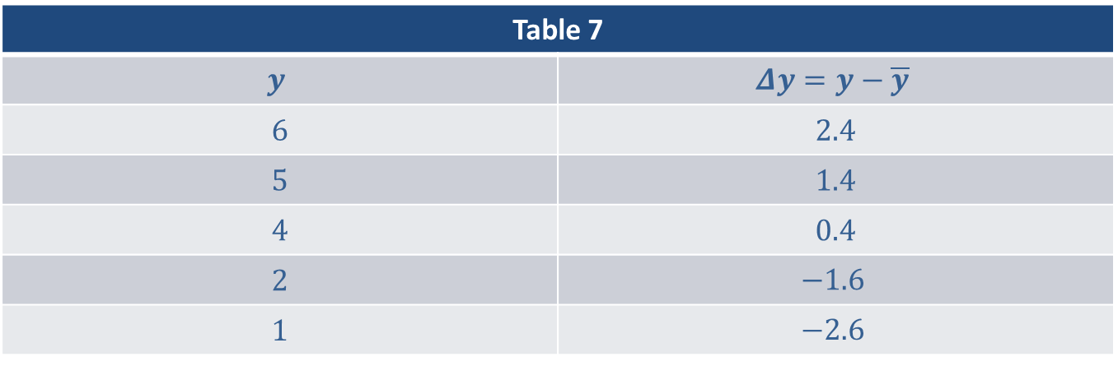
Example 3: Finding the Line of Best Fit and Correlation Coefficient (cont.)
Table 7
$$y$$ | $$Δy=y−\overline{y}$$
6 | 2.4
5 | 1.4
4 | 0.4
2 | $$−1.6$$
1 | $$−2.6$$

Slide 16

Example 3: Finding the Line of Best Fit and Correlation Coefficient (cont.)
We will need to know $∑{\left(Δx\right)}^{2}$, $∑ΔxΔy$, and $∑{\left(Δy\right)}^{2}$, so we make a third table leading to these sums.

Slide 17
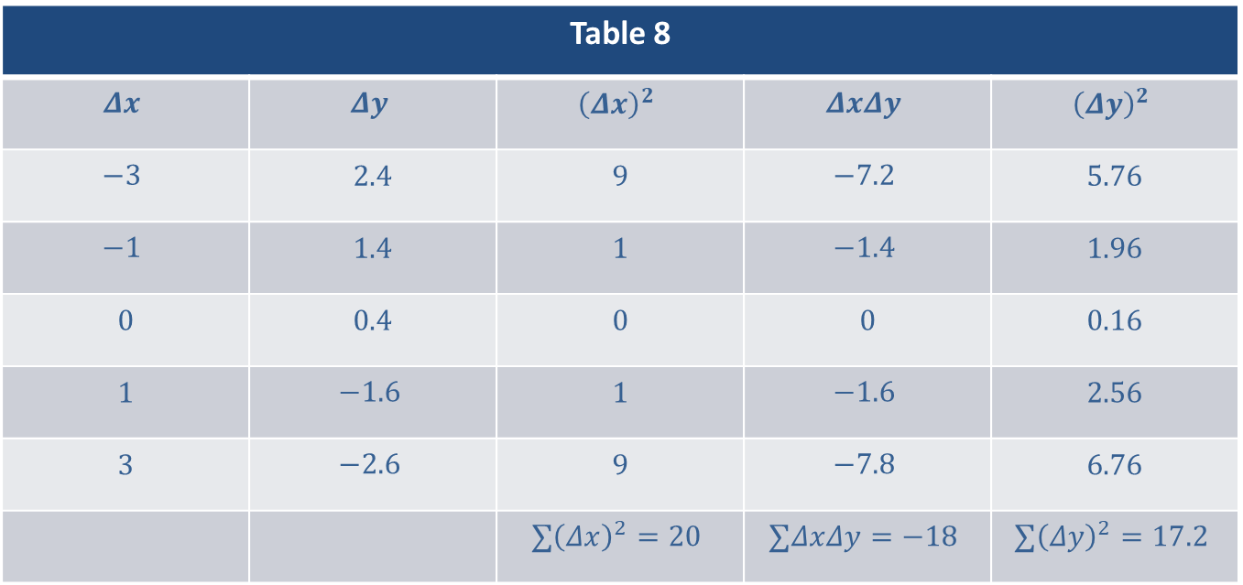
Example 3: Finding the Line of Best Fit and Correlation Coefficient (cont.)
Table 8
$$Δx$$ | $$Δy$$ | $${\left(Δx\right)}^{2}$$ | $$ΔxΔy$$ | $${\left(Δy\right)}^{2}$$
$$−3$$ | 2.4 | 9 | $$−7.2$$ | 5.76
$$−1$$ | 1.4 | 1 | $$−1.4$$ | 1.96
0 | 0.4 | 0 | 0 | 0.16
1 | $$−1.6$$ | 1 | $$−1.6$$ | 2.56
3 | $$−2.6$$ | 9 | $$−7.8$$ | 6.76
 |  | $$∑{\left(Δx\right)}^{2}=20$$ | $$∑ΔxΔy=−18$$ | $$∑{\left(Δy\right)}^{2}=17.2$$

Slide 18
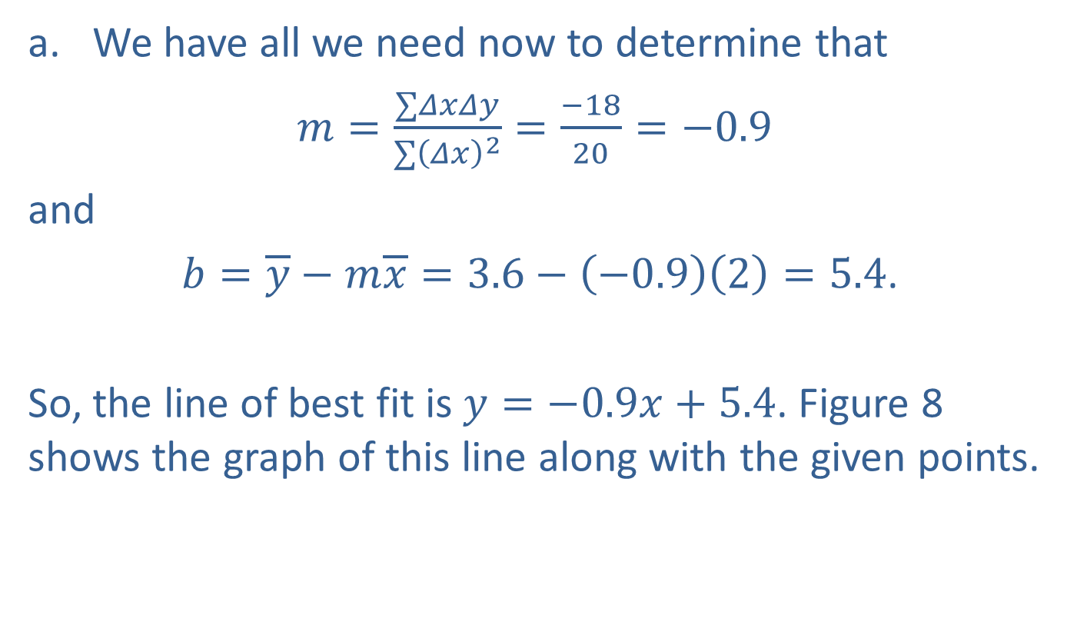
Example 3: Finding the Line of Best Fit and Correlation Coefficient (cont.)
​We have all we need now to determine that
​$m=\frac{∑ΔxΔy}{∑{\left(Δx\right)}^{2}}=\frac{−18}{20}=−0.9$
​and
​ $b=\overline{y}−m\overline{x}=3.6−\left(−0.9\right)\left(2\right)=5.4$.
​So, the line of best fit is $y=−0.9x+5.4$. Figure 8 shows the graph of this line along with the given points.
​

Slide 19
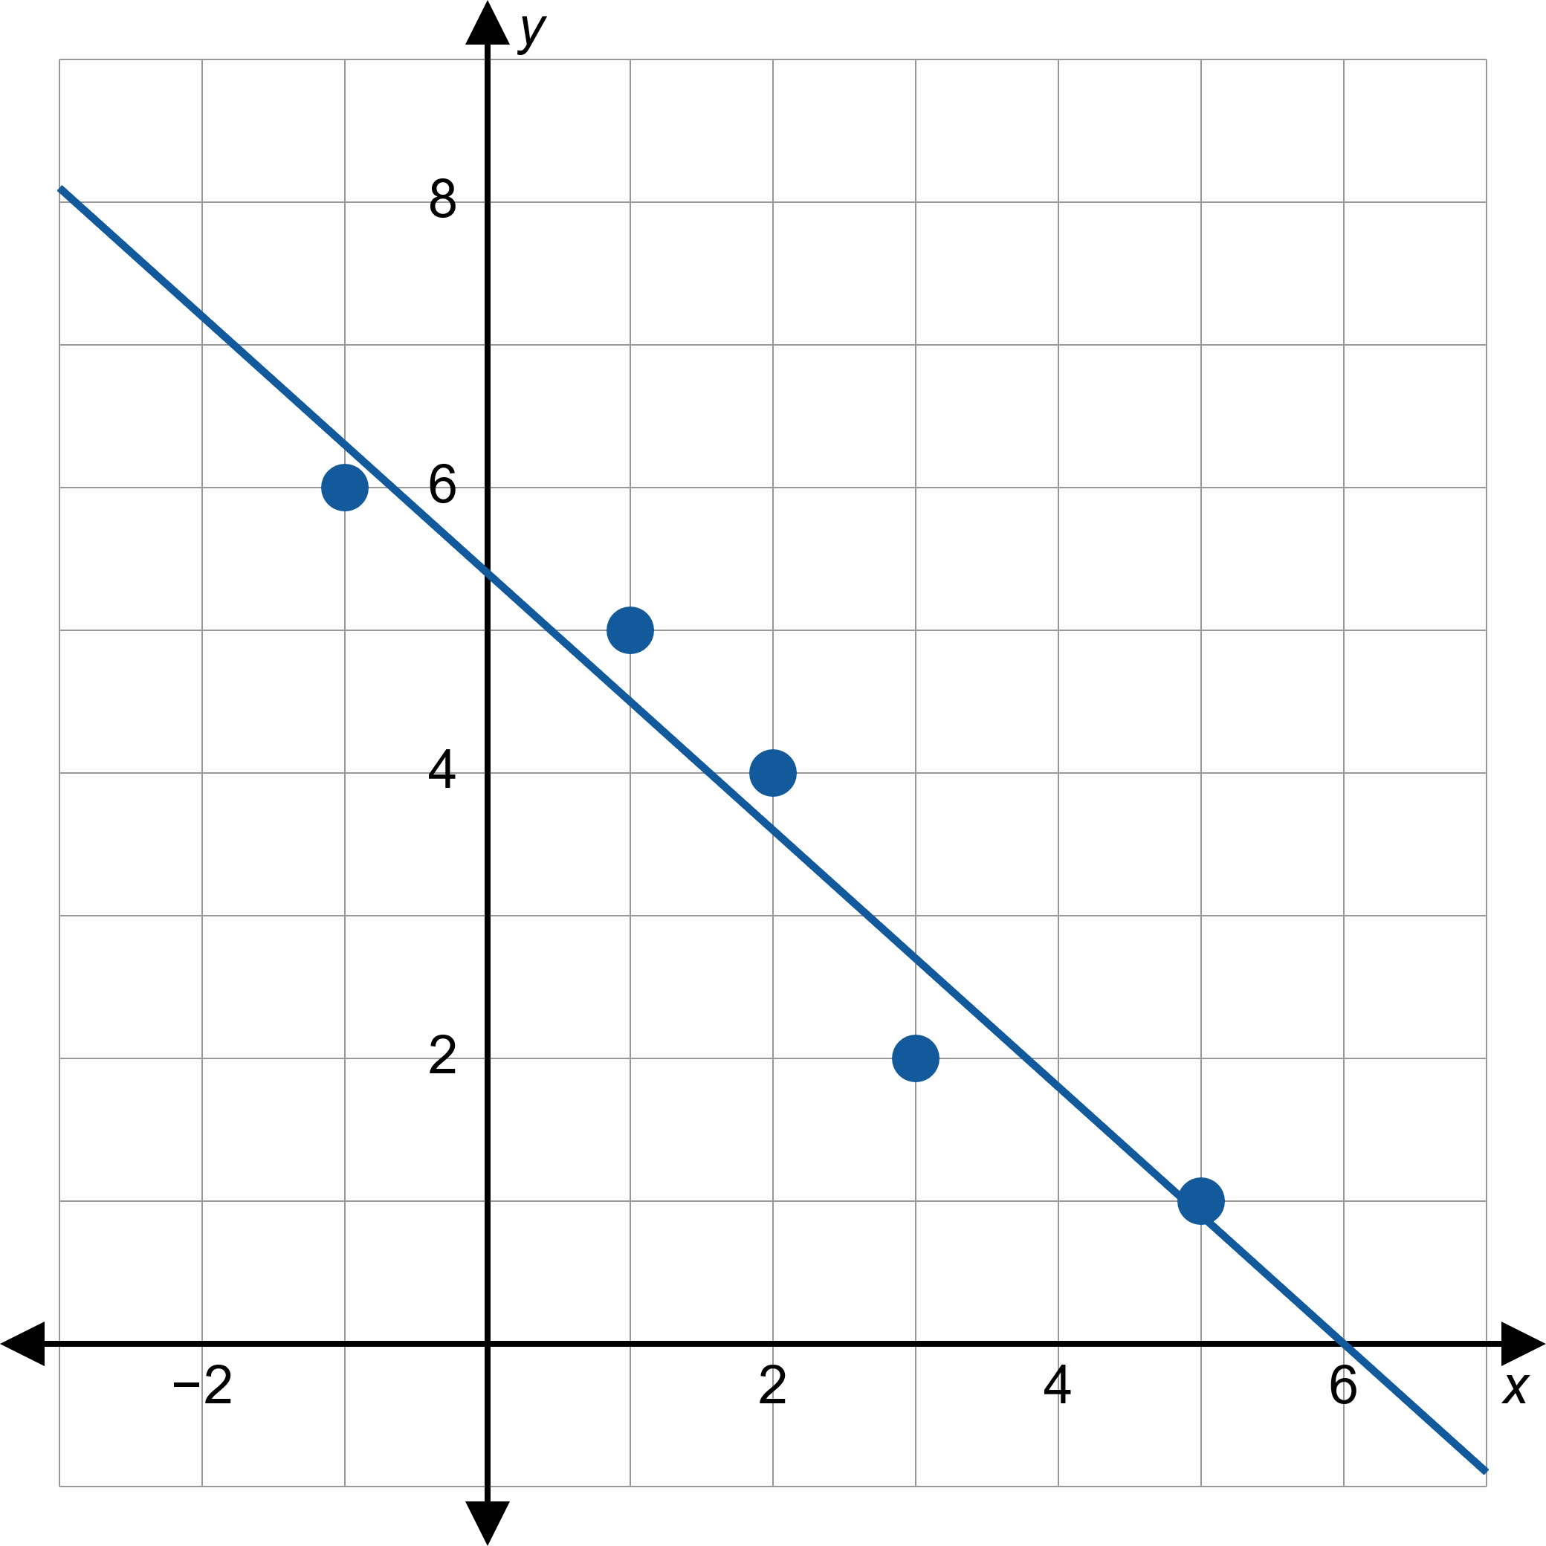

Example 3: Finding the Line of Best Fit and Correlation Coefficient (cont.)

Slide 20
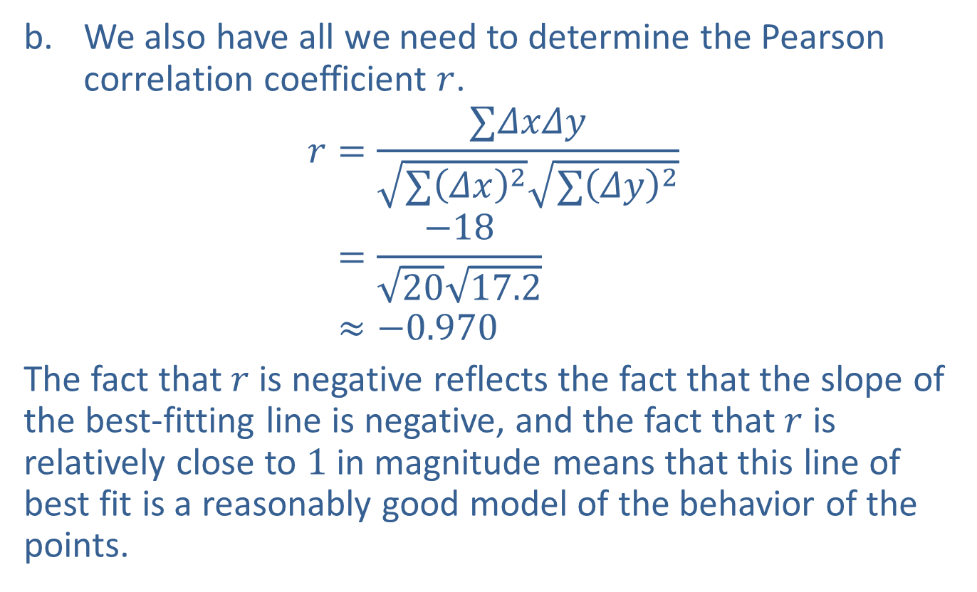
Example 3: Finding the Line of Best Fit and Correlation Coefficient (cont.)
​We also have all we need to determine the Pearson correlation coefficient $r$.
𝑟=∑𝛥𝑥𝛥𝑦∑𝛥𝑥2∑𝛥𝑦2𝑟=−182017.2𝑟≈−0.970
​The fact that $r$ is negative reflects the fact that the slope of the best-fitting line is negative, and the fact that $r$ is relatively close to 1 in magnitude means that this line of best fit is a reasonably good model of the behavior of the points.

Slide 21

Example 4: Finding the Line of Best Fit and Correlation Coefficient
Given the points graphed in Figure 9,
​use linear regression to find and graph the line of best fit, and
​find the Pearson correlation coefficient $r$.

Slide 22
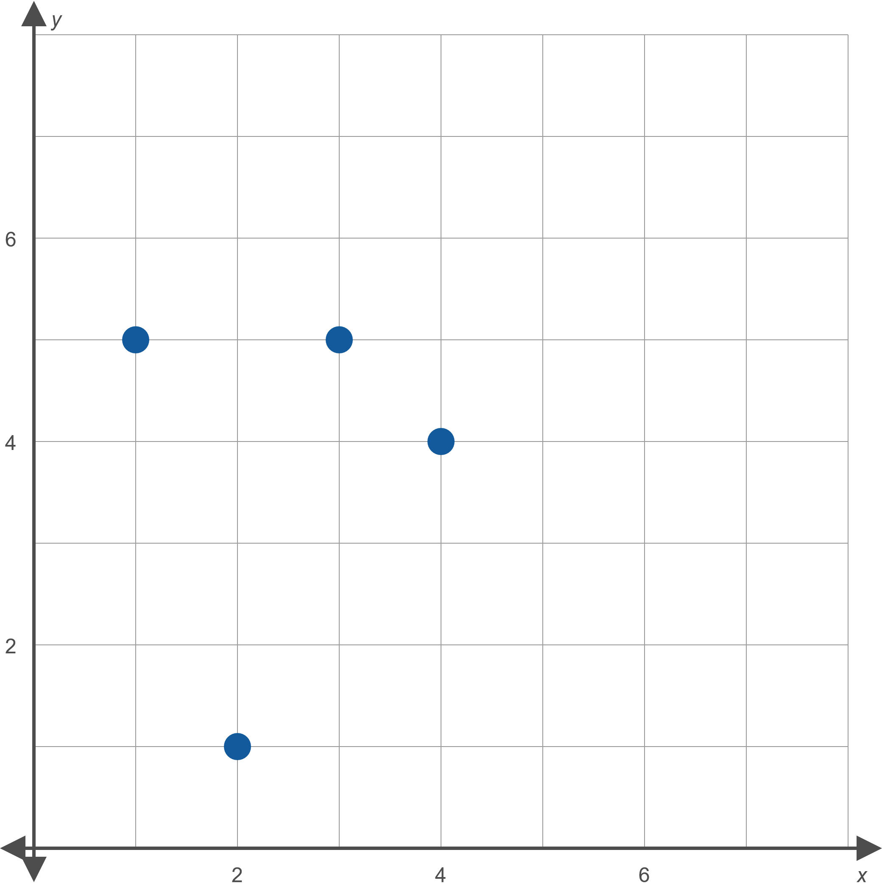
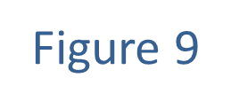
Example 4: Finding the Line of Best Fit and Correlation Coefficient (cont.)

Slide 23
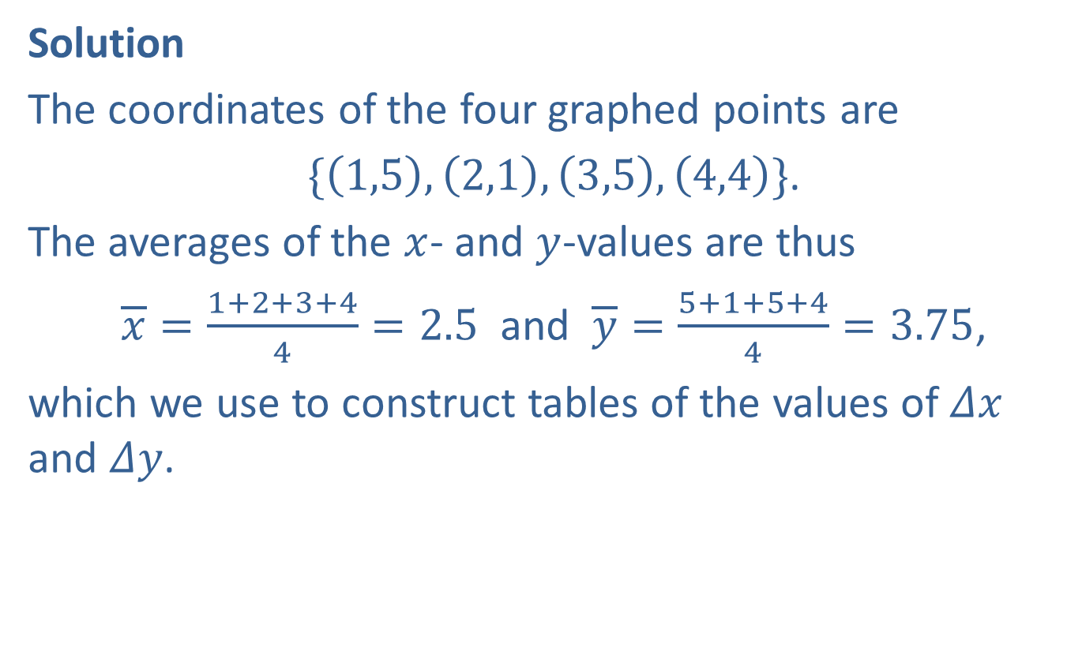
Example 4: Finding the Line of Best Fit and Correlation Coefficient (cont.)
Solution
The coordinates of the four graphed points are
$\{\left(1,5\right),\left(2,1\right),\left(3,5\right),\left(4,4\right)\}$.
The averages of the $x$- and $y$-values are thus
$\overline{x}=\frac{1+2+3+4}{4}=2.5$ and $\overline{y}=\frac{5+1+5+4}{4}=3.75$,
which we use to construct tables of the values of $Δx$ and $Δy$.

Slide 24
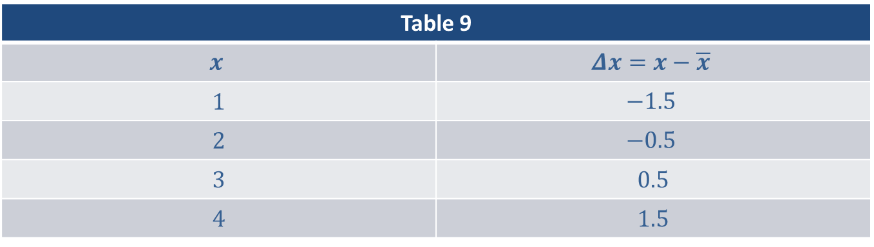
Example 4: Finding the Line of Best Fit and Correlation Coefficient (cont.)
Table 9
$$x$$ | $$Δx=x−\overline{x}$$
1 | $$−1.5$$
2 | $$−0.5$$
3 | 0.5
4 | 1.5

Slide 25
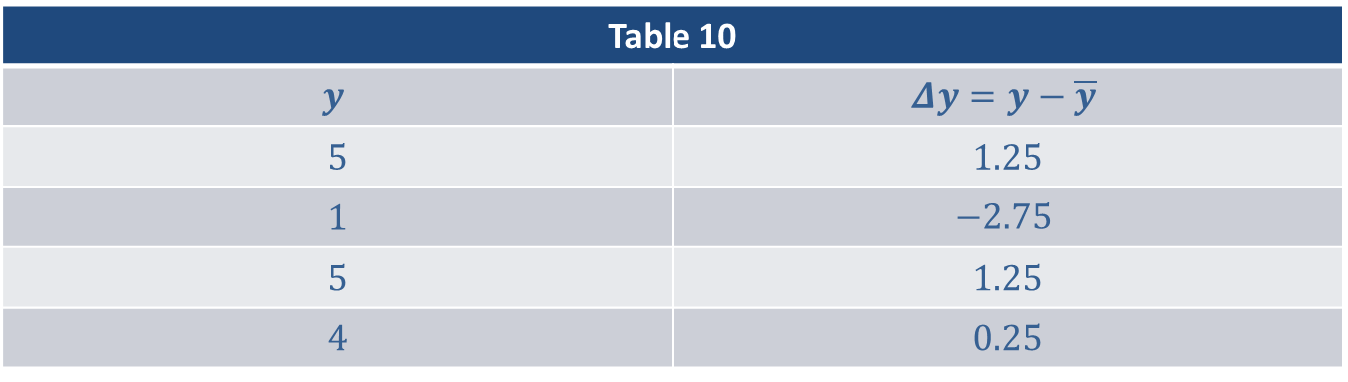
Example 4: Finding the Line of Best Fit and Correlation Coefficient (cont.)
Table 10
$$y$$ | $$Δy=y−\overline{y}$$
5 | 1.25
1 | $$−2.75$$
5 | 1.25
4 | 0.25

Slide 26
Example 4: Finding the Line of Best Fit and Correlation Coefficient (cont.)
We will need to know $∑{\left(Δx\right)}^{2}$, $∑ΔxΔy$, and $∑{\left(Δy\right)}^{2}$, so we make a third table leading to these sums.

Slide 27
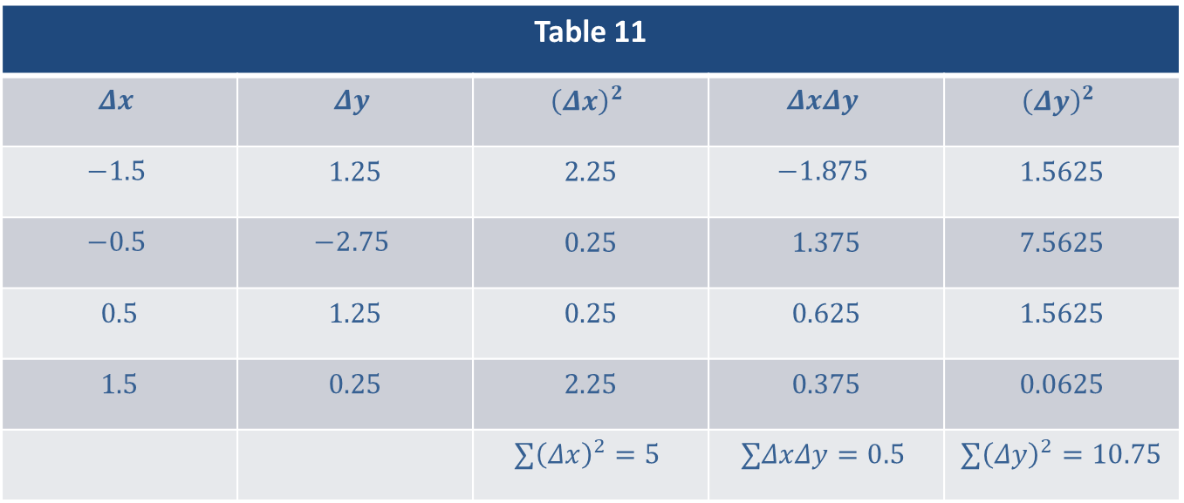
Example 4: Finding the Line of Best Fit and Correlation Coefficient (cont.)
Table 11
$$Δx$$ | $$Δy$$ | $${\left(Δx\right)}^{2}$$ | $$ΔxΔy$$ | $${\left(Δy\right)}^{2}$$
$$−1.5$$ | 1.25 | 2.25 | $$−1.875$$ | 1.5625
$$−0.5$$ | $$−2.75$$ | 0.25 | 1.375 | 7.5625
0.5 | 1.25 | 0.25 | 0.625 | 1.5625
1.5 | 0.25 | 2.25 | 0.375 | 0.0625
 |  | $$∑{\left(Δx\right)}^{2}=5$$ | $$∑ΔxΔy=0.5$$ | $∑{\left(Δy\right)}^{2}=10.75$

Slide 28
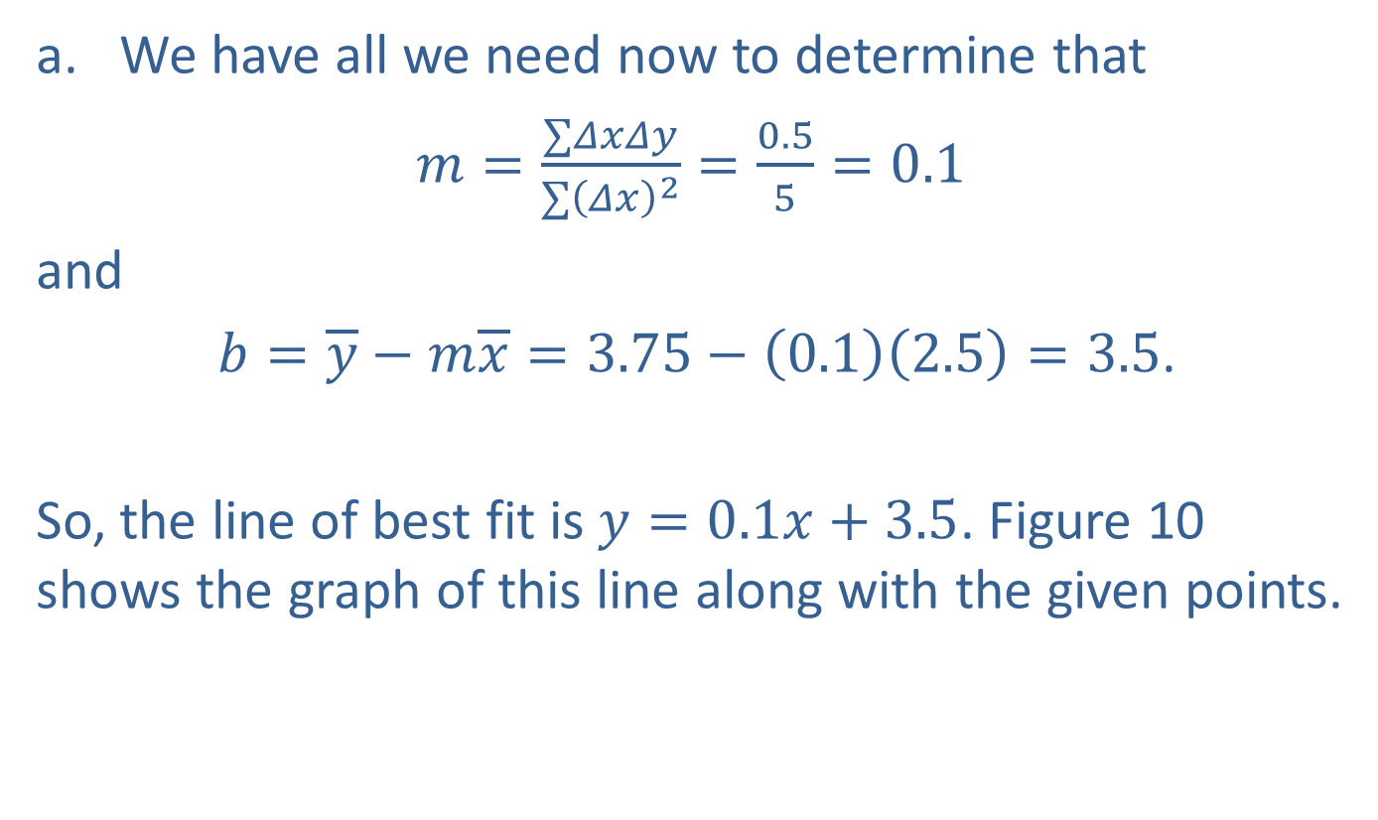
Example 4: Finding the Line of Best Fit and Correlation Coefficient (cont.)
​We have all we need now to determine that
​$m=\frac{∑ΔxΔy}{∑{\left(Δx\right)}^{2}}=\frac{0.5}{5}=0.1$
​and
​ $b=\overline{y}−m\overline{x}=3.75−\left(0.1\right)\left(2.5\right)=3.5$.
​
So, the line of best fit is $y=0.1x+3.5$. Figure 10 shows the graph of this line along with the given points.
​

Slide 29
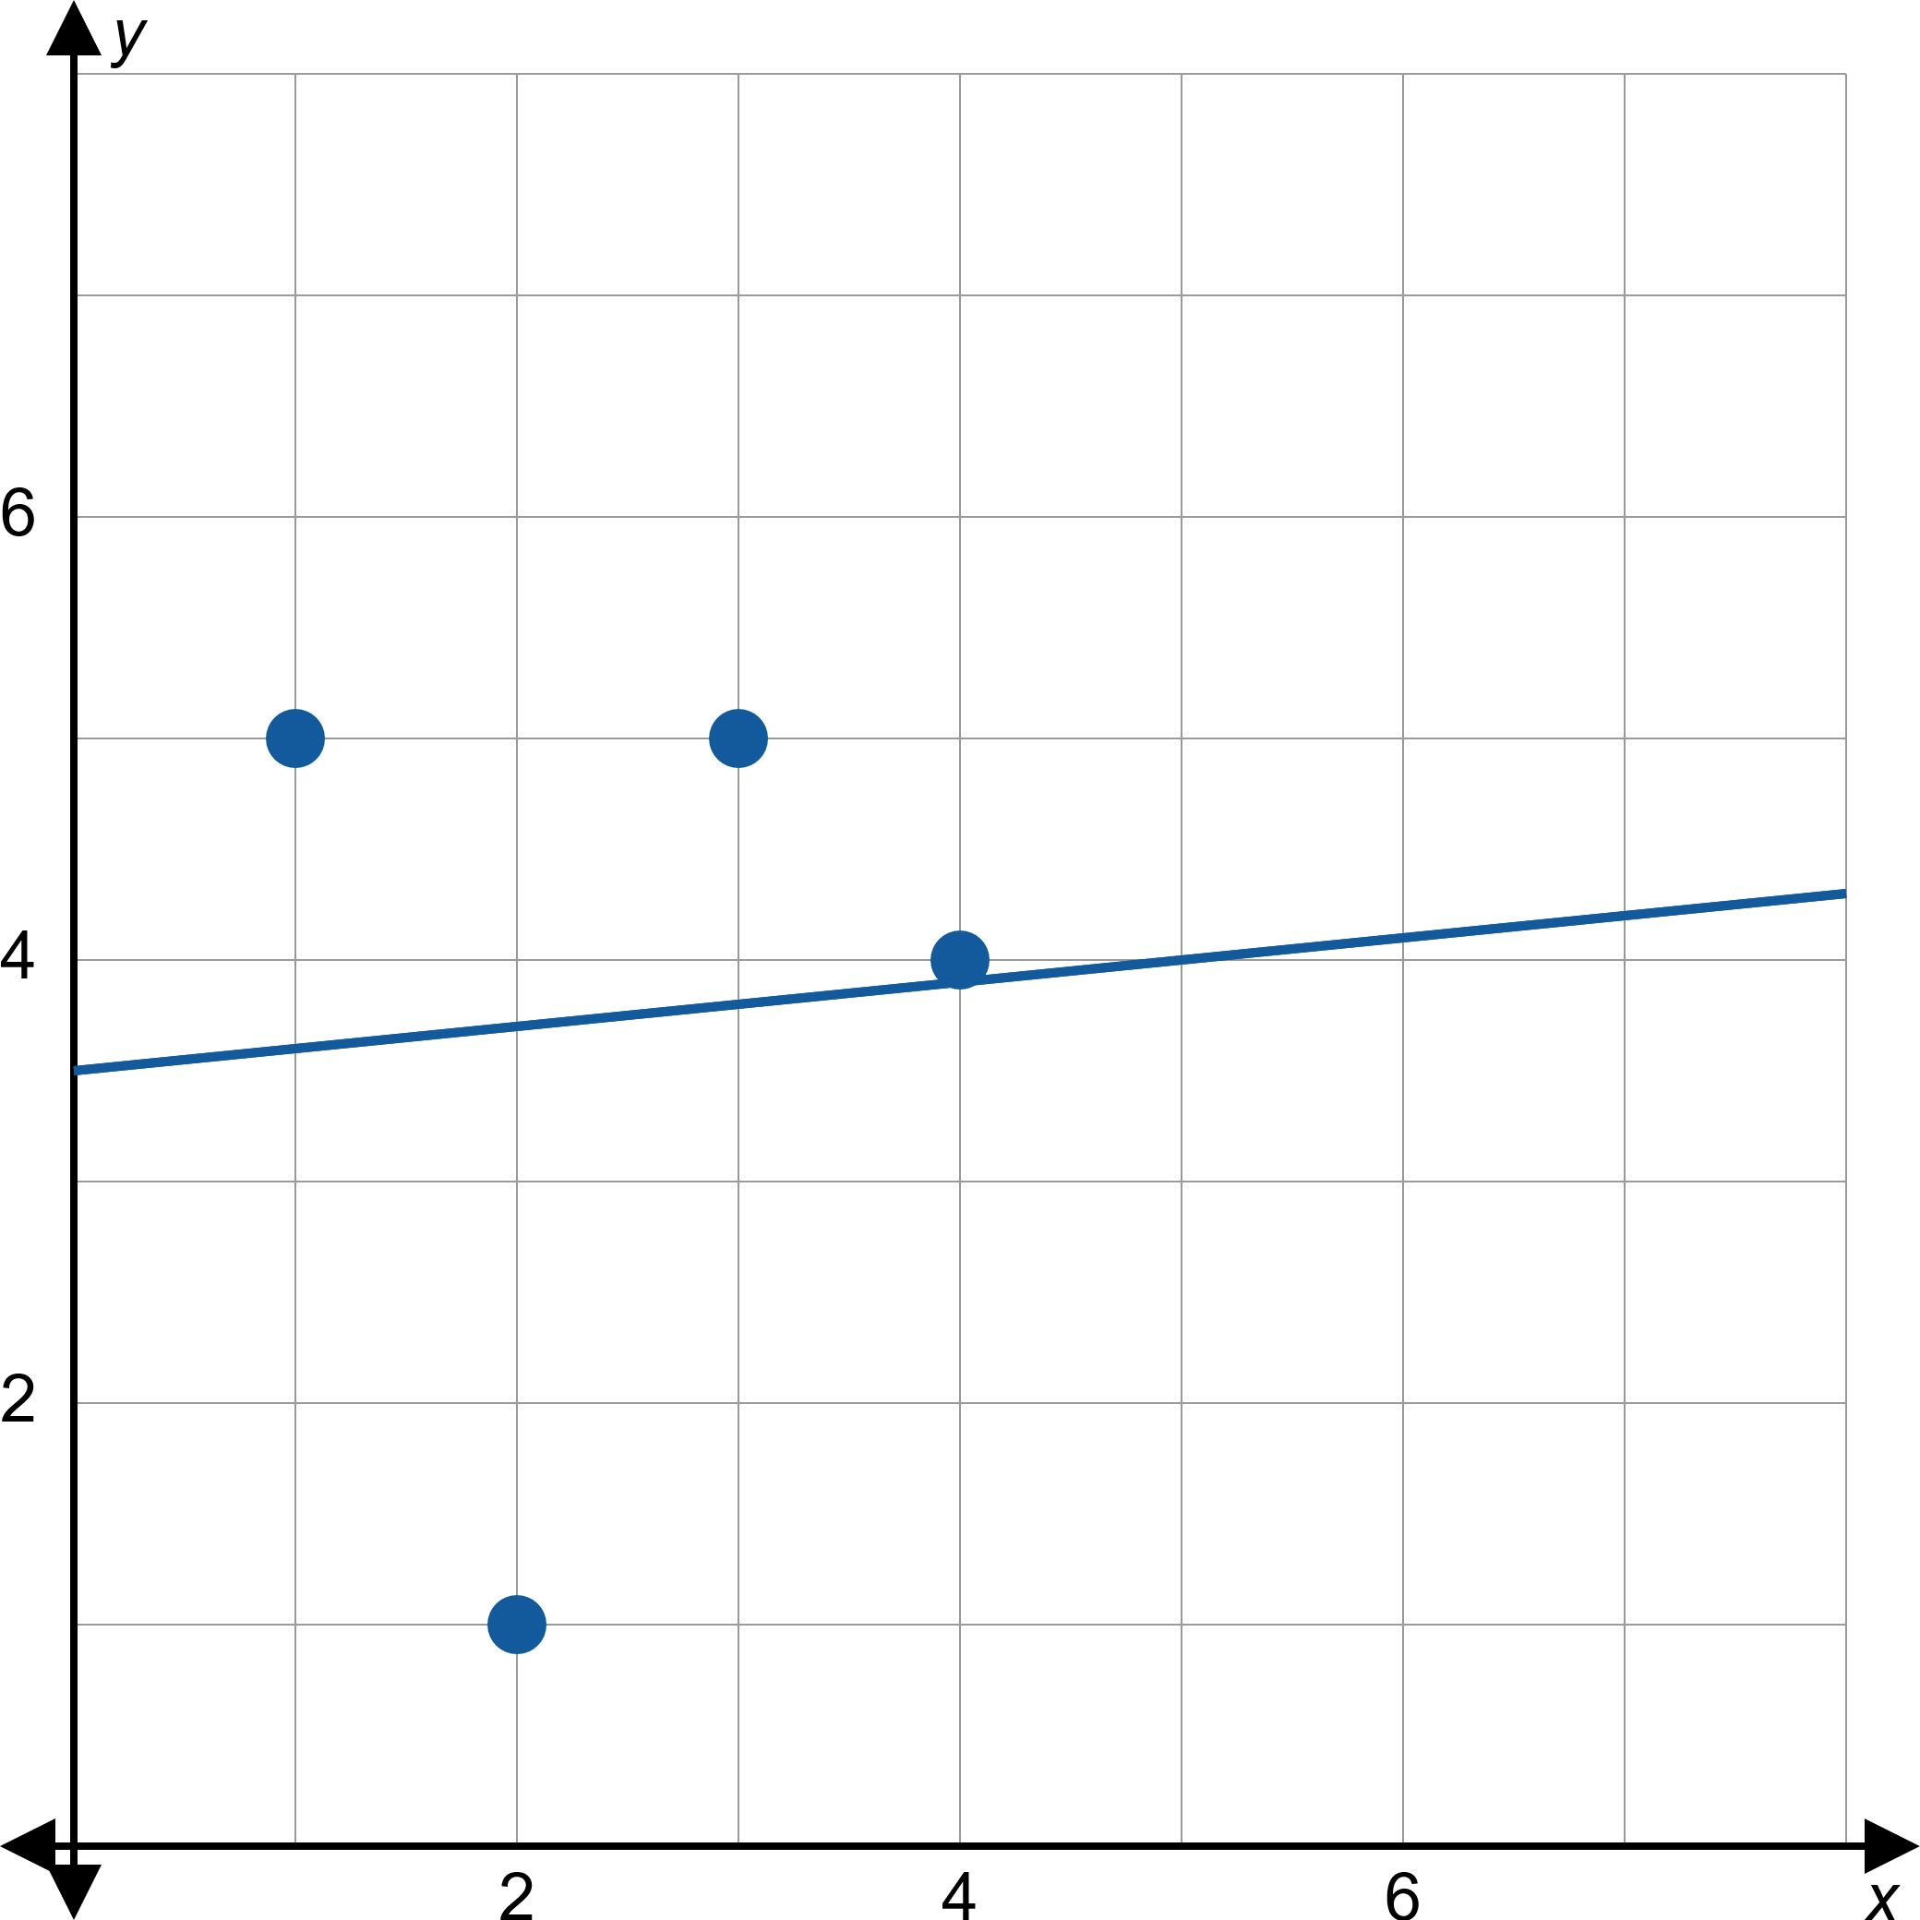
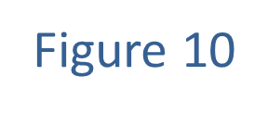
Example 4: Finding the Line of Best Fit and Correlation Coefficient (cont.)

Slide 30
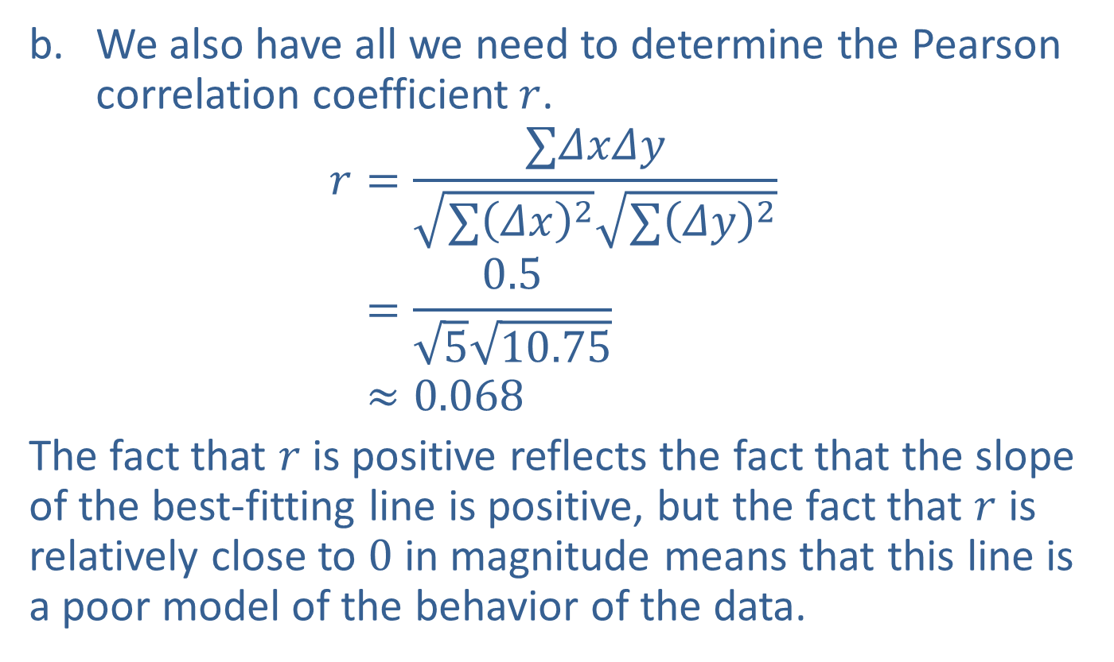
Example 4: Finding the Line of Best Fit and Correlation Coefficient (cont.)
​We also have all we need to determine the Pearson correlation coefficient$r$.
𝑟=∑𝛥𝑥𝛥𝑦∑𝛥𝑥2∑𝛥𝑦2𝑟=0.5510.75𝑟≈0.068
​The fact that $r$ is positive reflects the fact that the slope of the best-fitting line is positive, but the fact that $r$ is relatively close to 0 in magnitude means that this line is a poor model of the behavior of the data.

