Slide 1
Section 5.1
Transformations of Functions

Slide 2
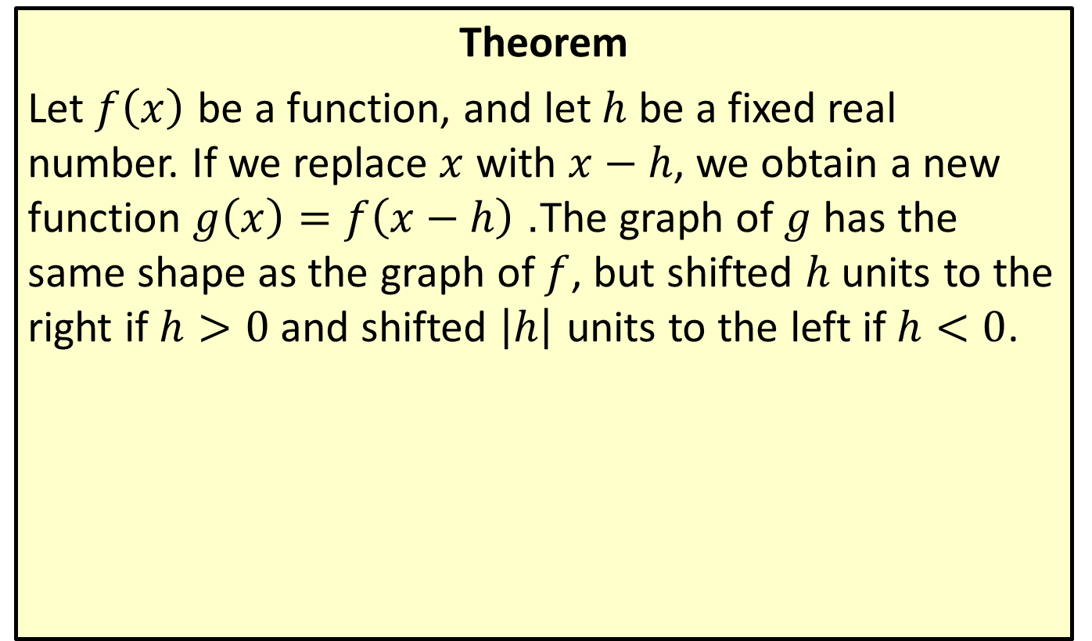
Horizontal Shifting/Translation
Theorem
Let $f⁡\left(x\right)$ be a function, and let $h$ be a fixed real number. If we replace $x$ with $x−h$, we obtain a new function $g\left(x\right)=f\left(x−h\right)$. The graph of $g$ has the same shape as the graph of $f$, but shifted $h$ units to the right if $h>0$ and shifted $\left|h\right|$ units to the left if $h<0$.

Slide 3

Example 1: Horizontal Shifting/Translation
Sketch the graphs of the following functions.
​$f\left(x\right)={\left(x+2\right)}^{3}$
​$g\left(x\right)=\left|x−4\right|$

Slide 4
Note:
Begin by identifying the underlying function that is being shifted.

Slide 5
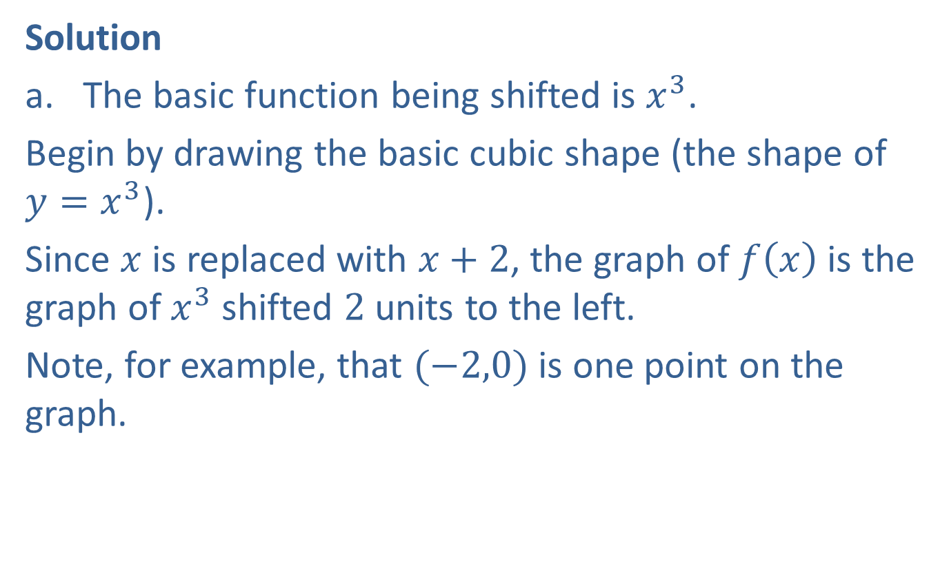
Example 1: Horizontal Shifting/Translation (cont.)
Solution
​The basic function being shifted is $x^{3}$.
​Begin by drawing the basic cubic shape (the shape of $y=x^{3}$).
​Since $x$ is replaced with $x+2$, the graph of $f⁡\left(x\right)$ is the graph of $x^{3}$ shifted 2 units to the left.
Note, for example, that $(−2,0)$ is one point on the graph.
​

Slide 6
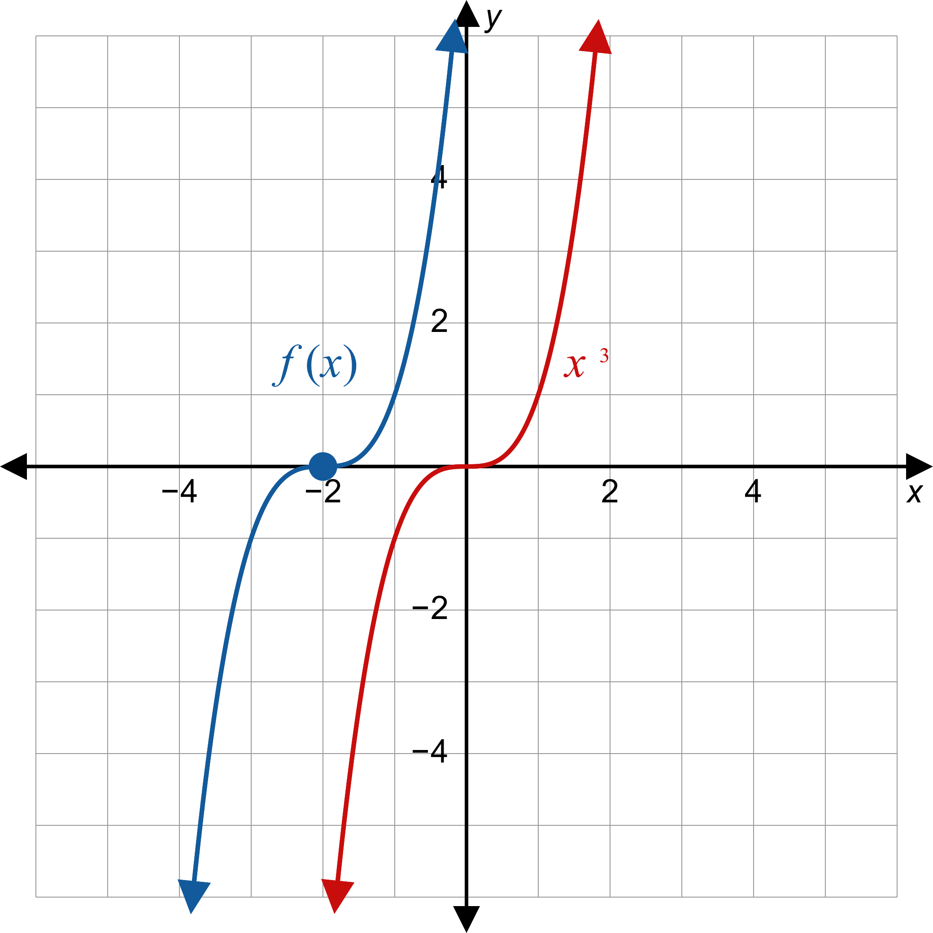

Example 1: Horizontal Shifting/Translation (cont.)

Slide 7

Example 1: Horizontal Shifting/Translation (cont.)
​The basic function being shifted is $|x|$.
​Start by graphing the basic absolute value function.
​The graph of $g\left(x\right)=\left|x−4\right|$ has the same shape, but shifted 4 units to the right.
​Note, for example, that $(4,0)$ lies on the graph of $g$.
​

Slide 8
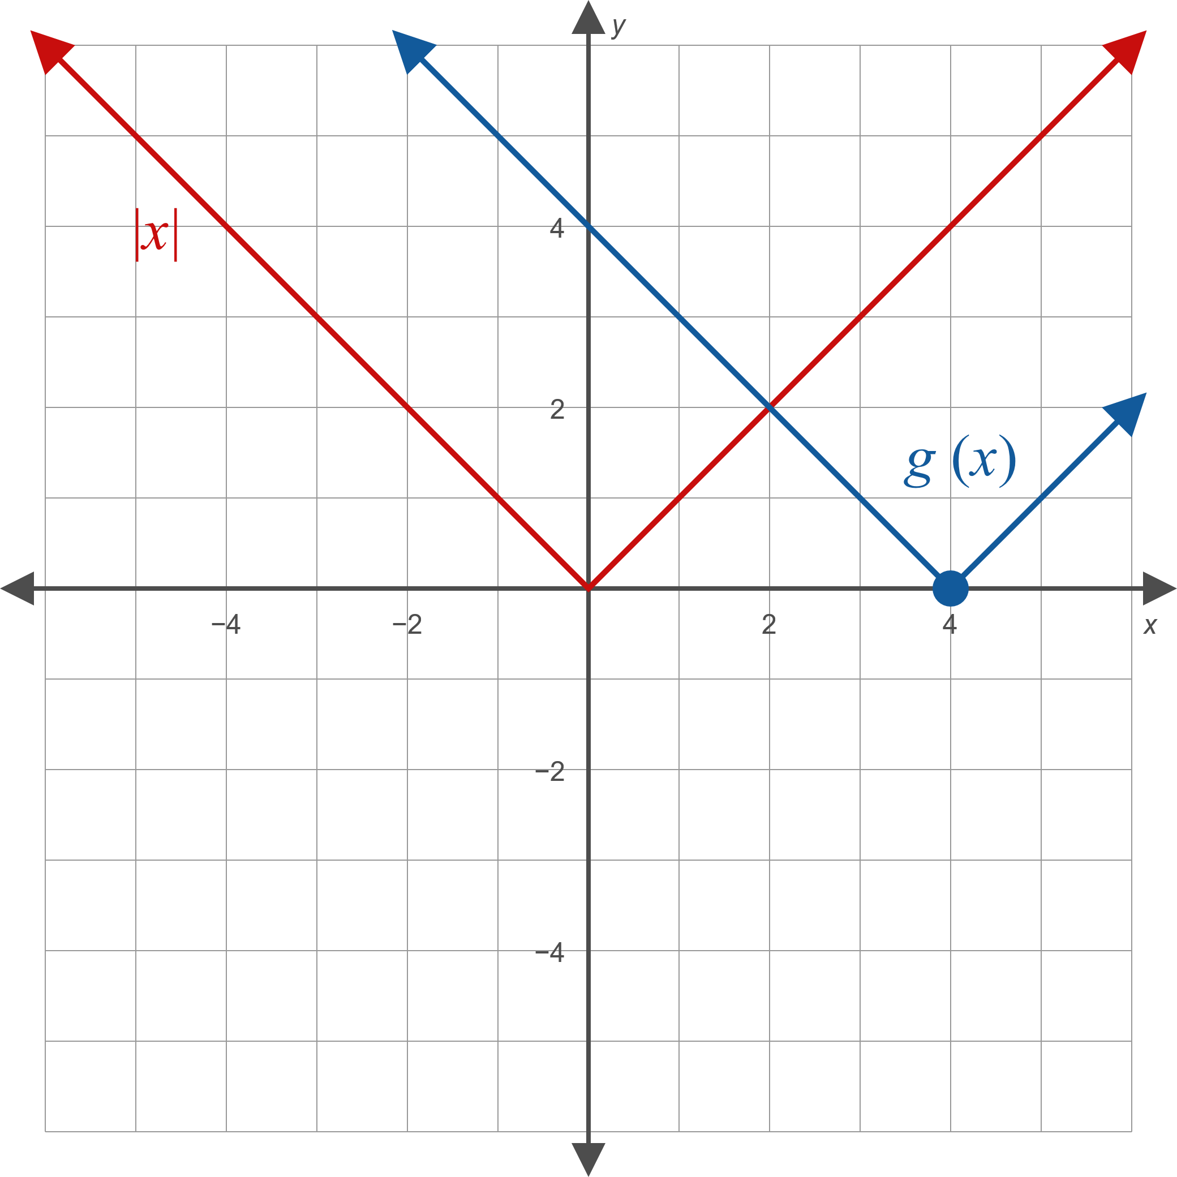

Example 1: Horizontal Shifting/Translation (cont.)

Slide 9
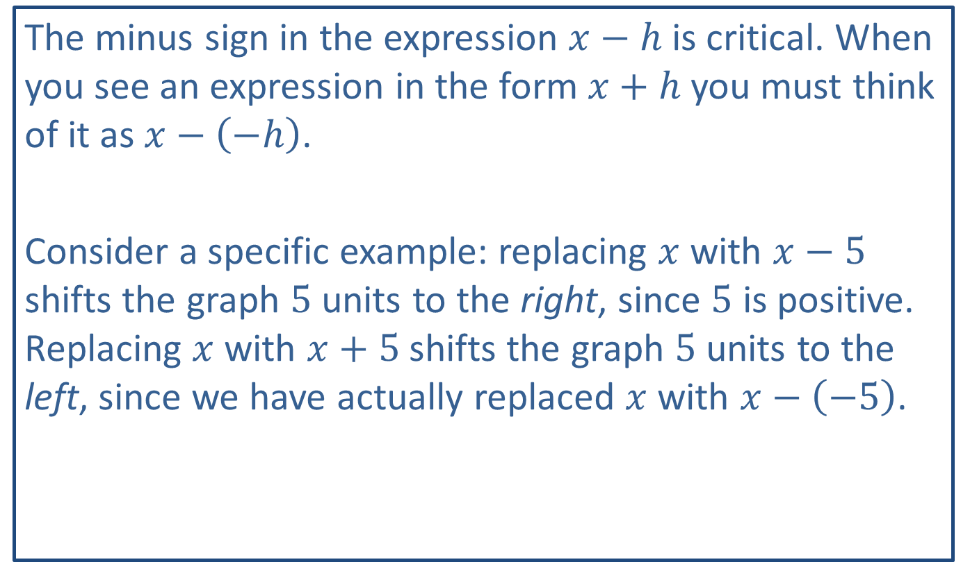
CAUTION!
The minus sign in the expression $x−h$ is critical. When you see an expression in the form $x+h$ you must think of it as $x−\left(−h\right)$.
Consider a specific example: replacing $x$ with $x−5$ shifts the graph 5 units to the right, since 5 is positive. Replacing $x$ with $x+5$ shifts the graph 5 units to the left, since we have actually replaced $x$ with $x−\left(−5\right)$.

Slide 10
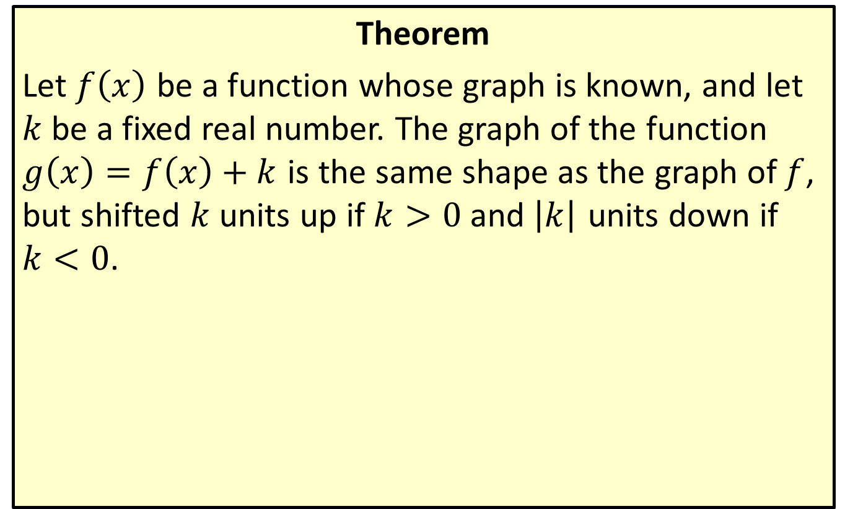
Vertical Shifting/Translation
Theorem
Let $f⁡\left(x\right)$ be a function whose graph is known, and let $k$ be a fixed real number. The graph of the function $g\left(x\right)=f\left(x\right)+k$ is the same shape as the graph of $f$, but shifted $k$ units up if $k>0$ and $\left|k\right|$ units down if $k<0$.

Slide 11

Example 2: Vertical Shifting/Translation
Sketch the graphs of the following functions.
​$f\left(x\right)=\frac{1}{x}+3$
​$g\left(x\right)=\sqrt[3]{x}−2$

Slide 12
Note:
As before, begin by identifying the basic function being shifted.

Slide 13

Example 2: Vertical Shifting/Translation (cont.)
Solution
​The basic function being shifted is $\frac{1}{x}$.
​The graph of $f\left(x\right)=\frac{1}{x}+3$ is the graph of $y=\frac{1}{x}$ shifted 3 units up.
​

Slide 14
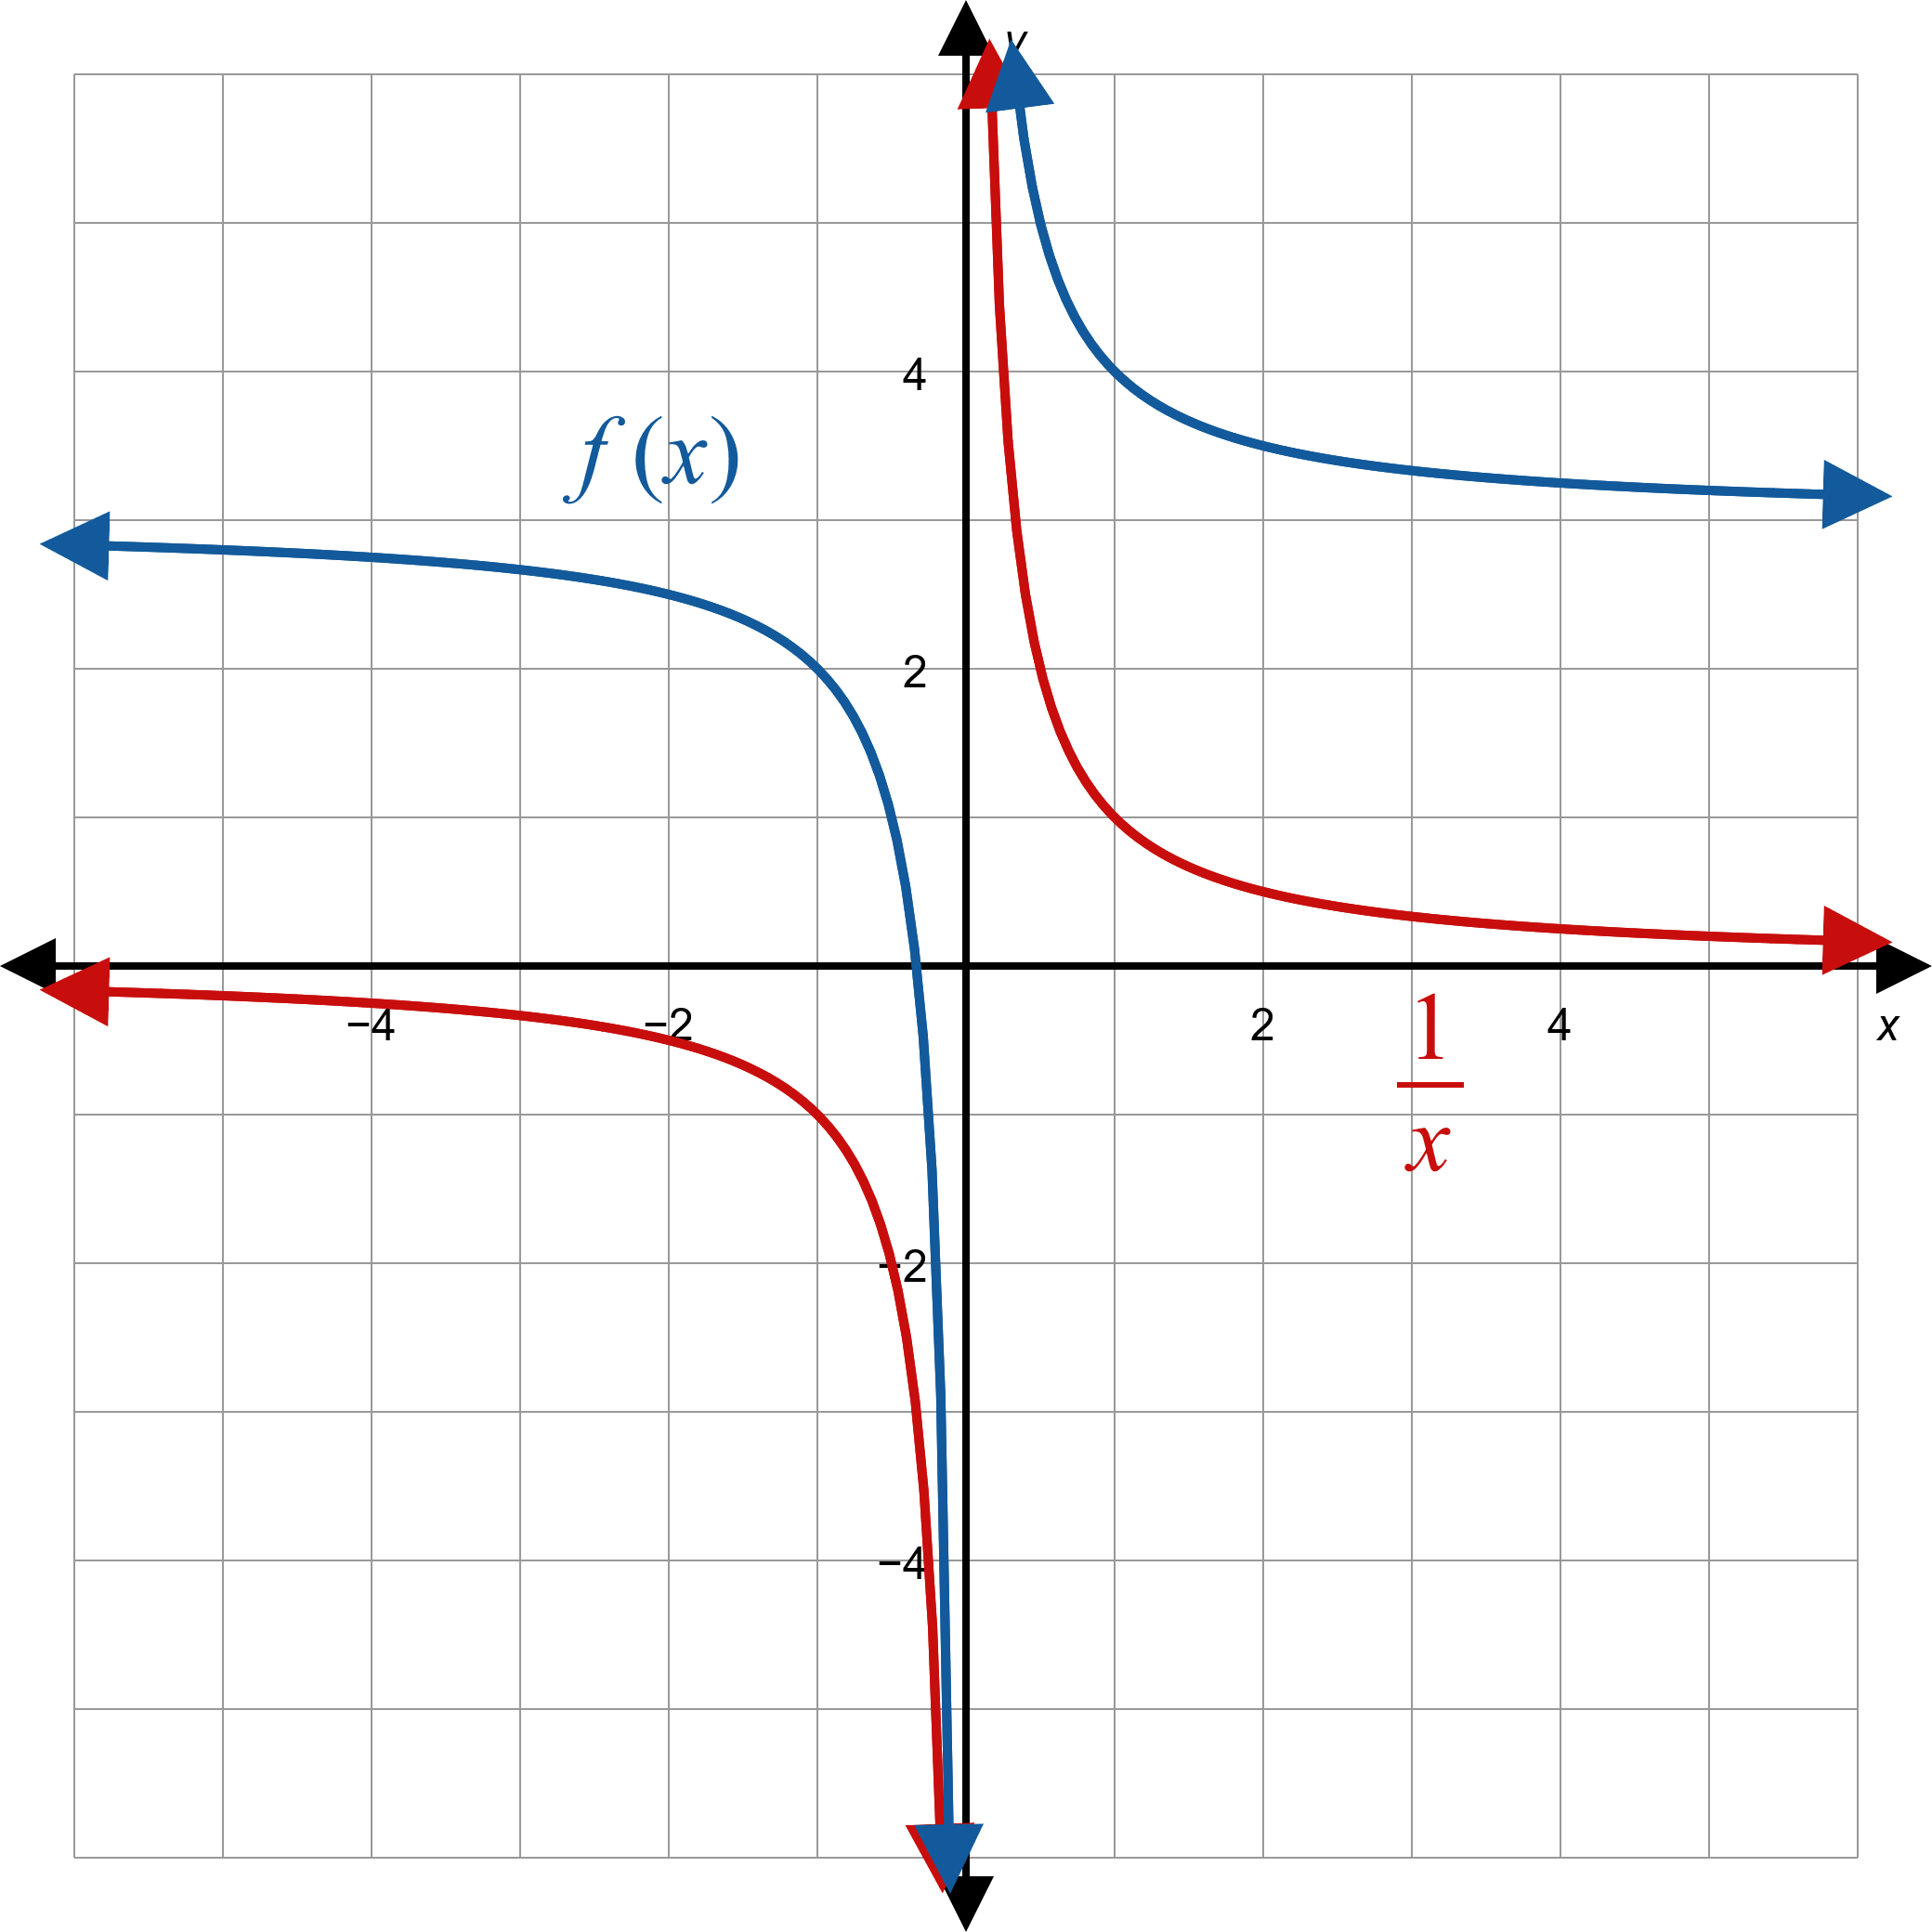
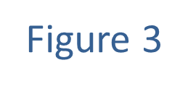
Example 2: Vertical Shifting/Translation (cont.)

Slide 15

Example 2: Vertical Shifting/Translation (cont.)
​Note that this doesn't change the domain.
​However, the range is affected; the range of $f$ is $\left(−∞,3\right)∪\left(3,∞\right)$.

Slide 16

Example 2: Vertical Shifting/Translation (cont.)
​The basic function being shifted is $\sqrt[3]{x}$.
​Begin by graphing the basic cube root shape.
​To graph $g\left(x\right)=\sqrt[3]{x}−2$, the graph of $y=\sqrt[3]{x}$ is shifted 2 units down.
​

Slide 17
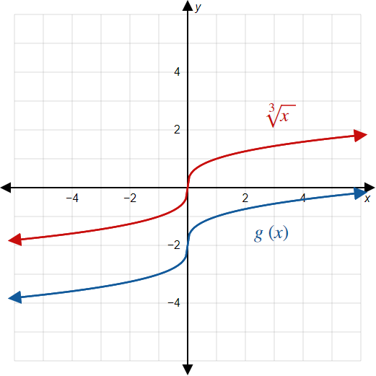

Example 2: Vertical Shifting/Translation (cont.)

Slide 18

Example 3: Horizontal and Vertical Shifting
Sketch the graph of the function $f\left(x\right)=\sqrt{x+4}+1$.

Slide 19
Note:
In this case, it doesn't matter which shift we apply first. However, when functions get more complicated, it is usually best to apply horizontal shifts before vertical shifts.

Slide 20
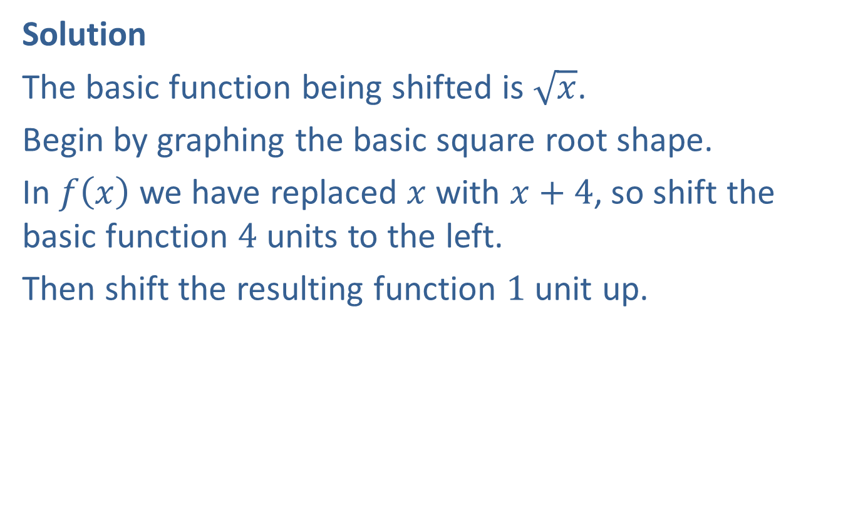
Example 3: Horizontal and Vertical Shifting (cont.)
Solution
The basic function being shifted is $\sqrt{x}$.
Begin by graphing the basic square root shape.
In $f⁡\left(x\right)$ we have replaced $x$ with $x+4$, so shift the basic function 4 units to the left.
Then shift the resulting function 1 unit up.

Slide 21
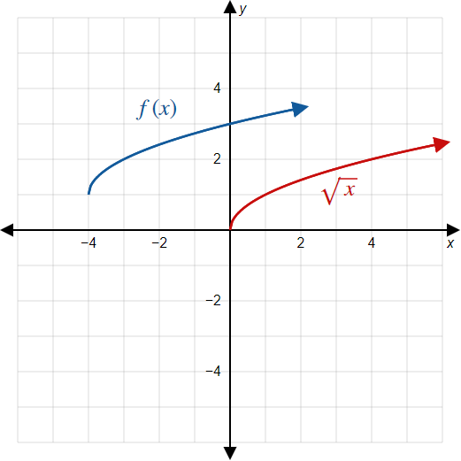

Example 3: Horizontal and Vertical Shifting (cont.)

Slide 22
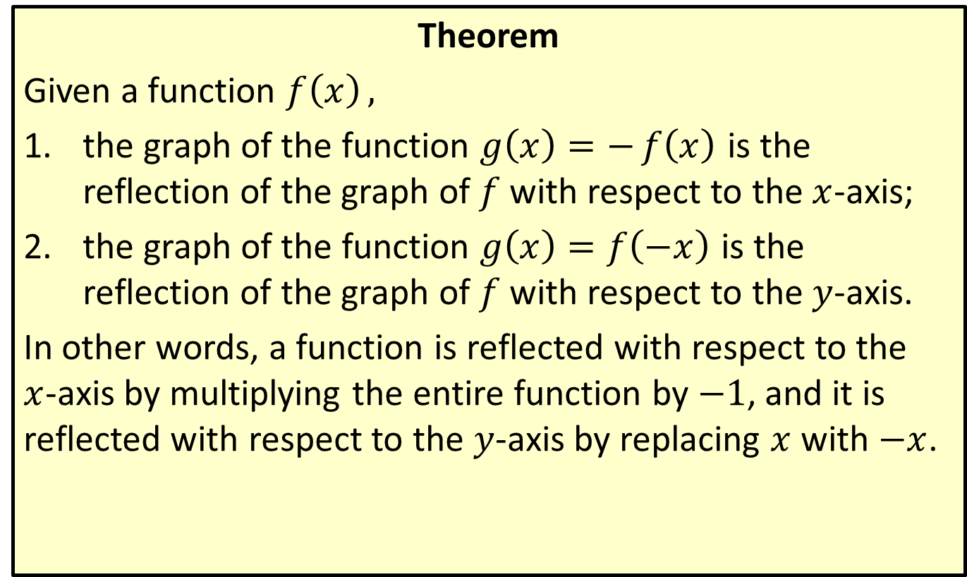
Reflecting with Respect to the Axes
Theorem
Given a function $f\left(x\right),$
​the graph of the function $g\left(x\right)=−f\left(x\right)$ is the reflection of the graph of $f$ with respect to the $x$-axis;
​the graph of the function $g\left(x\right)=f\left(−x\right)$ is the reflection of the graph of $f$ with respect to the $y$-axis.
In other words, a function is reflected with respect to the $x$-axis by multiplying the entire function by $−1$, and it is reflected with respect to the $y$-axis by replacing $x$ with $−x$.

Slide 23

Example 4: Reflecting with Respect to the Axes
Sketch the graphs of the following functions.
​$f\left(x\right)=−x^{2}$
​$g\left(x\right)=\sqrt{−x}$

Slide 24
Note:
We state that a function is reflected with respect to a particular axis. Visually, this means the function is reflected over (across) that axis.

Slide 25
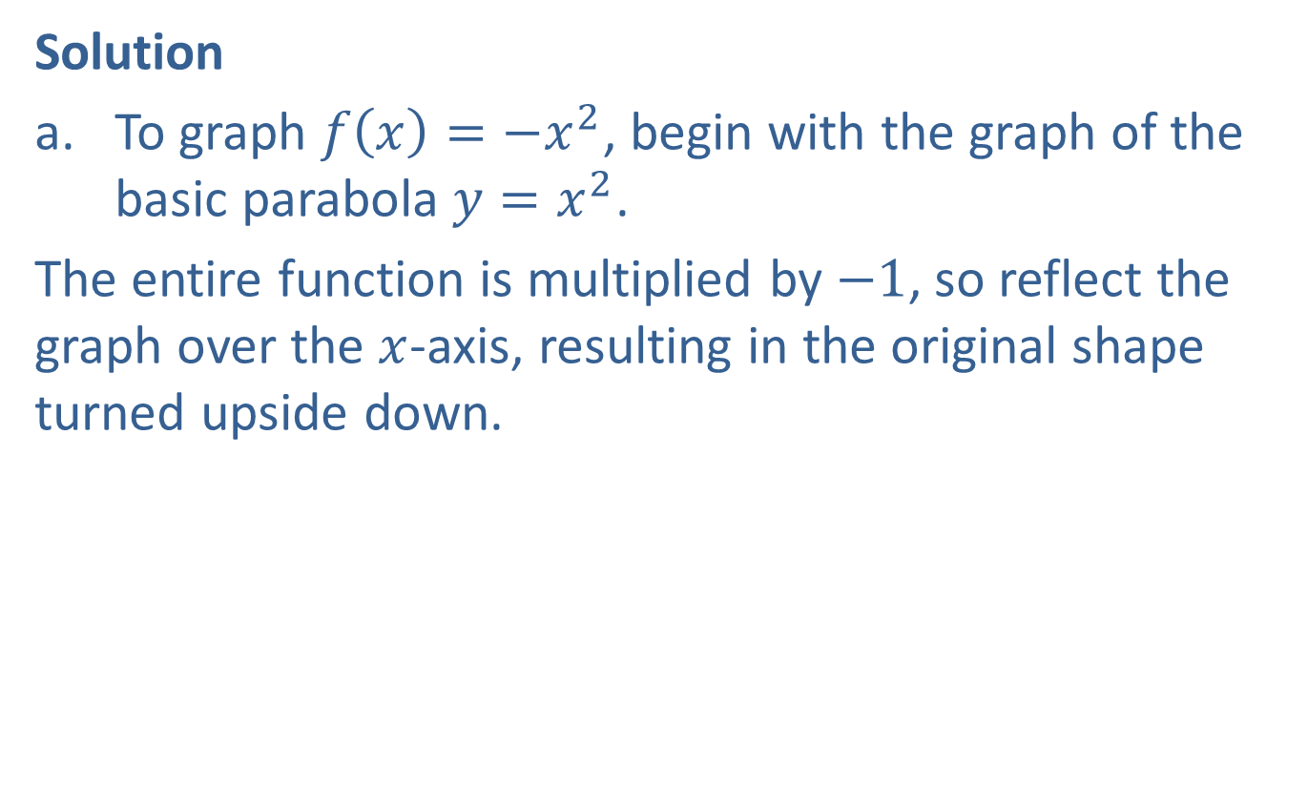
Example 4: Reflecting With Respect to the Axes (cont.)
Solution
​To graph $f\left(x\right)=−x^{2}$, begin with the graph of the basic parabola $y=x^{2}$.
​The entire function is multiplied by $−1$, so reflect the graph over the $x$-axis, resulting in the original shape turned upside down.
​

Slide 26
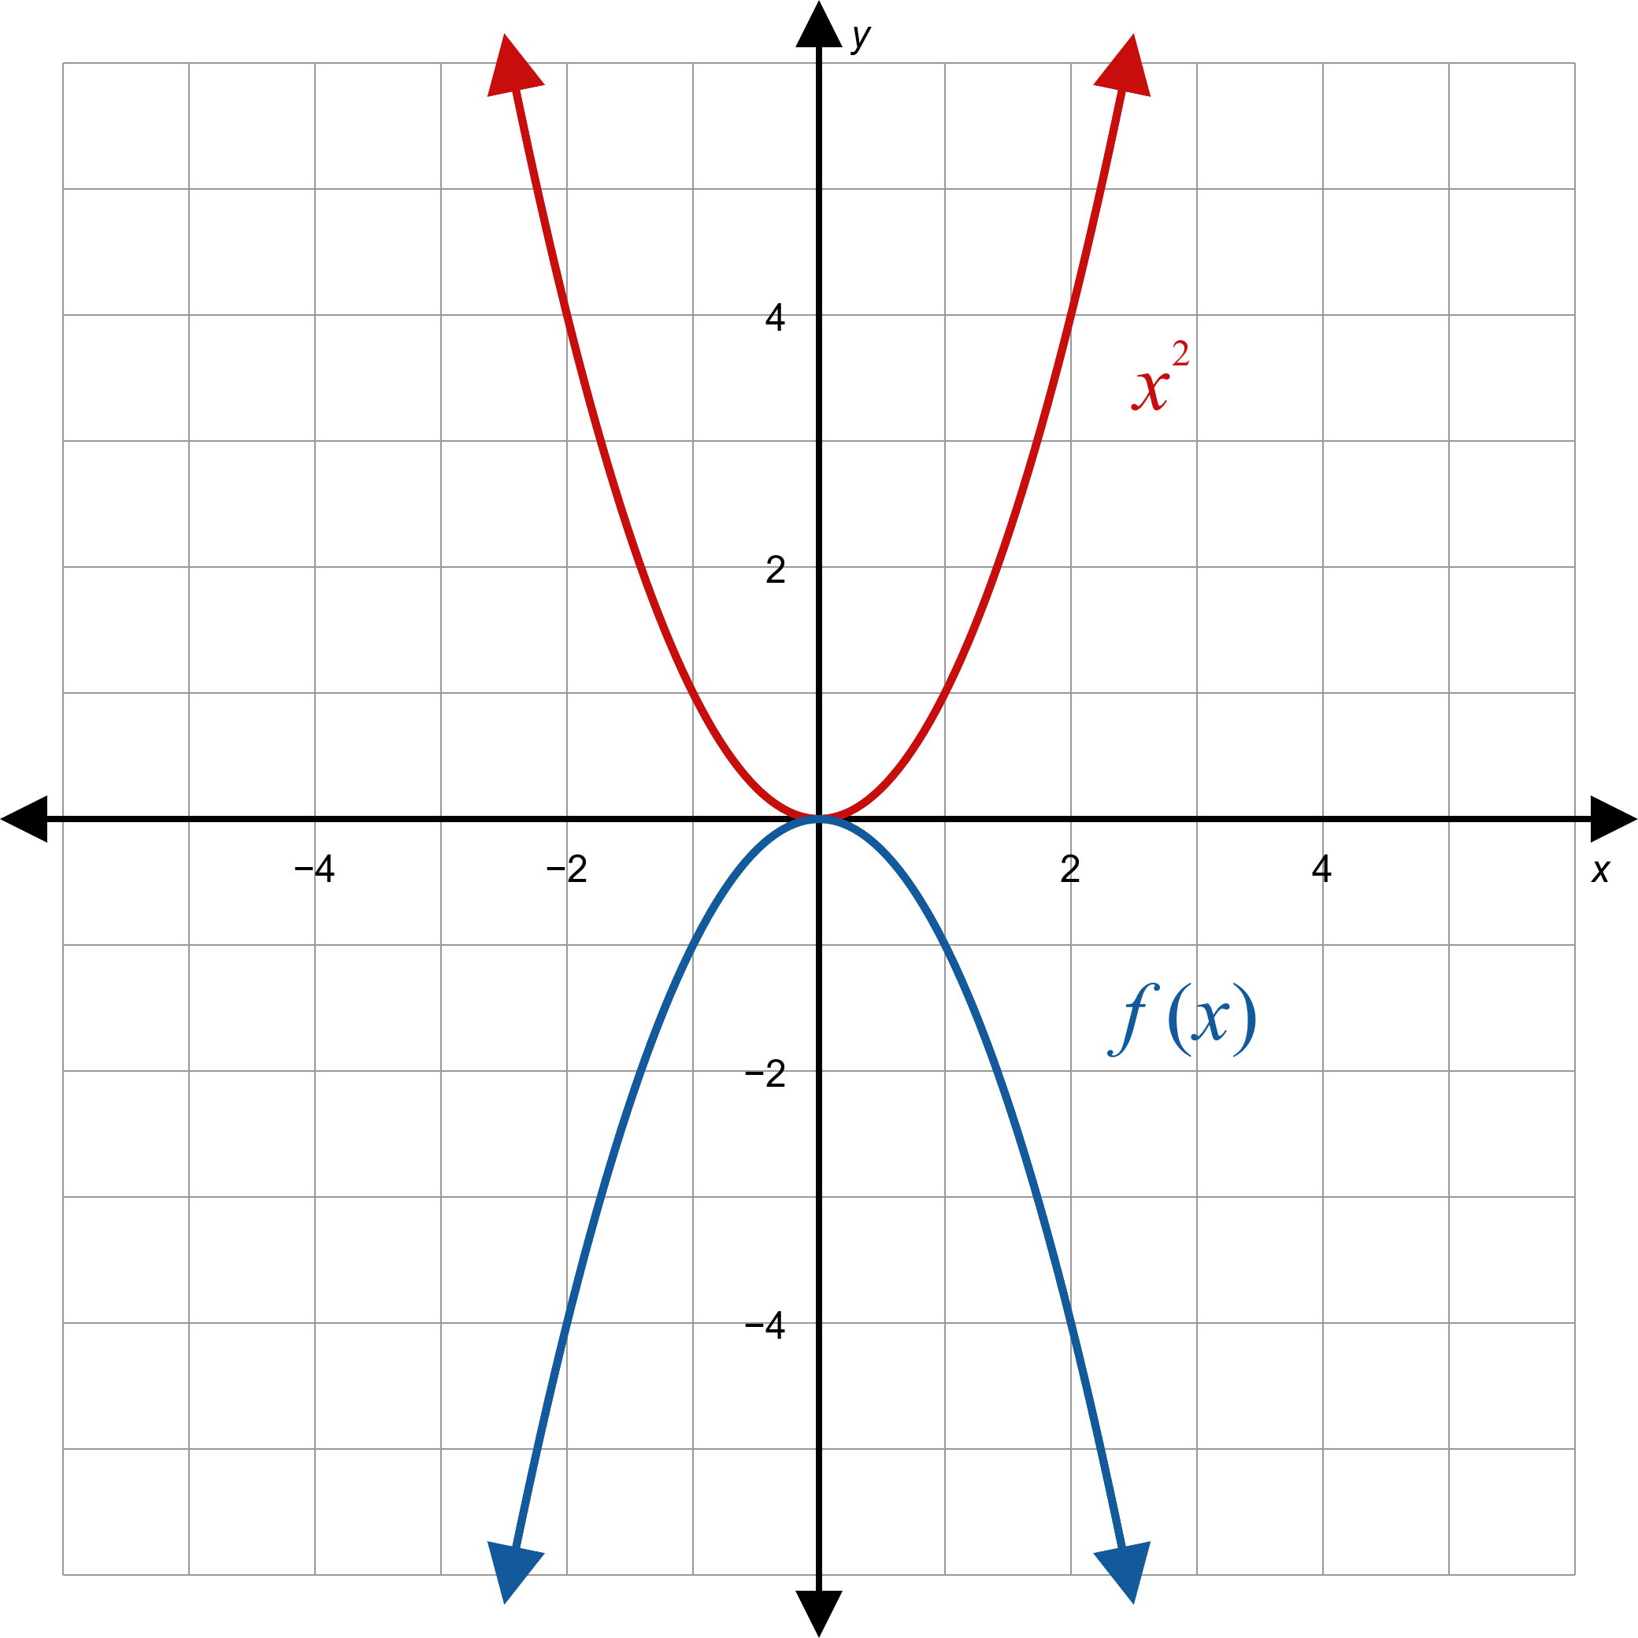

Example 4: Reflecting With Respect to the Axes (cont.)

Slide 27

Example 4: Reflecting With Respect to the Axes (cont.)
Note that the domain is still the entire real line, but the range of $f$ is the interval $(−∞,0]$.
​

Slide 28

Example 4: Reflecting With Respect to the Axes (cont.)
​To graph $g\left(x\right)=\sqrt{−x}$, begin by graphing $y=\sqrt{x}$, the basic square root function.
​In $g⁡\left(x\right)$, $x$ has been replaced with $−x$, so reflect the graph with respect to the $y$-axis.
​

Slide 29
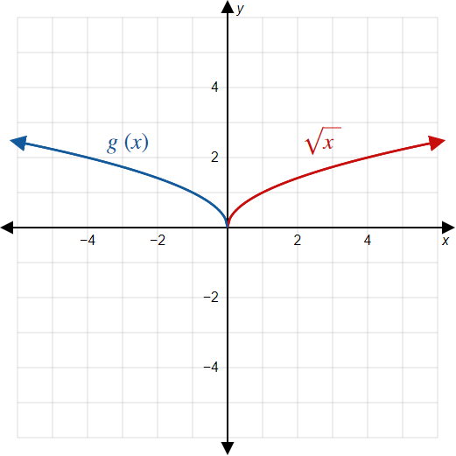

Example 4: Reflecting With Respect to the Axes (cont.)

Slide 30

Example 4: Reflecting With Respect to the Axes (cont.)
Note that this changes the domain but not the range. The domain of $g$ is the interval $(−∞,0]$ and the range is $(0,∞]$.
​

Slide 31
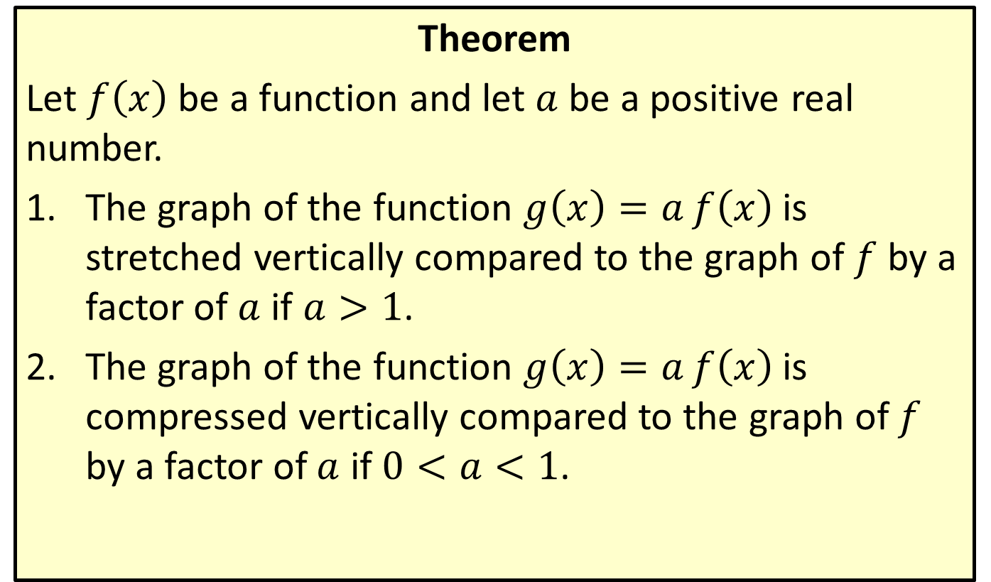
Vertical Stretching and Compressing
Theorem
Let $f⁡\left(x\right)$ be a function and let $a$ be a positive real number.
​The graph of the function $g\left(x\right)=af\left(x\right)$ is stretched vertically compared to the graph of $f$ by a factor of $a$ if $a>1$.
​The graph of the function $g\left(x\right)=af\left(x\right)$ is compressed vertically compared to the graph of $f$ by a factor of $a$ if $0<a<1$.

Slide 32

Example 5: Vertical Stretching and Compressing
Sketch the graphs of the following functions.
​$f\left(x\right)=\frac{\sqrt{x}}{10}$
​$g\left(x\right)=5\left|x\right|$

Slide 33
Note:
When graphing stretched or compressed functions, it may help to plot a few points of the new function.

Slide 34
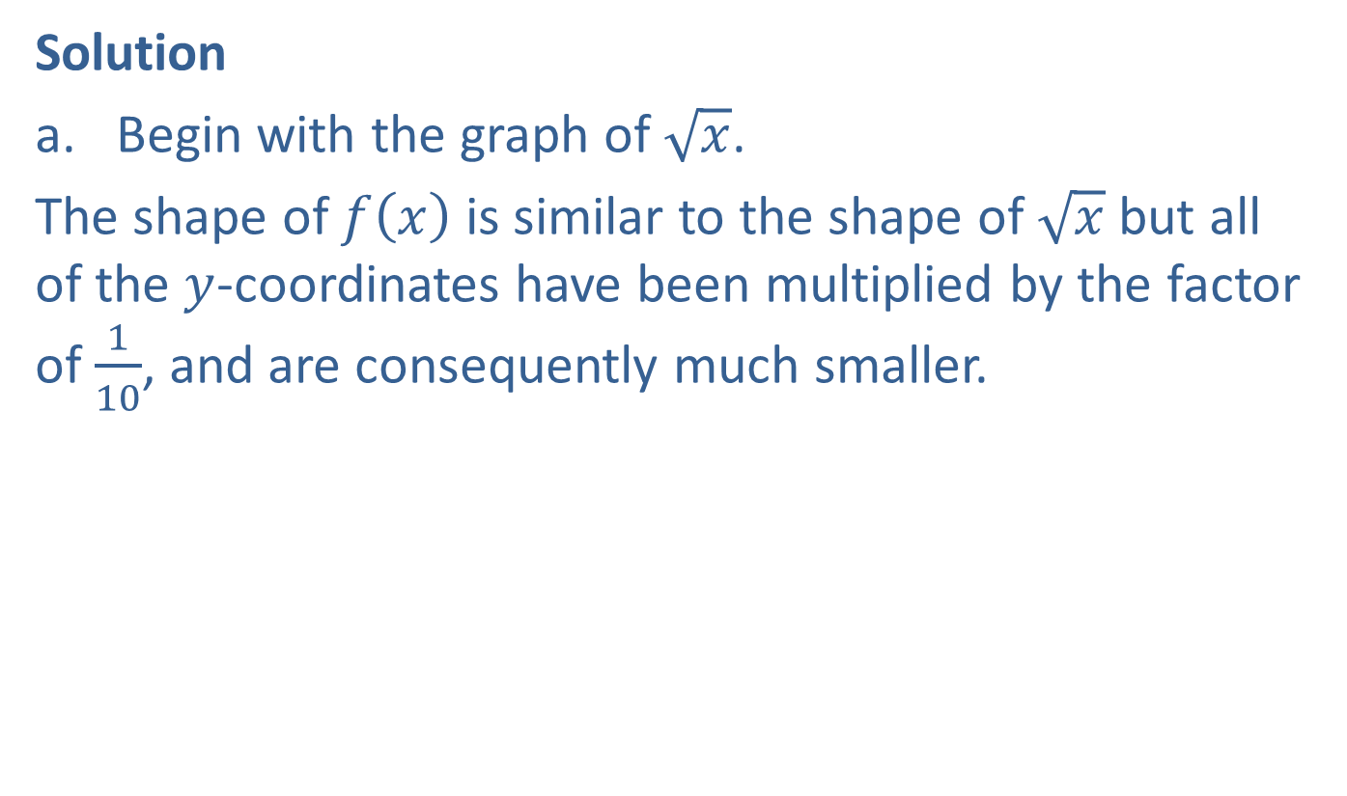
Example 5: Vertical Stretching and Compressing (cont.)
Solution
​Begin with the graph of $\sqrt{x}$.
​The shape of $f⁡\left(x\right)$ is similar to the shape of $\sqrt{x}$ but all of the $y$-coordinates have been multiplied by the factor of $\frac{1}{10}$, and are consequently much smaller.
​

Slide 35
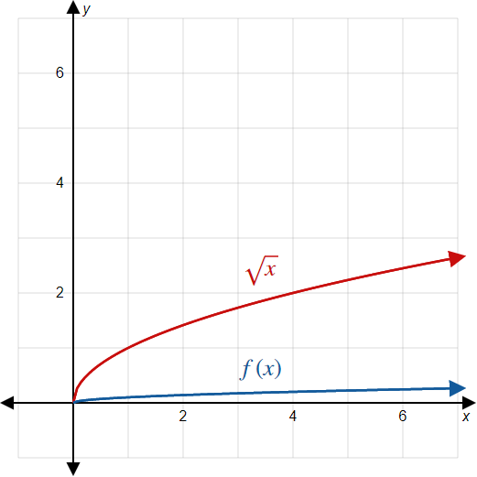

Example 5: Vertical Stretching and Compressing (cont.)

Slide 36

Example 5: Vertical Stretching and Compressing (cont.)
​Begin with the graph of the absolute value function.
​In contrast to the last example, the graph of $g\left(x\right)=5\left|x\right|$ is stretched compared to the standard absolute value function.
​Every second coordinate is multiplied by a factor of 5.
​

Slide 37
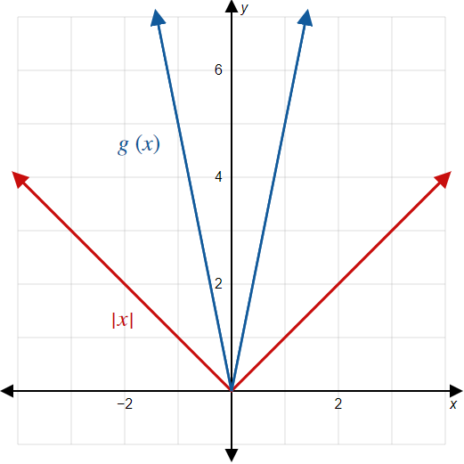

Example 5: Vertical Stretching and Compressing (cont.)

Slide 38
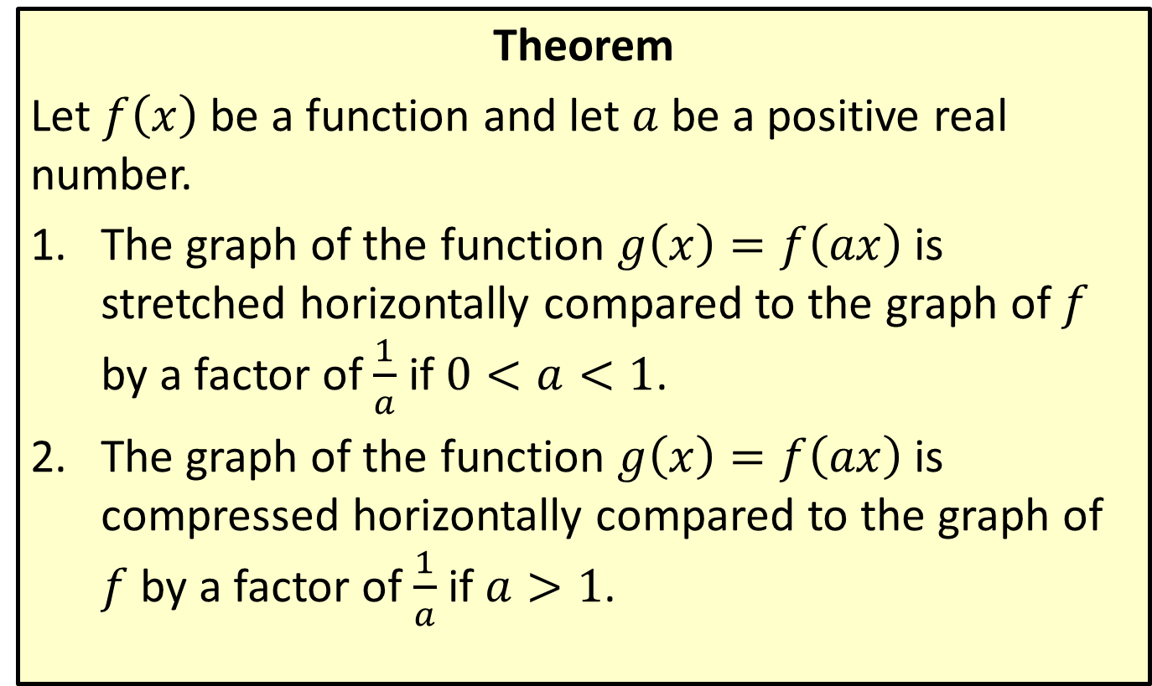
Horizontal Stretching and Compressing
Theorem
Let $f⁡\left(x\right)$ be a function and let $a$ be a positive real number.
​The graph of the function $g\left(x\right)=f\left(ax\right)$ is stretched horizontally compared to the graph of $f$ by a factor of $\frac{1}{a}$ if $0<a<1$.
​The graph of the function $g\left(x\right)=f\left(ax\right)$ is compressed horizontally compared to the graph of $f$ by a factor of $\frac{1}{a}$ if $a>1$.

Slide 39

Example 6: Horizontal Stretching and Compressing
Sketch the graph of the function ${f\left(x\right)=\left(\frac{x}{3}\right)}^{3}$.

Slide 40
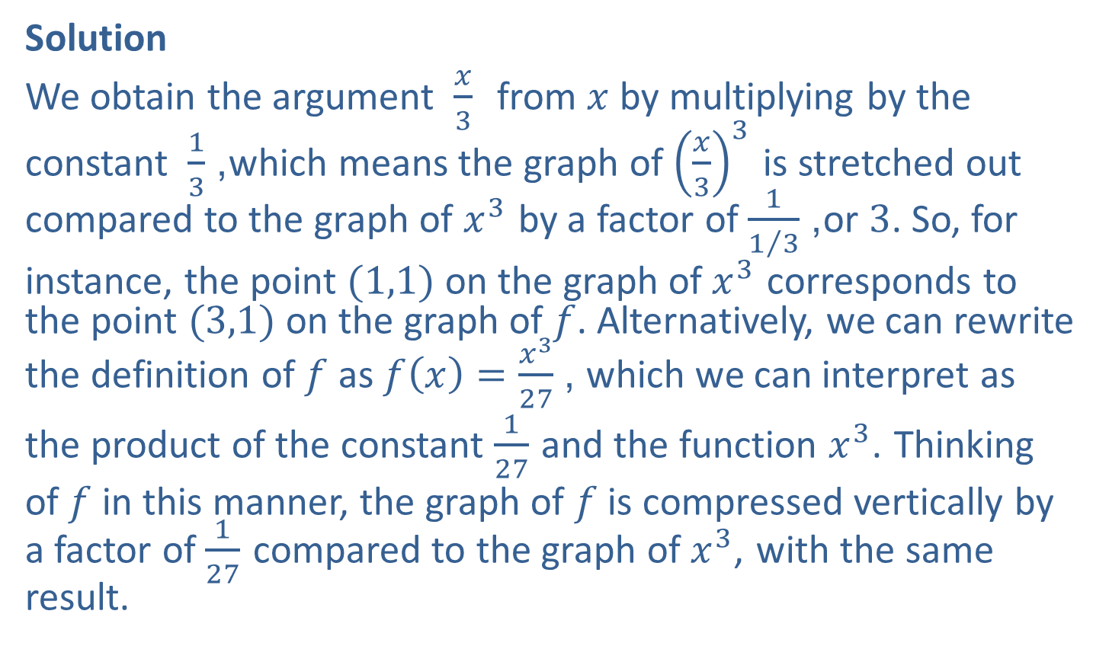
Example 6: Horizontal Stretching and Compressing (cont.)
Solution
We obtain the argument $\frac{x}{3}$ from $x$ by multiplying by the constant $\frac{1}{3}$, which means the graph of ${\left(\frac{x}{3}\right)}^{3}$ is stretched out compared to the graph of $x^{3}$ by a factor of $\frac{1}{1/3}$, or 3. So, for
instance, the point $(1,1)$ on the graph of $x^{3}$ corresponds to the point $(3,1)$ on the graph of $f$. Alternatively, we can rewrite the definition of $f$ as $f\left(x\right)=\frac{x^{3}}{27}$, which we can interpret as
the product of the constant $\frac{1}{27}$ and the function $x^{3}$. Thinking
of $f$ in this manner, the graph of $f$ is compressed vertically by a factor of $\frac{1}{27}$ compared to the graph of $x^{3}$, with the same result.

Slide 41
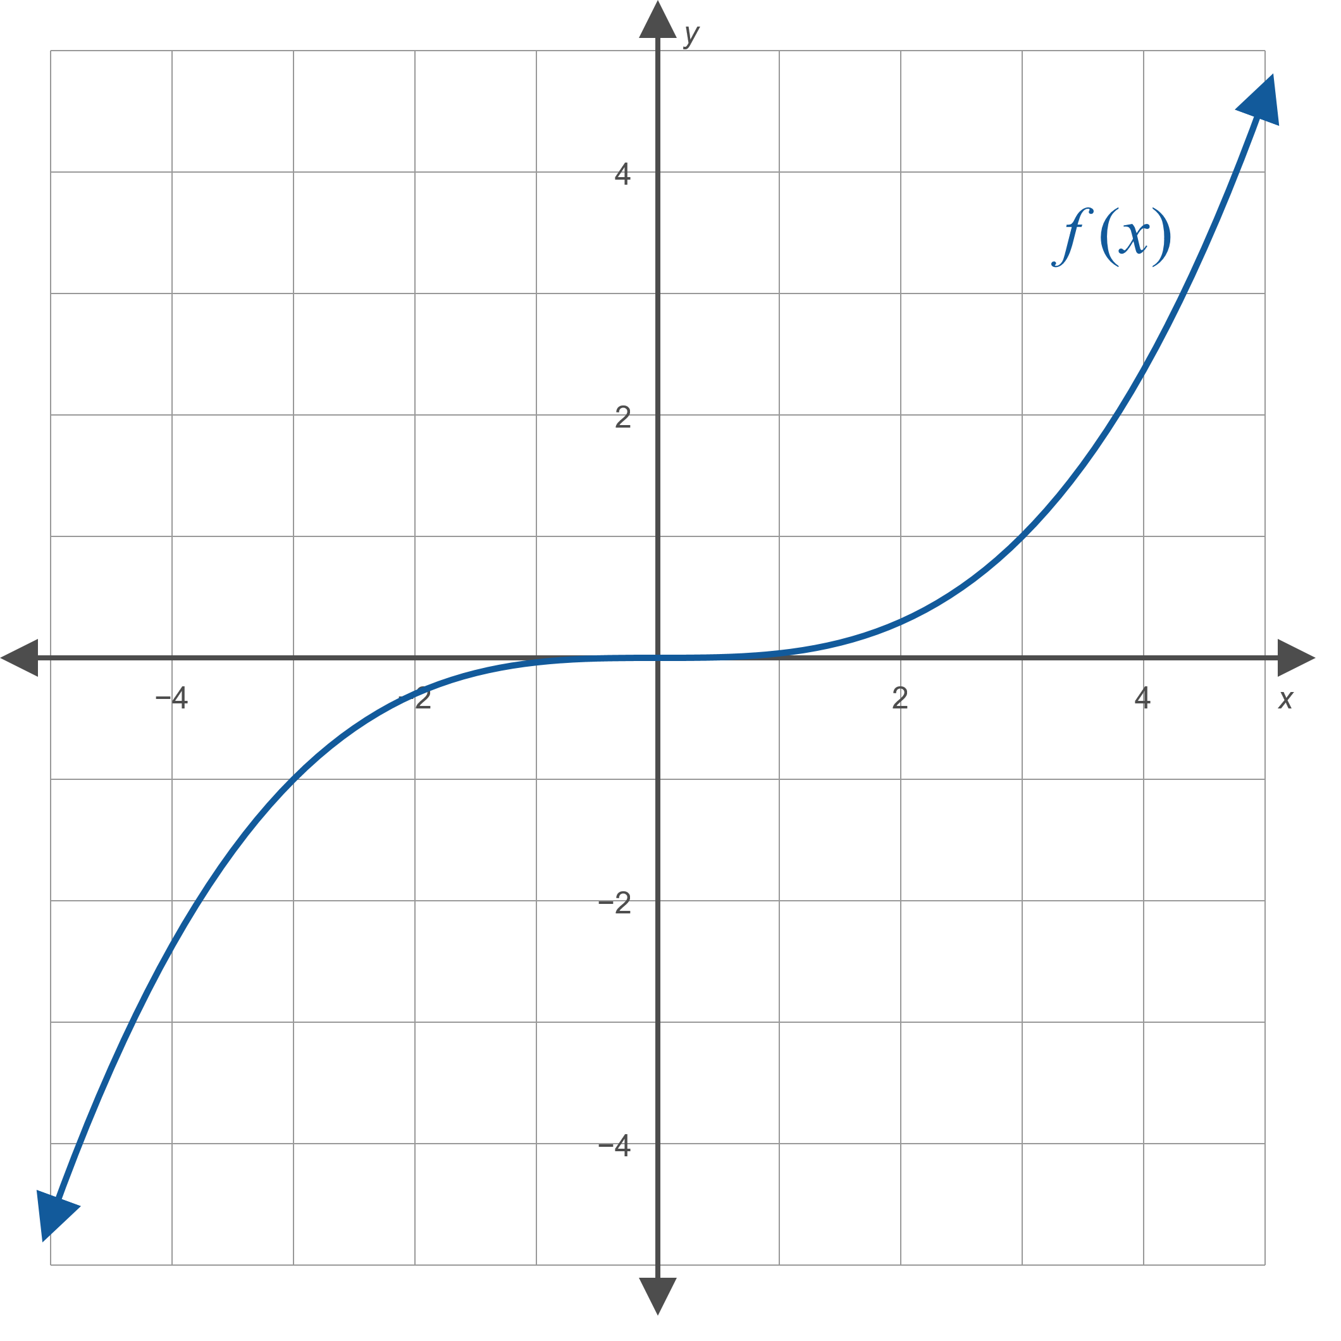

Example 6: Horizontal Stretching and Compressing (cont.)

Slide 42
Order of Transformations
Procedure
If a function g has been constructed from a simpler function f through a number of transformations, g can be understood by looking for transformations in the following order:
​Horizontal shifts
​Horizontal and vertical stretching and compressing
​Reflections
​Vertical shifts

Slide 43

Example 7: Order of Transformations
Describe the transformations needed to construct the function $g\left(x\right)=−2\sqrt{2x+1}+3$ from the basic square root function using the order of transformations.

Slide 44
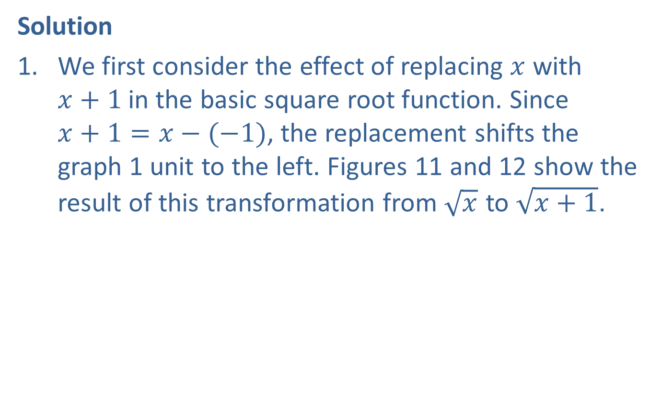
Example 7: Order of Transformations (cont.)
Solution
​We first consider the effect of replacing $x$ with $x+1$in the basic square root function. Since $x+1=x−(−1)$, the replacement shifts the graph 1 unit to the left. Figures 11 and 12 show the result of this transformation from $\sqrt{x}$ to $\sqrt{x+1}$.

Slide 45
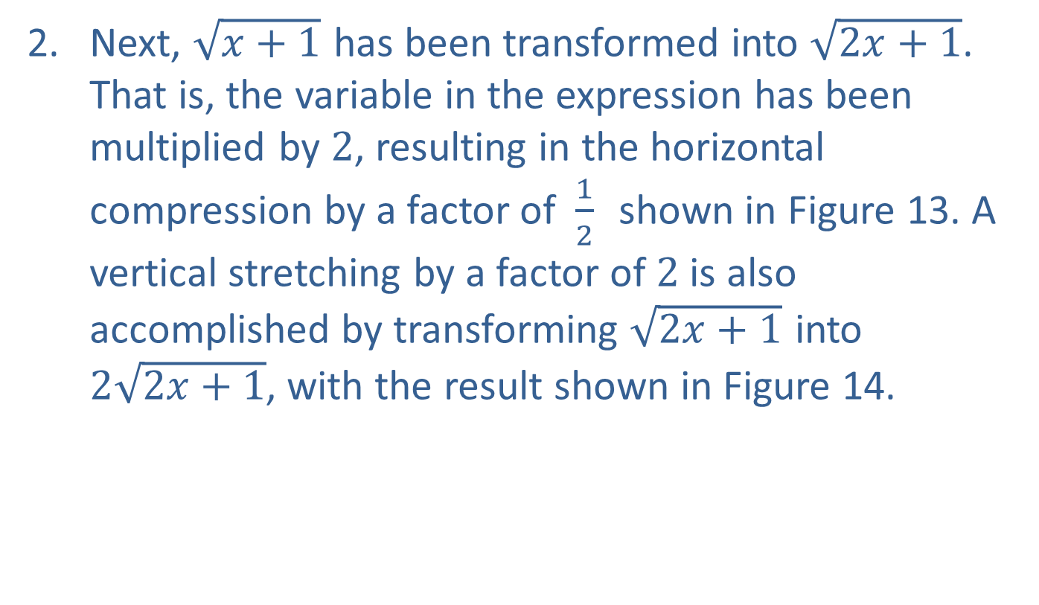
Example 7: Order of Transformations (cont.)
​Next, $\sqrt{x+1}$ has been transformed into $\sqrt{2x+1}$. That is, the variable in the expression has been multiplied by 2, resulting in the horizontal compression by a factor of $\frac{1}{2}$ shown in Figure 13. A vertical stretching by a factor of 2 is also accomplished by transforming $\sqrt{2x+1}$ into $2\sqrt{2x+1}$, with the result shown in Figure 14.

Slide 46
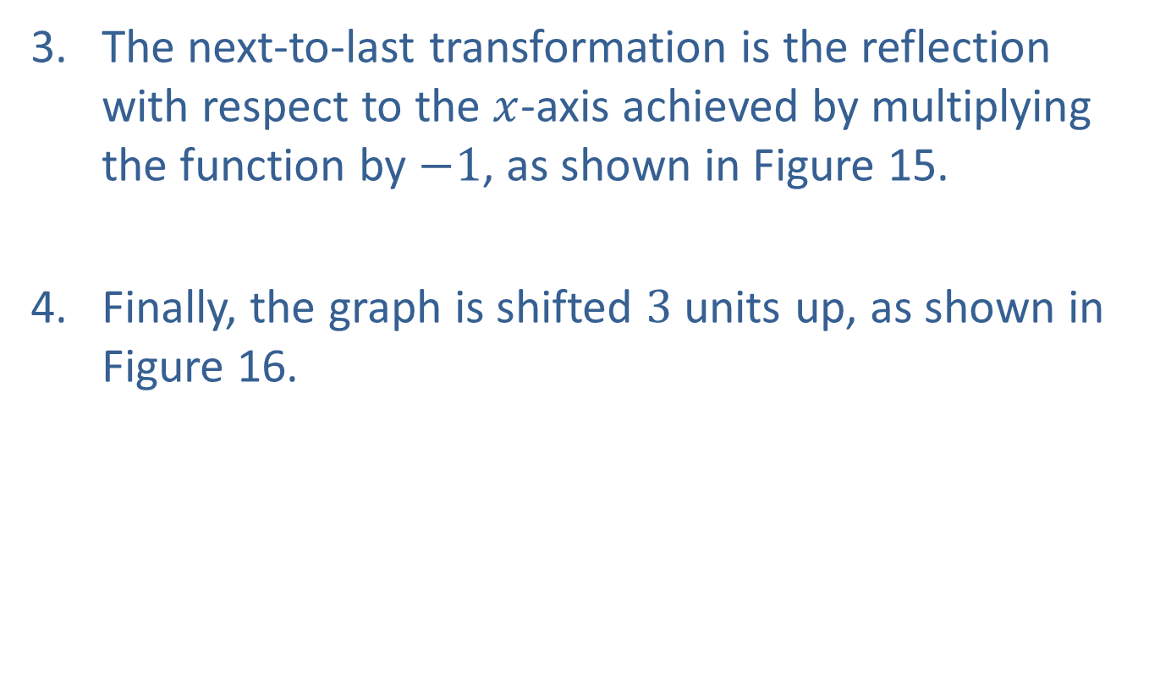
Example 7: Order of Transformations (cont.)
​The next-to-last transformation is the reflection with respect to the $x$-axis achieved by multiplying the function by $−1$, as shown in Figure 15.
​Finally, the graph is shifted 3 units up, as shown in Figure 16.

Slide 47
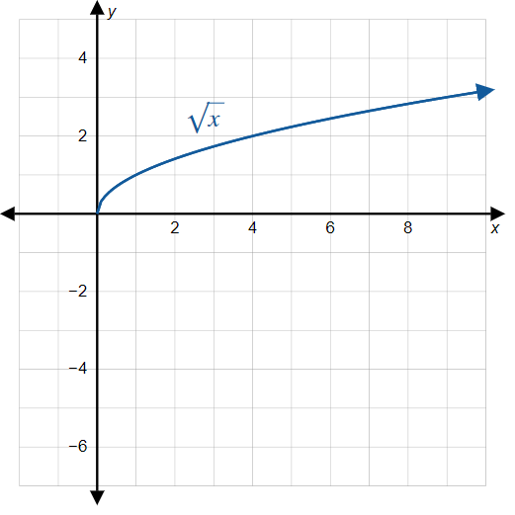

Example 7: Order of Transformations (cont.)

Slide 48
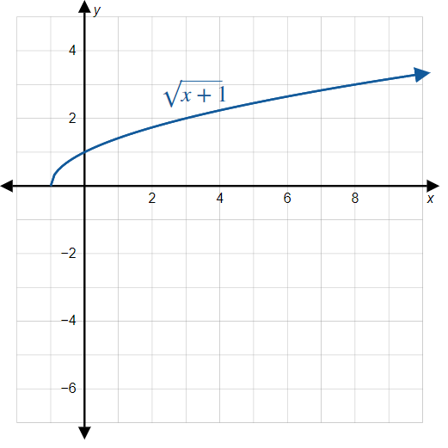

Example 7: Order of Transformations (cont.)

Slide 49
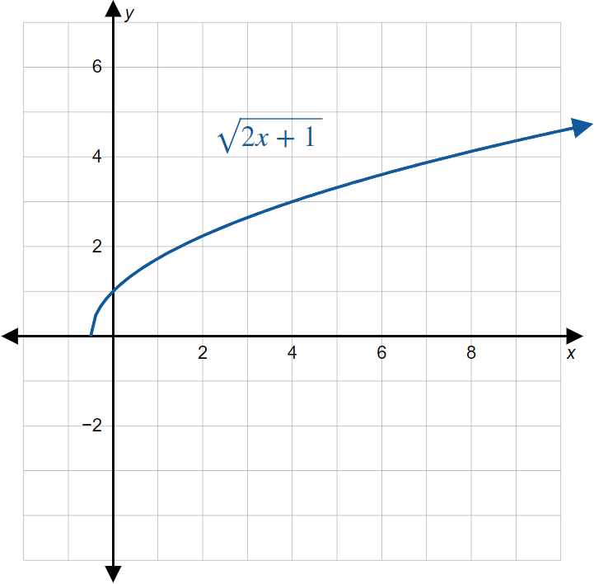

Example 7: Order of Transformations (cont.)

Slide 50
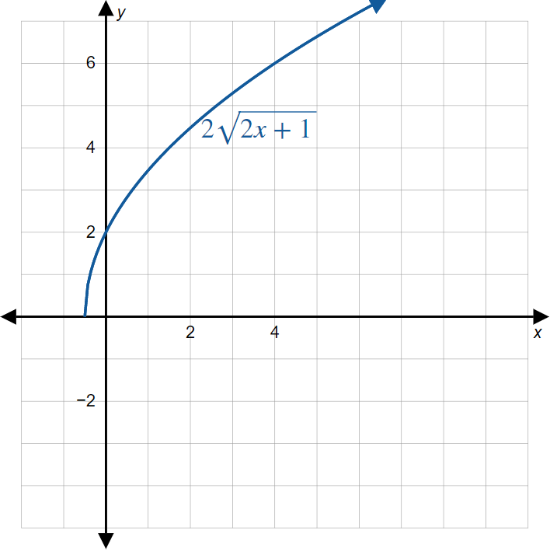

Example 7: Order of Transformations (cont.)

Slide 51
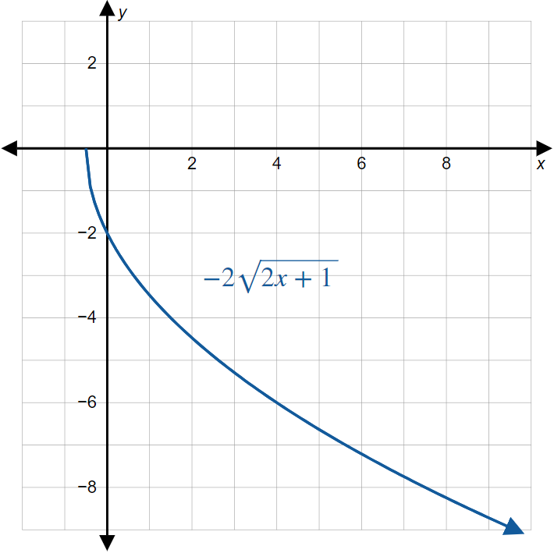

Example 7: Order of Transformations (cont.)

Slide 52
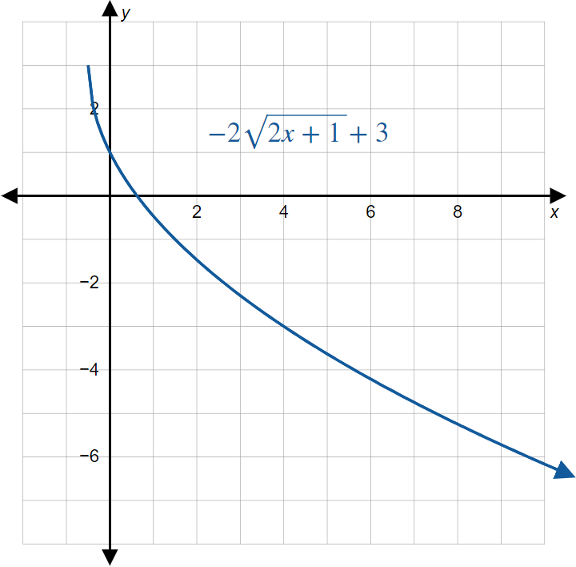

Example 7: Order of Transformations (cont.)

Slide 53

Example 8: Order of Transformations
Sketch the graph of the function $f\left(x\right)=\frac{1}{2−x}$.

Slide 54
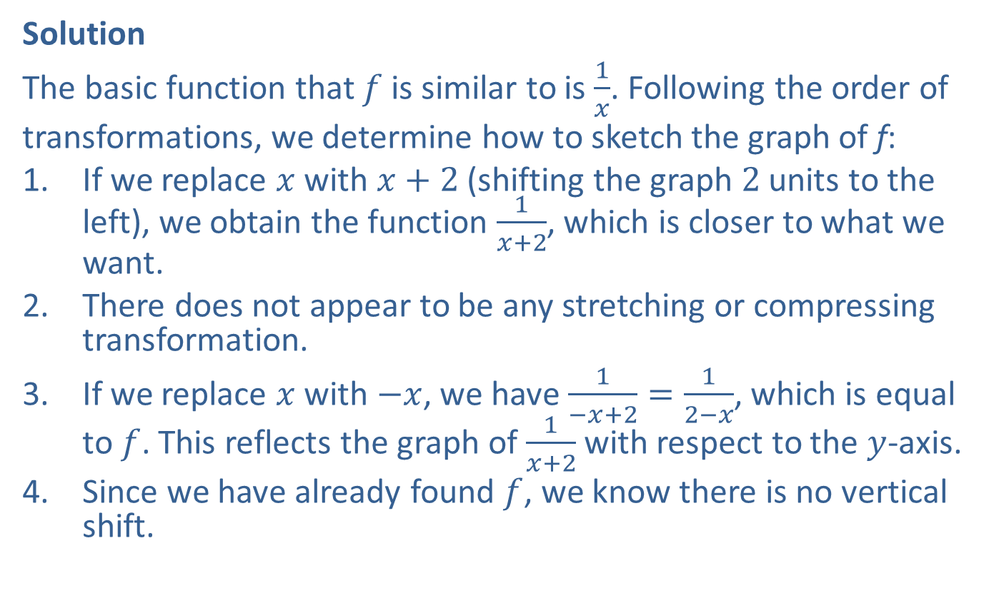
Example 8: Order of Transformations (cont.)
Solution
The basic function that $f$ is similar to is $\frac{1}{x}$. Following the order of
transformations, we determine how to sketch the graph of f:
​If we replace $x$ with $x+2$ (shifting the graph 2 units to the left), we obtain the function $\frac{1}{x+2}$, which is closer to what we want.
​There does not appear to be any stretching or compressing transformation.
​If we replace $x$ with $−x$, we have $\frac{1}{−x+2}=\frac{1}{2−x}$, which is equal to $f$. This reflects the graph of $\frac{1}{x+2}$ with respect to the $y$-axis.
​Since we have already found $f$, we know there is no vertical shift.

Slide 55

Example 8: Order of Transformations (cont.)
The entire sequence of transformations is shown next, ending with the graph of $f$.

Slide 56
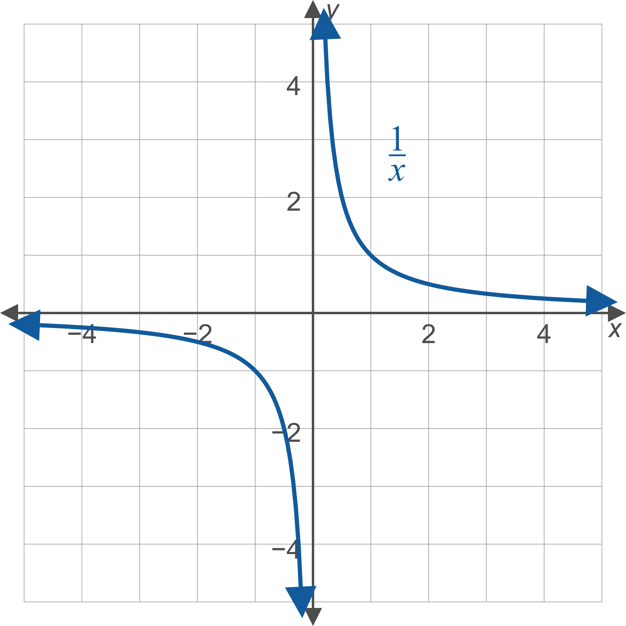
Example 8: Order of Transformations (cont.)

Slide 57

Example 8: Order of Transformations (cont.)

Slide 58

Example 8: Order of Transformations (cont.)

Slide 59

Example 8: Order of Transformations (cont.)
Note: An alternate approach to graphing $f\left(x\right)=\frac{1}{2−x}$ is to rewrite the function in the form $f\left(x\right)=−\frac{1}{x−2}$. In this form, the graph of $f$ is the graph of $\frac{1}{x}$ shifted two units to the right, and then reflected with respect to the $x$-axis. The result is the same, as you should verify. Rewriting an equation in a different, equivalent form never changes its graph.

