Slide 1
Section 5.2
Properties of Functions

Slide 2
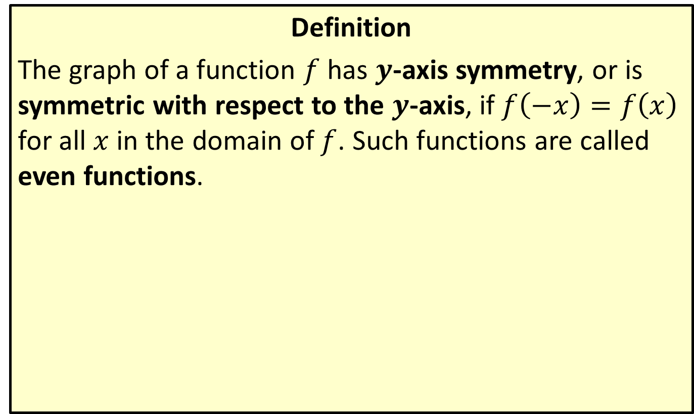

$y$-Axis Symmetry
Definition
The graph of a function $f$ has $y$-axis symmetry, or is symmetric with respect to the $y$-axis, if $f\left(−x\right)=f\left(x\right)$ for all $x$ in the domain of $f$. Such functions are called even functions.

Slide 3
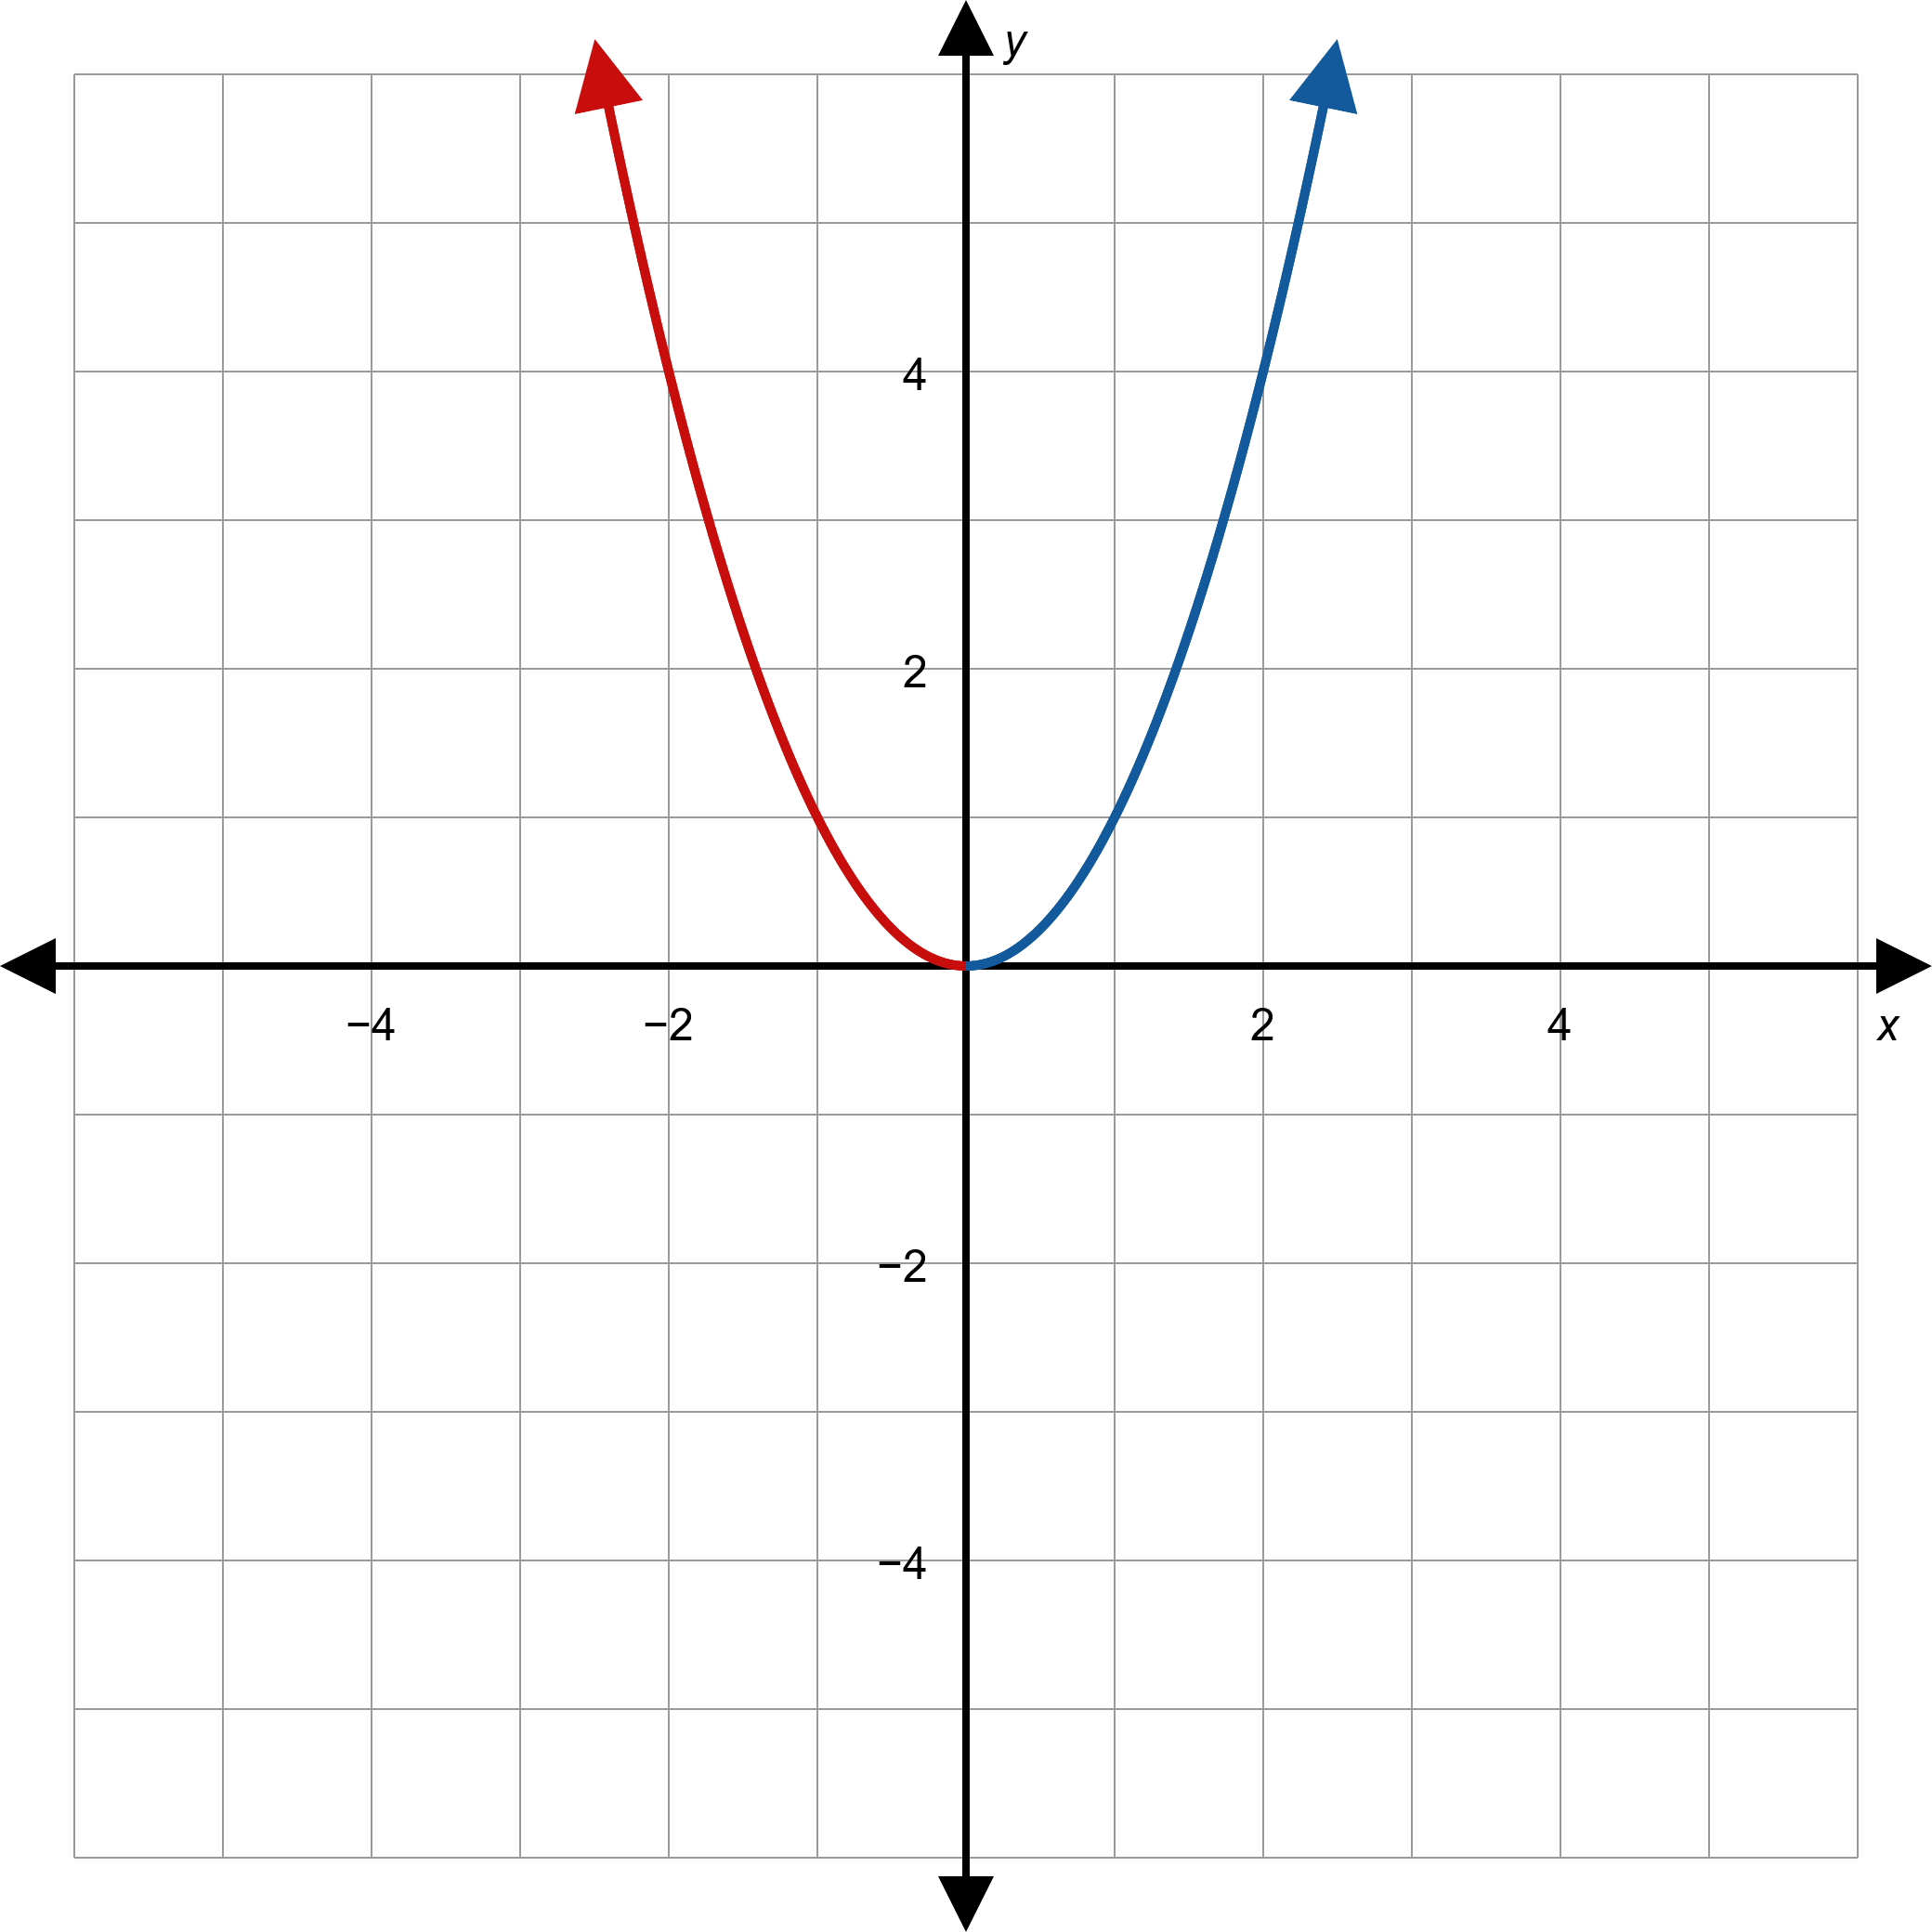
Figure 1: A Function with y-Axis Symmetry

Slide 4
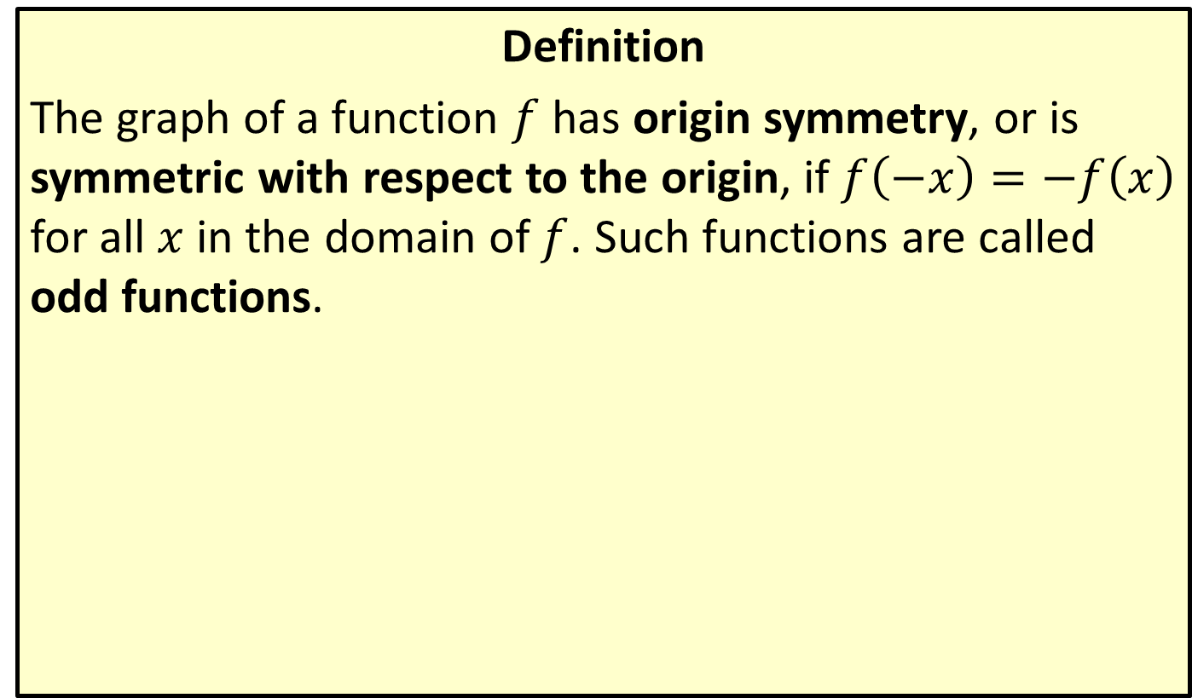
Origin Symmetry
Definition
The graph of a function $f$ has origin symmetry, or is symmetric with respect to the origin, if $f\left(−x\right)=−f⁡\left(x\right)$ for all $x$ in the domain of $f$. Such functions are called odd functions.

Slide 5
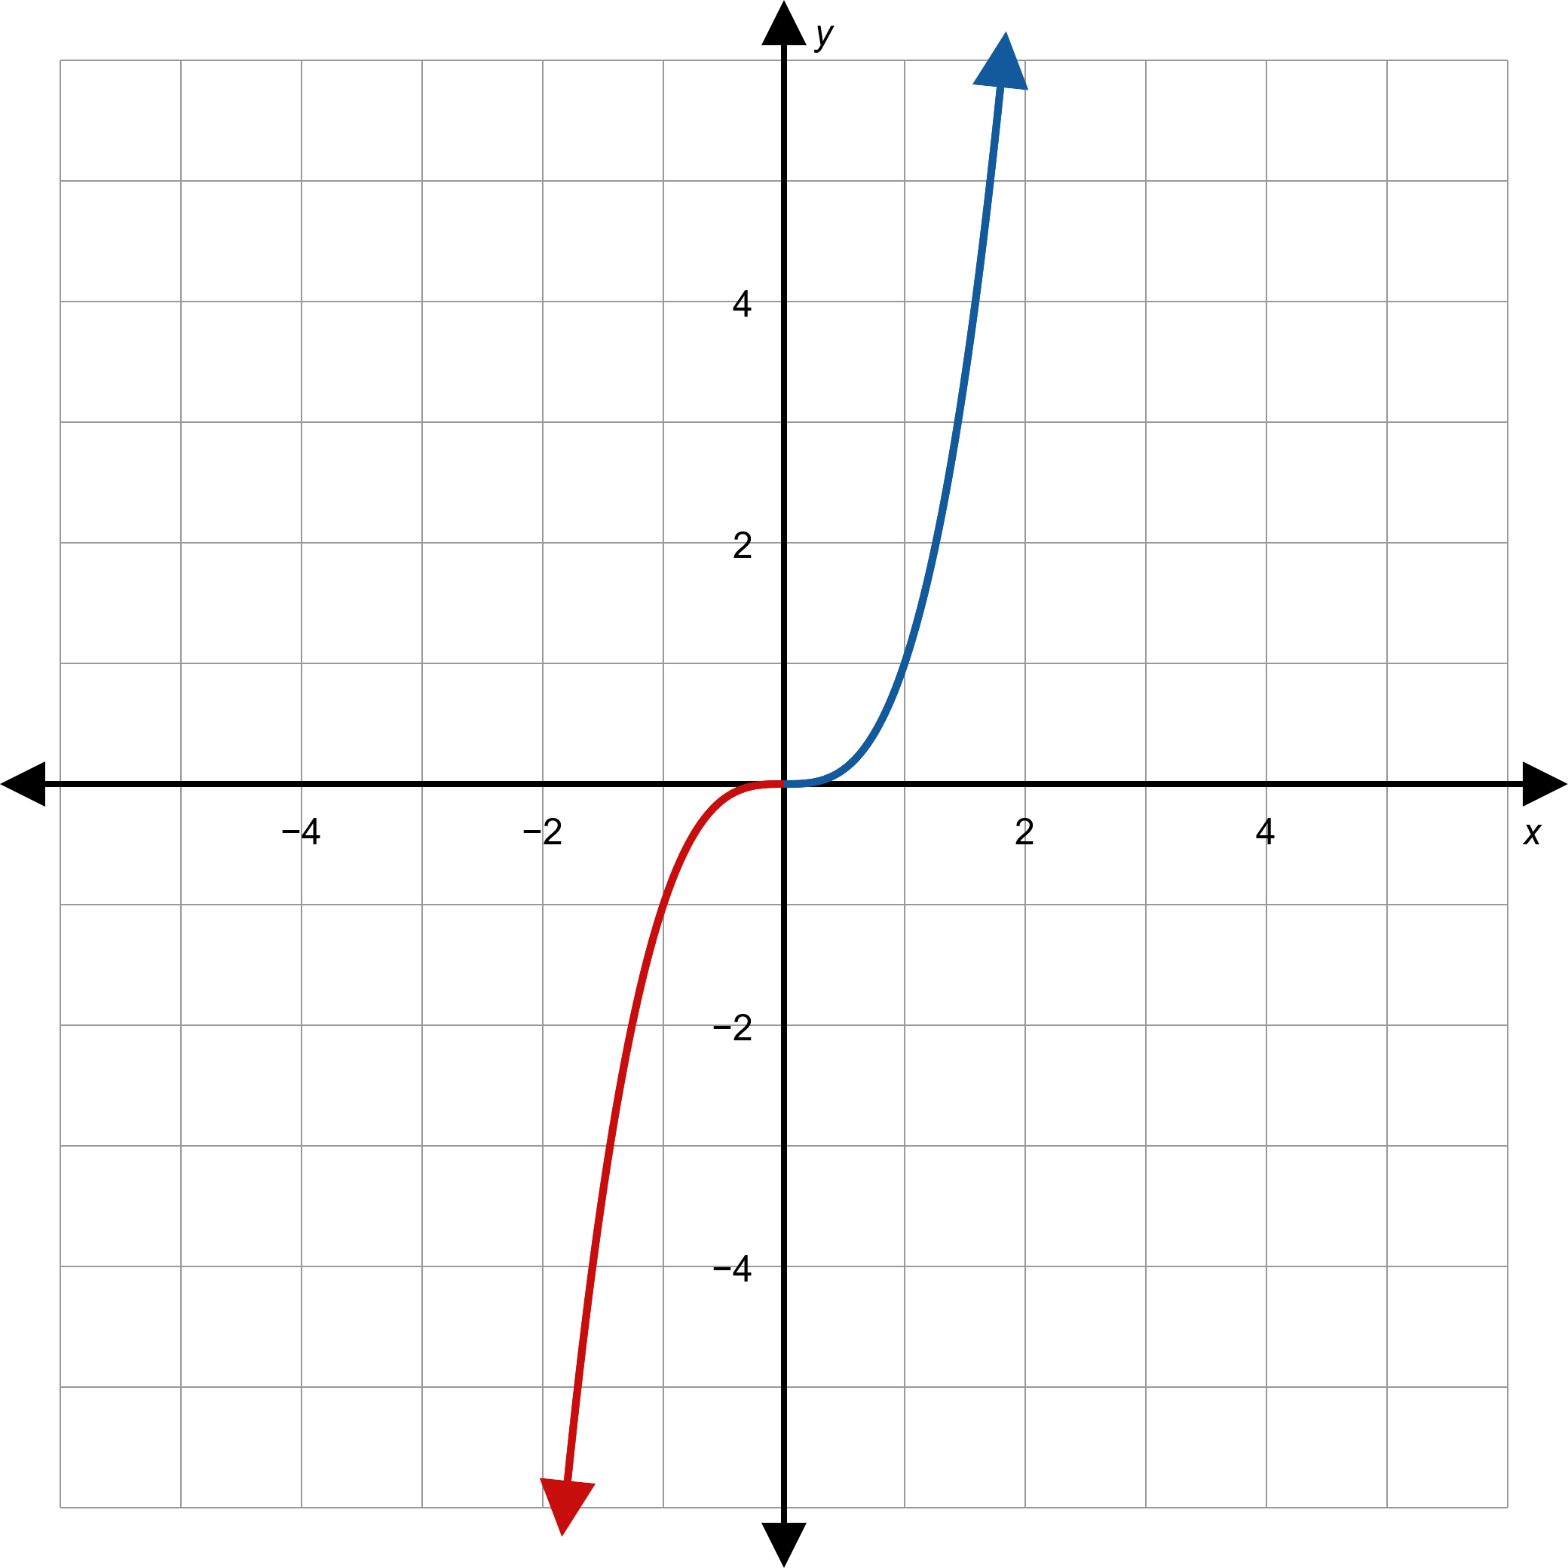
Figure 2: A Function with Origin Symmetry

Slide 6
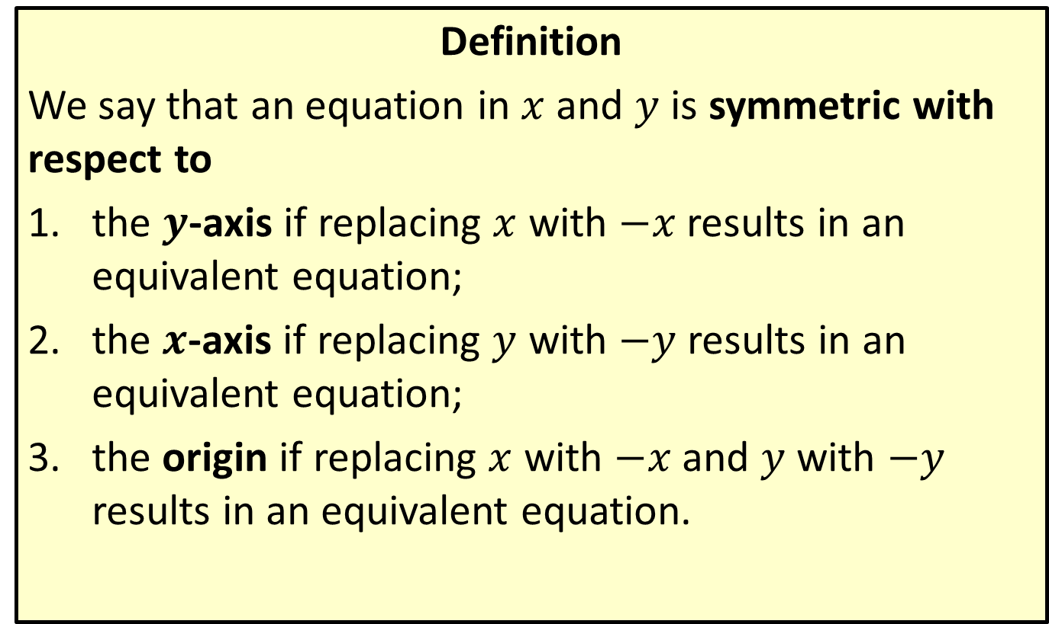
Symmetry of Equations
Definition
We say that an equation in $x$ and $y$ is symmetric with respect to
​the $y$-axis if replacing $x$ with $−x$ results in an equivalent equation;
​the $x$-axis if replacing $y$ with $−y$ results in an equivalent equation;
​the origin if replacing $x$ with $−x$ and $y$ with $−y$ results in an equivalent equation.

Slide 7

Example 1: Using Symmetry to Graph Relations
Sketch the graphs of the following relations, making use of symmetry.
​$f\left(x\right)=\frac{1}{x^{2}}$
​$g\left(x\right)=x^{3}−x$
​$x=y^{2}$

Slide 8
Note:
If you don't know where to begin when sketching a graph, plotting points often helps you understand the basic shape.

Slide 9
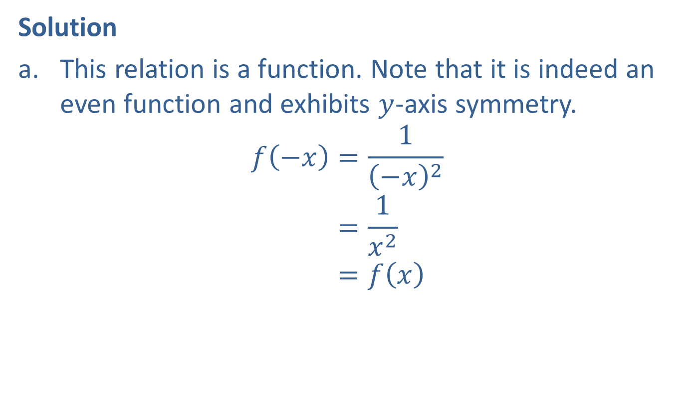
Example 1: Using Symmetry to Graph Relations (cont.)
Solution
​This relation is a function. Note that it is indeed an even function and exhibits $y$-axis symmetry.
𝑓−𝑥=1−𝑥2𝑓⁡−𝑥=1𝑥2𝑓⁡−𝑥=𝑓𝑥
​

Slide 10
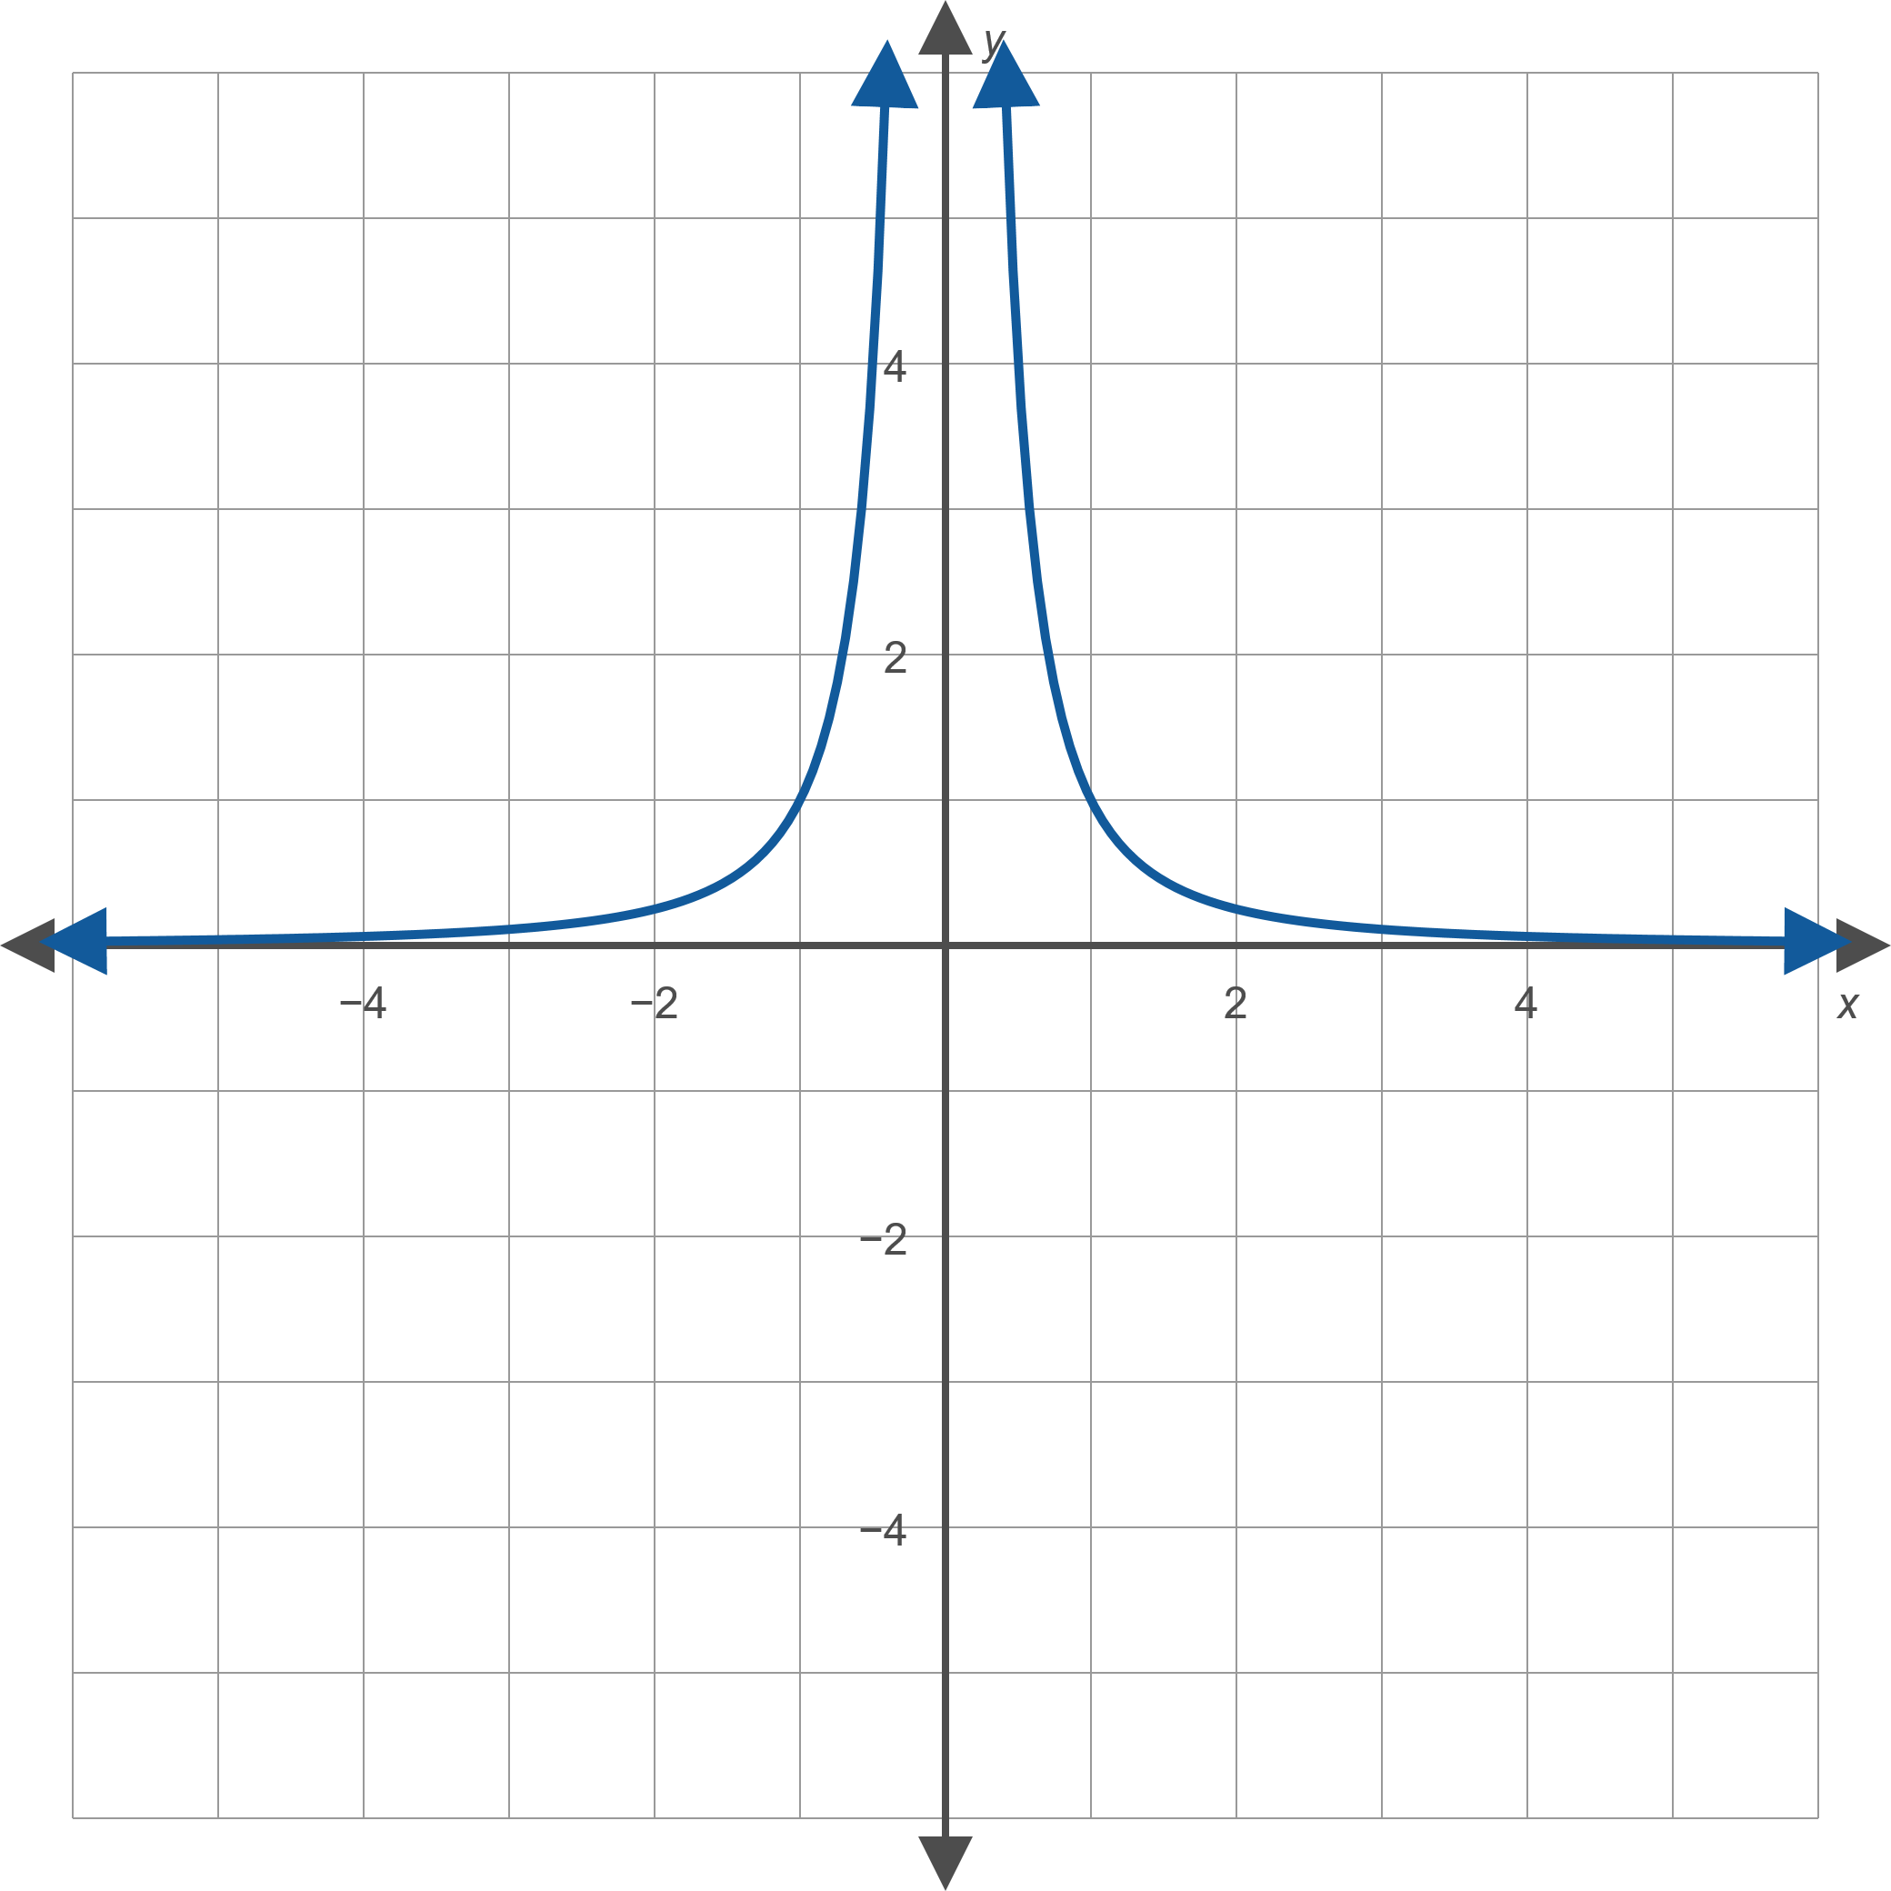
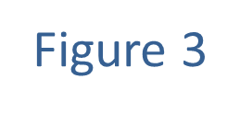
Example 1: Using Symmetry to Graph Relations (cont.)

Slide 11
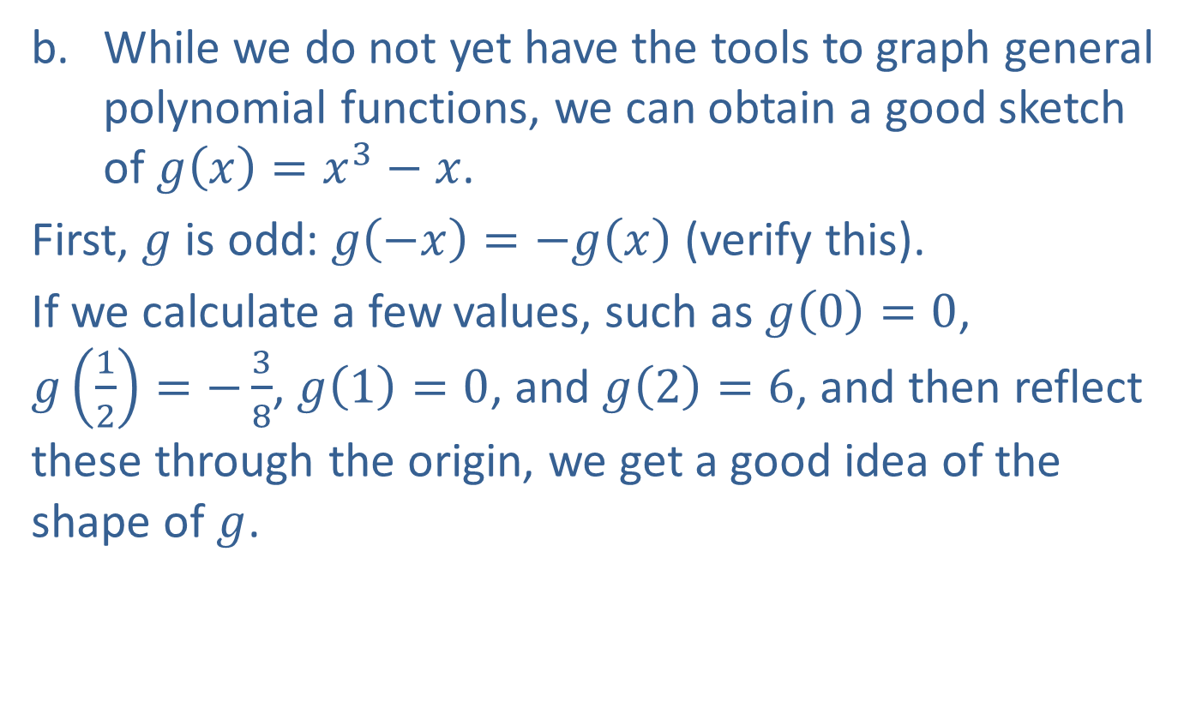
Example 1: Using Symmetry to Graph Relations (cont.)
​While we do not yet have the tools to graph general polynomial functions, we can obtain a good sketch of $g\left(x\right)=x^{3}−x$.
​First, $g$ is odd: $g\left(−x\right)=−g⁡\left(x\right)$ (verify this).
​If we calculate a few values, such as $g\left(0\right)=0$,
$g\left(\frac{1}{2}\right)=−\frac{3}{8}$, $g\left(1\right)=0$, and $g⁡\left(2\right)=6$, and then reflect these through the origin, we get a good idea of the shape of $g$.
​

Slide 12
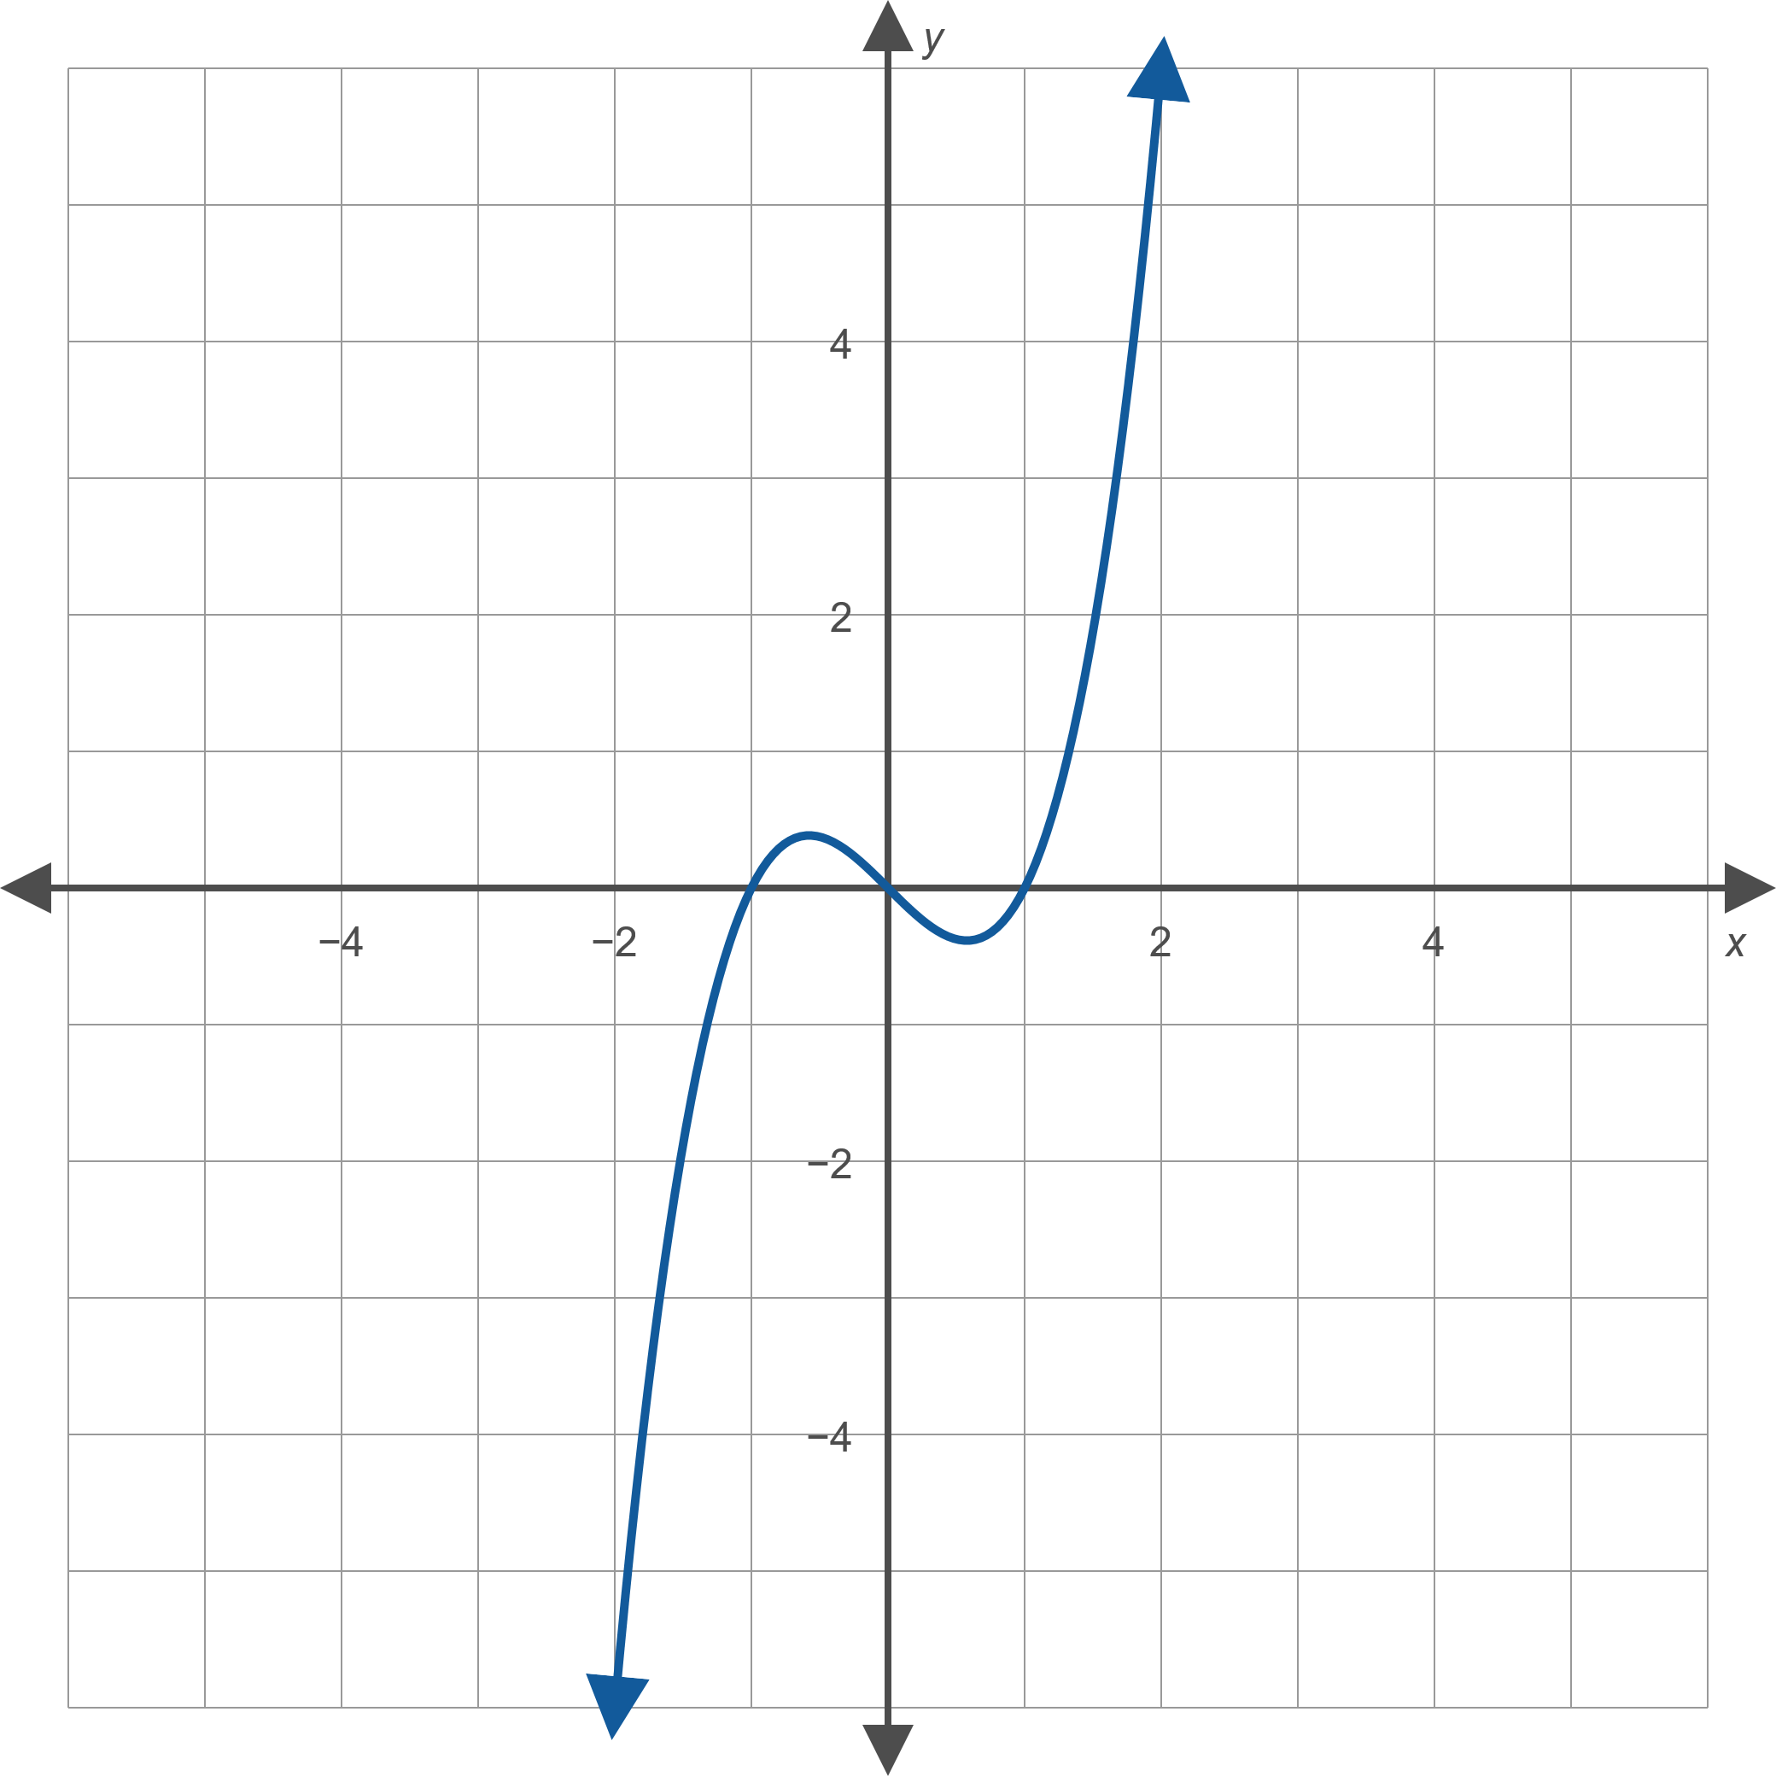
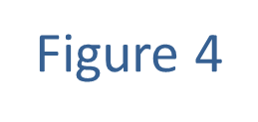
Example 1: Using Symmetry to Graph Relations (cont.)

Slide 13
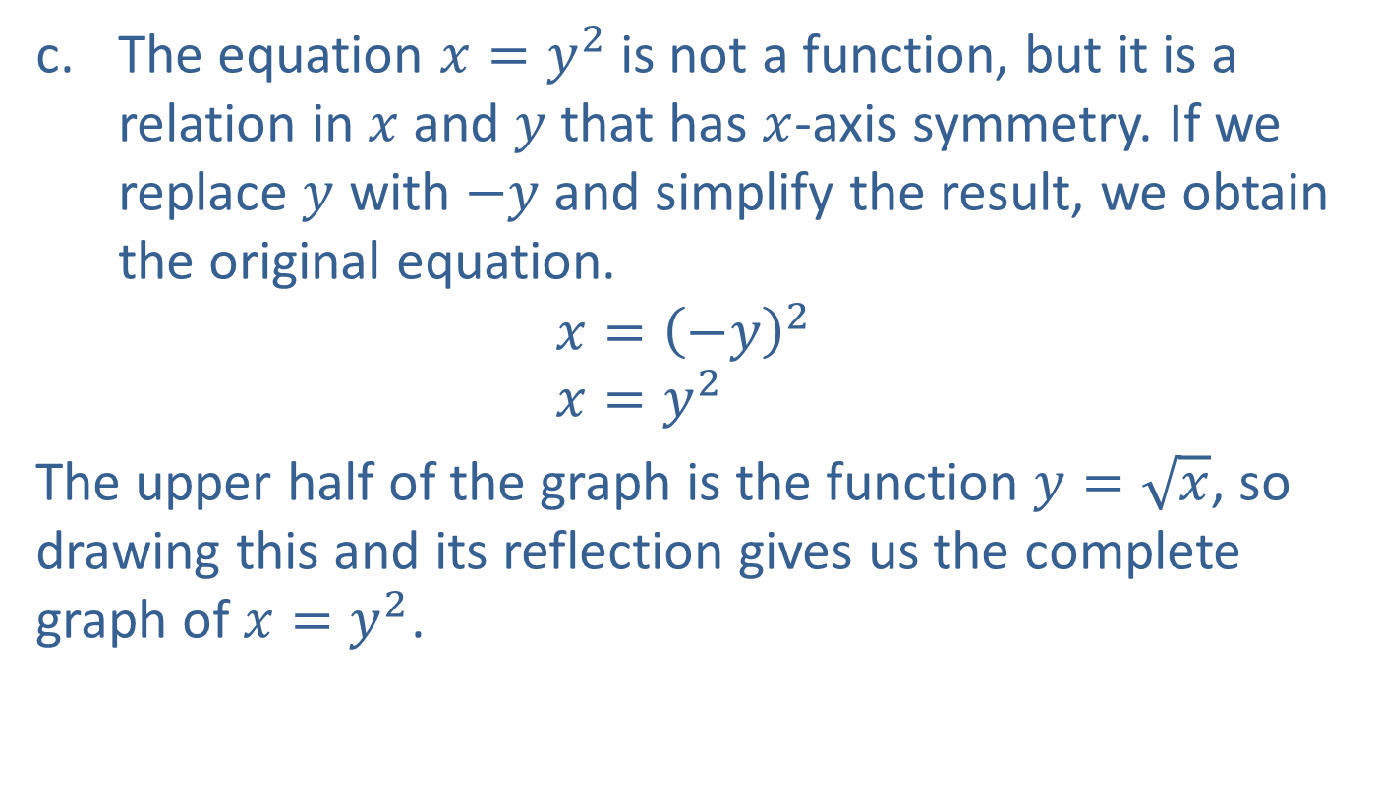
Example 1: Using Symmetry to Graph Relations (cont.)
​The equation $x=y^{2}$ is not a function, but it is a relation in $x$ and $y$ that has $x$-axis symmetry. If we replace $y$ with $−y$ and simplify the result, we obtain the original equation.
$$x={\left(−y\right)}^{2} \\ x=y^{2}$$
​The upper half of the graph is the function $y=\sqrt{x}$, so drawing this and its reflection gives us the complete graph of $x=y^{2}$.
​

Slide 14
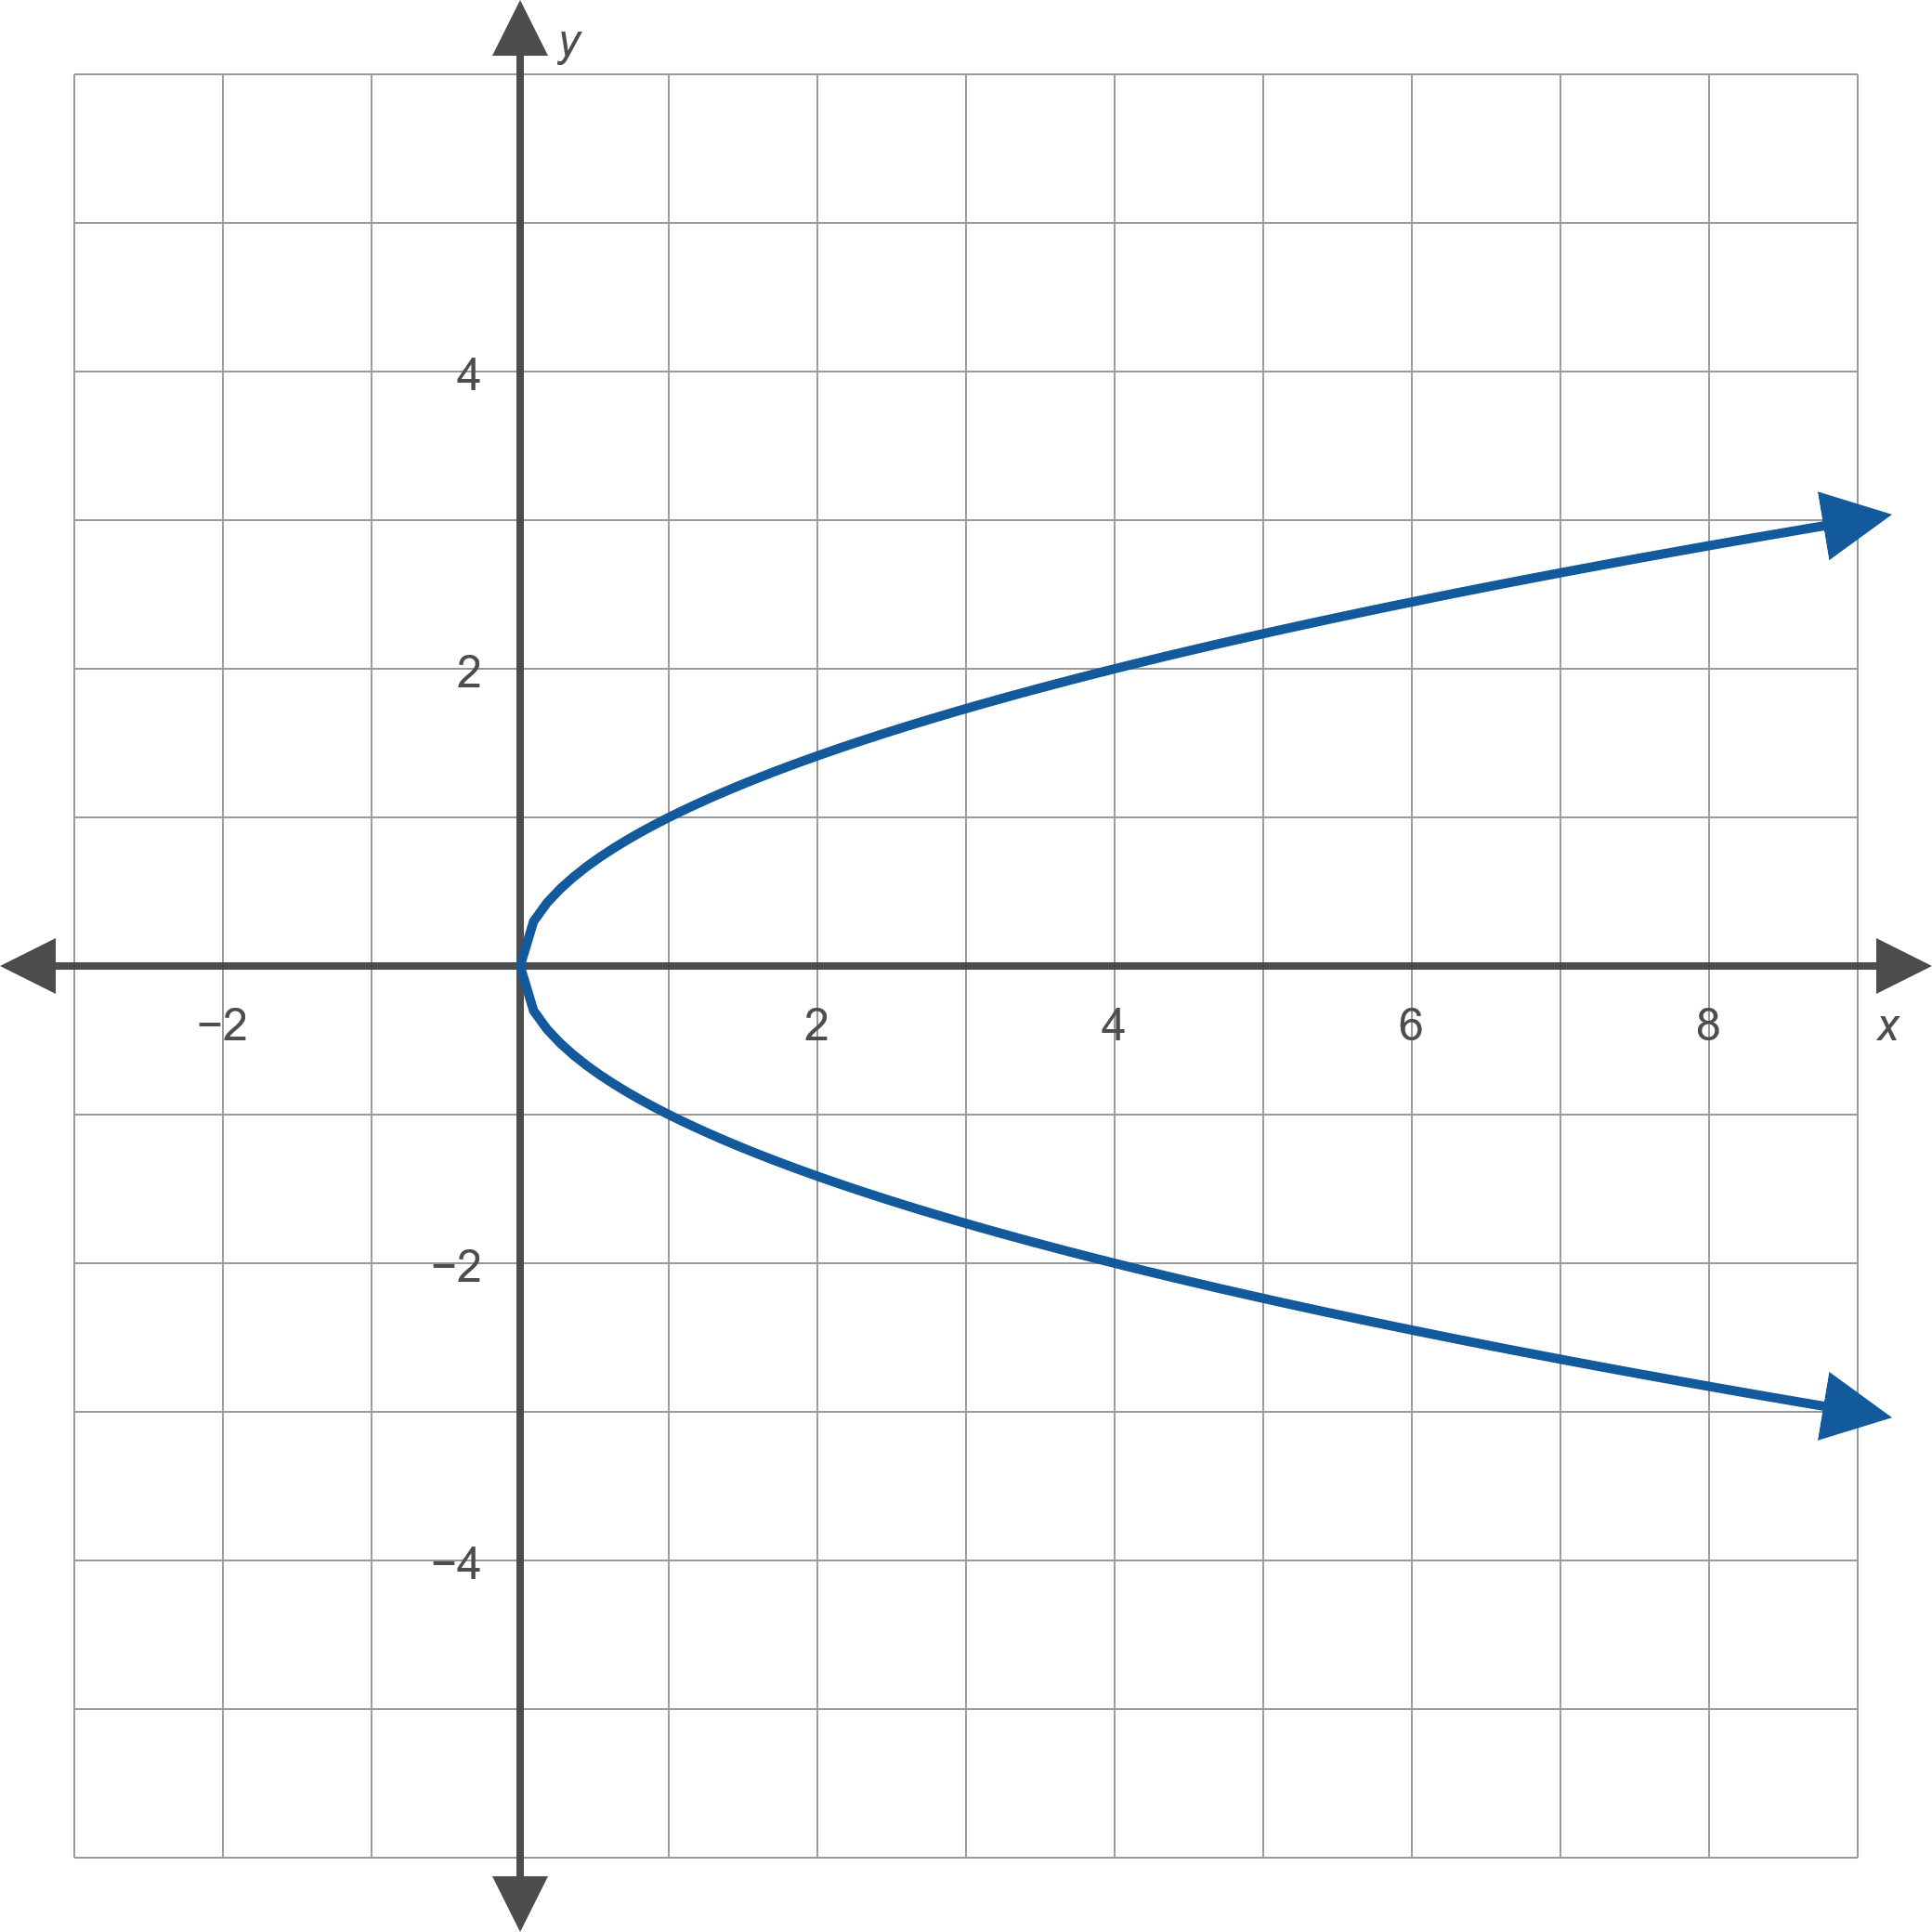
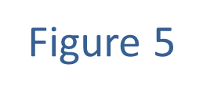
Example 1: Using Symmetry to Graph Relations (cont.)

Slide 15
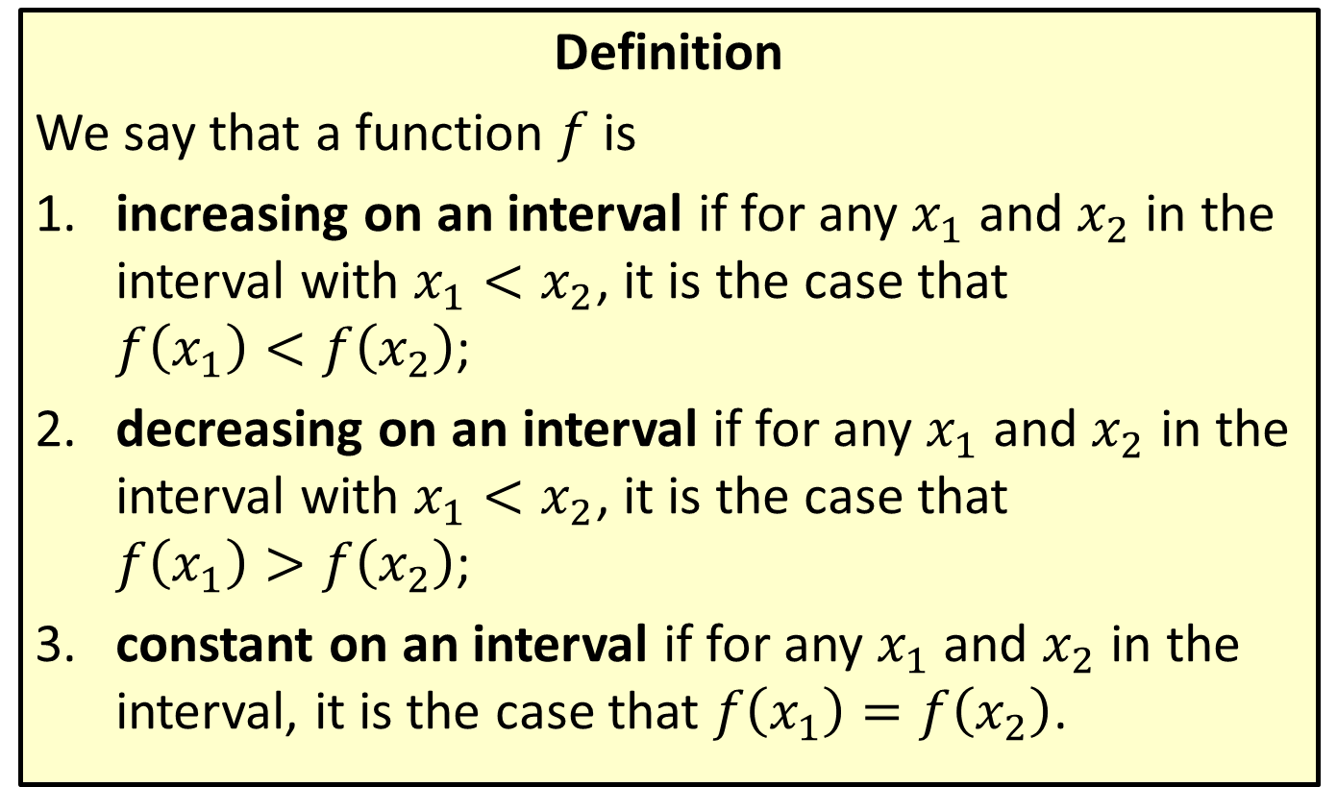
Increasing, Decreasing, and Constant
Definition
We say that a function $f$ is
​increasing on an interval if for any $x_{1}$ and $x_{2}$ in the interval with $x_{1}<x_{2}$, it is the case that
$f\left(x_{1}\right)<f\left(x_{2}\right)$;
​decreasing on an interval if for any $x_{1}$ and $x_{2}$ in the interval with $x_{1}<x_{2}$, it is the case that
$f\left(x_{1}\right)>f\left(x_{2}\right)$;
​constant on an interval if for any $x_{1}$ and $x_{2}$ in the interval, it is the case that $f\left(x_{1}\right)=f\left(x_{2}\right)$.

Slide 16

Example 2: Determining Intervals of Monotonicity
Determine the open intervals of monotonicity of the function $f\left(x\right)={\left(x−2\right)}^{2}−1$.

Slide 17

Example 2: Determining Intervals of Monotonicity (cont.)
Solution
We know that the graph of $f$ is the basic parabola shifted 2 units to the right and 1 unit down, as shown in Figure 6.

Slide 18
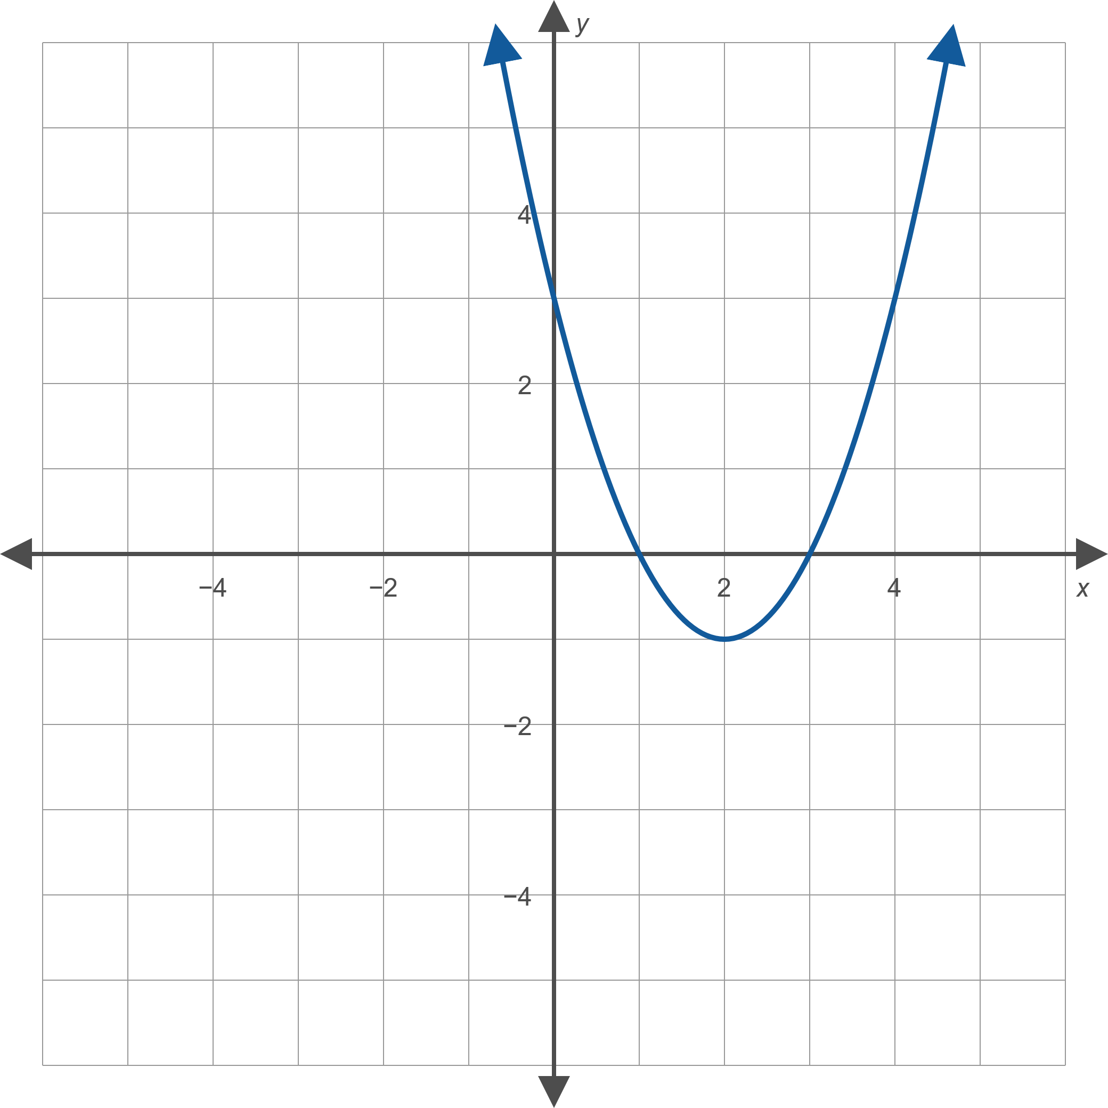
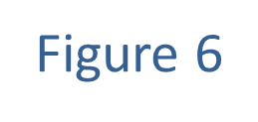
Example 2: Determining Intervals of Monotonicity (cont.)

Slide 19
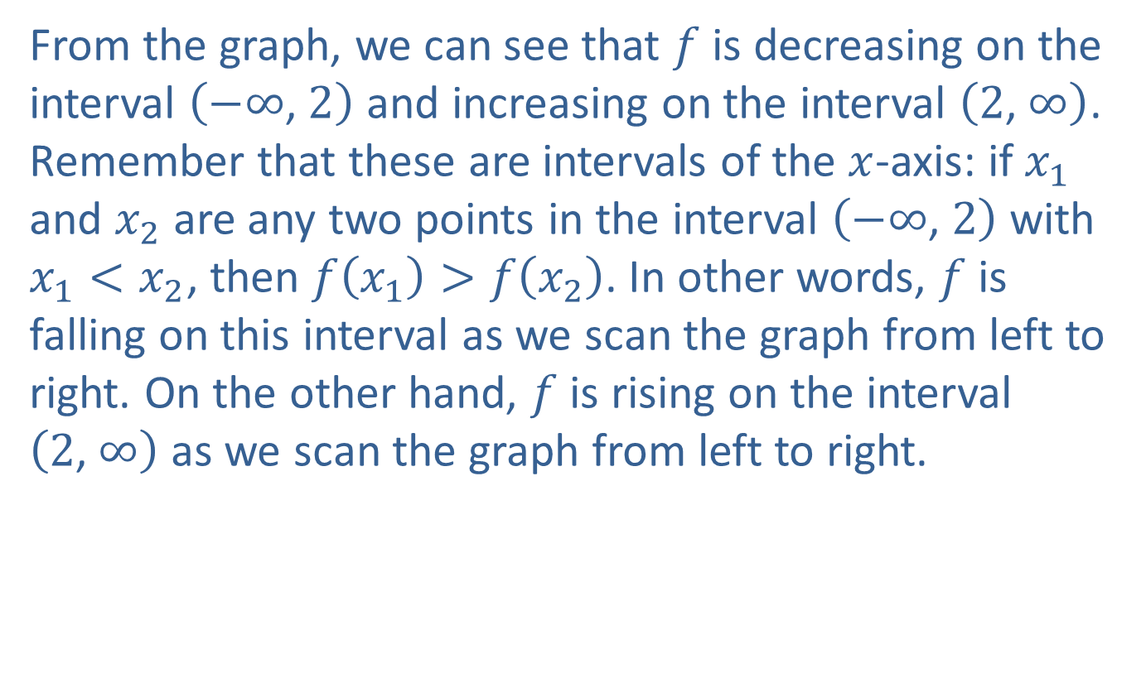
Example 2: Determining Intervals of Monotonicity (cont.)
From the graph, we can see that $f$ is decreasing on the interval $\left(−∞\text{, }2\right)$ and increasing on the interval $\left(2\text{, }∞\right)$. Remember that these are intervals of the $x$-axis: if $x_{1}$ and $x_{2}$ are any two points in the interval $\left(−∞\text{, }2\right)$ with $x_{1}<x_{2}$, then $f\left(x_{1}\right)>f\left(x_{2}\right)$. In other words, $f$ is falling on this interval as we scan the graph from left to right. On the other hand, $f$ is rising on the interval $\left(2\text{, }∞\right)$ as we scan the graph from left to right.

Slide 20
Example 3: Modeling the Water Level of a River
The water level of a certain river varied over the course of a year as follows. In January, the level was 13 feet. From that level, the water increased linearly to a level of 18 feet in May. The water remained constant at that level until July, at which point it began to decrease linearly to a final level of 11 feet in December. Graph the water level as a function of time and determine the open intervals of monotonicity.

Slide 21
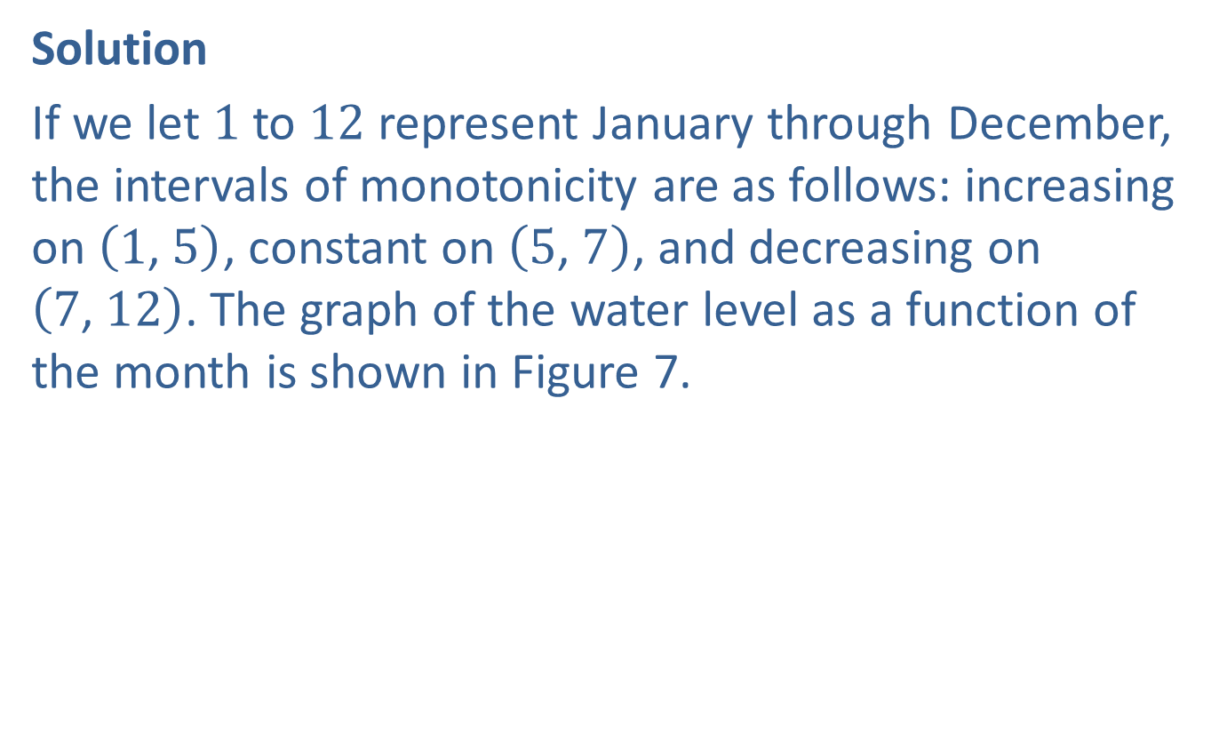
Example 3: Modeling the Water Level of a River (cont.)
Solution
If we let 1 to 12 represent January through December, the intervals of monotonicity are as follows: increasing on $\left(1\text{, }5\right)$, constant on $\left(5\text{, }7\right)$, and decreasing on $\left(7\text{, }12\right)$. The graph of the water level as a function of the month is shown in Figure 7.

Slide 22
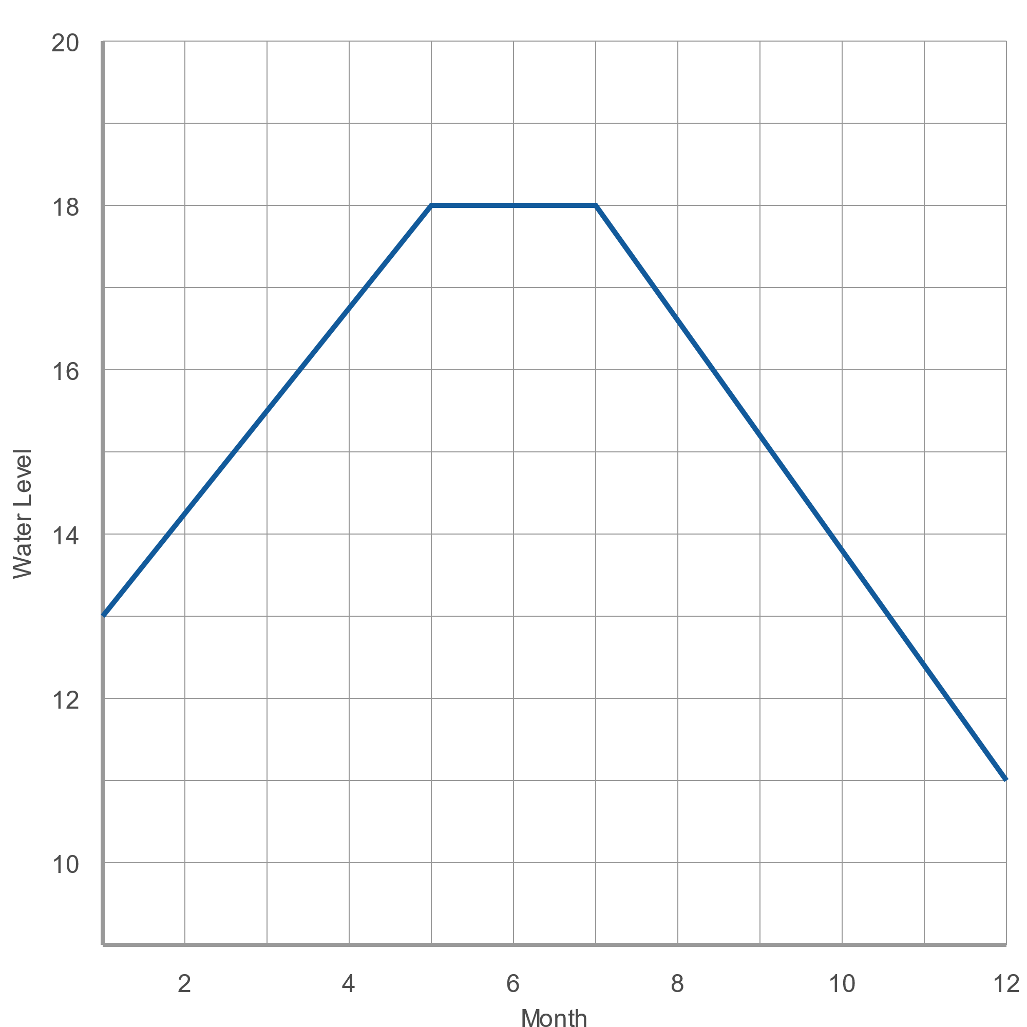
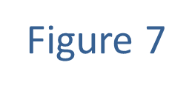
Example 3: Modeling the Water Level of a River (cont.)

Slide 23
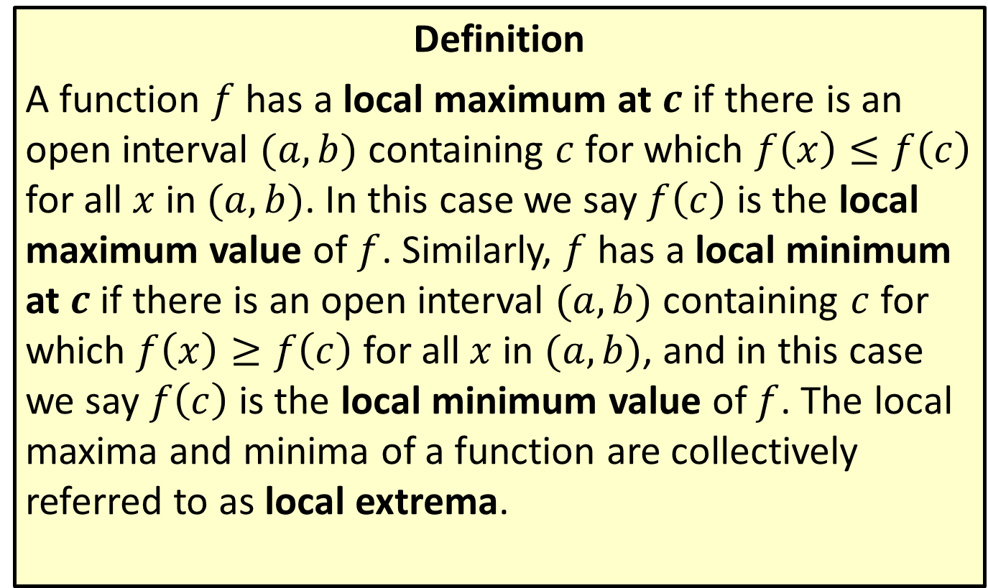
Local Extrema
Definition
A function $f$ has a local maximum at $c$ if there is an open interval $(a,b)$ containing $c$ for which $f\left(x\right)≤f\left(c\right)$ for all $x$ in $(a,b)$. In this case we say $f⁡\left(c\right)$ is the local maximum value of $f$. Similarly, $f$ has a local minimum at $c$ if there is an open interval $(a,b)$ containing $c$ for which $f\left(x\right)≥f\left(c\right)$ for all $x$ in $(a,b)$, and in this case we say $f⁡\left(c\right)$ is the local minimum value of $f$. The local maxima and minima of a function are collectively referred to as local extrema.

Slide 24

Example 4: Determining Local Extrema
Figure 10 shows the graph of a function $f$.
​Determine the locations and type of the local extrema of $f$.
​Determine the values of the local extrema of $f$.

Slide 25
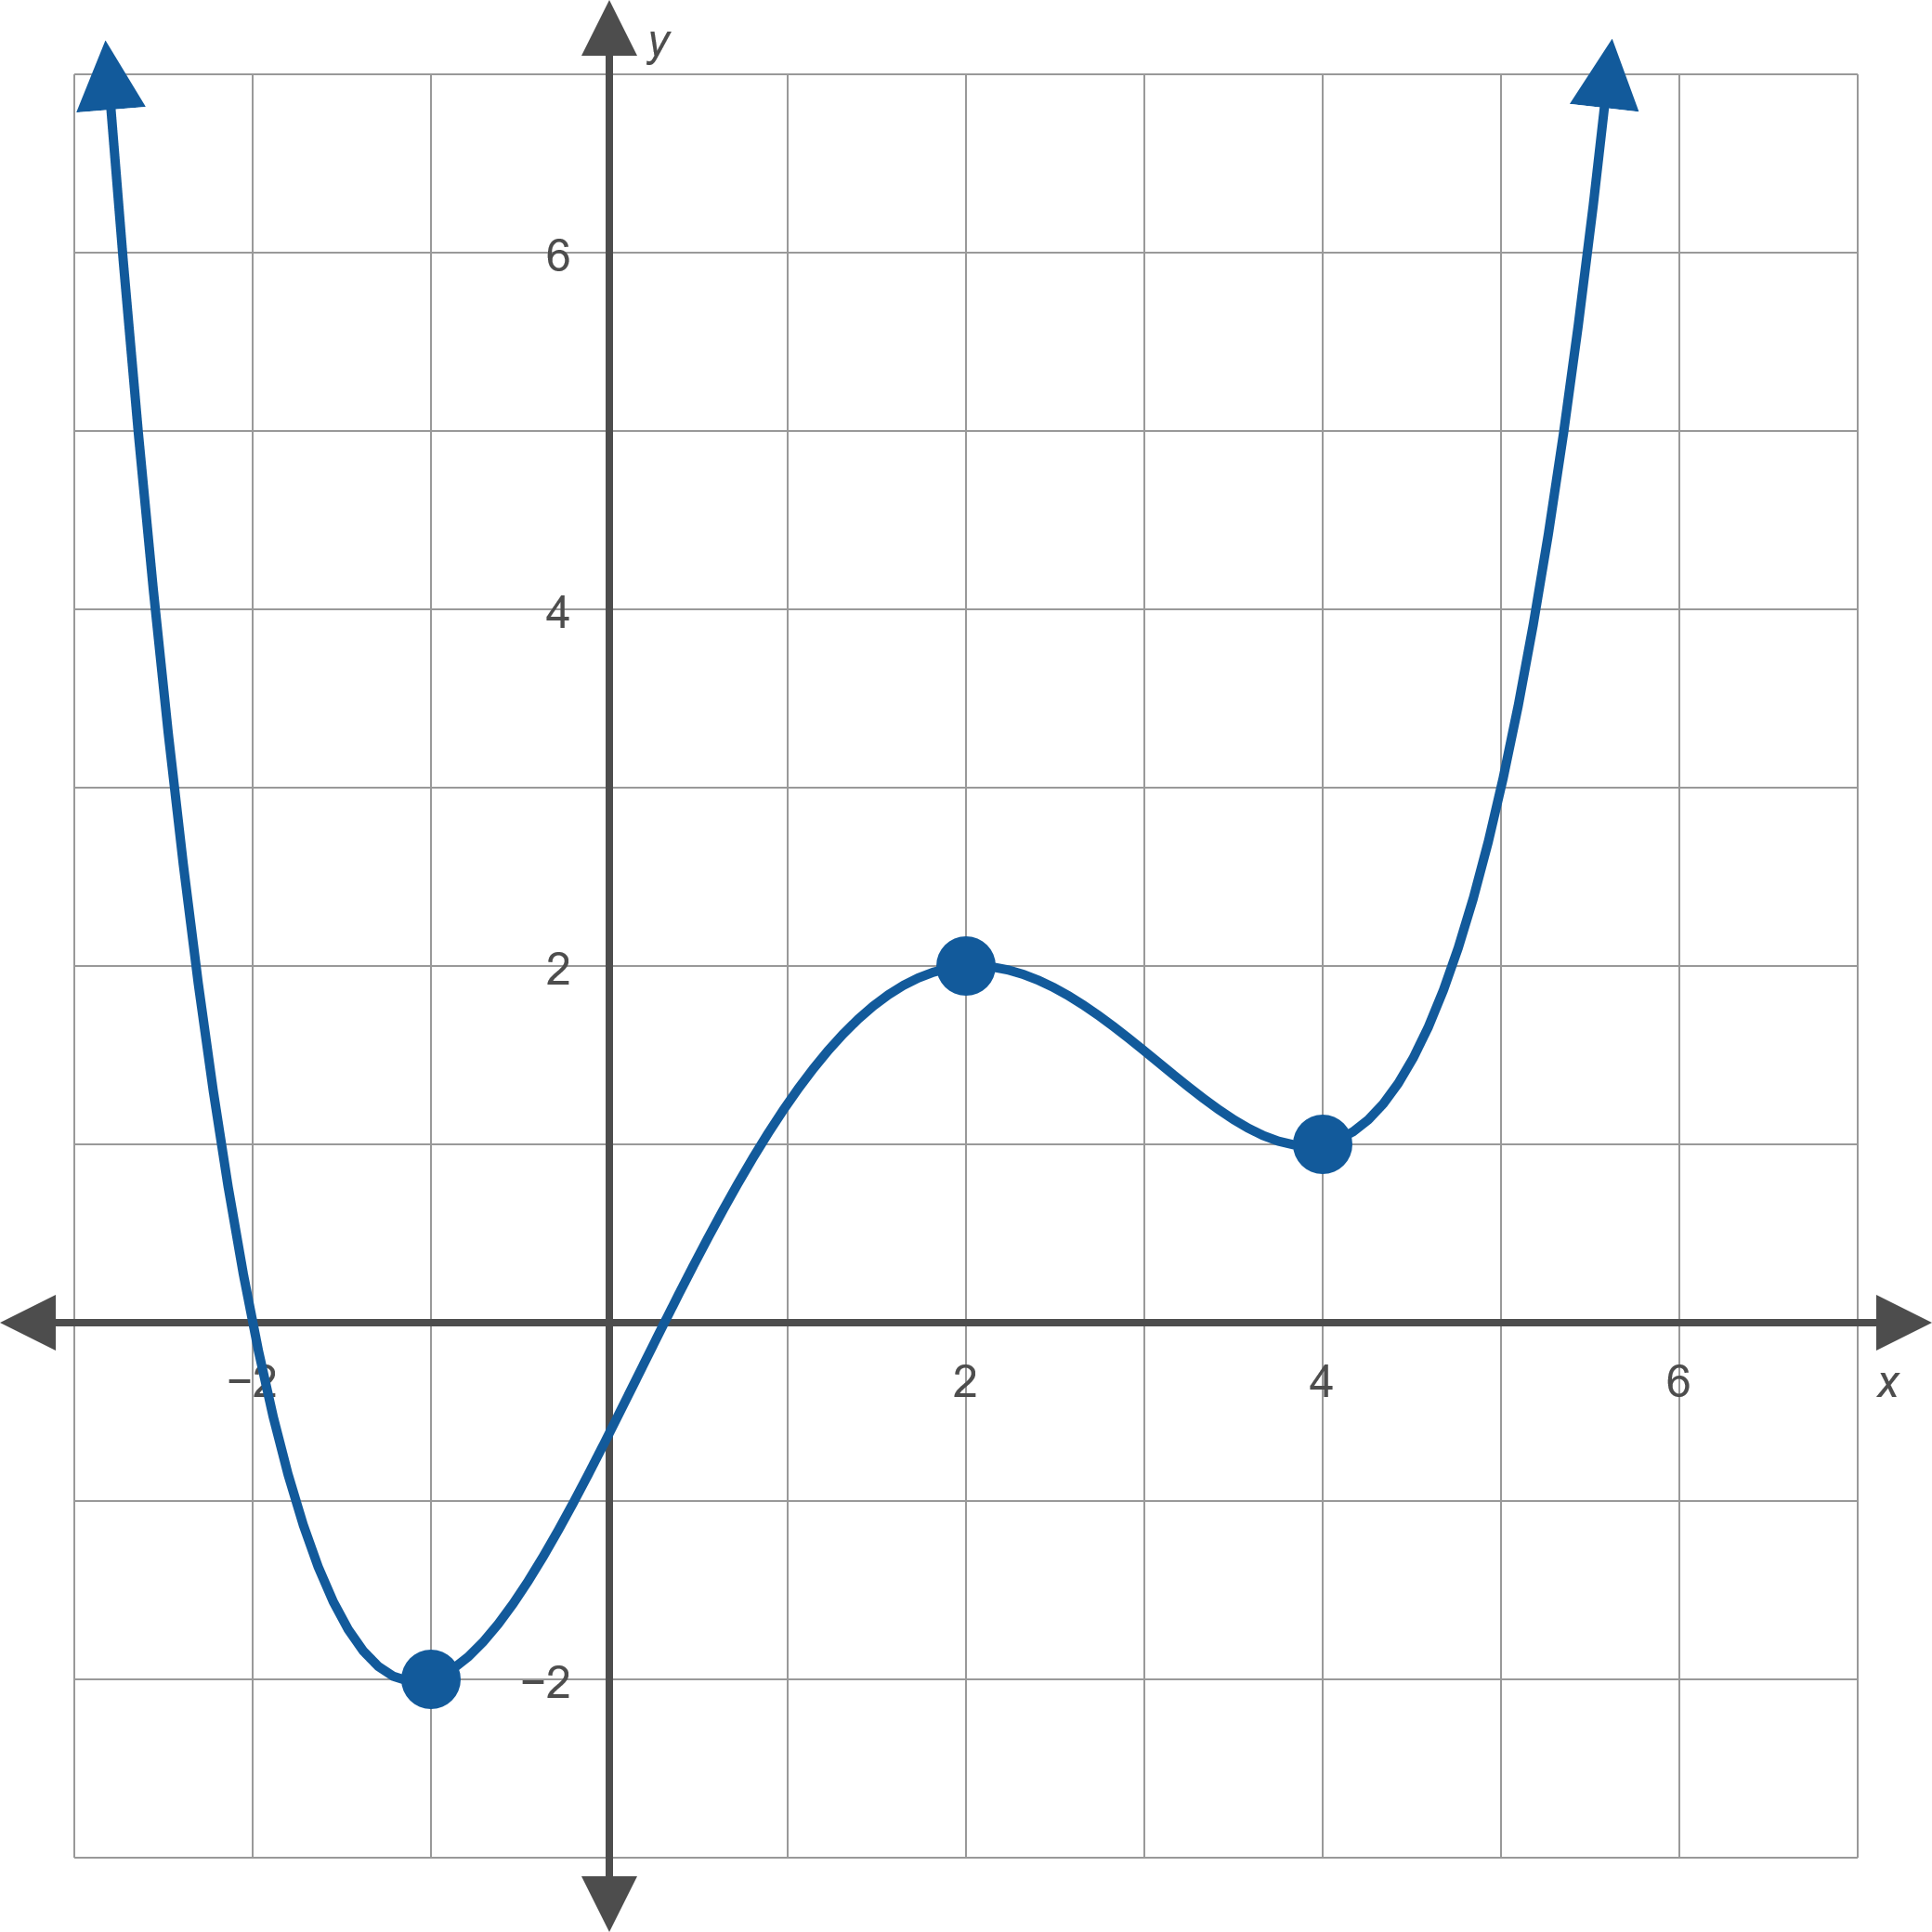
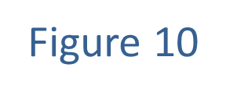
Example 4: Determining Local Extrema (cont.)

Slide 26
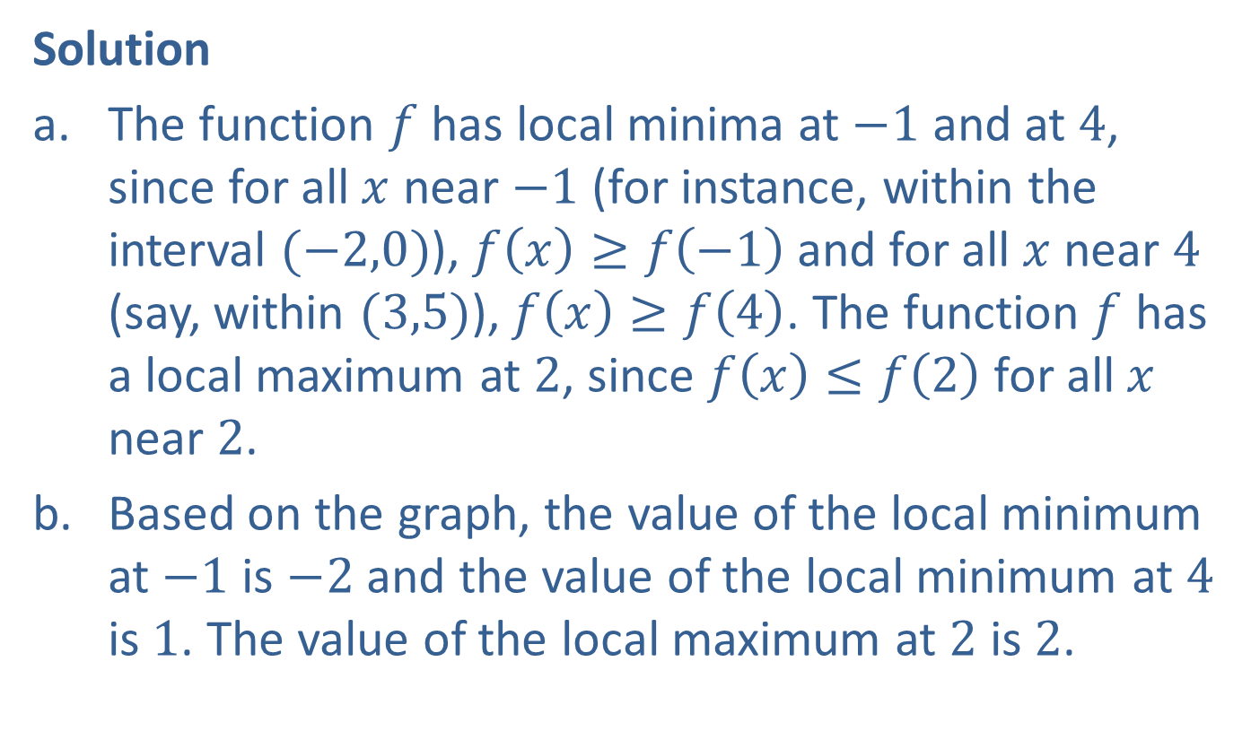
Example 4: Determining Local Extrema (cont.)
Solution
​The function $f$ has local minima at $−1$ and at 4, since for all $x$ near $−1$ (for instance, within the interval $(−2,0)$), $f\left(x\right)≥f\left(−1\right)$ and for all $x$ near 4 (say, within $(3,5)$), $f\left(x\right)≥f\left(4\right)$. The function $f$ has a local maximum at 2, since $f\left(x\right)≤f\left(2\right)$ for all $x$ near 2.
​Based on the graph, the value of the local minimum at $−1$ is $−2$ and the value of the local minimum at 4 is 1. The value of the local maximum at 2 is 2.

Slide 27
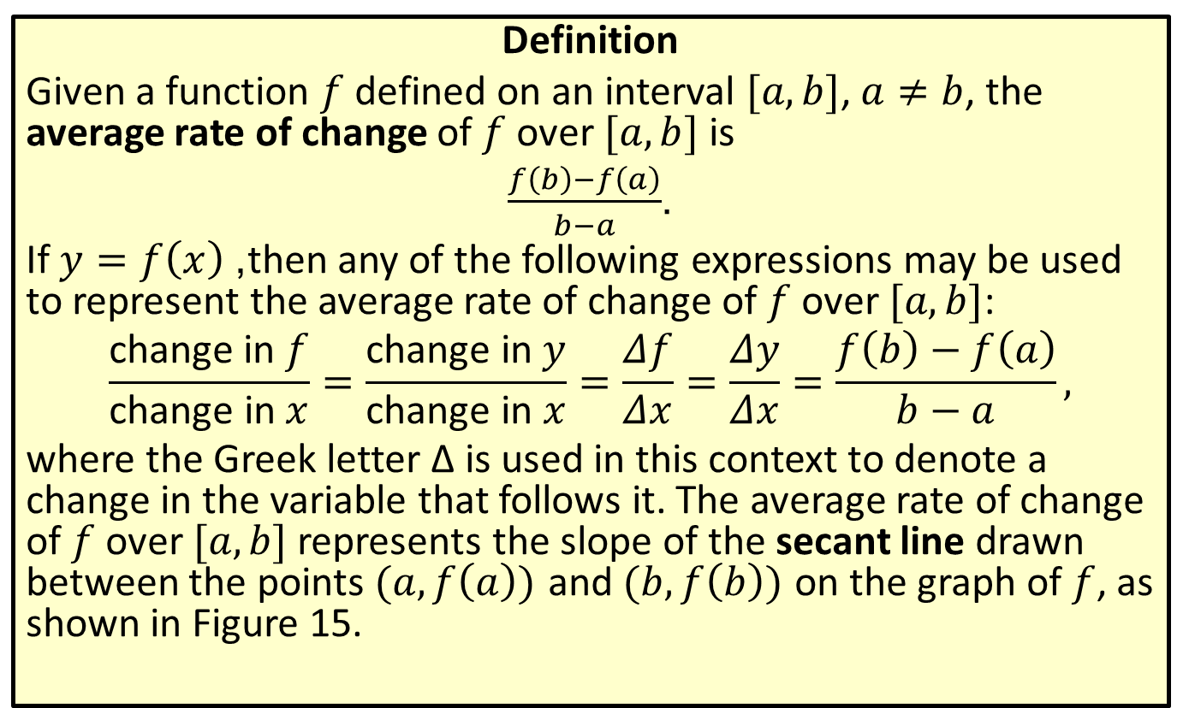
Average Rate of Change
Definition
Given a function $f$ defined on an interval $[a,b]$, $a≠b$, the average rate of change of $f$ over $[a,b]$ is
$\frac{f\left(b\right)−f\left(a\right)}{b−a}$.
If $y=f\left(x\right)$, then any of the following expressions may be used to represent the average rate of change of $f$ over $[a,b]$:
$$\frac{\text{change} \text{in} f}{\text{change} \text{in} x}=\frac{\text{change} \text{in} y}{\text{change} \text{in} x}=\frac{Δf}{Δx}=\frac{Δy}{Δx}=\frac{f\left(b\right)−f\left(a\right)}{b−a},$$
where the Greek letter Δ is used in this context to denote a change in the variable that follows it. The average rate of change of $f$ over $[a,b]$ represents the slope of the secant line drawn between the points $(a,f\left(a\right))$ and $(b,f\left(b\right))$ on the graph of $f$, as shown in Figure 15.

Slide 28
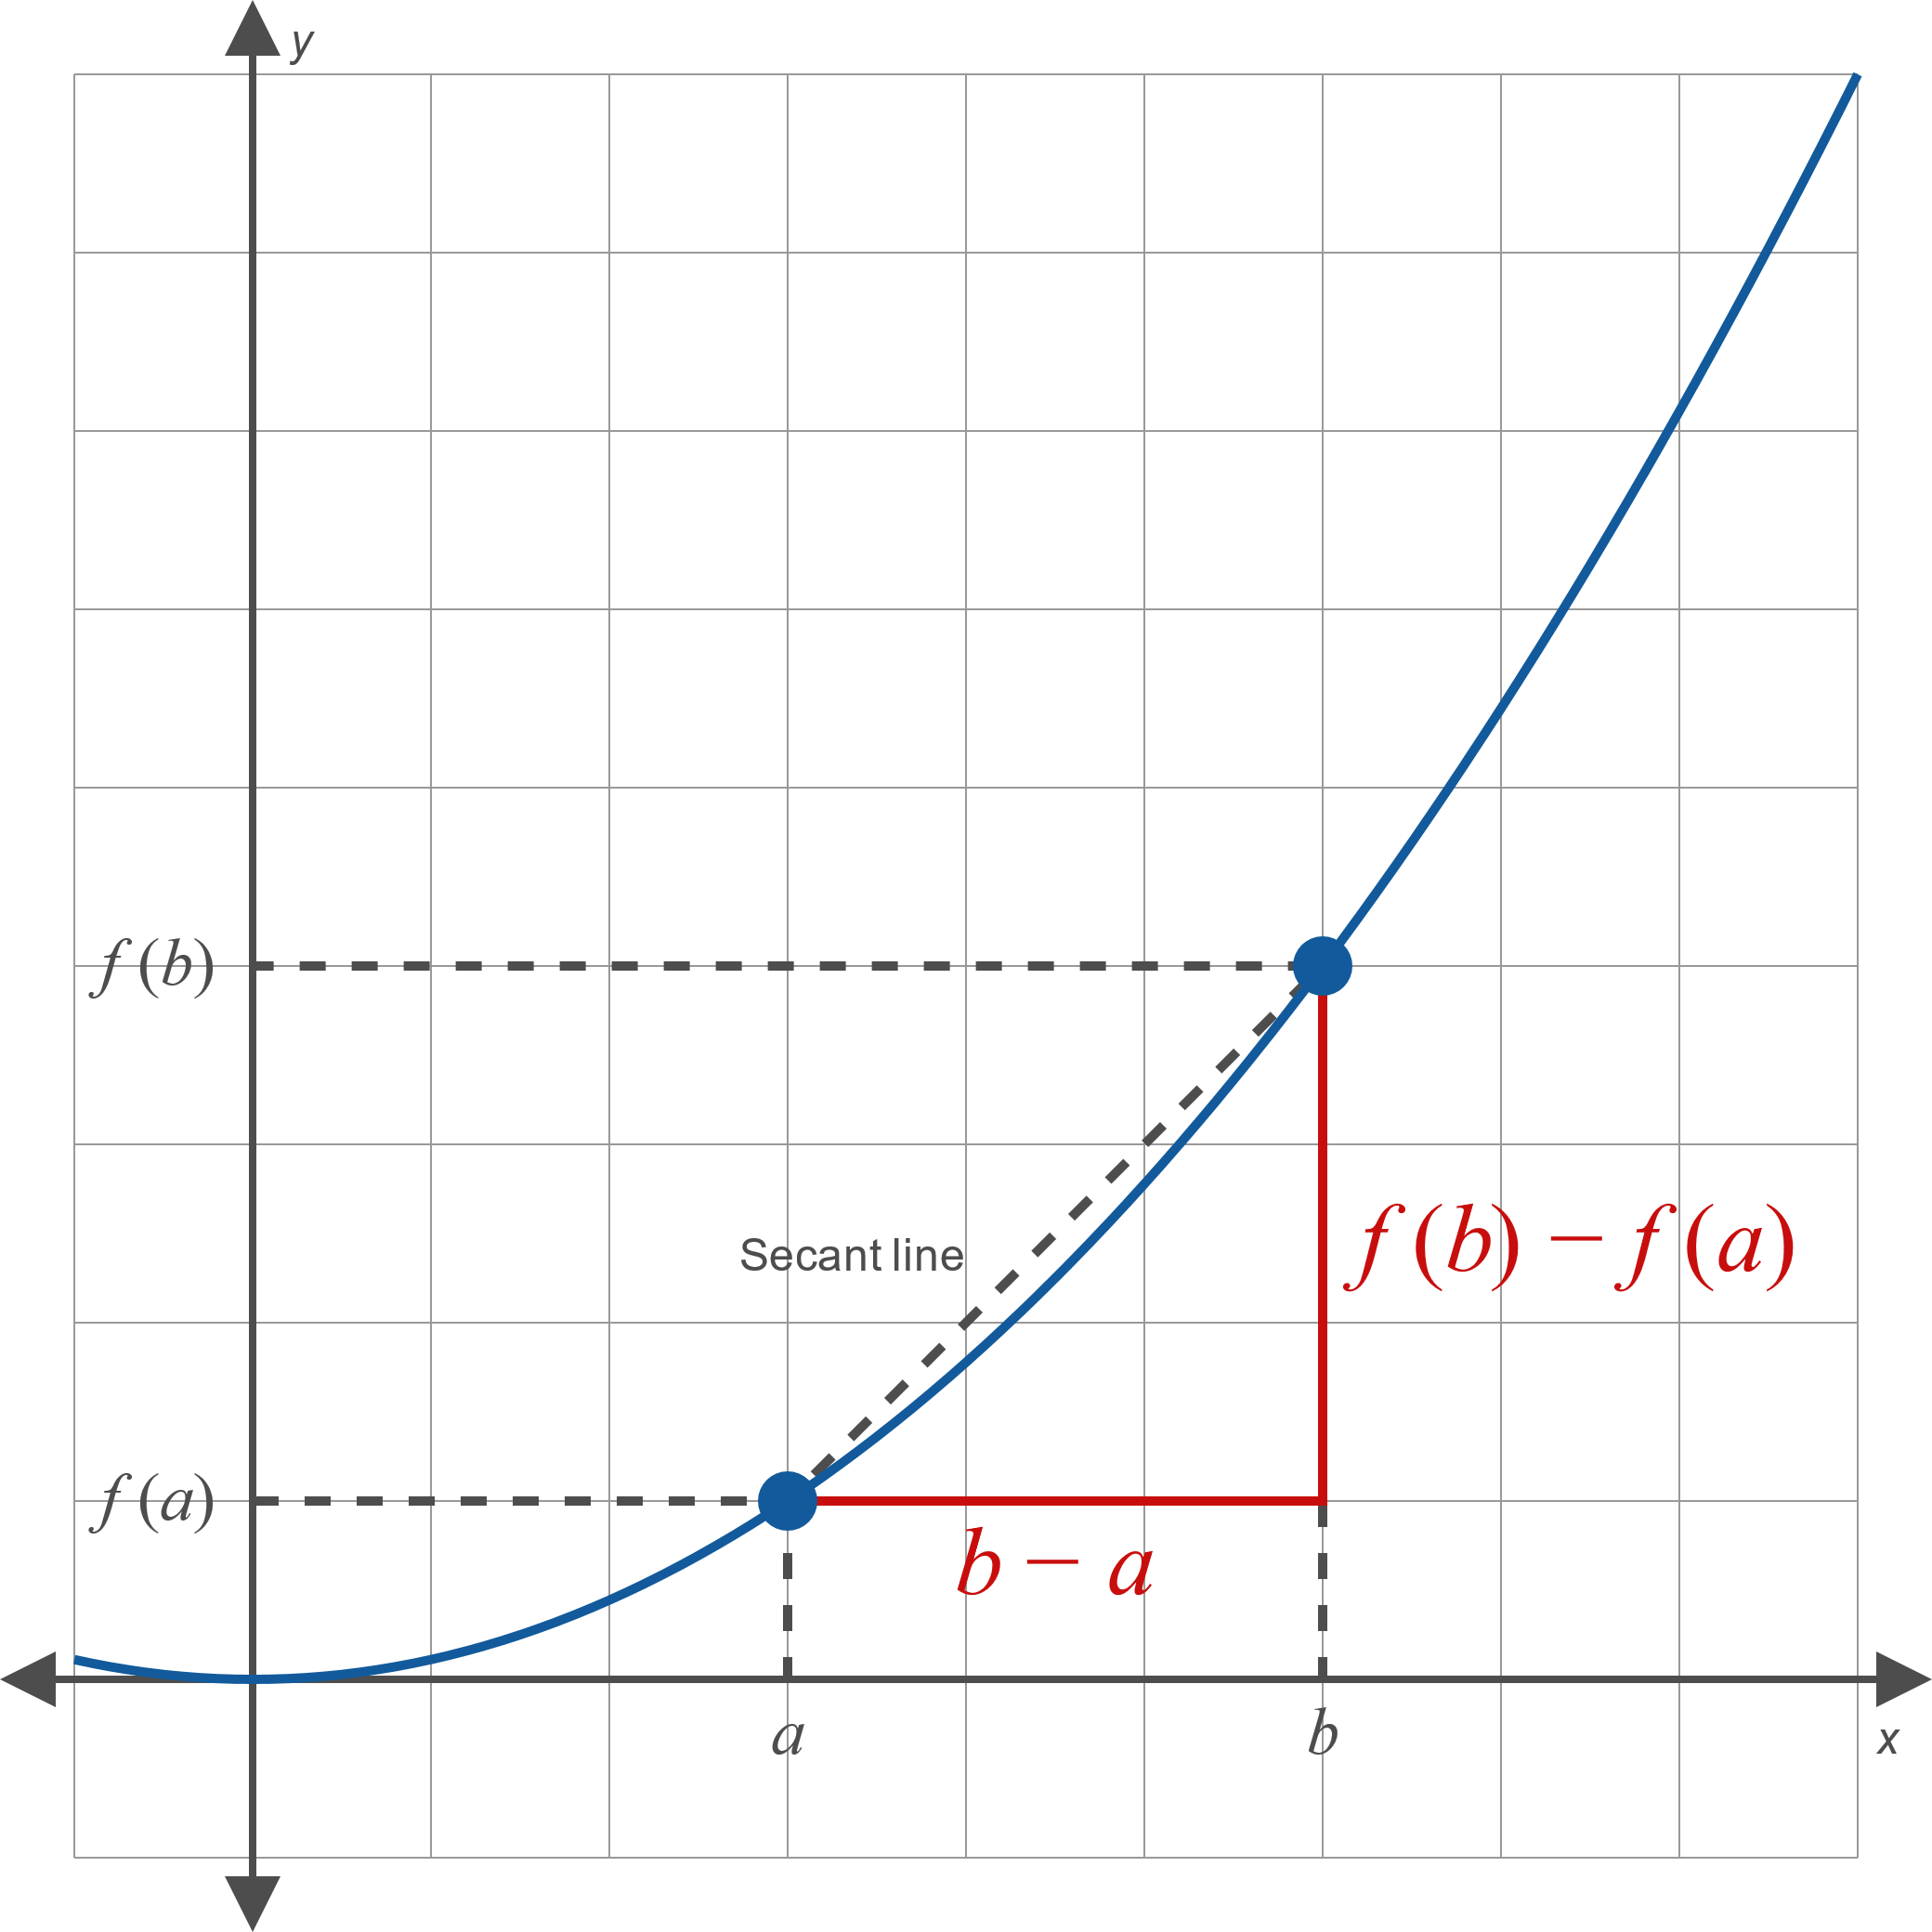
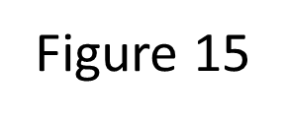
Average Rate of Change (cont.)

Slide 29
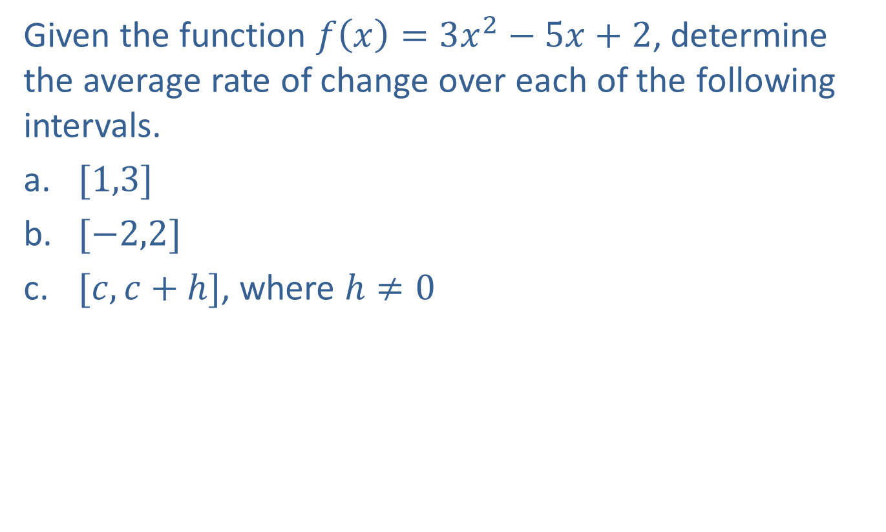
Example 5: Determining Average Rate of Change
Given the function $f\left(x\right)=3x^{2}−5x+2$, determine the average rate of change over each of the following intervals.
​$[1,3]$
​$[−2,2]$
​$[c,c+h]$, where $h≠0$

Slide 30
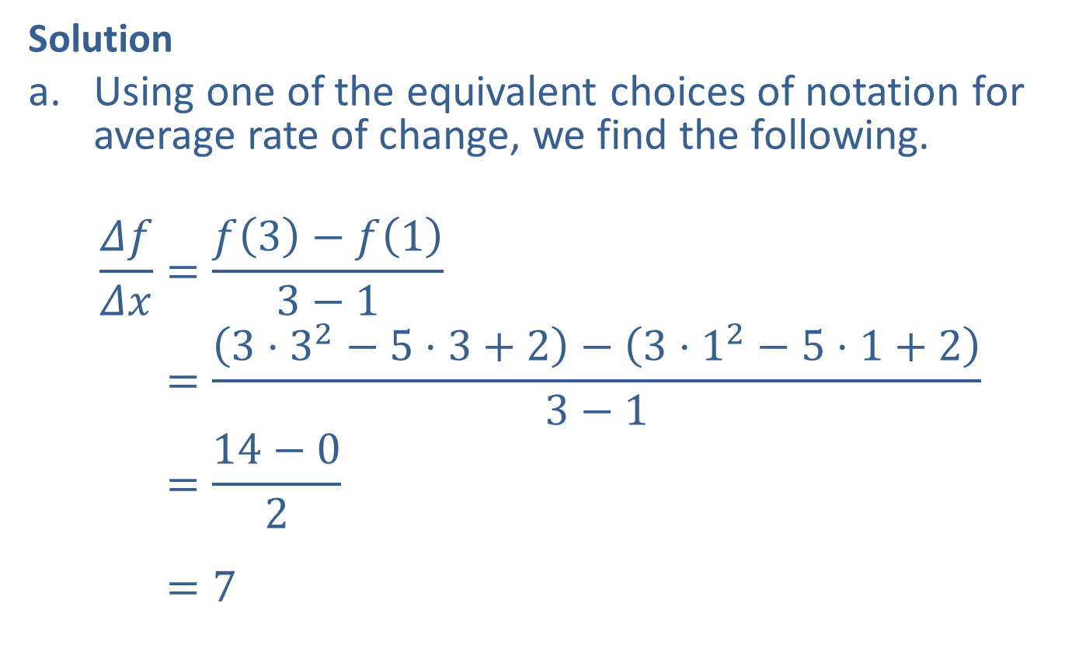
Example 5: Determining Average Rate of Change (cont.)
Solution
​Using one of the equivalent choices of notation for average rate of change, we find the following.
𝛥𝑓𝛥𝑥=𝑓3−𝑓13−1𝛥𝑓𝛥𝑥=3⋅32−5⋅3+2−3⋅12−5⋅1+23−1𝛥𝑓𝛥𝑥=14−02𝛥𝑓𝛥𝑥=7

Slide 31
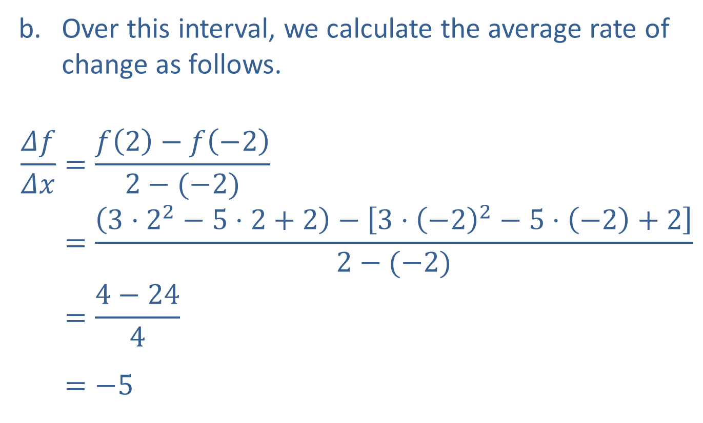
Example 5: Determining Average Rate of Change (cont.)
​Over this interval, we calculate the average rate of change as follows.
𝛥𝑓𝛥𝑥=𝑓2−𝑓−22−(−2)𝛥𝑓𝛥𝑥=3⋅22−5⋅2+2−3⋅−22−5⋅−2+22−(−2)𝛥𝑓𝛥𝑥=4−244𝛥𝑓𝛥𝑥=−5

Slide 32
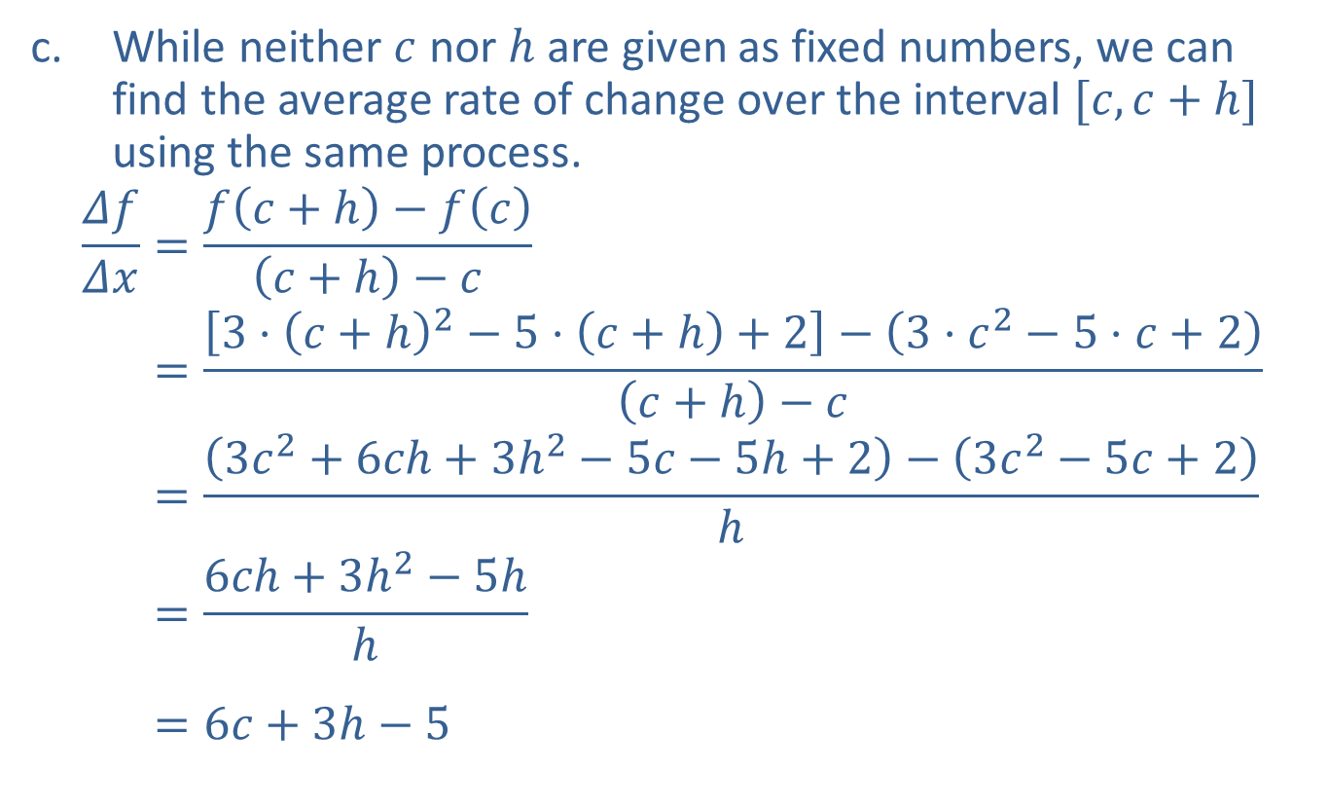
Example 5: Determining Average Rate of Change (cont.)
​While neither $c$ nor $h$ are given as fixed numbers, we can find the average rate of change over the interval $[c,c+h]$ using the same process.
𝛥𝑓𝛥𝑥=𝑓𝑐+h−𝑓𝑐𝑐+h−𝑐𝛥𝑓𝛥𝑥=3⋅𝑐+h2−5⋅𝑐+h+2−3⋅𝑐2−5⋅𝑐+2𝑐+h−𝑐𝛥𝑓𝛥𝑥=3𝑐2+6𝑐h+3h2−5𝑐−5h+2−3𝑐2−5𝑐+2h𝛥𝑓𝛥𝑥=6𝑐h+3h2−5hh𝛥𝑓𝛥𝑥=6𝑐+3h−5

Slide 33
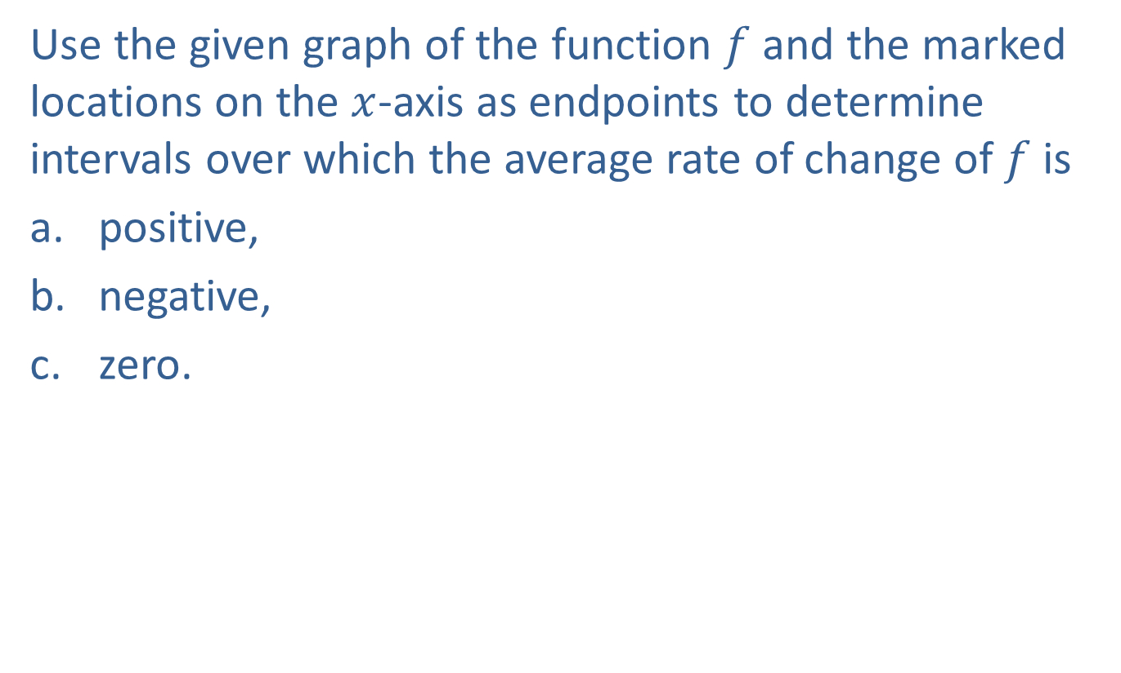
Example 6: Determining Intervals of Average Rate of Change
Use the given graph of the function $f$ and the marked locations on the $x$-axis as endpoints to determine intervals over which the average rate of change of $f$ is
​positive,
​negative,
​zero.

Slide 34
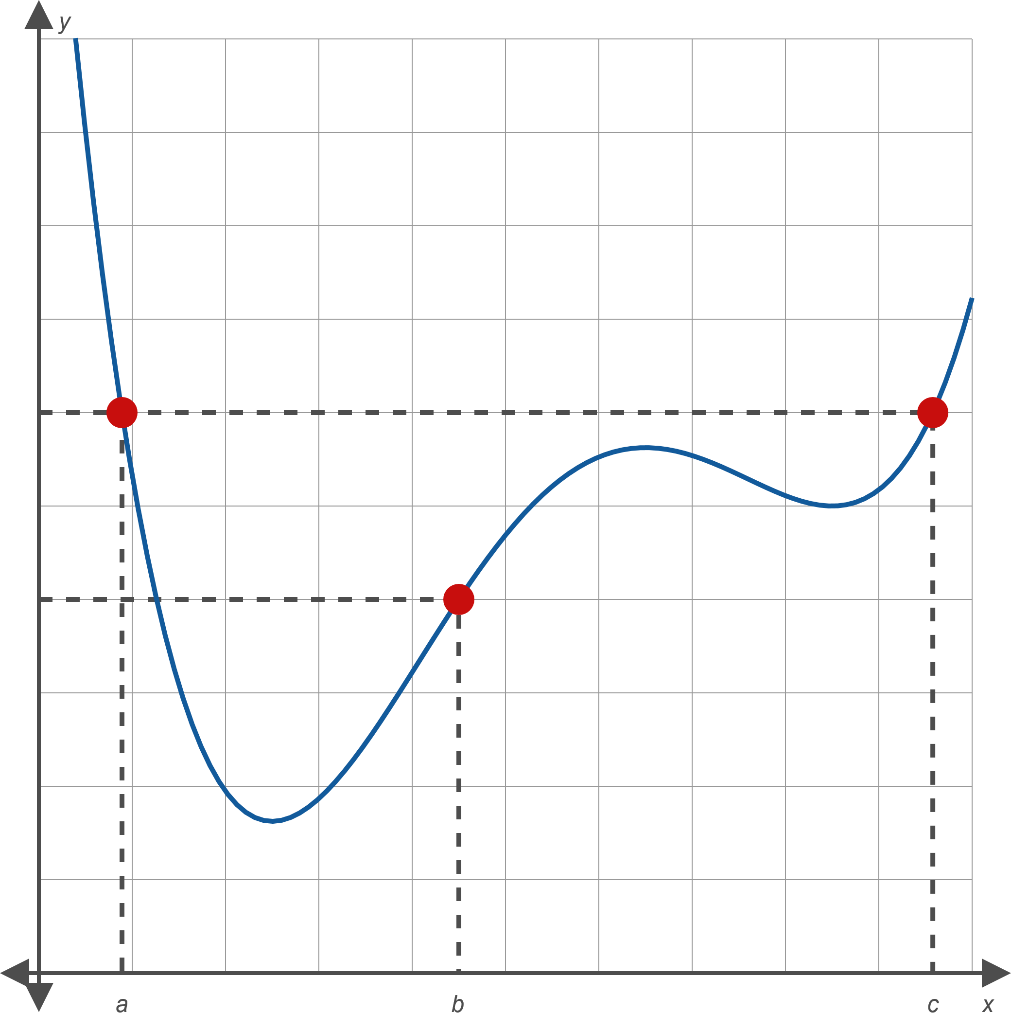
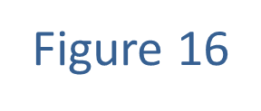
Example 6: Determining Intervals of Average Rate of Change (cont.)

Slide 35
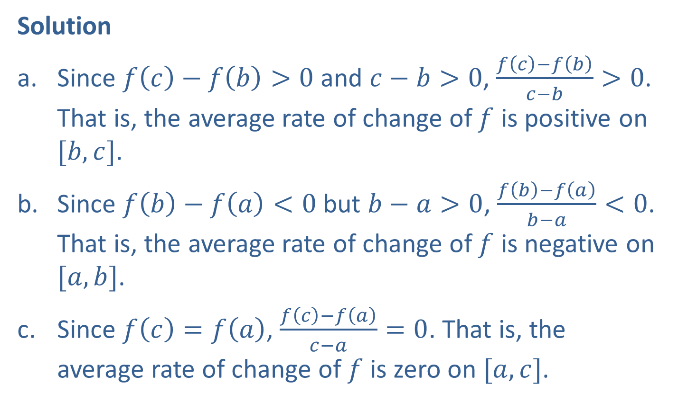
Example 6: Determining Intervals of Average Rate of Change (cont.)
Solution
​Since $f\left(c\right)−f\left(b\right)>0$ and $c−b>0$, $\frac{f\left(c\right)−f\left(b\right)}{c−b}>0$. That is, the average rate of change of $f$ is positive on $[b,c]$.
​Since $f\left(b\right)−f\left(a\right)<0$ but $b−a>0$, $\frac{f\left(b\right)−f\left(a\right)}{b−a}<0$. That is, the average rate of change of $f$ is negative on $[a,b]$.
​Since $f\left(c\right)=f\left(a\right)$, $\frac{f\left(c\right)−f\left(a\right)}{c−a}=0$. That is, the average rate of change of $f$ is zero on $[a,c]$.

