Slide 1
Section 6.2
Polynomial Division and the Division Algorithm

Slide 2
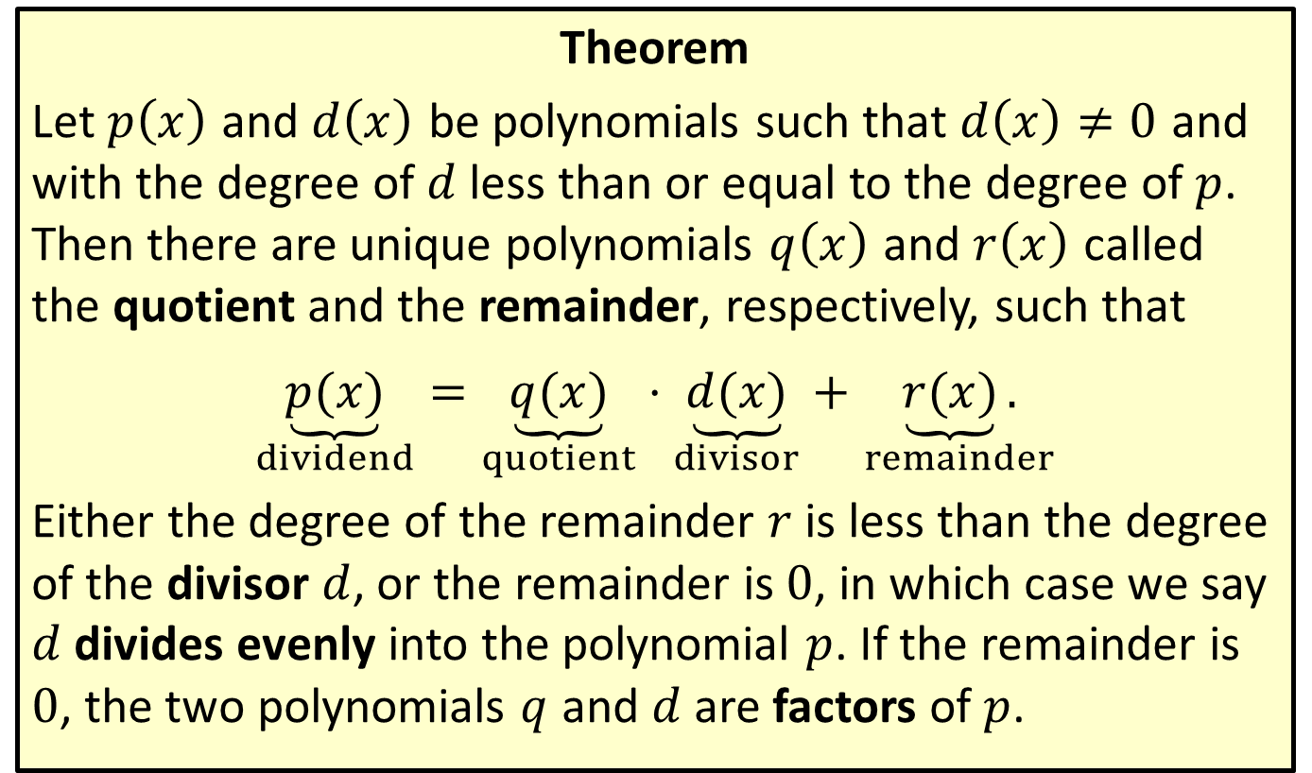
The Division Algorithm
Theorem
Let $p⁡\left(x\right)$ and $d⁡\left(x\right)$ be polynomials such that $d\left(x\right)≠0$ and with the degree of $d$ less than or equal to the degree of $p$. Then there are unique polynomials $q⁡\left(x\right)$ and $r⁡\left(x\right)$ called the quotient and the remainder, respectively, such that
$\underset{dividend}{\underbrace{p(x)}}=\underset{quotient}{\underbrace{q(x)}}⋅\underset{divisor}{\underbrace{d(x)}}+$ $\underset{remainder}{\underbrace{r(x)}.}$
Either the degree of the remainder $r$ is less than the degree of the divisor $d$, or the remainder is 0, in which case we say $d$ divides evenly into the polynomial $p$. If the remainder is 0, the two polynomials $q$ and $d$ are factors of $p$.

Slide 3
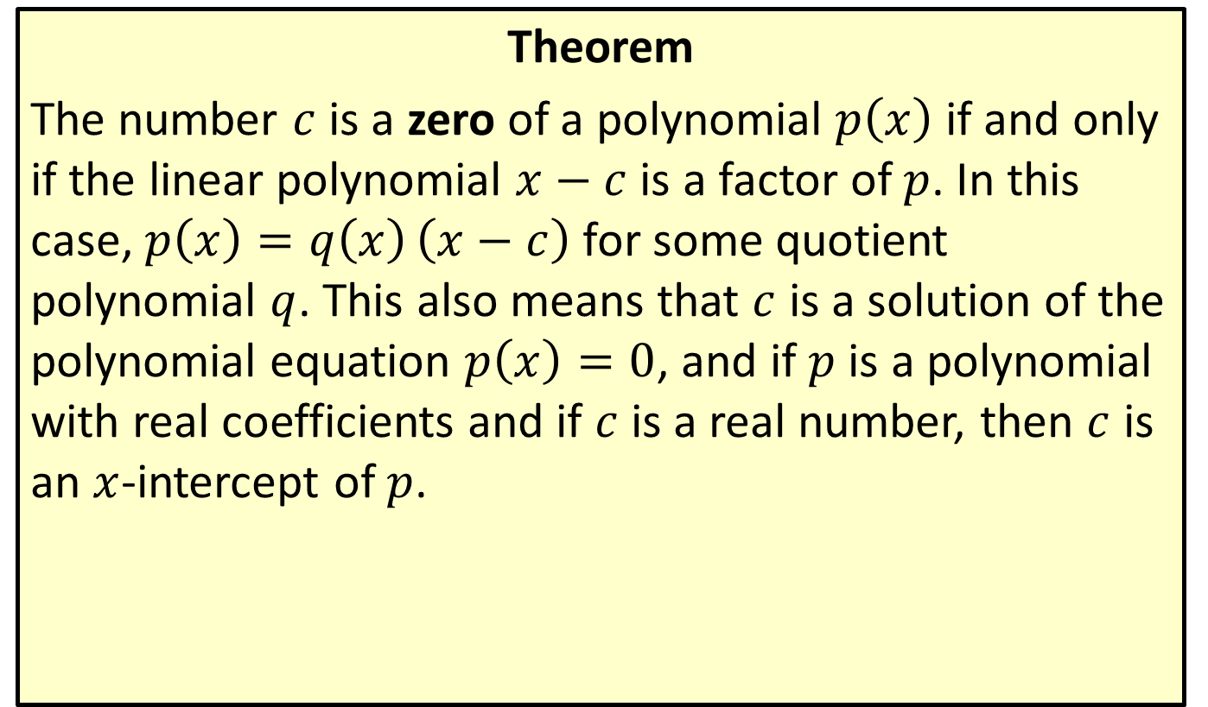
Zeros and Linear Factors
Theorem
The number $c$ is a zero of a polynomial $p⁡\left(x\right)$ if and only if the linear polynomial $x−c$ is a factor of $p$. In this case, $p\left(x\right)=q\left(x\right)\left(x−c\right)$ for some quotient polynomial $q$. This also means that $c$ is a solution of the polynomial equation $p\left(x\right)=0$, and if $p$ is a polynomial with real coefficients and if $c$ is a real number, then $c$ is an $x$-intercept of $p$.

Slide 4
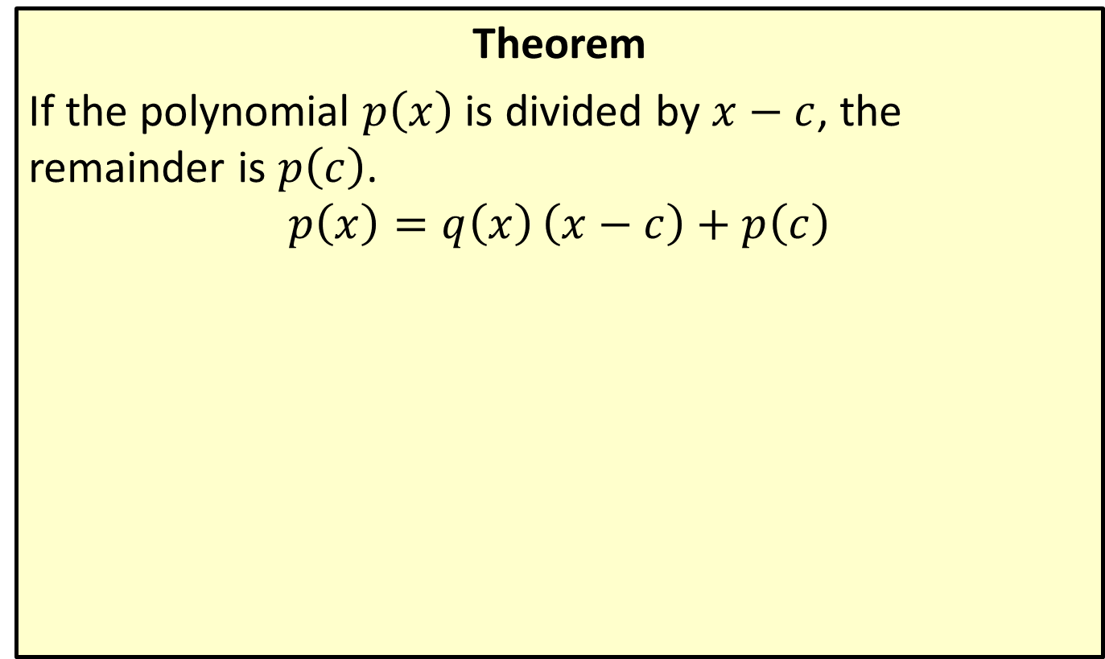
The Remainder Theorem
Theorem
If the polynomial $p⁡\left(x\right)$ is divided by $x−c$, the remainder is $p⁡\left(c\right)$.
$$p\left(x\right)=q\left(x\right)\left(x−c\right)+p\left(c\right)$$

Slide 5

Example 1: Polynomial Long Division
Divide the polynomial $x^{2}+2x−24$ by the polynomial $x+6$.

Slide 6
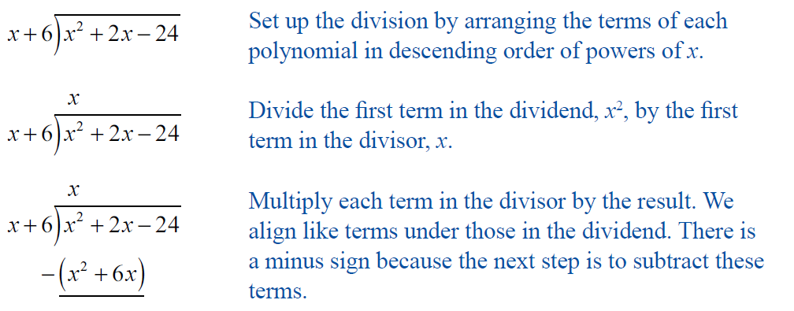
Example 1: Polynomial Long Division (cont.)
Solution

Slide 7
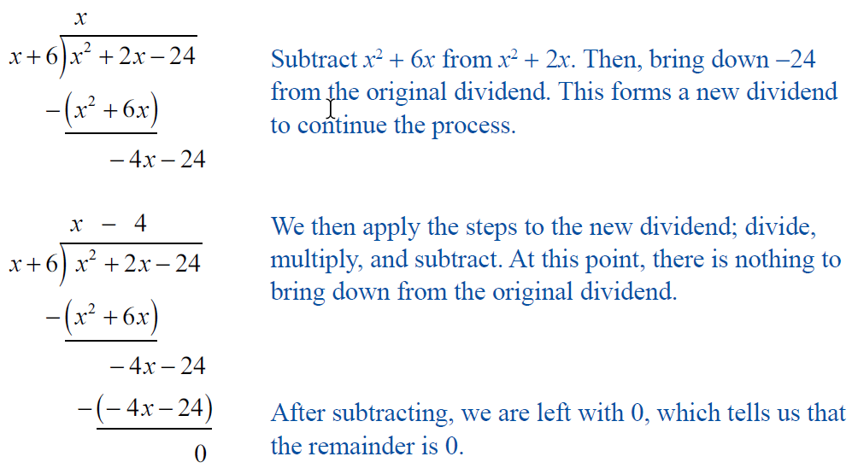
Example 1: Polynomial Long Division (cont.)

Slide 8

Example 1: Polynomial Long Division (cont.)
Thus, the quotient is $x−4$ with a remainder of 0.

Slide 9
Polynomial Long Division
Procedure
Step 1: Arrange the terms of each polynomial in descending order.
Step 2: Divide the first term in the dividend by the first term in the divisor. This gives the first term of the quotient.
Step 3: Multiply the entire divisor by the result (the first term of the quotient) and write this beneath the dividend so that like terms line up.

Slide 10
Polynomial Long Division (cont.)
Step 4: Subtract the product from the dividend.
Step 5: Bring down the rest of the original dividend, forming a new dividend.
Step 6: Repeat the process with the new dividend. Continue until the degree of the remainder is less than the degree of the divisor.

Slide 11

Example 2: Polynomial Long Division
Divide the polynomial $6x^{5}−5x^{4}+10x^{3}−15x^{2}−19$ by the polynomial $2x^{2}−x+3$.

Slide 12
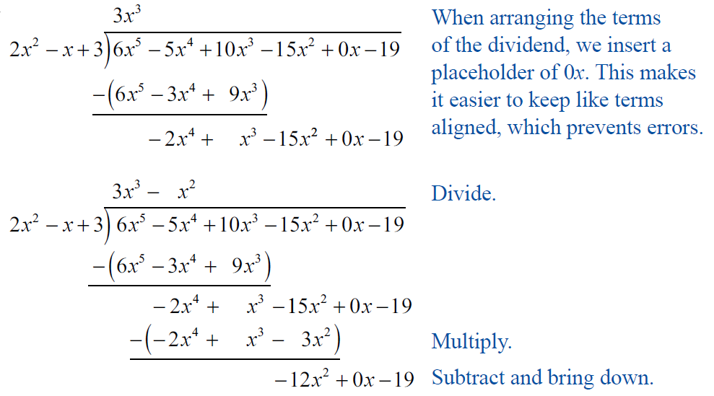
Example 2: Polynomial Long Division (cont.)
Solution

Slide 13
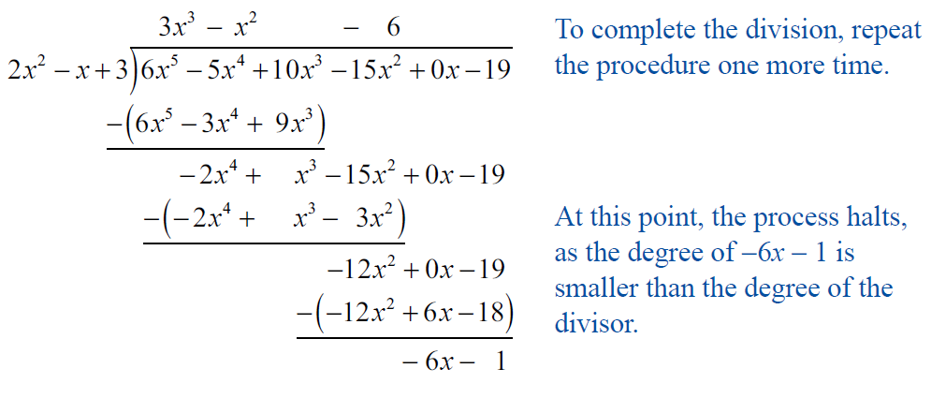
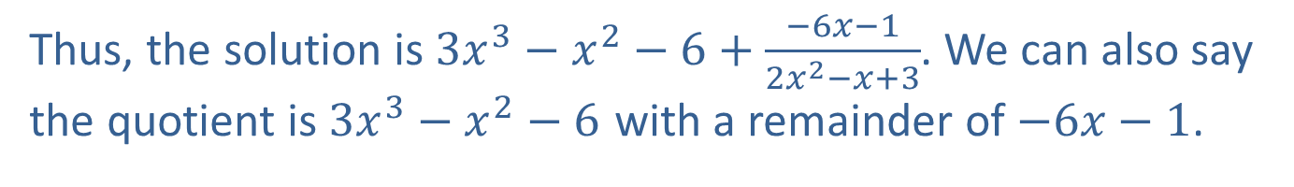
Example 2: Polynomial Long Division (cont.)
​
​
​
Thus, the solution is $3x^{3}−x^{2}−6+\frac{−6x−1}{2x^{2}−x+3}$. We can also say the quotient is $3x^{3}−x^{2}−6$ with a remainder of $−6x−1$.

Slide 14
CAUTION!
Although polynomial long division is a straightforward process, one common error is to forget to distribute the minus sign in each step as one polynomial is subtracted from the one above it. A good way to avoid this error is to put parentheses around the polynomial being subtracted, as shown in Examples 1 and 2.

Slide 15

Example 3: Polynomial Long Division with Complex Numbers
Divide $p\left(x\right)=x^{4}+1$ by $d\left(x\right)=x^{2}+i$.

Slide 16
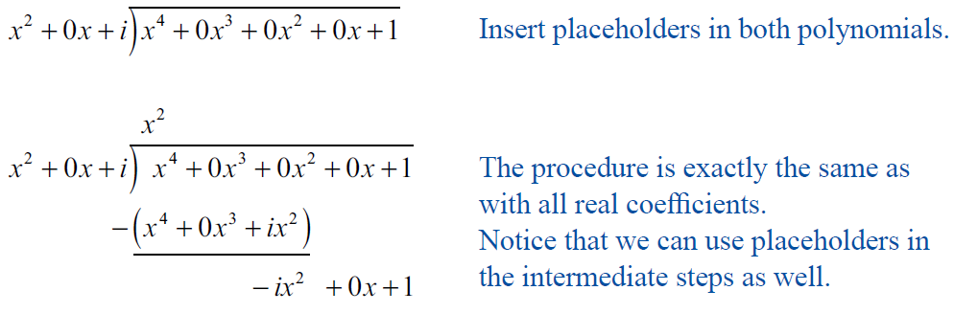
Example 3: Polynomial Long Division with Complex Numbers (cont.)
Solution

Slide 17
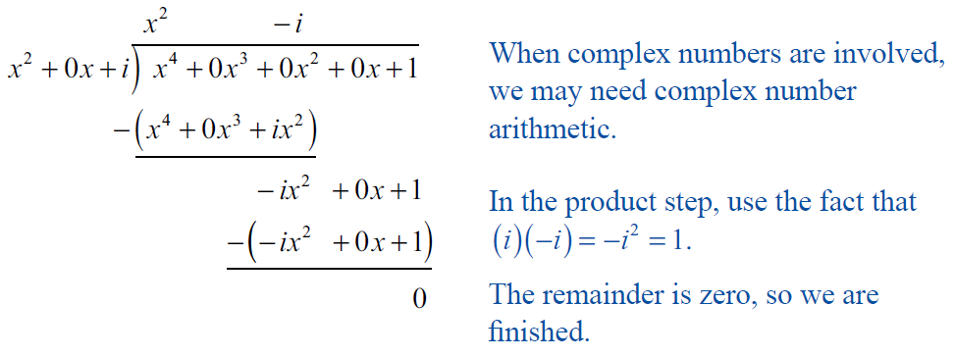
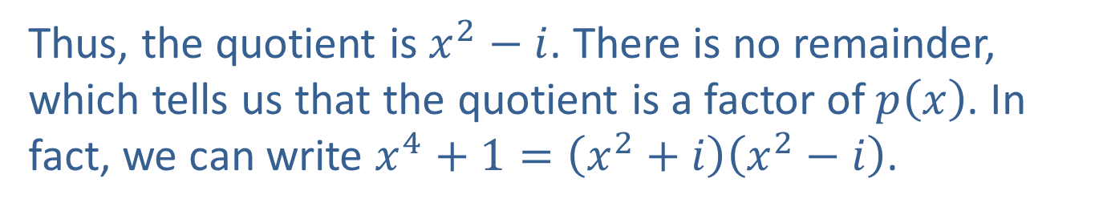
Example 3: Polynomial Long Division with Complex Numbers (cont.)
Thus, the quotient is $x^{2}−i$. There is no remainder, which tells us that the quotient is a factor of $p⁡\left(x\right)$. In fact, we can write $x^{4}+1=\left(x^{2}+i\right)\left(x^{2}−i\right)$.

Slide 18
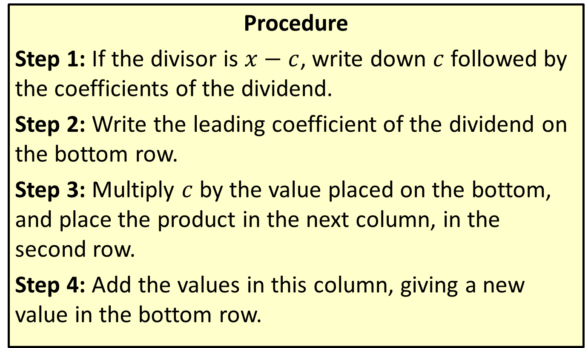
Synthetic Division
Procedure
Step 1: If the divisor is $x−c$, write down $c$ followed by the coefficients of the dividend.
Step 2: Write the leading coefficient of the dividend on the bottom row.
Step 3: Multiply $c$ by the value placed on the bottom, and place the product in the next column, in the second row.
Step 4: Add the values in this column, giving a new value in the bottom row.

Slide 19
Synthetic Division (cont.)
Step 5: Repeat this process until the table is complete.
Step 6: The numbers in the bottom row are the coefficients of the quotient, plus the remainder (which is the final value in this row). Note that the first term of the quotient will have degree one less than the first term of the dividend.

Slide 20

Example 4: Synthetic Division
For each polynomial $p$ below, divide $p$ by $x−c$ using synthetic division. Use the result to determine if the given $c$ is a zero. If not, determine $p⁡\left(c\right)$.
​$p\left(x\right)=−2x^{4}+11x^{3}−5x^{2}−3x+15$; $c=5$
​$p\left(x\right)=3x^{8}+9x^{7}−x^{3}−3x^{2}+x−1$; $c=−3$

Slide 21
Note:
Remember, unlike in long division, we add the vertically aligned values of synthetic division.

Slide 22
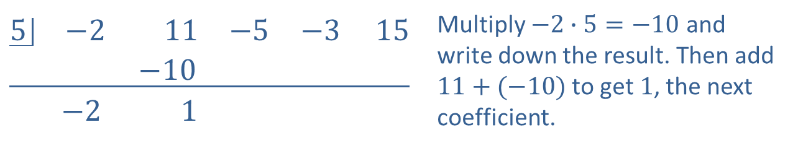
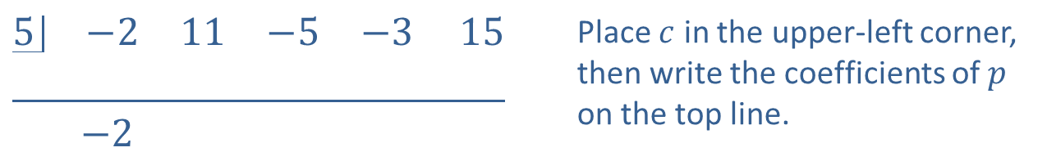
Example 4: Synthetic Division (cont.)
Solution
​
$$\underline{\begin{matrix}5 & −2 & 11 & −5 & −3 15 \\ & & & & \end{matrix}}$$ $$\begin{matrix} & −2 & & & \end{matrix}$$ | Place $c$ in the upper-left corner, then write the coefficients of $p$ on the top line.
$$\underline{\begin{matrix}5 & −2 & 11 & −5 & −3 15 \\ & & −10 & & \end{matrix}}$$ $$\begin{matrix} & −2 & 1 & & \end{matrix}$$ | Multiply $−2∙5=−10$ and write down the result. Then add $11+(−10)$ to get $1$, the next coefficient.

Slide 23
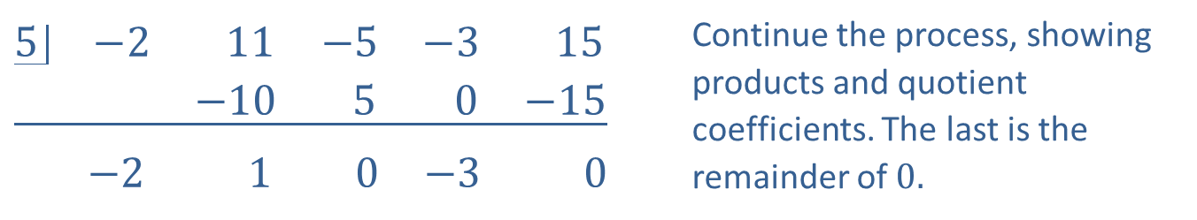
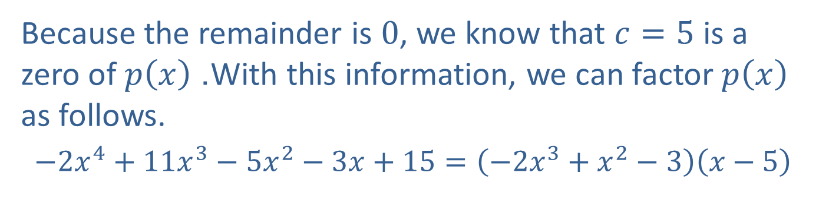
Example 4: Synthetic Division (cont.)
$$\underline{\begin{matrix}5 & −2 & 11 & −5 & −3 & 15 \\ & & −10 & 5 & 0 & −15\end{matrix}}$$ $\begin{matrix} & −2 & 1 & 0 & −3 & 0\end{matrix}$ | Continue the process, showing products and quotient coefficients. The last is the remainder of $0.$
​Because the remainder is 0, we know that $c=5$ is a zero of $p⁡\left(x\right)$. With this information, we can factor $p⁡\left(x\right)$ as follows.
​ $−2x^{4}+11x^{3}−5x^{2}−3x+15=\left(−2x^{3}+x^{2}−3\right)\left(x−5\right)$

Slide 24
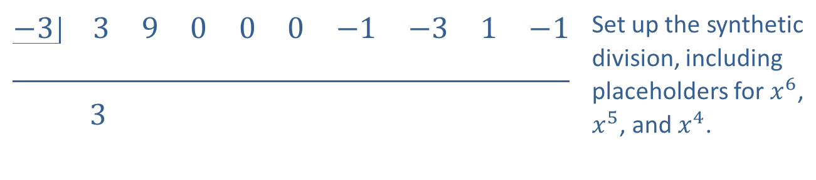
Example 4: Synthetic Division (cont.)
​While placeholders for missing terms are useful in long division, they are necessary when doing synthetic division.
​
$$\underline{\begin{matrix}−3 & 3 & 9 & 0 & 0 & 0 & −1 & −3 & 1 & −1 \\ & & & & & & & & & \end{matrix}}$$ $\begin{matrix} & 3 & & & & & & & & \end{matrix}$ | Set up the synthetic division, including placeholders for $x^{6}$, $x^{5}$, and $x^{4}$.

Slide 25
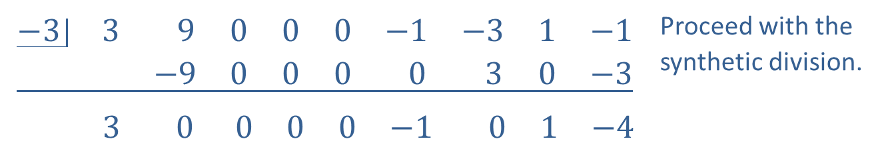
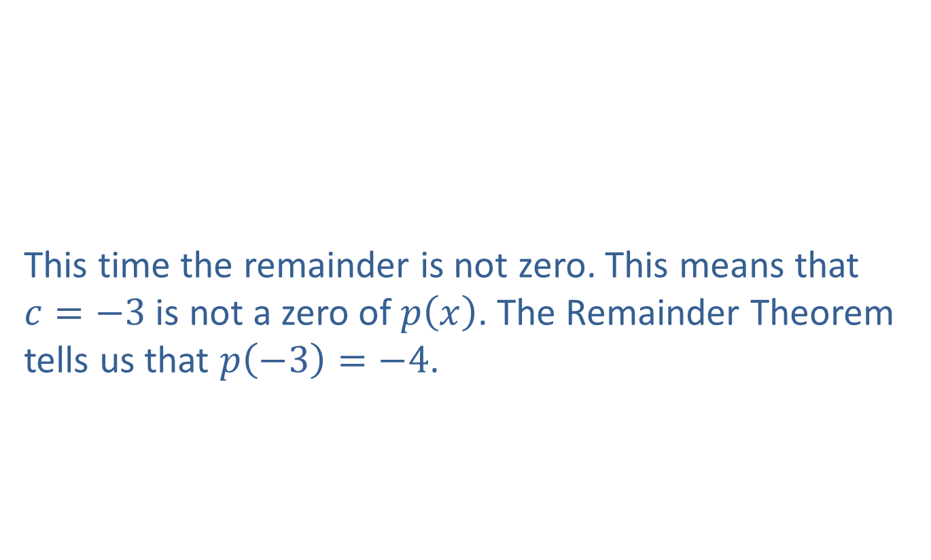
Example 4: Synthetic Division (cont.)
​
This time the remainder is not zero. This means that $c=−3$ is not a zero of $p⁡\left(x\right)$. The Remainder Theorem tells us that $p\left(−3\right)=−4$.
$$\underline{\begin{matrix}−3 & 3 & 9 & 0 & 0 & 0 & −1 & −3 & 1 & −1 \\ & & −9 & 0 & 0 & 0 & 0 & 3 & 0 & −3\end{matrix}}$$ $\begin{matrix} & 3 & 0 & 0 & 0 & 0 & −1 & 0 & 1 & −4\end{matrix}$ | Proceed with the synthetic division.

Slide 26

Example 5: Synthetic Division (with Complex Numbers)
Compute $\frac{−3x^{3}+\left(5−2i\right)x^{2}+\left(−4+i\right)x+\left(1−i\right)}{x−1+i}$ using synthetic division.

Slide 27
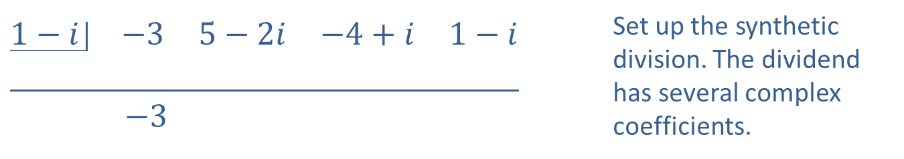

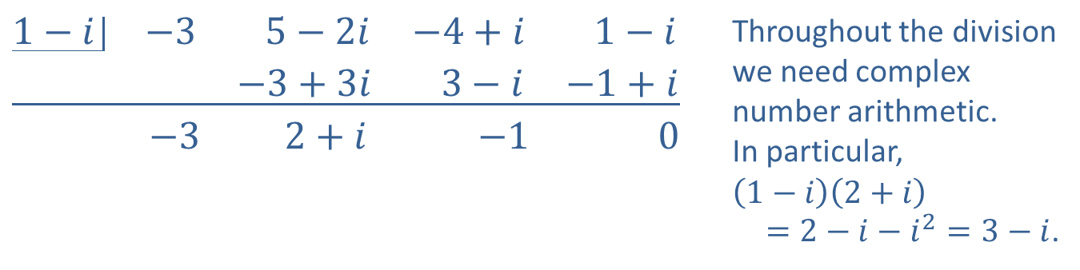
Example 5: Synthetic Division (with Complex Numbers) (cont.)
Solution
Thus, the quotient is $−3x^{2}+\left(2+i\right)x−1$.
$$\underline{\begin{matrix}1−i & −3 & 5−2i & −4+i & 1−i \\ & & & & \end{matrix}}$$ $$\begin{matrix} & −3 & & & \end{matrix}$$ | Set up the synthetic division. The dividend has several complex coefficients.
$$\underline{\begin{matrix}1−i & −3 & 5−2i & −4+i & 1−i \\ & & −3+3i & 3−i & −1+i\end{matrix}}$$ $$\begin{matrix} & −3 & 2+i & −1 & 0\end{matrix}$$ | Throughout the division we need complex number arithmetic. In particular, $$\left(1−i\right)\left(2+i\right)$$ $=2−i−i^{2}=3−i$.

Slide 28

Example 6: Constructing Polynomials
Construct a polynomial that has the given properties.
​Third-degree, zeros of $−3$, 2, and 5, and goes to $−∞$ as $x→∞$.
​Fourth-degree, zeros of $−5$, $−2$, 1, and 3, and $y$-intercept at $\left(0,15\right)$.

Slide 29
Note:
When constructing polynomials from a set of factors, it is easier to keep the result in factored form until the last step. Often, it is fine to leave the polynomial in factored form.

Slide 30
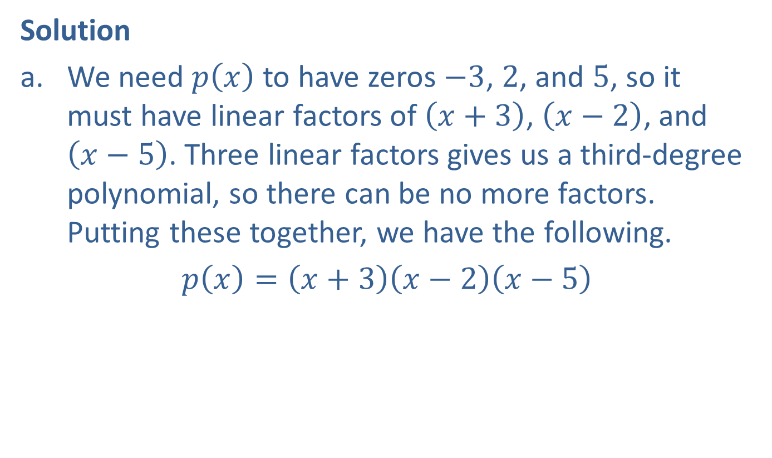
Example 6: Constructing Polynomials (cont.)
Solution
​We need $p⁡\left(x\right)$ to have zeros $−3$, 2, and 5, so it must have linear factors of $\left(x+3\right)$, $\left(x−2\right)$, and $\left(x−5\right)$. Three linear factors gives us a third-degree polynomial, so there can be no more factors. Putting these together, we have the following.
​$p\left(x\right)=\left(x+3\right)\left(x−2\right)\left(x−5\right)$
​

Slide 31
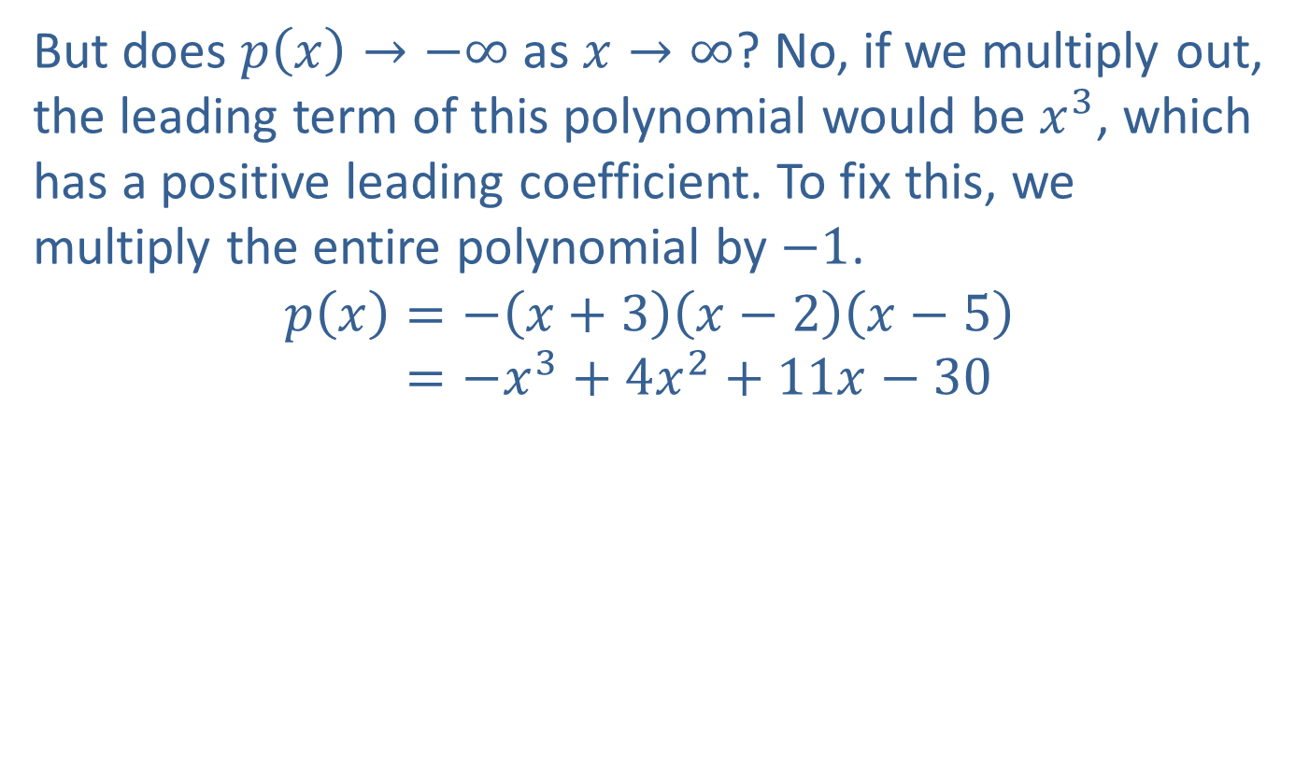
Example 6: Constructing Polynomials (cont.)
​But does $p\left(x\right)→−∞$ as $x→∞$? No, if we multiply out, the leading term of this polynomial would be $x^{3}$, which has a positive leading coefficient. To fix this, we multiply the entire polynomial by $−1$.
𝑝𝑥=−𝑥+3𝑥−2𝑥−5𝑝⁡𝑥=−𝑥3+4𝑥2+11𝑥−30

Slide 32
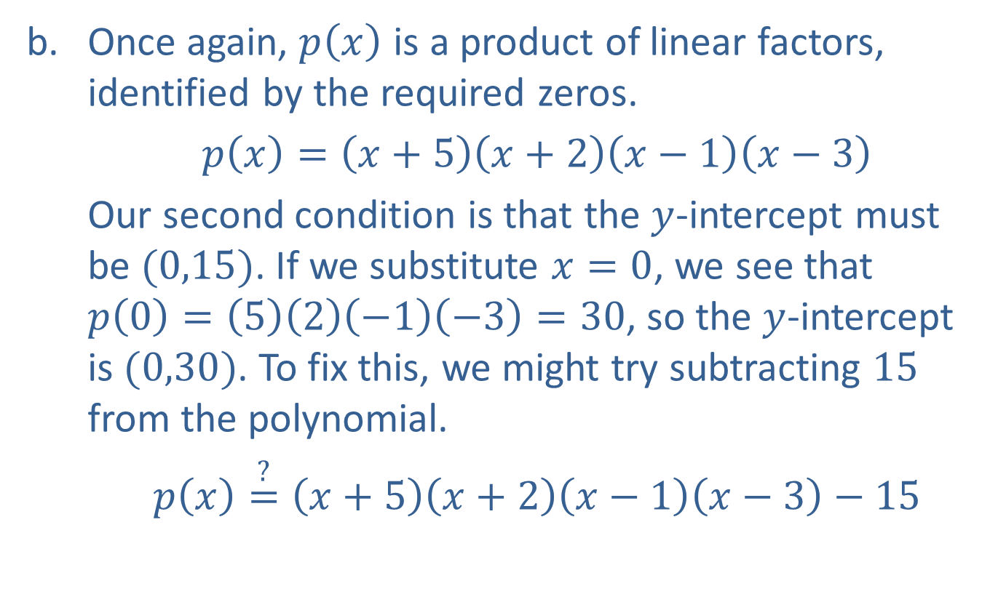
Example 6: Constructing Polynomials (cont.)
​Once again, $p⁡\left(x\right)$ is a product of linear factors, identified by the required zeros.
​$p\left(x\right)=\left(x+5\right)\left(x+2\right)\left(x−1\right)\left(x−3\right)$
​Our second condition is that the $y$-intercept must be $(0,15)$. If we substitute $x=0$, we see that $p\left(0\right)=\left(5\right)\left(2\right)\left(−1\right)\left(−3\right)=30$, so the $y$-intercept is $(0,30)$. To fix this, we might try subtracting 15 from the polynomial.
$p\left(x\right)\overset{?}{=}\left(x+5\right)\left(x+2\right)\left(x−1\right)\left(x−3\right)−15$

Slide 33
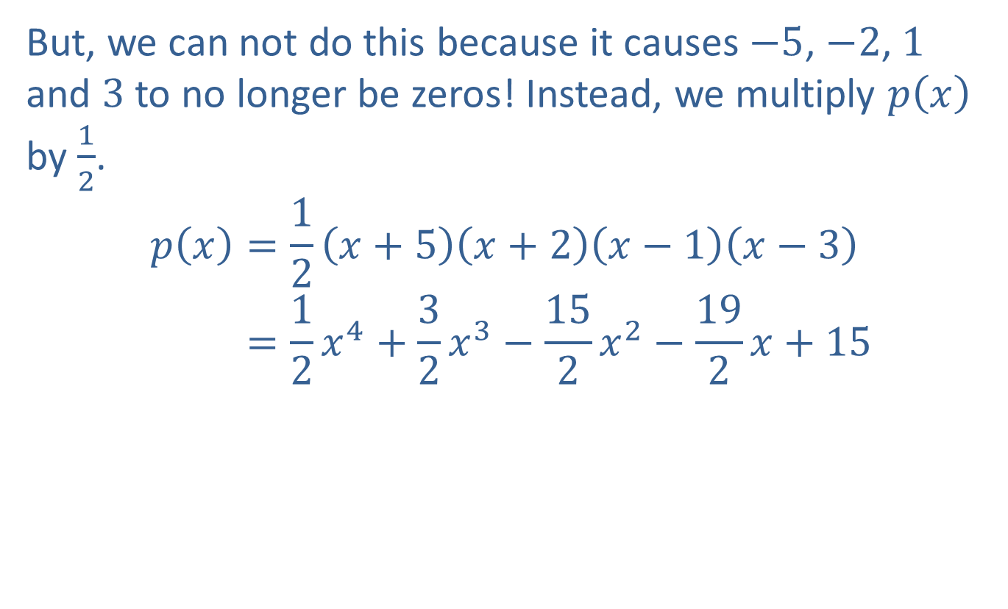
Example 6: Constructing Polynomials (cont.)
​​But, we can not do this because it causes $−5$, $−2$, 1 and 3 to no longer be zeros! Instead, we multiply $p⁡\left(x\right)$ by $\frac{1}{2}$.
𝑝𝑥=12𝑥+5𝑥+2𝑥−1𝑥−3𝑝⁡𝑥=12𝑥4+32𝑥3−152𝑥2−192𝑥+15

