Slide 1
Section 6.4
The Fundamental Theorem of Algebra

Slide 2
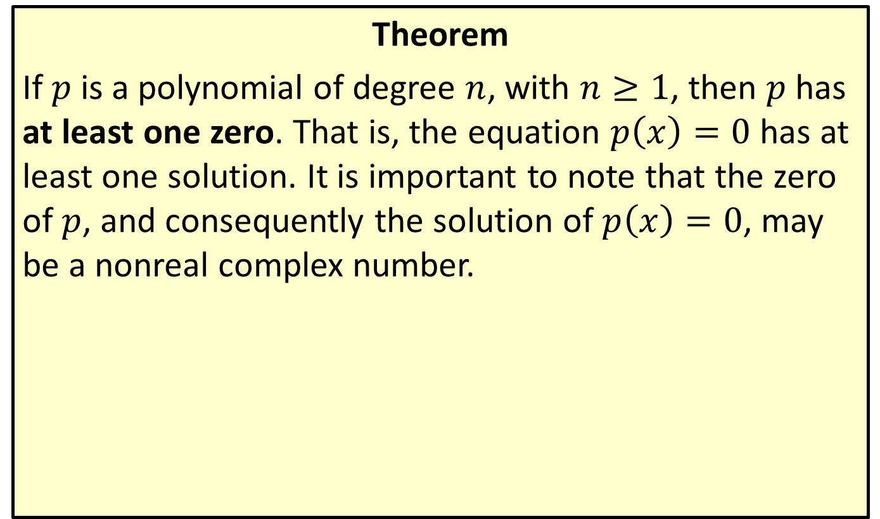
The Fundamental Theorem of Algebra
Theorem
If $p$ is a polynomial of degree $n$, with $n≥1$, then $p$ has at least one zero. That is, the equation $p\left(x\right)=0$ has at least one solution. It is important to note that the zero of $p$, and consequently the solution of $p\left(x\right)=0$, may be a nonreal complex number.

Slide 3
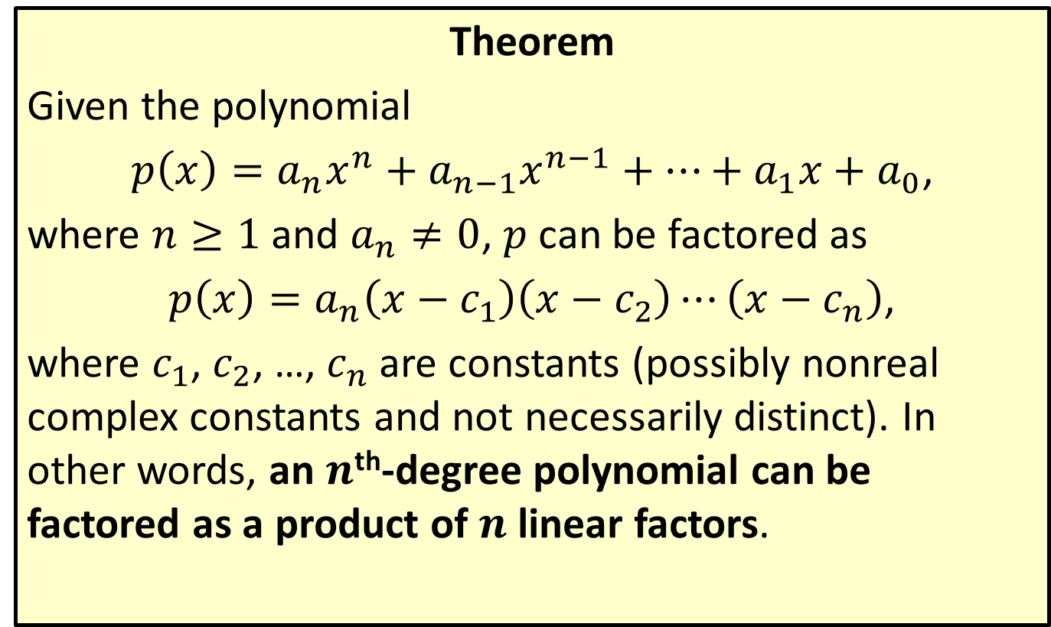
The Linear Factors Theorem
Theorem
Given the polynomial
$p\left(x\right)=a_{n}x^{n}+a_{n−1}x^{n−1}+…+a_{1}x+a_{0}$,
where $n≥1$ and $a_{n}≠0$, $p$ can be factored as
$p\left(x\right)=a_{n}\left(x−c_{1}\right)\left(x−c_{2}\right)⋯\left(x−c_{n}\right)$,
where $c_{1}$, $c_{2}$, …, $c_{n}$ are constants (possibly nonreal complex constants and not necessarily distinct). In other words, an $n$^{th}-degree polynomial can be factored as a product of $n$ linear factors.

Slide 4
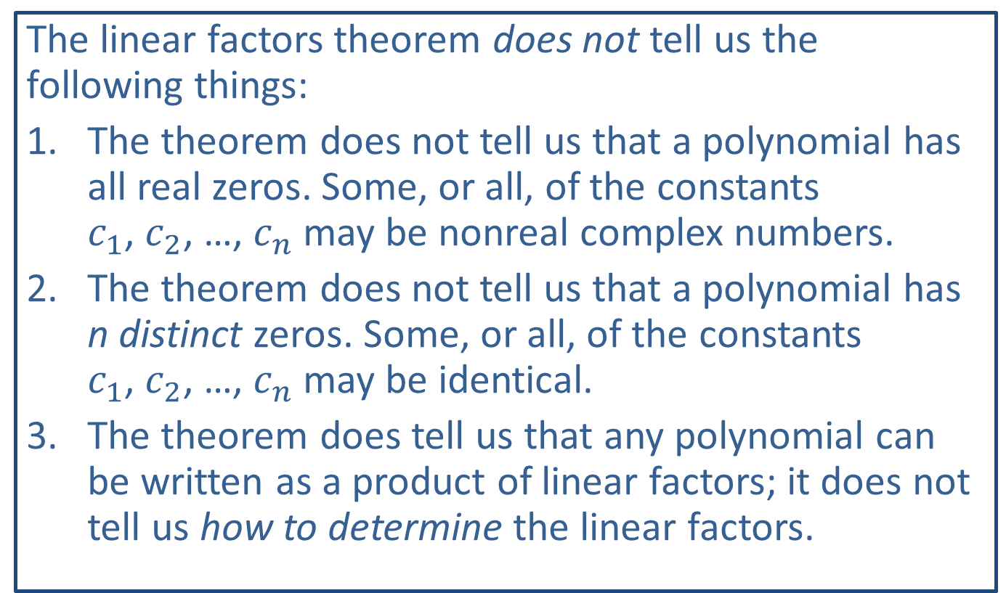
CAUTION!
The linear factors theorem does not tell us the following things:
​The theorem does not tell us that a polynomial has all real zeros. Some, or all, of the constants $c_{1}$, $c_{2}$, …, $c_{n}$ may be nonreal complex numbers.
​The theorem does not tell us that a polynomial has n distinct zeros. Some, or all, of the constants $c_{1}$, $c_{2}$, …, $c_{n}$ may be identical.
​The theorem does tell us that any polynomial can be written as a product of linear factors; it does not tell us how to determine the linear factors.

Slide 5
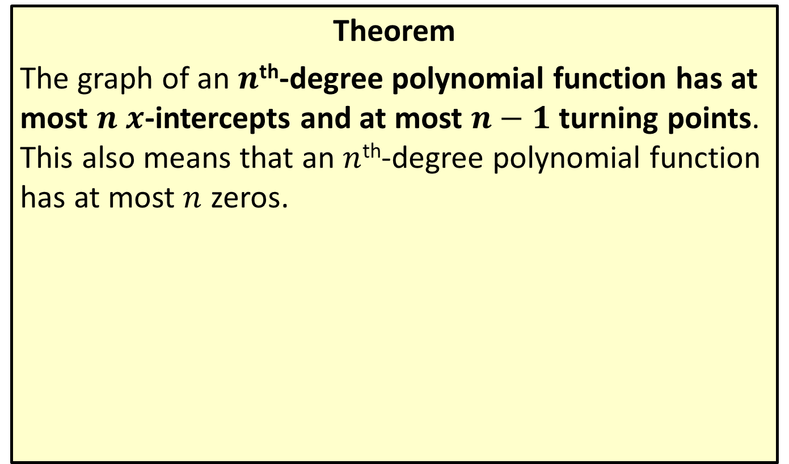
Interpreting the Linear Factors Theorem
Theorem
The graph of an $n$^{th}-degree polynomial function has at most $n$ $x$-intercepts and at most $n−1$ turning points. This also means that an $n$^{th}-degree polynomial function has at most $n$ zeros.

Slide 6
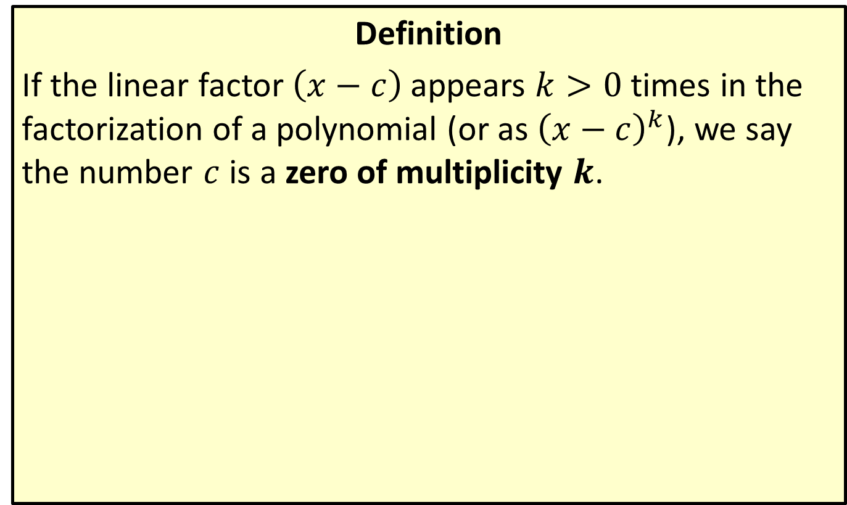
Multiplicity of Zeros
Definition
If the linear factor $\left(x−c\right)$ appears $k>0$ times in the factorization of a polynomial (or as ${\left(x−c\right)}^{k}$), we say the number $c$ is a zero of multiplicity $k$.

Slide 7
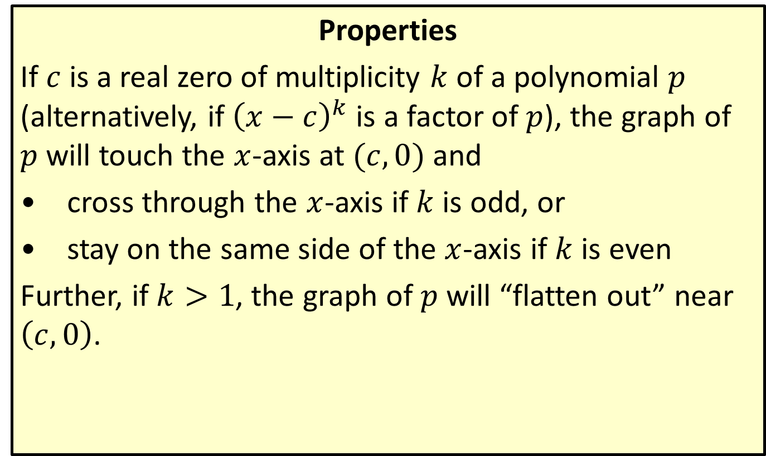
Geometric Meaning of Multiplicity
Properties
If $c$ is a real zero of multiplicity $k$ of a polynomial $p$ (alternatively, if ${\left(x−c\right)}^{k}$ is a factor of $p$), the graph of $p$ will touch the $x$-axis at $(c,0)$ and
​cross through the $x$-axis if $k$ is odd, or
​stay on the same side of the $x$-axis if $k$ is even
Further, if $k>1$, the graph of $p$ will “flatten out” near $\left(c,0\right)$.

Slide 8

Example 1: Graphing Polynomial Functions
Sketch the graph of the polynomial
$f\left(x\right)=\left(x+2\right){\left(x+1\right)}^{2}{\left(x−3\right)}^{3}$.

Slide 9
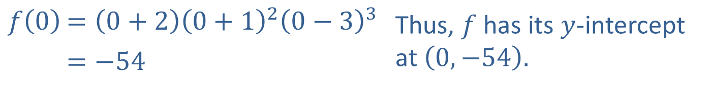
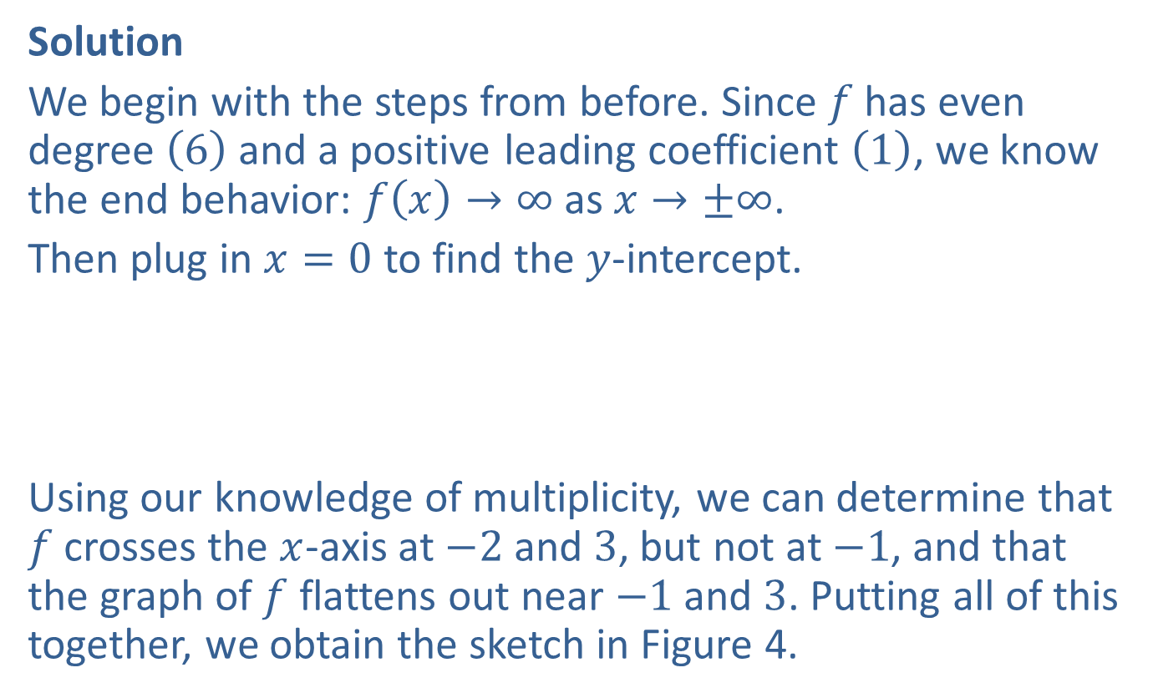
Example 1: Graphing Polynomial Functions (cont.)
Solution
We begin with the steps from before. Since $f$ has even degree $\left(6\right)$ and a positive leading coefficient $\left(1\right)$, we know the end behavior: $f\left(x\right)→∞$ as $x→±∞$.
Then plug in $x=0$ to find the $y$-intercept.
Using our knowledge of multiplicity, we can determine that $f$ crosses the $x$-axis at $−2$ and 3, but not at $−1$, and that the graph of $f$ flattens out near $−1$ and 3. Putting all of this together, we obtain the sketch in Figure 4.
$$f\left(0\right)$$ | $=\left(0+2\right){\left(0+1\right)}^{2}{\left(0−3\right)}^{3}$ | Thus, $f$ has its $y$-intercept at $\left(0,−54\right)$.
 | $=−54$

Slide 10
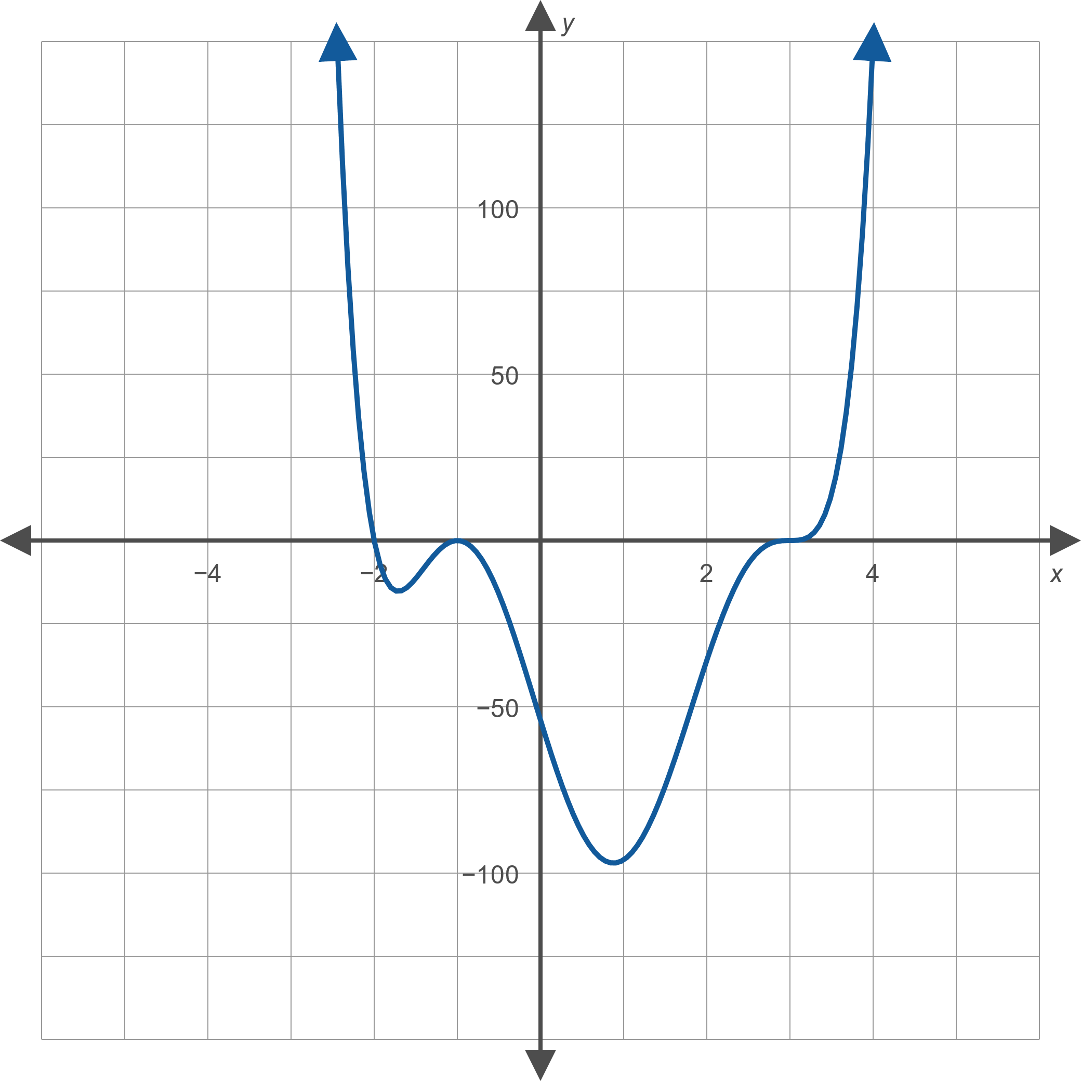
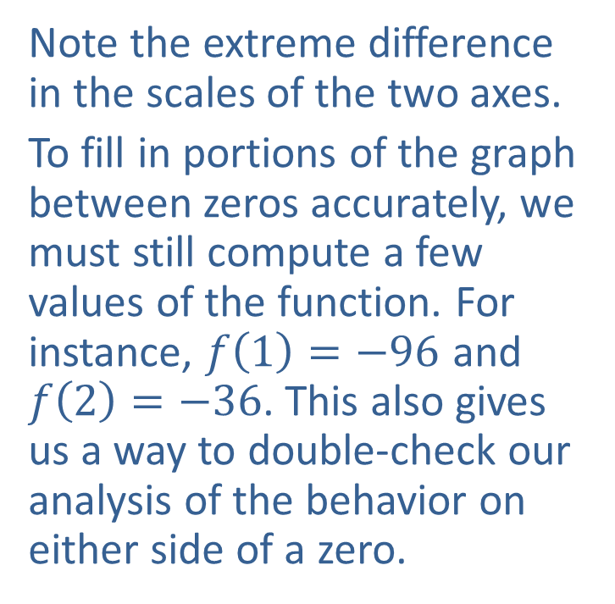
Example 1: Graphing Polynomial Functions (cont.)
Note the extreme difference in the scales of the two axes.
To fill in portions of the graph between zeros accurately, we must still compute a few values of the function. For instance, $f\left(1\right)=−96$ and $f\left(2\right)=−36$. This also gives us a way to double-check our analysis of the behavior on either side of a zero.
Figure 4

Slide 11
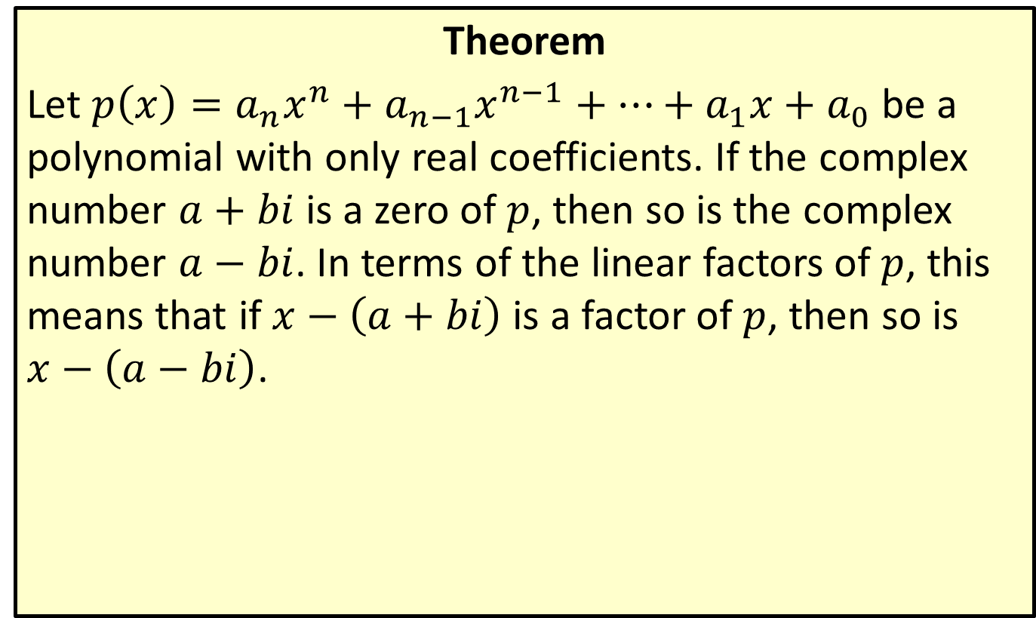
The Conjugate Roots Theorem
Theorem
Let $p\left(x\right)=a_{n}x^{n}+a_{n−1}x^{n−1}+…+a_{1}x+a_{0}$ be a polynomial with only real coefficients. If the complex number $a+bi$ is a zero of $p$, then so is the complex number $a−bi$. In terms of the linear factors of $p$, this means that if $x−\left(a+bi\right)$ is a factor of $p$, then so is $x−\left(a−bi\right)$.

Slide 12

Example 2: Factoring Polynomials
Given that $4−3i$ is a zero of the polynomial $f\left(x\right)=x^{4}−8x^{3}+200x−625$, factor $f$ completely.

Slide 13
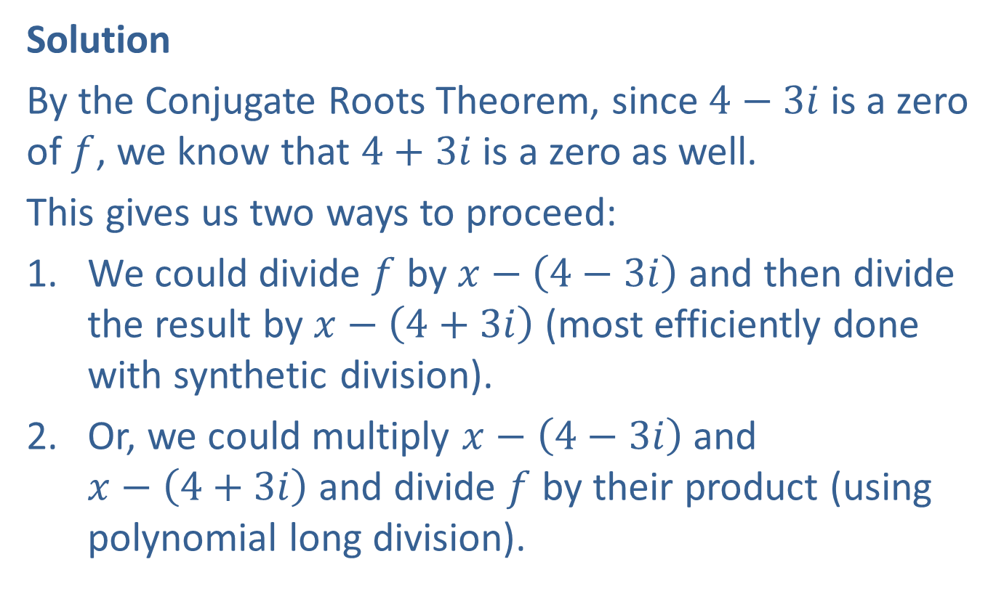
Example 2: Factoring Polynomials (cont.)
Solution
By the Conjugate Roots Theorem, since $4−3i$ is a zero of $f$, we know that $4+3i$ is a zero as well.
This gives us two ways to proceed:
​We could divide $f$ by $x−\left(4−3i\right)$ and then divide the result by $x−\left(4+3i\right)$ (most efficiently done with synthetic division).
​Or, we could multiply $x−\left(4−3i\right)$ and $x−\left(4+3i\right)$ and divide $f$ by their product (using polynomial long division).

Slide 14
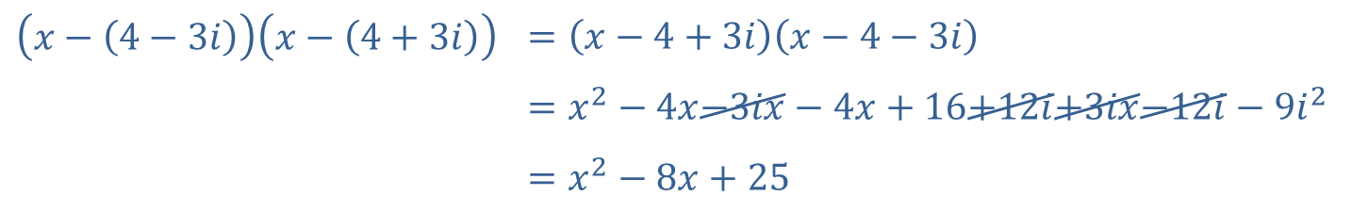
Example 2: Factoring Polynomials (cont.)
In either case, we will be left with a quadratic polynomial that we know we can factor.
If we take the second approach, the first step is as follows:
$$\left(x−\left(4−3i\right)\right)\left(x−\left(4+3i\right)\right)$$ | $$=\left(x−4+3i\right)\left(x−4−3i\right)$$
 | $$=x^{2}−4x−3ix−4x+16+12i+3ix−12i−9i^{2}$$
 | $$=x^{2}−8x+25$$

Slide 15
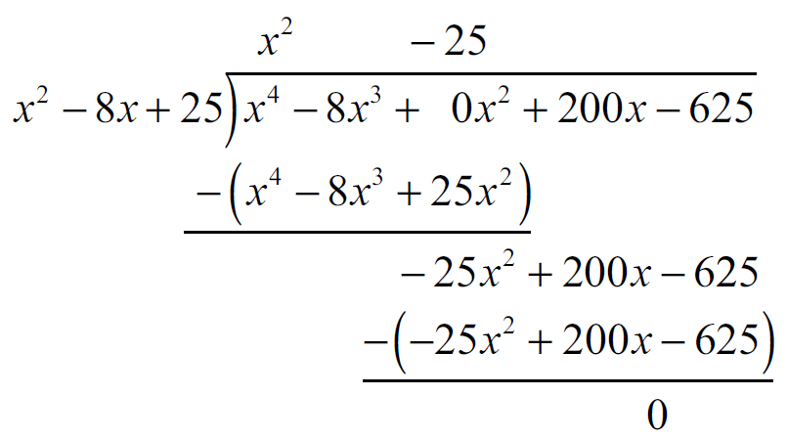

Example 2: Factoring Polynomials (cont.)
Now we divide $f$ by this product:
The quotient, $x^{2}−25$, is a difference of two squares and is easily factored, giving us our final result:
$$f\left(x\right)=\left(x−4+3i\right)\left(x−4−3i\right)\left(x−5\right)\left(x+5\right)$$

Slide 16

Example 3: Constructing Polynomials
Construct a fourth-degree real-coefficient polynomial function $f$ with zeros of 2, $−5$, and $1+i$ such that $f\left(1\right)=12$.

Slide 17
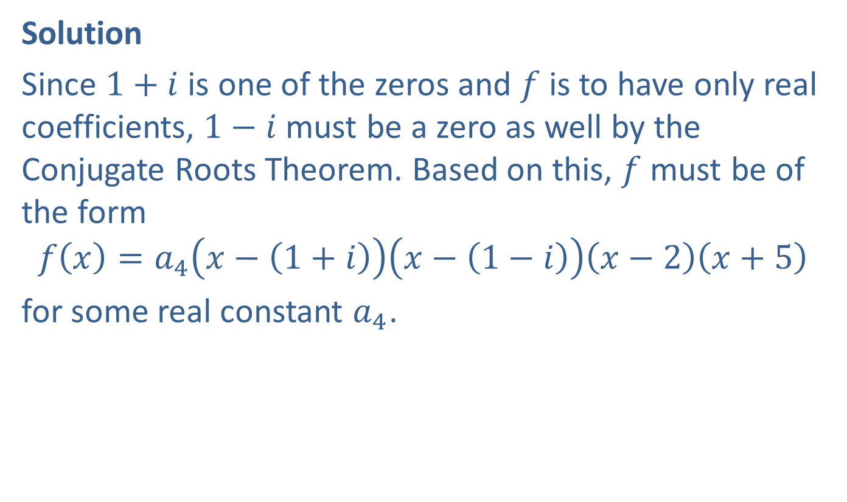
Example 3: Constructing Polynomials (cont.)
Solution
Since $1+i$ is one of the zeros and $f$ is to have only real coefficients, $1−i$ must be a zero as well by the Conjugate Roots Theorem. Based on this, $f$ must be of the form
$$f\left(x\right)=a_{4}\left(x−\left(1+i\right)\right)\left(x−\left(1−i\right)\right)\left(x−2\right)\left(x+5\right)$$
for some real constant $a_{4}$.

Slide 18

Example 3: Constructing Polynomials (cont.)
We must find $a_{4}$ so that $f\left(1\right)=12$. In order to do this, we begin by multiplying out $\left(x−\left(1+i\right)\right)\left(x−\left(1−i\right)\right)$:
𝑥−1+𝑖𝑥−1−𝑖=𝑥−1−𝑖𝑥−1+𝑖𝑥−1+𝑖𝑥−1−𝑖=𝑥2−2𝑥+2

Slide 19
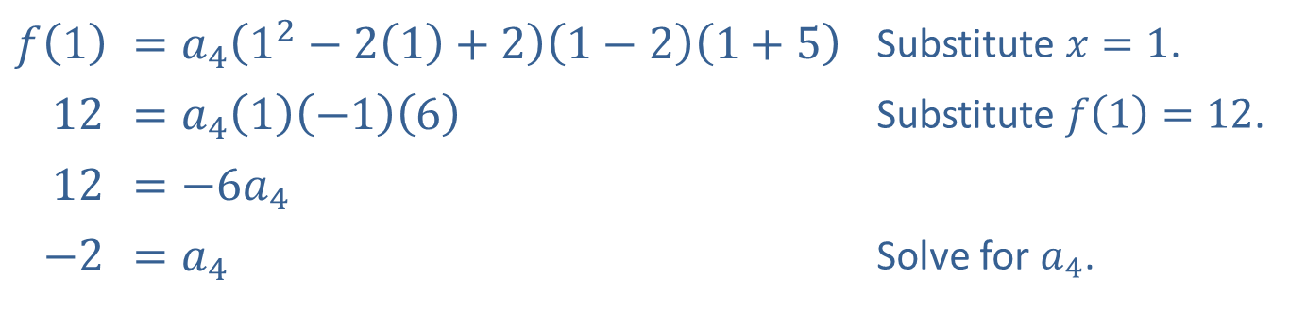

Example 3: Constructing Polynomials (cont.)
We then plug in $x=1$ and $f\left(1\right)=12$, then solve for $a_{4}$.
In factored form, the polynomial is
$f\left(x\right)=−2\left(x−1−i\right)\left(x−1+i\right)\left(x−2\right)\left(x+5\right)$,
which, if multiplied out, is
$f\left(x\right)=−2x^{4}−2x^{3}+28x^{2}−52x+40$.
$$f⁡\left(1\right)$$ | ​$=a_{4}\left(1^{2}−2\left(1\right)+2\right)\left(1−2\right)\left(1+5\right)$ | Substitute $x=1$.
​12 | ​$=a_{4}\left(1\right)\left(−1\right)\left(6\right)$ | Substitute $f\left(1\right)=12$.
​12 | ​$=−6a_{4}$
​$−2$ | ​$=a_{4}$ | Solve for $a_{4}$.

