Slide 1
Section 6.5
Rational Functions and Rational Inequalities

Slide 2
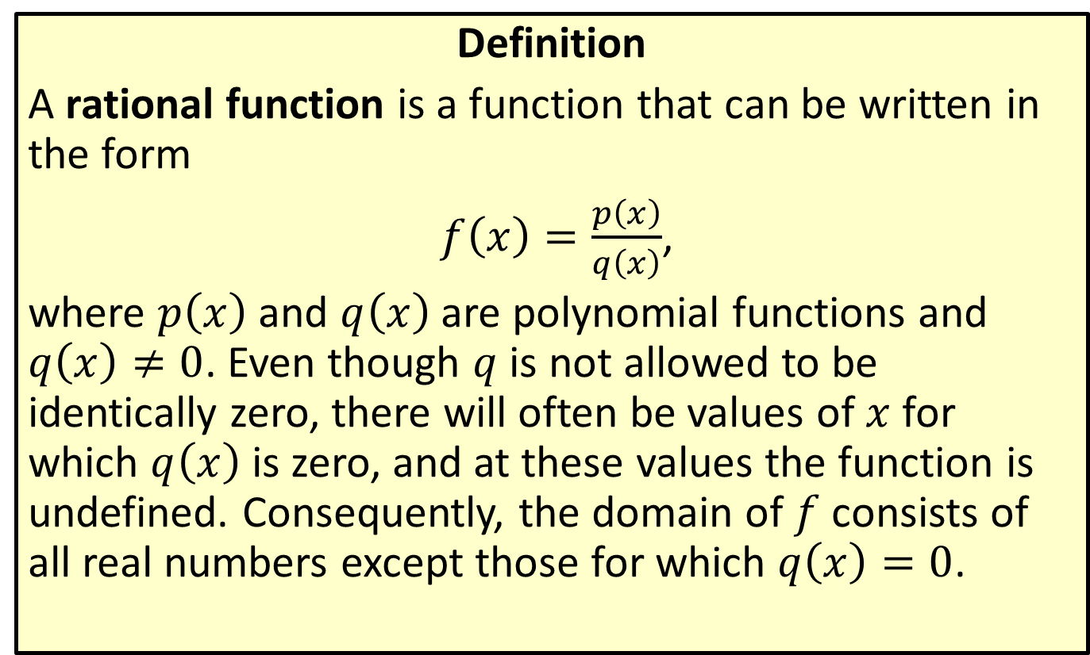
Rational Functions
Definition
A rational function is a function that can be written in the form
$f\left(x\right)=\frac{p\left(x\right)}{q\left(x\right)}$,
where $p⁡\left(x\right)$ and $q⁡\left(x\right)$ are polynomial functions and $q\left(x\right)≠0$. Even though $q$ is not allowed to be identically zero, there will often be values of $x$ for which $q⁡\left(x\right)$ is zero, and at these values the function is undefined. Consequently, the domain of $f$ consists of all real numbers except those for which $q\left(x\right)=0$.

Slide 3
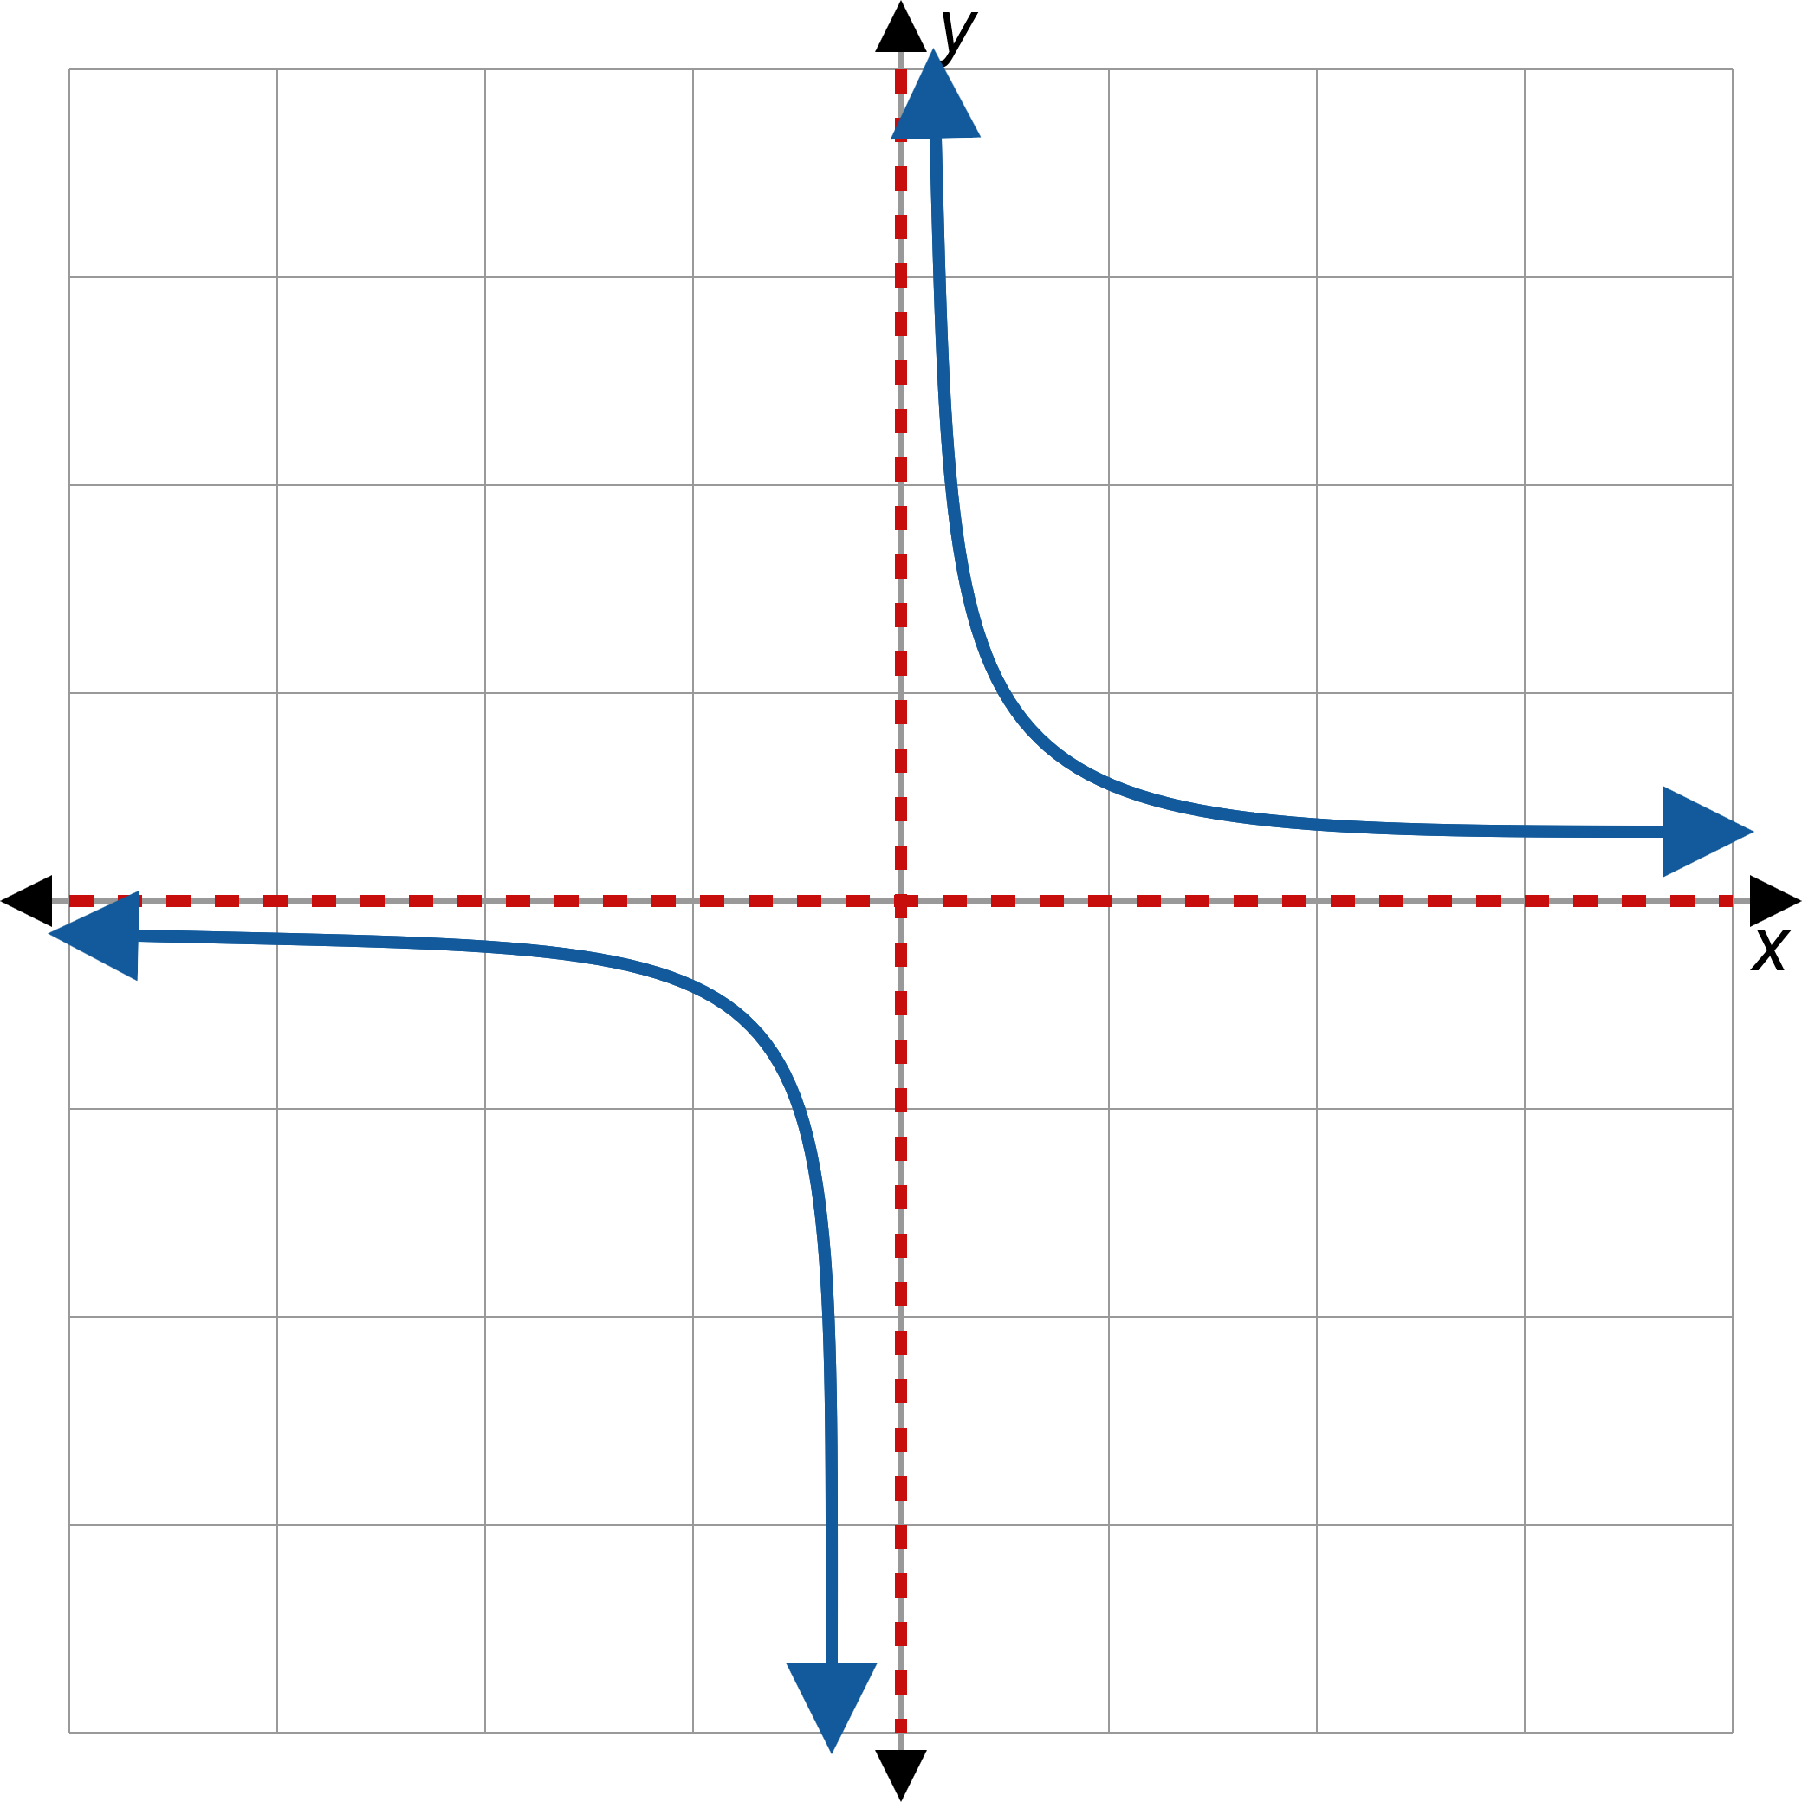
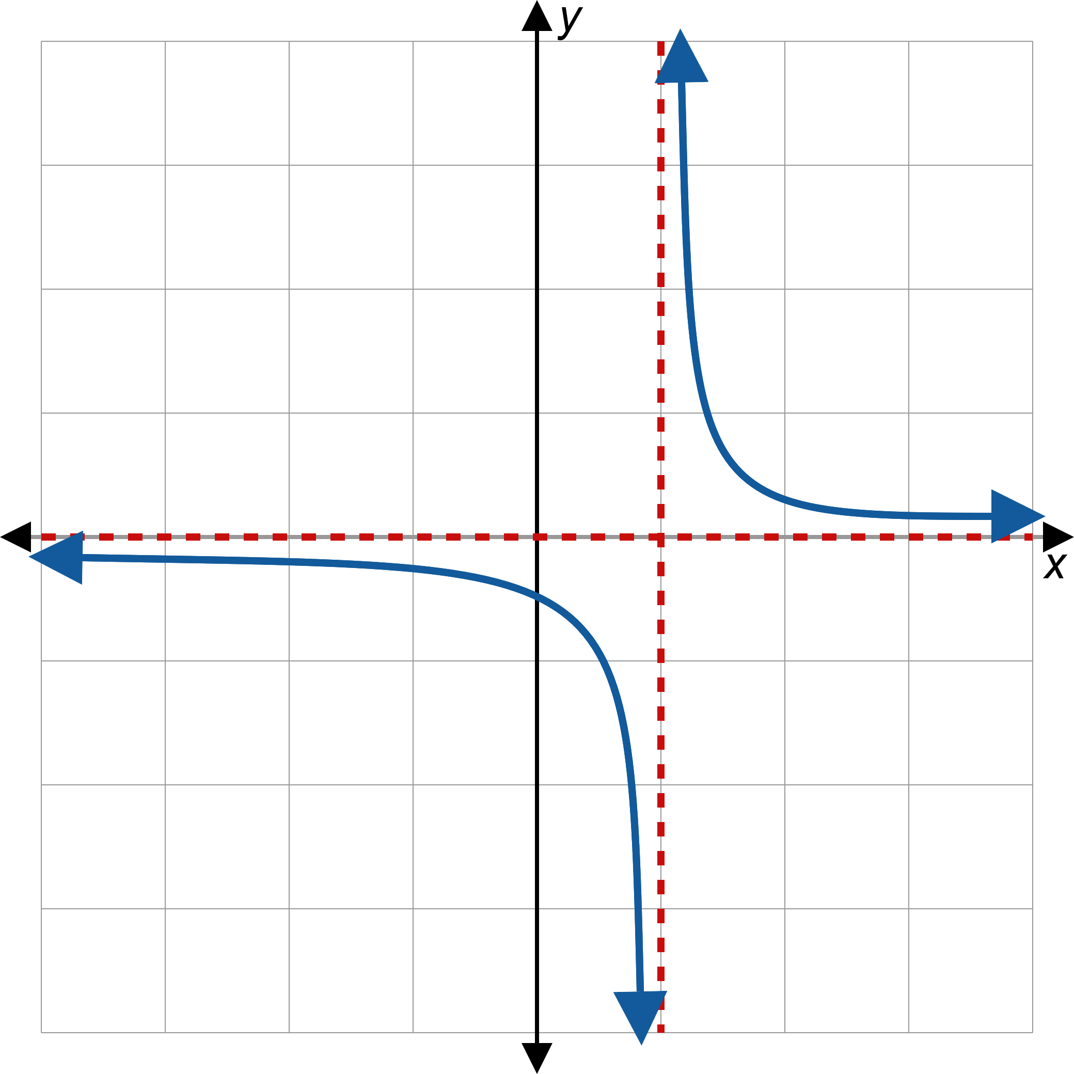
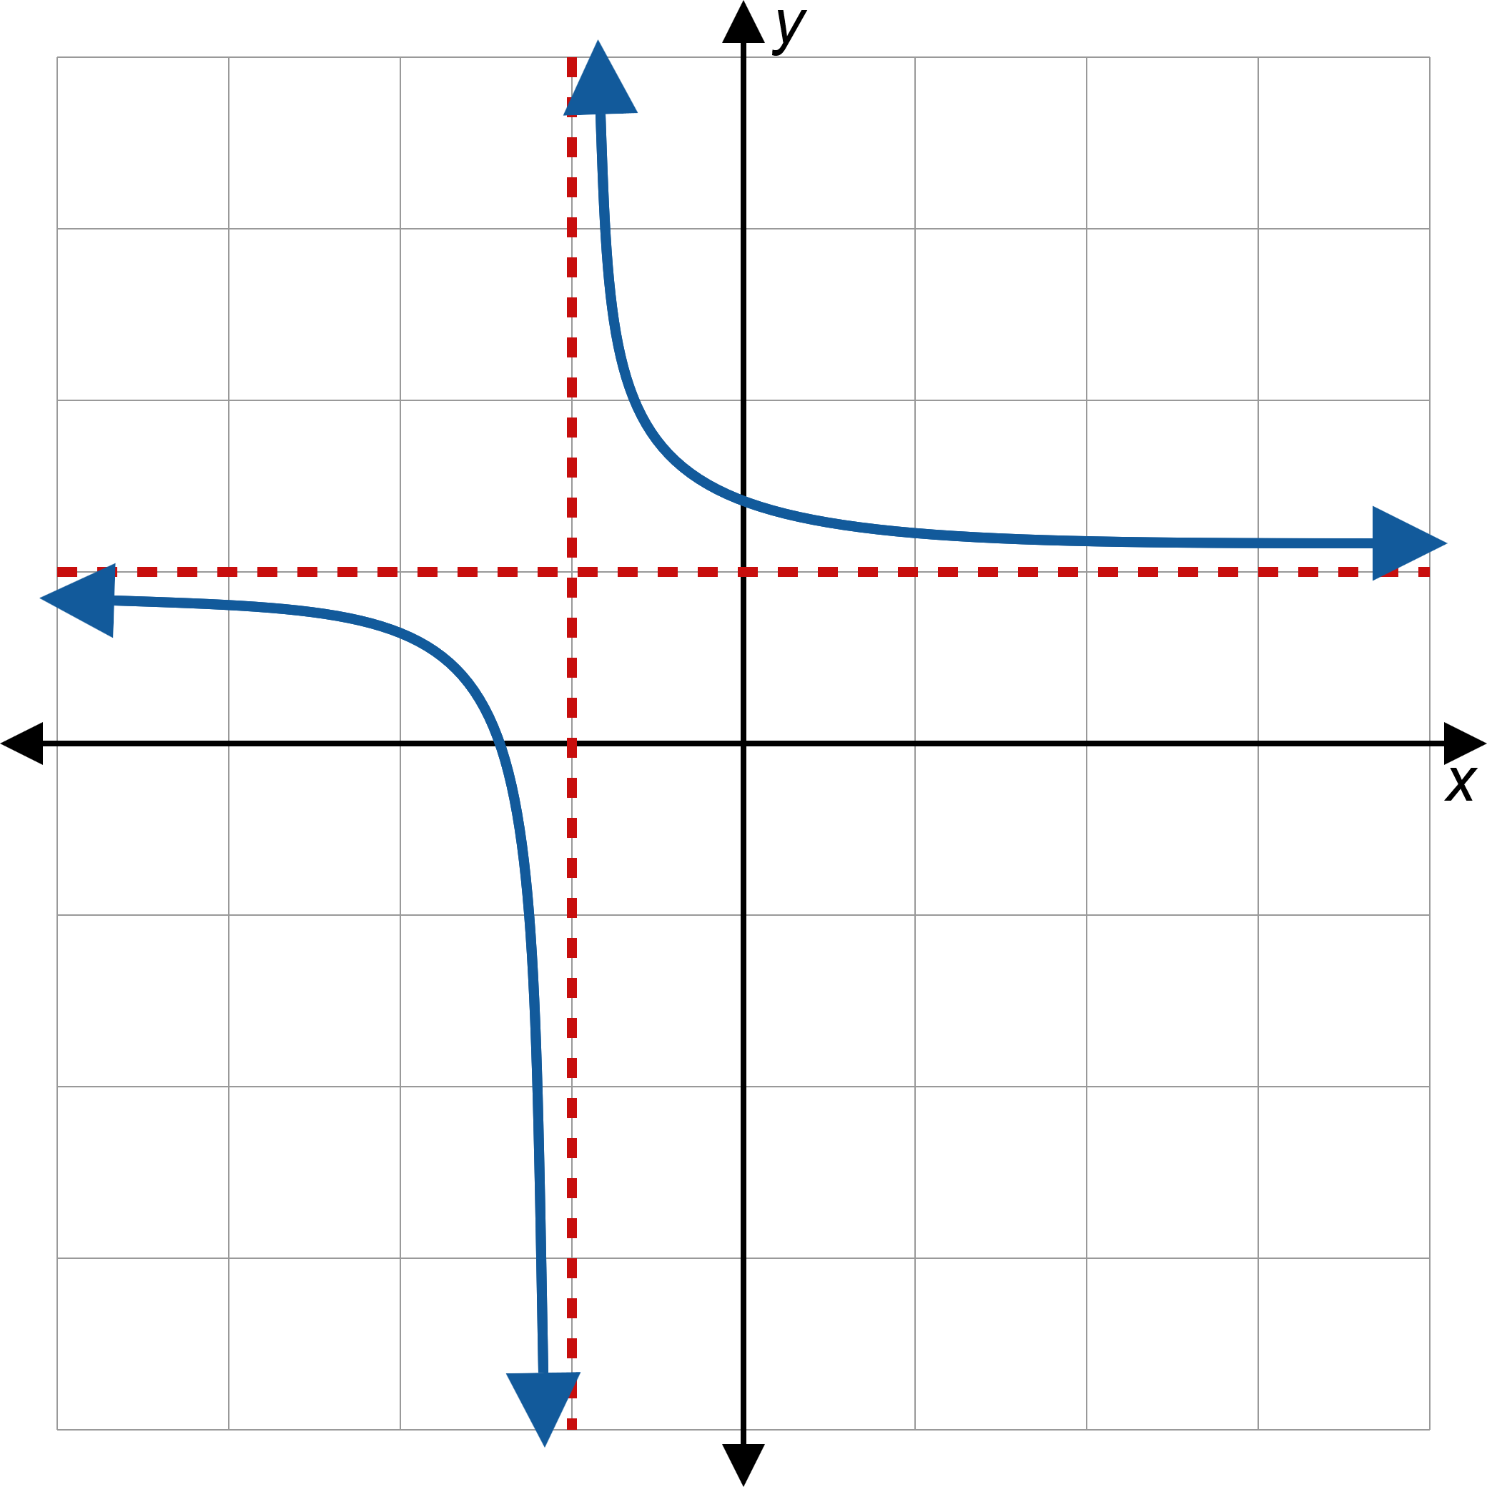
Rational Functions (cont.)
Figure 1: Graphs of Three Rational Functions

Slide 4
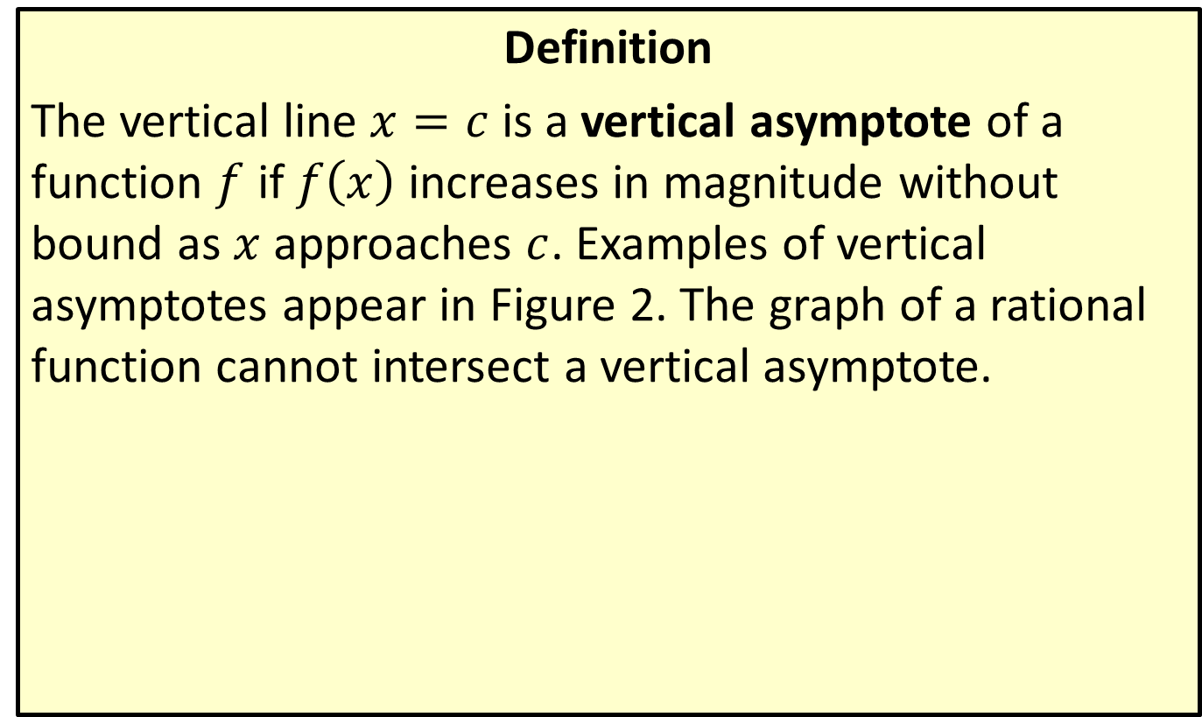
Vertical Asymptotes
Definition
The vertical line $x=c$ is a vertical asymptote of a function $f$ if $f⁡\left(x\right)$ increases in magnitude without bound as $x$ approaches $c$. Examples of vertical asymptotes appear in Figure 2. The graph of a rational function cannot intersect a vertical asymptote.

Slide 5
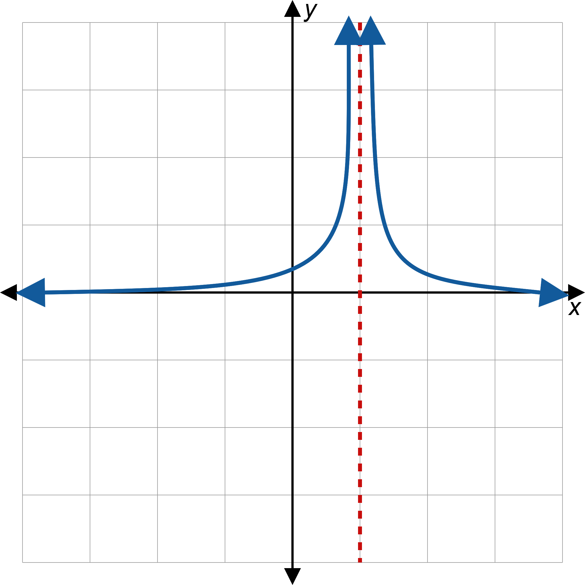
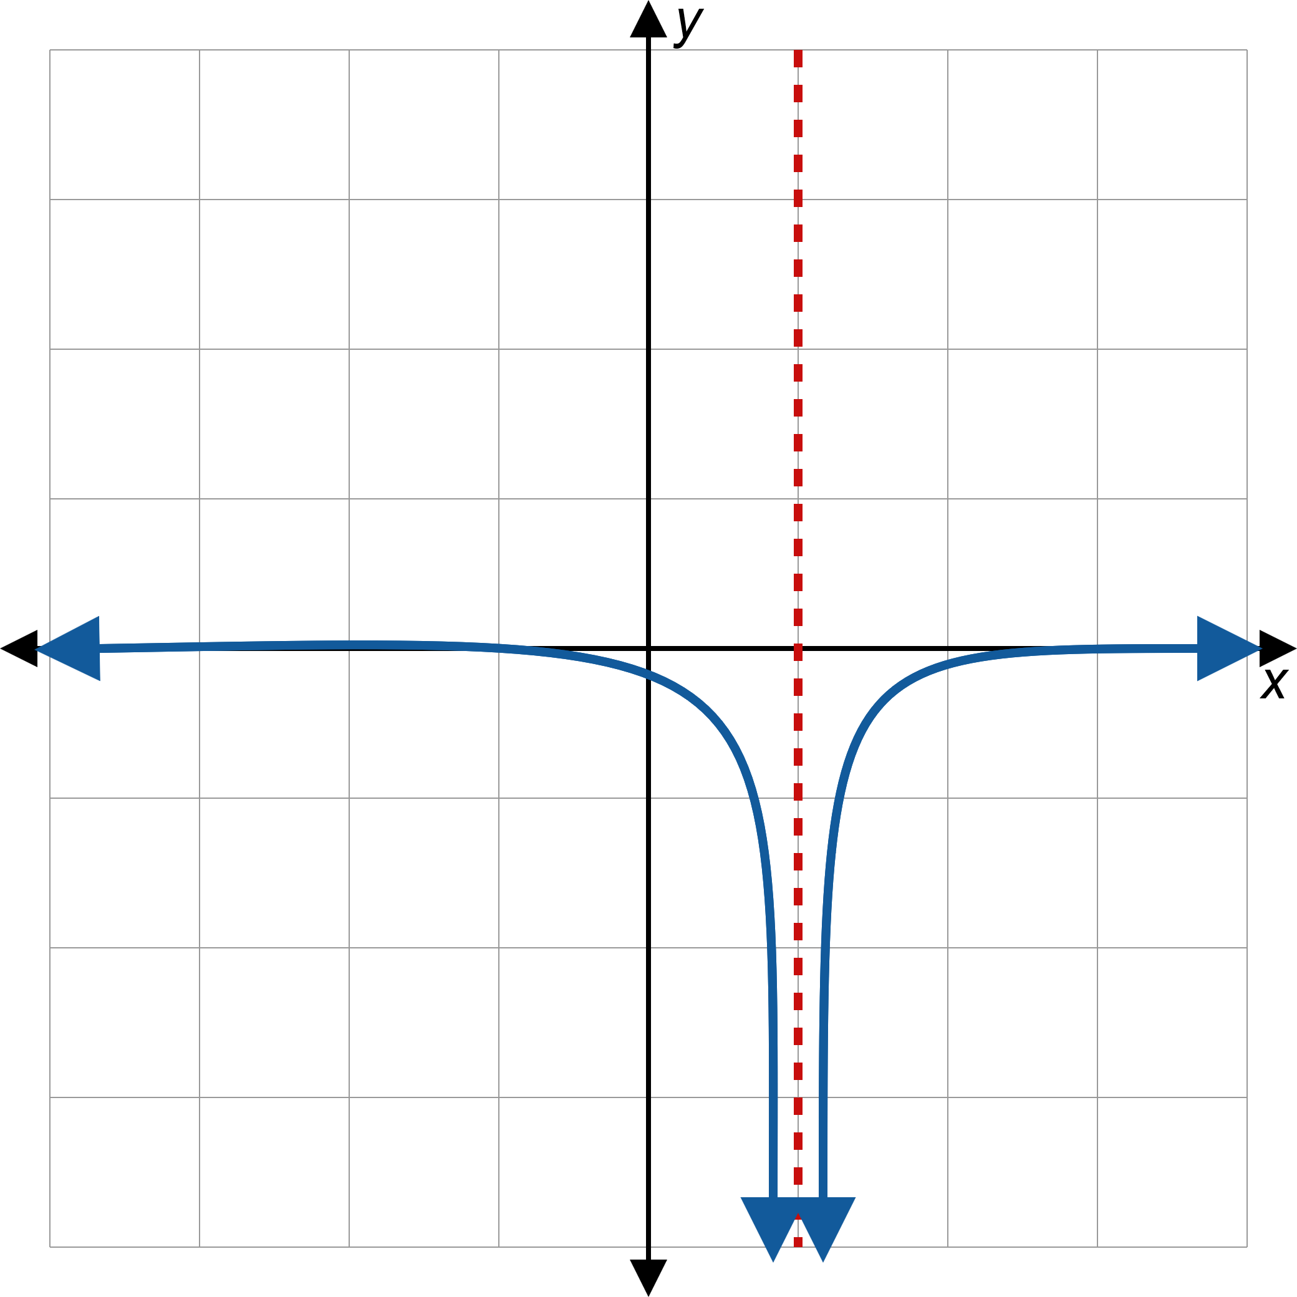
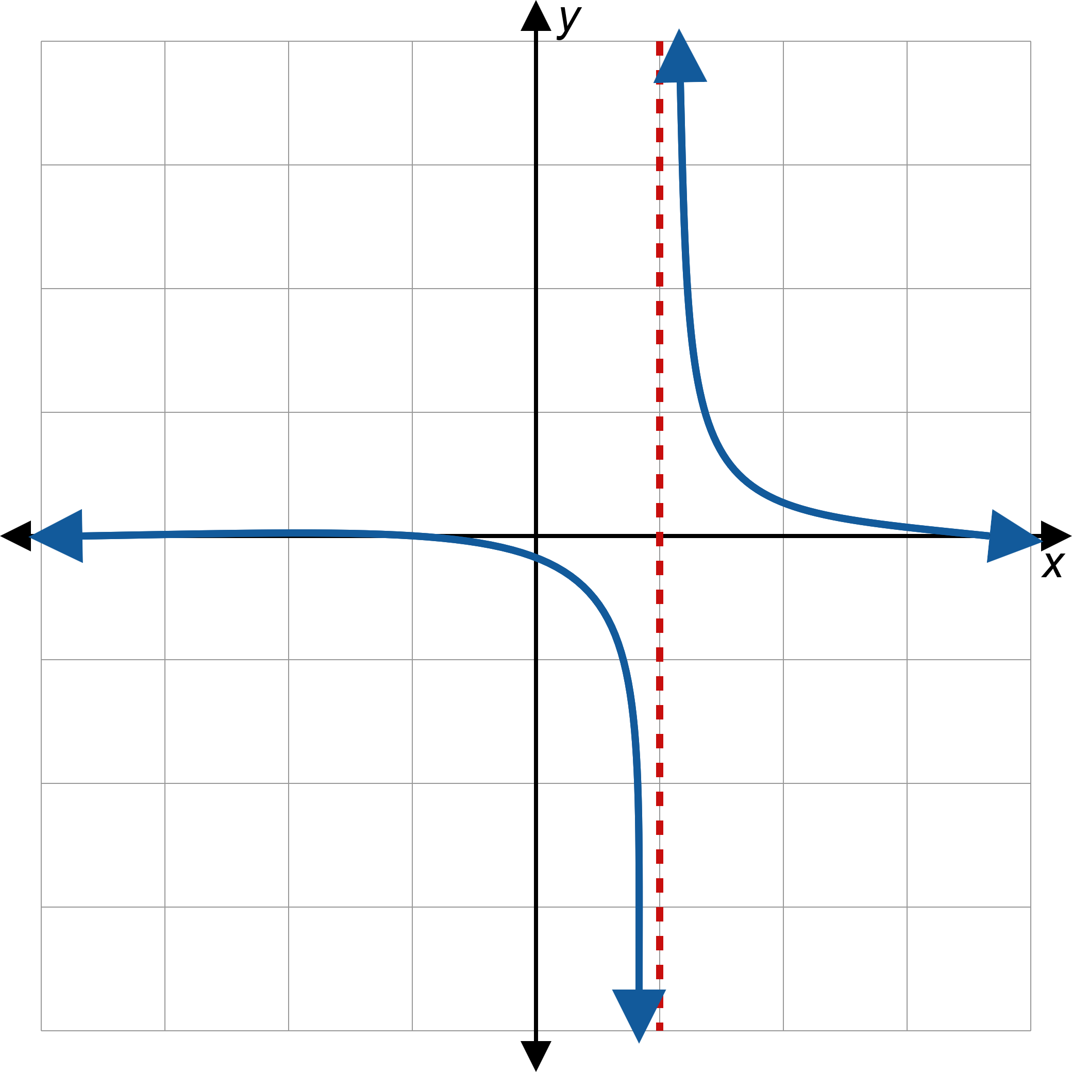
Vertical Asymptotes (cont.)
Figure 2: Vertical Asymptotes

Slide 6
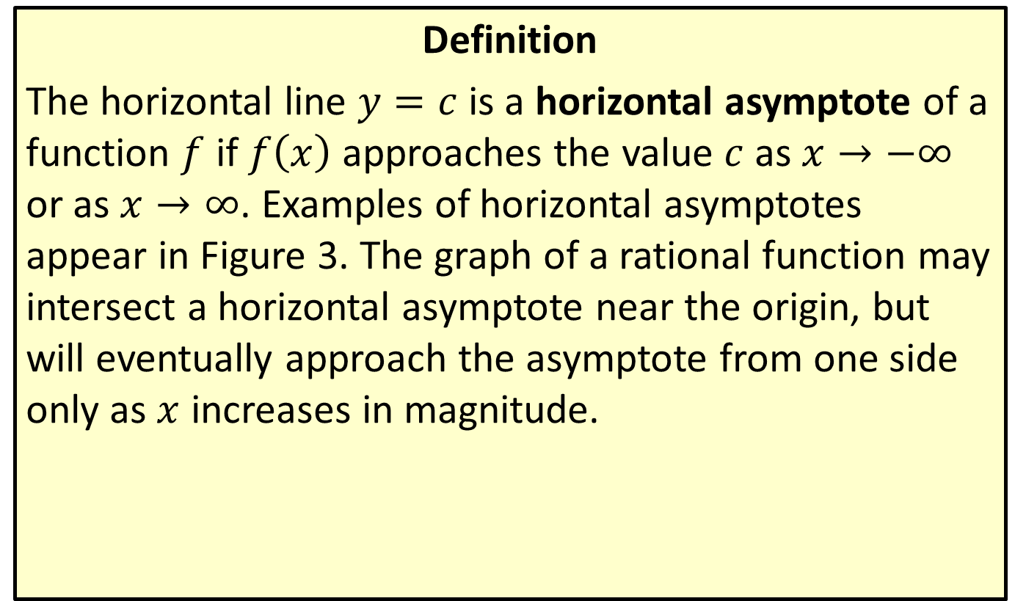
Horizontal Asymptotes
Definition
The horizontal line $y=c$ is a horizontal asymptote of a function $f$ if $f⁡\left(x\right)$ approaches the value $c$ as $x→−∞$ or as $x→∞$. Examples of horizontal asymptotes appear in Figure 3. The graph of a rational function may intersect a horizontal asymptote near the origin, but will eventually approach the asymptote from one side only as $x$ increases in magnitude.

Slide 7
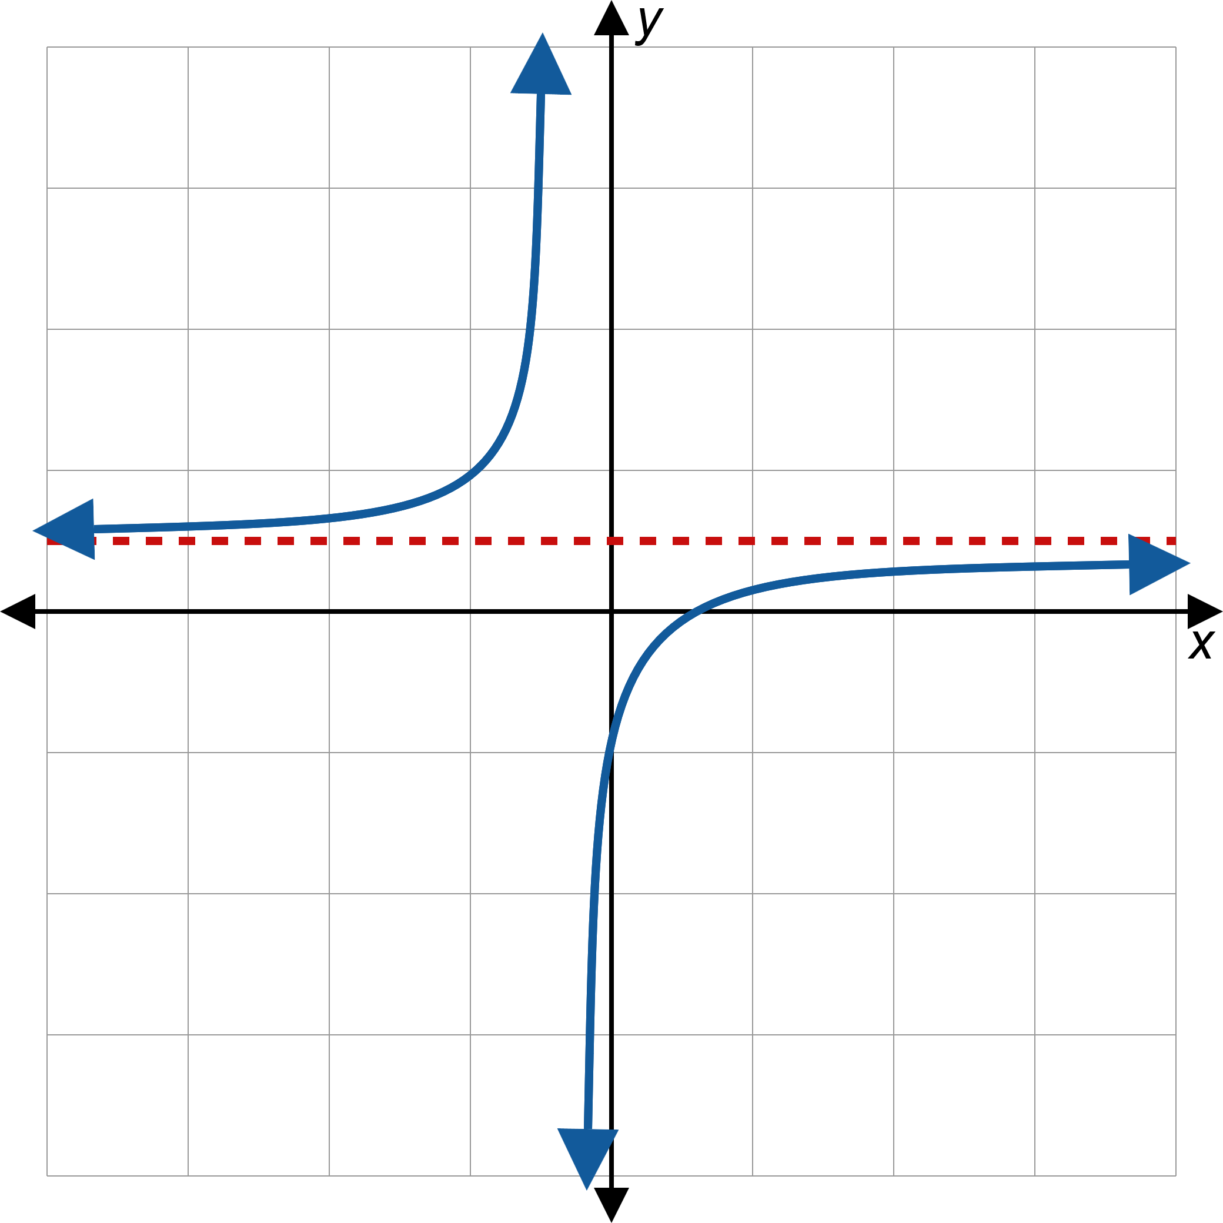
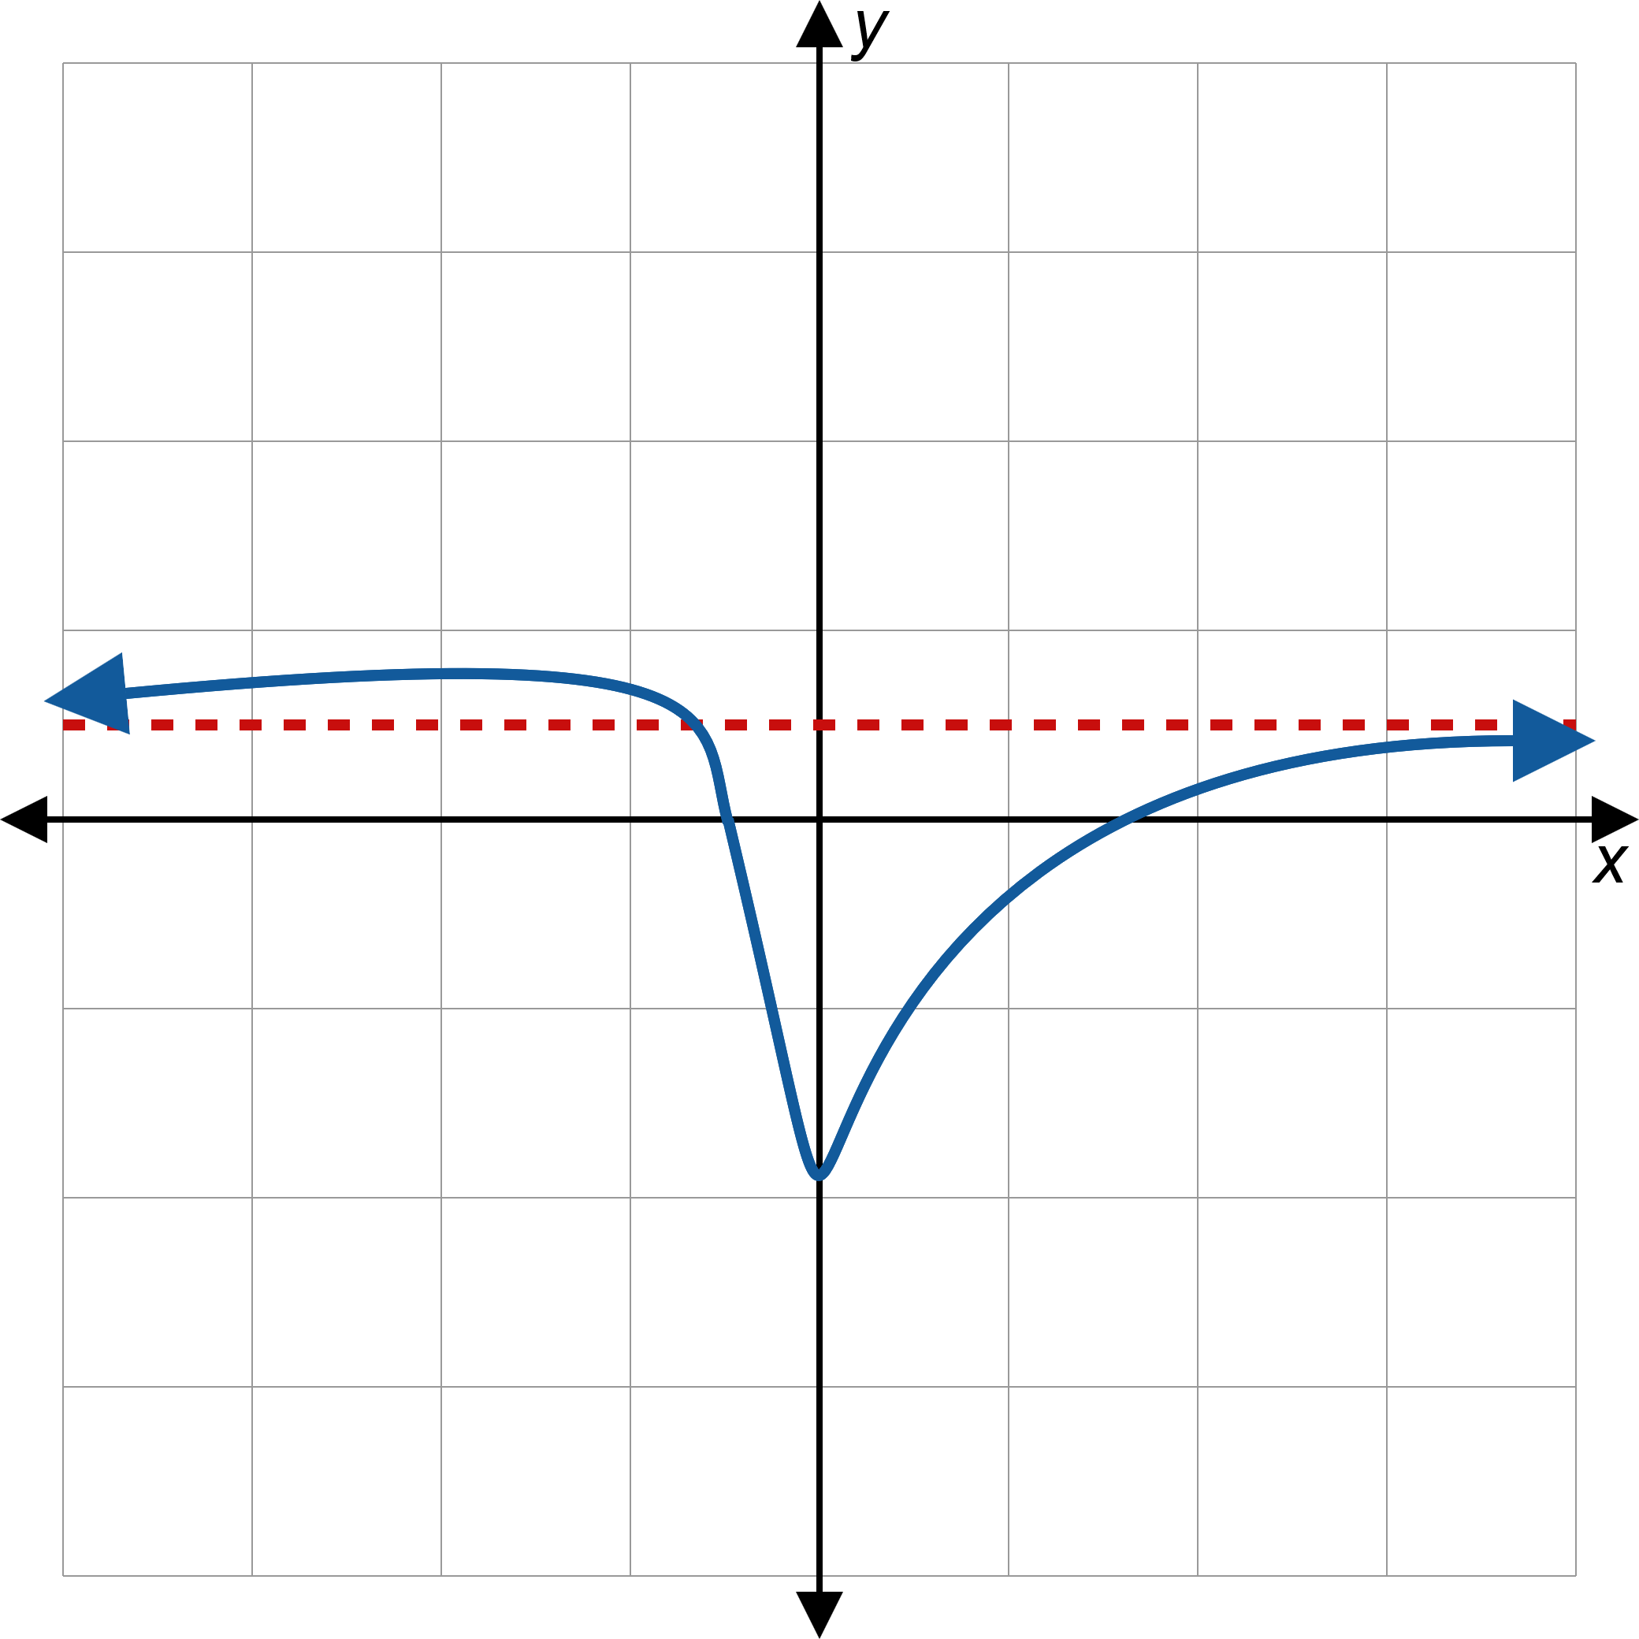
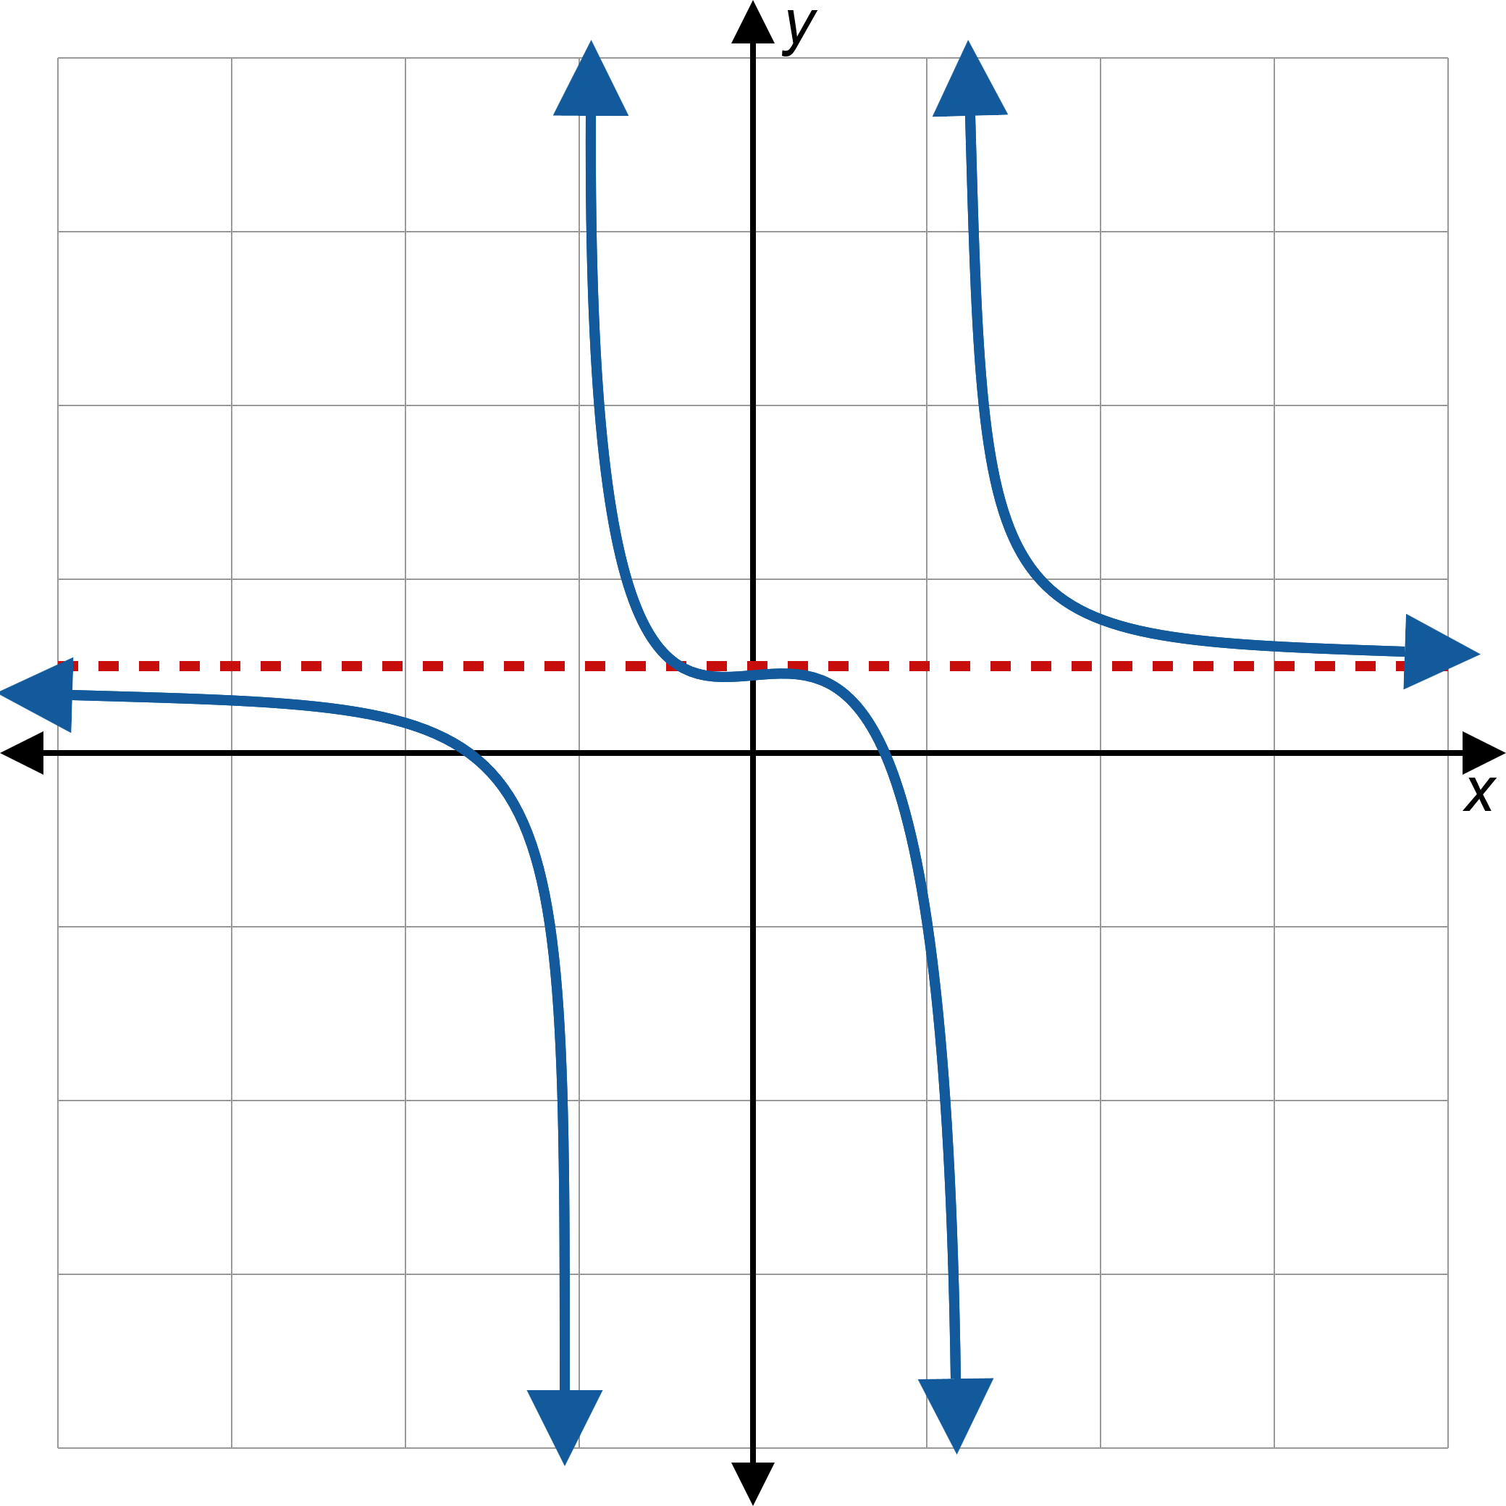
Horizontal Asymptotes (cont.)
Figure 3: Horizontal Asymptotes

Slide 8
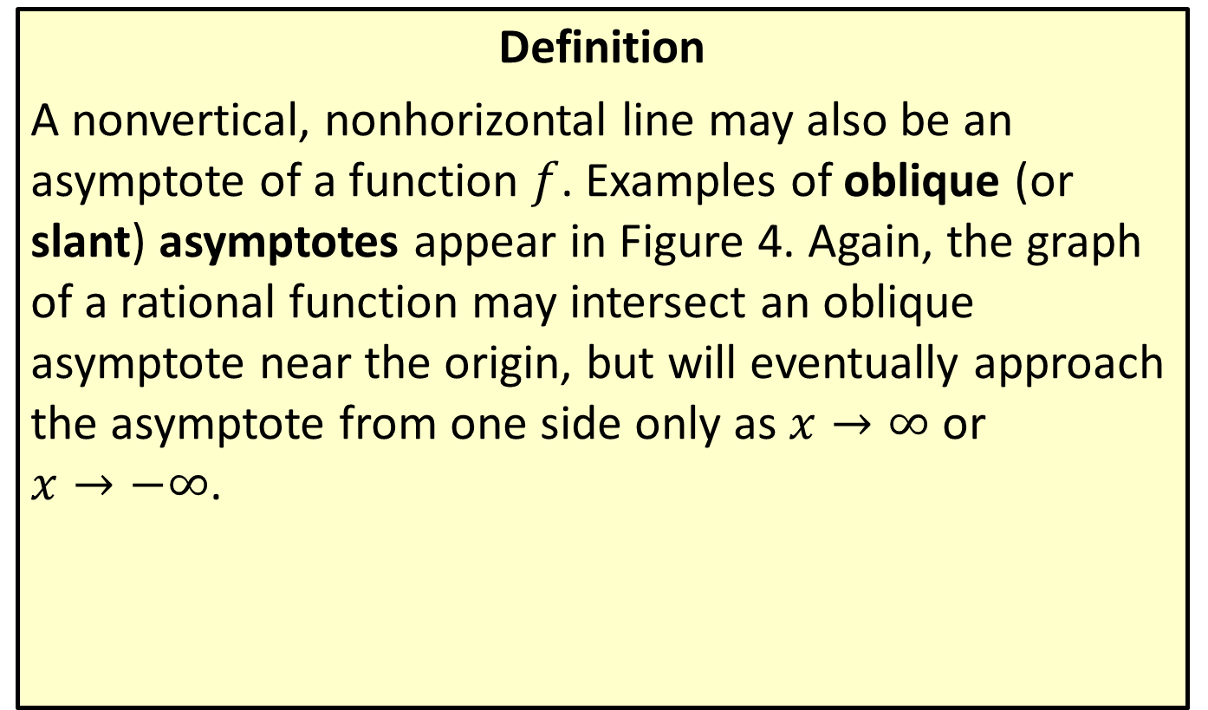
Oblique Asymptotes
Definition
A nonvertical, nonhorizontal line may also be an asymptote of a function $f$. Examples of oblique (or slant) asymptotes appear in Figure 4. Again, the graph of a rational function may intersect an oblique asymptote near the origin, but will eventually approach the asymptote from one side only as $x→∞$ or
$x→−∞$.

Slide 9
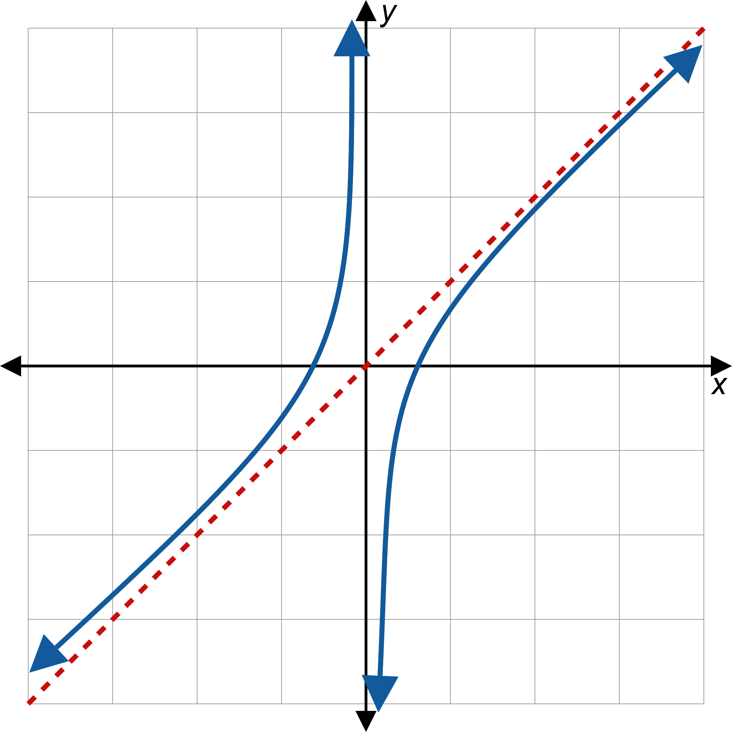
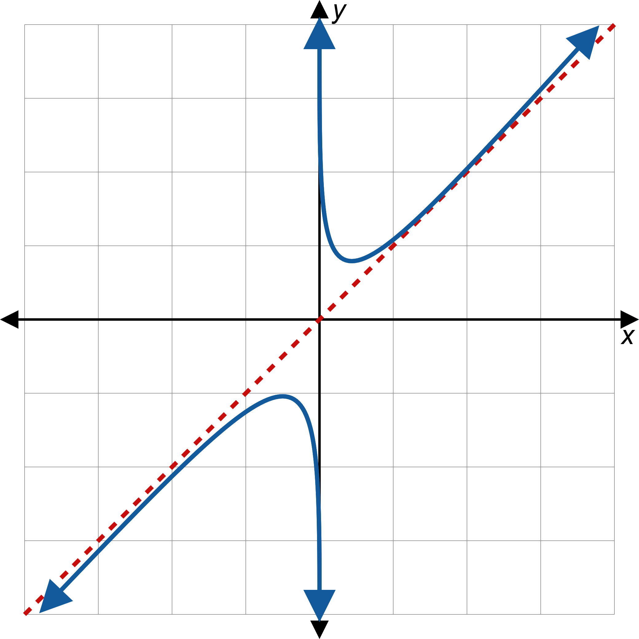
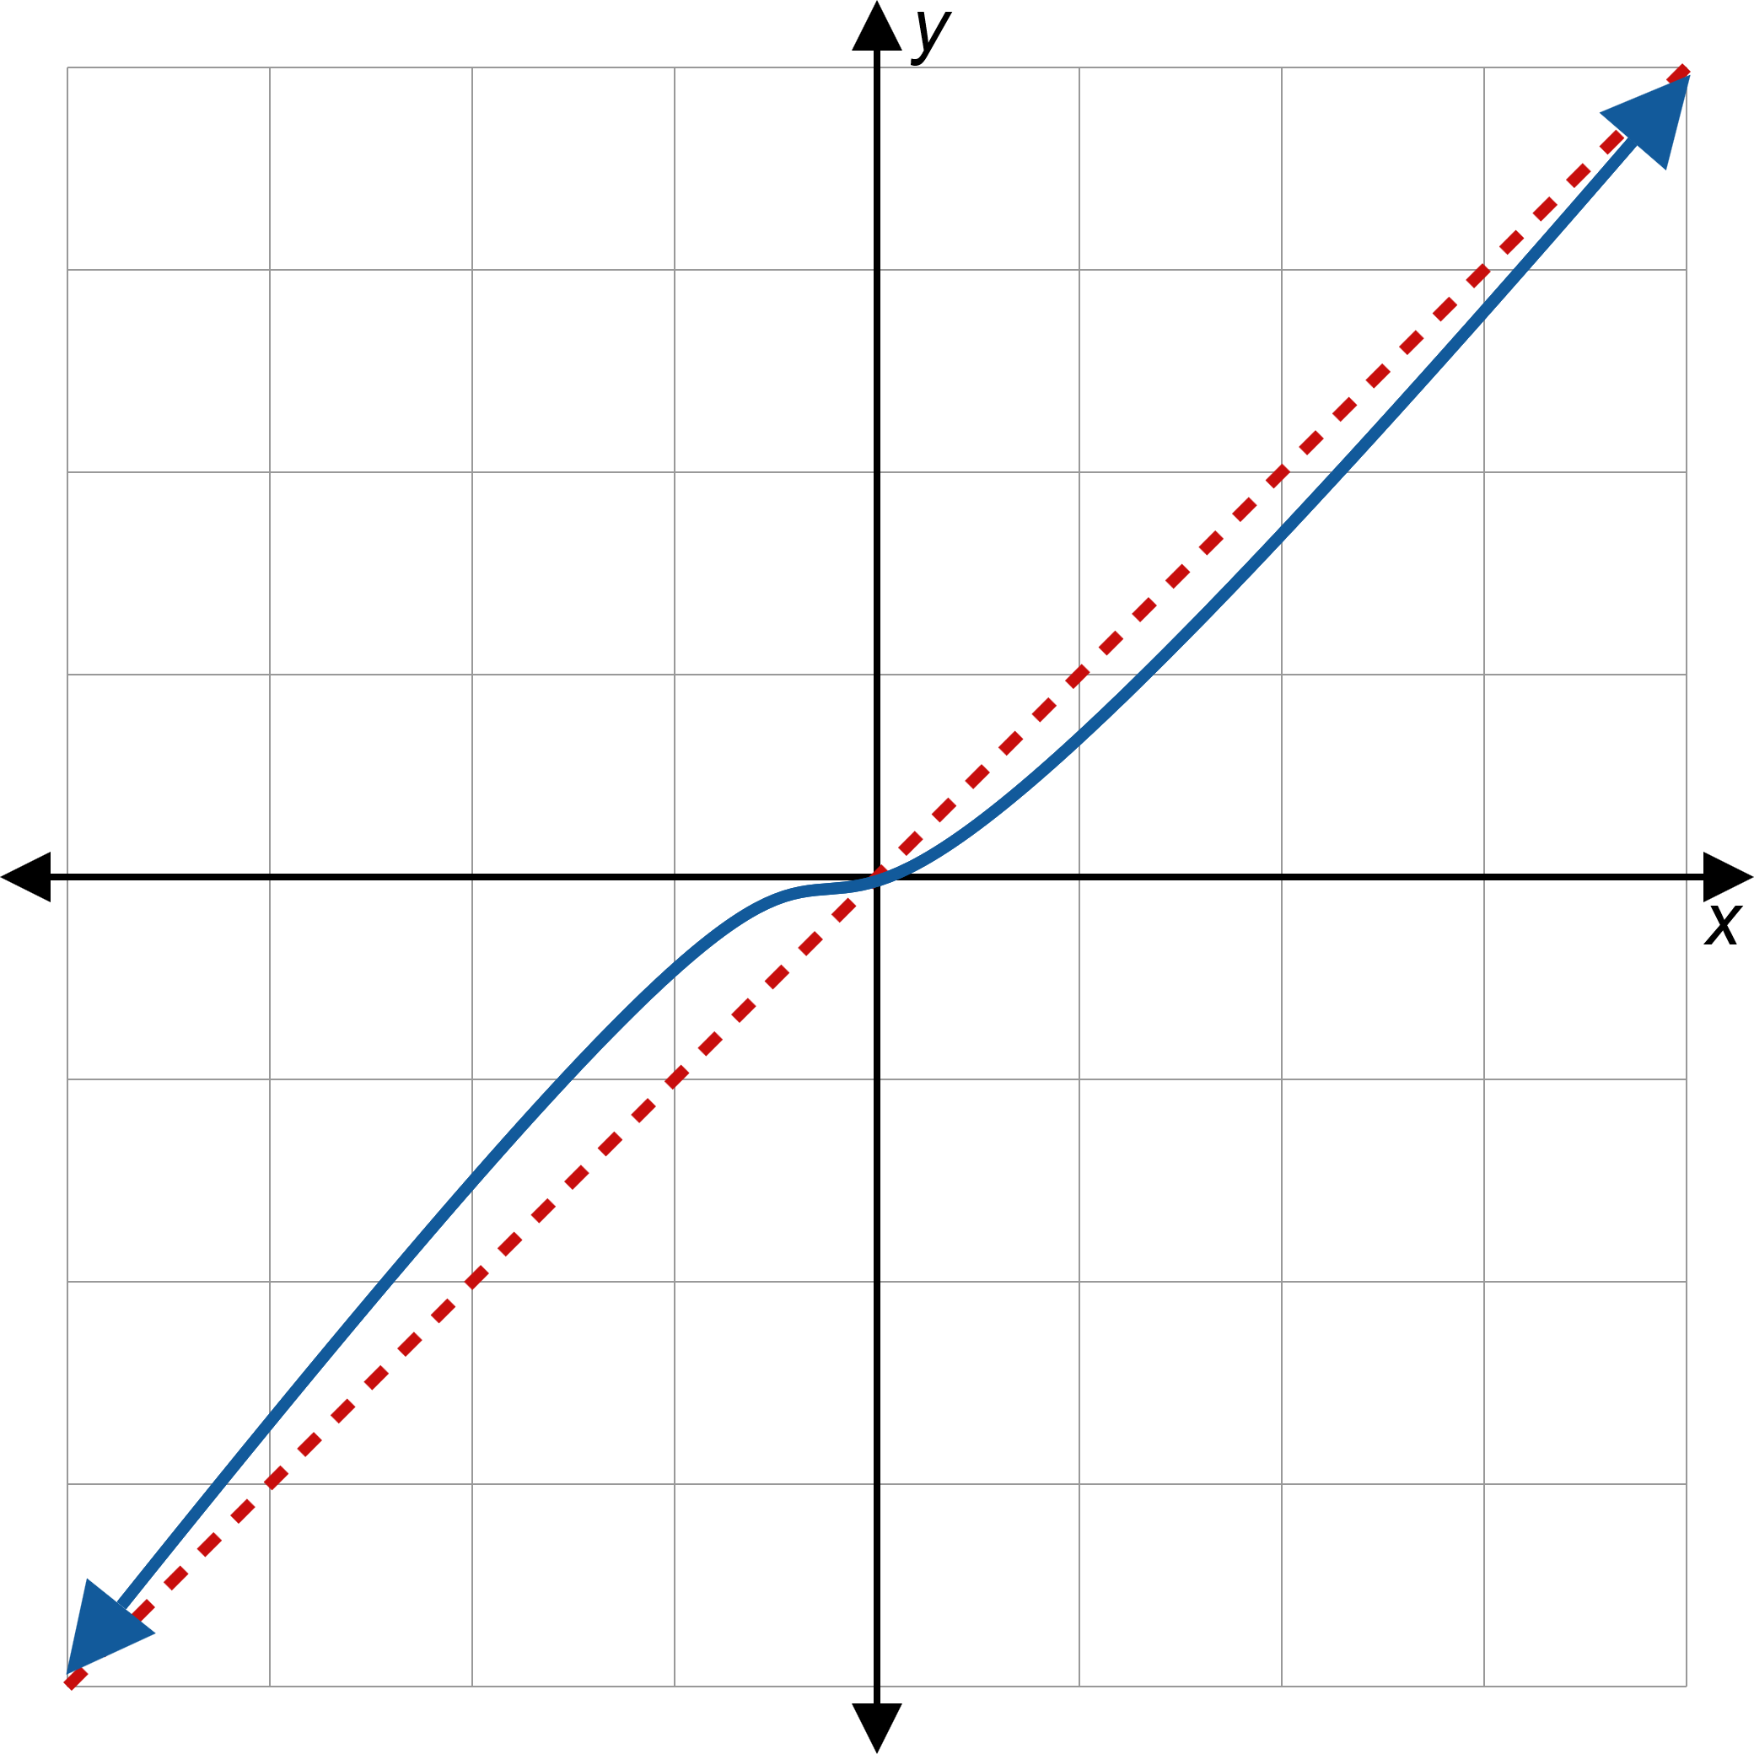
Oblique Asymptotes (cont.)
Figure 4: Oblique Asymptotes

Slide 10
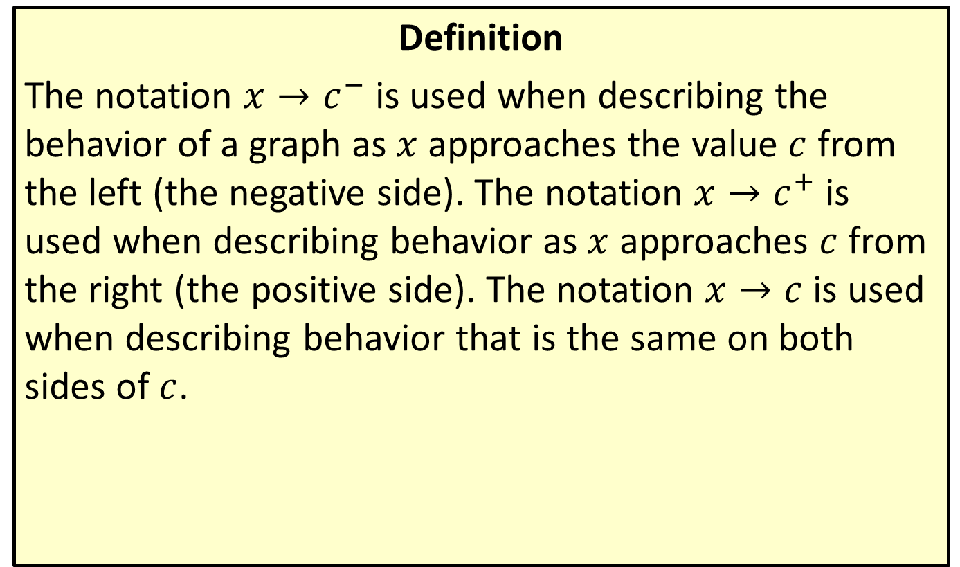
Asymptote Notation
Definition
The notation $x→c^{−}$ is used when describing the behavior of a graph as $x$ approaches the value $c$ from the left (the negative side). The notation $x→c^{+}$ is used when describing behavior as $x$ approaches $c$ from the right (the positive side). The notation $x→c$ is used when describing behavior that is the same on both sides of $c$.

Slide 11
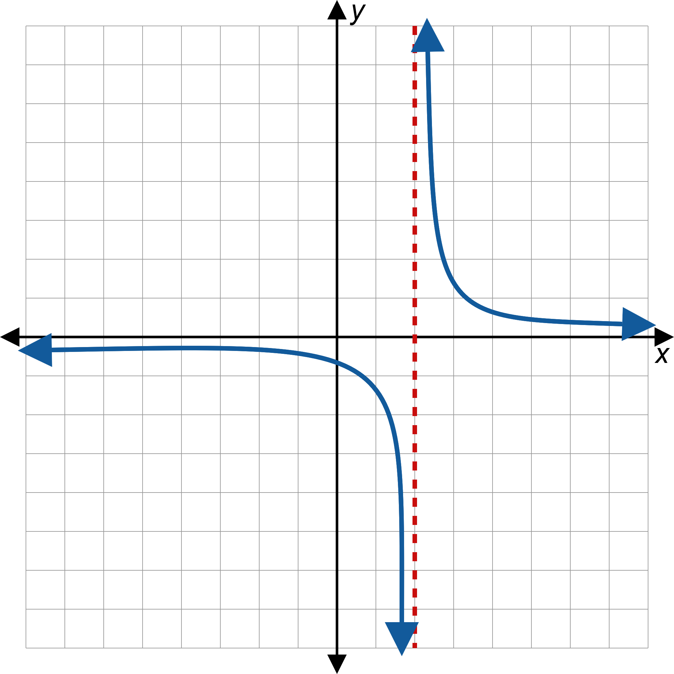
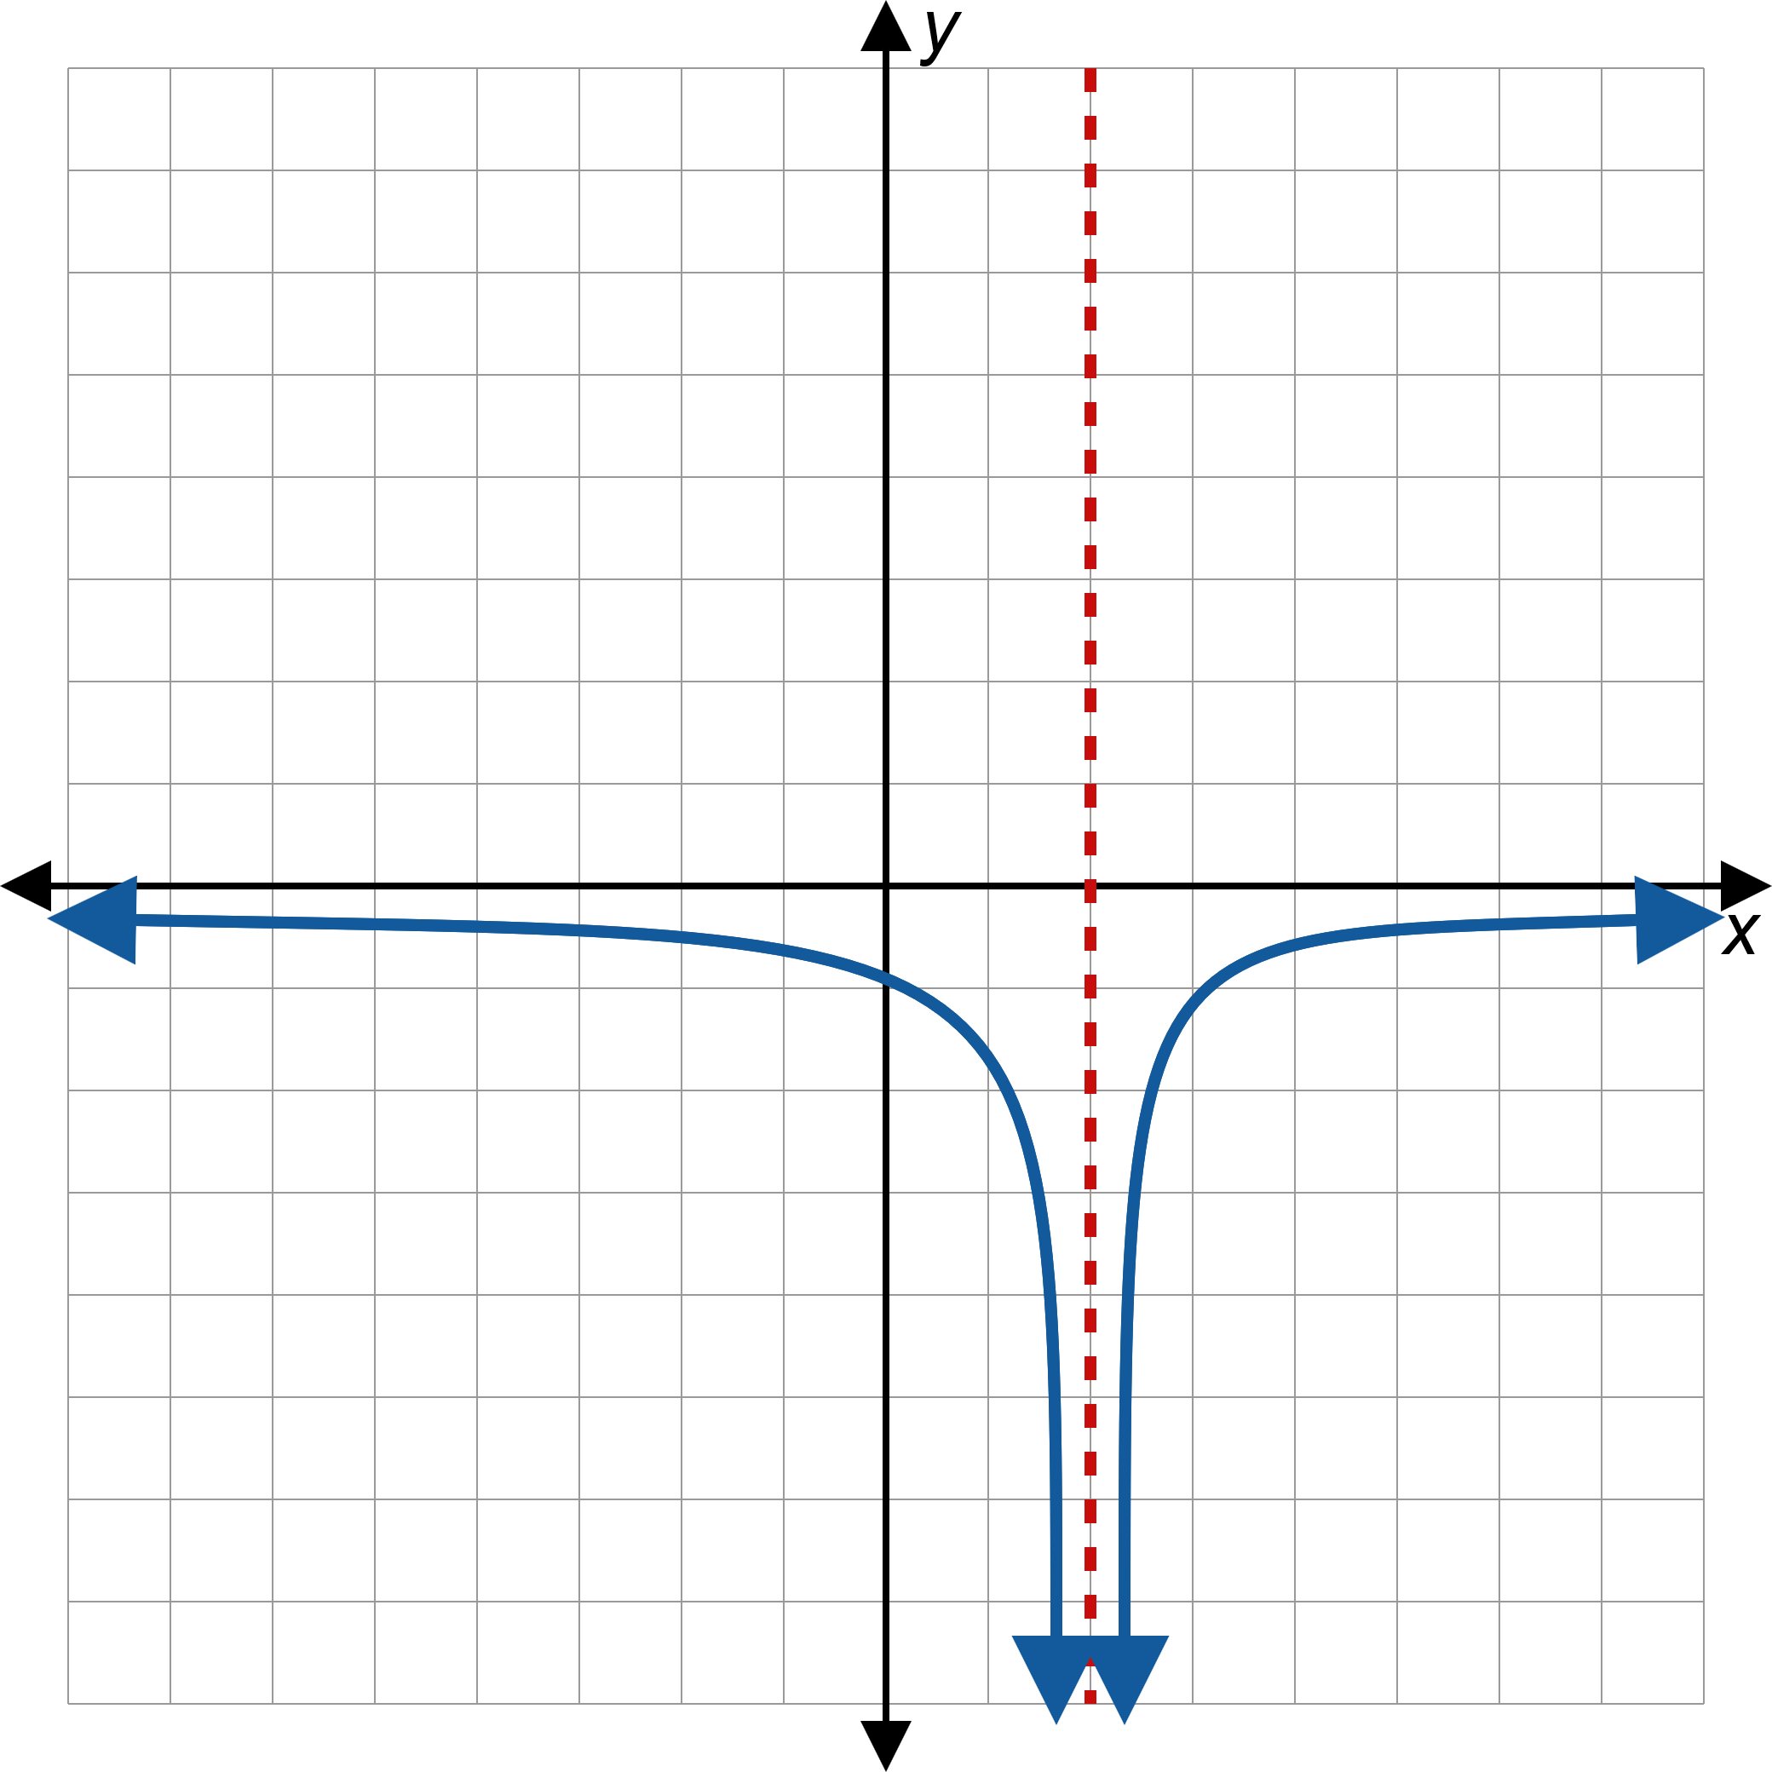
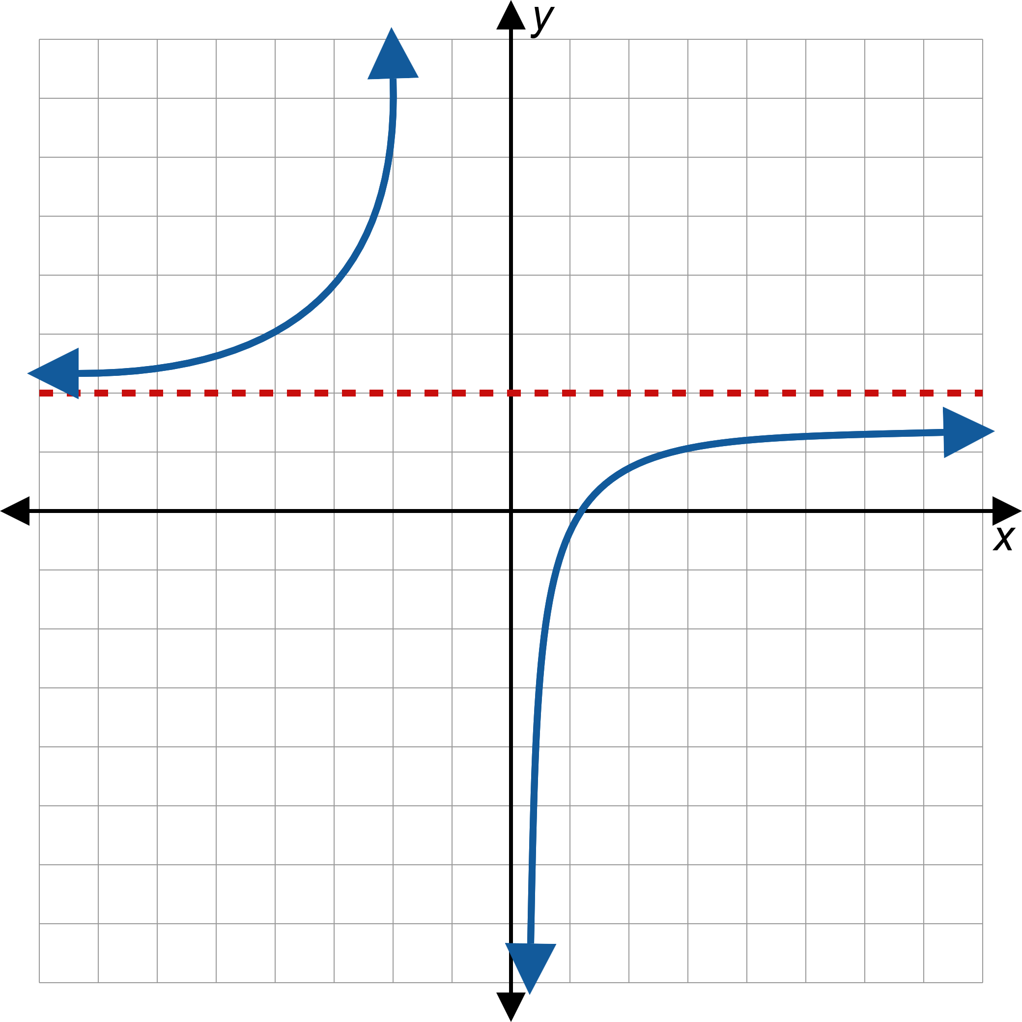
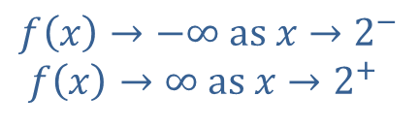
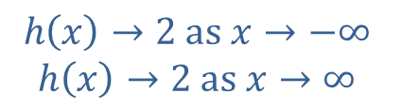

Asymptote Notation (cont.)
Figure 5: Asymptote Notation
$$f\left(x\right)→−∞ \text{as} x→2^{−}$$
$f\left(x\right)→∞ \text{as} x→2^{+}$
$$g\left(x\right)→−∞ \text{as} x→2$$
$$h\left(x\right)→2 \text{as} x→−∞$$
$$h\left(x\right)→2 \text{as} x→∞$$

Slide 12
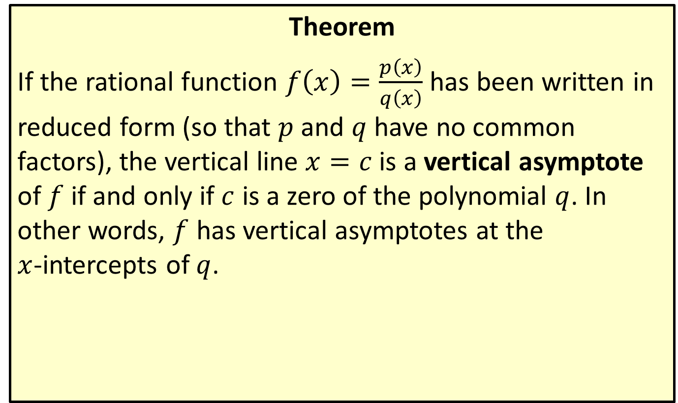
Equations for Vertical Asymptotes
Theorem
If the rational function $f\left(x\right)=\frac{p\left(x\right)}{q\left(x\right)}$ has been written in reduced form (so that $p$ and $q$ have no common factors), the vertical line $x=c$ is a vertical asymptote of $f$ if and only if $c$ is a zero of the polynomial $q$. In other words, $f$ has vertical asymptotes at the
$x$-intercepts of $q$.

Slide 13
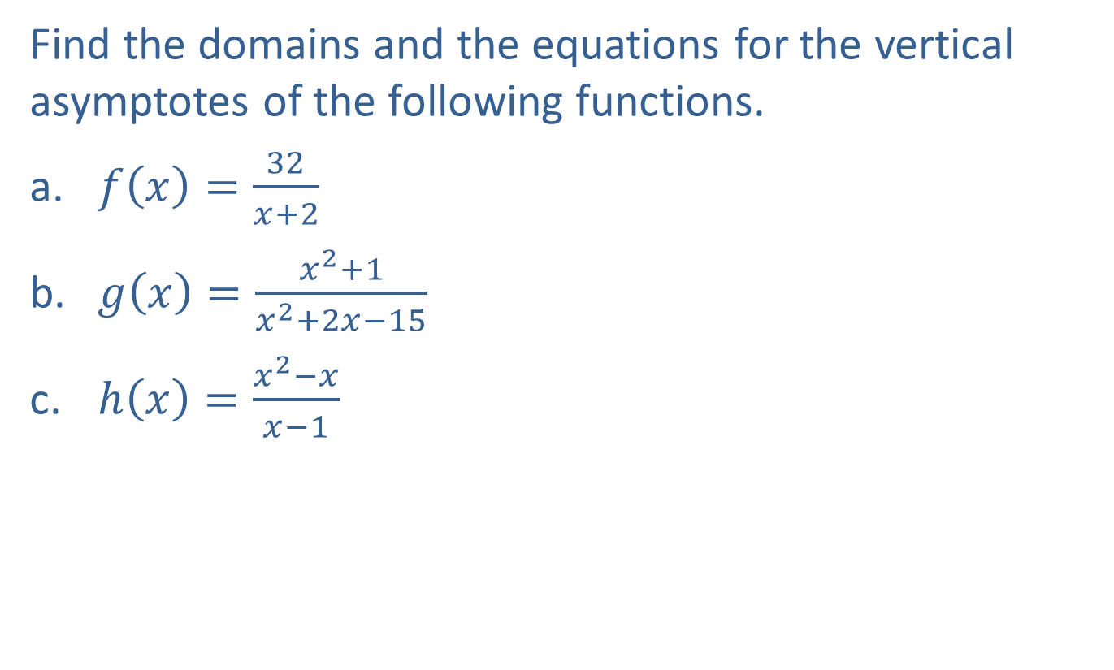
Example 1: Vertical Asymptotes
Find the domains and the equations for the vertical asymptotes of the following functions.
​$f\left(x\right)=\frac{32}{x+2}$
​$g\left(x\right)=\frac{x^{2}+1}{x^{2}+2x−15}$
​$h\left(x\right)=\frac{x^{2}−x}{x−1}$

Slide 14
Note:
We must always find the domain before canceling common factors. Even if a zero is removed from the denominator when finding the reduced form, that value is not part of the domain.

Slide 15
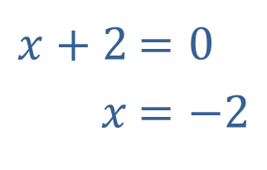
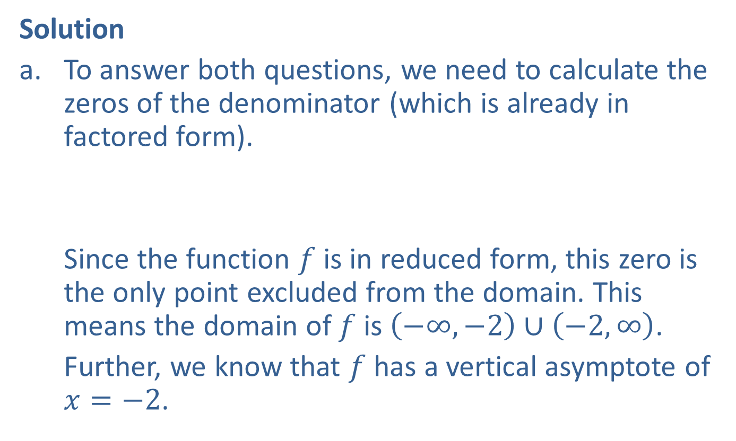
Example 1: Vertical Asymptotes (cont.)
Solution
​To answer both questions, we need to calculate the zeros of the denominator (which is already in factored form).
​
​Since the function $f$ is in reduced form, this zero is the only point excluded from the domain. This means the domain of $f$ is $\left(−∞,−2\right)∪\left(−2,∞\right)$.
​Further, we know that $f$ has a vertical asymptote of
$x=−2$.
​$x+2$ | ​$=0$
​$x$ | ​$=−2$

Slide 16
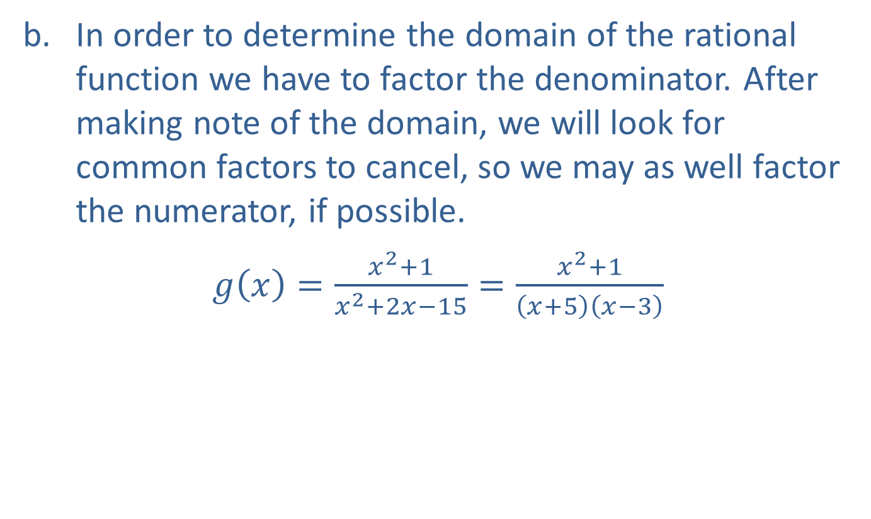
Example 1: Vertical Asymptotes (cont.)
​In order to determine the domain of the rational function we have to factor the denominator. After making note of the domain, we will look for common factors to cancel, so we may as well factor the numerator, if possible.
​$g\left(x\right)=\frac{x^{2}+1}{x^{2}+2x−15}=\frac{x^{2}+1}{\left(x+5\right)\left(x−3\right)}$

Slide 17
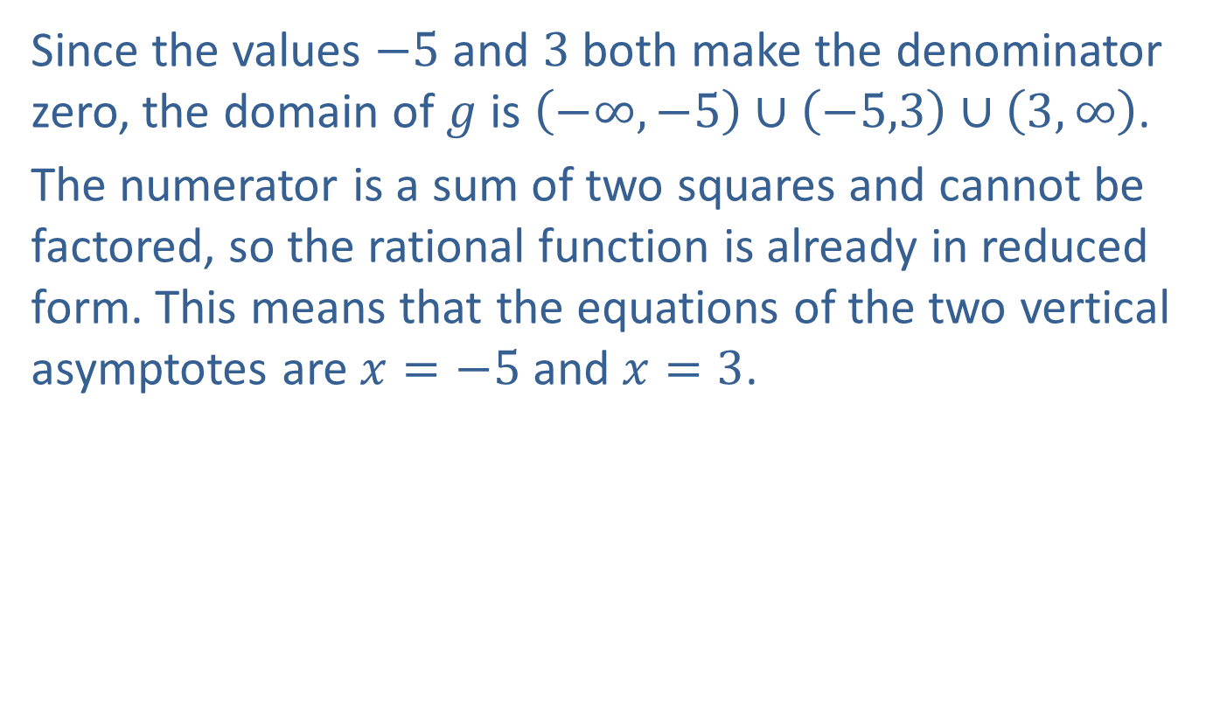
Example 1: Vertical Asymptotes (cont.)
​Since the values $−5$ and 3 both make the denominator zero, the domain of $g$ is $\left(−∞,−5\right)∪\left(−5,3\right)∪\left(3,∞\right)$.
​The numerator is a sum of two squares and cannot be factored, so the rational function is already in reduced form. This means that the equations of the two vertical asymptotes are $x=−5$ and $x=3$.

Slide 18
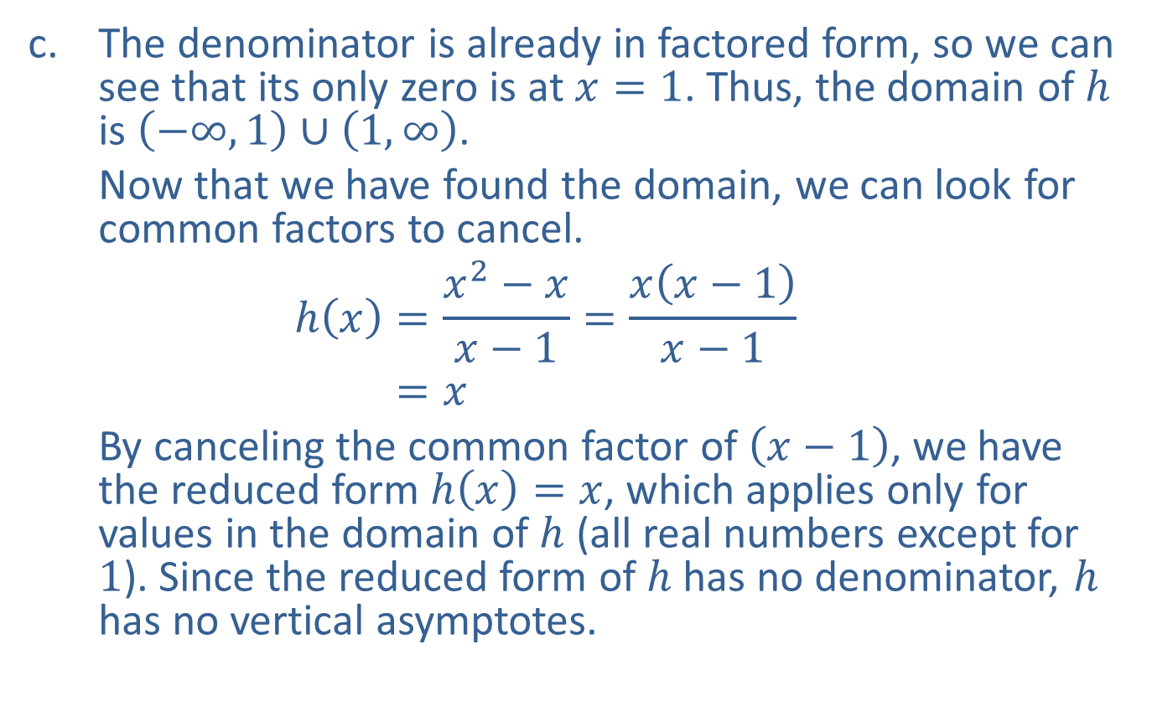
Example 1: Vertical Asymptotes (cont.)
​The denominator is already in factored form, so we can see that its only zero is at $x=1$. Thus, the domain of $h$ is $\left(−∞,1\right)∪\left(1,∞\right)$.
​Now that we have found the domain, we can look for common factors to cancel.
h𝑥=𝑥2−𝑥𝑥−1=𝑥𝑥−1𝑥−1h⁡𝑥=𝑥
​By canceling the common factor of $\left(x−1\right)$, we have the reduced form $h\left(x\right)=x$, which applies only for values in the domain of $h$ (all real numbers except for 1). Since the reduced form of $h$ has no denominator, $h$ has no vertical asymptotes.

Slide 19
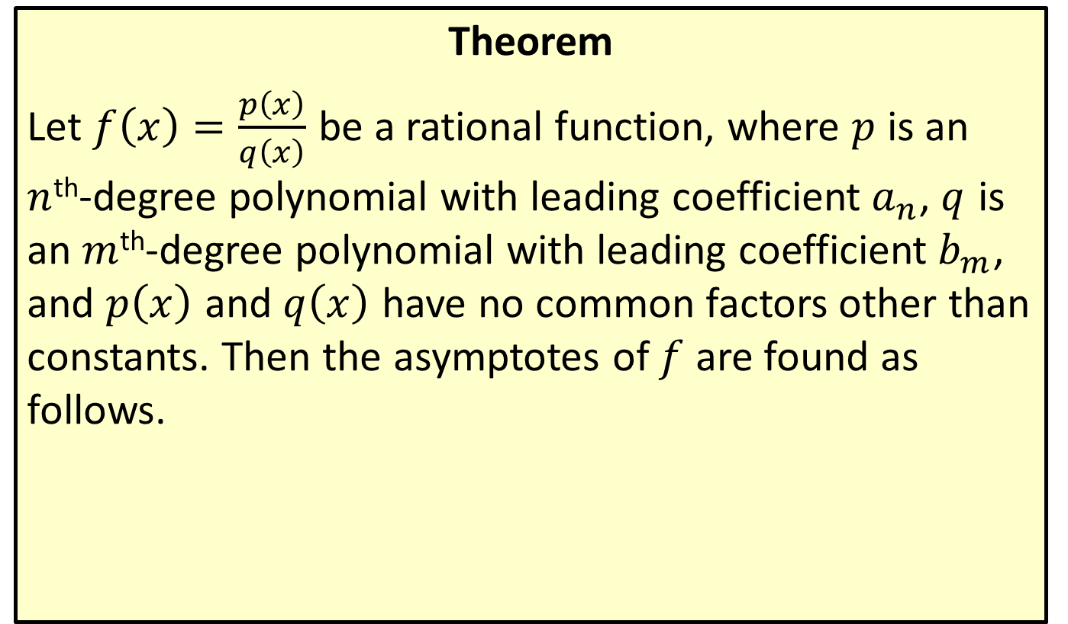
Equations for Horizontal and Oblique Asymptotes
Theorem
Let $f\left(x\right)=\frac{p\left(x\right)}{q\left(x\right)}$ be a rational function, where $p$ is an $n$^{th}-degree polynomial with leading coefficient $a_{n}$, $q$ is an $m$^{th}-degree polynomial with leading coefficient $b_{m}$, and $p⁡\left(x\right)$ and $q⁡\left(x\right)$ have no common factors other than constants. Then the asymptotes of $f$ are found as follows.

Slide 20
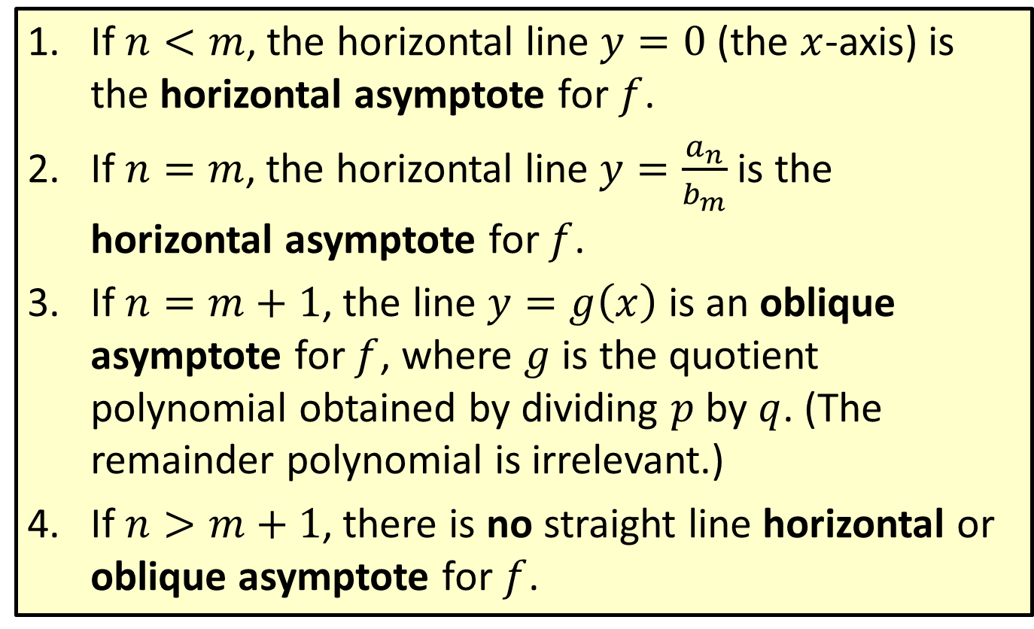
Equations for Horizontal and Oblique Asymptotes (cont.)
​If $n<m$, the horizontal line $y=0$ (the $x$-axis) is the horizontal asymptote for $f$.
​If $n=m$, the horizontal line $y=\frac{a_{n}}{b_{m}}$ is the horizontal asymptote for $f$.
​If $n=m+1$, the line $y=g\left(x\right)$ is an oblique asymptote for $f$, where $g$ is the quotient polynomial obtained by dividing $p$ by $q$. (The remainder polynomial is irrelevant.)
​If $n>m+1$, there is no straight line horizontal or oblique asymptote for $f$.

Slide 21
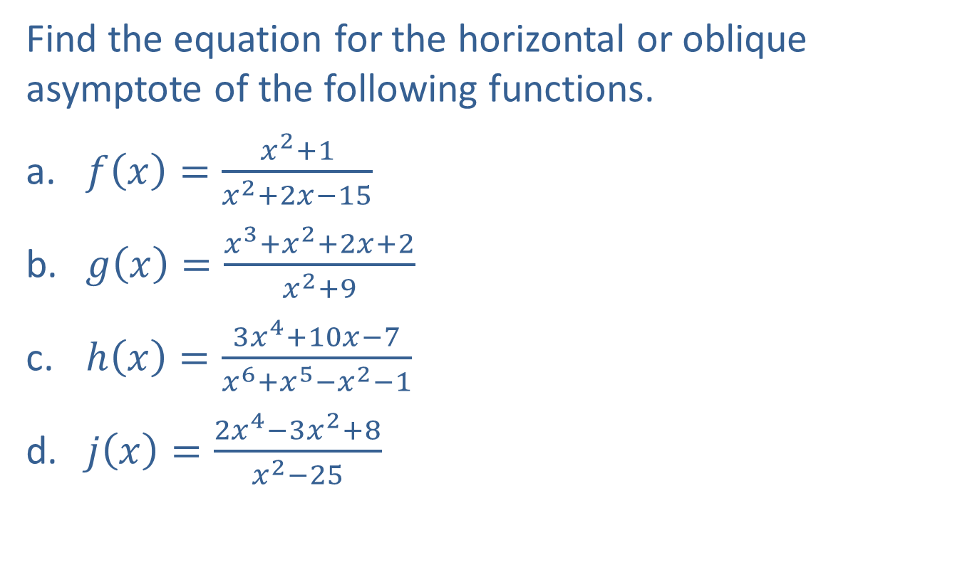
Example 2: Horizontal and Oblique Asymptotes
Find the equation for the horizontal or oblique asymptote of the following functions.
​$f\left(x\right)=\frac{x^{2}+1}{x^{2}+2x−15}$
​$g\left(x\right)=\frac{x^{3}+x^{2}+2x+2}{x^{2}+9}$
​$h\left(x\right)=\frac{3x^{4}+10x−7}{x^{6}+x^{5}−x^{2}−1}$
​$j\left(x\right)=\frac{2x^{4}−3x^{2}+8}{x^{2}−25}$

Slide 22
Note:
Always begin by comparing the degrees of the numerator and the denominator.

Slide 23

Example 2: Horizontal and Oblique Asymptotes (cont.)
Solution
​First, note that the degrees of the numerator and denominator of $f$ are both equal to two. This means that the line $y=\frac{a_{2}}{b_{2}}=1$ is the horizontal asymptote of $f$.

Slide 24
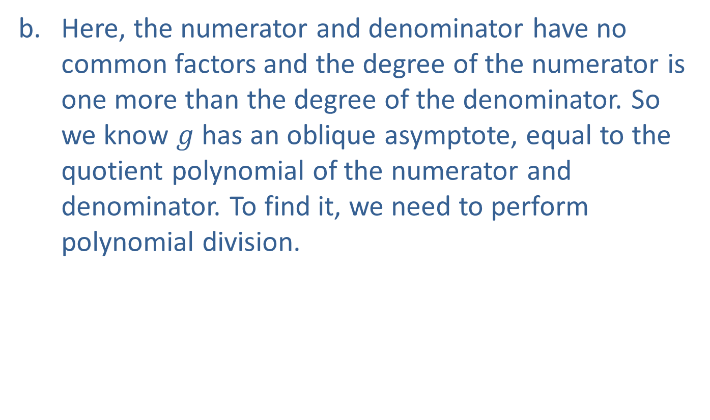
Example 2: Horizontal and Oblique Asymptotes (cont.)
​Here, the numerator and denominator have no common factors and the degree of the numerator is one more than the degree of the denominator. So we know $g$ has an oblique asymptote, equal to the quotient polynomial of the numerator and denominator. To find it, we need to perform polynomial division.

Slide 25
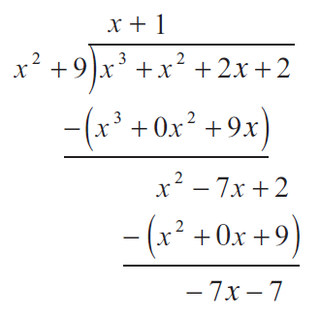

Example 2: Horizontal and Oblique Asymptotes (cont.)
​This tells us that $g\left(x\right)=x+1+\frac{−7x−7}{x^{2}+9}$, but we only need the quotient, $x+1$, to find that the equation for the oblique asymptote is $y=x+1$.

Slide 26
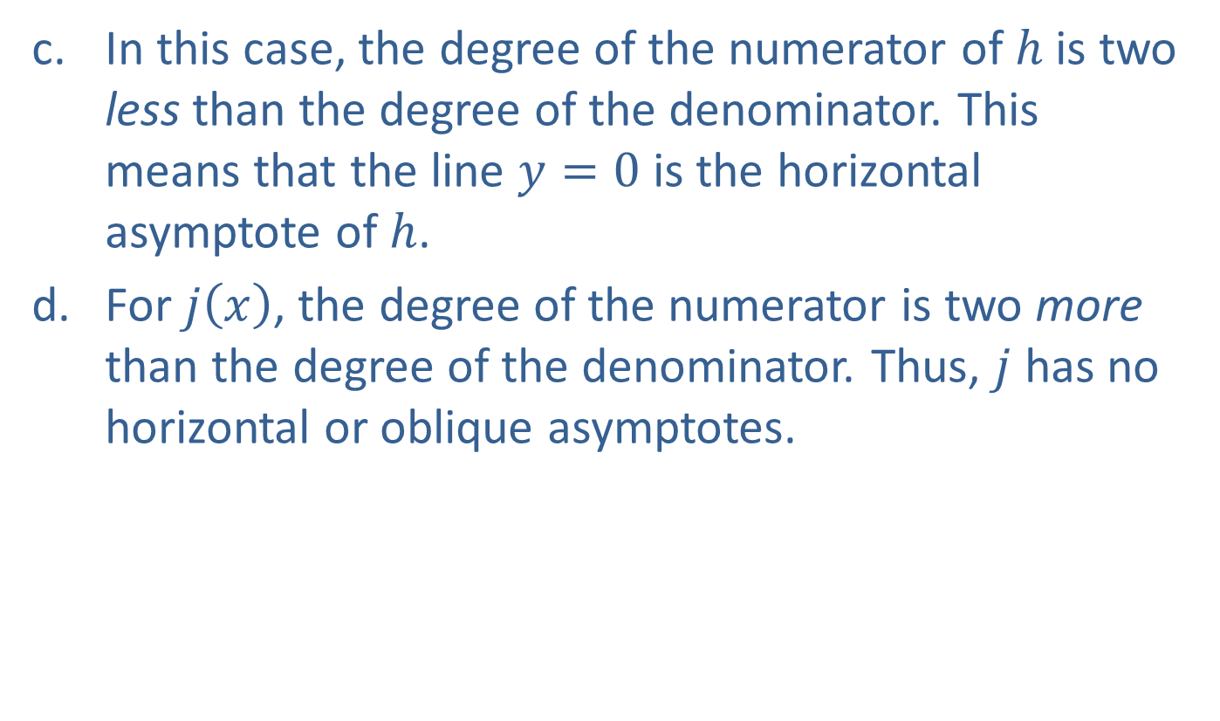
Example 2: Horizontal and Oblique Asymptotes (cont.)
​In this case, the degree of the numerator of $h$ is two less than the degree of the denominator. This means that the line $y=0$ is the horizontal asymptote of $h$.
​For $j⁡\left(x\right)$, the degree of the numerator is two more than the degree of the denominator. Thus, $j$ has no horizontal or oblique asymptotes.

Slide 27
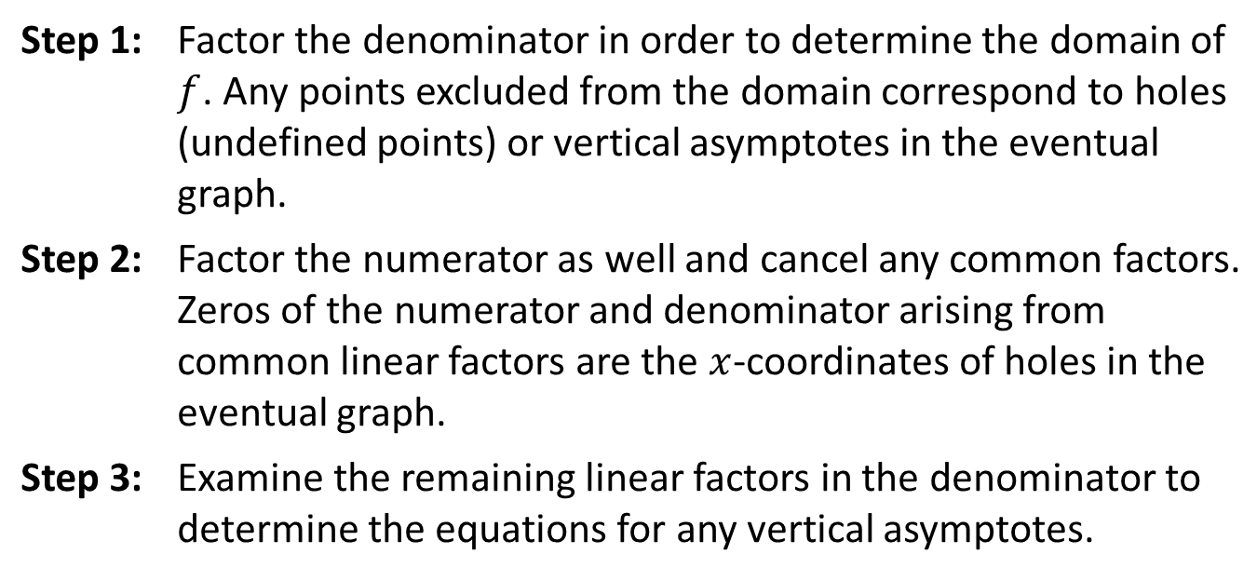

Graphing Rational Functions
Procedure
Given a rational function $f$,
Step 1: | Factor the denominator in order to determine the domain of $f$. Any points excluded from the domain correspond to holes (undefined points) or vertical asymptotes in the eventual graph.
Step 2: | Factor the numerator as well and cancel any common factors. Zeros of the numerator and denominator arising from common linear factors are the $x$-coordinates of holes in the eventual graph.
Step 3: | Examine the remaining linear factors in the denominator to determine the equations for any vertical asymptotes.

Slide 28
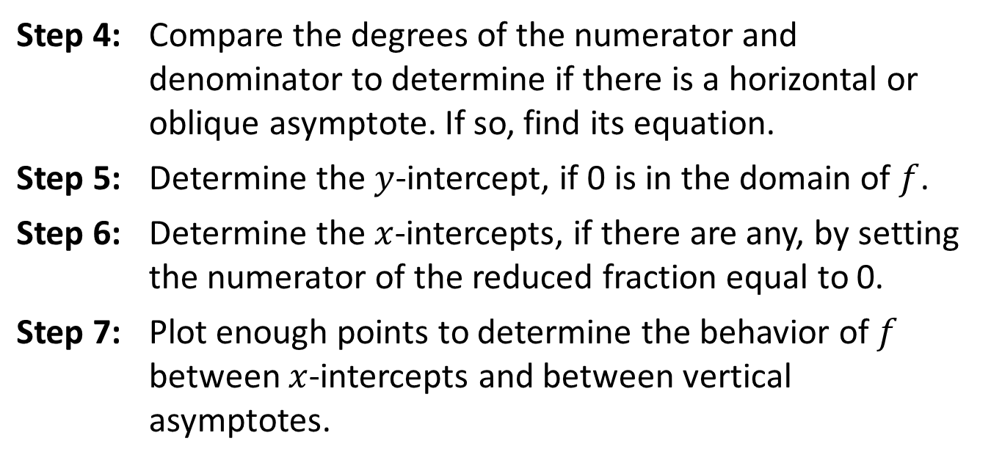
Graphing Rational Functions (cont.)
Step 4: | Compare the degrees of the numerator and denominator to determine if there is a horizontal or oblique asymptote. If so, find its equation.
Step 5: | Determine the $y$-intercept, if 0 is in the domain of $f$.
Step 6: | Determine the $x$-intercepts, if there are any, by setting the numerator of the reduced fraction equal to 0.
Step 7: | Plot enough points to determine the behavior of $f$ between $x$-intercepts and between vertical asymptotes.

Slide 29

Example 3: Graphing Rational Functions
Sketch the graphs of the following rational functions.
​$f\left(x\right)=\frac{x^{2}−x}{x−1}$
​$g\left(x\right)=\frac{x^{2}+1}{x^{2}+2x−15}$
​$h\left(x\right)=\frac{x^{3}+x^{2}+2x+2}{x^{2}+9}$

Slide 30
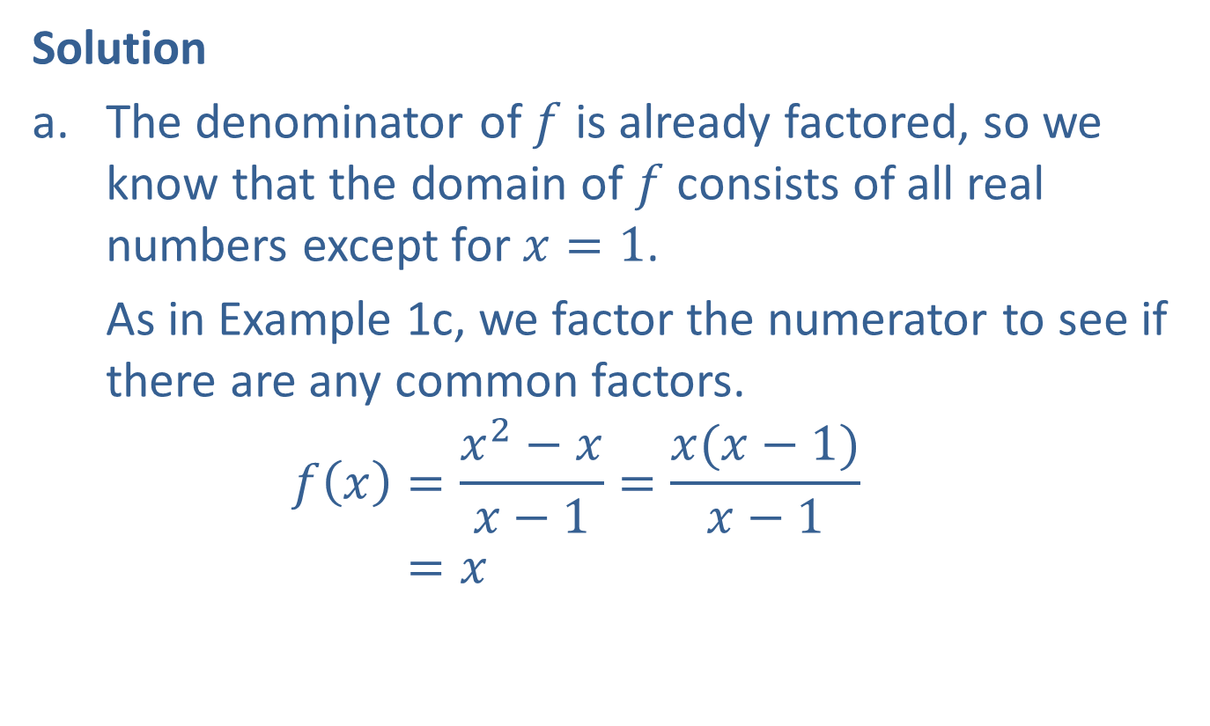
Example 3: Graphing Rational Functions (cont.)
Solution
​The denominator of $f$ is already factored, so we know that the domain of $f$ consists of all real numbers except for $x=1$.
​As in Example 1c, we factor the numerator to see if there are any common factors.
𝑓𝑥=𝑥2−𝑥𝑥−1=𝑥(𝑥−1)𝑥−1𝑓⁡𝑥=𝑥

Slide 31
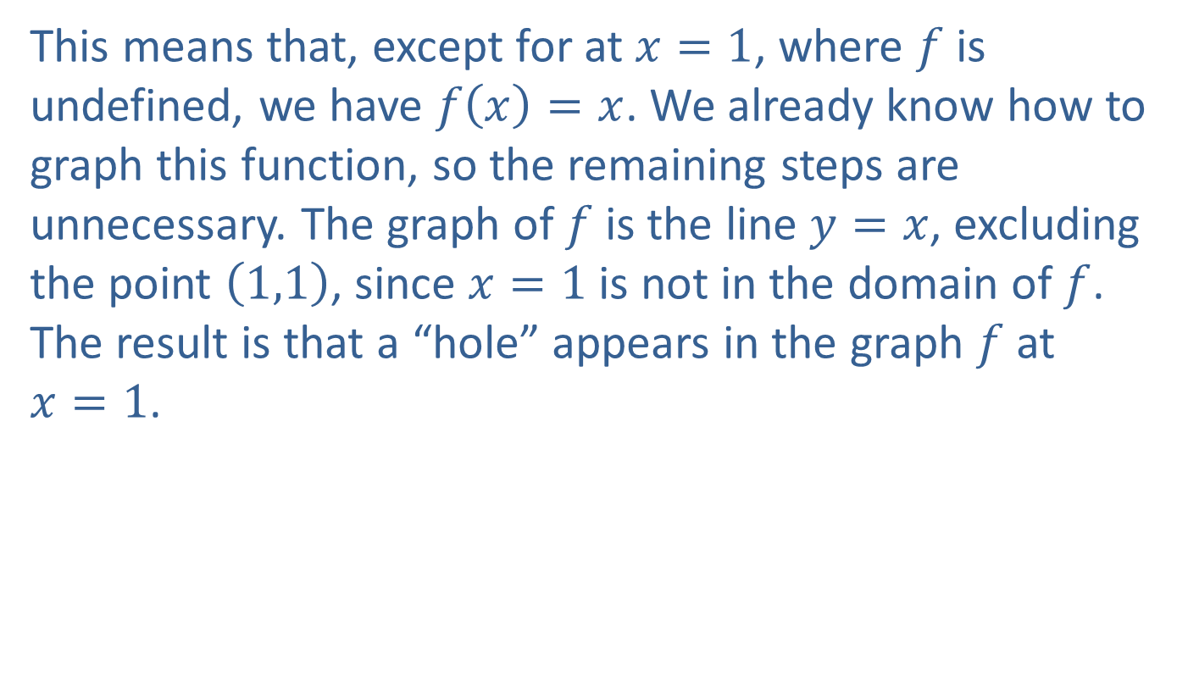
Example 3: Graphing Rational Functions (cont.)
​This means that, except for at $x=1$, where $f$ is undefined, we have $f\left(x\right)=x$. We already know how to graph this function, so the remaining steps are unnecessary. The graph of $f$ is the line $y=x$, excluding the point $\left(1,1\right)$, since $x=1$ is not in the domain of $f$. The result is that a “hole” appears in the graph $f$ at
$x=1$.​

Slide 32
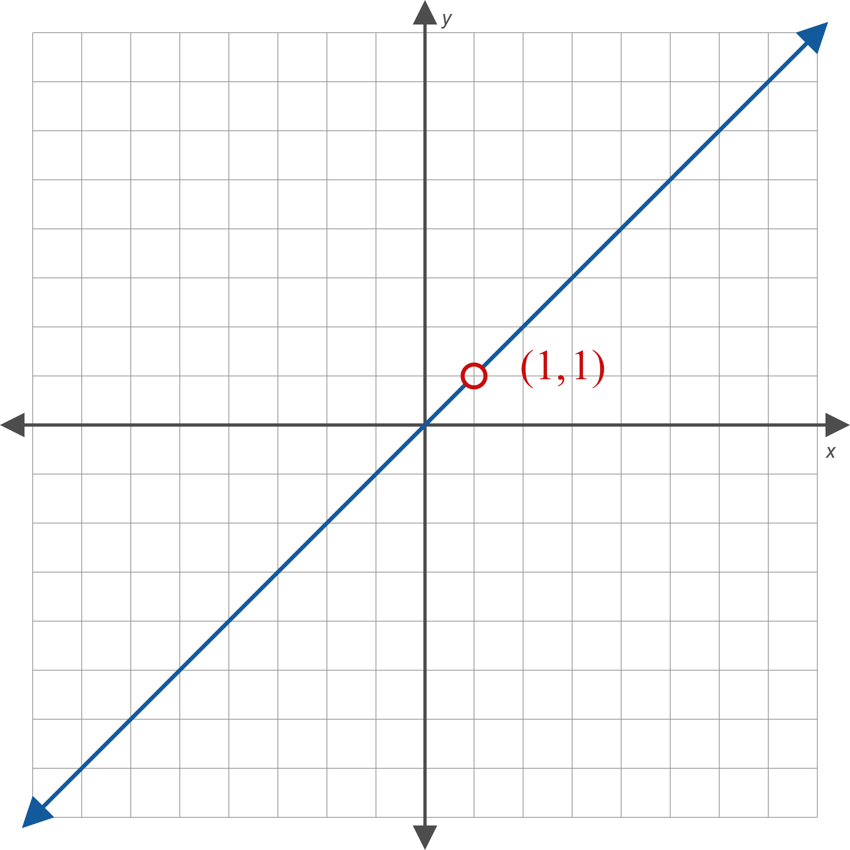
Example 3: Graphing Rational Functions (cont.)
Figure 6

Slide 33
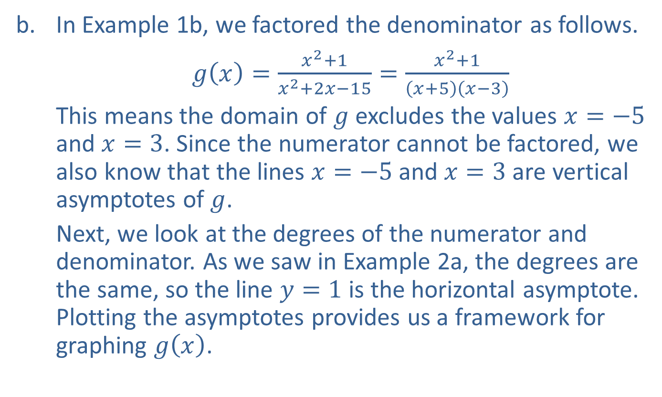
Example 3: Graphing Rational Functions (cont.)
​In Example 1b, we factored the denominator as follows.
​$g\left(x\right)=\frac{x^{2}+1}{x^{2}+2x−15}=\frac{x^{2}+1}{\left(x+5\right)\left(x−3\right)}$
​This means the domain of $g$ excludes the values $x=−5$ and $x=3$. Since the numerator cannot be factored, we also know that the lines $x=−5$ and $x=3$ are vertical asymptotes of $g$.
​Next, we look at the degrees of the numerator and denominator. As we saw in Example 2a, the degrees are the same, so the line $y=1$ is the horizontal asymptote. Plotting the asymptotes provides us a framework for graphing $g⁡\left(x\right)$.​

Slide 34
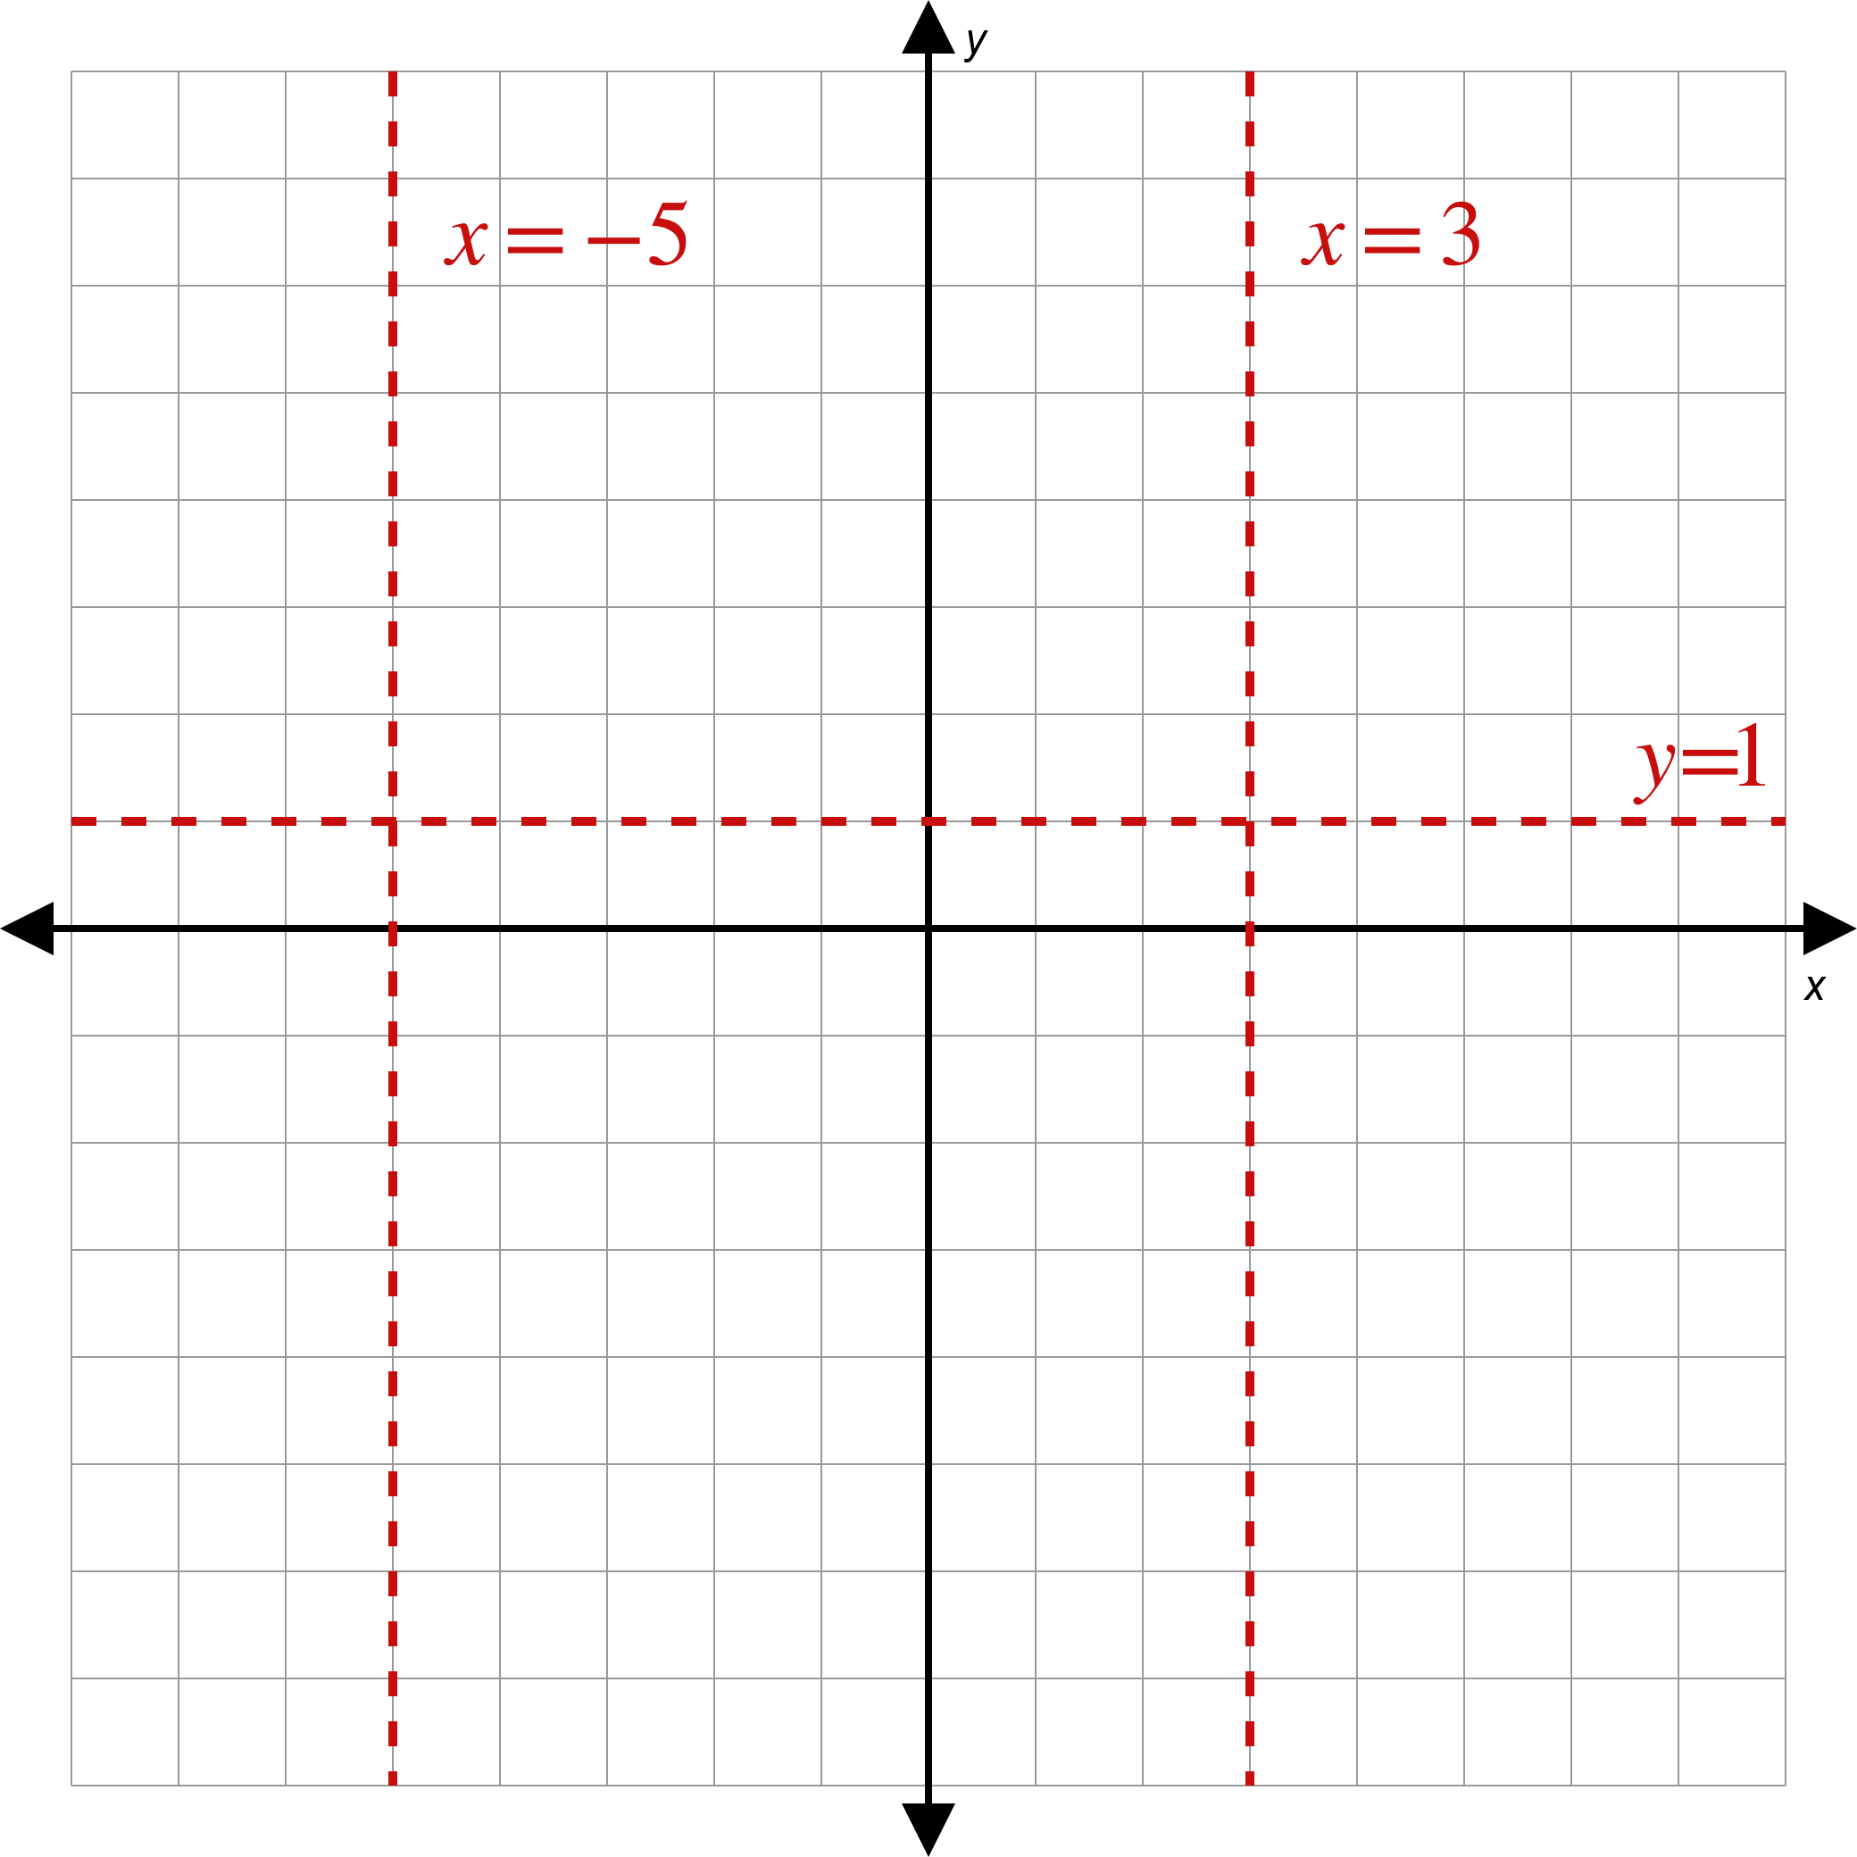
Example 3: Graphing Rational Functions (cont.)
Figure 7

Slide 35
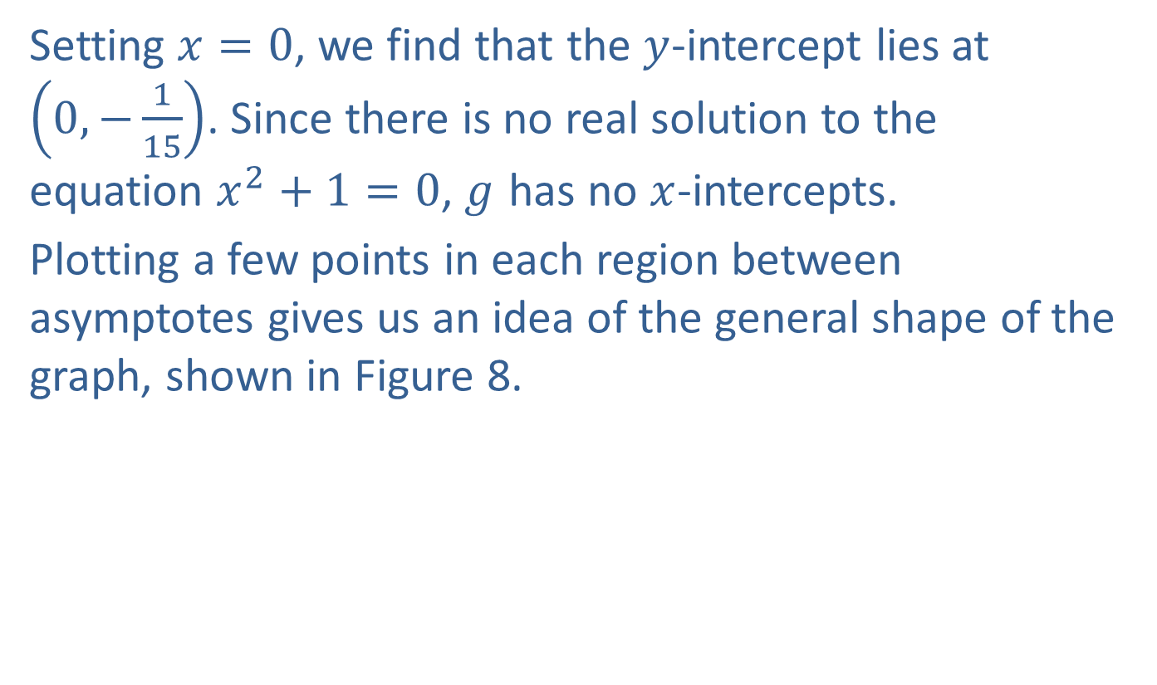
Example 3: Graphing Rational Functions (cont.)
​Setting $x=0$, we find that the $y$-intercept lies at $\left(0,−\frac{1}{15}\right)$. Since there is no real solution to the equation $x^{2}+1=0$, $g$ has no $x$-intercepts.
​Plotting a few points in each region between asymptotes gives us an idea of the general shape of the graph, shown in Figure 8.
​

Slide 36
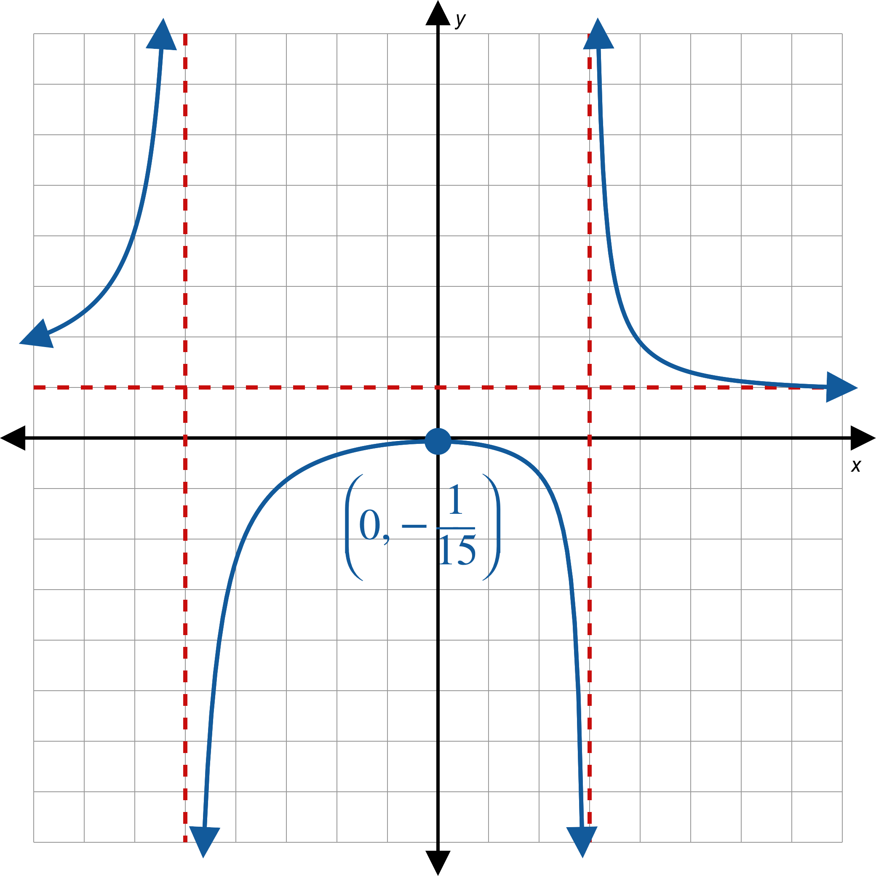
Example 3: Graphing Rational Functions (cont.)
Figure 8

Slide 37
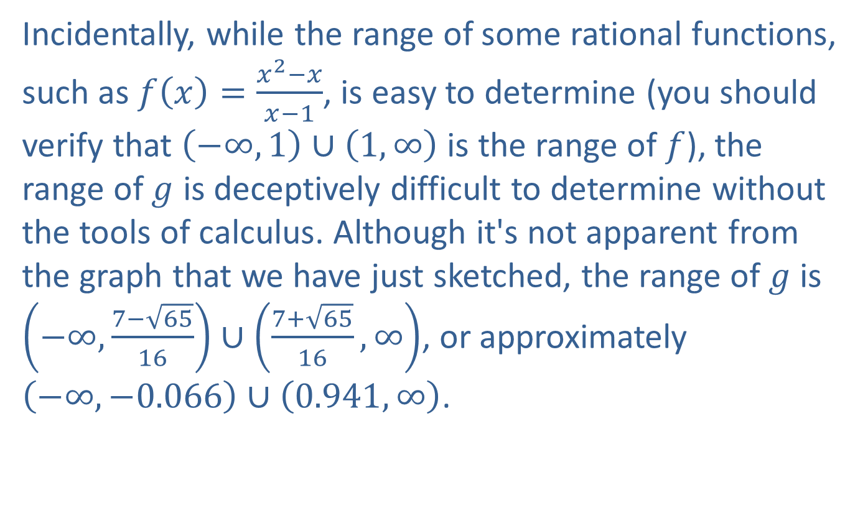
Example 3: Graphing Rational Functions (cont.)
​Incidentally, while the range of some rational functions, such as $f\left(x\right)=\frac{x^{2}−x}{x−1}$, is easy to determine (you should verify that $\left(−∞,1\right)∪\left(1,∞\right)$ is the range of $f$), the range of $g$ is deceptively difficult to determine without the tools of calculus. Although it's not apparent from the graph that we have just sketched, the range of $g$ is $\left(−∞,\frac{7−\sqrt{65}}{16}\right)∪\left(\frac{7+\sqrt{65}}{16},∞\right)$, or approximately $\left(−∞,−0.066\right)∪\left(0.941,∞\right)$.
​

Slide 38
Note:
There really isn’t much we can say with honesty about the range of rational functions without the tools of calculus. For instance, even the range of the deceptively simple rational function in Example 3b isn’t possible to determine without differentiation to find the critical points. The graphs in Figures 9 and 10 indicate subtle behavior near 0 and 16.

Slide 39
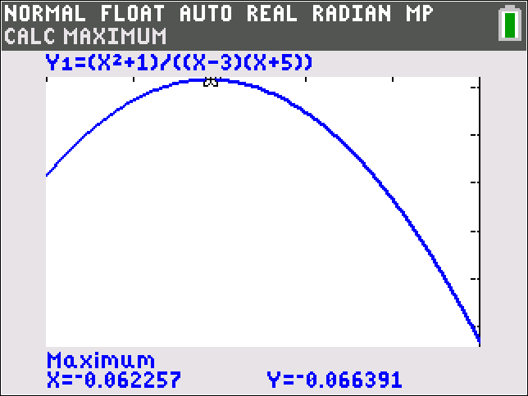
Example 3: Graphing Rational Functions (cont.)
Figure 9

Slide 40

Example 3: Graphing Rational Functions (cont.)
Figure 10

Slide 41

Example 3: Graphing Rational Functions (cont.)
​The denominator of this function cannot be factored, so there are no restrictions on the domain of $h$. Further, we saw in Example 2b that this function has an oblique asymptote of $y=x+1$.
​As usual, we calculate the $y$-intercept by substituting $x=0$.
​$h\left(0\right)=\frac{0^{3}+0^{2}+2\left(0\right)+2}{0^{2}+9}=\frac{2}{9}$

Slide 42

Example 3: Graphing Rational Functions (cont.)
​There are different approaches to finding the
$x$-intercepts. Looking at the numerator, we might guess that $−1$ is a zero of the numerator. A quick calculation confirms this: ${\left(−1\right)}^{3}+{\left(−1\right)}^{2}+2\left(−1\right)+2=0$. This means we can factor the numerator. Using synthetic or long division, we have $\left(x+1\right)\left(x^{2}+2\right)$. Thus, $(−1,0)$ is the only $x$-intercept.
​With the intercepts and a few other plotted points, we obtain the graph of $h$.
​

Slide 43

Example 3: Graphing Rational Functions (cont.)
Figure 11

Slide 44

Rational Inequalities
Definition
A rational inequality is any inequality that can be written in the form
$f⁡\left(x\right)<0$, $f⁡\left(x\right)≤0$, $f⁡\left(x\right)>0$, or $f⁡\left(x\right)≥0$,
where $f⁡\left(x\right)$ is a rational function.

Slide 45


Solving Rational Inequalities Using the Sign-Test Method
Procedure
To solve a rational inequality $f\left(x\right)<0$, $f\left(x\right)≤0$,
$f\left(x\right)>0$, or $f\left(x\right)≥0$, where the rational function
$f\left(x\right)=\frac{p\left(x\right)}{q\left(x\right)}$ is in reduced form:
Step 1: | Find the real zeros of the numerator $p⁡\left(x\right)$. These values are the zeros of $f$.
Step 2: | Find the real zeros of the denominator $q⁡\left(x\right)$. These values are the locations of the vertical asymptotes of $f$.

Slide 46

Solving Rational Inequalities Using the Sign-Test Method (cont.)
Step 3: | Place the values from steps 1 and 2 on a number line, splitting it into intervals.
Step 4: | Within each interval, select a test point and evaluate $f$ at that number. If the result is positive, then $f\left(x\right)>0$ for all $x$ in the interval. If the result is negative, then $f\left(x\right)<0$ for all $x$ in the interval.

Slide 47

Solving Rational Inequalities Using the Sign-Test Method (cont.)
Step 5: | Write the solution set, consisting of all of the intervals that satisfy the given inequality. If the inequality is not strict (uses $≤$ or $≥$), then the zeros of $p$ are included in the solution set as well. The zeros of $q$ are never included in the solution set (as they are not in the domain of $f$).

Slide 48

Example 4: Solving Rational Inequalities
Solve the rational inequality $\frac{x^{2}+1}{x^{2}+2x−15}>0$.

Slide 49

Example 4: Solving Rational Inequalities (cont.)
Solution
Begin by finding the zeros of the numerator and denominator. As we’ve seen in previous examples, the rational expression can be factored as follows.
$$\frac{x^{2}+1}{x^{2}+2x−15}=\frac{x^{2}+1}{\left(x+5\right)\left(x−3\right)}$$

Slide 50


Example 4: Solving Rational Inequalities (cont.)
Thus, we can see that the numerator has no zeros, while the denominator has zeros at $x=−5$ and $x=3$.
Therefore, we place the values $−5$ and 3 on a number line.
Figure 12

Slide 51

Example 4: Solving Rational Inequalities (cont.)
This splits the number line into the intervals $(−∞,−5)$, $(−5,3)$, $(3,∞)$. We then evaluate $f⁡\left(x\right)$ for a test point in each interval.

Slide 52

Example 4: Solving Rational Inequalities (cont.)
Interval | Test Point | Evaluate | Result
$$(−∞,−5)$$ | $$x=−6$$ | 𝑓−6=−62+1−62+2−6−15𝑓⁡−6=379 | $f\left(x\right)>0$ on $(−∞,−5)$ Positive
$$(−5,3)$$ | $$x=0$$ | 𝑓0=02+102+20−15𝑓⁡0=−115 | $f⁡\left(x\right)<0$ on $(−5,3)$ Negative
$$(3,∞)$$ | $$x=4$$ | 𝑓4=42+142+24−15𝑓⁡4=179 | $f\left(x\right)>0$ on $(3,∞)$ Positive
Table 2

Slide 53

Example 4: Solving Rational Inequalities (cont.)
Then, the solution to the inequality consists of those intervals where $f\left(x\right)>0$, which is the set
$\left(−∞,−5\right)∪\left(3,∞\right)$.

Slide 54

CAUTION!
It is very important to write rational inequalities in their proper form before solving them. Attempting to simplify them may cause us to neglect asymptotes. Suppose, for example, we tried to solve the inequality
$$\frac{x}{x+2}<3$$
by multiplying through by $x+2$, thus clearing the inequality of fractions. The result would be
$x<3x+6$,
a simple linear inequality. We can solve this to obtain $x>−3$, or the interval $(−3,∞)$. But does this really work?

Slide 55

CAUTION! (cont.)
The number $−\frac{5}{2}$ is in this interval, but $\frac{−\frac{5}{2}}{−\frac{5}{2}+2}=5$,
which is not less than 3. Also, note that $−4$ solves the inequality, but $−4$ is not in the interval $(−3,∞)$.
What went wrong? By multiplying through by $x+2$, we made the assumption that $x+2$ was positive, since we did not worry about possibly reversing the inequality symbol. But we don't know beforehand if $x+2$ is positive or not, since we are trying to solve for the variable $x$.
To solve this inequality correctly, we have to write it in the standard form of a rational inequality, as shown in Example 5.

Slide 56

Example 5: Solving Rational Inequalities
Solve the rational inequalities $\frac{x}{x+2}<3$ and $\frac{x}{x+2}≤3$.

Slide 57


Example 5: Solving Rational Inequalities (cont.)
Solution
Most of the work can be done for both inequalities at the same time.
We begin by subtracting 3 from both sides and then write the left-hand side as a single rational function.
​$\frac{x}{x+2}−3$ | ​$<0$ | and
​$\frac{x}{x+2}−\frac{3\left(x+2\right)}{x+2}$ | ​$<0$
​$\frac{−2x−6}{x+2}$ | ​$<0$
​$\frac{x}{x+2}−3$ | ​$≤0$
​$\frac{x}{x+2}−\frac{3\left(x+2\right)}{x+2}$ | ​$≤0$
​$\frac{−2x−6}{x+2}$ | ​$≤0$

Slide 58

Example 5: Solving Rational Inequalities (cont.)
Then factor $−2$ from the numerator of the fraction and divide both sides by $−2$ (reversing the inequality symbol) to obtain the simpler inequalities
$\frac{x+3}{x+2}>0$ and $\frac{x+3}{x+2}≥0$.
Now that the inequalities are in standard form, we can follow the procedure for solving rational inequalities.

Slide 59



Example 5: Solving Rational Inequalities (cont.)
The zeros of the numerator and denominator are $−3$ and $−2$, respectively. Placing these values on a number line,
Figure 13
we have the intervals $(−∞,−3)$, $(−3,−2)$, and $(−2,∞)$.

Slide 60

Example 5: Solving Rational Inequalities (cont.)
Interval | Test Point | Evaluate | Result
$$(−∞,−3)$$ | $$x=−4$$ | 𝑓−4=−4+3−4+2𝑓⁡−4=12 | $f⁡\left(x\right)>0$ on $(−∞,−3)$ Positive
$$(−3,−2)$$ | $$x=−2.5$$ | 𝑓−2.5=−2.5+3−2.5+2𝑓⁡−2.5=−1 | $f⁡\left(x\right)<0$ on $(−3,−2)$ Negative
$$(−2,∞)$$ | $$x=0$$ | 𝑓0=0+30+2𝑓⁡0=32 | $f⁡\left(x\right)>0$ on $(−2,∞)$ Positive
Table 3

Slide 61

Example 5: Solving Rational Inequalities (cont.)
The final step is to evaluate which intervals satisfy each inequality. The solution to the first inequality is the union of the two intervals where $f$ is positive.
$$\left(−∞,−3\right)∪\left(−2,∞\right)$$
For the second inequality, we have to decide which endpoints to include. We include $x=−3$, since this is a zero of the rational function, but we do not include
$x=−2$, since the value is not in the domain of $f$. Thus, the solution to the second inequality is
$\left(−∞,−3\right]∪\left(−2,∞\right)$.

