Slide 1
Section 8.1
Ellipses

Slide 2
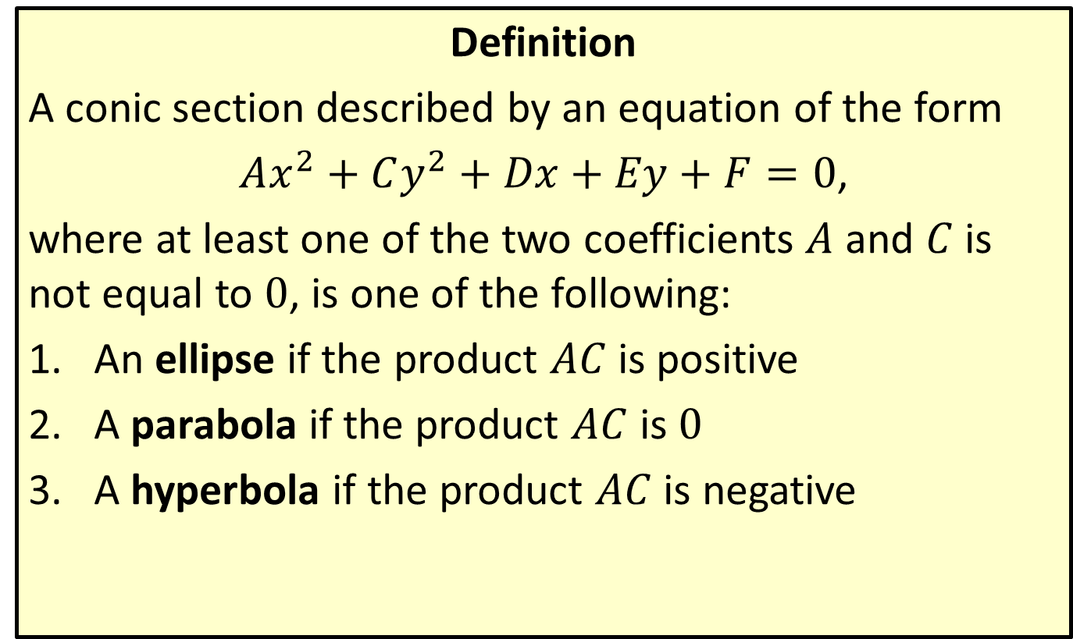
Algebraic Definition of Conics
Definition
A conic section described by an equation of the form
$Ax^{2}+Cy^{2}+Dx+Ey+F=0$,
where at least one of the two coefficients $A$ and $C$ is not equal to 0, is one of the following:
​An ellipse if the product $AC$ is positive
​A parabola if the product $AC$ is 0
​A hyperbola if the product $AC$ is negative

Slide 3
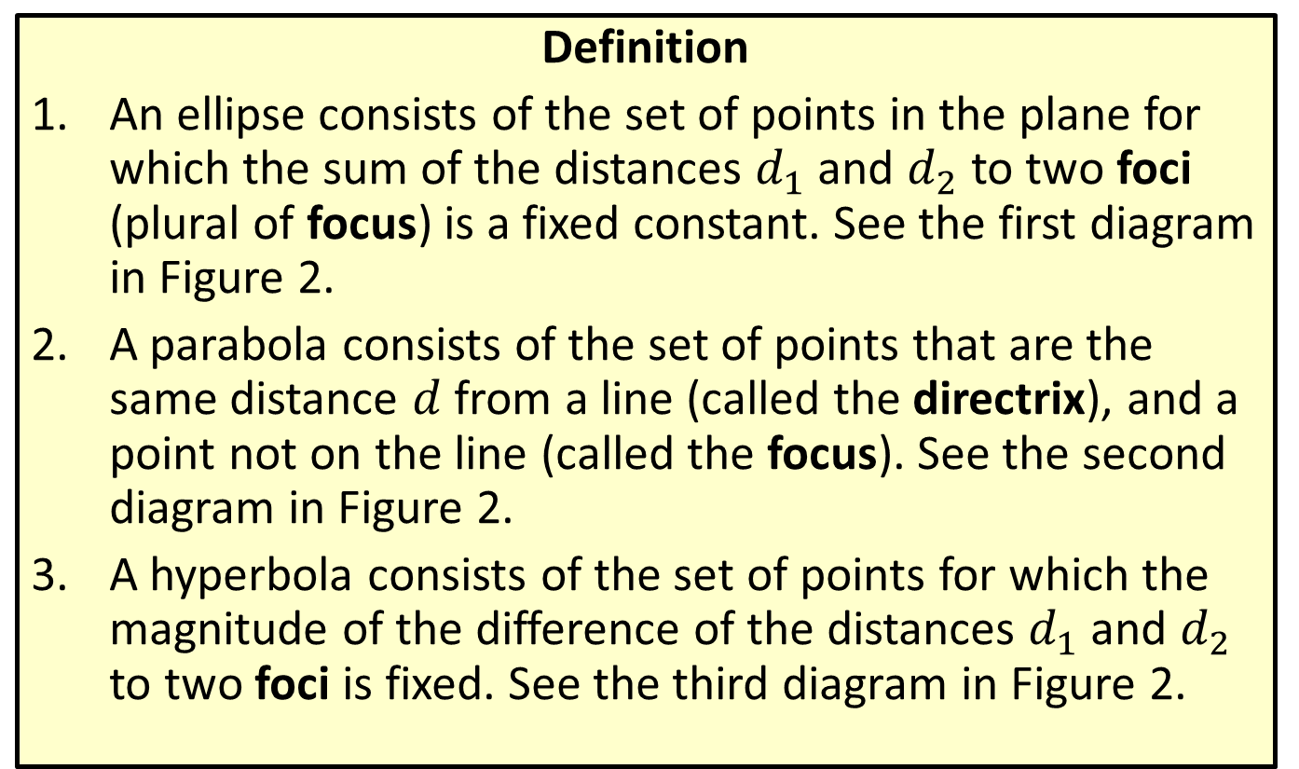
Plane Geometric Definition of Conics
Definition
​An ellipse consists of the set of points in the plane for which the sum of the distances $d_{1}$ and $d_{2}$ to two foci (plural of focus) is a fixed constant. See the first diagram in Figure 2.
​A parabola consists of the set of points that are the same distance $d$ from a line (called the directrix), and a point not on the line (called the focus). See the second diagram in Figure 2.
​A hyperbola consists of the set of points for which the magnitude of the difference of the distances $d_{1}$ and $d_{2}$ to two foci is fixed. See the third diagram in Figure 2.

Slide 4
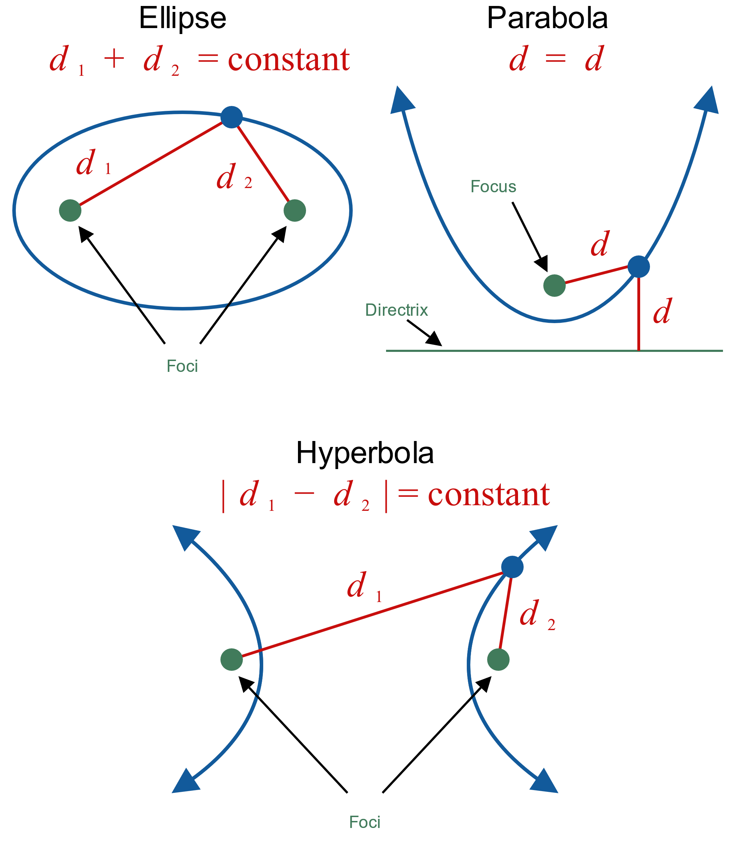
Plane Geometric Definition of Conics (cont.)
Figure 2

Slide 5

Example 1: Graphing an Ellipse Centered at the Origin
Determine the foci of the ellipse $\frac{x^{2}}{16}+\frac{y^{2}}{9}=1$, and then graph the ellipse.

Slide 6
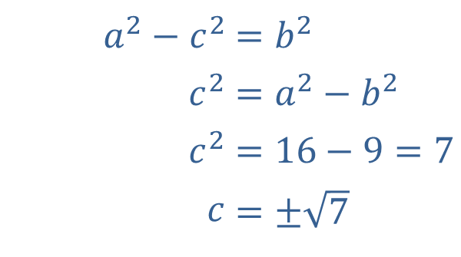
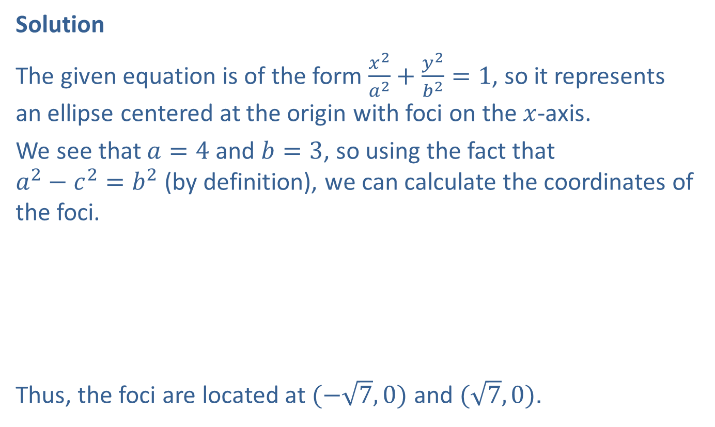
Example 1: Graphing an Ellipse Centered at the Origin (cont.)
Solution
The given equation is of the form $\frac{x^{2}}{a^{2}}+\frac{y^{2}}{b^{2}}=1$, so it represents an ellipse centered at the origin with foci on the $x$-axis.
We see that $a=4$ and $b=3$, so using the fact that
$a^{2}−c^{2}=b^{2}$ (by definition), we can calculate the coordinates of the foci.
Thus, the foci are located at $(−\sqrt{7},0)$ and $(\sqrt{7},0)$.
​$a^{2}−c^{2}$ | ​$=b^{2}$
​$c^{2}$ | ​$=a^{2}−b^{2}$
​$c^{2}$ | ​$=16−9=7$
​$c$ | ​$=±\sqrt{7}$

Slide 7
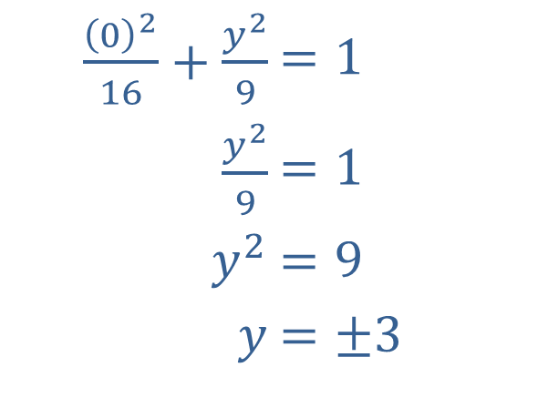

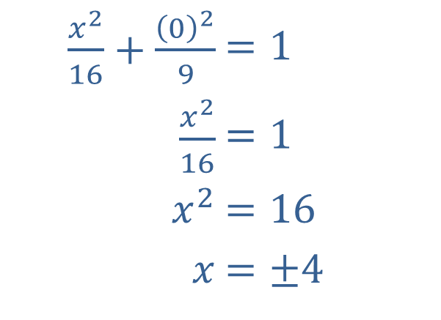
Example 1: Graphing an Ellipse Centered at the Origin (cont.)
Again, we know the graph of this equation is an ellipse. To graph it, we will compute the $x$- and $y$-intercepts.
Setting $x$ and $y$ equal to zero, we have:
​
​$\frac{{\left(0\right)}^{2}}{16}+\frac{y^{2}}{9}$ | ​$=1$
​$\frac{y^{2}}{9}$ | ​$=1$
​$y^{2}$ | ​$=9$
​$y$ | ​$=±3$
​$\frac{x^{2}}{16}+\frac{{\left(0\right)}^{2}}{9}$ | ​$=1$
​$\frac{x^{2}}{16}$ | ​$=1$
​$x^{2}$ | ​$=16$
​$x$ | ​$=±4$
and

Slide 8
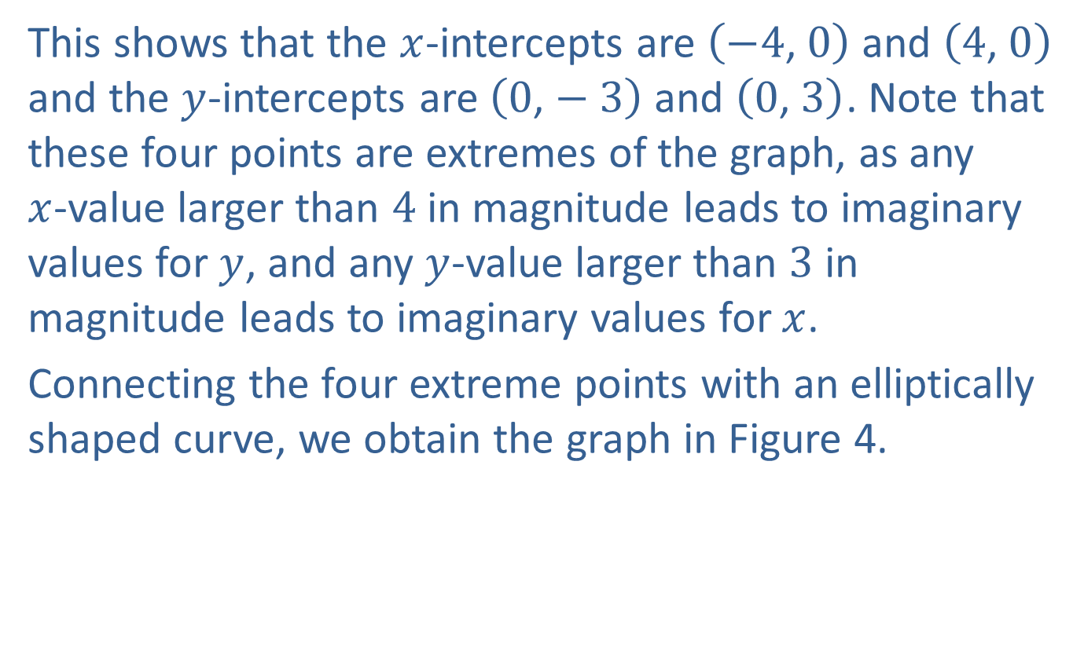
Example 1: Graphing an Ellipse Centered at the Origin (cont.)
This shows that the $x$-intercepts are $\left(−4\text{, }0\right)$ and $\left(4\text{, }0\right)$ and the $y$-intercepts are $\left(0\text{,}−3\right)$ and $\left(0\text{, }3\right)$. Note that these four points are extremes of the graph, as any
$x$-value larger than 4 in magnitude leads to imaginary values for $y$, and any $y$-value larger than 3 in magnitude leads to imaginary values for $x$.
Connecting the four extreme points with an elliptically shaped curve, we obtain the graph in Figure 4.

Slide 9
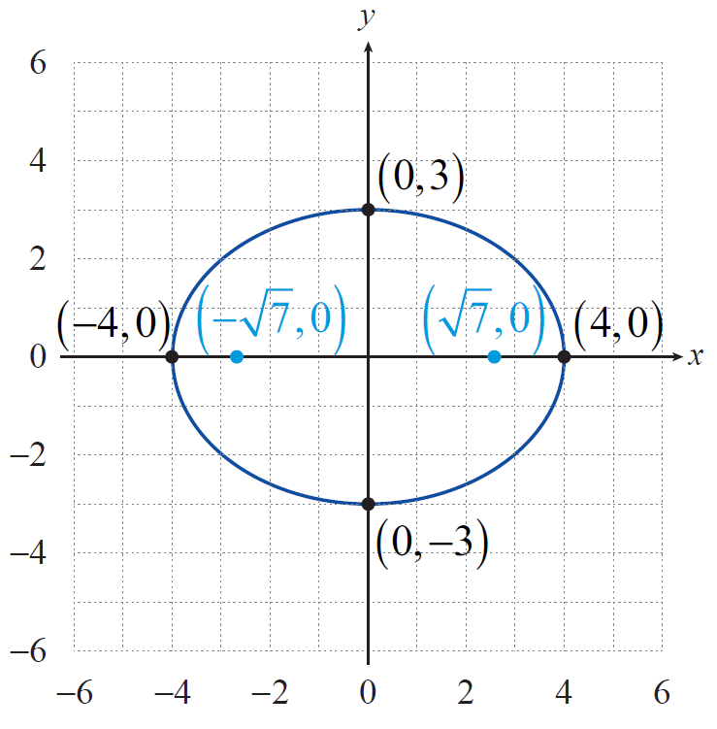
Example 1: Graphing an Ellipse Centered at the Origin (cont.)
Figure 4

Slide 10
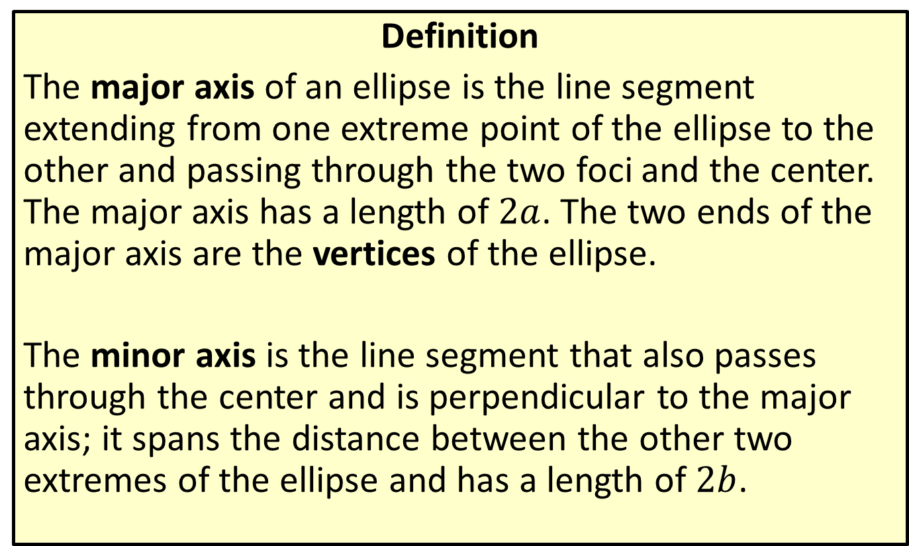
Axes and Vertices of an Ellipse
Definition
The major axis of an ellipse is the line segment extending from one extreme point of the ellipse to the other and passing through the two foci and the center. The major axis has a length of $2a$. The two ends of the major axis are the vertices of the ellipse.
The minor axis is the line segment that also passes through the center and is perpendicular to the major axis; it spans the distance between the other two extremes of the ellipse and has a length of $2b$.

Slide 11
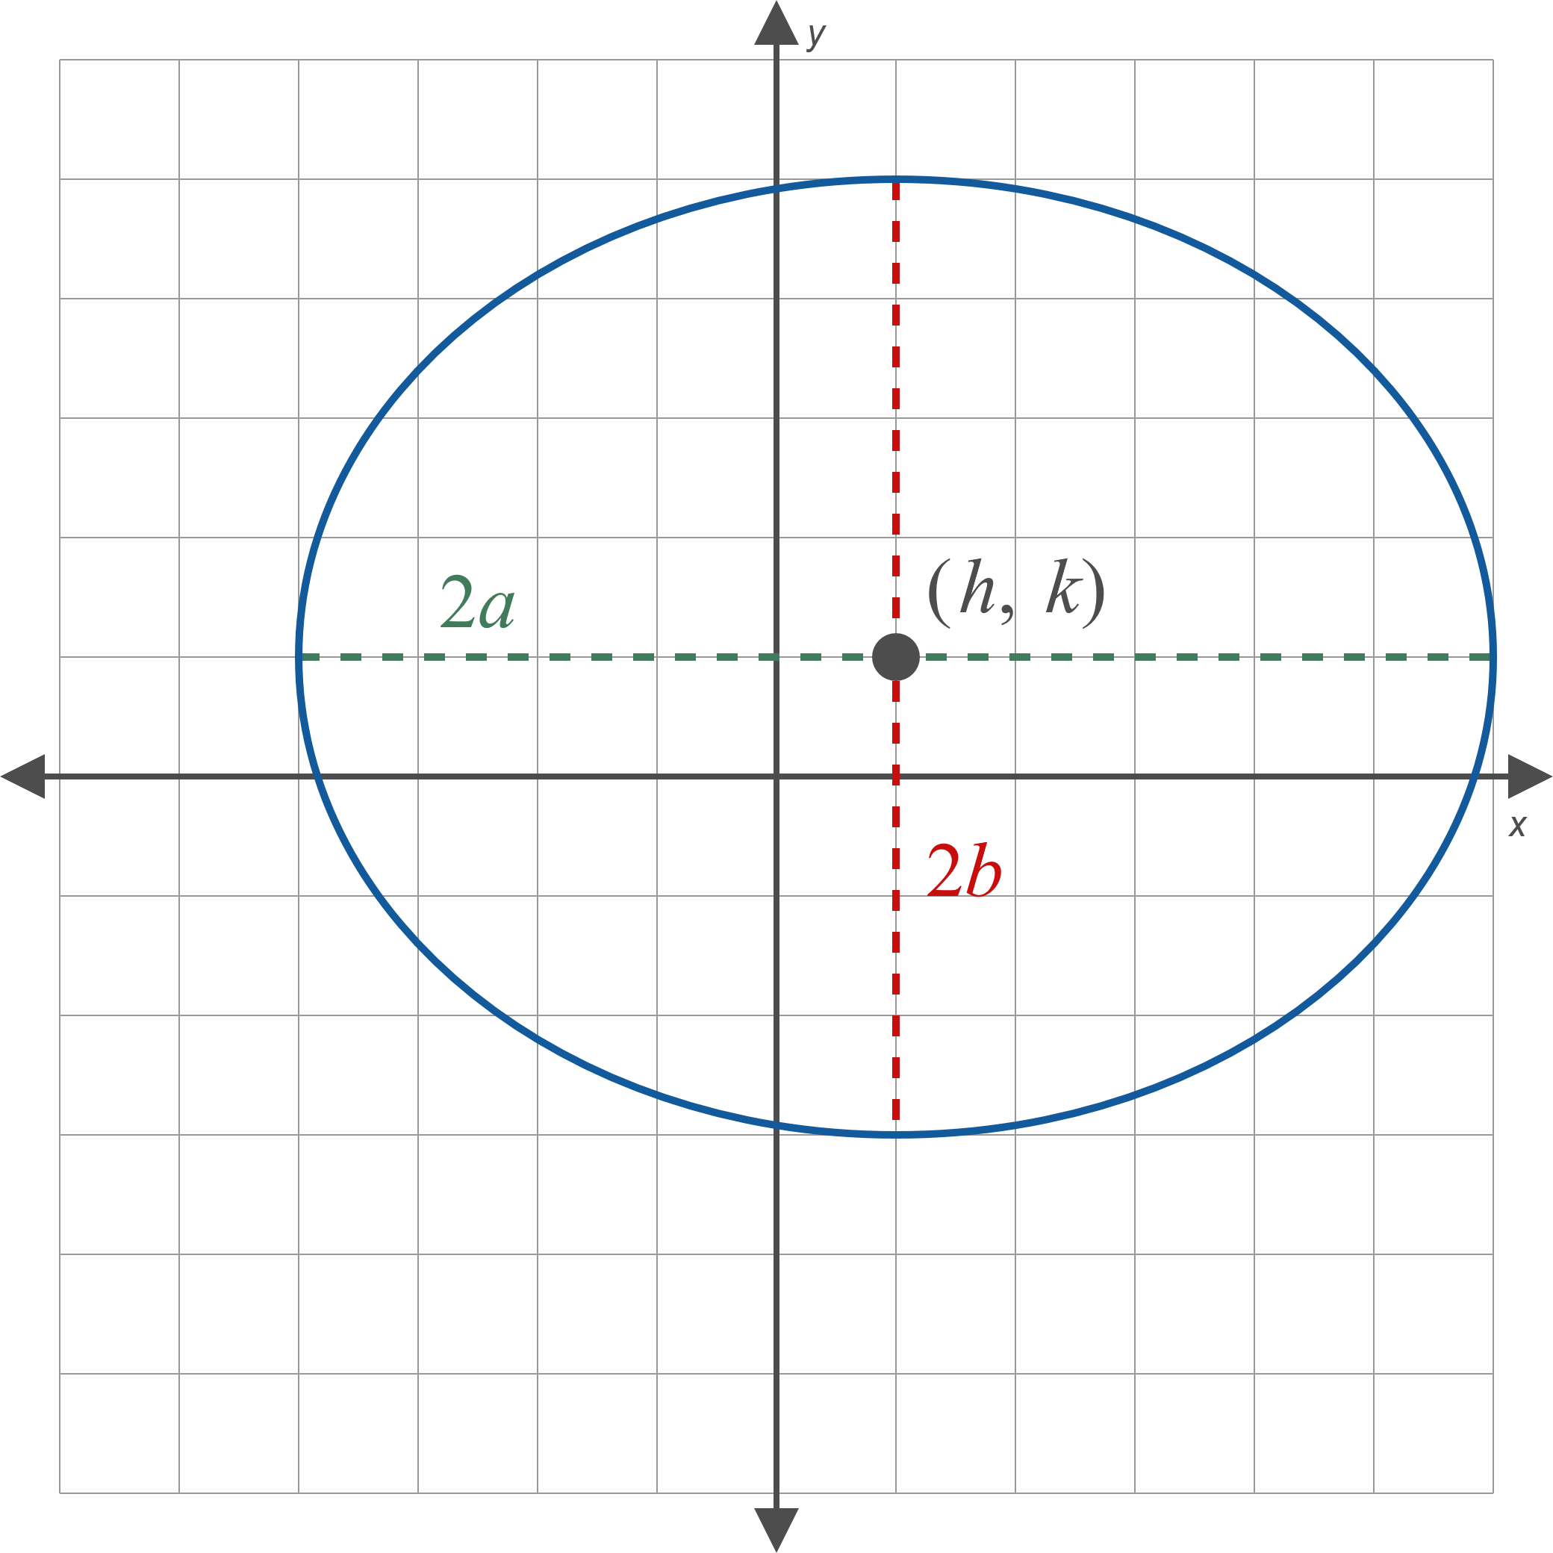
Axes and Vertices of an Ellipse (cont.)
Figure 7

Slide 12
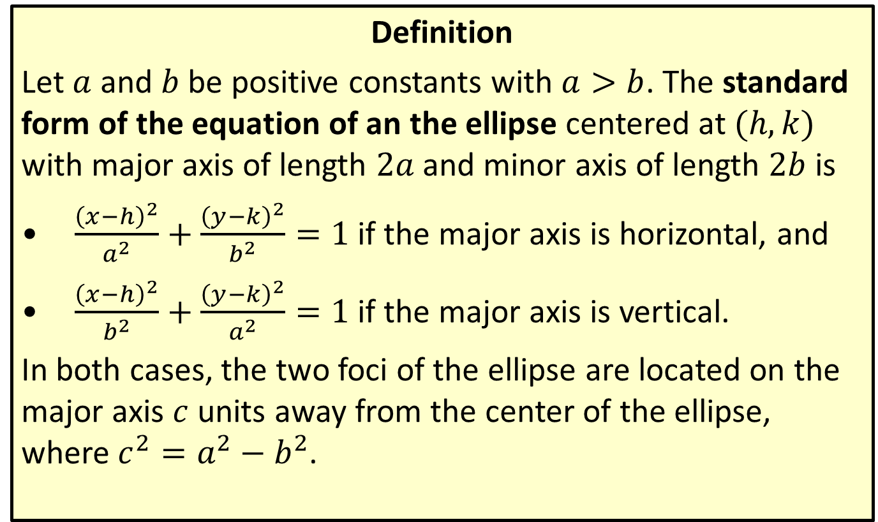
Standard Form of the Equation of an Ellipse
Definition
Let $a$ and $b$ be positive constants with $a>b$. The standard form of the equation of an the ellipse centered at $(h,k)$ with major axis of length $2a$ and minor axis of length $2b$ is
​$\frac{{\left(x−h\right)}^{2}}{a^{2}}+\frac{{\left(y−k\right)}^{2}}{b^{2}}=1$ if the major axis is horizontal, and
​$\frac{{\left(x−h\right)}^{2}}{b^{2}}+\frac{{\left(y−k\right)}^{2}}{a^{2}}=1$ if the major axis is vertical.
In both cases, the two foci of the ellipse are located on the major axis $c$ units away from the center of the ellipse, where $c^{2}=a^{2}−b^{2}$.

Slide 13

Example 2: Graphing an Ellipse with Equation in Standard Form
Graph the ellipse $\frac{{\left(x−1\right)}^{2}}{25}+\frac{{\left(y+4\right)}^{2}}{9}=1$. Include the foci on the graph.

Slide 14
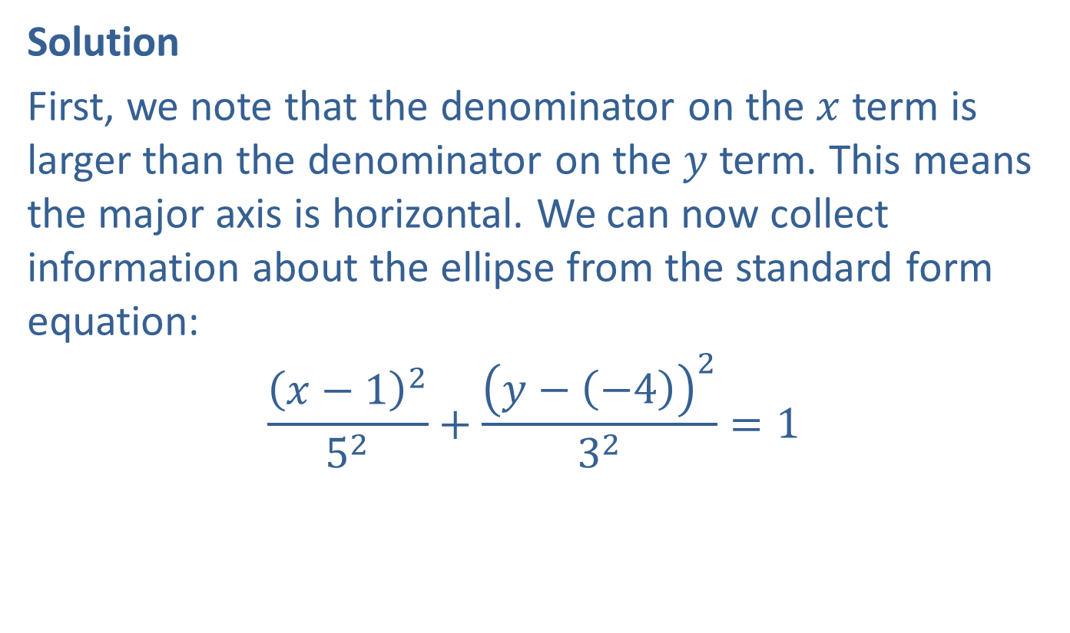
Example 2: Graphing an Ellipse with Equation in Standard Form (cont.)
Solution
First, we note that the denominator on the $x$ term is larger than the denominator on the $y$ term. This means the major axis is horizontal. We can now collect information about the ellipse from the standard form equation:
$$\frac{{\left(x−1\right)}^{2}}{5^{2}}+\frac{{\left(y−\left(−4\right)\right)}^{2}}{3^{2}}=1$$

Slide 15

Example 2: Graphing an Ellipse with Equation in Standard Form (cont.)
The ellipse is centered at $(1,−4)$, and we have $a=5$ and $b=3$. This means the major axis extends from $(−4,−4)$ to $(6,−4)$ and the minor axis runs from $(1,−7)$ to $(1,−1)$. Connecting these points with an elliptical curve will provide a good graph.

Slide 16
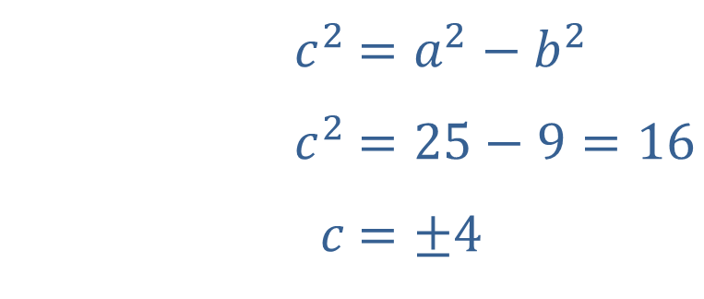
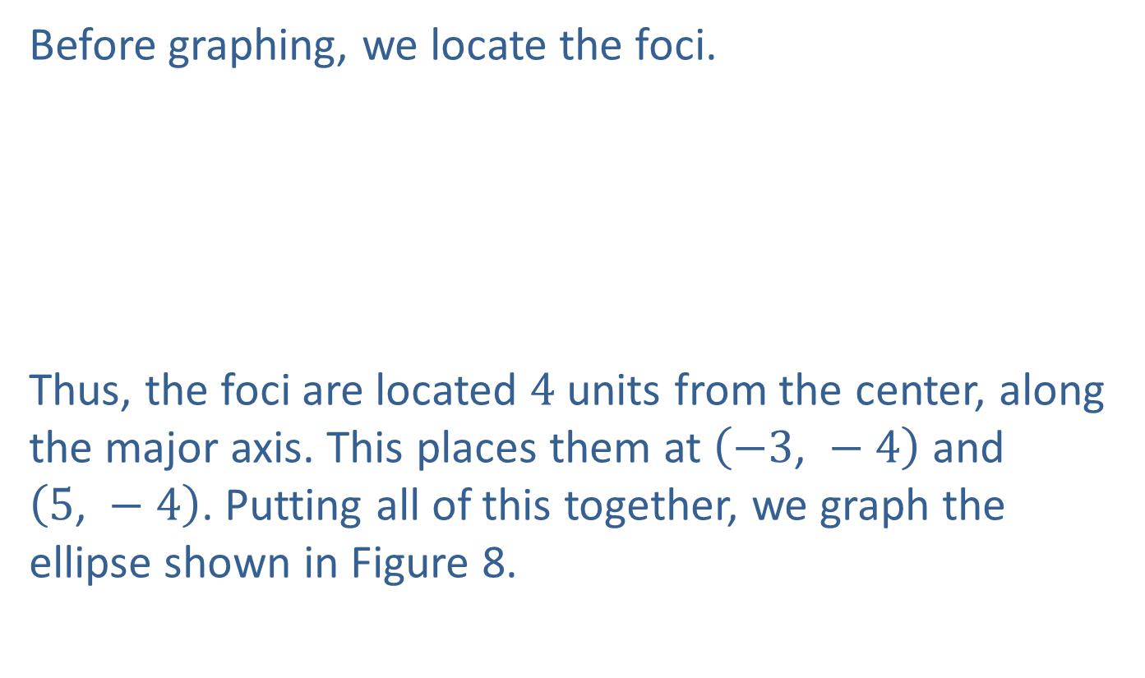
Example 2: Graphing an Ellipse with Equation in Standard Form (cont.)
Before graphing, we locate the foci.
​
Thus, the foci are located 4 units from the center, along the major axis. This places them at $\left(−3\text{, }−4\right)$ and
$\left(5\text{, }−4\right)$. Putting all of this together, we graph the ellipse shown in Figure 8.
​$c^{2}$ | ​$=a^{2}−b^{2}$
​$c^{2}$ | ​$=25−9=16$
​$c$ | ​$=±4$

Slide 17
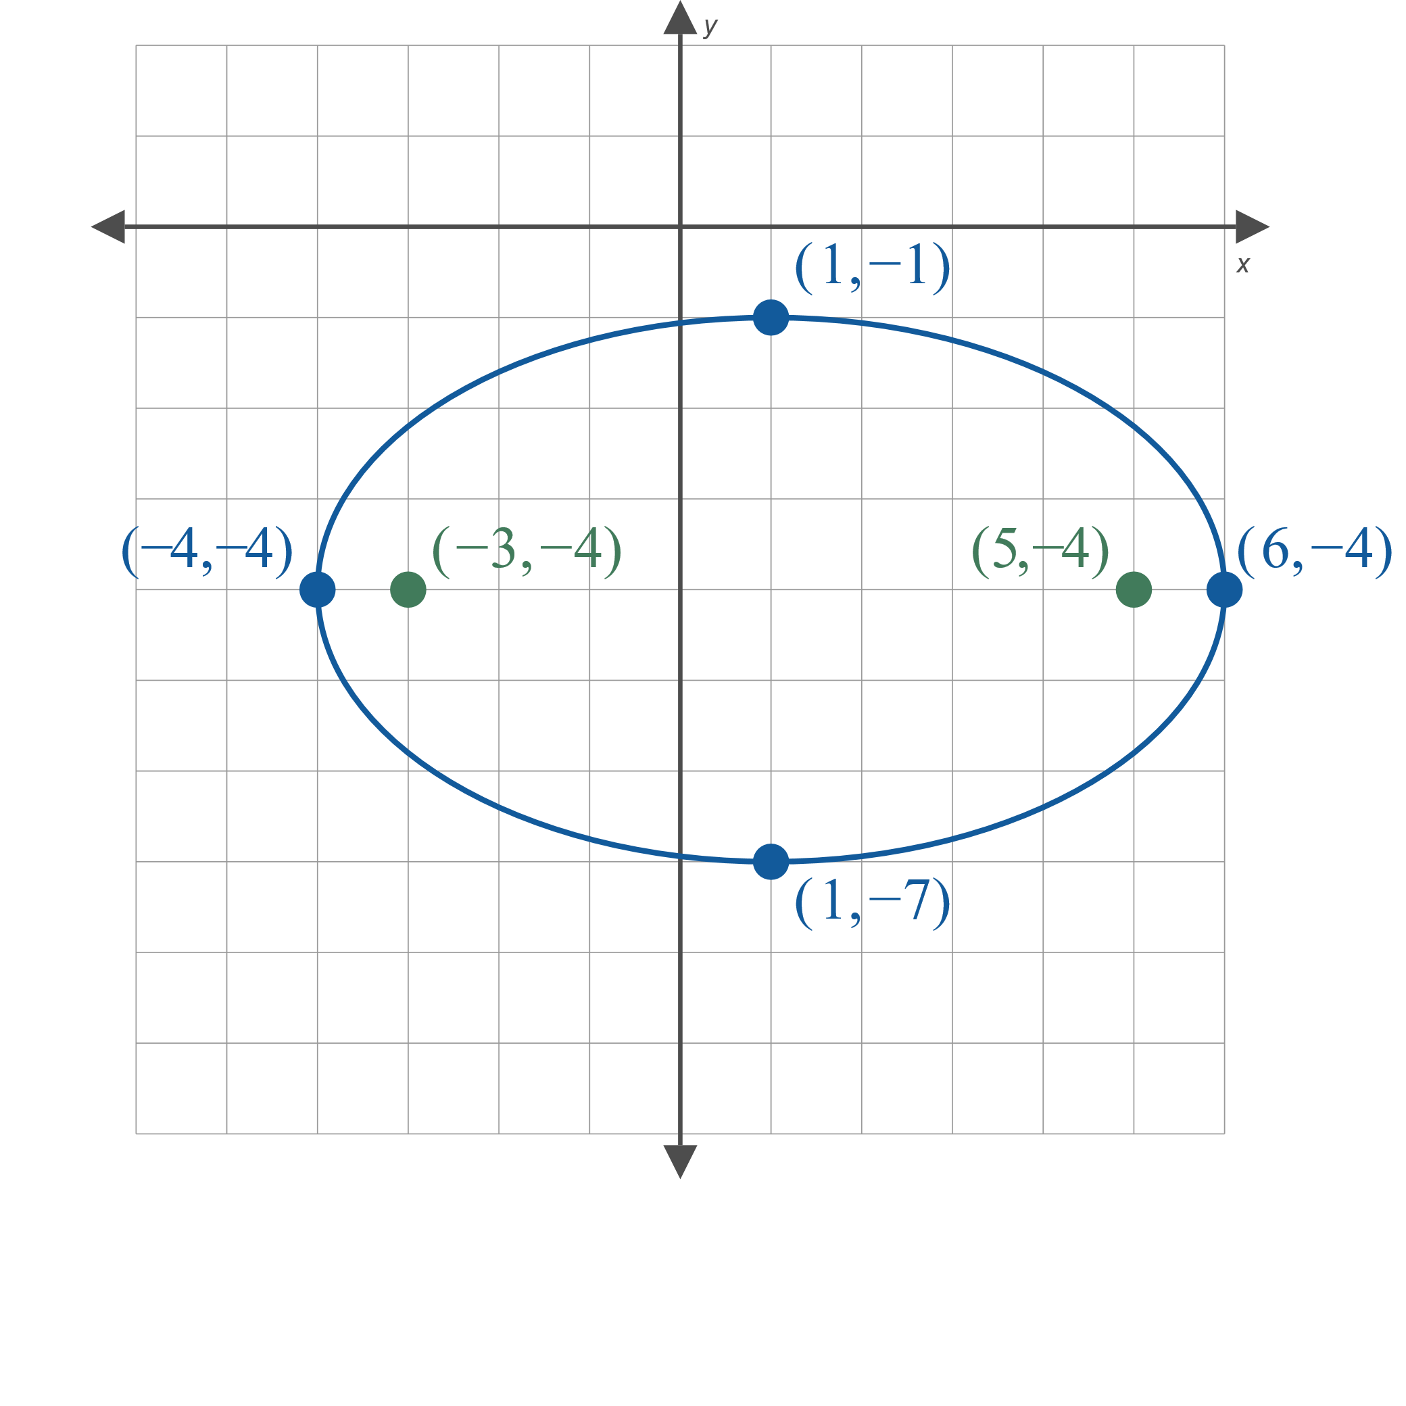
Example 2: Graphing an Ellipse with Equation in Standard Form (cont.)
Figure 8

Slide 18

Example 3: Graphing an Ellipse with Equation Not in Standard Form
Graph the ellipse
$25x^{2}+4y^{2}+100x−24y+36=0$.

Slide 19
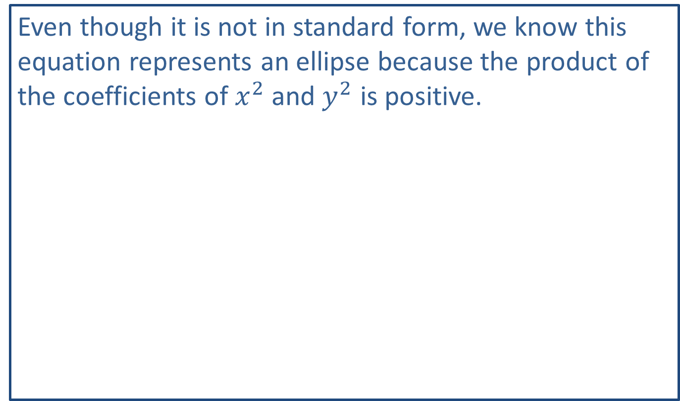
Note:
Even though it is not in standard form, we know this equation represents an ellipse because the product of the coefficients of $x^{2}$ and $y^{2}$ is positive.

Slide 20
Example 3: Graphing an Ellipse with Equation Not in Standard Form (cont.)
Solution
As written, the equation doesn't provide any useful information about the ellipse. To rewrite it in standard form, we need to complete the square for both variables.

Slide 21
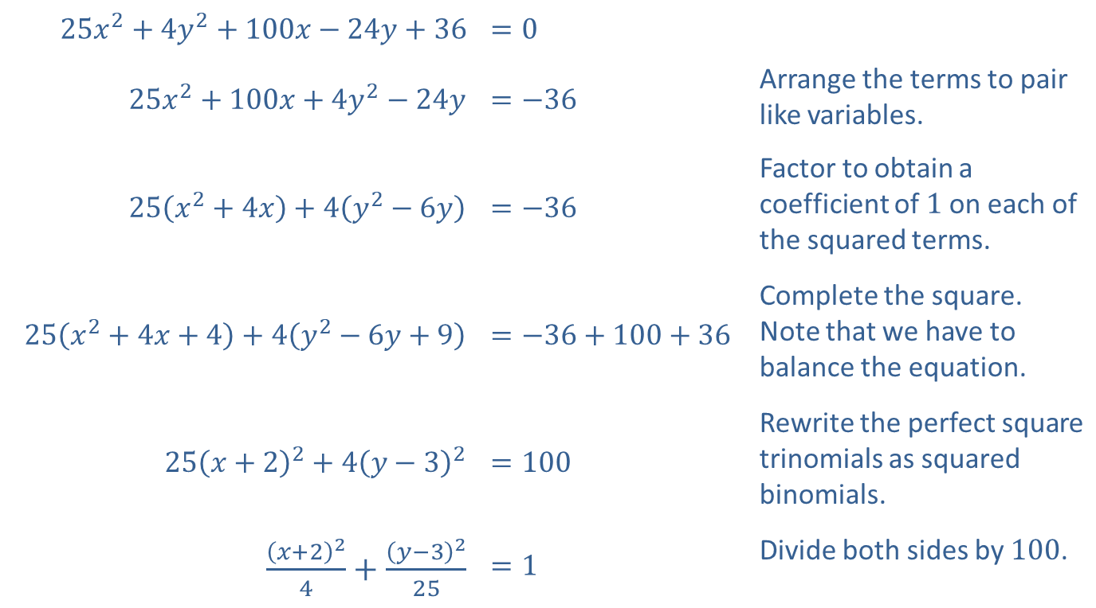
Example 3: Graphing an Ellipse with Equation Not in Standard Form (cont.)
​$25x^{2}+4y^{2}+100x−24y+36$ | ​$=0$
​$25x^{2}+100x+4y^{2}−24y$ | ​$=−36$ | Arrange the terms to pair like variables.
​$25\left(x^{2}+4x\right)+4\left(y^{2}−6y\right)$ | ​$=−36$ | Factor to obtain a coefficient of 1 on each of the squared terms.
​$25\left(x^{2}+4x+4\right)+4\left(y^{2}−6y+9\right)$ | ​$=−36+100+36$ | Complete the square. Note that we have to balance the equation.
​$25{\left(x+2\right)}^{2}+4{\left(y−3\right)}^{2}$ | ​$=100$ | Rewrite the perfect square trinomials as squared binomials.
​$\frac{{\left(x+2\right)}^{2}}{4}+\frac{{\left(y−3\right)}^{2}}{25}$ | ​$=1$ | Divide both sides by 100.

Slide 22
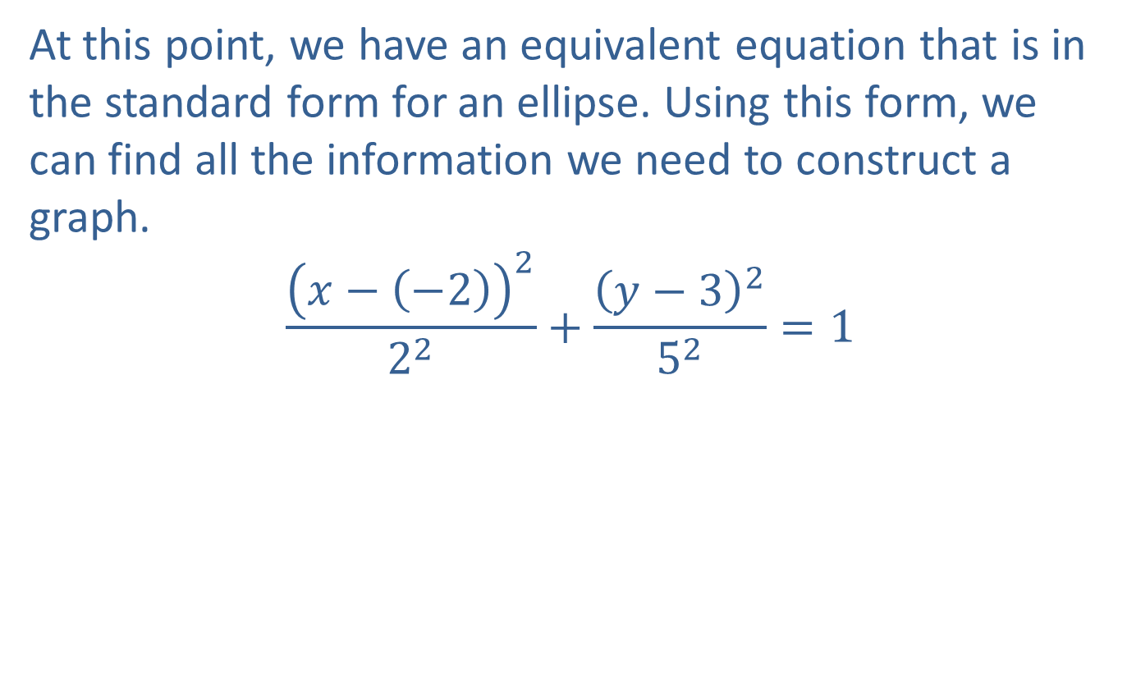
Example 3: Graphing an Ellipse with Equation Not in Standard Form (cont.)
At this point, we have an equivalent equation that is in the standard form for an ellipse. Using this form, we can find all the information we need to construct a graph.
$$\frac{{\left(x−\left(−2\right)\right)}^{2}}{2^{2}}+\frac{{\left(y−3\right)}^{2}}{5^{2}}=1$$

Slide 23
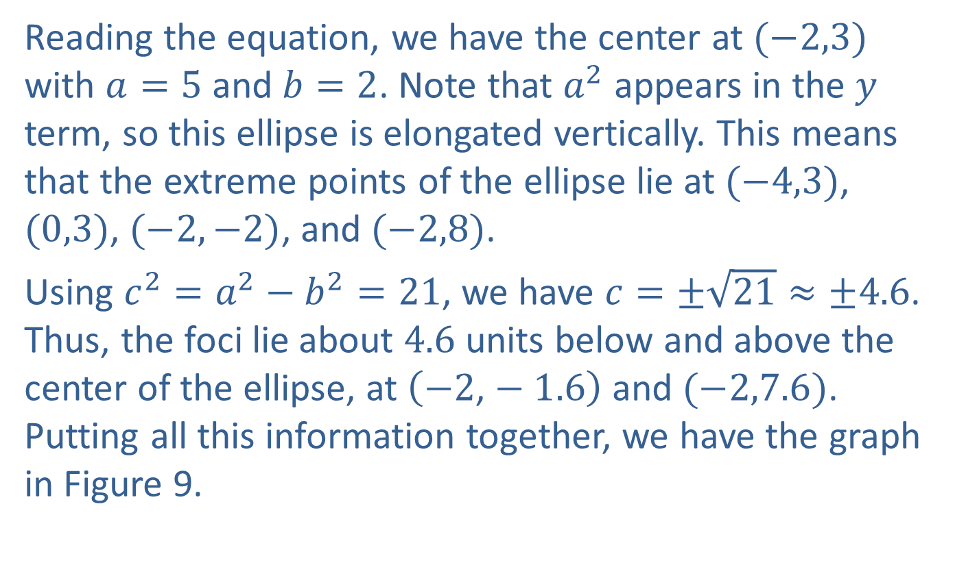
Example 3: Graphing an Ellipse with Equation Not in Standard Form (cont.)
Reading the equation, we have the center at $(−2,3)$ with $a=5$ and $b=2$. Note that $a^{2}$ appears in the $y$ term, so this ellipse is elongated vertically. This means that the extreme points of the ellipse lie at $(−4,3)$, $(0,3)$, $(−2,−2)$, and $(−2,8)$.
Using $c^{2}=a^{2}−b^{2}=21$, we have $c=±\sqrt{21}≈±4.6$. Thus, the foci lie about 4.6 units below and above the center of the ellipse, at $\left(−2\text{,}−1.6\right)$ and $(−2,7.6)$. Putting all this information together, we have the graph in Figure 9.

Slide 24
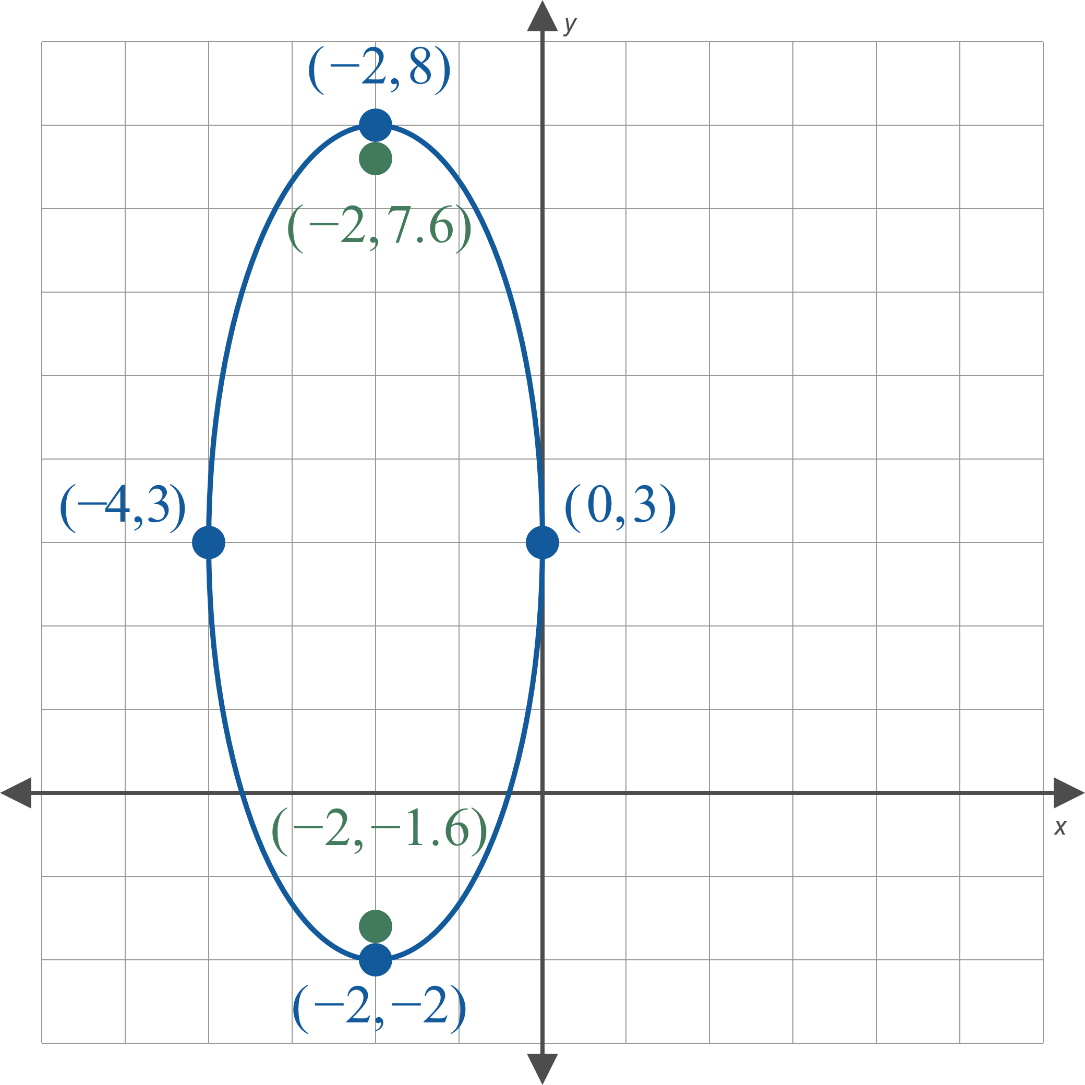
Example 3: Graphing an Ellipse with Equation Not in Standard Form (cont.)
Figure 9

Slide 25
Example 4: Constructing the Equation for an Ellipse
Construct the standard form of the equation of the ellipse in Figure 12.

Slide 26
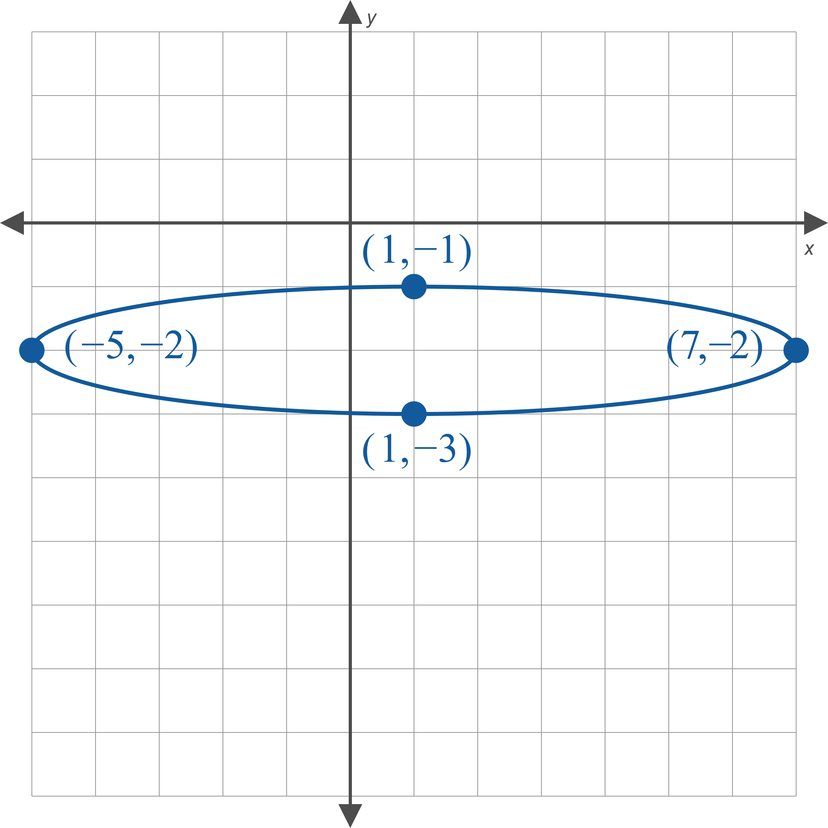
Example 4: Constructing the Equation for an Ellipse (cont.)
Figure 12

Slide 27

Example 4: Constructing the Equation for an Ellipse (cont.)
Solution
In order to construct the standard form equation, we need four pieces of information: the center of the ellipse, whether the major axis is horizontal or vertical, and the values of $a$ and $b$.

Slide 28
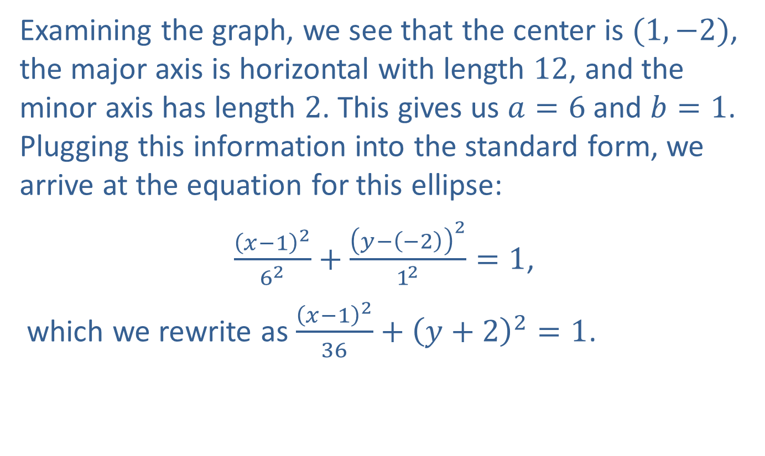
Example 4: Constructing the Equation for an Ellipse (cont.)
Examining the graph, we see that the center is $(1,−2)$, the major axis is horizontal with length 12, and the minor axis has length 2. This gives us $a=6$ and $b=1$. Plugging this information into the standard form, we arrive at the equation for this ellipse:
$\frac{{\left(x−1\right)}^{2}}{6^{2}}+\frac{{\left(y−\left(−2\right)\right)}^{2}}{1^{2}}=1$,
which we rewrite as $\frac{{\left(x−1\right)}^{2}}{36}+{\left(y+2\right)}^{2}=1$.

Slide 29
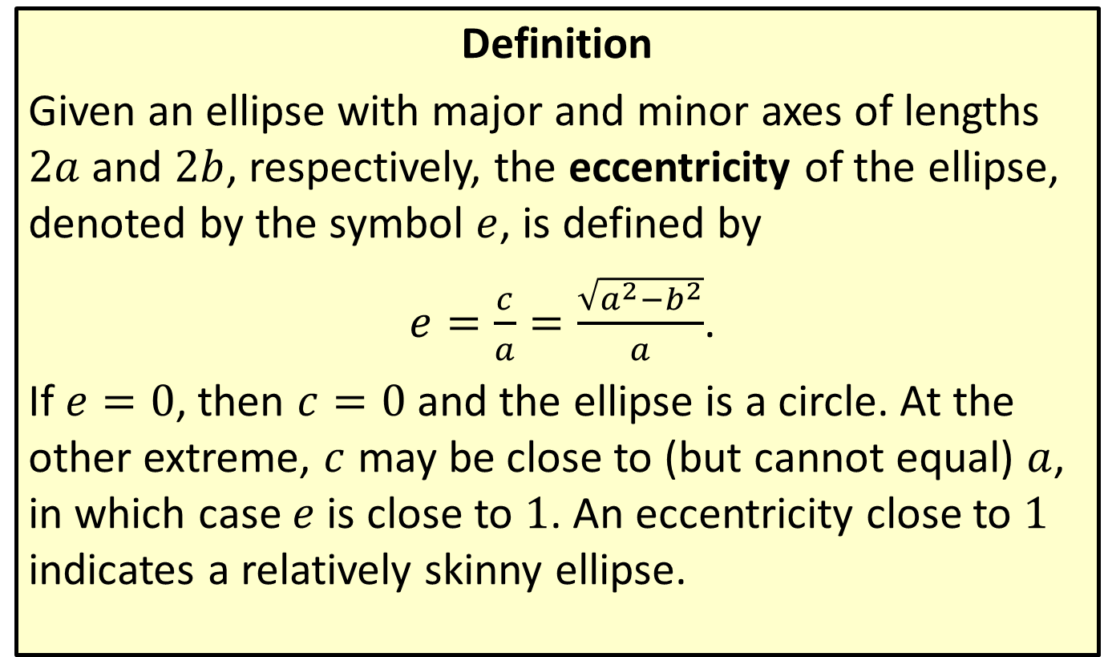
Eccentricity of an Ellipse
Definition
Given an ellipse with major and minor axes of lengths $2a$ and $2b$, respectively, the eccentricity of the ellipse, denoted by the symbol $e$, is defined by
$e=\frac{c}{a}=\frac{\sqrt{a^{2}−b^{2}}}{a}$.
If $e=0$, then $c=0$ and the ellipse is a circle. At the other extreme, $c$ may be close to (but cannot equal) $a$, in which case $e$ is close to 1. An eccentricity close to 1 indicates a relatively skinny ellipse.

Slide 30
Kepler's Laws of Planetary Motion
Theorem
​The planets orbit the sun in elliptical paths, with the sun at one focus of each orbit.
​A line segment between the sun and a given planet sweeps out equal areas of space in equal intervals of time.
​The square of the time needed for a planet to complete a full revolution about the sun is proportional to the cube of the orbit's semimajor axis (half of the major axis).

Slide 31
Example 5: Planetary Orbits
Given that the furthest Earth gets from the sun is approximately 94.56 million miles, and that the eccentricity of Earth's orbit is approximately 0.017, estimate the closest approach of Earth to the sun.

Slide 32
Example 5: Planetary Orbits (cont.)
Solution
Kepler's First Law states that each planet follows an elliptical orbit, and that the sun is positioned at one focus of the ellipse. Thus, Earth is furthest from the sun when it is at the end of the ellipse's major axis on the other side of the center from the sun.

Slide 33
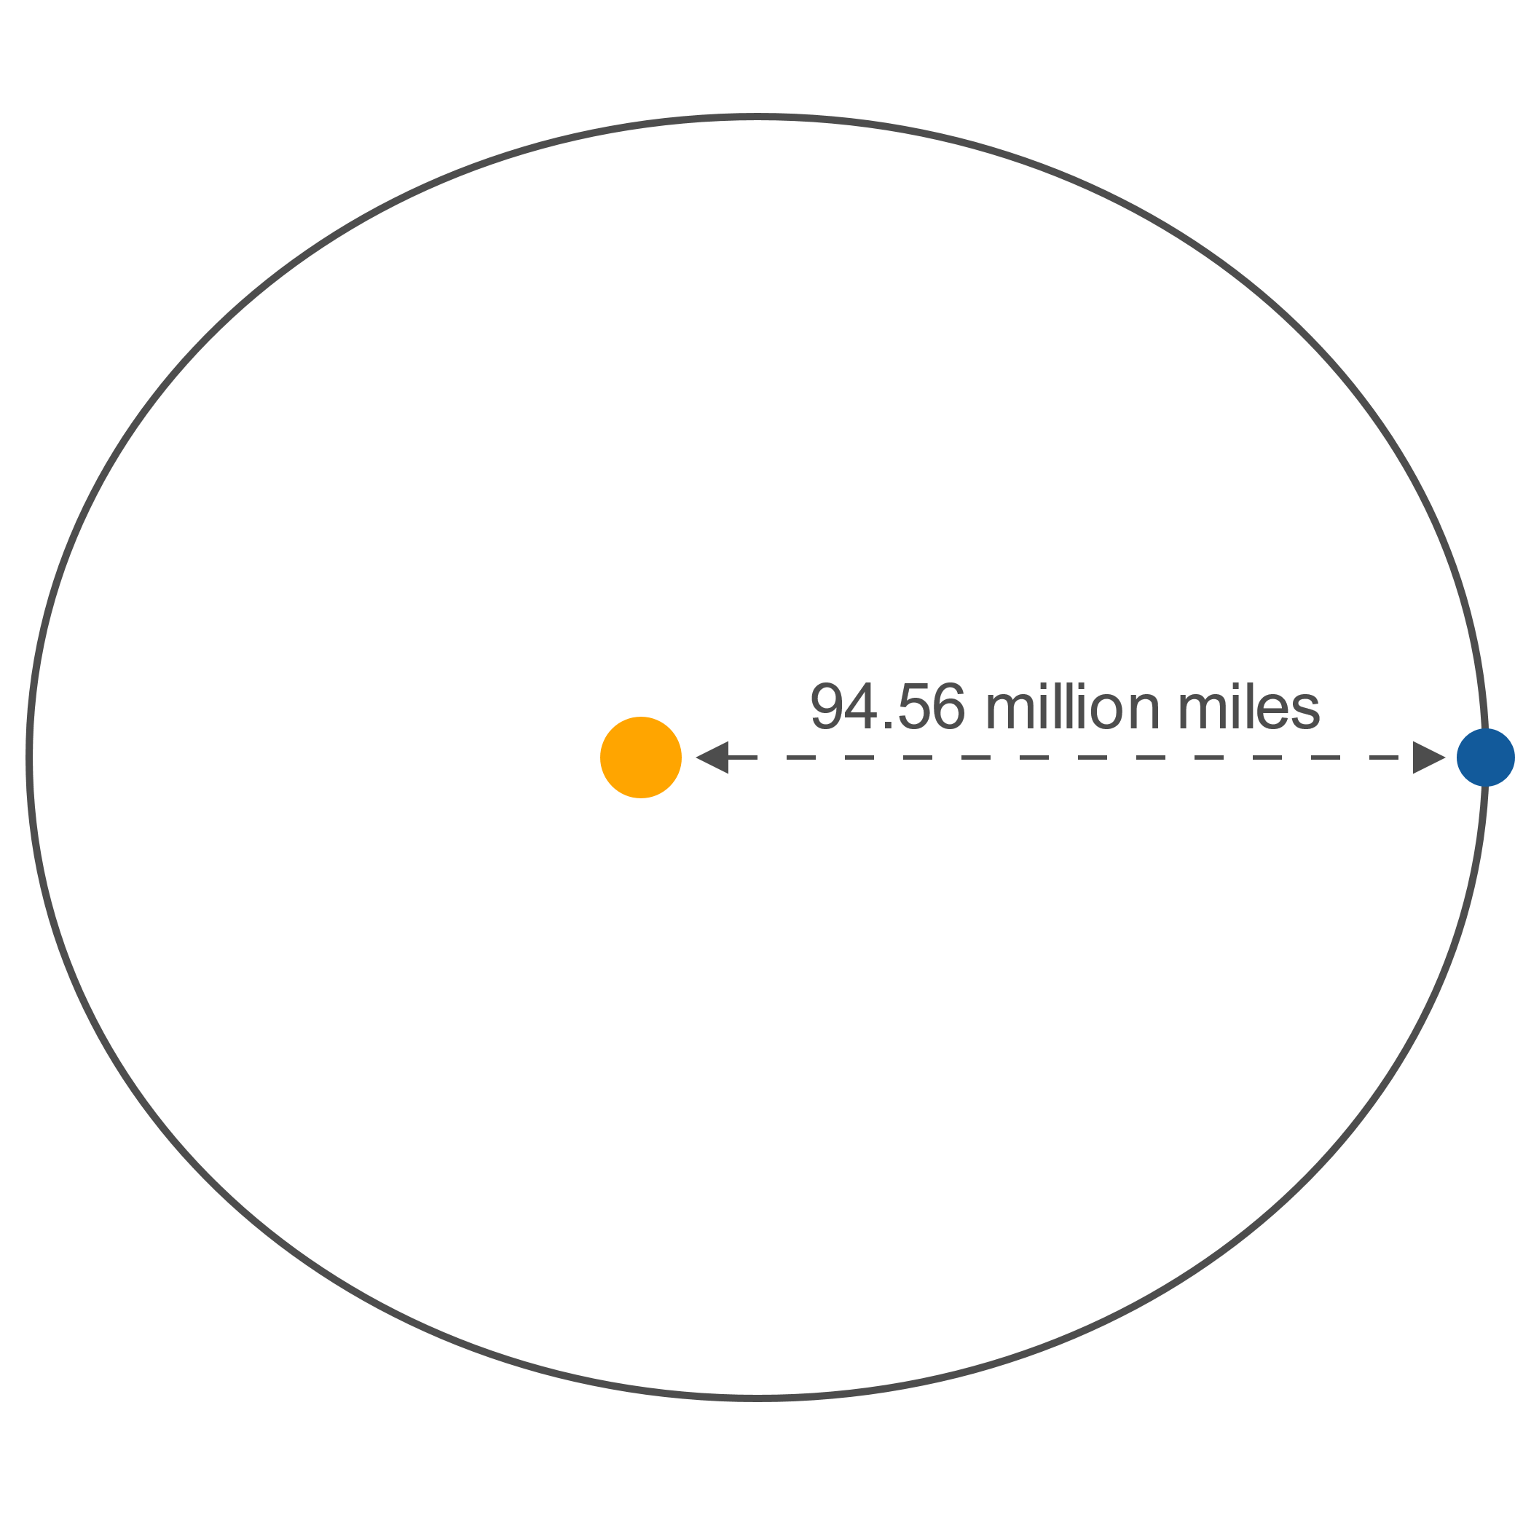
Example 5: Planetary Orbits (cont.)
Figure 13

Slide 34
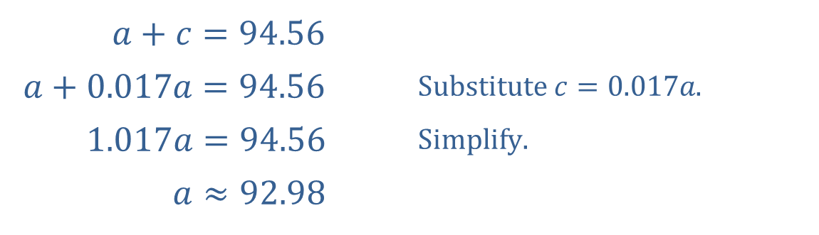
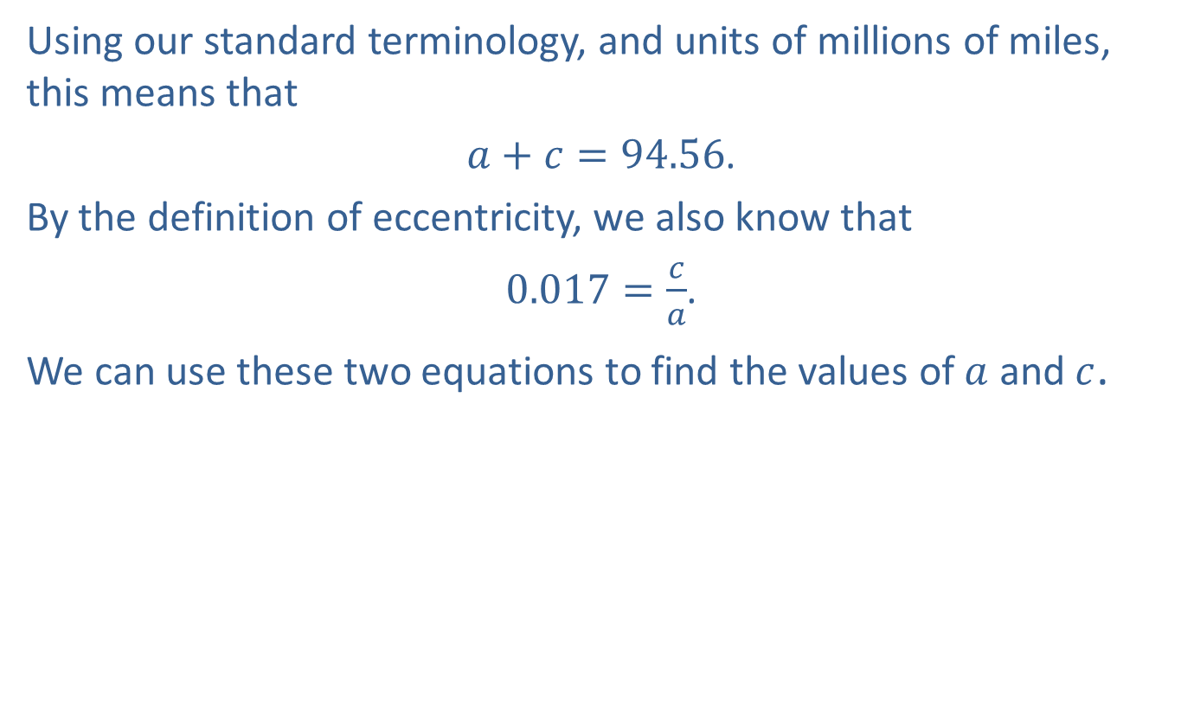
Example 5: Planetary Orbits (cont.)
Using our standard terminology, and units of millions of miles, this means that
$a+c=94.56$.
By the definition of eccentricity, we also know that
$0.017=\frac{c}{a}$.
We can use these two equations to find the values of $a$ and $c$.
​
​$a+c=94.56$ | ​
​$a+0.017a=94.56$ | ​$\text{Substitute} c=0.017a\text{.}$
​$1.017a=94.56$ | ​$\text{Simplify}\text{.}$
​$a≈92.98$ | ​

Slide 35

Example 5: Planetary Orbits (cont.)
Substituting back into our first equation, we have
$c≈94.56−92.98$, so $c≈1.58$.
The closest approach to the sun must be a distance of $a−c$, which is approximately $92.98−1.58=91.40$ million miles.

