Slide 1
Section A.3
Using a Graphing Calculator to Solve Equations

Slide 2
Objectives
Use a TI-84 Plus graphing calculator to solve (or estimate the solutions of) polynomial equations by using one of the following strategies:
a. graph one function and find the zeros of the function, or
b. graph two functions and find the points of intersection of the graphs.
Use a TI-84 Plus graphing calculator to solve absolute value equations and inequalities.

Slide 3
Polynomial Functions
Notes
When a polynomial is second-degree or higher, the same factor may occur multiple times. This means that the corresponding zero may appear more than once. That is, if a binomial factor is squared, then the corresponding zero is said to be of multiplicity 2. If the factor is cubed, then the corresponding zero is of multiplicity 3, and so on.

Slide 4
Polynomial Functions
Notes (cont.)
For example, and there are technically three zeros, −5, 4, and 4. But 4 appears twice, so 4 is a zero of multiplicity 2 and the only distinct zeros are −5 and 4. As we will see, this has a major effect on the nature of the corresponding graph of the function.

Slide 5
Polynomial Functions
Zeros of Polynomial Functions
1. Nonconstant linear functions have 1 zero. (The graph crosses the x-axis once.)
2. Quadratic functions have 2 zeros, 1 zero, or none. (The graph crosses the x-axis twice, just touches the x-axis, or doesn’t cross at all.)
3. Cubic functions have 3 zeros, 2 zeros, or 1 zero. (The graph crosses the x-axis three times, crosses once and just touches once, or crosses just once.)

Slide 6
Polynomial Functions
Notes
Important Note about the Graphs of Polynomial Functions
The graph of every polynomial function is a smooth continuous graph. (That is, there are no holes, jumps from one point to another, or sharp points in the graph of a polynomial function.)

Slide 7
Example 1: Using One Graph to Solve a Polynomial Equation
Use a graphing calculator to solve the equation
Solution
Manipulate the equation so that one side is 0. Graph the indicated function on the nonzero side. The zeros of this function are the roots of the original equation. (See Section 4.5 for more information about entering and graphing an equation on a TI-84 Plus graphing calculator.)

Slide 8
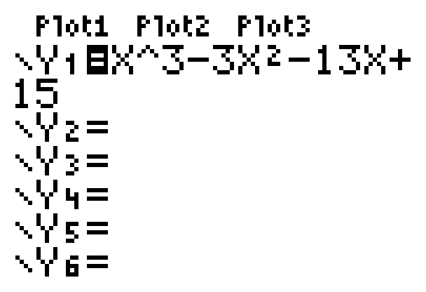
Example 1: Using One Graph to Solve a Polynomial Equation (cont.)
Enter the function as follows:

Slide 9
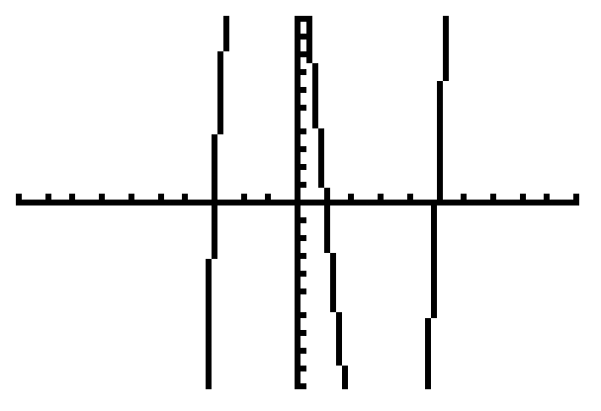
Example 1: Using One Graph to Solve a Polynomial Equation (cont.)
With the standard window the graph will appear as follows:
Note: You may want to increase the y-values on the window to see a more complete graph. This will not change the zeros.

Slide 10

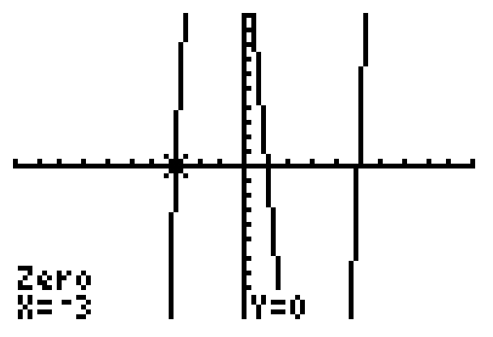
Example 1: Using One Graph to Solve a Polynomial Equation (cont.)
With the > CALC > 2:zero sequence of commands you will find the following zeros (and therefore solutions to the equation):
x = −3, x = 1, and x = 5.

Slide 11

Example 1: Using One Graph to Solve a Polynomial Equation (cont.)
Note: See Section 4.5 for a more in-depth explanation for finding the zero of a function. With the command you will find only approximations of the zeros.

Slide 12
Example 2: Using Two Graphs to Solve a Polynomial Equation
Solve the polynomial equation using a graphing calculator.
Solution
Graph the function indicated on each side of the equation. Find the points of intersection of these two graphs. The x-values of these points are the roots of the original equation.

Slide 13
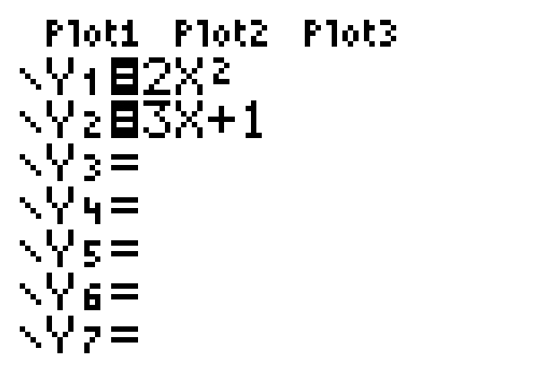
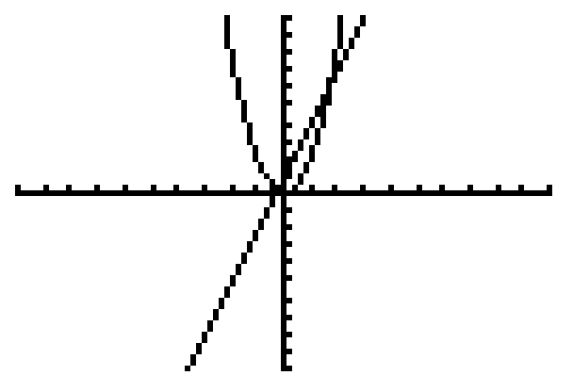
Example 2: Using Two Graphs to Solve a Polynomial Equation (cont.)
Enter the functions as follows:
With the standard window the graphs will appear as follows:

Slide 14
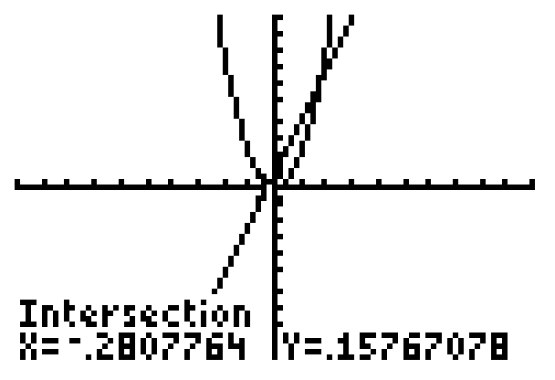
Example 2: Using Two Graphs to Solve a Polynomial Equation (cont.)
With the > CALC > 5:intersect sequence of commands you will find the following approximate x-­values of the points of intersection (and therefore approximate solutions to the equation):
x ≈ − .28 and x ≈ 1.78 (accurate to two decimal places).
Note: See Section 4.5 for an explanation of the intersect function.

Slide 15

Example 3: Using Two Graphs to Solve an Absolute Value Equation
Solve the equation using a graphing calculator.
Solution
Graph the functions indicated on each side of the equation. This includes the constant function. Find the points of intersection of these two graphs. The x-values of these points are the roots of the original equation. Remember that the absolute value command can be found in the >NUM menu.

Slide 16
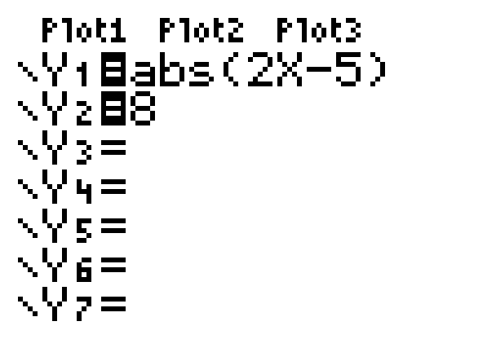
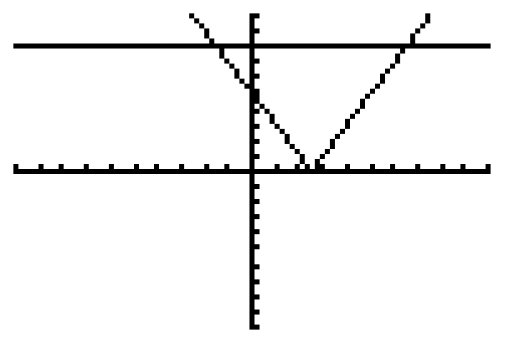
Example 3: Using Two Graphs to Solve an Absolute Value Equation (cont.)
Enter the functions as follows:
With the standard window the graphs will appear as follows:

Slide 17
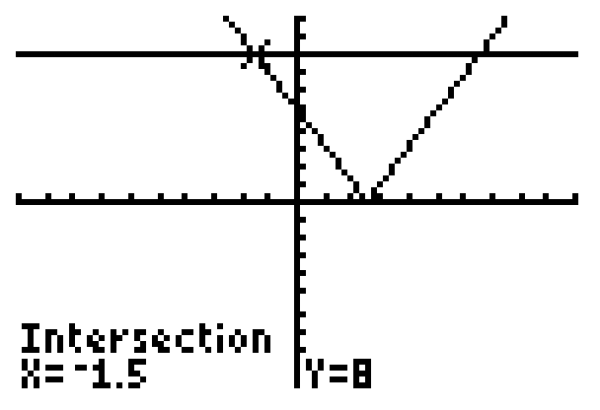
Example 3: Using Two Graphs to Solve an Absolute Value Equation (cont.)
With the > CALC > 5:intersect sequence of
commands you will find the following x-values at the
points of intersection (and therefore the solutions to
the equation):
x = −1.5 and x = 6.5

Slide 18
Example 4: Using a Graphing Calculator to Solve Absolute Value Inequalities
Use a graphing calculator to solve the inequalities:
Both inequalities can be solved by using the graphs
from Example 3.
Solution
We change the window for a clearer view: use the interval [−10, 10] for x and the interval [−1, 15] for y. This gives:

Slide 19
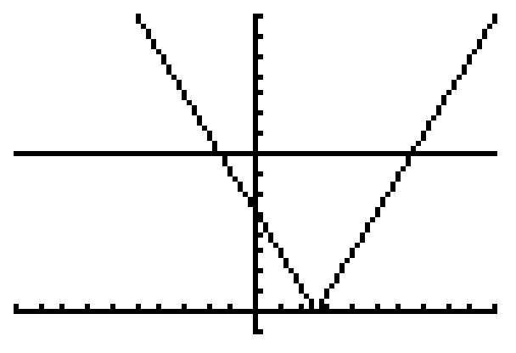
Example 4: Using a Graphing Calculator to Solve Absolute Value Inequalities (cont.)
a. From Example 3, we know that the intersections occur at x = −1.5 and x = 6.5. Looking at the graph we see that the graph of the absolute value is below the line y = 8 on the interval (−1.5, 6.5). Thus the interval (−1.5, 6.5) is the solution set for |2x − 5|< 8.

Slide 20
Example 4: Using a Graphing Calculator to Solve Absolute Value Inequalities (cont.)
b. Looking at the graph we see that the graph of the absolute value is above the line y = 8 on the
intervals Thus the solution
set is for |2x – 5| > 8.

