Slide 1
Section A.4
Determinants

Slide 2
Objectives
Evaluate 2 × 2 and 3 × 3 determinants.
Solve equations involving determinants.

Slide 3
Determinant
Determinant
A determinant is a real number associated with a square matrix and is indicated by enclosing the array between two vertical bars. For a matrix A, the corresponding determinant is designated as det(A) and is read “the determinant of A.”

Slide 4
Determinant
Value of a 2 × 2 Determinant

Slide 5
Example 1: 2×2 Determinants

Slide 6
Determinant
Value of a 3×3 Determinant

Slide 7
Determinant
Notes
CAUTION: The negative sign in the middle term of the expansion (representing −1 times a₁₂) is a critical part of the method and is a source of error for many students. Be careful.

Slide 8
Determinant
Notes
There are methods other than expanding by minors for evaluating 3 × 3 determinants. The advantage of learning to expand by minors is that this method can be used for evaluating higher-order determinants.

Slide 9
Example 2: 3×3 Determinants
Solution
Using Row 1, mentally delete the shaded regions.

Slide 10
Example 2: 3×3 Determinants (cont.)

Slide 11
Example 2: 3×3 Determinants (cont.)

Slide 12
Example 3: Equations with Determinants

Slide 13
Example 3: Equations with Determinants (cont.)

Slide 14

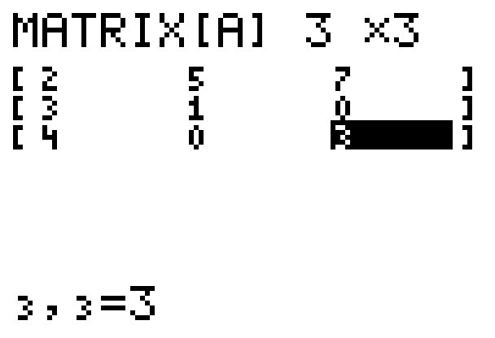
Example 4: Evaluating Determinants with a Calculator
Use a TI-84 Plus calculator to find the value of det(A) for the following matrix.
Solution
Step 1: Press > MATRIX, go
to the EDIT menu and enter the
appropriate dimensions and numbers
in the matrix A. The display should
appear as follows.

Slide 15


Example 4: Evaluating Determinants with a Calculator (cont.)
Step 2: Press > QUIT then > MATRIX again and go to the MATH menu. On the MATH menu choose 1:det( and press . The display should appear as follows.

Slide 16
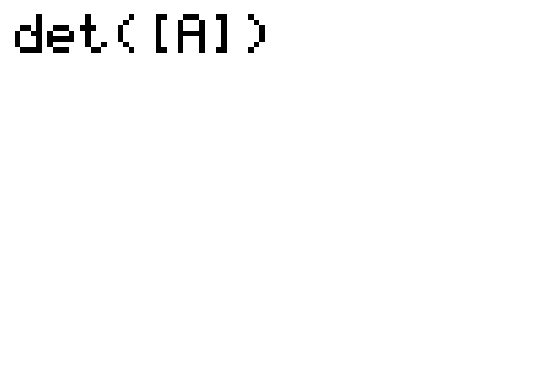
Example 4: Evaluating Determinants with a Calculator (cont.)
Step 3: Press > MATRIX again and on the NAMES menu choose 1:[A]3 × 3 by pressing . Then type a right parenthesis ). The display should appear as follows.

Slide 17
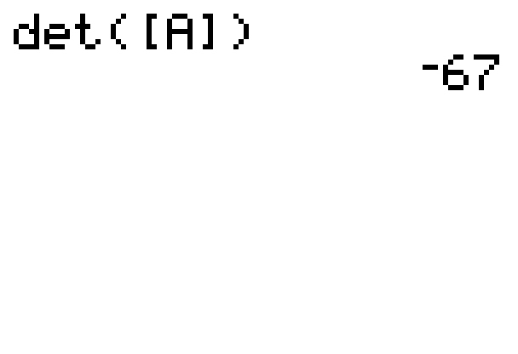
Example 4: Evaluating Determinants with a Calculator (cont.)
Step 4: Press and the display should appear as
follows with the answer.

Slide 18
Practice Problems

Slide 19
Practice Problems

Slide 20
Practice Problem Answers
1. −29 2. 0 3. −26
4. 92 5. 16

