Slide 1
Section 1.6
Multiplication and Division with Fractions

Slide 2
Objectives
Reduce fractions to lowest terms.
Write fractions as equivalent fractions with specified denominators.
Multiply and divide fractions.

Slide 3
Rational Numbers Defined
Rational Number
A rational number is a number that can be written in
the form where a and b are integers and b ≠ 0.

Slide 4
Rational Numbers Defined
Notes
There are fractions that cannot be written with the numerator and denominator as integers. For example,
is a fraction (very useful in trigonometry) but also an
irrational number.

Slide 5
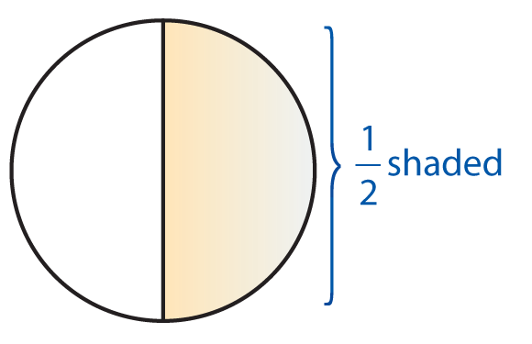
Example 1: Fractions
a. can mean 1 of 2 equal parts.
If you read of a book, then you can view this as
having read one of two equal parts of the book. If the book has 50 pages, then you read 25 pages,
since, as we will see,

Slide 6
Example 1: Fractions (cont.)
b. can mean to divide: (−45) ÷ 9.

Slide 7
Rational Numbers Defined
Placement of Negative Signs in Fractions
If a and b are real numbers, and b ≠ 0, then
For example:

Slide 8
Example 2: Negative Signs in Fractions

Slide 9
Multiplication
Multiplication with Fractions
To multiply two fractions, multiply the numerators and multiply the denominators.
For example:

Slide 10
Multiplication
The Fundamental Principle of Fractions

Slide 11
Multiplication
To Build a Fraction to Higher Terms
To build a fraction to higher terms, use the fundamental principle and multiply both the numerator and denominator by the same nonzero number.

Slide 12
Example 3: Building Fractions to Higher Terms
a. Write in the form of an equivalent fraction with
denominator 28.
Solution
Because we know 7 ⋅ 4 = 28, use k = 4 and

Slide 13
Example 3: Building Fractions to Higher Terms (cont.)
b. Build to higher terms with denominator of 16a.
Solution
Because we know that 8 ⋅ 2a = 16a, use k = 2a and

Slide 14
Multiplication
To Reduce a Fraction
To reduce a fraction, factor both the numerator and denominator and use the fundamental principle to “divide out” any common factors. If the numerator and the denominator have no common prime factors, the fraction has been reduced to lowest terms.

Slide 15
Example 4: Reducing Fractions
a. Reduce to lowest terms using prime
factorization.
Solution
Note that the negative sign can be placed in the numerator or in front of the fraction. We seldom use the negative sign in the denominator.

Slide 16
Example 4: Reducing Fractions (cont.)
b. Find the product in lowest terms. (Do
not find the product directly. Factor and reduce as you multiply. Treat the variables as you would numbers.)
Solution

Slide 17
Example 4: Reducing Fractions (cont.)
c. Find the product in lowest terms.
(Note: The number 1 is implied to be a factor even if it is not written.)
Solution
Remember that if all factors are divided out (in the numerator or denominator), you must use 1 even if it is not written.

Slide 18
Example 5: Fraction of a Number
Solution

Slide 19
Division
Reciprocal
If a ≠ 0 and b ≠ 0, the reciprocal of and
0 has no reciprocal, since is undefined.

Slide 20
Division
Division with Fractions
To divide by a nonzero fraction, multiply by its reciprocal.

Slide 21
Example 6: Dividing Fractions with Negative Numbers
Solution

Slide 22
Example 6: Dividing Fractions with Negative Numbers (cont.)
Note that, just as with integers, the product of two
negative fractions is positive. In algebra, an
improper fraction (a fraction with the numerator greater than the denominator), is preferred to the
mixed number
Improper fractions are perfectly acceptable as long as they are reduced, meaning the numerator and denominator have no common factors.

Slide 23
Example 7: Dividing Fractions with Variables
Solution

Slide 24
Example 8: Multiplication and Division of Fractions
Solution

Slide 25
Example 9: Multiplication and Division of Fractions
If of a number is 99, what is the number?
Solution
Because we know the product, 99, the missing number
can be found by dividing the product by
The other number is 264. That is of 264 is 99.

Slide 26
Division
Important Note About Expressions Involving Fractions in Algebra
An expression with a fraction as the coefficient can be
written in two different forms. For example, and
have the same meaning. That is, for all values of x,
we have

Slide 27
Practice Problems
Multiply or divide as indicated and reduce each answer to lowest terms.

Slide 28
Practice Problems (cont.)
5. Multiply the quotient of and by
6. The product of with another number is
What is the other number?

Slide 29
Practice Problem Answers

