Slide 1
Section 1.8
Order of Operations

Slide 2
Objectives
Follow the rules for order of operations to evaluate expressions.

Slide 3
Rules for Order of Operations
Rules for Order of Operations
1. Simplify within grouping symbols, such as parentheses ( ), brackets [ ], and braces { }, working from the innermost grouping outward.
2. Find any powers indicated by exponents.
3. Moving from left to right, perform any multiplications or divisions in the order they appear.
4. Moving from left to right, perform any additions or subtractions in the order they appear.

Slide 4
Rules for Order of Operations
Notes
Other grouping symbols are the absolute value bars
(such as|3 + 5|), the fraction bar (as in ), and
the square root symbol (such as ).

Slide 5
Rules for Order of Operations
Even though the mnemonic PEMDAS is helpful, remember that multiplication and division are performed as they appear, left to right. Also, addition and subtraction are performed as they appear, left to right.
Notes

Slide 6
Example 1: Order of Operations with Integers
Use the rules for order of operations to evaluate each of the following expressions.
Solution
Exponents.
Divide and multiply, left to right.
Subtract.

Slide 7
Example 1: Order of Operations with Integers (cont.)
Solution
Exponents.
Subtract inside the parentheses.
Multiply.
Subtract (or add algebraically).

Slide 8
Example 1: Order of Operations with Integers (cont.)
Solution
Exponents.
Multiply inside the parentheses.
Subtract inside the parentheses.
Divide inside the brackets.

Slide 9
Example 1: Order of Operations with Integers (cont.)
Add inside the brackets.
Multiply.
Add.
Note: Because of the rules for order of operations at no time did we even subtract 9 − 2.

Slide 10
Example 2: Order of Operations with Fractions
Use the rules for order of operations to evaluate each of the following expressions.
Solution
Change the mixed number to an improper fraction and find the LCD in the parentheses.

Slide 11
Example 2: Order of Operations with Fractions (cont.)
Add within parentheses.
Divide and reduce.

Slide 12
Example 2: Order of Operations with Fractions (cont.)
Solution
Exponents.
Divide, then multiply and reduce.

Slide 13
Example 2: Order of Operations with Fractions (cont.)
Find the LCD.
Add.

Slide 14
Example 2: Order of Operations with Fractions (cont.)
Solution
Divide.
Multiply and reduce.

Slide 15
Example 2: Order of Operations with Fractions (cont.)
Simplify.
Find the LCD.
Subtract.

Slide 16

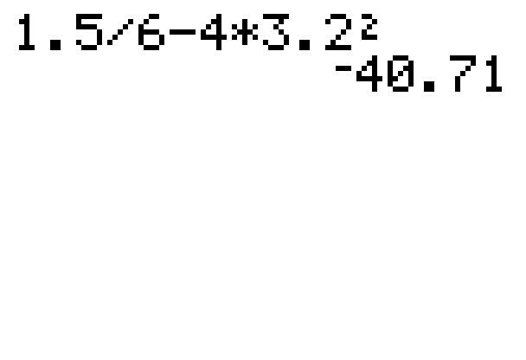
Example 3: Order of Operations with Decimals (using Calculators)
Graphing calculators are programmed to use the rules for order of operations. Use your graphing calculator to find the value of each of the following expressions. Note that the key gives the exponent 2.
Solution

Slide 17
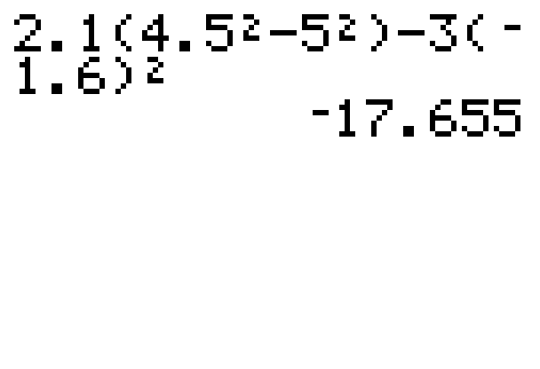
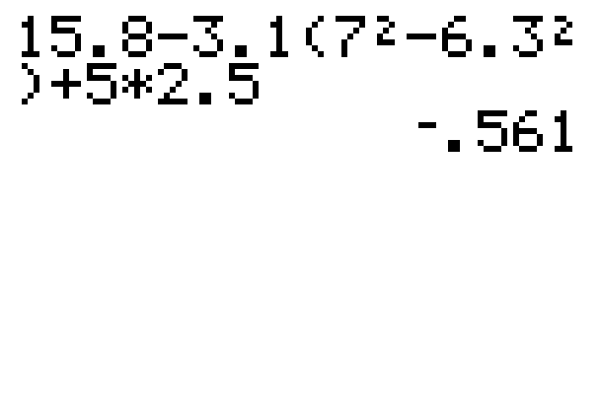
Example 3: Order of Operations with Decimals (using Calculators) (cont.)
Solution
Solution

Slide 18
Practice Problems
Use the rules for order of operations to evaluate each expression.

Slide 19
Practice Problems (cont.)
Simplify.

Slide 20
Practice Problem Answers
1. 108 2. −8 3. −27
4. 5. 6.
7.

