Slide 1
Section 10.5
Graphing Quadratic Functions: Parabolas

Slide 2
Objectives
Graph a parabola (a quadratic function) and determine its vertex, domain, range, line of symmetry, and zeros.
Solve applied problems using quadratic functions and the concepts of maximum and minimum.

Slide 3
Introduction to Quadratic Functions:
Vertical Line Test
If any vertical line intersects a graph in more than one point, then the relation is not a function.

Slide 4
Introduction to Quadratic Functions:
Quadratic Functions
Any function that can be written in the form
where a, b, and c are real numbers and a ≠ 0 is a quadratic function.

Slide 5
Example 1: Quadratic Functions
Find the line of symmetry, the vertex, the domain, and the range of each quadratic function. Then graph the functions, setting up a table of values for x and y as an aid and choosing values of x on each side of the line of symmetry.
a. y = 2x² − 3
Solution
Line of symmetry is x = 0. (The parabola opens upward since a is positive.)

Slide 6
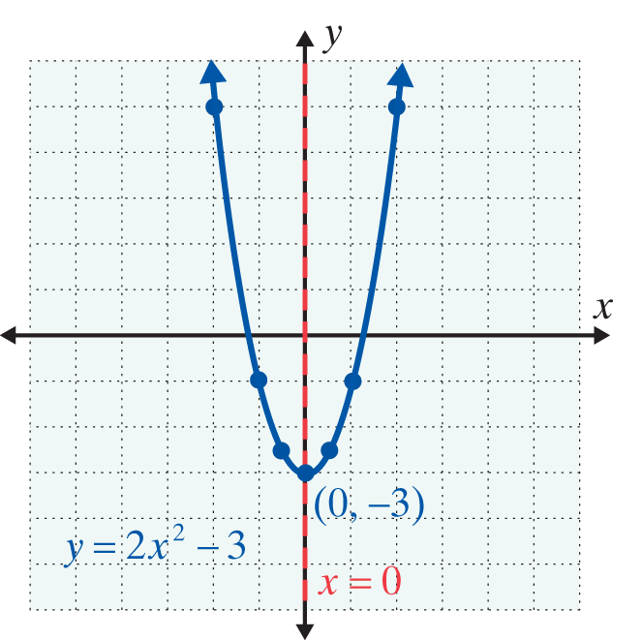
Example 1: Quadratic Functions (cont.)
Vertex = (0,−3); Domain = (−∞, ∞) or {x|x is any real number}; Range = [−3, ∞) or {y|y ≥ −3}
x | y
0 | −3
1 | −1
−1 | −1
2 | 5
−2 | 5

Slide 7
Example 1: Quadratic Functions (cont.)
b.
Solution
Line of symmetry is (The parabola opens down since a is negative.)
Vertex = Domain = (−∞, ∞) or {x|x is any real
number}; Range = [− ∞,0) or {y|y ≤ 0}

Slide 8
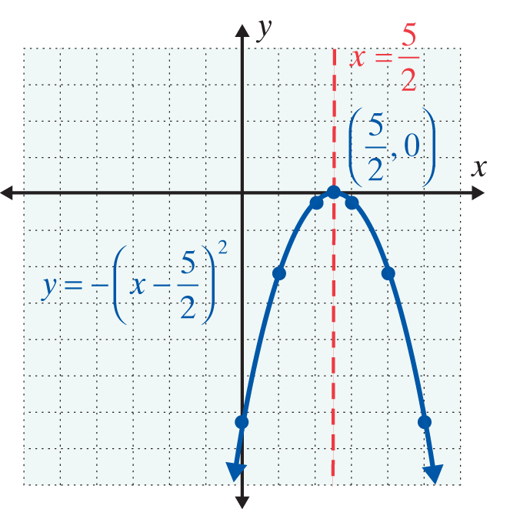
Example 1: Quadratic Functions (cont.)
x |  | 2 | 3 | 1 | 4 | 0 | 5
y | 0

Slide 9
Functions of the Form
NOTES
Rather than memorize the formula for the coordinates of the vertex, you should just remember that the x-coordinate of the vertex is Substituting this
value for x in the function will give the y-value for the vertex.

Slide 10
Example 2: Graphing Quadratic Functions
a. For y = x² − 6x + 1, find the zeros of the function, the line of symmetry, the vertex, the domain, the range, and graph the parabola.
Solution

Slide 11
Example 2: Graphing Quadratic Functions (cont.)
The zeros are
Change the form of the function for easier graphing.

Slide 12
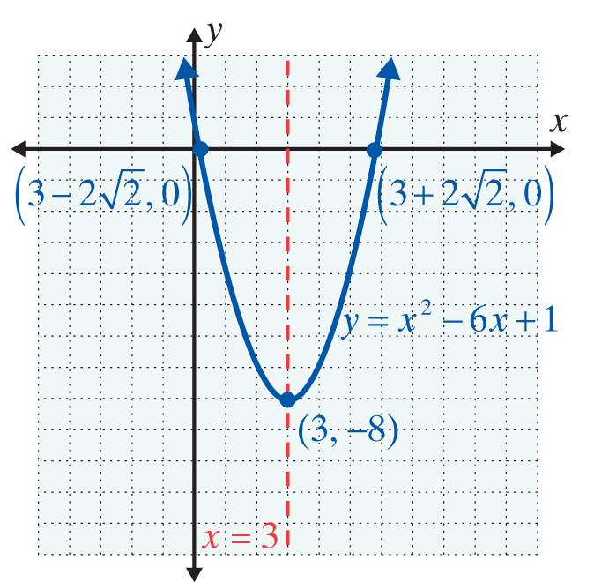
Example 2: Graphing Quadratic Functions (cont.)
Summary:

Slide 13
Example 2: Graphing Quadratic Functions (cont.)
b. For y = −x² − 4x + 2, find the zeros of the function, the line of symmetry, the vertex, the domain, the range, and graph the parabola.
Solution

Slide 14
Example 2: Graphing Quadratic Functions (cont.)
The zeros are
Change the form of the function for easier graphing.

Slide 15
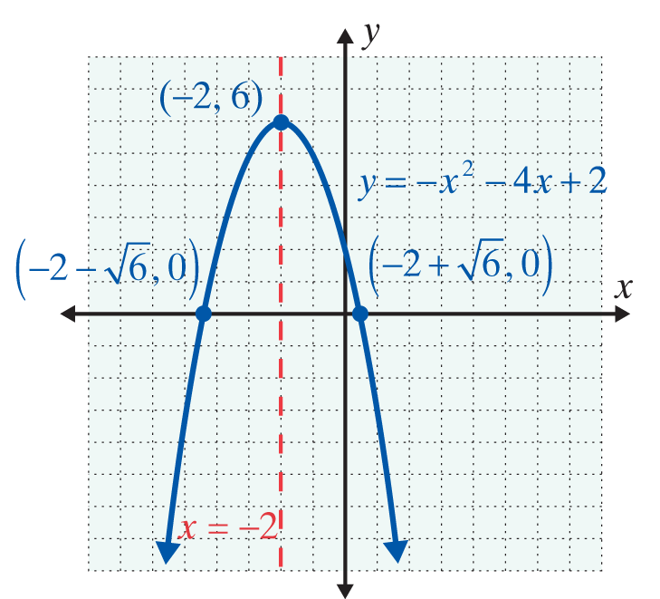
Example 2: Graphing Quadratic Functions (cont.)
Summary:

Slide 16
Example 2: Graphing Quadratic Functions (cont.)
c. For y = 2x² − 6x + 5, find the zeros of the function, the line of symmetry, the vertex, the domain, the range, and graph the parabola.
Solution

Slide 17
Example 2: Graphing Quadratic Functions (cont.)
There are no real zeros because the discriminant is negative. The graph will not cross the x-axis. Now using another approach, the vertex is at

Slide 18
Example 2: Graphing Quadratic Functions (cont.)
and
So we have the vertex at and the following results:

Slide 19
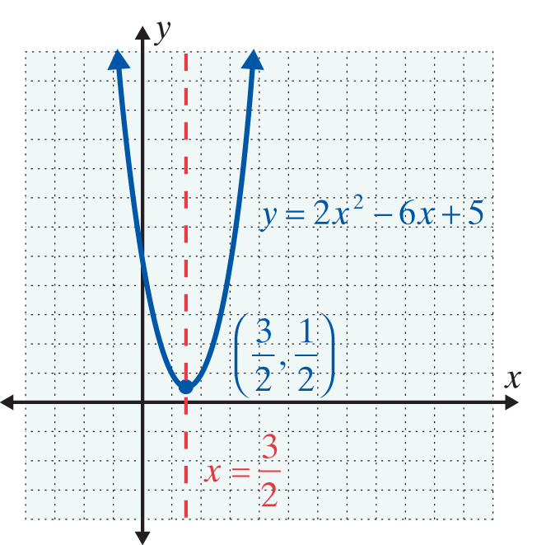
Example 2: Graphing Quadratic Functions (cont.)
Summary:

Slide 20
Applications with Maximum and Minimum Values
Minimum and Maximum Values
For a parabola with its equation in the form
y = a(x − h)² + k,
1. If a > 0, then the parabola opens upward and (h, k) is the lowest point and the y-value k is called the minimum value of the function.
2. If a < 0, then the parabola opens downward and (h, k) is the highest point and y-value k is called the maximum value of the function.

Slide 21
Example 3: Minimum and Maximum Values
a. A sandwich company sells hot dogs at the local baseball stadium for $3.00 each. On average they sell 2000 hot dogs per game. The company estimates that each time the price is raised by 25¢, they will sell 100 fewer hot dogs. What price should they charge to maximize their revenue (income) per game? What will be the maximum revenue?

Slide 22
Example 3: Minimum and Maximum Values (cont.)
Solution
Let x = number of 25¢ increases in price.
Then 3.00 + 0.25x = price per hot dog,
and 2000 − 100x = number of hot dogs sold.
Revenue (R) = (price per unit) ∙ (number of units sold)
So,

Slide 23
Example 3: Minimum and Maximum Values (cont.)
The revenue is represented by a quadratic function and the maximum revenue occurs at the point where
For x = 4,
price per hot dog = 3.00 + 0.25(4) = $4.00,
and revenue = (4)(2000 − 100 · 4) = $6400.
Thus the company will make its maximum revenue of $6400 by charging $4 per hot dog.

Slide 24
Example 3: Minimum and Maximum Values (cont.)
b. A rancher is going to build three sides of a rectangular corral next to a river. He has 240 feet of fencing and wants to enclose the maximum area possible inside the corral. What are the dimensions of the corral with the maximum area and what is this area?
Solution
Let x = length of one of the two equal sides of the rectangular corral.
Then 240 −2x = length of third side of the rectangular corral.

Slide 25
Example 3: Minimum and Maximum Values (cont.)
Since area equals length times width, the area, A, of the corral is represented by the quadratic function A = x(240 − 2x) = 240x − 2x², the maximum area occurs
at the point where
Two sides of the rectangle are 60 feet and the third side is 240 − 2(60) = 120 feet.
The maximum area possible is 60(120) = 7200 square feet.

Slide 26
Practice Problems
1. Write the function y = 2x² − 4x + 3 in the form y = a(x − h)² + k.
2. Find the zeros of the function y = x² − 7x + 10.
3. Find the vertex and the range of the function y = −x² + 4x − 5.

Slide 27
Practice Problem Answers
2. x = 2, 5
3. Vertex: (2, −1), Range: (−∞,−1]

