Slide 1
Section 10.6
Solving Quadratic and Rational Inequalities

Slide 2
Objectives
Solve quadratic inequalities.
Solve higher-degree polynomial inequalities.
Solve rational inequalities.
Graph the solutions of inequalities on real number lines.
Use a graphing calculator as an aid in solving quadratic inequalities.

Slide 3
Quadratic Inequalities: Solved Algebraically
To Solve a Polynomial Inequality Algebraically
1. Arrange the terms so that one side of the inequality is 0.
2. Factor the polynomial expression, if possible, and find the points where each factor is 0. (Use the quadratic formula, if necessary.)
3. Mark each of these points on a number line. These are the interval endpoints.

Slide 4
Quadratic Inequalities: Solved Algebraically
To Solve a Polynomial Inequality Algebraically (cont.)
4. Test one point from each interval to determine the sign of the polynomial expression for all points in that interval.
5. The solution consists of those intervals where the test points satisfy the original inequality.
6. Mark a bracket for an endpoint that is included and a parenthesis for an endpoint that is not included.

Slide 5
Example 1: Solving Polynomial Inequalities by Factoring
Solve the following inequalities by factoring and using a number line. Graph the solution set on a number line.
Solution
Add −8 to both sides so that one side is 0.
Factor.

Slide 6
Example 1: Solving Polynomial Inequalities by Factoring (cont.)
Set each factor equal to 0 to locate the interval endpoints
Mark these points on a number line and test one point from each of the intervals formed.

Slide 7
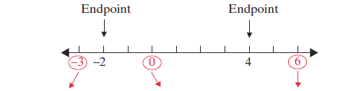
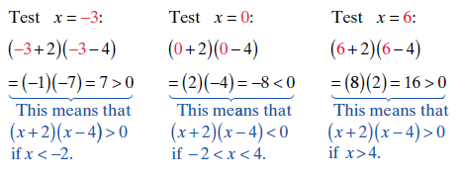
Example 1: Solving Polynomial Inequalities by Factoring (cont.)

Slide 8

Example 1: Solving Polynomial Inequalities by Factoring (cont.)
Graphically, the solution set is,
The solution is:
algebraic notation or interval notation

Slide 9
Example 1: Solving Polynomial Inequalities by Factoring (cont.)
Solution
Set each factor equal to 0 to locate the interval endpoints.
Add −13x to both sides so that one side is 0.
Factor.

Slide 10
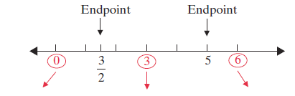
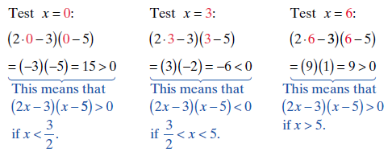
Example 1: Solving Polynomial Inequalities by Factoring (cont.)
Test one point from each interval formed.

Slide 11

Example 1: Solving Polynomial Inequalities by Factoring (cont.)
The solution includes both endpoints since the
inequality includes 0:
The solution is:
algebraic notation or interval notation

Slide 12
Example 1: Solving Polynomial Inequalities by Factoring (cont.)
Solution
Set each factor equal to 0 to locate the interval endpoints

Slide 13
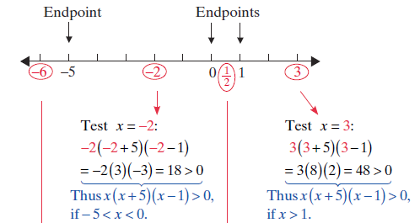
Example 1: Solving Polynomial Inequalities by Factoring (cont.)
Test one point from each interval formed.

Slide 14
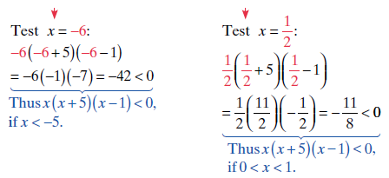

Example 1: Solving Polynomial Inequalities by Factoring (cont.)

Slide 15
Example 1: Solving Polynomial Inequalities by Factoring (cont.)
The solution is:
algebraic notation or interval notation

Slide 16
Example 2: Solving Polynomial Inequalities Using the Quadratic Formula
Solve the following inequalities using the quadratic
formula and a number line. Graph the solution set on a
number line.
Solution The quadratic expression cannot
be factored with integer coefficients. Use the quadratic
formula and find the roots of the equation
Then use these roots as endpoints for the intervals. The
test points can themselves be integers.

Slide 17
Example 2: Solving Polynomial Inequalities Using the Quadratic Formula (cont.)
Use the quadratic formula.

Slide 18
Example 2: Solving Polynomial Inequalities Using the Quadratic Formula (cont.)
The endpoints are
Test one point from each interval formed.
Note: With a calculator, you can determine that

Slide 19
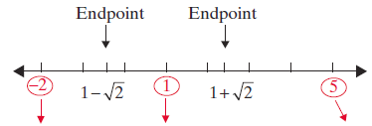
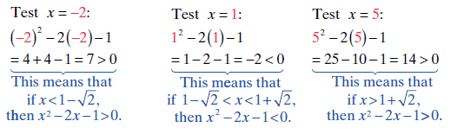
Example 2: Solving Polynomial Inequalities Using the Quadratic Formula (cont.)

Slide 20
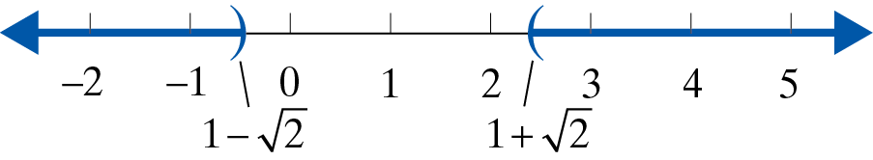
Example 2: Solving Polynomial Inequalities Using the Quadratic Formula (cont.)
The solution is:
algebraic notation or interval notation

Slide 21
Example 2: Solving Polynomial Inequalities Using the Quadratic Formula (cont.)
Solution: To find where use the quadratic formula:

Slide 22
Example 2: Solving Polynomial Inequalities Using the Quadratic Formula (cont.)
Since these values are nonreal, the polynomial is either always positive or always negative for all real values of x. Therefore, we only need to test one point. If that point satisfies the inequality, then the solution is all real numbers. If it does not, then there is no solution. In this example, we test x = 0 because the polynomial is easy to evaluate for x = 0.

Slide 23

Example 2: Solving Polynomial Inequalities Using the Quadratic Formula (cont.)
Since the real number 0 satisfies the inequality, the solution is all real numbers. In interval notation we write and in algebraic notation we write Graphically, the solution set is:

Slide 24
Solving Rational Inequalities
To Solve a Rational Inequality
1. Simplify the inequality so that one side is 0 and the other side has a single fraction with both the numerator and denominator in factored form.
2. Find the points that cause the factors in the numerator or in the denominator to be 0.
3. Mark each of these points on a number line. These are the interval endpoints.

Slide 25
Solving Rational Inequalities
To Solve a Rational Inequality (cont.)
4. Test one point from each interval to determine the sign of the rational expression for all points in that interval.
5. The solution consists of those intervals where the test points satisfy the original inequality.
6. Mark a bracket for an endpoint that is included and a parenthesis for an endpoint that is not included. Remember that no denominator can be 0.

Slide 26
Example 3: Solving Rational Inequalities
Solve and graph the following rational inequalities.
Solution Set each factor in the numerator and the denominator equal to 0 to locate the interval endpoints.
Mark each of these points on a number line and test one point from each of the intervals formed.

Slide 27
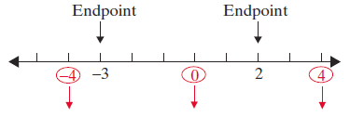
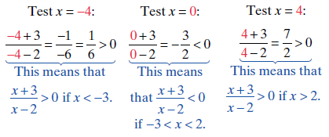
Example 3: Solving Rational Inequalities (cont.)
(Consider these points as endpoints of intervals.)

Slide 28
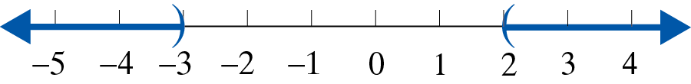
Example 3: Solving Rational Inequalities (cont.)
Graphically, the solution set is:
The solution is:
algebraic notation or interval notation

Slide 29
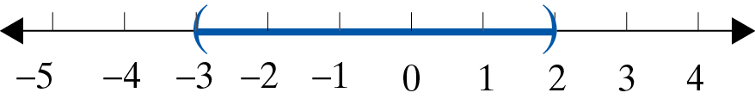
Example 3: Solving Rational Inequalities (cont.)
Solution: Using the graph and test points from Example 3a, we know that
Graphically, the solution set is:

Slide 30
Example 3: Solving Rational Inequalities (cont.)
The solution is:
algebraic notation or interval notation

Slide 31
Example 4: Solving Rational Inequalities
Solve the following rational inequality.
Solution
One side must be 0.
Rewrite 1 as a fraction using the LCD, x – 4, as the denominator.
Simplify to get one fraction.

Slide 32
Example 4: Solving Rational Inequalities (cont.)
Set each linear expression equal to 0 to find the interval endpoints.
Test a value from each of the intervals:

Slide 33
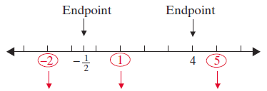
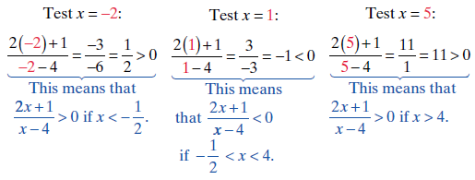
Example 4: Solving Rational Inequalities (cont.)

Slide 34
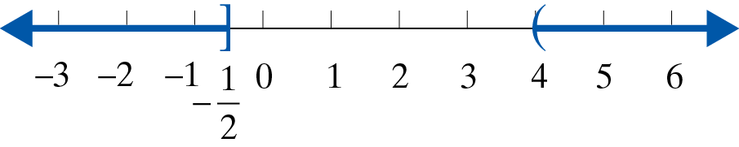
Example 4: Solving Rational Inequalities (cont.)
The solution includes the endpoint since the
inequality (≥) includes 0. However, the endpoint 4 is
not included in the solution because the rational
inequality is undefined (the denominator equals 0)
when x = 4. Graphically, the solution set is:

Slide 35
Example 4: Solving Rational Inequalities (cont.)
The solution is:
algebraic notation or interval notation

Slide 36
Solving Rational Inequalities
Notes
Notice that in the first step, we do not multiply by the denominator x − 4. The reason is that the variable expression is positive for some values of x and negative for other values of x. Therefore, if we did multiply by x − 4, we would not be able to determine whether the inequality should stay as ≥ or be reversed to ≤.

Slide 37
Solving Quadratic Inequalities Using a Graphing Calculator
To Solve a Polynomial Inequality Using a Graphing Calculator
1. Arrange the terms so that one side of the inequality is 0.
2. Form a function by letting y = [the polynomial], and graph the function. Be sure to set the WINDOW so that all of the zeros are easily seen. This may be difficult if large numbers are involved.

Slide 38


Solving Quadratic Inequalities Using a Graphing Calculator
To Solve a Polynomial Inequality Using a Graphing Calculator (cont.)
3. Use the CALC key ( ) and select 2:zero to find (or approximate) the real zeros of the function, if there are any.
a. The values of x for which the y-values are above the x-axis satisfy y > 0.
b. The values of x for which the y-values are below the x-axis satisfy y < 0.

Slide 39
Solving Quadratic Inequalities Using a Graphing Calculator
To Solve a Polynomial Inequality Using a Graphing Calculator (cont.)
4. Endpoints of intervals are included if the inequality includes 0, as in y ≥ 0 or y ≤ 0.

Slide 40
Example 5: Solving a Quadratic Inequality Using a Graphing Calculator
Solve the following quadratic inequalities using a graphing calculator. Graph the solution set on a real number line.
Solution This inequality was solved algebraically in Example 1a. We repeat the solution here using a graphing calculator to show how the two methods are related.

Slide 41
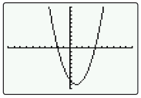


Example 5: Solving a Quadratic Inequality Using a Graphing Calculator (cont.)
Manipulate the inequality so that one side is 0.
Press and enter the function:
Press and graph the function.
The graph will appear as illustrated above. (In this case the graph is a parabola.)

Slide 42

Example 5: Solving a Quadratic Inequality Using a Graphing Calculator (cont.)
Find the zeros (or estimate the zeros) as follows:
Step 1: Press CALC ( ).
Step 2: Press or choose 2:zero
Step 3: Follow the directions for moving the cursor to
Left Bound?, Right Bound?, and Guess? for each point. (Press each time.)
Note: If there are no real zeros, then the graph will be entirely above or entirely below the x-axis.

Slide 43
Example 5: Solving a Quadratic Inequality Using a Graphing Calculator (cont.)
The solution is then dependent on the nature of the
inequality. It will be either the empty set (no solution)
or the entire set of real numbers
In this case, the zeros are x = −2 and x = 4 (just as we found in Example 1a). Because we want to know where y > 0, we look at the graph and choose the intervals for x where the curve is above the x-axis. (Note: Endpoints are not included because the inequality does not include 0.)

Slide 44
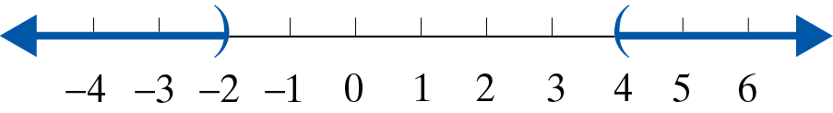
Example 5: Solving a Quadratic Inequality Using a Graphing Calculator (cont.)
Thus the solution consists of the union of two intervals:

Slide 45
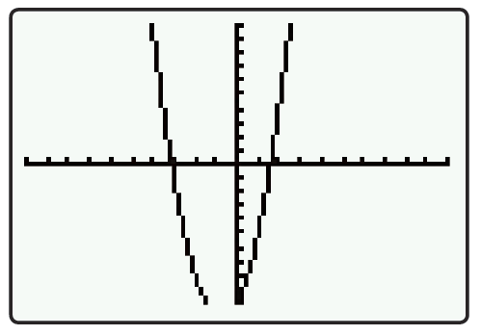
Example 5: Solving a Quadratic Inequality Using a Graphing Calculator (cont.)
Solution: Press and enter the function:
Press to graph the function.
The graph will appear as illustrated
here. (In this case the graph is a
parabola.)

Slide 46


Example 5: Solving a Quadratic Inequality Using a Graphing Calculator (cont.)
Find the zeros (or estimate the zeros) as follows:
Step 1: Press CALC ( ).
Step 2: Press or choose 2:zero.
Step 3: Follow the directions for moving the cursor to
Left Bound?, Right Bound?, and Guess? for each point. (Press each time.)

Slide 47
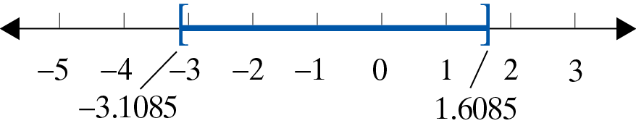
Example 5: Solving a Quadratic Inequality Using a Graphing Calculator (cont.)
In this case the zeros are estimates: x ≈ −3.1085 and
x ≈ 1.6085.
Because we want to know where y ≤ 0, we look at the graph and find the intervals for x where the curve is below the x-axis and include the endpoints because 0 is included in the inequality.
Thus the solution is the closed interval [−3.1085,1.6085].

Slide 48
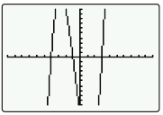
Example 6: Solving a Higher-Degree Polynomial Inequality Using a Graphing Calculator
Solve the following third-degree polynomial inequality using a graphing calculator:
Solution Press and enter the function
Press to graph the function.
The graph will appear as illustrated here. (In this case the graph is not a parabola.)

Slide 49
Example 6: Solving a Higher-Degree Polynomial Inequality Using a Graphing Calculator (cont.)
Find the zeros (or estimate the zeros) as follows:
Step 1: Press CALC ( ).
Step 2: Press or choose 2:zero.
Step 3: Follow the directions for moving the cursor to
Left Bound?, Right Bound?, and Guess? for each point.
(Press each time.)
In this case there are three zeros: x = −4, x = −1, and
x = 3.

Slide 50
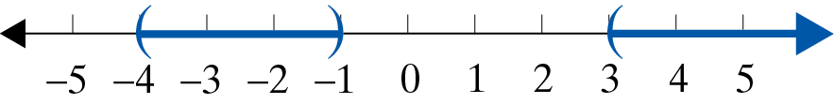
Example 6: Solving a Higher-Degree Polynomial Inequality Using a Graphing Calculator (cont.)
Because we want to know where y > 0, we look at the graph and find the intervals for x where the curve is above the x-axis. Do not include the endpoints because 0 is not included in the inequality.
Thus the solution is the union of two intervals:

Slide 51
Practice Problems
Solve each of the following inequalities algebraically. Graph each solution set on a real number line. Write the answers in interval notation.
Use a graphing calculator to solve the following inequalities. Write the answers in interval notation.

Slide 52



Practice Problem Answers
1.
2.
3.
4.
5.

