Slide 1
Section 11.1
Algebra of Functions

Slide 2
Objectives
Find the sum, difference, product, and quotient of two functions.
Graph the sum of two functions.
Use a graphing calculator to graph the sum of two functions.

Slide 3
Algebraic Operations with Functions
If and represent two functions and x is a value in the domain of both functions, then:
1. Sum of two functions:
2. Difference of two functions:
3. Product of two functions:
4. Quotient of two functions:

Slide 4
Example 1: Algebraic Operations with Functions
Let Find the
following functions.

Slide 5
Example 1: Algebraic Operations with Functions (cont.)

Slide 6
Example 1: Algebraic Operations with Functions (cont.)
d. Evaluate each of the functions found in parts a. - c. at x = 2.
Solution
Evaluating each of these functions at x = 2 gives the following results.

Slide 7
Example 2: Algebraic Operations with Functions

Slide 8
Example 2: Algebraic Operations with Functions (cont.)

Slide 9
Example 2: Algebraic Operations with Functions (cont.)
d. Evaluate each of the functions found in parts a. - c. at x = 3.
Solution
Evaluating each of these functions at x = 3 gives the following results.

Slide 10
Example 3: Algebraic Operations with Functions with Limited Domains
Let Find the following functions and state the domain of each function.
The domain of f is the set of all real numbers. However, the domain of the sum is restricted to the domain of g, the radical function. In this case we must have x – 2 ≥ 0. Thus in interval notation, the domain is [2, ∞).

Slide 11
Example 3: Algebraic Operations with Functions with Limited Domains (cont.)
For this function, the denominator cannot be 0, so x ≠ 2. Therefore, we must have x – 2 > 0 and the domain, in interval notation, is (2, ∞).
Note: The domain can become smaller than, but never larger than, the domain of the two original functions.

Slide 12
Practice Problems

Slide 13
Practice Problems (cont.)

Slide 14
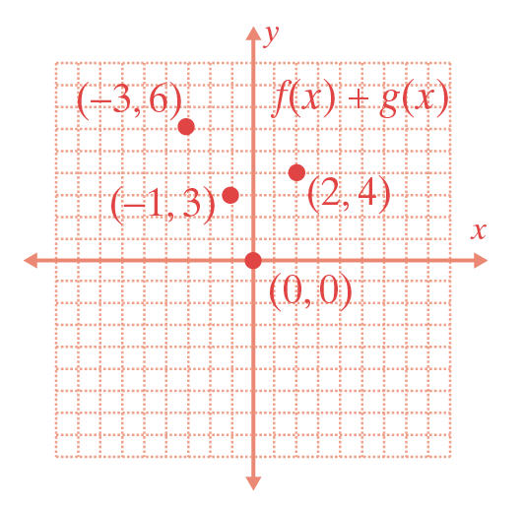
Practice Problem Answers

