Slide 1
Section 11.2
Composition of Functions and Inverse Functions

Slide 2
Objectives
Form the composition of two functions.
Determine if a function is one-to-one using the horizontal line test.
Show that two functions are inverses by verifying that
Find the inverse of a one-to-one function.
Graph the inverses of functions by reflecting the graphs of the functions across the line y = x.

Slide 3
Composition of Functions
Composition of Functions
For two functions f and g, the composite function is defined as follows:
Domain of The domain of consists of those values of x in the domain of g for which g(x) is in the domain of f.

Slide 4
Example 1: Compositions
a. Form the compositions
Solution
Note: Both are defined for all real numbers.

Slide 5
Example 1: Compositions (cont.)
b. Form the composite functions
Solution
Note: For the expression under the radical to be defined, we must have g(x) ≥ 3. Because x² + 4 ≥ 3 for all real numbers, the domain of is all real numbers.

Slide 6
Example 1: Compositions (cont.)
Note: is defined only for x ≥ 3. (Here the domain comes from f before the simplification.)

Slide 7
Example 1: Compositions (cont.)

Slide 8
One-to-One Functions
One-to-One Functions
A function is a one-to-one function (or 1-1 function) if for each value of y in the range there is only one corresponding value of x in the domain.

Slide 9
One-to-One Functions
Horizontal Line Test
A function is one-to-one if no horizontal line intersects the graph of the function at more than one point.

Slide 10
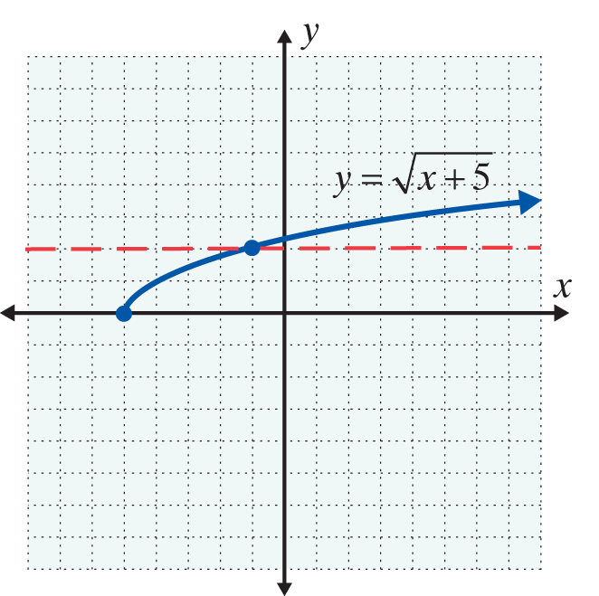
Example 2: One-to-One Functions
Determine whether each function is or is not one-to-one.
a.
Solution
The horizontal line test shows that this function is one-to-one.

Slide 11
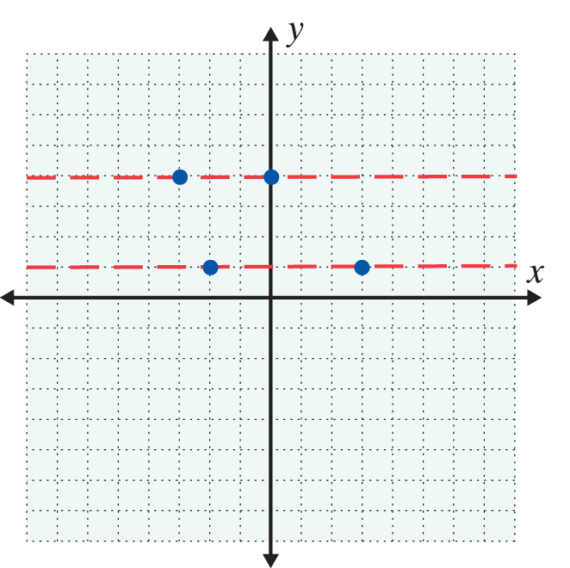
Example 2: One-to-One Functions (cont.)
Solution
This function is not one-to-one. Both y-values, 4 and 1, have more than one corresponding x-value.

Slide 12
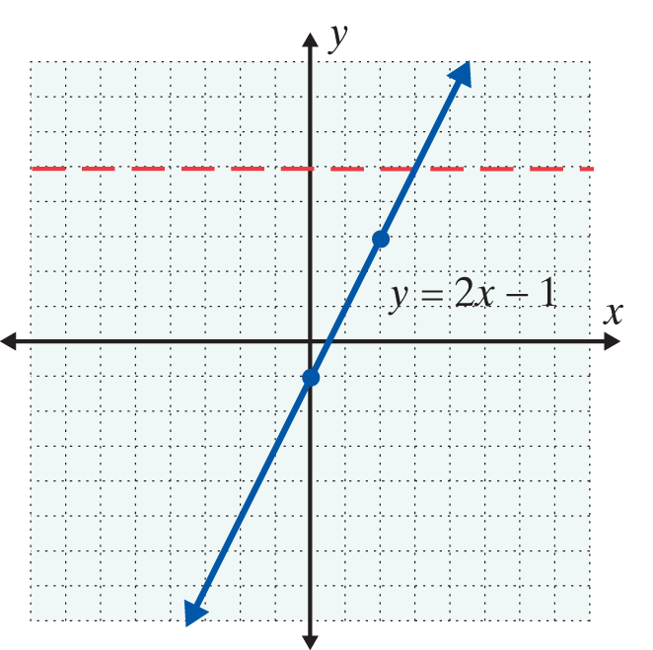
Example 2: One-to-One Functions (cont.)
c. y = 2x – 1
Solution
The graph of the function y = 2x – 1 is a straight line. Straight lines that are not vertical and not horizontal represent one-to-one functions. (Vertical lines are not functions in the first place and horizontal lines fail the horizontal line test.)

Slide 13
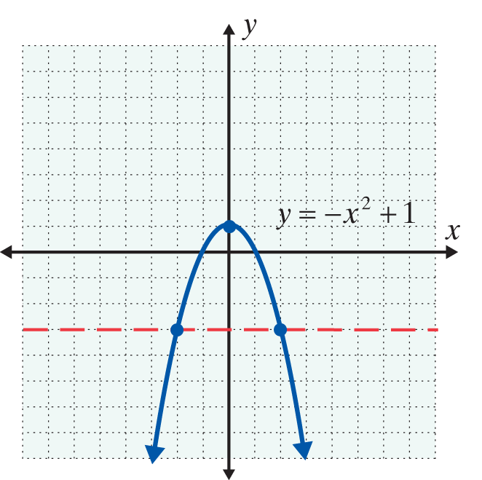
Example 2: One-to-One Functions (cont.)
d. y = – x² + 1
Solution
The graph of the function
y = – x² + 1 is a parabola and the horizontal line test shows that the function is not one-to-one.

Slide 14
Inverse Functions
Inverse Functions
If f is a one-to-one function with ordered pairs of the form (x, y), then its inverse function, denoted as f ⁻¹ , is also a one-to-one function with ordered pairs of the form (y, x).

Slide 15
Inverse Functions
Notes
The notation f ⁻¹(x) represents the inverse of a one-to-one function. This inverse is a new function in which the x- and y-values have been interchanged. f ⁻¹(x)
does NOT mean because the −1 is NOT an exponent.

Slide 16
Inverse Functions
To Determine whether Two Functions are Inverses
If f and g are one-to-one functions and
then f and g are inverse functions.

Slide 17
Example 3: Inverse Functions
Use the definition of inverse functions to show that f and g are inverse functions.
Solution
The domain of both
functions is the set of all real numbers.

Slide 18
Example 3: Inverse Functions (cont.)

Slide 19
Example 3: Inverse Functions (cont.)

Slide 20
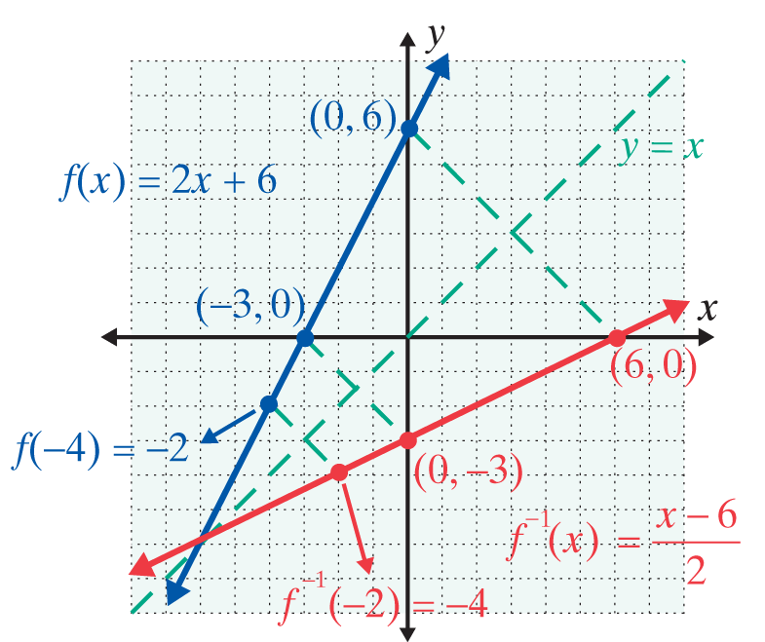
Example 3: Inverse Functions (cont.)
The graph shows that the line y = x is a line of symmetry for the graphs of the inverse functions.

Slide 21
Example 3: Inverse Functions (cont.)

Slide 22
Example 3: Inverse Functions (cont.)

Slide 23
Example 3: Inverse Functions (cont.)

Slide 24
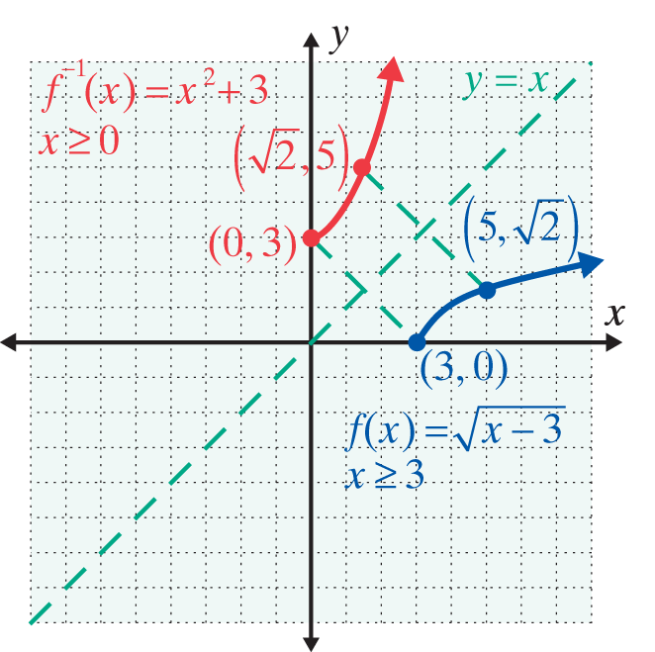
Example 3: Inverse Functions (cont.)
The graph shows that the line y = x is a line of symmetry for the graphs of the inverse functions. Note that these graphs are only parts of parabolas and the domains have been restricted accordingly.

Slide 25
Example 4: Evaluating Compositions of Inverses

Slide 26
Example 4: Evaluating Compositions of Inverses (cont.)

Slide 27
Example 4: Evaluating Compositions of Inverses (cont.)

Slide 28
Finding the Inverse of a One-to-One Function
To Find the Inverse of a One-to-One Function
1. Let y = f(x). (In effect, substitute y for f(x).)
2. Interchange x and y.
3. In the new equation, solve for y in terms of x.
4. Substitute f ⁻¹(x) for y. (This new function is the inverse of f.)

Slide 29
Example 5: Finding the Inverse

Slide 30
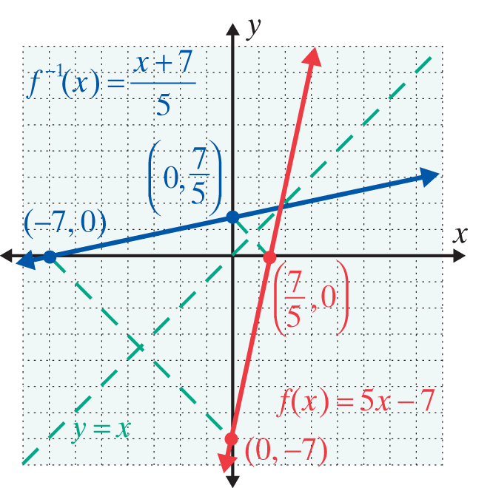
Example 5: Finding the Inverse (cont.)

Slide 31
Example 5: Finding the Inverse (cont.)

Slide 32
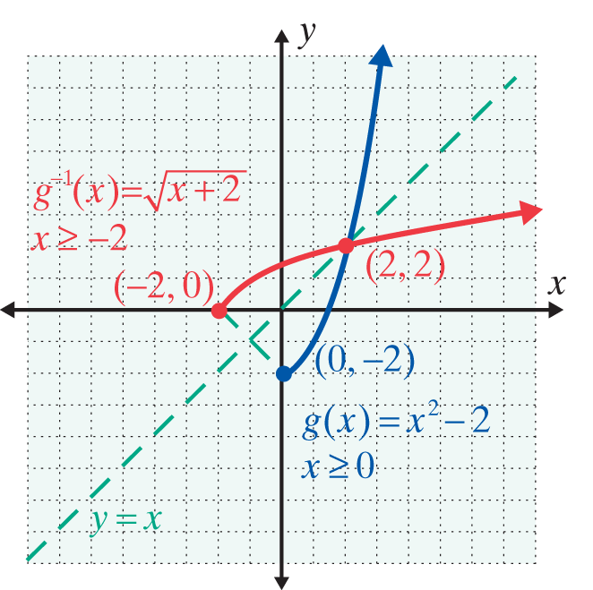
Example 5: Finding the Inverse (cont.)

Slide 33
Practice Problems

Slide 34
Practice Problems (cont.)

Slide 35
Practice Problem Answers

