Slide 1
Section 11.3
Exponential Functions

Slide 2
Objectives
Graph exponential functions.
Solve applied problems involving exponential functions: exponential growth, exponential decay, and compound interest.

Slide 3
Exponential Functions
Exponential Functions
An exponential function is a function of the form
where b > 0, b ≠ 1, and x is any real number.

Slide 4
Exponential Functions
Notes
The two conditions b > 0 and b ≠ 1 in the definition are important. We must have b > 0 so that b^{x} is defined for all real x. For example, we do not consider y = (−2)^{x} to
be an exponential function because is not a real number. Also, b ≠ 1. Because the function y = 1^{x} = 1 for all real x, this function is not considered to be an exponential function.

Slide 5
Exponential Decay
Notes
Because and so on, for
fractions between 0 and 1, we can write an exponential function with a fractional base between 0 and 1 (these are exponential decay functions) in the form of an exponential function with a base greater than 1 and a negative exponent. Thus we write

Slide 6
Exponential Decay
General Concepts of Exponential Functions
For b > 1: 1. b^{x} > 0 2. b^{x} increases to the right and is called an exponential growth function. 3. b⁰ = 1, so (0, 1) is the y-intercept. | For 0 < b < 1: 1. b^{x} > 0 2. b^{x} decreases to the right and is called an exponential decay function. 3. b⁰ = 1, so (0, 1) is the y-intercept.

Slide 7
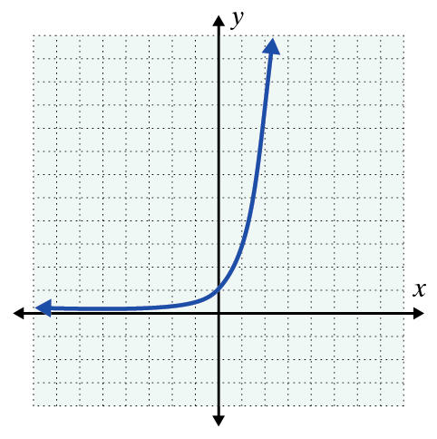
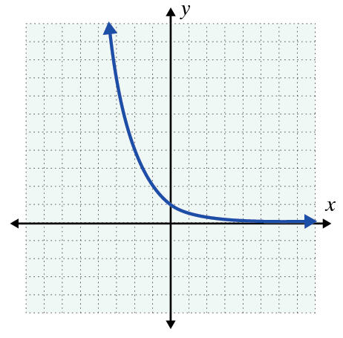
Exponential Decay
General Concepts of Exponential Functions (cont.)
4. b^{x} approaches the x-axis for negative values of x. (The x-axis is a horizontal asymptote.) | 4. b^{x} approaches the x-axis for positive values of x. (The x-axis is a horizontal asymptote.)

Slide 8
Example 1: Exponential Growth
a. A scientist has 10,000 bacteria present when t = 0. She knows the bacteria grow according to the function y = y₀ · 2^{0.5t} where t is measured in hours. How many bacteria will be present at the end of one day?
Solution
Substitute t = 24 hours and y₀ = 10,000 into the function.

Slide 9

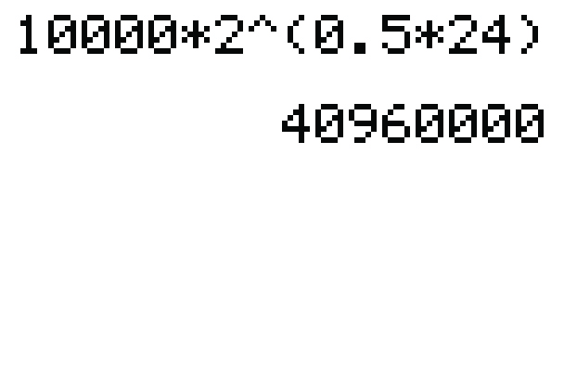
Example 1: Exponential Growth (cont.)
You could also use your TI-84 Plus graphing calculator by entering the numbers as shown in the following display. Press to get the result.

Slide 10
Example 1: Exponential Growth (cont.)
b. Use the formula for exponential growth, y = y₀b^{t}, to determine the exponential function that fits the following information: y₀ = 5000 bacteria, and there are 135,000 bacteria present after 3 days.
Solution
Use y = y₀b^{t} where t is measured in days. Substitute 135,000 for y, 3 for t, and 5000 for y₀, then solve for b.

Slide 11
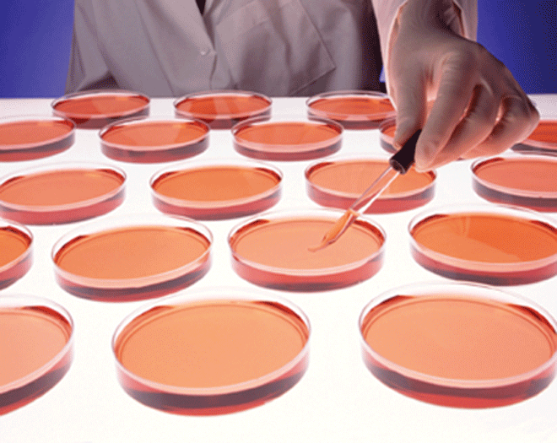
Example 1: Exponential Growth (cont.)

Slide 12
Compound Interest
Compound Interest
Compound interest on a principal P invested at an annual interest rate r (in decimal form) for t years that is compounded n times per year can be calculated using the following formula:
where A is the amount accumulated.

Slide 13
Example 2: Compound Interest
a. If P dollars are invested at a rate of interest r (in decimal form) compounded annually (once a year, n = 1) for t years, the formula for the amount A
becomes Find the value
of $1000 invested at r = 6% = 0.06 for 3 years.
Solution
We have P = 1000, r = 0.06, and t = 3.

Slide 14

Example 2: Compound Interest (cont.)
Note: To use your calculator to evaluate (1.06)³, enter 1.06, press the key, enter 3, then press the key.

Slide 15
Example 2: Compound Interest (cont.)
b. What will be the value of a principal investment of $1000 invested at 6% for 3 years if interest is compounded monthly (12 times per year)?
Solution Use the formula for compound interest.
We have P = 1000, r = 0.06, n = 12, and t = 3.

Slide 16
Example 2: Compound Interest (cont.)
c. Find the value of A if $1000 is invested at 6% for 3 years and interest is compounded daily. (Note: Banks and savings institutions often use 360 days per year.)
Solution Use the formula for compound interest.
We have P = 1000, r = 0.06, n = 360, and t = 3.

Slide 17
The Number e
The Number e
The number e is defined to be
Note: The number e is on the TI-84 Plus calculator above the divide key.

Slide 18
The Number e
Continuously Compounded Interest
Continuously compounded interest on a principal P invested at an annual interest rate r for t years can be calculated using the following formula:
where A is the amount accumulated.

Slide 19


Example 3: Calculating Continuously Compounded Interest Using a TI-84 Plus Calculator
Find the value of $1000 invested at 6% for 3 years if interest is compounded continuously. (In this case, P = $1000, r = 6% = 0.06, and t = 3.)
Solution
Press and and e^( will appear on the display.
To find the value of

Slide 20
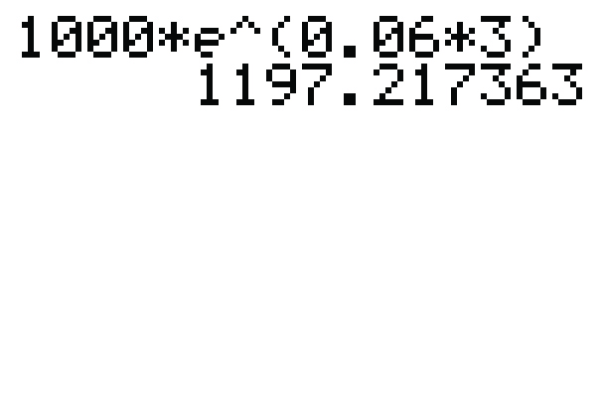
Example 3: Calculating Continuously Compounded Interest Using a TI-84 Plus Calculator (cont.)
enter the numbers as shown and press to get the result.
Thus the value of $1000 compounded continuously at 6% for 3 years will be $1197.22. (Note that from Example 2c there is only a 2 cent gain in A when $1000 is compounded continuously instead of daily at 6% for 3 years.)
The entire exponent must be in parentheses.

Slide 21
Practice Problems
1. Sketch the graph of the exponential function
f(x) = 2 · 3^{x} and label 3 points on the graph.
2. Sketch the graph of the exponential decay function
y = 0.5 · 2^{−x} and label 3 points on the graph.
3. Find the value of $5000 invested at 8% for 10 years if interest is a. compounded monthly, b. compounded continuously.

Slide 22
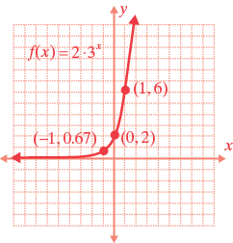
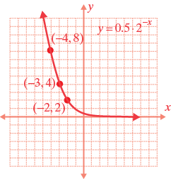
Practice Problem Answers
1. 2.
3. a. $11,098.20 b. $11,127.70

