Slide 1
Section 11.8
Applications

Slide 2
Objective
Solve applied problems using logarithmic and exponential equations.

Slide 3
Example 1: Exponential Growth
Suppose that the formula represents the
number of bacteria present after t days, where is
the initial number of bacteria. In how many days will
the bacteria double in number?
Solution
is double the initial number present.
Take the natural log of both sides.

Slide 4
Example 1: Exponential Growth (cont.)
Power rule of logarithms; ln e = 1
The number of bacteria will double in approximately 1.73 days. Note that this number is completely independent of the number of bacteria initially present. That is, if or the doubling time is the same, namely 1.73 days.

Slide 5
Example 2: Continuously Compounded Interest
If $1000 is invested at a rate of 6% compounded
continuously, in how many years will it grow to $5000?
Solution
Formula for continuously compounded interest
Substitute A = 5000, P = 1000, and r = 0.06.
Take the natural log of both sides.
Power rule of logarithms; lne = 1

Slide 6
Example 2: Continuously Compounded Interest (cont.)
$1000 will grow to $5000 in approximately 26.82 years.

Slide 7
Example 3: The Richter Scale
a. The magnitude of an earthquake is measured on the Richter scale as a logarithm of the intensity of the shock wave. For magnitude R and intensity I, the formula is R = log I. The 1994 earthquake in Northridge, California measured 6.7 on the Richter scale. What was the intensity of this earthquake?
Solution
Substitute 6.7 for R in the formula and solve for I:

Slide 8
Example 3: The Richter Scale (cont.)
b. The Long Beach earthquake in 1933 measured 6.2 on the Richter scale. How much stronger was the Northridge earthquake than the 1933 Long Beach earthquake?
Solution
The comparative sizes of the quakes can be found by finding the ratio of the intensities. For the Long Beach quake,

Slide 9
Example 3: The Richter Scale (cont.)
Therefore, the ratio of the two intensities is
Thus the Northridge earthquake had an intensity about 3.16 times the intensity of the Long Beach earthquake.

Slide 10
Example 4: Half-life of Radium
The half-life of a substance is the time needed for the
substance to decay to one-half of its original amount.
The half-life of radium-226, a common isotope of
radium, is 1600 years. If 10 grams are present today,
how many grams will remain in 500 years?
Solution
The model for radioactive decay is
Since the half-life is 1600 years, if we assume
then y would be 5 g after 1600 years. We solve for k as
follows.

Slide 11
Example 4: Half-life of Radium (cont.)
Substitute y = 5, and t = 1600.
The model is
Take the natural log of both sides.
Power rule for logarithms; ln e = 1

Slide 12
Example 4: Half-life of Radium (cont.)
Substituting t = 500 gives
Thus there will still be about 8.05 g of the radium-226 remaining after 500 years.

Slide 13
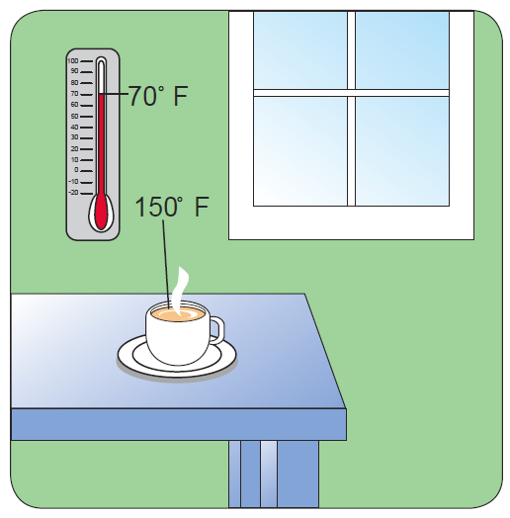
Example 5: Newton’s Law of Cooling
Suppose that the room temperature is 70°, and the
temperature of a cup of tea is 150° when
it is placed on the table. In 5 minutes,
the tea cools to 120°. How long
will it take for the tea to cool to 100°?
Solution
Using the formula (Newton’s law of cooling), first find A and then k.

Slide 14
Example 5: Newton’s Law of Cooling (cont.)
We know that C = 70° and that T = 150° when t = 0.
Find A by substituting these values.
Therefore, the formula can be written as
Since T = 120° when t = 5, substituting these values
allows us to find k.

Slide 15
Example 5: Newton’s Law of Cooling (cont.)
Take the natural log of both sides.

Slide 16
Example 5: Newton’s Law of Cooling (cont.)
The formula can now be written as
With all the constants in the formula known, we can
find t when T = 100°.
Take the natural log of both sides.

Slide 17
Example 5: Newton’s Law of Cooling (cont.)
The tea will cool to 100° in about 10.43 minutes.

