Slide 1
Section 12.1
Translations and Reflections

Slide 2
Objectives
Calculate and understand the difference quotient.
Understand the concepts of horizontal and vertical translations.
Graph translations and reflections of functions. That is, given the graph of a function y = f(x) graph translations and reflections of the form
y = ± f(x−h) + k.

Slide 3
Example 1: Using f(x) Notation
For the function f (x) = 2x² − 4, find:

Slide 4
Example 1: Using f(x) Notation (cont.)

Slide 5
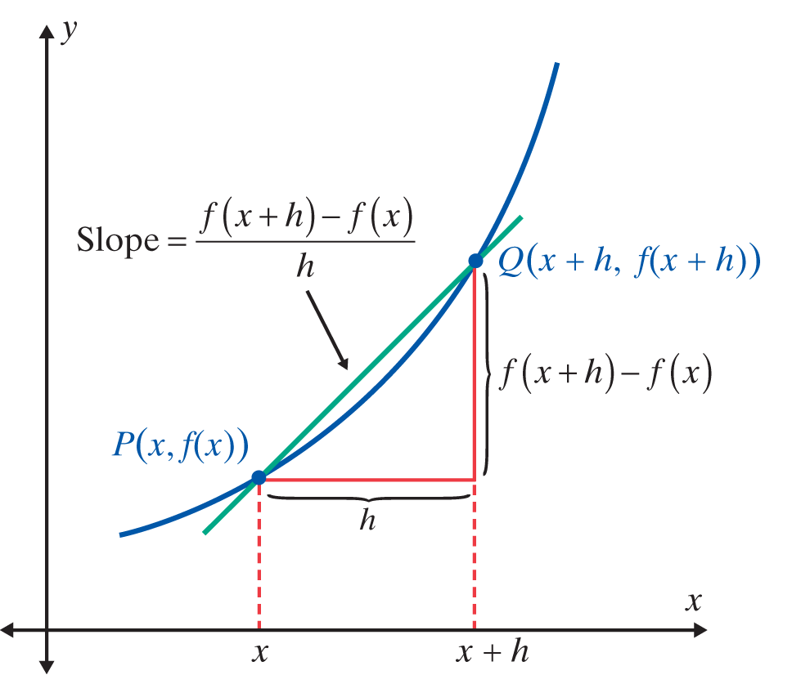
The Difference Quotient
Notes
The line illustrated in the figure (through two points on the graph) is called a secant line.

Slide 6
The Difference Quotient
Notes
Note carefully that f (x + h) is not the same as f(x) + h.
For example,

Slide 7
Example 2: Finding the Difference Quotient for a Given Function
a. Find the difference quotient for the function f (x) = 2 − 6x.
Solution

Slide 8
Example 2: Finding the Difference Quotient for a Given Function (cont.)

Slide 9
Example 2: Finding the Difference Quotient for a Given Function (cont.)

Slide 10
Horizontal and Vertical Translations
Horizontal and Vertical Translations
Given the graph of y = f(x), the graph of y = f (x − h) + k is
1. a horizontal translation of h units, and
2. a vertical translation of k units
of the graph of y = f(x).
Draw the graph of y = f(x) in relation to (h, k) as if (h, k) were the origin, (0, 0). This new graph will be the graph of y = f (x − h) + k.

Slide 11
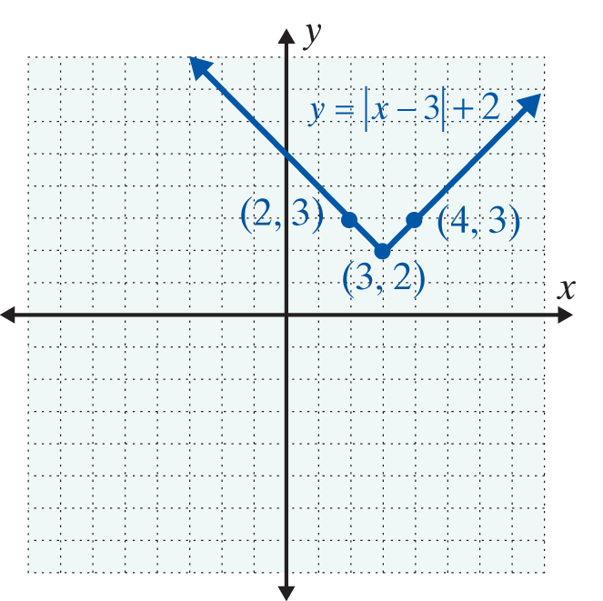
Example 3: Horizontal and Vertical Translations of the Function y = |x|
Graph each of the following functions.
Solution Here (h, k) = (3, 2) so there is a horizontal translation of 3 units right and 2 units up. In effect, (3, 2) is now the vertex of the new graph just as (0, 0) is the vertex of the original graph. You should check that the points shown on the graph here do indeed satisfy the function.

Slide 12
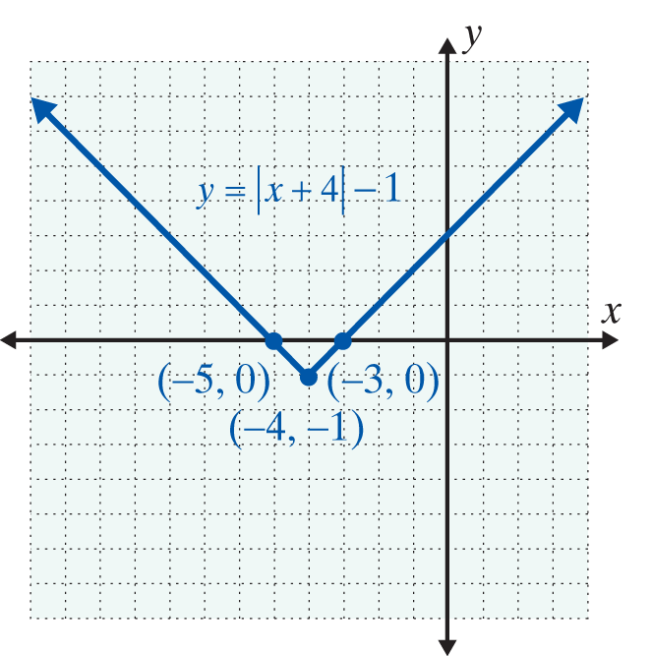
Example 3: Horizontal and Vertical Translations of the Function y = |x| (cont.)
Solution
Here (h, k)= (−4,−1) so the horizontal translation is −4 (4 units left) and the vertical translation is −1 (1 unit down). The effect is that the vertex is now at the point (−4,−1).

Slide 13
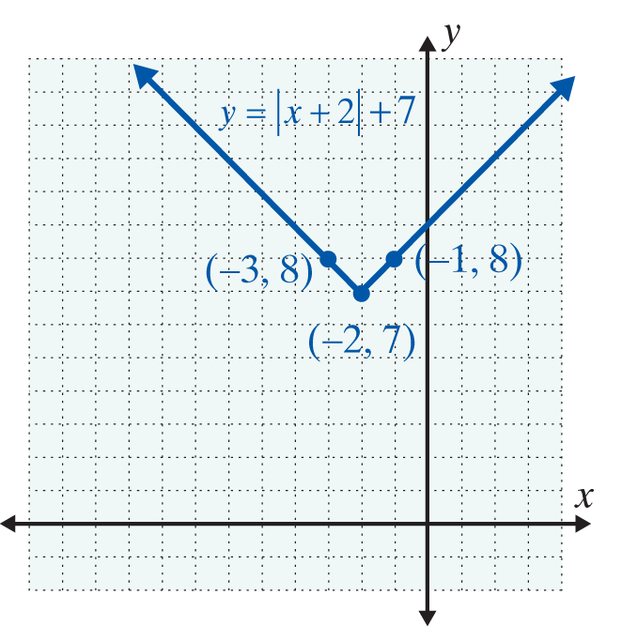
Example 3: Horizontal and Vertical Translations of the Function y = |x| (cont.)
Solution
Here (h, k) = (−2, 7) so the horizontal translation is −2 (2 units left) and the vertical translation is 7 (7 units up). The effect is that the vertex is now at the point (−2, 7).

Slide 14
Example 4: Reflections and Translations of the Function y = |x|
Graph the function y = −|x + 2|+ 5.
Solution
The reflection is performed first, followed by the translations.
Here (h, k) = (−2, 5), and the graph is reflected across the x-axis. We show step-by-step how to “arrive” at the graph. (You may do these steps mentally and graph only the last step.)

Slide 15
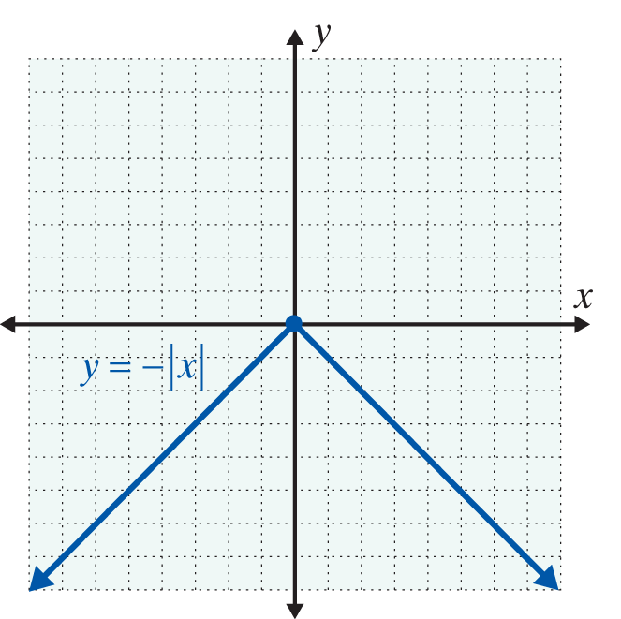
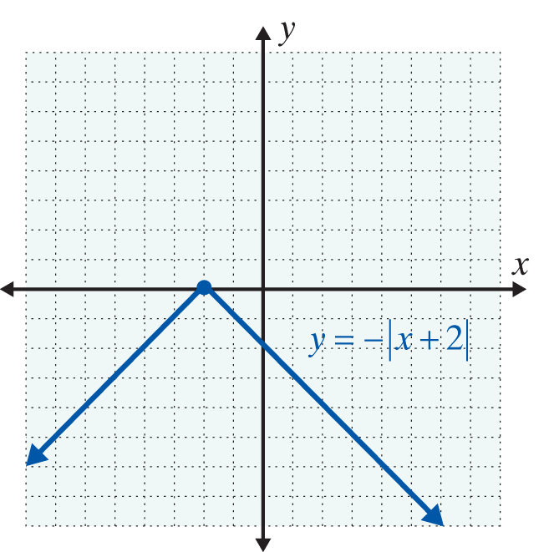
Example 4: Reflections and Translations of the Function y = |x| (cont.)
Step 1: Graph the reflection y = −|x|.
Step 2: Translate the graph 2 units to the left.

Slide 16
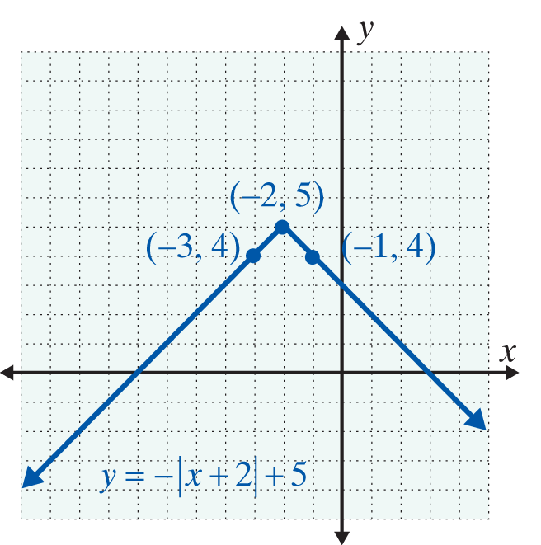
Example 4: Reflections and Translations of the Function y = |x| (cont.)
Step 3: Translate the graph 5 units up.

Slide 17
Example 5: Translations of Functions with Graphs Given
Solution

Slide 18
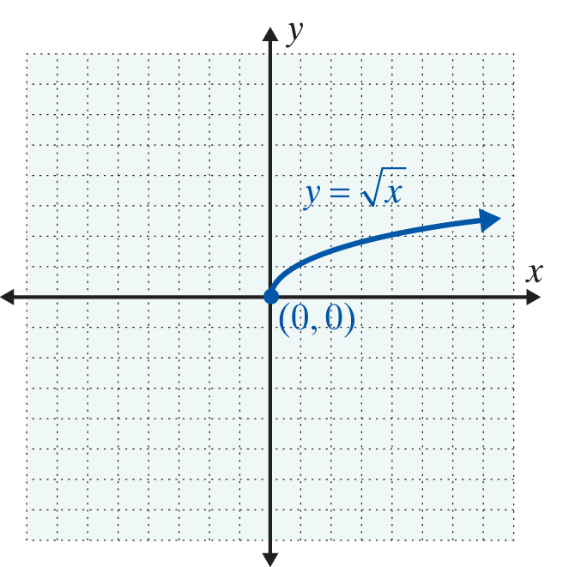
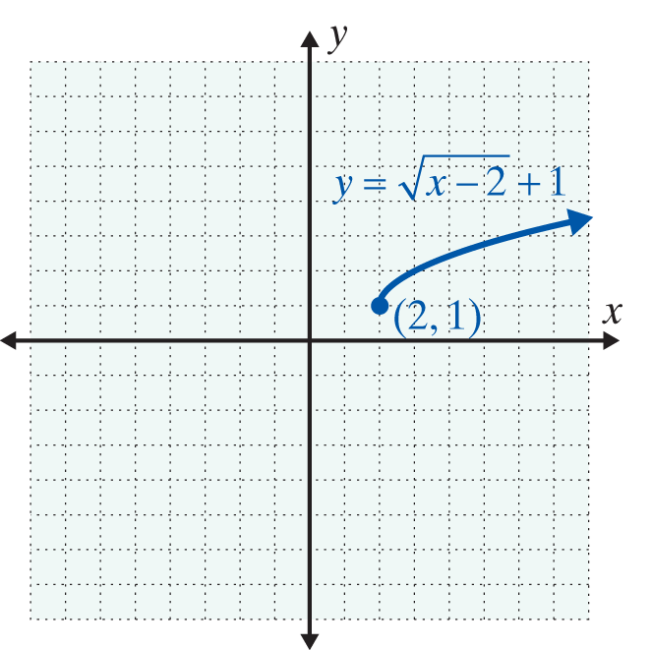
Example 5: Translations of Functions with Graphs Given (cont.)

Slide 19
Example 5: Translations of Functions with Graphs Given (cont.)
Solution
Here (h, k) = (3,−2) so translate the graph horizontally 3 units and vertically −2 units. (Add 3 to each x-value and −2 to each y-value.)

Slide 20
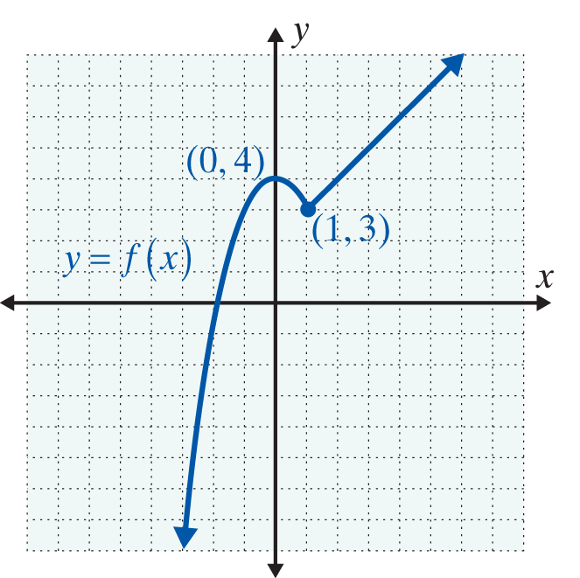
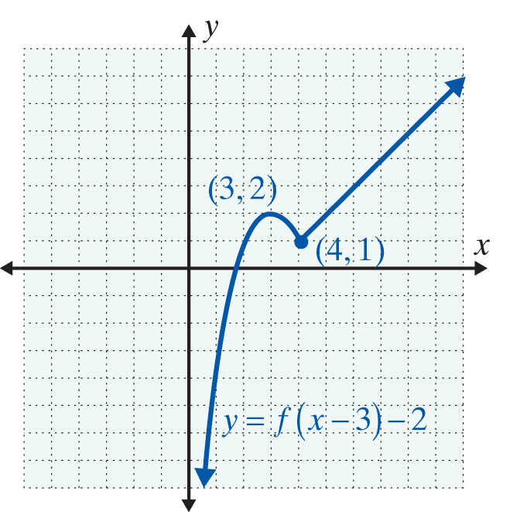
Example 5: Translations of Functions with Graphs Given (cont.)

Slide 21
Practice Problems

Slide 22
Practice Problem Answers

