Slide 1
Section 12.2
Parabolas as Conic Sections

Slide 2
Objectives
Graph parabolas that open left or right (horizontal parabolas).
Find the vertices, y-intercepts, and lines of symmetry for horizontal parabolas.

Slide 3
Parabolas
Equations of Horizontal Parabolas
Equations of horizontal parabolas (parabolas that open to the left or right) can be written in the form
The parabola opens left if a < 0 and right if a > 0.
The vertex is at (h, k).
The line y = k is the line of symmetry.

Slide 4
Example 1: Horizontal Parabolas
a. For find the vertex, the y-intercepts, and the line of symmetry. Then sketch the graph.
Solution
To find the vertex, complete the square.
The vertex is at (−5, 3).

Slide 5
Example 1: Horizontal Parabolas (cont.)
To find the y-intercepts, let x = 0 and use the square root method as follows:

Slide 6
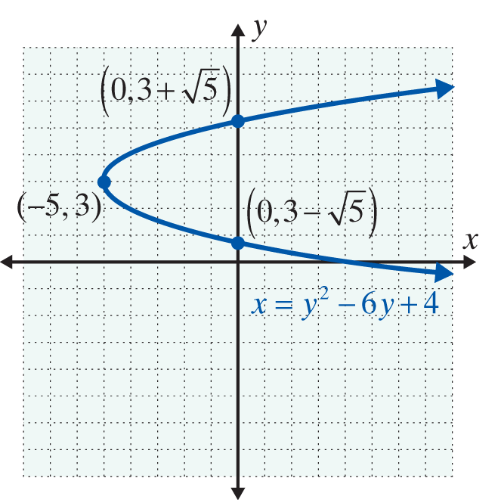
Example 1: Horizontal Parabolas (cont.)
Since a = 1, the parabola has the same shape as x = y².
Vertex: (−5, 3)
y-intercepts:
Line of symmetry: y = 3

Slide 7
Example 1: Horizontal Parabolas (cont.)
b. For find the vertex, the y-intercepts, and the line of symmetry. Then sketch the graph.
Solution
To find the vertex, complete the square.

Slide 8
Example 1: Horizontal Parabolas (cont.)
The vertex is at (8, −1).
To find the y-intercepts, let x = 0 and factor.

Slide 9
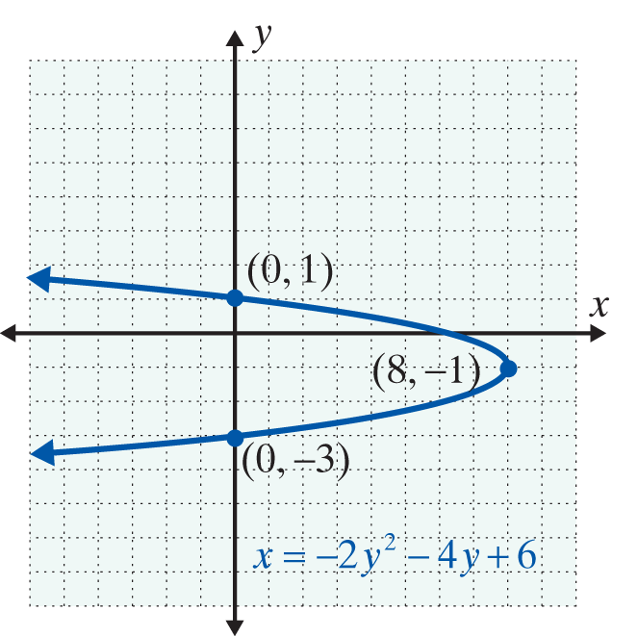
Example 1: Horizontal Parabolas (cont.)
Since a = −2, the graph opens to the left and is slightly narrower than x = y².
Vertex: (8, −1)
y-intercepts: (0, −3) and (0, 1)
Line of symmetry: y = −1

Slide 10
Example 2: Using a Graphing Calculator to Graph Horizontal Parabolas
Use a graphing calculator to graph the horizontal parabola Find the y-intercepts using the CALC features of the calculator.
Solution
To solve for y, complete the square and use the square root property as follows.

Slide 11
Example 2: Using a Graphing Calculator to Graph Horizontal Parabolas (cont.)

Slide 12
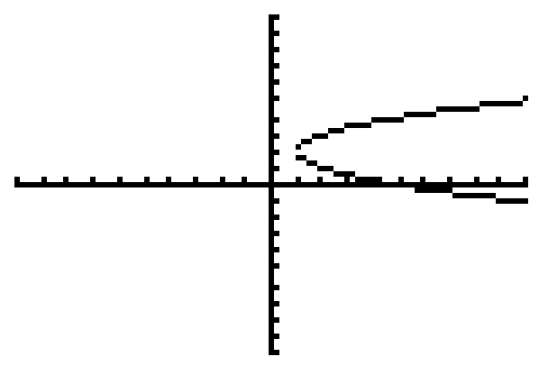
Example 2: Using a Graphing Calculator to Graph Horizontal Parabolas (cont.)
From this graph, we can determine that there are no y-intercepts.

Slide 13
Practice Problems
1. Write the equation in the form
2. Find the vertex, y-intercepts, and line of symmetry for the curve
3. Find the y-intercepts for the curve

Slide 14
Practice Problem Answers

