Slide 1
Section 12.3
Distance Formula and Circles

Slide 2
Objectives
Find the distance between any two points in a plane.
Write the equation of a circle given its center and radius.
Graph circles centered at the point (h, k).

Slide 3
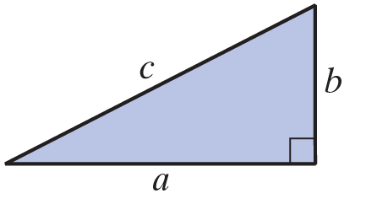
Distance Between Two Points
The Pythagorean Theorem
In a right triangle, if c is the length of the hypotenuse and a and b are the lengths of the legs, then

Slide 4
Distance Between Two Points
The Distance Formula
For two points and in a plane, the
distance between the points is

Slide 5
Example 1: The Distance Formula
a. Find the distance between the two points (3, 4) and (−2, 7).
Solution

Slide 6
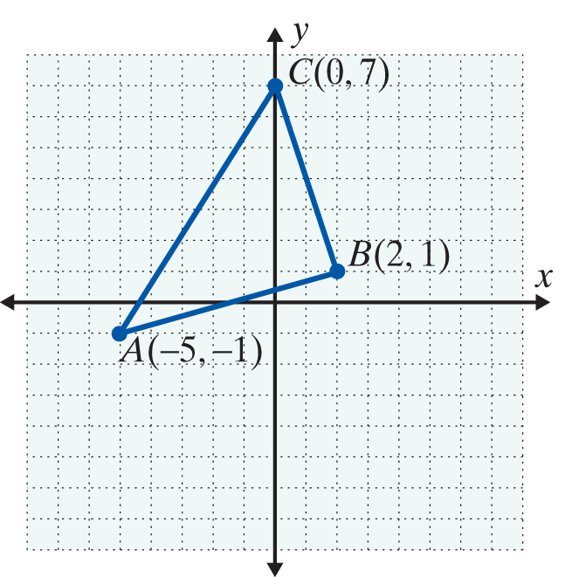
Example 1: The Distance Formula
b. Use the distance formula (3 times) and the Pythagorean theorem to determine whether or not the triangle with vertices at A(−5, −1), B(2, 1), and
C(0, 7) is a right triangle.
Solution
Find the lengths of the three line segments AB, AC, and BC, and decide whether or not the Pythagorean theorem is satisfied.

Slide 7
Example 1: The Distance Formula (cont.)

Slide 8
Equations of Circles
Circle, Center, Radius, and Diameter
A circle is the set of all points in a plane that are a fixed distance from a fixed point.
The fixed point is called the center of the circle.
The distance from the center to any point on the circle is called the radius of the circle.

Slide 9
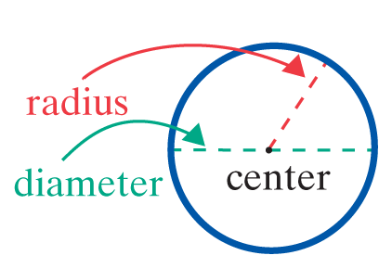
Equations of Circles
Circle, Center, Radius, and Diameter (cont.)
The distance from one point on the
circle to another point on the circle
measured through the center is
called the diameter of the circle.
Note: The diameter is twice the length of the radius.

Slide 10
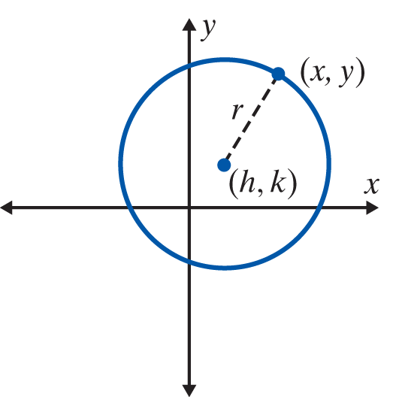
Equations of Circles
Equation of a Circle
The equation of a circle with radius r and center at
(h, k) is
If the center is at the origin, (0, 0),
the equation simplifies to

Slide 11
Example 2: Equations of Circles
a. Find the equation of the circle with its center at the origin and radius Are the points and
(1, 2) on the circle?
Solution
The equation of the circle is
To determine whether or not the points and
(1, 2) are on the circle, substitute each of these points
into the equation.
Substituting gives

Slide 12
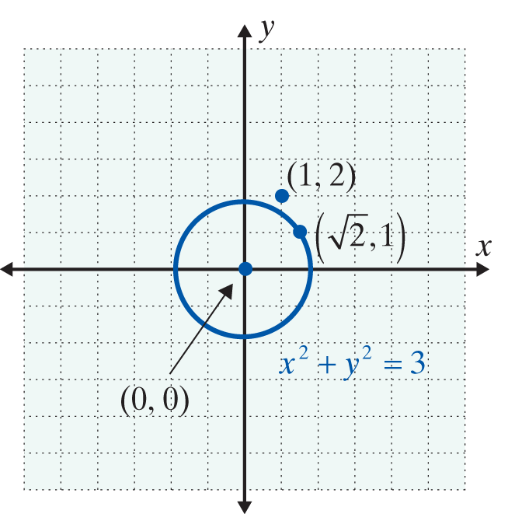
Example 2: Equations of Circles (cont.)
Substituting (1, 2) gives
Therefore, is on the circle, but (1, 2) is not on the circle.

Slide 13
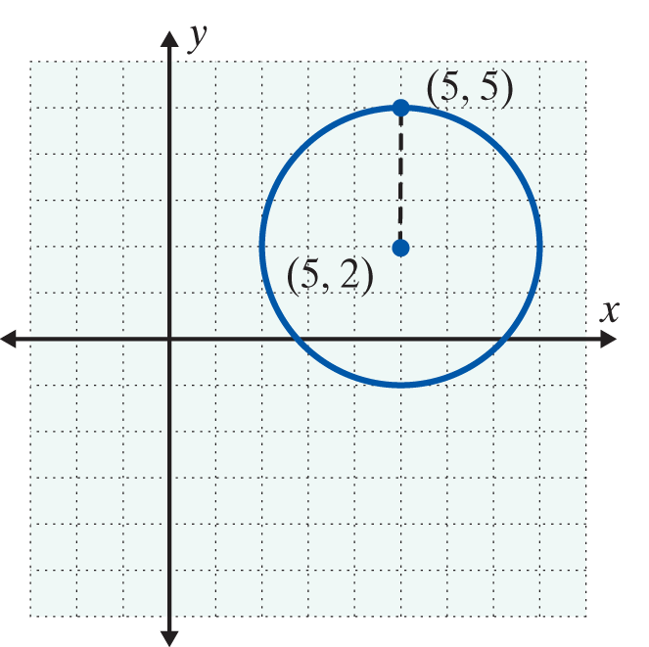
Example 2: Equations of Circles (cont.)
b. Find the equation of the circle with center at (5, 2) and radius 3. Is the point (5, 5) on the circle?
Solution
The equation of the circle is
Substituting (5, 5) gives
Therefore, (5, 5) is on the circle.

Slide 14
Example 2: Equations of Circles (cont.)
c. Show that represents a circle.
Find its center and radius. Then graph the circle.
Solution
Rearrange the terms and complete the square
for and
Add 16 and 1 to both sides.
Complete the square

Slide 15
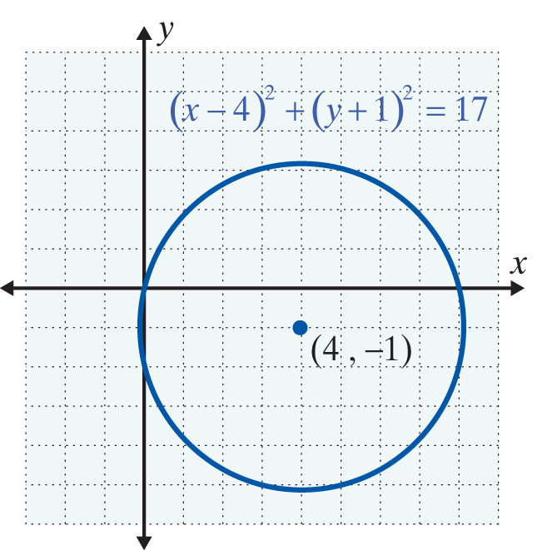
Example 2: Equations of Circles (cont.)
Standard form for the equation of a circle
Center is at (4, −1) and
radius =

Slide 16

Example 3: Using a Graphing Calculator to Graph Circles
Use a graphing calculator with a “square window” to graph the circle
Solution
Press the key and set the values to −6 and 6 for Xmin and Xmax and −4 and 4 for Ymin and Ymax, respectively.
Solving for y² gives:
Solving for y₁ and y₂ gives:

Slide 17
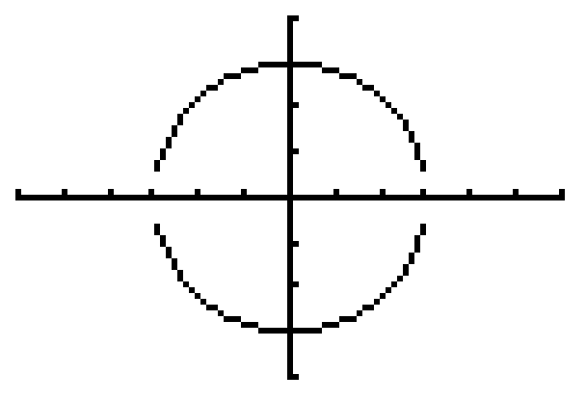
Example 3: Using a Graphing Calculator to Graph Circles (cont.)
Graphing both y₁ and y₂ gives the following graph of
the circle.

Slide 18
Practice Problems
1. Find the distance between the two points (5, 3) and
(−1, −3).
2. Find the equation of the circle with center at (−2, 3) and radius 6.
3. Write the equation in standard form and find the center and radius for the circle with equation

Slide 19
Practice Problem Answers

