Slide 1
Section 12.4
Ellipses and Hyperbolas

Slide 2
Objectives
Graph ellipses centered at the origin or at another point (h, k).
Graph hyperbolas centered at the origin or at another point (h, k).
Find the equations for the asymptotes of hyperbolas.

Slide 3
Equations of Ellipses
Ellipse
An ellipse is the set of all points in a plane for which the sum of the distances from two fixed points is constant.
Each of the fixed points is called a focus (plural foci).
The center of an ellipse is the point midway between the foci.

Slide 4
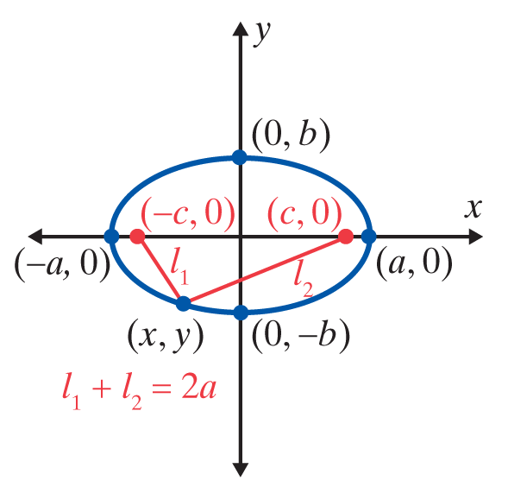
Equations of Ellipses
Ellipse (cont.)
The graph of an ellipse with its center at the origin (0, 0), foci at (−c, 0) and (c, 0),
x-intercepts at (−a, 0) and
(a, 0), and y-intercepts at and (0, −b) and (0, b)
(where a² > b²).

Slide 5
Equations of Ellipses
Equation of an Ellipse
The standard form for the equation of an ellipse with its center at the origin is
The points (a, 0) and (−a, 0) are the x-intercepts (called vertices).
The points (0, b) and (0, −b) are the y-intercepts (called vertices).

Slide 6
Equations of Ellipses
Equation of an Ellipse (cont.)
When a² > b²:
1. The segment of length 2a joining the x-intercepts is called the major axis.
2. The segment of length 2b joining the y-intercepts is called the minor axis.

Slide 7
Equations of Ellipses
Equation of an Ellipse (cont.)
When b² > a²:
1. The segment of length 2b joining the y-intercepts is called the major axis.
2. The segment of length 2a joining the x-intercepts is called the minor axis.
Note: In either case, the foci lie on the major axis.

Slide 8
Example 1: Equation of an Ellipse - Major Axis Horizontal
Graph the ellipse
Solution
First, divide both sides of the given equation by 64 to find the standard form.

Slide 9
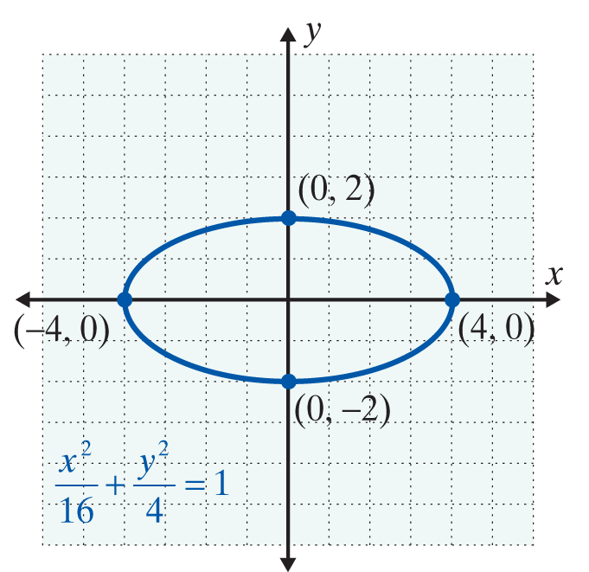
Example 1: Equation of an Ellipse - Major Axis Horizontal (cont.)
The curve is an ellipse. In this case and the major axis is 2a = 8. Also, and the minor axis is 2b = 4. The endpoints of the major axis are (−4, 0) and (4, 0). The endpoints of the minor axis are (0, −2) and (0, 2). The major and minor axes intersect at the center of the ellipse, (0, 0).

Slide 10
Example 2: Equation of an Ellipse - Major Axis Vertical
Graph the ellipse
Solution
The equation is in standard form with a² = 1 and b² = 9.
Because b² > a², we know the major axis is vertical. That is, the ellipse is elongated along the y-axis.
The points (0, −3) and (0, 3) are the endpoints of the major axis.
The points (−1, 0) and (1, 0) are the endpoints of the minor axis.

Slide 11
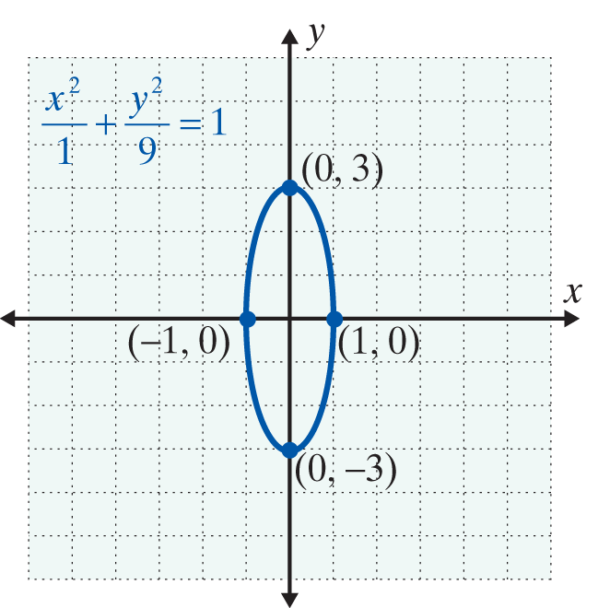
Example 2: Equation of an Ellipse - Major Axis Vertical (cont.)

Slide 12
Equations of Hyperbolas
Hyperbola
A hyperbola is the set of all points in a plane such that the absolute value of the difference of the distances from two fixed points is constant.
Each of the fixed points is called a focus (plural foci).
The center of a hyperbola is the point midway between the foci.

Slide 13
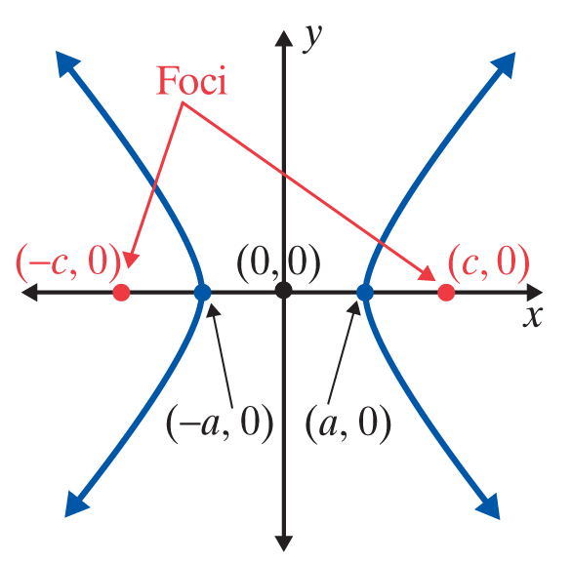
Equations of Hyperbolas
Hyperbola (cont.)
The graph of a hyperbola with its center at the origin (0, 0), foci along the x-axis at (−c, 0) and (c, 0), and x-intercepts at (−a, 0) and (a, 0). There are no y-intercepts.

Slide 14
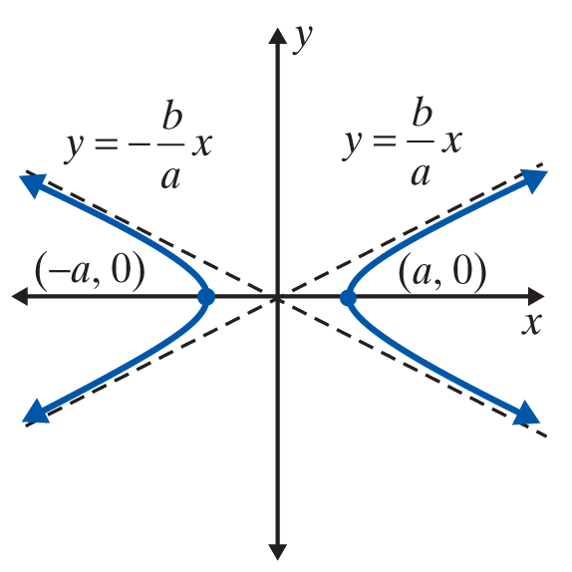
Equations of Hyperbolas
Equations of Hyperbolas
In general, there are two standard forms for equations of hyperbolas with their centers at the origin.
x-intercepts (vertices) at
(a, 0) and (−a, 0)
No y-intercepts
Asymptotes:
The curves “open” left and right.

Slide 15
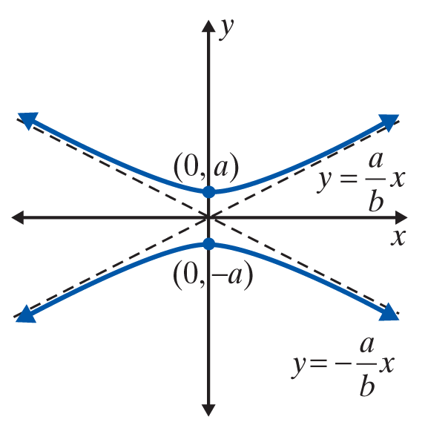
Equations of Hyperbolas
Equations of Hyperbolas (cont.)
y-intercepts (vertices) at
(0, a) and (0, −a)
No x-intercepts
Asymptotes:
The curves “open” up and down.

Slide 16
Example 3: Hyperbola Opening Left and Right
Graph the hyperbola x² – 4y² = 16.
Solution
Write the equation in standard form by dividing both sides by 16:
Here a² = 16 and b² = 4. So, using a = 4 and b = 2, the asymptotes are

Slide 17
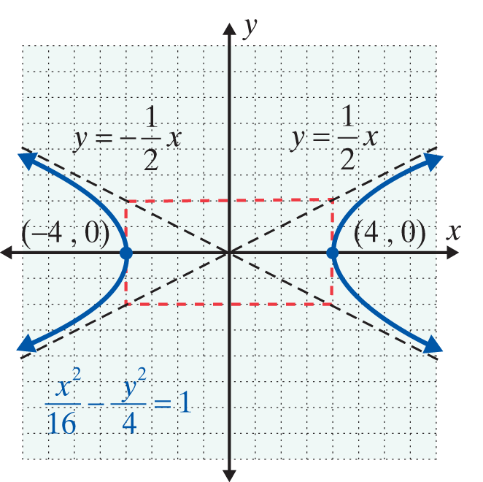
Example 3: Hyperbola Opening Left and Right (cont.)
The vertices are (−4, 0) and (4, 0) the curve opens left and right. (Note that the fundamental rectangle has sides of lengths 2a = 8 and 2b = 4.)

Slide 18
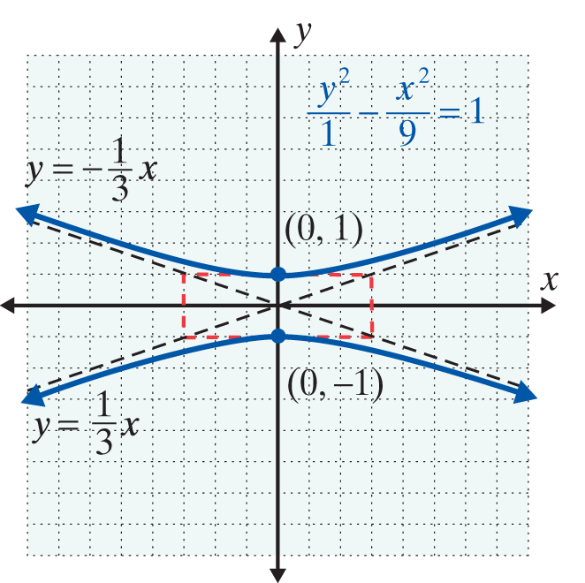
Example 4: Hyperbola Opening Up and Down
Graph the hyperbola
Solution
Here a² = 1 and b² = 9. So a = 1 and b = 3 and the asymptotes
are The
vertices are (0, −1) and (0, 1) the curve opens up and down.
(Note that the fundamental rectangle has sides of lengths 2a = 2 and 2b = 6.)

Slide 19
Ellipses and Hyperbolas with Centers at (h, k)
Ellipse with Center at (h, k)
The equation of an ellipse with its center at (h, k) is
Note: a and b are distances from (h, k) to the vertices. (See the figure on next slide.)

Slide 20
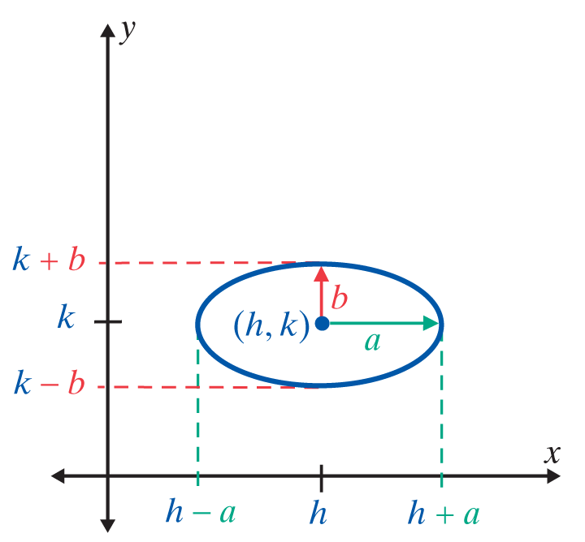
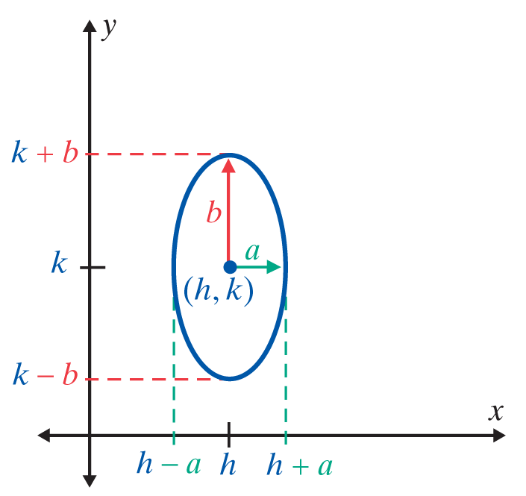
Ellipses and Hyperbolas with Centers at (h, k)

Slide 21
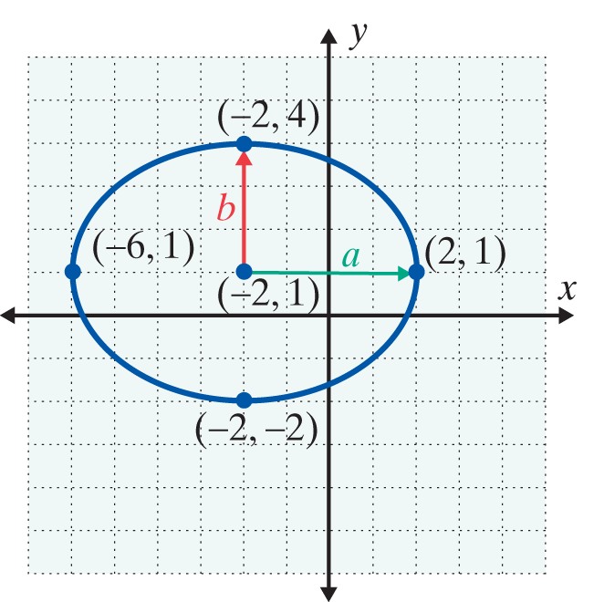
Example 5: Ellipse with Center at (h, k)
Graph the ellipse
Solution
The graph of is
translated 2 units left and 1 unit up so that the center is at (−2, 1) with a = 4 and b = 3. The graph is shown here with the center and vertices labeled.

Slide 22
Ellipses and Hyperbolas with Centers at (h, k)
Hyperbola with Center at (h, k)
The equation of a hyperbola with its center at (h, k) is
Note: a and b are used as in the standard form but are measured from (h, k). (See the figure on next slide.)

Slide 23
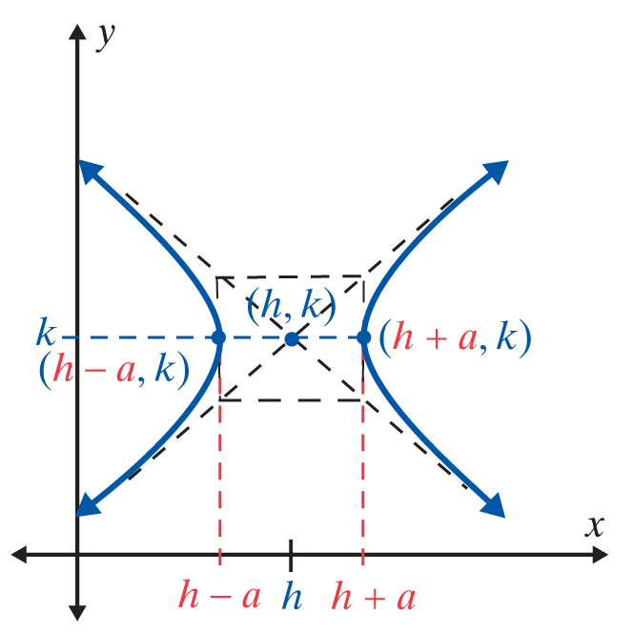
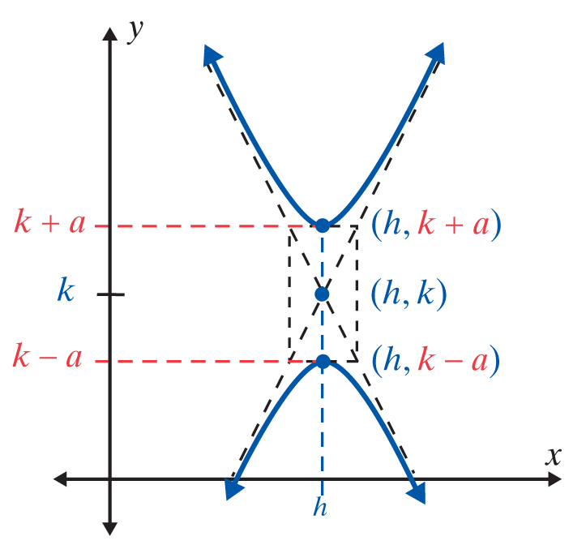
Ellipses and Hyperbolas with Centers at (h, k)

Slide 24
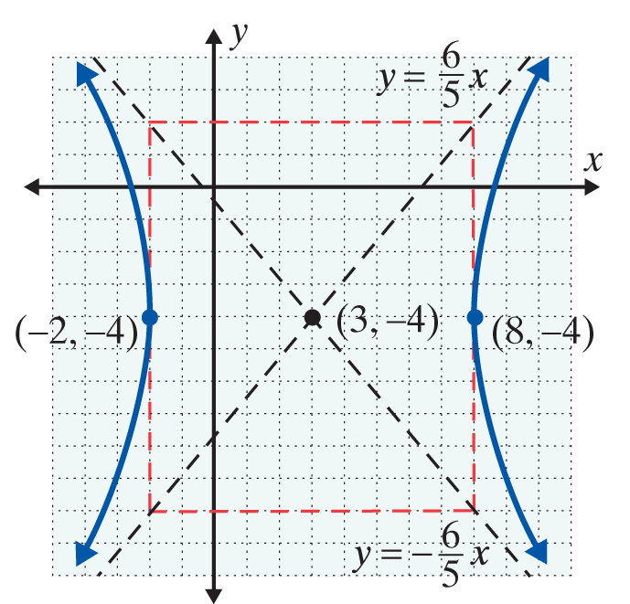
Example 6: Hyperbola with Center at (h, k)
Graph the hyperbola
Solution
The graph of
is translated 3 units right and 4 units down so that the center is at (3, −4) with a = 5 and b = 6. The graph is shown here with its asymptotes, the center, and the vertices labeled.

Slide 25
Practice Problems
1. Write the equation 2x² + 9y² = 18 in standard form. State the length of the major axis and the length of the minor axis.
2. Write the equation x² – 9y² = 9 in standard form. Write the equations of the asymptotes.
3. Graph the ellipse
4. Graph the hyperbola

Slide 26
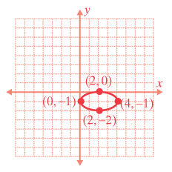
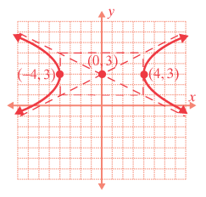
Practice Problem Answers

