Slide 1
Section 12.5
Nonlinear Systems of Equations

Slide 2
Objective
Solve systems of equations where one or both equations are nonlinear

Slide 3
Example 1: A System of One Quadratic and One Linear Equation
Solve the following systems of equations and graph both curves in each system on the same set of axes.
Solution
Solve x + y = 5 for y (or x). Then substitute into the other equation.

Slide 4
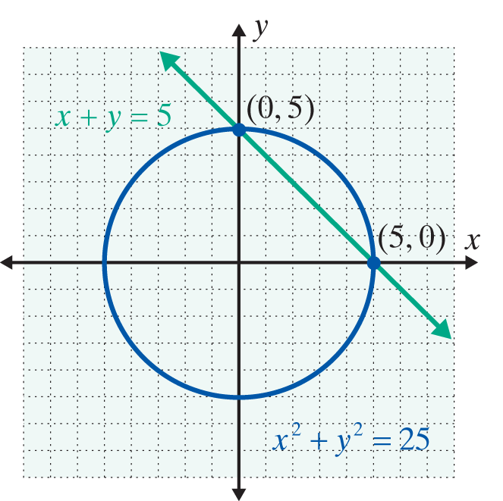
Example 1: A System of One Quadratic and One Linear Equation (cont.)
The solutions (points of intersection) are (0, 5) and (5, 0).

Slide 5
Example 1: A System of One Quadratic and One Linear Equation (cont.)
Solution
Solve the linear equation for y (or x), then substitute into the quadratic equation. (In this case, the quadratic equation is already solved for y, so we could have chosen to make the substitution into the linear equation instead.)

Slide 6
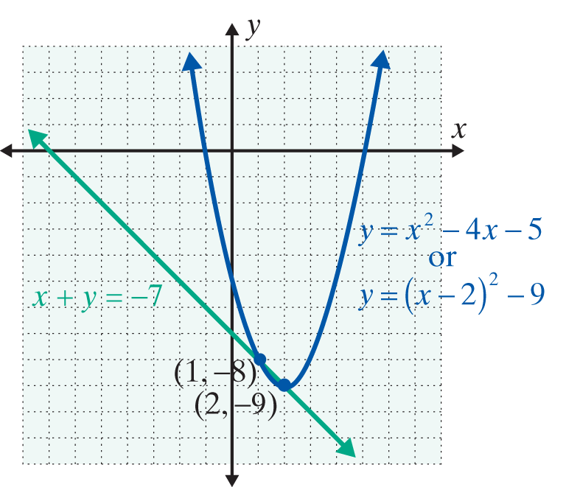
Example 1: A System of One Quadratic and One Linear Equation (cont.)
The solutions are (2, −9) and (1, −8).

Slide 7
Example 2: A System of Two Quadratic Equations
Solution
Here addition will eliminate y².

Slide 8
Example 2: A System of Two Quadratic Equations (cont.)
There are four points of intersection:

Slide 9
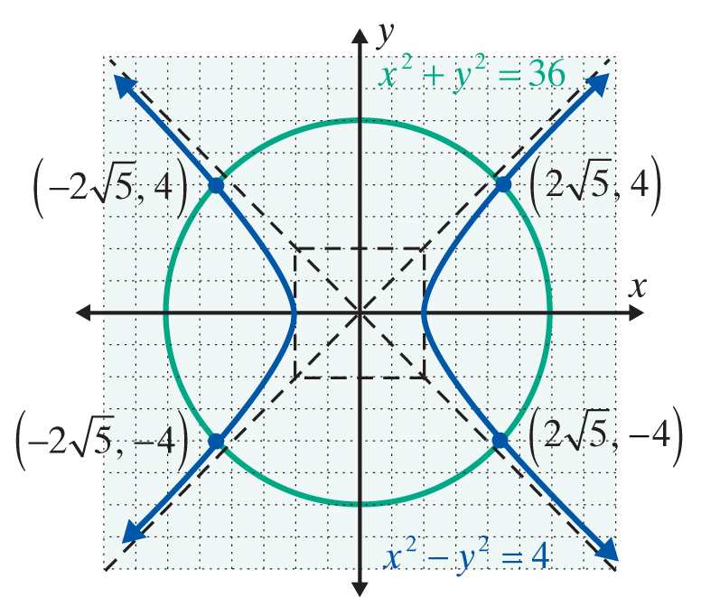
Example 2: A System of Two Quadratic Equations (cont.)

Slide 10
Solving a System of Two Quadratic Equations
Notes
In the examples and the exercises the curves do intersect. However, there are many situations where the curves do not intersect. This can be confirmed both algebraically and graphically.

Slide 11
Practice Problems
Solve each of the following systems algebraically and graphically.

Slide 12
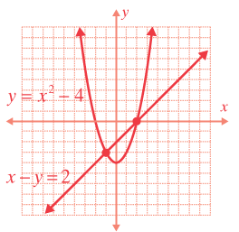
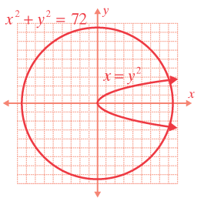
Practice Problem Answers

