Slide 1
Section 2.6
Introduction to Problem Solving

Slide 2
Objectives
Understand the four basic steps in solving applications.
Solve word problems involving translating number phrases, consecutive integers, and other applications.

Slide 3
Problem Solving
Basic Steps for Solving Applications
1. Understand the problem. For example,
a. Read the problem carefully, maybe several times.
b. Understand all the words.
c. If it helps, restate the problem in your own words.
d. Be sure that there is enough information.

Slide 4
Problem Solving
Basic Steps for Solving Applications (cont.)
2. Devise a plan. For example,
a. Guess, estimate, or make a list of possibilities.
b. Draw a picture or diagram.
c. Represent the unknown quantity with a variable and form an equation.

Slide 5
Problem Solving
Basic Steps for Solving Applications (cont.)
3. Carry out the plan. For example,
a. Try all the possibilities you have listed.
b. Study your picture or diagram for insight into the solution.
c. Solve any equation that you may have set up.

Slide 6
Problem Solving
Basic Steps for Solving Applications (cont.)
4. Look back over the results. For example,
a. Can you see an easier way to solve the problem?
b. Does your solution actually work? Does it make sense in terms of the wording of the problem? Is it reasonable?
c. If there is an equation, check your answer in the equation.

Slide 7
Problem Solving
Notes
You may find that many of the applications in this section can be solved by “reasoning,” and there is nothing wrong with that approach. Reasoning is a fundamental part of all of mathematics. However, keep in mind that the algebraic techniques you are learning are important. They also involve reasoning and will prove very useful in solving more complicated problems in later sections and in later courses.

Slide 8
Example 1: Number Problems
a. If a number is decreased by 36 and the result is 76 less than twice the number, what is the number?
Solution
Let n = the unknown number.

Slide 9
Example 1: Number Problems (cont.)
The number is 40.

Slide 10
Example 1: Number Problems (cont.)
b. Three times the sum of a number and 5 is equal to twice the number plus 5. Find the number.
Solution
Let x = the unknown number.

Slide 11
Example 1: Number Problems (cont.)
The number is −10.

Slide 12
Example 1: Number Problems (cont.)
c. One integer is 4 more than three times a second integer. Their sum is 24. What are the two integers?
Solution
Let n = the second integer,
then 3n + 4 = the first integer.

Slide 13
Example 1: Number Problems (cont.)
The two integers are 5 and 19.

Slide 14
Consecutive Integers
Consecutive Integers
Integers are consecutive if each is 1 more than the previous integer. Three consecutive integers can be represented as
n, n + 1, and n + 2.

Slide 15
Consecutive Integers
Consecutive Even Integers
Even integers are consecutive if each is 2 more than the previous even integer. Three consecutive even integers can be represented as
n, n + 2, and n + 4
where n is an even integer.

Slide 16
Consecutive Integers
Consecutive Odd Integers
Odd integers are consecutive if each is 2 more than the previous odd integer. Three consecutive odd integers can be represented as
n, n + 2, and n + 4
where n is an odd integer.

Slide 17
Example 2: Consecutive Integers
a. Three consecutive odd integers are such that their sum is −3. What are the integers?
Solution
Let n = the first odd integer,
then n + 2 = the second odd integer
and n + 4 = the third odd integer.
Set up and solve the related equation.

Slide 18
Example 2: Consecutive Integers (cont.)
The three consecutive odd integers are −3, −1, and 1.

Slide 19
Example 2: Consecutive Integers (cont.)
b. Find three consecutive integers such that the sum of the first and third is 76 less than three times the second.
Solution
Let n = the first integer,
then n + 1 = the second integer
and n + 2 = the third integer.
Set up and solve the related equation.

Slide 20
Example 2: Consecutive Integers (cont.)
The three consecutive integers are 75, 76, and 77.

Slide 21
Example 3: Applications
a. Joe pays $800 per month to rent an apartment. If this is of his monthly income, what is his monthly income?
Solution Let x = Joe’s monthly income, then
Joe’s monthly income is $2000.

Slide 22
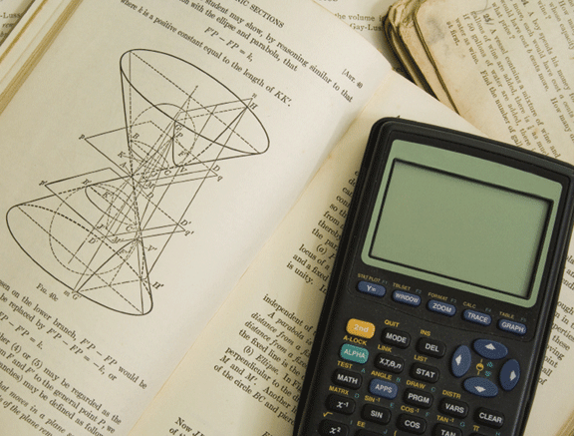
Example 3: Applications (cont.)
b. A student bought a calculator and a textbook for a total of $200.80 (including tax). If the textbook cost $20.50 more than the calculator, what was the cost of each item?
Solution
Let x = cost of the calculator,
then x + 20.50 = cost of the textbook.

Slide 23
Example 3: Applications (cont.)
The equation to be solved is:

Slide 24
Example 3: Applications (cont.)
The calculator costs $90.15 and the textbook costs $90.15 + $20.50 = $110.65, with tax included in each price.

