Slide 1
Section 3.1
Working with Formulas

Slide 2
Objectives
Evaluate formulas for given values of the variables.
Solve formulas for specified variables in terms of the other variables.
Use formulas to solve a variety of applications.

Slide 3
Working with Formulas
Notes
SPECIAL COMMENT: Be sure to use the letters just as they are given in the formulas. In mathematics, there is little or no flexibility between capital and small letters as they are used in formulas. In general, capital letters have special meanings that are different from corresponding small letters. For example, capital A may mean the area of a triangle and small a may mean the length of one side, two completely different ideas.

Slide 4
Working with Formulas
Formula | Meaning
I = Prt | The simple interest I earned by investing money is equal to the product of the principal P times the rate of interest r times the time t in one year or part of a year.
 | Temperature in degrees Celsius C equals times the difference between the Fahrenheit temperature F and 32.

Slide 5
Working with Formulas
Formula | Meaning
d = rt | The distance traveled d equals the product of the rate of speed r and the time t.
P = 2l + 2w | The perimeter P of a rectangle is equal to twice the length l plus twice the width w.

Slide 6
Working with Formulas
Formula | Meaning
L = 2π rh | The lateral surface area L (top and bottom not included) of a cylinder is equal to 2π times the radius r of the base times the height h.
F = ma | In physics, the force F acting on an object is equal to its mass m times its acceleration a.

Slide 7
Working with Formulas
Formula | Meaning
α + β + γ = 180° | The sum of the angles (α, β, and γ) of a triangle is 180°. Note: α, β, and γ are the Greek lowercase letters alpha, beta, and gamma, respectively.
P = a + b + c | The perimeter P of a triangle is equal to the sum of the lengths of the three sides a, b, and c.

Slide 8
Example 1: Evaluating Formulas
a. A note is a loan for a period of 1 year or less, and the interest earned (or paid) is called simple interest. A note involves only one payment at the end of the term of the note and includes both principal and interest. The formula for calculating simple interest is:
I = Prt
where
I = interest (earned or paid)
P = principal (the amount invested or borrowed)

Slide 9
Example 1: Evaluating Formulas (cont.)
r = rate of interest (stated as an annual or yearly rate)
t = time (one year or part of a year)
Note: The rate of interest is usually given in percent form and converted to decimal or fraction form for calculations. For the purpose of calculations, we will use 360 days in one year and 30 days in a month. Before the use of computers, this was common practice in business and banking.

Slide 10
Example 1: Evaluating Formulas (cont.)
Maribel loaned $5000 to a friend for 90 days at an annual interest rate of 8%. How much will her friend pay her at the end of the 90 days?
Solution
Here, P = $5000,
r = 8% = 0.08,
t = 90 days

Slide 11
Example 1: Evaluating Formulas (cont.)
Find the interest by substituting in the formula I = Prt and evaluating.
The interest is $100 and the amount to be paid at the end of 90 days is
principal + interest = $5000 + $100 = $5100.

Slide 12
Example 1: Evaluating Formulas (cont.)
b. Given the formula first find C if
F = 212° (212 degrees Fahrenheit) and then find F if C = 20° (20 degrees Celsius).
Solution F = 212°, so substitute 212 for F in the formula.
That is, 212°F is the same as 100°C. Water will boil at 212°F at sea level. This means that if the temperature is measured in degrees Celsius instead of degrees Fahrenheit, water will boil at 100°C at sea level.

Slide 13
Example 1: Evaluating Formulas (cont.)
C = 20°, so substitute 20 for C in the formula.
That is, a temperature of 20°C is the same as a comfortable spring day temperature of 68°F.
Now solve for F.
Multiply both sides by
Simplify.
Add 32 to both sides.
Simplify.

Slide 14
Example 1: Evaluating Formulas (cont.)
c. The lifting force F exerted on an airplane wing is found by multiplying some constant k by the area A of the wing’s surface and by the square of the plane’s velocity v. The formula is F = kAv². Find the force on a plane’s wing during take off if the area of
the wing is 120 ft², k is and the plane is traveling
80 miles per hour during take off.

Slide 15
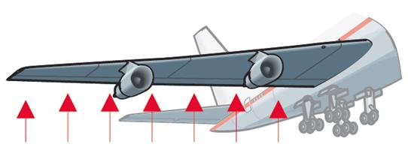
Example 1: Evaluating Formulas (cont.)
Solution
We know that A = 120, and v = 80. Substitution gives
The force is measured in pounds.

Slide 16
Example 1: Evaluating Formulas (cont.)
d. The perimeter of a triangle is 38 feet. One side is 5 feet long and a second side is 18 feet long. How long is the third side?
Solution
Using the formula P = a + b + c, substitute P = 38, a = 5, and b = 18.

Slide 17
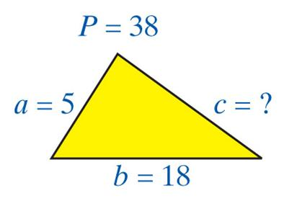
Example 1: Evaluating Formulas (cont.)
Then solve for the third side.
The third side is 15 feet long.

Slide 18
Example 2: Solving for Different Variables
a. Given d = rt, solve for t in terms of d and r. We want to represent the time in terms of distance and rate. We will use this concept later in word problems.
Solution
Treat r and d as if they were constants.
Divide both sides by r.
Simplify.

Slide 19
Example 2: Solving for Different Variables (cont.)
b. Given solve for P in terms of V and k.
Solution
Multiply both sides by P.
Simplify.
Divide both sides by V.
Simplify.

Slide 20
Example 2: Solving for Different Variables (cont.)
c. Given as in Example 1b, solve for F in
terms of C. This would give a formula for finding Fahrenheit temperature given a Celsius temperature value.
Solution
Treat C as a constant.
Multiply both sides by
Simplify.

Slide 21
Example 2: Solving for Different Variables (cont.)
Thus is solved for F, and is
solved for C. These are two forms of the same formula.
Add 32 to both sides.
Simplify.

Slide 22
Example 2: Solving for Different Variables (cont.)
d. Given the equation 2x + 4y = 10,
1. solve first for x in terms of y, and then
2. solve for y in terms of x.
This equation is typical of the algebraic equations that we will discuss in Chapter 4.
Solution 1. Solving for x yields
Treat 4y as a constant.
Subtract 4y from both sides.
(This is the same as adding −4y.)

Slide 23
Example 2: Solving for Different Variables (cont.)
Simplify.
2. Solving for y yields
Divide both sides by 2.
Simplify.
Treat 2x as a constant.
Subtract 2x from both sides.
Simplify.

Slide 24
Example 2: Solving for Different Variables (cont.)
or we can write
Divide both sides by 4.
Simplify.
All forms are correct.

Slide 25
Example 2: Solving for Different Variables (cont.)
e. Given 3x − y = 15, solve for y in terms of x.
Solution Solving for y gives
Subtract 3x from both sides.
Multiply both sides by −1 (or divide both sides by −1)
Simplify using the distributive property.

Slide 26
Practice Problems
1. 2x − y = 5; solve for y.
2. 2x − y = 5; solve for x.
3. solve for h.
4. L = 2π rh; solve for r.
5. P = 2l + 2w; solve for w.

Slide 27
Practice Problem Answers

