Slide 1
Section 3.2
Formulas in Geometry

Slide 2
Objectives
Recognize and use appropriate geometric formulas for computations.

Slide 3
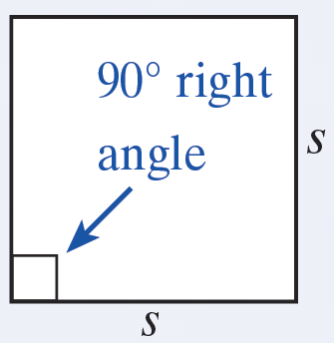
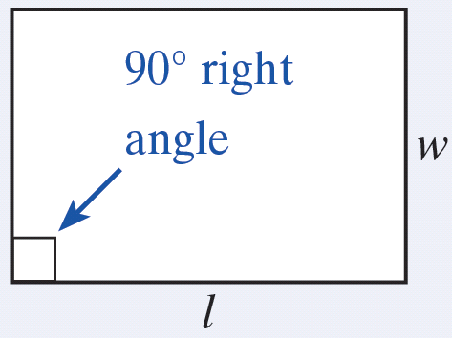
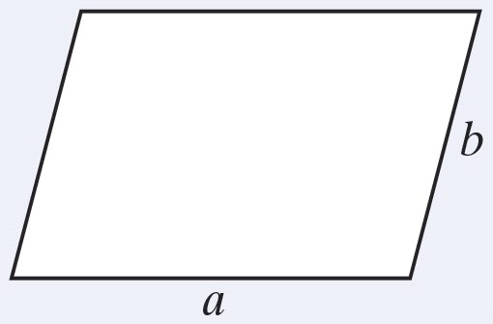
Perimeter
Formulas for Perimeter
Square
P = 4s
Rectangle
P = 2l + 2w
Parallelogram
P = 2a + 2b

Slide 4
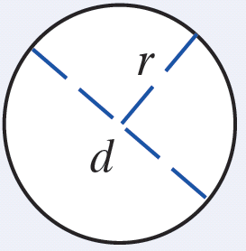
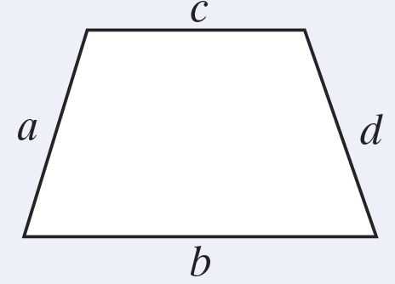
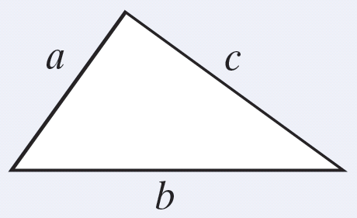
Perimeter
Formulas for Perimeter (cont.)
Circle
C = 2π r
C = π d
Trapezoid
P = a + b + c + d
Triangle
P = a + b + c

Slide 5
Perimeter
Terminology and Notation Related to Circles
Term | Notation | Definition
Circumference | C | The perimeter of a circle is called its circumference.
Radius | r | The distance from the center of a circle to any point on the circle is called the radius of the circle.

Slide 6
Perimeter
Terminology and Notation Related to Circles
Term | Notation | Definition
Diameter | d | The distance from one point on a circle to another point on the circle measured through its center is called the diameter of the circle. Note: The diameter is twice the radius: d = 2r.

Slide 7
Perimeter
Terminology and Notation Related to Circles
Term | Notation | Definition
Pi | π | π is a Greek letter used for the constant 3.1415926535… (π is an irrational number.)

Slide 8
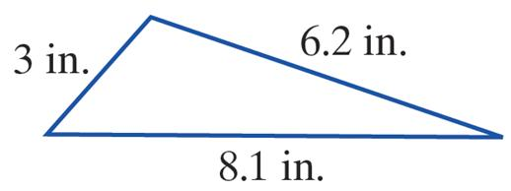
Example 1: Perimeter
a. Find the perimeter of the triangle with sides labeled as in the figure.
Solution
The perimeter is 17.3 inches.

Slide 9
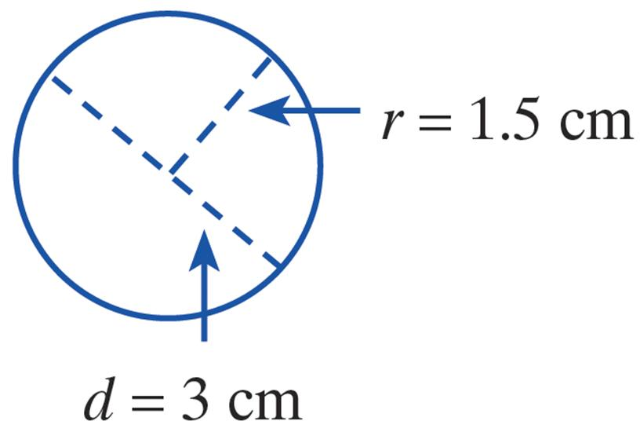
Example 1: Perimeter (cont.)
b. Find the circumference of a circle with a diameter of 3 centimeters.
Solution
Method 1: Sketch the figure.

Slide 10
Example 1: Perimeter (cont.)
Method 2: Sketch the figure.
Note that the result is the same with either formula. The circumference is approximately 9.42 centimeters.

Slide 11
Example 2: Perimeter
The perimeter of a football field is 1040 feet. If the length is 360 feet, what is the width?
Solution
Substitute 1040 for P and 360 for l.
Simplify.
Subtract 720 from both sides.
Simplify.

Slide 12
Example 2: Perimeter (cont.)
Divide both sides by 2.
Simplify.
The width of the field is 160 feet.

Slide 13
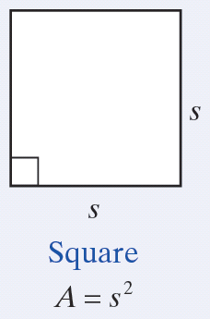
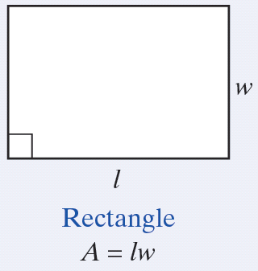
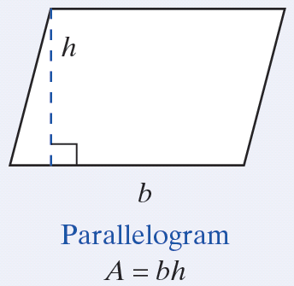
Area
Formulas for Area

Slide 14
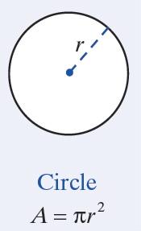
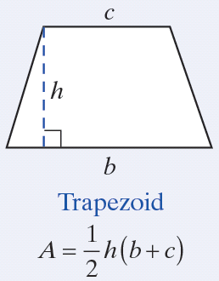
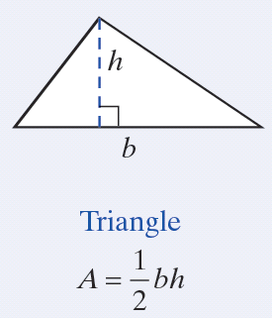
Area
Formulas for Area (cont.)

Slide 15
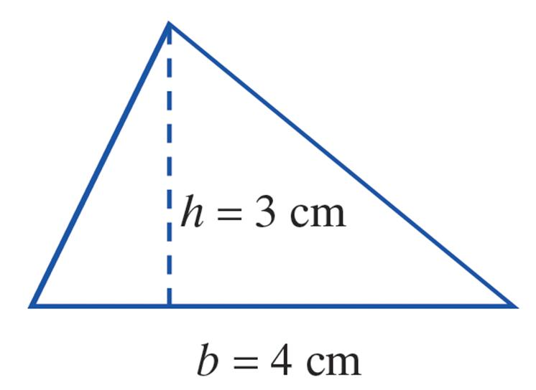
Example 3: Area
a. Find the area of a triangle with a height of 3 cm and a base of 4 cm.
Solution Sketch the figure.
The area is 6 cm².

Slide 16
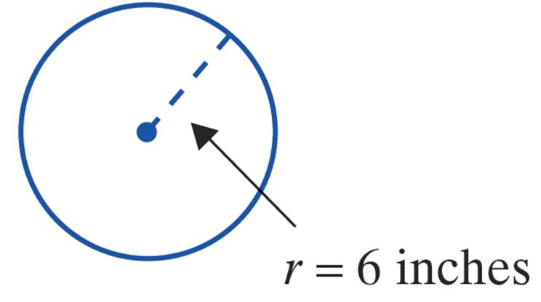
Example 3: Area (cont.)
b. Find the area of a circle with a radius of 6 inches. (Use π = 3.14.)
Solution Sketch the figure.
The area is approximately 113.04 square inches.

Slide 17
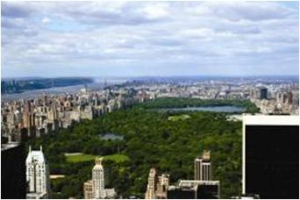
Example 4: Area
Central Park in New York City is rectangular in shape and has an area of approximately 1.25 square miles. If it is 2.5 miles long, how wide is it?
Solution
The width of the park is 0.5 miles.
Substitute 1.25 for A and 2.5 for l.
Divide both sides by 2.5.

Slide 18
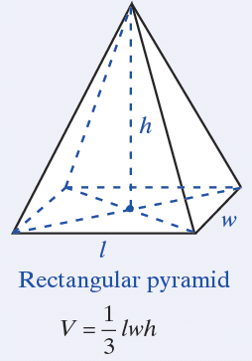
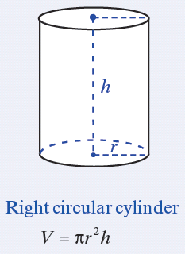
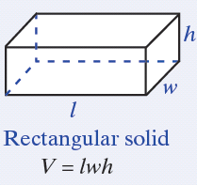
Volume
Formulas for Volume

Slide 19
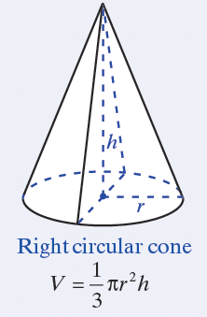
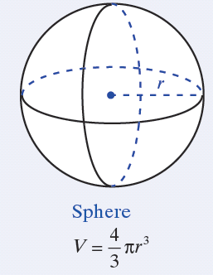
Volume
Formulas for Volume (cont.)

Slide 20
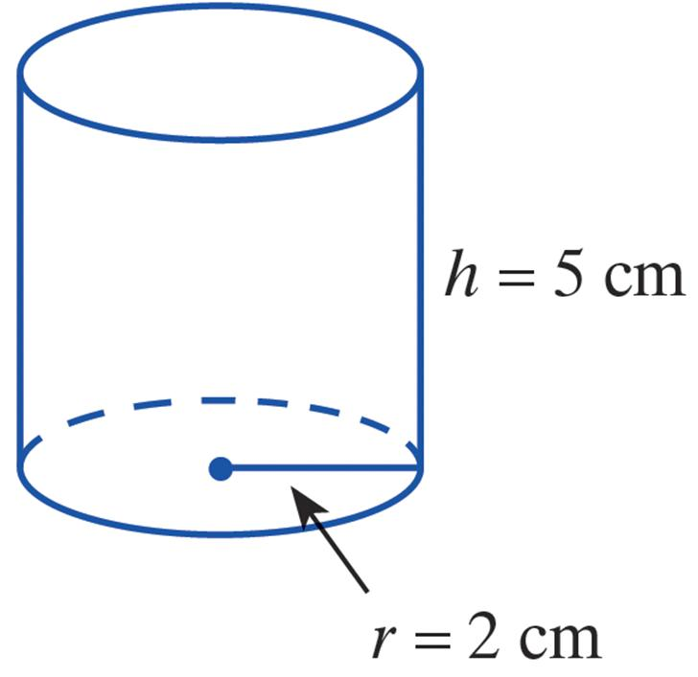
Example 5: Volume
a. Find the volume of a right circular cylinder with a radius of 2 centimeters and a height of 5 centimeters.
Solution Sketch the figure.
The volume is approximately 62.80 cubic centimeters.

Slide 21
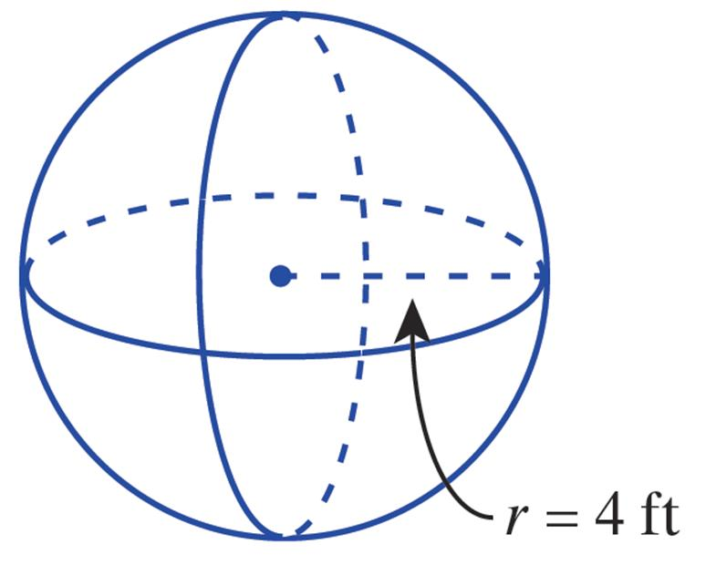
Example 5: Volume (cont.)
b. Find the volume of a sphere with a radius of 4 feet.
Solution Sketch the figure.
The volume is approximately 267.95 cubic feet.

Slide 22
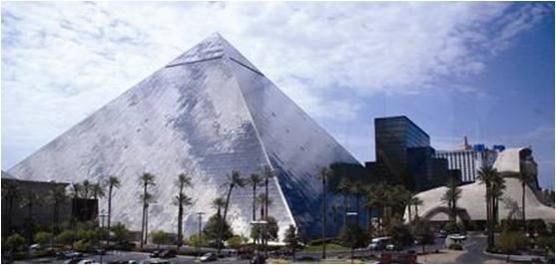
Example 6: Volume
The Luxor Hotel in Las Vegas is 30 stories tall and shaped like a pyramid. Its volume is approximately 36 million square feet. If the base of the hotel is a square with sides 556 ft long, what is the approximate height of the pyramid? (Round your answer to the nearest integer.)

Slide 23
Example 6: Volume (cont.)
Solution
The height is approximately 349 feet.
Substitute 36,000,000 for V and 556 for l and w.
Simplify.
Multiply both sides by

Slide 24
Practice Problems
1. Find the area of a square with sides 4 cm long.
2. Find the area of a circle with a diameter 6 in.
3. Find the perimeter of a rectangle 3.5 m long and 1.6 m wide.
4. Find the volume of a rectangular solid with a length of 16 ft, a width of 10 ft, and a height of 1.4 ft.

Slide 25
Practice Problem Answers
1. 16 cm²
2. 28.26 in.² (or exactly 9π in.²)
3. 10.2 m
4. 224 ft³

