Slide 1
Section 3.3
Applications: Distance-Rate-Time, Interest, Average

Slide 2
Objectives
Solve the following types of problems using linear equations:
Distance-rate-time problems,
Simple interest problems,
Average problems, and
Cost problems.

Slide 3
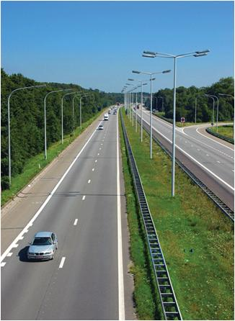
Example 1: Distance-Rate-Time
A motorist averaged 45 mph for the first part of a trip and 54 mph for the last part of the trip. If the total trip of 303 miles took 6 hours, what was the time for each part?
Solution
Analysis of strategy:
What is being asked for?
Total time minus time for 1st part of
trip gives time for 2nd part of trip.

Slide 4
Example 1: Distance-Rate-Time (cont.)
Let t = time for 1st part of trip
6 − t = time for 2nd part of trip
rate · time = distance
1st Part | 45 | t | 45t
2nd Part | 54 | 6 – t | 54(6 − t)

Slide 5
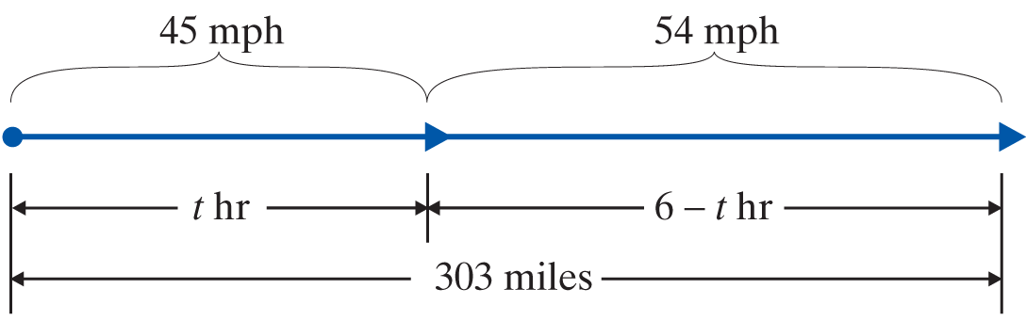
Example 1: Distance-Rate-Time (cont.)
45t + 54(6 − t) = 303

Slide 6
Example 1: Distance-Rate-Time (cont.)

Slide 7
Example 1: Distance-Rate-Time (cont.)

Slide 8
Example 2: Interest
Kara has had $40,000 invested for one year, some in a savings account which paid 7% and the rest in a high-risk stock which yielded 12% for the year. If her interest income last year was $3550, how much did she have in the savings account and how much did she invest in the stock?
Solution
Let x = amount invested at 7%
40,000 − x = amount invested at 12%
Total amount invested minus amount invested at 7% represents amount invested at 12%.

Slide 9
Example 2: Interest (cont.)
principle · rate = interest
Savings Account | x | 0.07 | 0.07(x)
Stock | 40,000 – x | 0.12 | 0.12(40,000 – x)

Slide 10
Example 2: Interest (cont.)
Multiply both sides of the equation by 100 to eliminate the decimal.
Amount invested at 7%
Amount invested at 12%
Check
and $1750 + $1800 = $3550.
Kara had $25,000 in the savings account at 7% interest and invested $15,000 in the stock at 12% interest.

Slide 11
Example 3: Average (or Mean)
Suppose that you have scores of 85, 92, 82 and 88 on four exams in your English class. What score will you need on the fifth exam to have an average of 90?
Solution
Let x = your score on the fifth exam.
The sum of all the scores, including the unknown fifth exam, divided by 5 must equal 90.

Slide 12
Example 3: Average (or Mean) (cont.)
Assuming that each exam is worth 100 points, you cannot attain an average of 90 on the five exams.

Slide 13
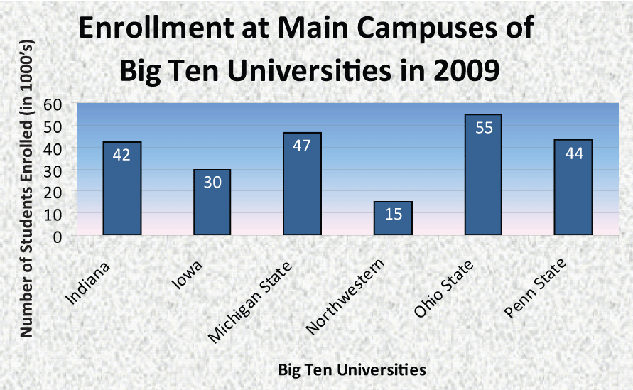
Example 4: Bar Graphs
The bar graph shows the enrollment at the main campuses at six Big Ten universities. Use the graph to find the following (note that the units on the graph are in thousands):

Slide 14
Example 4: Bar Graphs (cont.)
a. Find the average enrollment over the six schools. (Round to the nearest thousand.)
Solution
Find the sum: 42 + 30 + 47 + 15 + 55 + 44 = 233.
Divide by 6: 233 ÷ 6 ≈ 39.
The average enrollment is approximately 39,000 students.

Slide 15
Example 4: Bar Graphs (cont.)
b. Which university has the lowest enrollment?
Solution
Northwestern has the lowest enrollment: 15,000 students.
c. Find the difference in enrollment between Ohio State and Penn State.
Solution
The difference is 55,000 − 44,000 = 11,000 students.

Slide 16
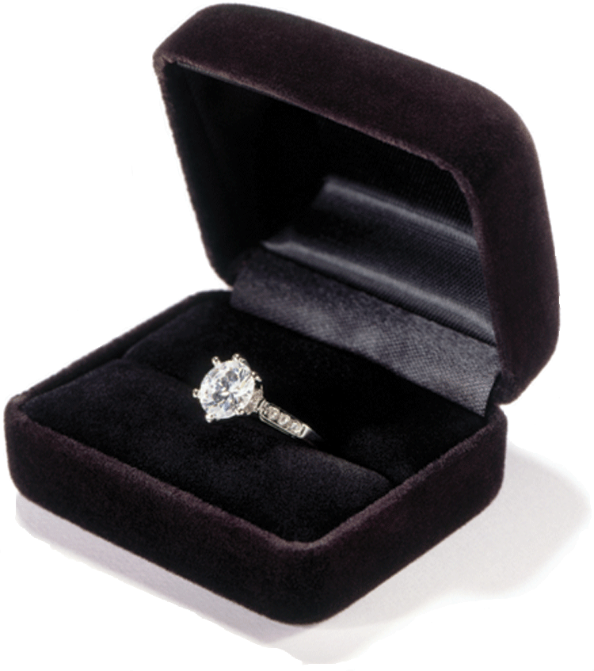
Example 5: Cost
A jeweler paid $350 for a ring. He wants to price the ring for sale so that he can give a 30% discount on the marked selling price and still make a profit of 20% on his cost. What should be the marked selling price of the ring?
Solution
Again, we make use of the relationship
S − C = P (selling price − cost = profit).

Slide 17
Example 5: Cost (cont.)
Let x = marked selling price,
then x − 0.30x = actual selling price
and 350 = cost.
The actual selling price is the marked selling price minus the 30% discount on the ring.
The profit is 20% of what he paid originally.

Slide 18
Example 5: Cost (cont.)

Slide 19
Example 5: Cost (cont.)

