Slide 1
Section 3.4
Linear Inequalities

Slide 2
Objectives
Understand and use set-builder notation.
Understand and use interval notation.
Solve linear inequalities.
Solve compound inequalities.

Slide 3
Sets and Set-Builder Notation
Notes
Special Comments about Union and Intersection
The concepts of union and intersection are part of set theory which is very useful in a variety of courses including abstract algebra, probability, and statistics. These concepts are also used in analyzing inequalities and analyzing relationships among sets in general.

Slide 4
Sets and Set-Builder Notation
Notes (cont.)
The union (symbolized ∪, as in A ∪ B) of two (or more) sets is the set of all elements that belong to either one set or the other set or to both sets. The intersection (symbolized ∩, as in A ∩ B) of two (or more) sets is the set of all elements that belong to both sets. The word or is used to indicate union and the word and is used to indicate intersection. For example, if A = {1, 2, 3} and
B = {2, 3, 4}, then the numbers that belong to A or B is the set A ∪ B = {1, 2, 3, 4}. The set of numbers that belong to A and B is the set A ∩ B = {2, 3}.

Slide 5
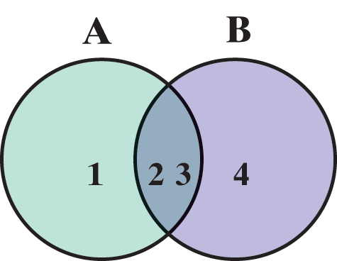
Sets and Set-Builder Notation
Notes (cont.)
These relationships can be illustrated using the following Venn diagram.

Slide 6
Sets and Set-Builder Notation
Notes (cont.)
Similarly, union and intersection notation can be used for sets with inequalities.
For example, can be written in the form
Also, can be written in the form

Slide 7


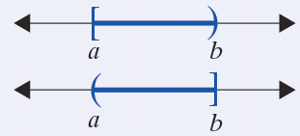
Intervals of Real Numbers
Type of Interval | Algebraic Notation | Interval Notation | Graph
Open Interval | a < x < b | (a, b)
Closed Interval | a ≤ x ≤ b | [a, b]
Half-open Interval

Slide 8
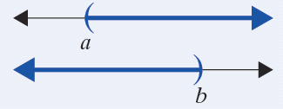
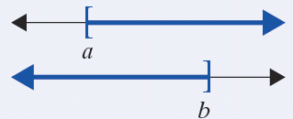
Intervals of Real Numbers
Type of Interval | Algebraic Notation | Interval Notation | Graph
Open Interval
Half-open Interval

Slide 9
Intervals of Real Numbers
Notes
The symbol for infinity ∞ (or −∞) is not a number. It is used to indicate that the interval is to include all real numbers from some point on (either in the positive direction or the negative direction) without end.

Slide 10
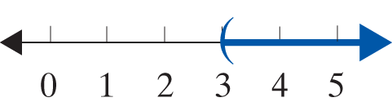
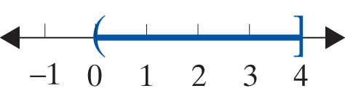
Example 1: Graphing Intervals
a. Graph the open interval
Solution
b. Graph the half-open interval
Solution

Slide 11
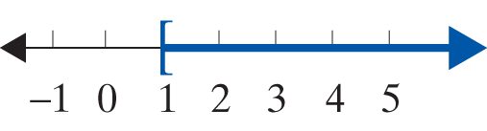
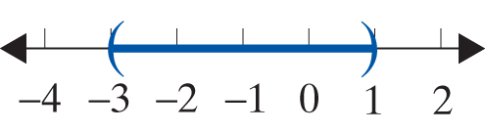
Example 1: Graphing Intervals (cont.)
c. Represent the following graph using algebraic notation, and state what kind of interval it is.
Solution x ≥ 1 is a half-open interval.
d. Represent the following graph using interval notation, and state what kind of interval it is.
Solution (−3, 1) is an open interval.

Slide 12
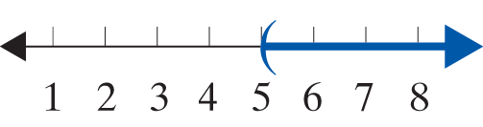
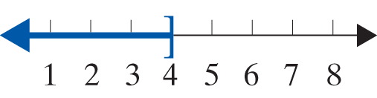
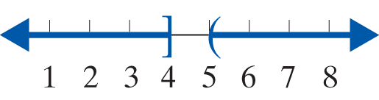
Example 2: Sets of Real Numbers Illustrating Union
Graph the set {x|x > 5 or x ≤ 4}. The word or implies those values of x that satisfy at least one of the inequalities.
Solution x > 5
x ≤ 4
x > 5 or x ≤ 4
The solution graph shows the union ∪ of the first two graphs.

Slide 13
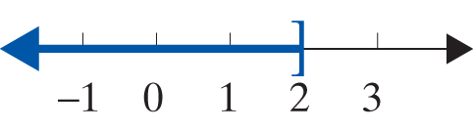
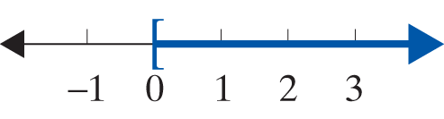
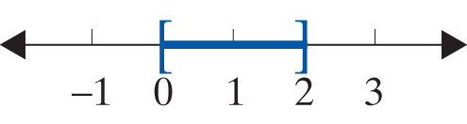
Example 3: Sets of Real Numbers Illustrating Intersection
Graph the set {x|x ≤ 2 and x ≥ 0}. The word and implies those values of x that satisfy both inequalities.
Solution x ≤ 2
x ≥ 0
x ≤ 2 and x ≥ 0

Slide 14
Example 3: Sets of Real Numbers Illustrating Intersection (cont.)
The solution graph shows the intersection ∩ of the first two graphs. In other words, the third graph shows the points in common between the first two graphs in this example.
This set can also be indicated as {x|0 ≤ x ≤ 2}.

Slide 15
Solving Linear Inequalities
Linear Inequalities
Inequalities of the given form, where a, b, and c are real numbers and a ≠ 0,
ax + b < c and ax + b ≤ c
ax + b > c and ax + b ≥ c
are called linear inequalities.
The inequalities c < ax + b < d and c ≤ ax + b ≤ d are called compound linear inequalities. (This includes c < ax + b ≤ d and c ≤ ax + b < d as well.)

Slide 16
Solving Linear Inequalities
Rules for Solving Linear Inequalities
1. Simplify each side of the inequality by removing any grouping symbols and combining like terms.
2. Use the addition property of equality to add the opposites of constants or variable expressions so that variable expressions are on one side of the inequality and constants are on the other.

Slide 17
Solving Linear Inequalities
Rules for Solving Linear Inequalities (cont.)
3. Use the multiplication property of equality to multiply both sides by the reciprocal of the coefficient of the variable (that is, divide both sides by the coefficient) so that the new coefficient is 1. If this coefficient is negative, reverse the sense of the inequality.
4. A quick (and generally satisfactory) check is to select any one number in your solution and substitute it into the original inequality.

Slide 18
Example 4: Solving Linear Inequalities
Solve the following linear inequalities and graph the solution set. Write the solution set using interval notation. Assume that x is a real number.
a. 6x + 5 ≤ −1
Solution

Slide 19
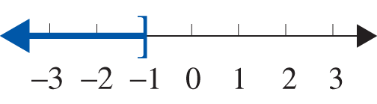
Example 4: Solving Linear Inequalities (cont.)
Use interval notation. Note that the interval (−∞, −1] is a half-open interval.

Slide 20
Example 4: Solving Linear Inequalities (cont.)
Solution

Slide 21
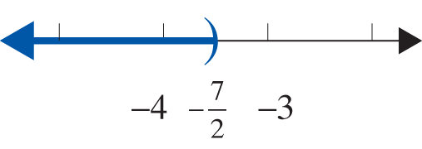
Example 4: Solving Linear Inequalities (cont.)
Use interval notation. Note that the interval
is an open interval.

Slide 22
Example 4: Solving Linear Inequalities (cont.)
Solution

Slide 23
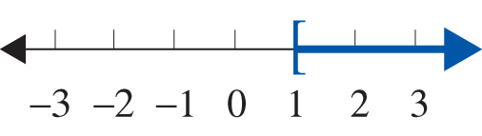
Example 4: Solving Linear Inequalities (cont.)
Use interval notation. Note that the interval [1, ∞) is a half-open interval.

Slide 24
Example 4: Solving Linear Inequalities (cont.)
Solution

Slide 25
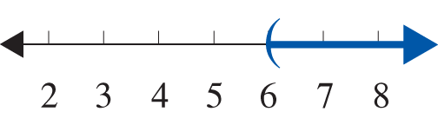
Example 4: Solving Linear Inequalities (cont.)
Use interval notation. Note that the interval (6, ∞) is an open interval.

Slide 26
Example 5: Solving Compound Inequalities
a. Solve the compound inequality −5 ≤ 4x − 1 < 11 and graph the solution set. Write the solution set using interval notation. Assume that x is a real number.
Solution

Slide 27
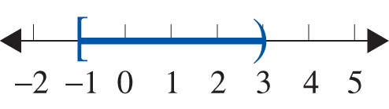
Example 5: Solving Compound Inequalities (cont.)
The solution set is the half-open interval [−1, 3).

Slide 28
Example 5: Solving Compound Inequalities (cont.)
b. Solve the compound inequality 5 ≤ −3 − 2x ≤ 13 and graph the solution set. Write the solution set using interval notation. Assume that x is a real number.
Solution

Slide 29
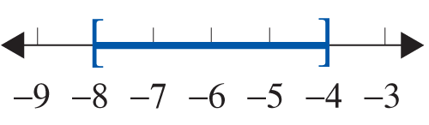
Example 5: Solving Compound Inequalities (cont.)
The solution set is the closed interval [−8, −4].

Slide 30
Example 5: Solving Compound Inequalities (cont.)
c. Solve the compound inequality and
graph the solution set. Write the solution set using interval notation. Assume that x is a real number.
Solution

Slide 31
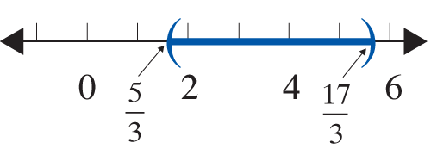
Example 5: Solving Compound Inequalities (cont.)

Slide 32

Example 6: Application with an Inequality
A math student has grades of 85, 98, 93, and 90 on four examinations. If he must average 90 or better to receive an A for the course, what scores can he receive on the final exam and earn an A? (Assume that the final exam counts the same as the other exams.)
Solution
Let x = score on final exam.
The average is found by adding the
scores and dividing by 5.

Slide 33
Example 6: Application with an Inequality (cont.)
If the student scores 84 or more on the final exam, he will average 90 or more and receive an A in math.

Slide 34

Example 7: Application with an Inequality
Ellen is going to buy 30 stamps, some 28-cent and some 44-cent. If she has $9.68, what is the maximum number of 44-cent stamps she can buy?
Solution
Let x = number of 44-cent stamps,
then 30 − x = number of 28-cent stamps.
Ellen cannot spend more than $9.68.

Slide 35
Example 7: Application with an Inequality (cont.)
Ellen can buy at most eight 44-cent stamps if she buys a total of 30 stamps.

Slide 36
Practice Problems
Graph each set of real numbers on a real number line.
Solve each of the following inequalities and graph the solution sets. Write each solution set in interval notation. Assume that x is a real number.

Slide 37




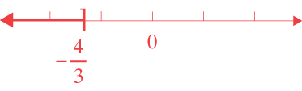

Practice Problem Answers
1. 2.
3. 4. (−∞, −4)
5.
6. [−3, 4)

