Slide 1
Section 3.5
Absolute Value Equations and Inequalities

Slide 2
Objectives
Solve absolute value equations.
Solve equations with two absolute value expressions.
Solve absolute value inequalities.

Slide 3
Absolute Value Equations
Absolute Value
For any real number x,

Slide 4
Absolute Value Equations
Solving Absolute Value Equations
For c > 0:
Note: If the absolute value expression is isolated on one side of the equation, we say that the equation is in standard form. You may need to manipulate the absolute value equation to get it into standard form before you can solve it. (See Example 1d.)

Slide 5
Example 1: Solving Absolute Value Equations
Solve the following equations involving absolute value.
Solution x = 5 or x = −5
Solution

Slide 6
Example 1: Solving Absolute Value Equations (cont.)
Solution
There is no number that has a negative absolute value. Therefore, this equation has no solution. (The solution is ∅ and the equation is a contradiction.)

Slide 7
Example 1: Solving Absolute Value Equations (cont.)
Solution

Slide 8
Equations with Two Absolute Value Expressions
Solving Equations with Two Absolute Value Expressions
If then either a = b or a = −b.
More generally,
if then either ax + b = cx + d or
ax + b = −(cx + d).

Slide 9
Example 2: Solving Equations with Two Absolute Value Expressions
Solution
In this case, the two expressions (x + 5) and (2x + 1) are equal to each other or are opposites of each other.
Note the use of parentheses. We want the opposite of the entire expression (2x + 1).
Make sure to check that both 4 and −2 satisfy the original equation.

Slide 10
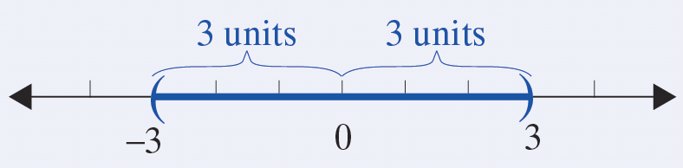
Absolute Value Inequalities
Algebraic Notation | Graph | Interval Notation
|x| < 3 −3 < x < 3 (the intersection) |  | (−3, 3)

Slide 11
Absolute Value Inequalities
Solving Absolute Value Inequalities with < (or ≤)
For c > 0:
a. If then −c < x < c.
b. If then −c < ax + b < c.
The inequalities in a. and b. are also true if < is replaced by ≤.

Slide 12
Absolute Value Inequalities
Solving Absolute Value Inequalities with < (or ≤) (cont.)
Note: If the absolute value expression is isolated on one side of the inequality, we say that the inequality is in standard form. You may need to manipulate the absolute value inequality to get it into standard form before you can solve it. (See Example 3c and 3e.)

Slide 13
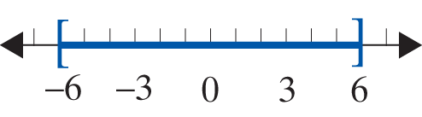
Example 3: Solving Absolute Value Inequalities
Solve the following absolute value inequalities and graph the solution sets.
Solution

Slide 14
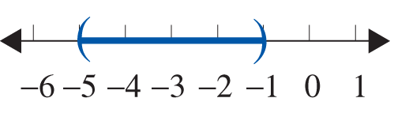
Example 3: Solving Absolute Value Inequalities (cont.)
Solution

Slide 15
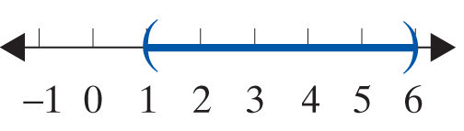
Example 3: Solving Absolute Value Inequalities (cont.)
Solution
Divide both sides by 3 in order to get the inequality in standard form. Remember, we must get the expression in standard form before solving any absolute value inequality.

Slide 16
Example 3: Solving Absolute Value Inequalities (cont.)
Solution
Since absolute value is always nonnegative (greater than or equal to 0), no number has an absolute value
less than Thus there is no solution, ∅.

Slide 17
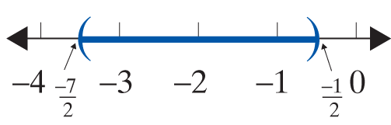
Example 3: Solving Absolute Value Inequalities (cont.)
Solution
Add −4 to both sides in order to get the expression in standard form.

Slide 18
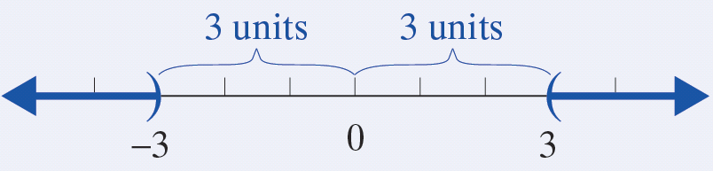
Absolute Value Inequalities
Algebraic Notation | Graph | Interval Notation
|x| > 3 x > 3 or x < −3 (the union) |  | (−∞, −3 )∪(3, ∞)

Slide 19
Absolute Value Inequalities
Notes
The expression x > 3 or x < −3 cannot be combined into one inequality expression. The word or must separate the inequalities since any number that satisfies one or the other is a solution to the absolute value inequality. There are no numbers that satisfy both inequalities.

Slide 20
Absolute Value Inequalities
Solving Absolute Value Inequalities with > (or ≥)
For c > 0:
a. If then x < −c or x > c.
b. If then ax + b < −c or ax + b > c.
The inequalities in a. and b. are true if > is replaced by ≥.

Slide 21
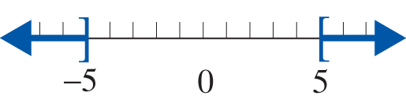
Example 4: Solving Absolute Value Inequalities
Solve the following absolute value inequalities and graph the solution set.
Solution

Slide 22
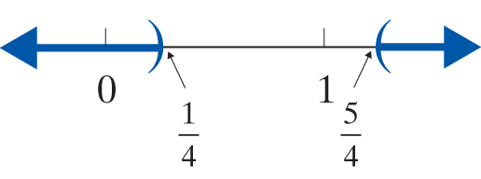
Example 4: Solving Absolute Value Inequalities (cont.)
Solution

Slide 23

Example 4: Solving Absolute Value Inequalities (cont.)
Solution
There is nothing to do here except observe that no matter what is substituted for x, the absolute value will be greater than −6. Absolute value is always nonnegative (greater than or equal to 0). The solution to the inequality is all real numbers, so shade the entire number line. In interval notation, x is in (−∞, ∞).

Slide 24
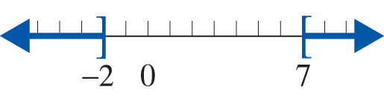
Example 4: Solving Absolute Value Inequalities (cont.)
Solution
Add 5 to both sides in order to get the inequality in standard form.

Slide 25
Practice Problems
Solve the following equations.
1. 2.
3. 4.
Solve the following absolute value inequalities and graph the solution sets.
5. 6. 7.

Slide 26

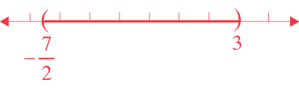

Practice Problem Answers
1. x = −10 or x = 10 2. x = −3.6 or x = 4.6
3. No solution 4.
5. [−1, 13]
6.
7.

