Slide 1
Section 4.1
The Cartesian Coordinate System

Slide 2
Objectives
Graph and label ordered pairs of real numbers as points on a plane.
Find ordered pairs of real numbers that satisfy a given equation.
Locate points on a given graph of a line.

Slide 3
Graphing Ordered Pairs
One-to-One Correspondence
There is a one-to-one correspondence between points in a plane and ordered pairs of real numbers.

Slide 4
Example 1: Graphing Ordered Pairs
Graph the sets of ordered pairs.
a. {A(−2, 1), B(−1, −4), C(0, 2), D(1, 3), E(2, −3)}
Note: The listing of ordered pairs within the braces can be in any order.
Solution:
To locate points: start at the origin (0, 0), move left or right for the x-coordinate and up or down for the y-coordinate.
For A(−2, 1), move 2 units left and 1 unit up.
For B(−1, −4), move 1 unit left and 4 units down.
For C(0, 2), move no units left or right and 2 units up.

Slide 5
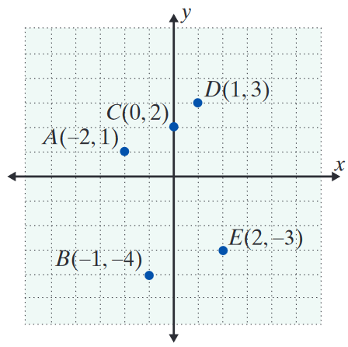
Example 1: Graphing Ordered Pairs (cont.)
For D(1, 3), move 1 unit right and 3 units up.
For E(2, −3), move 2 units right and 3 units down.

Slide 6
Example 1: Graphing Ordered Pairs (cont.)
b. {A(−1, 3), B(0, 1), C(1, −1), D(2, −3), E(3, −5)}
Solution:
To locate each point, start at the origin, and:
For A(−1, 3), move 1 unit left and 3 units up.
For B(0, 1), move no units left or right and 1 unit up.
For C(1, −1), move 1 unit right and 1 unit down.

Slide 7
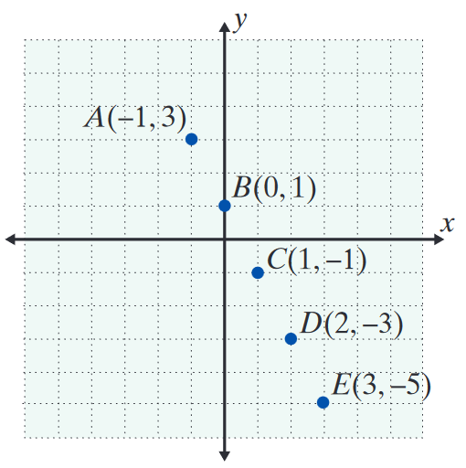
Example 1: Graphing Ordered Pairs (cont.)
For D(2, −3), move 2 units right and 3 units down.
For E(3, −5), move 3 units right and 5 units down.

Slide 8
Example 2: Determining Ordered Pairs
a. Determine which, if any, of the ordered pairs (0, −2),
and (2, 5) satisfy the equation y = 3x − 2.
Solution:
We will substitute 0, and 2 for x in the equation
y = 3x − 2 and see if the corresponding y-values match those in the given ordered pairs.

Slide 9
Example 2: Determining Ordered Pairs (cont.)
The point (2, 5) does not satisfy the equation y = 3x − 2 because, as just illustrated, y = 4 when x = 2, not 5.

Slide 10
Example 2: Determining Ordered Pairs (cont.)
b. Determine the missing coordinate in each of the following ordered pairs so that the point will satisfy the equation 2x + 3y = 12:
(0, ), (3, ), ( , 0), ( , −2).
Solution:
The missing value can be found by substituting the given value for x (or for y) into the equation
2x + 3y = 12 and solving for the other variable.

Slide 11
Example 2: Determining Ordered Pairs (cont.)

Slide 12
Example 2: Determining Ordered Pairs (cont.)

Slide 13
Example 2: Determining Ordered Pairs (cont.)
c. Complete the table below so that each ordered pair will satisfy the equation y = 1 − 2x.
Solution:
Substituting each given value for x and y into the equation y = 1 − 2x gives the following table of ordered pairs.
x | y = 1 − 2x | y | (x, y)
0
 |  | 3
5

Slide 14
Example 2: Determining Ordered Pairs (cont.)

Slide 15
Example 2: Determining Ordered Pairs (cont.)
x | y = 1 − 2x | y | (x, y)
0 | 1 = 1 − 2(0) | 1 | (0, 1)
−1 | 3 = 1 − 2(−1) | 3 | (−1, 3)
 | 0 = 1 − 2 | 0
5 | 1 = 1 − 2(5) | −9 | (5, −9)

Slide 16
Graphing Ordered Pairs
Notes
Although this discussion is related to ordered pairs of real numbers, most of the examples use ordered pairs of integers. This is because ordered pairs of integers are relatively easy to locate on a graph and relatively easy to read from a graph. Ordered pairs with fractions, decimals, or radicals must be located by estimating the positions of the points.

Slide 17
Graphing Ordered Pairs
Notes (cont.)
The precise coordinates intended for such points can be difficult or impossible to read because large dots must be used so the points can be seen. Even with these difficulties, you should understand that we are discussing ordered pairs of real numbers and that points with fractions, decimals, and radicals as coordinates do exist and should be plotted by estimating their positions.

Slide 18
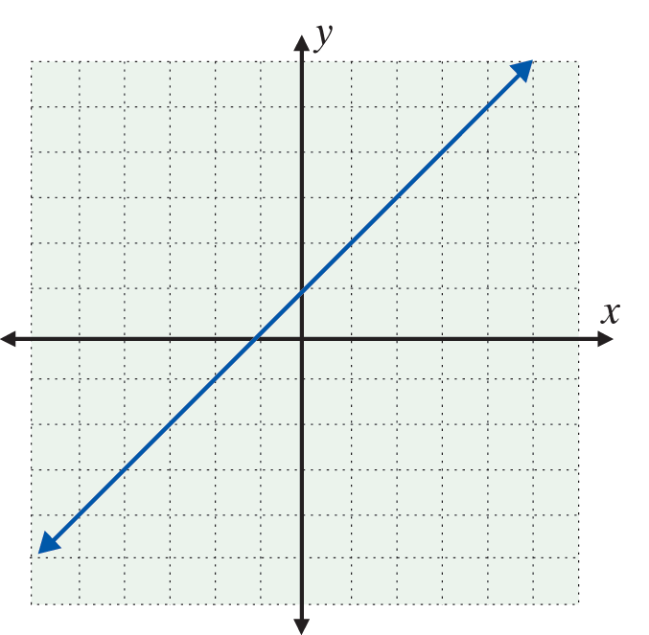
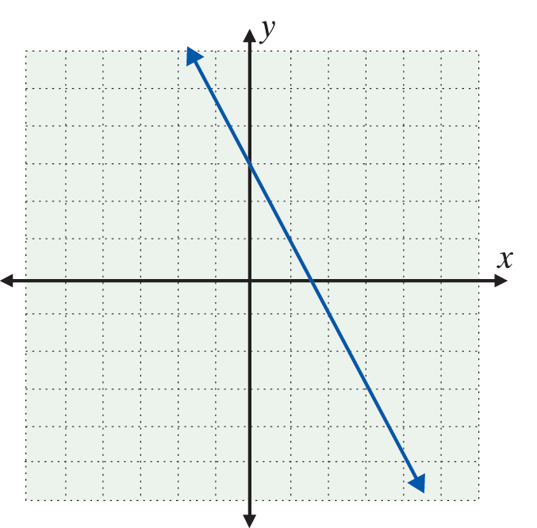
Example 3: Reading Points on a Graph
The graphs of two lines are given. Each line contains an infinite number of points. Use the grid to help you locate (or estimate) three points on each line.
a. b.

Slide 19
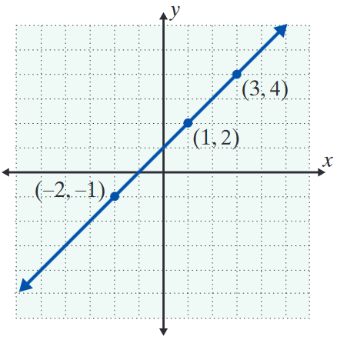
Example 3: Reading Points on a Graph (cont.)
Solution:
Three points on this graph are (−2, −1), (1, 2), and (3, 4).
  (Of course there is more than one correct answer to this type of question. Use your own judgment.)

Slide 20
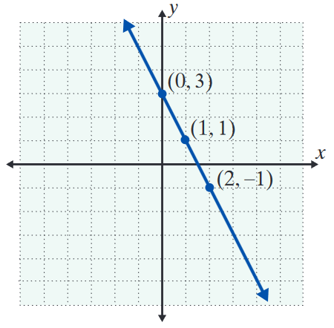
Example 3: Reading Points on a Graph (cont.)
Solution:
Three points on this graph are (0, 3), (1, 1), and (2, −1). (You may also estimate with fractions. For example, one point appears to
  be

Slide 21
Practice Problems
1. Determine which ordered pairs satisfy the equation 3x + y = 14.
a. (5, −1) b. (4, 2) c. (−1, 17)
2. Given 3x + y = 5, find the missing coordinate of each ordered pair so that it will satisfy the equation.
a. (0, ) b. c. ( , 2)

Slide 22
Practice Problems (cont.)
3. Complete the table so that each ordered pair will
satisfy the equation

Slide 23
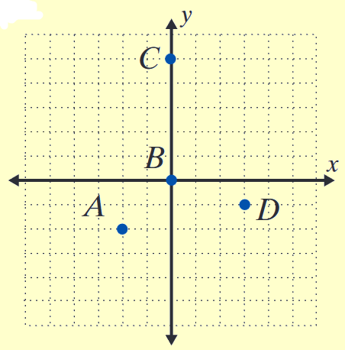
Practice Problems (cont.)
4. List the sets of ordered pairs corresponding to the points on the graph.

Slide 24
Practice Problem Answers
1. All satisfy the equation.
2. a. ( 0, 5 ) b. c. ( 1, 2 )
3.
4.

