Slide 1
Section 4.2
Graphing Linear Equations in Two Variables: Ax + By = C

Slide 2
Objectives
Plot points that satisfy a linear equation and draw the corresponding line.
Recognize the standard form of a linear equation in two variables: Ax + By = C
Find the x-intercept and y-intercept of a line and graph the corresponding line.

Slide 3
The Standard Form: Ax + By = C
Standard Form of a Linear Equation
Any equation of the form
Ax + By = C,
where A, B, and C are real numbers and A and B are not both equal to 0, is called the standard form of a linear equation.

Slide 4
The Standard Form: Ax + By = C
Notes
Note that in the standard form Ax + By = C, A and B may be positive, negative, or 0, but A and B cannot both equal 0.

Slide 5
The Standard Form: Ax + By = C
To Graph a Linear Equation in Two Variables
1. Locate any two points that satisfy the equation. (Choose values for x and y that lead to simple solutions. Remember that there is an infinite number of choices for either x or y. But, once a value for x or y is chosen, the corresponding value for the other variable is found by substituting into the equation.)
2. Plot these two points on a Cartesian coordinate system.

Slide 6
The Standard Form: Ax + By = C
To Graph a Linear Equation in Two Variables (cont.)
3. Draw a line through these two points. (Note: Every point on that line will satisfy the equation.)
4. To check: Locate a third point that satisfies the equation and check to see that it does indeed lie on the line.

Slide 7
Example 1: Graphing a Linear Equation in Two Variables
Graph each of the following linear equations.
a. 2x + 3y = 6
Solution
Make a table with headings x and y and, whenever possible, choose values for x or y that lead to simple solutions for the other variable. (Values chosen for x and y are shown in red.)

Slide 8
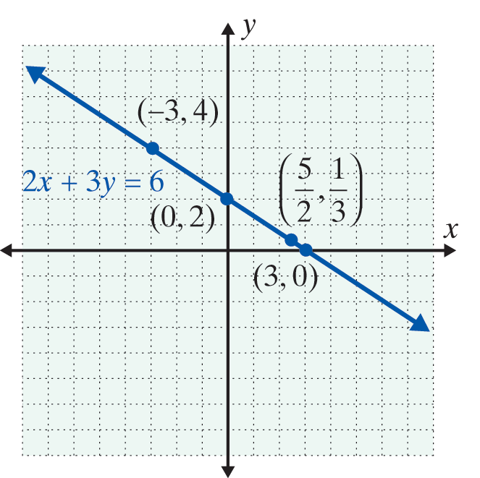
Example 1: Graphing a Linear Equation in Two Variables (cont.)

Slide 9
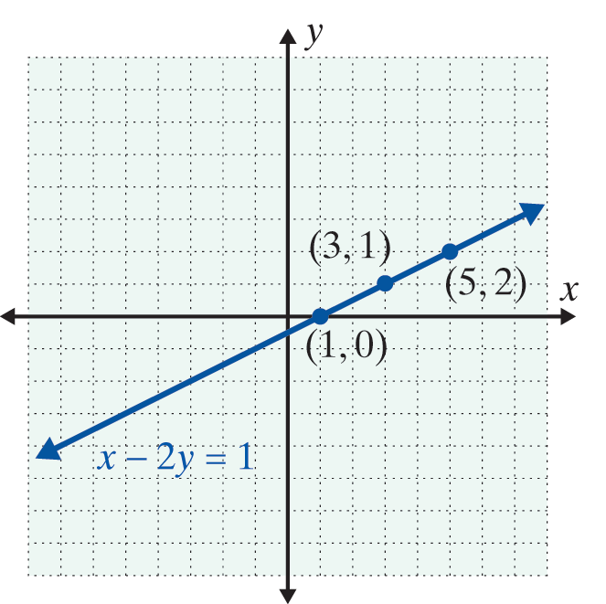
Example 1: Graphing a Linear Equation in Two Variables (cont.)
b. x − 2y = 1
Solution
Solve the equation for x (x = 2y + 1) and substitute 0, 1, and 2 for y.

Slide 10
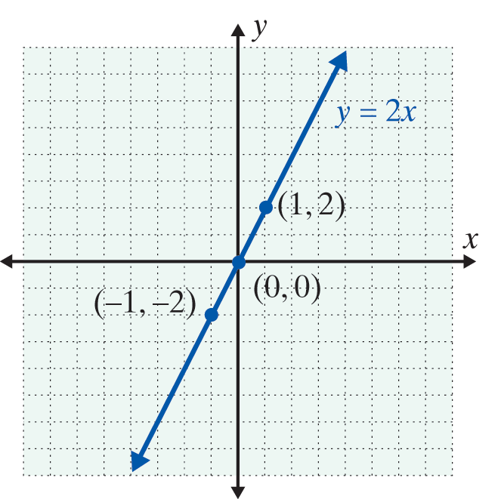
Example 1: Graphing a Linear Equation in Two Variables (cont.)
c. y = 2x
Solution
Substitute −1, 0, and 1 for x.

Slide 11
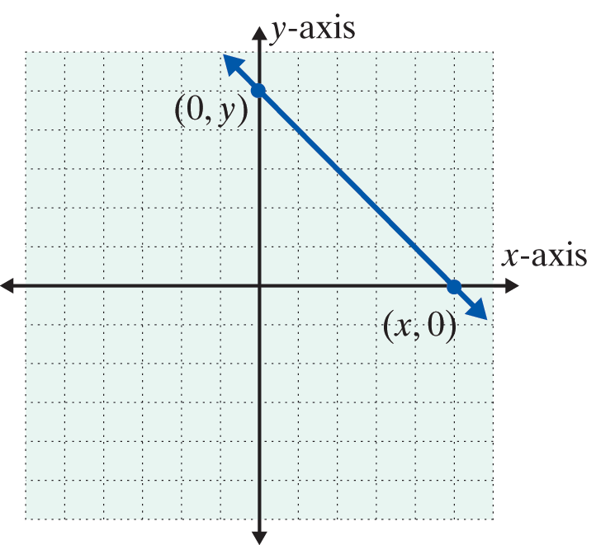
Locating the y-intercept and x-intercept
Intercepts
1. To find the y-intercept (where
the line crosses the y-axis),
substitute x = 0 and solve for y.
2. To find the x-intercept (where
the line crosses the x-axis),
substitute y = 0 and solve for x.

Slide 12
Example 2: x- and y-Intercepts
Graph the following linear equations by locating the y-intercept and the x-intercept.
a. x + 3y = 9
Solution

Slide 13
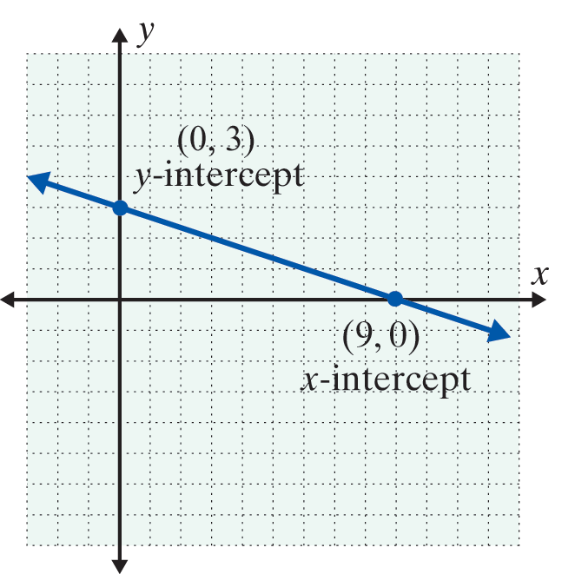
Example 2: x- and y-Intercepts (cont.)
Plot the two intercepts and draw the line that contains them.

Slide 14
Example 2: x- and y-Intercepts (cont.)
b. 3x − 2y = 12
Solution

Slide 15
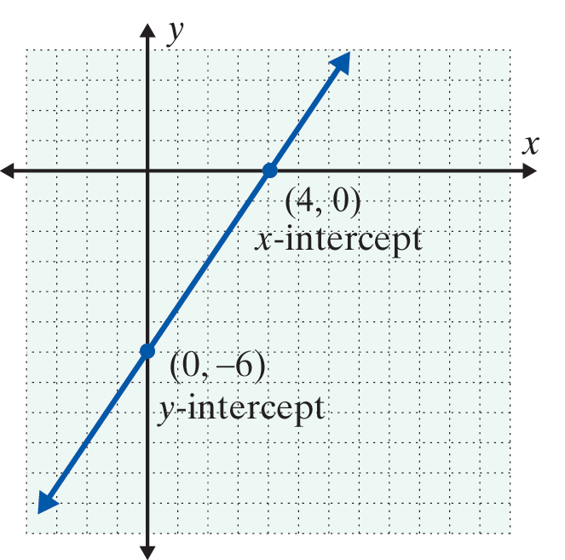
Example 2: x- and y-Intercepts (cont.)
Plot the two intercepts and draw the line that contains them.

Slide 16
Locating the y-intercept and x-intercept
Notes
In general, the intercepts are easy to find because substituting 0 for x or y leads to an easy solution for the other variable. However, when the intercepts result in a point with fractional (or decimal) coordinates and estimation is involved, then a third point that satisfies the equation should be found to verify that the line is graphed correctly.

Slide 17
Practice Problems
1. Find the missing coordinate of each ordered pair so that it belongs to the solution set of the equation 2x + y = 4:
(0, ), ( , 0), ( , 8), (−1, )
2. Does the ordered pair satisfy the equation 3x + 2y = 6?
3. Find the x-intercept and y-intercept of the equation −3x + y = 9.
4. Graph the linear equation x − 2y = 3.

Slide 18
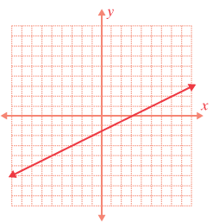
Practice Problem Answers

