Slide 1
Section 4.3
The Slope-Intercept Form:
y = mx + b

Slide 2
Objectives
Interpret the slope of a line as a rate of change.
Find the slope of a line given two points.
Find the slopes of and graph horizontal and vertical lines.
Find the slopes and y-intercepts of lines and then graph the lines.
Write the equations of lines given the slopes and y-intercepts.

Slide 3
Calculating the Slope
Slope
Let P₁(x₁, y₁) and P₂(x₂, y₂) be two points on a line. The slope can be calculated as follows:
Note: The letter m is standard notation for representing the slope of a line.

Slide 4
Example 1: Finding the Slope of a Line
Find the slope of the line that contains the points (−1, 2) and (3, 5), and then graph the line.
Solution

Slide 5
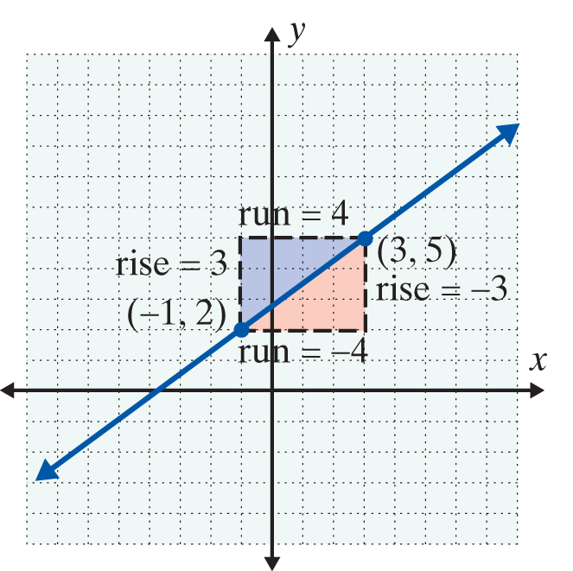
Example 1: Finding the Slope of a Line (cont.)

Slide 6
Example 2: Finding the Slope of a Line
Find the slope of the line that contains the points (1, 3) and (5, 1), and then graph the line.
Solution

Slide 7
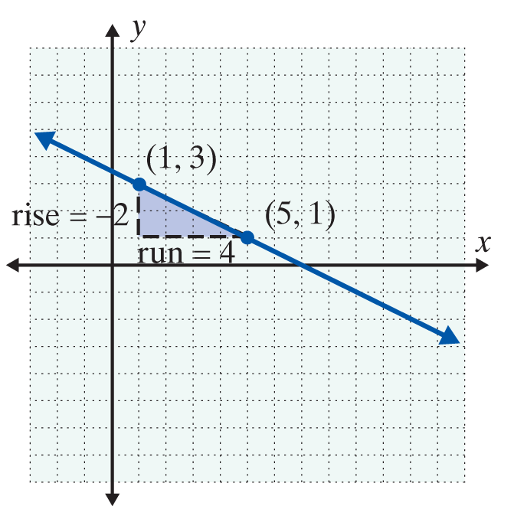
Example 2: Finding the Slope of a Line (cont.)

Slide 8
Calculating the Slope
Notes
Lines with positive slope go up (increase) as we move along the line from left to right.
Lines with negative slope go down (decrease) as we move along the line from left to right.

Slide 9
Slopes of Horizontal and Vertical Lines
Horizontal and Vertical Lines
The following two general statements are true for horizontal and vertical lines:
1. For horizontal lines (of the form y = b), the slope is 0.
2. For vertical lines (of the form x = a), the slope is undefined.

Slide 10
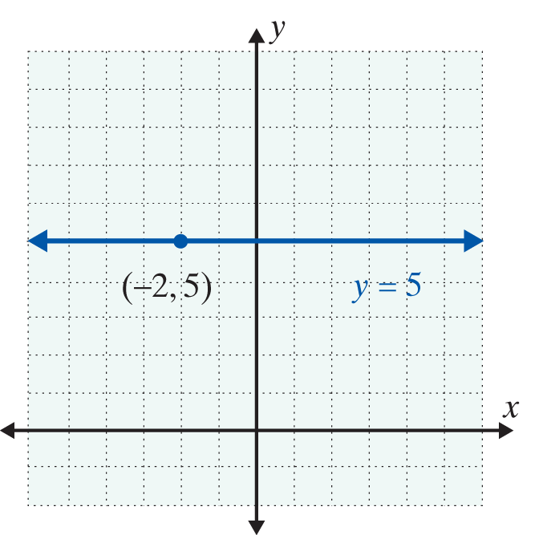
Example 3: Slopes of Horizontal and Vertical Lines
a. Find the equation and slope of the horizontal line through the point (−2, 5).
Solution
The equation is y = 5 and
the slope is 0.

Slide 11
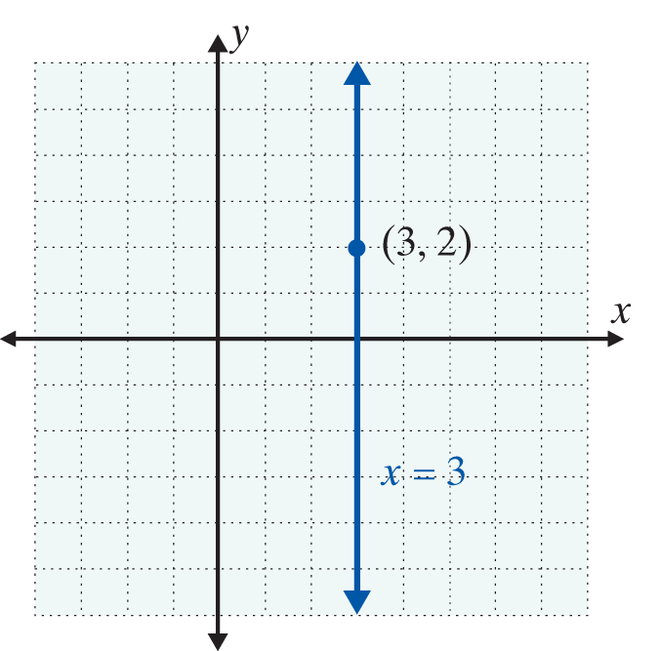
Example 3: Slopes of Horizontal and Vertical Lines (cont.)
b. Find the equation and slope of the vertical line through the point (3, 2).
Solution
The equation is x = 3 and
the slope is undefined.

Slide 12
Slope-Intercept Form: y = mx + b
For y = mx + b, m is the Slope
For an equation in the form y = mx + b, the slope of the line is m.

Slide 13
Slope-Intercept Form: y = mx + b
Slope-Intercept Form
y = mx + b is called the slope-intercept form for the equation of a line, where m is the slope and (0, b) is the y-intercept.

Slide 14
Example 4: Using the Form y = mx + b
a. Find the slope and y-intercept of −2x + 3y = 6 and graph the line.
Solution Solve for y.
Thus m = which is
The slope, and b is 2 making the y-intercept equal (0, 2).

Slide 15
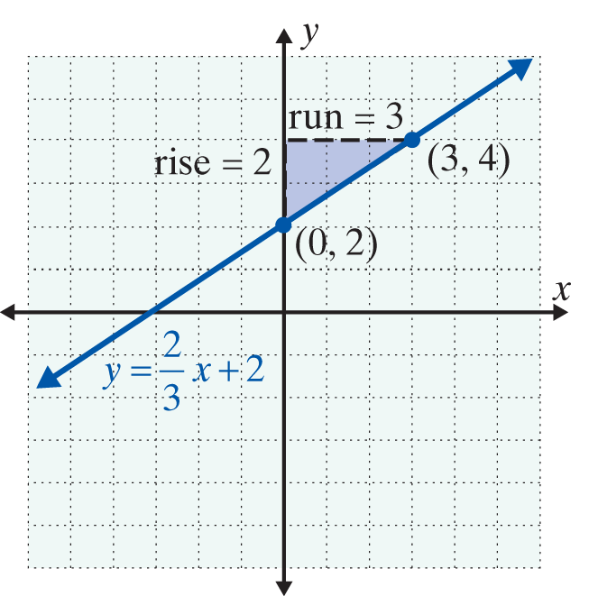
Example 4: Using the Form y = mx + b (cont.)
As shown in the graph, if we “rise” 2 units up and “run” 3 units to the right from the y-intercept (0, 2), we locate another point (3, 4). The line can be drawn through these two points.

Slide 16
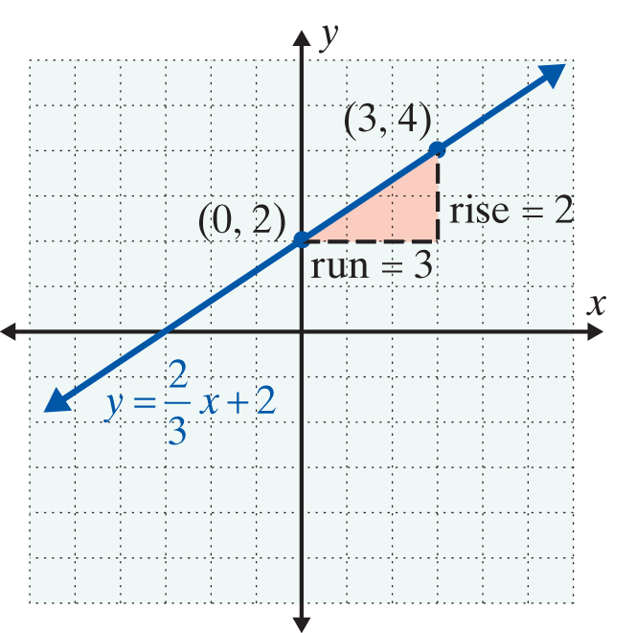
Example 4: Using the Form y = mx + b (cont.)
Note: As shown in the graph on the right, we could also first “run” 3 units right and “rise” 2 units up from the y-intercept to locate the point (3, 4) on the graph.

Slide 17
Example 4: Using the Form y = mx + b (cont.)
b. Find the slope and y-intercept of x + 2y = −6 and graph the line.
Solution Solve for y.
Thus m = which is
the slope, and b is −3 making the y-intercept equal (0, −3).

Slide 18
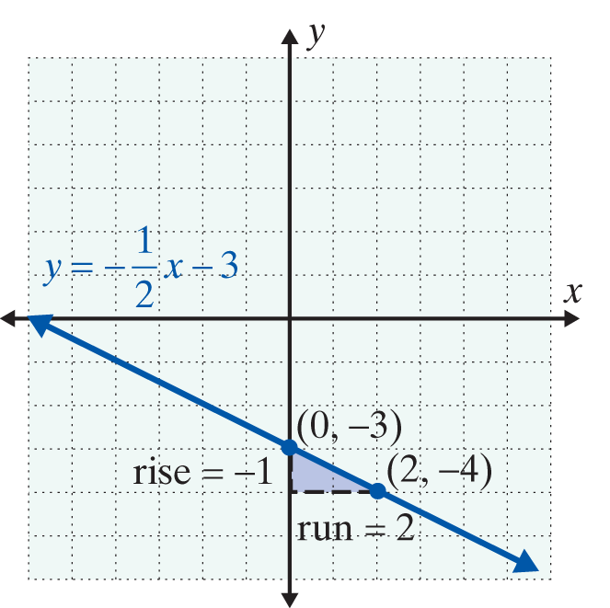
Example 4: Using the Form y = mx + b (cont.)
We can treat
and the “rise” as −1 and the “run” as 2. Moving from (0, −3) as shown in the figure, we locate another point (2, −4) on the graph and draw the line.

Slide 19
Example 4: Using the Form y = mx + b (cont.)
c. Find the equation of the line through the point
(0, −2) with slope
Solution
Because the x-coordinate is 0, we know that the point
(0, −2) is the y-intercept. So b = −2. The slope is
So Substituting in slope-intercept form
y = mx + b gives the result:

Slide 20
Practice Problems
1. Find the slope of the line through the two points (1, 3) and (4, 6). Graph the line.
2. Find the equation of the line through the point (0, 5)
with slope
3. Find the slope and y-intercept for the line 2x + y = 7.
4. Write the equation for the horizontal line through the point (−1, 3). What is the slope of this line?
5. Write the equation for the vertical line through the point (−1, 3). What is the slope of this line?

Slide 21
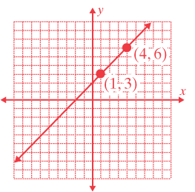
Practice Problem Answers

