Slide 1
Section 4.4
The Point-Slope Form:
y – y₁ = m (x – x₁)

Slide 2
Objectives
Graph a line given its slope and one point on the line.
Find the equation of a line given its slope and one point on the line using the formula y – y₁ = m(x – x₁).
Find the equation of a line given two points on the line.
Recognize and know how to find lines that are parallel and perpendicular.

Slide 3
Example 1: Graph a Line Given a Point and the Slope
Graph the line with slope and which passes through the point (2, 5).
Solution
Start from the point (2, 5) and locate another point on
the line using the slope as There are
four ways to proceed. Here are two:
1. Move 4 units right and 3 units down, or
2. Move 3 units down and 4 units right.

Slide 4
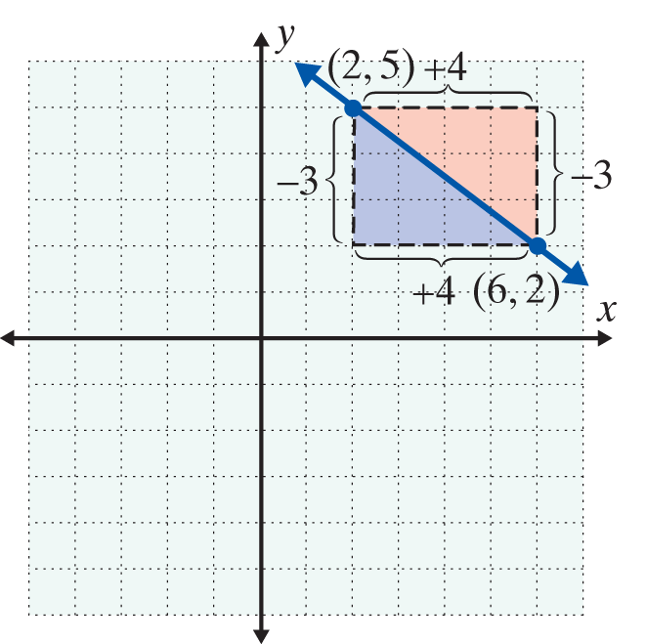
Example 1: Graph a Line Given a Point and the Slope (cont.)
Either way, you arrive at the same point (6, 2).
This means that we can move from the given point either with the rise first or the run first.
Note: Any numbers in the ratio of −3 to 4 can be used for the moves, such as −6 to 8 or 9 to −12.

Slide 5
Point-Slope Form: y – y₁ = m (x – x₁)
Point-Slope Form
An equation of the form
y – y₁ = m (x – x₁)
is called the point-slope form for the equation of a line that contains the point (x₁, y₁) and has slope m.

Slide 6
Example 2: Finding Equations of Lines Using the Slope and a Point
Find the equation of the line with a slope of and
passing through the point (2, 3). Graph the line using the point and slope.
Solution
Substitute the values into the point-slope form.

Slide 7
Example 2: Finding Equations of Lines Using the Slope and a Point (cont.)

Slide 8
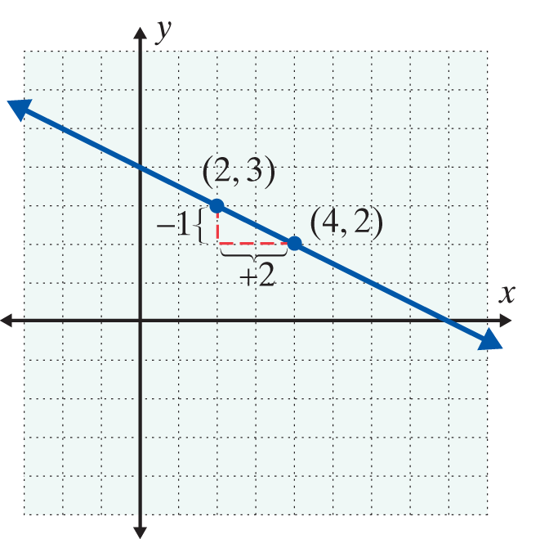
Example 2: Finding Equations of Lines Using the Slope and a Point (cont.)
The point one unit down and two units right from (2, 3) will be on the line because the slope is

Slide 9
Example 2: Finding Equations of Lines Using the Slope and a Point (cont.)
With a negative slope, either the rise is negative and the run is positive, or the rise is positive and the run is negative. In either case, as the previous figure and the following figure illustrate, the line is the same.

Slide 10
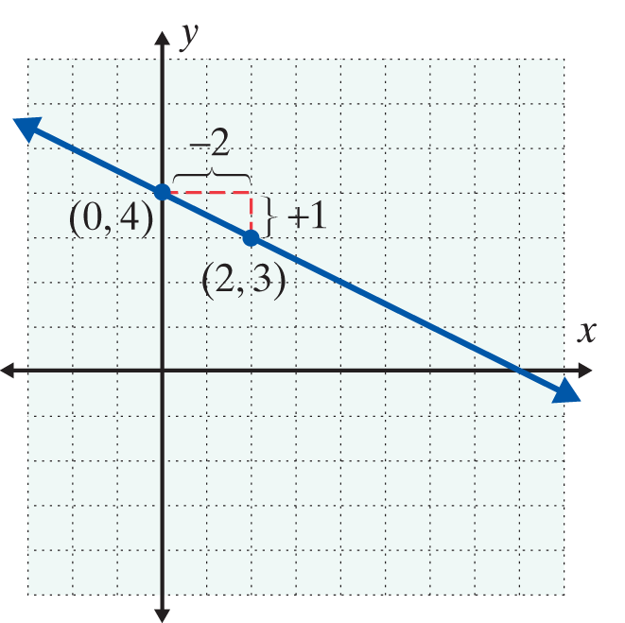
Example 2: Finding Equations of Lines Using the Slope and a Point (cont.)
The point one unit up and two units to the left from (2, 3) is on the line because the slope is

Slide 11
Finding the Equations of Lines Given Two Points
Finding the Equation of a Line Given Two Points
To find the equation of a line given two points on the line
1. Use the formula to find the slope.
2. Use this slope, m, and either point in the point- slope formula y – y₁ = m (x – x₁) to find the equation.

Slide 12
Example 3: Using Two Points to Find the Equation of a Line
Find the equation of the line containing the two points (−1, 2) and (4, −2).
Solution First, find the slope.
Now use one of the given points and the point-slope form for the equation of a line.
(Note: (−1, 2) and (4, −2) are used on the next page to illustrate that either point may be used.)

Slide 13
Example 3: Using Two Points to Find the Equation of a Line (cont.)

Slide 14
Parallel Lines and Perpendicular Lines
Parallel Lines and Perpendicular Lines
Parallel lines are lines that never intersect (never cross each other) and these lines have the same slope. (Note: All vertical lines (undefined slopes) are parallel to one another.)
Perpendicular lines are lines that intersect at 90° (right) angles and whose slopes are negative reciprocals of each other. Horizontal lines are perpendicular to vertical lines.

Slide 15
Example 4: Finding the Equations of Parallel Lines
Find the equation of the line through the point (2, 3) and parallel to the line 5x + 3y = 1. Graph both lines.
Solution
First, solve for y to find the slope of the given line.
Thus any line parallel to this
line has slope

Slide 16
Example 4: Finding the Equations of Parallel Lines (cont.)
Now use the point-slope form y – y₁ = m (x – x₁)
with and (x₁, y₁) = (2, 3).

Slide 17
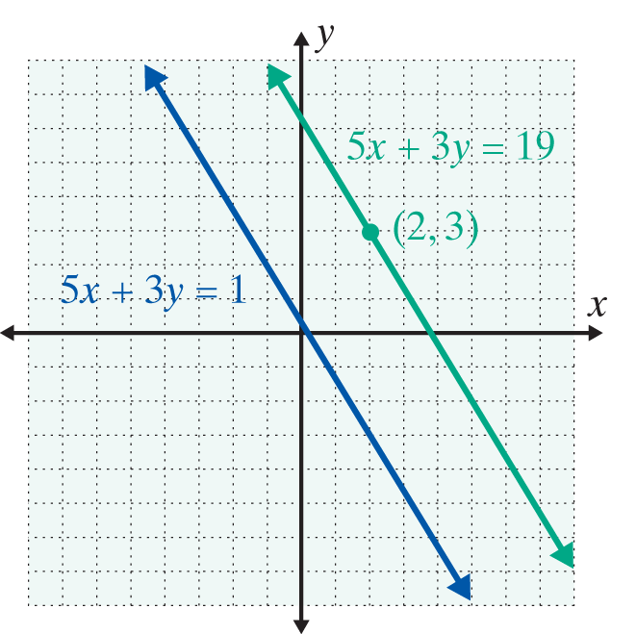
Example 4: Finding the Equations of Parallel Lines (cont.)

Slide 18
Example 5: Finding the Equations of Perpendicular Lines
Find the equation of the line through the point (2, 3) and perpendicular to the line 5x + 3y = 1. Graph both lines.
Solution
We know from Example 4 that the slope of the line
5x + 3y = 1 is Thus any line perpendicular to this
line must have slope (the negative reciprocal of

Slide 19
Example 5: Finding the Equations of Perpendicular Lines (cont.)
Now using the point-slope form y – y₁ = m (x – x₁) with
and (x₁, y₁) = (2, 3), we have

Slide 20
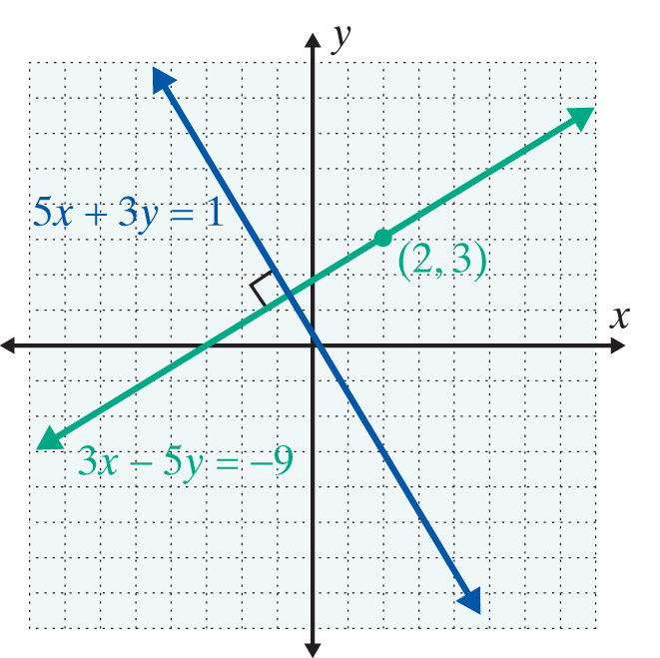
Example 5: Finding the Equations of Perpendicular Lines (cont.)

Slide 21
Parallel Lines and Perpendicular Lines
Summary of Formulas and Properties of Straight Lines
1. Ax + By = C Standard form
2. Slope of a line
3. y = mx + b Slope-intercept form
4. y – y₁ = m (x – x₁) Point-slope form

Slide 22
Parallel Lines and Perpendicular Lines
Summary of Formulas and Properties of Straight Lines (cont.)
5. y = b Horizontal line, slope 0
6. x = a Vertical line, undefined slope
7. Parallel lines have the same slope.
8. Perpendicular lines have slopes that are negative reciprocals of each other.

Slide 23
Practice Problems
Find a linear equation in standard form whose graph satisfies the given conditions.
1. Passes through the point (4, −1) with m = 2
2. Parallel to y = −3x + 4 and contains the point (−1, 5)
3. Perpendicular to 2x + y = 1 and passes through the origin (0, 0)
4. Contains the two points (6, −2) and (2, 0)

Slide 24
Practice Problem Answers
1. 2x – y = 9
2. 3x + y = 2
3. x − 2y = 0
4. x + 2y = 2

