Slide 1
Section 4.5
Introduction to Functions and Function Notation

Slide 2
Objectives
Find the domain and range of a relation or function.
Determine whether a relation is or is not a function.
Use the vertical line test to determine whether a graph is or is not the graph of a function.
Write a function using function notation.
Use a graphing calculator to graph functions.

Slide 3
Relations and Functions
Note
The ordered pairs discussed in this text are ordered pairs of real numbers. However, more generally, ordered pairs might be other types of pairs such as (child, mother), (city, state), or (name, batting average).

Slide 4
Relations and Functions
Relation, Domain, and Range
A relation is a set of ordered pairs of real numbers.
The domain, D, of a relation is the set of all first coordinates in the relation.
The range, R, of a relation is the set of all second coordinates in the relation.

Slide 5
Example 1: Finding the Domain and Range
Find the domain and range for each of the following relations.
Solution
Note that 6 is written only once in the domain and 2 is written only once in the range, even though each appears more than once in the relation.

Slide 6
Example 1: Finding the Domain and Range (cont.)
Solution

Slide 7
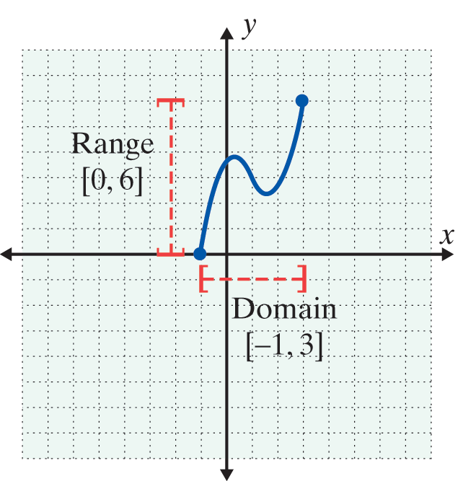
Example 2: Reading the Domain and Range from the Graph of a Relation
Identify the domain and range from the graph of each relation.
a.
Solution
The domain consists of the set of x-values for all points on the graph. In this case the domain is the interval [−1, 3].
The range consists of the set of y-values for all points on the graph. In this case, the range is the interval [0,6].

Slide 8
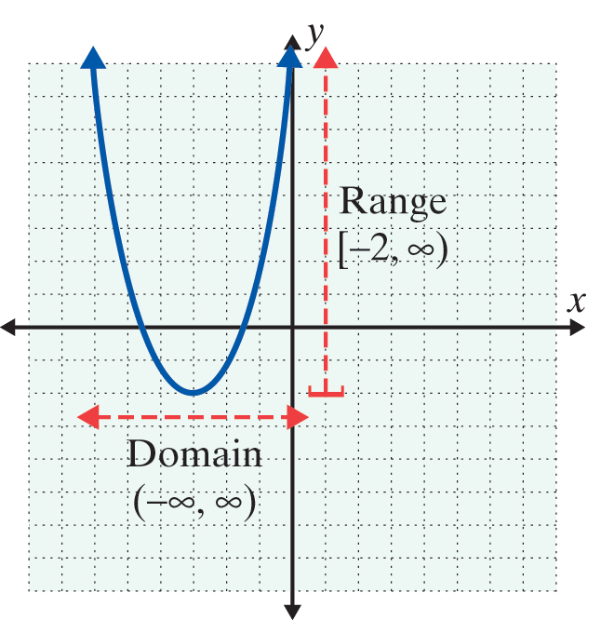
Example 2: Reading the Domain and Range from the Graph of a Relation (cont.)
b.
Solution
There is no restriction on the x-­values which means that for every real number there is a point on the graph with that number as its x-value. Thus the domain is the interval (−∞, ∞).
The y-values begin at −2 and then increase to infinity. The range is the interval [−2, ∞).

Slide 9
Relations and Functions
Function
A function is a relation in which each domain element has exactly one corresponding range element.

Slide 10
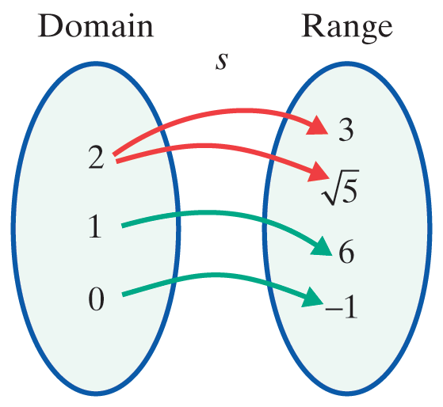
Example 3: Functions
Determine whether or not each of the following relations is a function.
Solution
s is not a function. The number 2 appears as a first coordinate more than once.

Slide 11
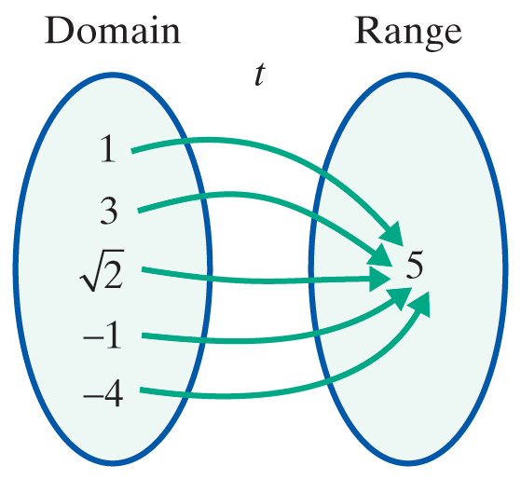
Example 3: Functions (cont.)
Solution
t is a function. Each first coordinate appears only once. The fact that the second coordinates are all the same has no effect on the concept of a function.

Slide 12
Vertical Line Test
Vertical Line Test
If any vertical line intersects the graph of a relation at more than one point, then the relation is not a function.

Slide 13
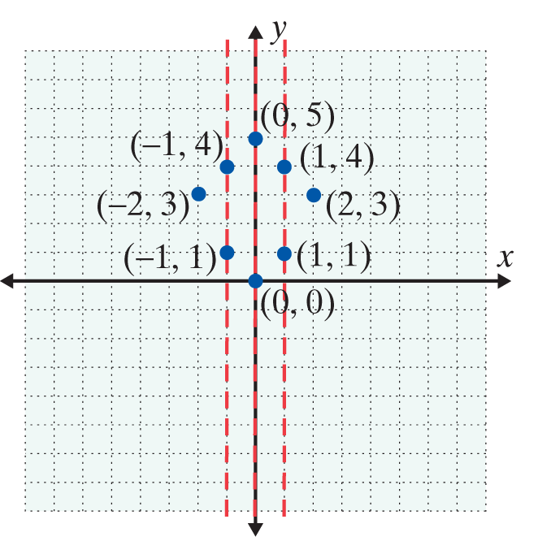
Example 4: Vertical Line Test
Use the vertical line test to determine whether or not each of the following graphs represents a function. Then list the domain and range of each graph.
a.

Slide 14
Example 4: Vertical Line Test (cont.)
Solution
The relation is not a function since a vertical line can be drawn that intersects the graph at more than one point. Listing the ordered pairs shows that several x­-coordinates appear more than once.
Here D = {−2 , −1, 0, 1, 2} and R = {0, 1, 3, 4, 5}.

Slide 15
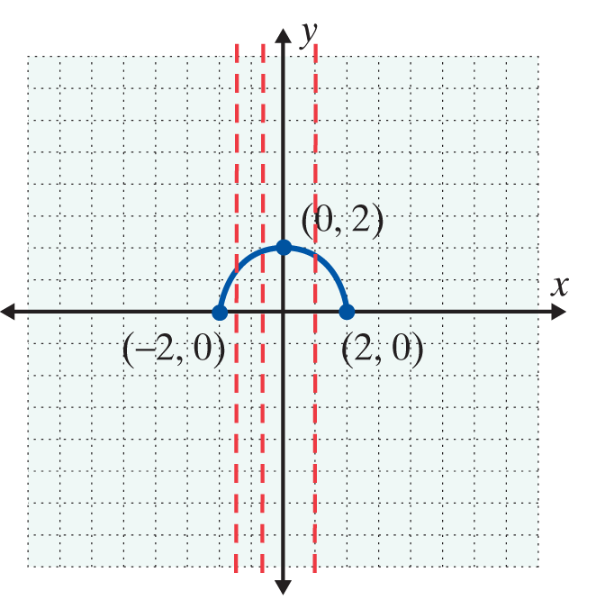
Example 4: Vertical Line Test (cont.)
b.
Solution
The relation is a function. No vertical line will intersect the graph at more than one point. Several vertical lines are drawn to illustrate this.
For this function, we see from the graph that D = [−2, 2] and R = [0, 2].

Slide 16
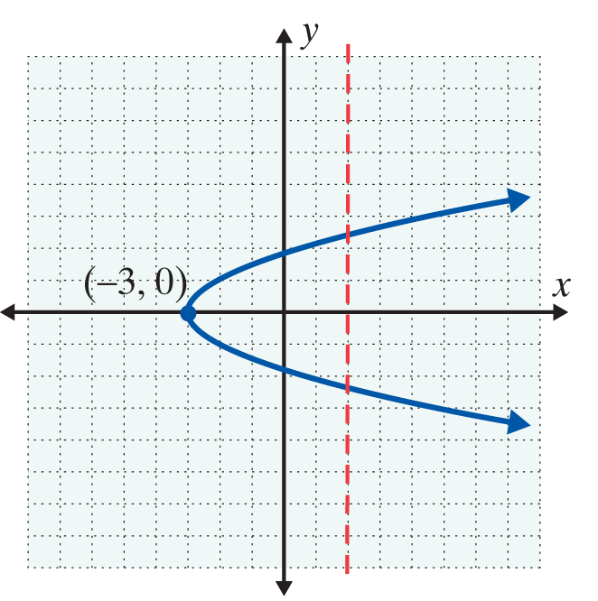
Example 4: Vertical Line Test (cont.)
c.
Solution
The relation is not a function. At least one vertical line (drawn) intersects the graph at more than one point.
Here D = [−3, ∞) and
R = (−∞, ∞).

Slide 17
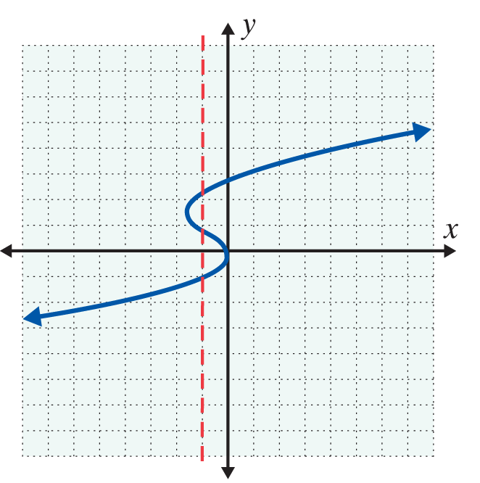
Example 4: Vertical Line Test (cont.)
d.
Solution
The relation is not a function. At least one vertical line intersects the graph at more than one point.
Here D = (−∞, ∞), and
R = (−∞, ∞).

Slide 18
Linear Functions
Linear Function
A linear function is a function represented by an equation of the form
y = mx + b.
The domain of a linear function is the set of all real numbers: D = (−∞, ∞).

Slide 19
Domains of Nonlinear Functions
Note
In determining the domain of a function, one fact to remember at this stage is that no denominator can equal 0. In future chapters we will discuss other nonlinear functions with limited domains.

Slide 20
Example 5: Domain
Find the domain for the function
Solution
The domain is all real numbers for which the expression
is defined. Thus or x ≠ 5,
because the denominator is 0 when x = 5.
Note: Here interval notation tells us that x can be any real number except 5.

Slide 21
Example 6: Function Evaluation
For the function g(x) = 4x + 5, find:
a. g(2)
Solution
b. g(−1)
Solution
c. g(0)
Solution
g(2)
= 4(2) + 5
= 13
g(−1)
= 4(−1) + 5
= 1
g(0)
= 4(0) + 5
= 5

Slide 22
Example 7: Nonlinear Function Evaluation
For the function find:
a. h(4)
Solution
b. h(0)
Solution
c. h(−3)
Solution

Slide 23
Example 8: Graphing Functions with a TI-84 Plus
Use a TI-84 Plus graphing calculator to find the graphs of each of the following functions. Use the CALC key to find the point where each graph intersects the x-axis. Changing the WINDOW may help you get a “better” or “more complete” picture of the function. This is a judgment call on your part.

Slide 24

Example 8: Graphing Functions with a TI-84 Plus (cont.)
a. 3x + y = −1
Solution
To have the calculator graph a nonvertical straight line, you must first solve the equation for y. Solving for y gives,
y = −3x − 1.
(It is important that the key be used to indicate
the negative sign in front of 3x. This is not the same as the subtraction key.)

Slide 25
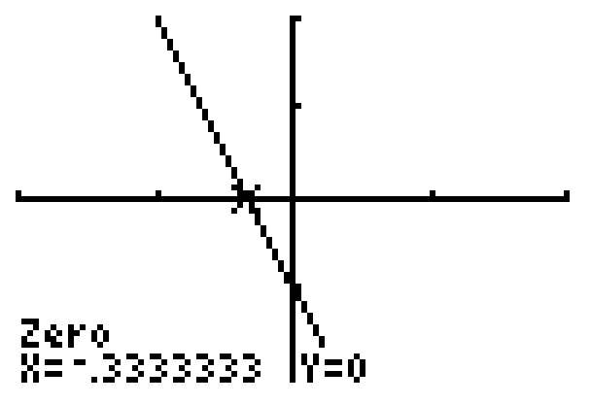
Example 8: Graphing Functions with a TI-84 Plus (cont.)
Note: Vertical lines are not functions and cannot be graphed by the calculator in function mode.

Slide 26
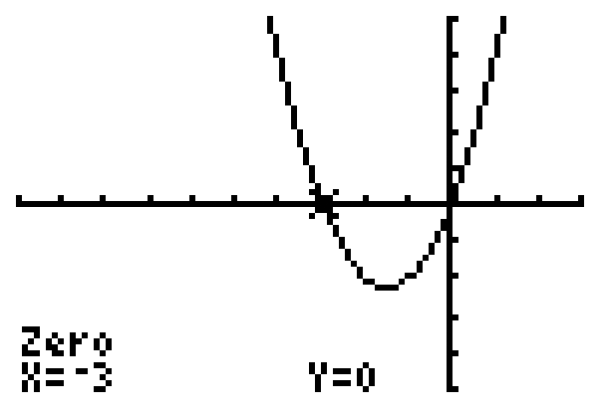
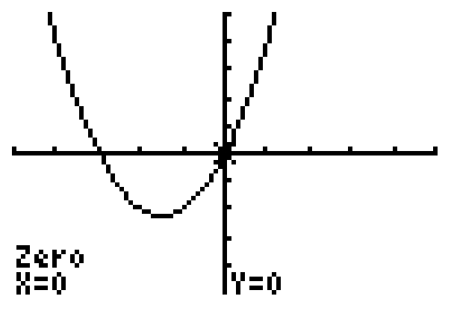
Example 8: Graphing Functions with a TI-84 Plus (cont.)
Solution
Since the graph of this function has two x-intercepts, we have shown the graph twice. Each graph shows the coordinates of a distinct x-intercept.

Slide 27
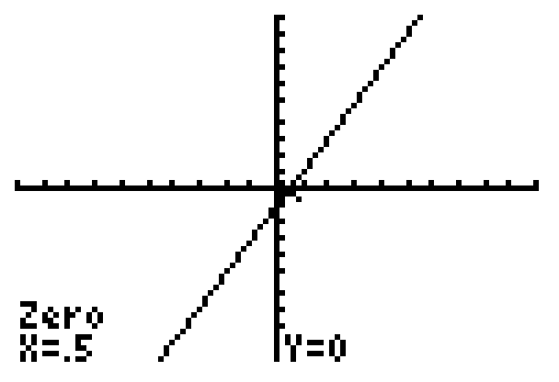
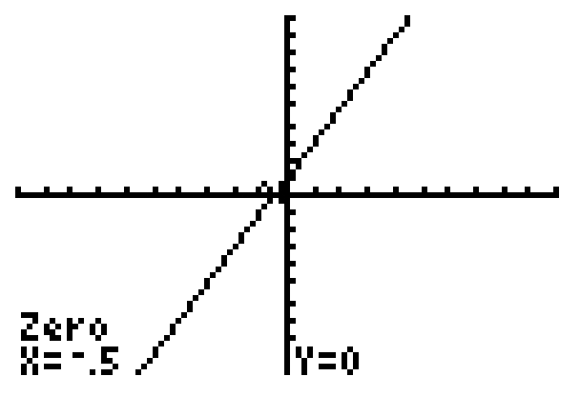
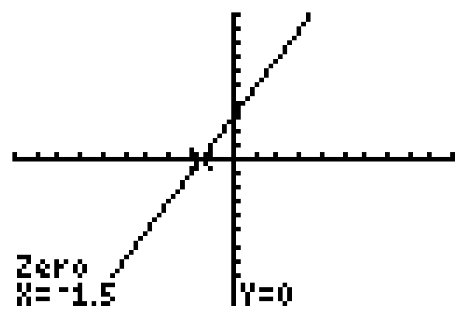
Example 8: Graphing Functions with a TI-84 Plus (cont.)
c. y = 2x −1; y = 2x + 1; y = 2x + 3
Solution
y = 2x −1
y = 2x + 1
y = 2x + 3

Slide 28
Using a TI-84 Plus Graphing Calculator to Graph Functions
Note
The standard window shows 96 pixels across the window and 64 pixels up and down the window. This gives a ratio of 3 to 2 and can give a slightly distorted view of the actual graph because the vertical pixels are squeezed into a smaller space. For Example 8c, the graphs of all three functions are in the standard window. Experiment by changing the window to a square window, say −9 to 9 for x and −6 to 6 for y.

Slide 29
Using a TI-84 Plus Graphing Calculator to Graph Functions
Note (cont.)
Then graph the functions and notice the slight differences (and better representation) in the appearances on the display.

Slide 30
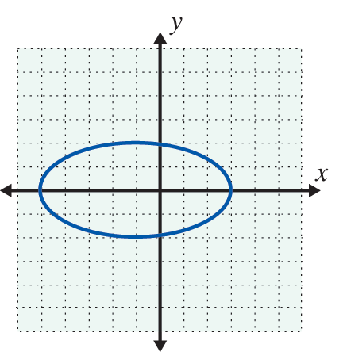
Practice Problems
1. State the domain and range of the relation {(5, 6), (7, 8), (9, 0.5), (11, 0.3)}. Is the relation a function? Explain briefly.
2. Use the vertical line text to determine whether the graph on the right represents a function.
3. For the function
find a. f(2) b. f(0) c. f(−1).

Slide 31
Practice Problem Answers
1. D = {5, 7, 9, 11}; R ={0.3, 0.5, 6, 8} Yes, the relation is a function because each x-coordinate appears only once.
2. Not a function
3. a. 10 b. −4 c. −2

