Slide 1
Section 4.6
Graphing Linear Inequalities in Two Variables

Slide 2
Objectives
Graph linear inequalities.
Graph linear inequalities using a graphing calculator.

Slide 3
Graphing Linear Inequalities: y < mx + b
Graphing Linear Inequalities
1. First, graph the boundary line (dashed if the inequality is < or >, solid if the inequality is ≤ or ≥).
2. Next, determine which side of the line to shade using one of the following methods.
Method 1
a. Test any one point obviously on one side of the line.
b. If the test-point satisfies the inequality, shade the half-plane on that side of the line. Otherwise, shade the other half-plane.

Slide 4
Graphing Linear Inequalities: y < mx + b
Graphing Linear Inequalities (cont.)
(Note: The point (0, 0), if it is not on the boundary
line, is usually the easiest point to test.)
Method 2
a. Solve the inequality for y (assuming that the line is not vertical).
b. If the solution shows y < or y ≤ , then shade the half-plane below the line.

Slide 5
Graphing Linear Inequalities: y < mx + b
Graphing Linear Inequalities (cont.)
c. If the solution shows y > or y ≥ , then shade the half-plane above the line.
(Note: If the boundary line is vertical, then solve for x. If the solution shows x > or x ≥ , then shade the half-plane to the right. If the solution shows x < or
x ≤ , then shade the half-plane to the left.)
3. The shaded half-plane (and the line if it is solid) is the solution to the inequality.

Slide 6
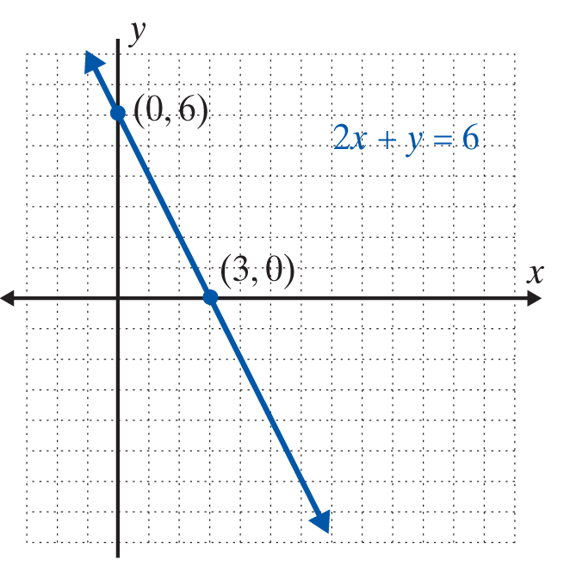
Example 1: Graphing Linear Inequalities
a. Graph the half-plane that satisfies the inequality
Solution
Method 1 is used in this example.
Step 1: Graph the boundary line
2x + y = 6 as a solid line because
the inequality is ≤ (less than or
equal to).

Slide 7
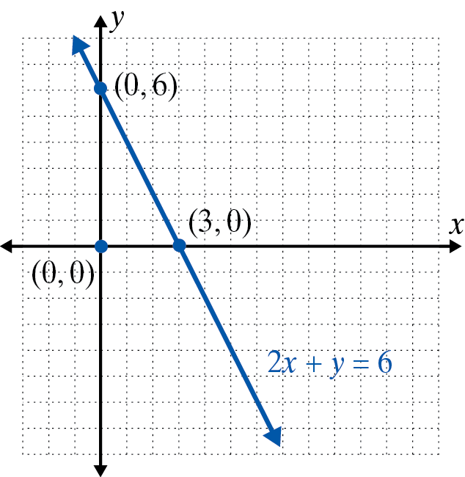
Example 1: Graphing Linear Inequalities (cont.)
Step 2: Test any point on one side of the line. In this example, we have chosen (0, 0).
This is a true statement.

Slide 8
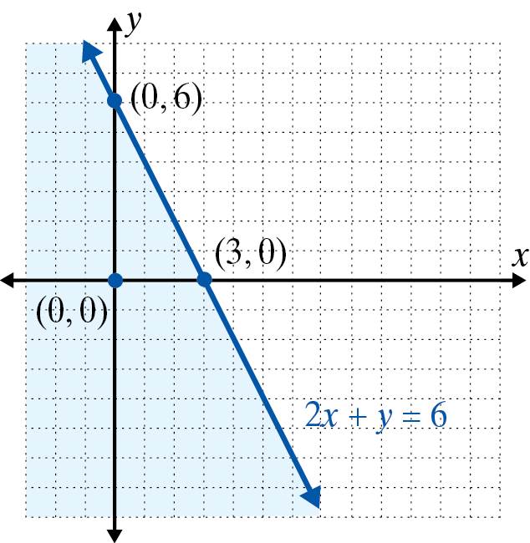
Example 1: Graphing Linear Inequalities (cont.)
Step 3: Shade the half-plane on the same side of the line as the point (0, 0). (The shaded half-plane and the boundary line is the solution set to the inequality.)

Slide 9
Example 1: Graphing Linear Inequalities (cont.)
b. Graph the solution set to the inequality y > 2x.
Solution
Since the inequality is already solved for y, Method 2 is easy to apply.
Step 1: Graph the boundary line y = 2x as a dashed line because the inequality is >.
Step 2: The solution shows >, so by Method 2, the graph consists of those points above the line. Shade the half-plane above the line.

Slide 10
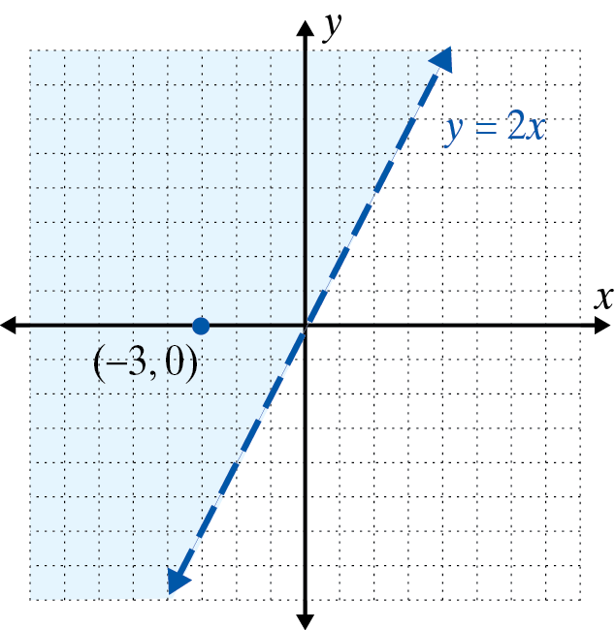
Example 1: Graphing Linear Inequalities (cont.)
Note: As a check, we see that the point (−3, 0) gives 0 > −6, a true statement. Thus we know we have shaded the correct half-plane.

Slide 11
Example 1: Graphing Linear Inequalities (cont.)
c. Graph the half-plane that satisfies the inequality y > 1.
Solution
Again, the inequality is already solved for y and Method 2 is used.
Step 1: Graph the boundary line y = 1 as a dashed line because the inequality is >. (The boundary line is a horizontal line.)
Step 2: By Method 2, shade the half-plane above the line.

Slide 12
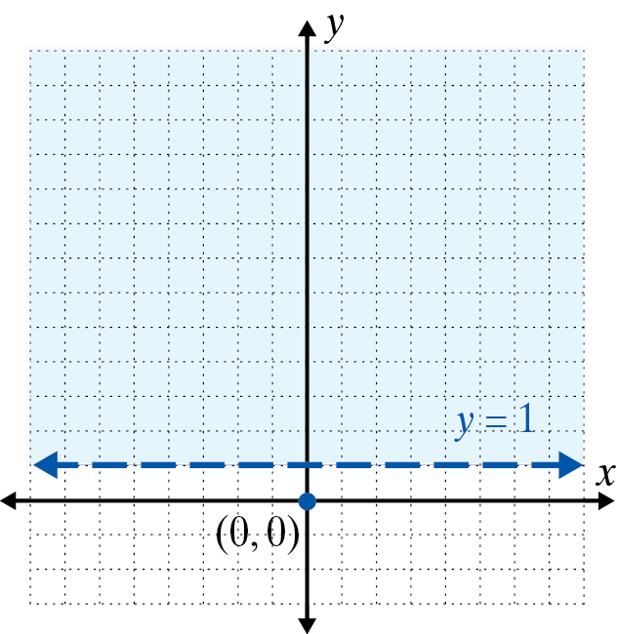
Example 1: Graphing Linear Inequalities (cont.)

Slide 13
Example 1: Graphing Linear Inequalities (cont.)
d. Graph the solution set to the inequality x ≤ 0.
Solution
The boundary line is a vertical line and Method 1 is used.
Step 1: Graph the boundary line x = 0 as a solid line because the inequality is ≤ (less than or equal to). Note that this is the y-axis.

Slide 14
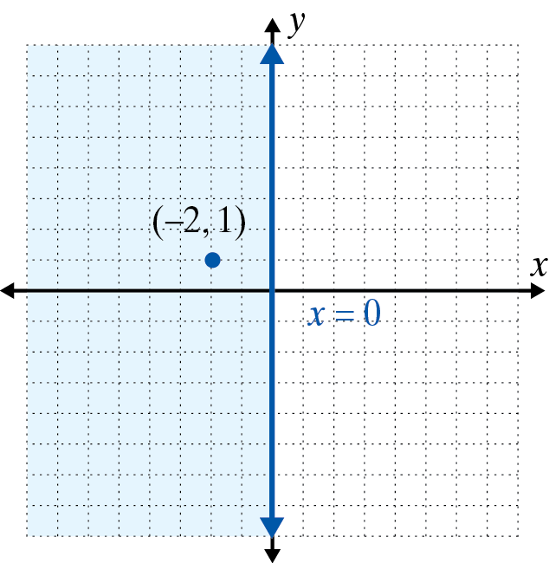
Example 1: Graphing Linear Inequalities (cont.)
Step 2: Test the point (−2, 1).
−2 ≤ 0
This statement is true.
Step 3: Shade the half-plane on the same side of the line as (−2, 1). This half-plane consists of the points with x-coordinate 0 or negative.

Slide 15

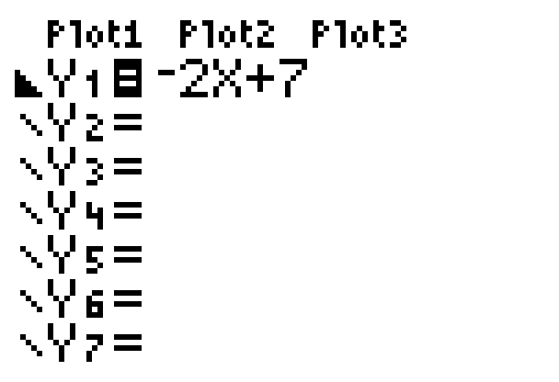

Example 2: Graphing Linear Inequalities Using a Calculator
a. Graph the linear inequality
Solution
Step 1: Solving the inequality for y gives:
Step 2: Press the key and enter the function:
\Y₁ = −2X + 7.
Step 3: Go to the \ and hit
three times so that the display
appears as follows:

Slide 16

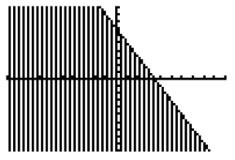
Example 2: Graphing Linear Inequalities Using a Calculator (cont.)
Step 4: Press and (using the standard
WINDOW settings) the following graph should appear on the display.

Slide 17
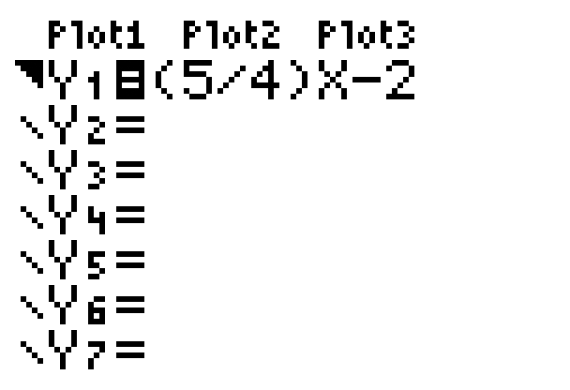
Example 2: Graphing Linear Inequalities Using a Calculator (cont.)
b. Graph the linear inequality −5x + 4y > −8.
Solution
Step 1: Solving the inequality for y gives:
Step 2: Press the key and enter the function:
Step 3: Go to the \ and hit
two times so that the display
appears as follows:

Slide 18

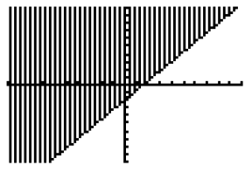
Example 2: Graphing Linear Inequalities Using a Calculator (cont.)
Step 4: Press and (using the standard WINDOW settings) the following graph should appear on the display. (Note: The boundary line should actually be dotted.)

Slide 19
Practice Problems
1. Which of the following points satisfy the inequality x + y < 3?
a. (2, 1) b. c. (0, 5) d. (−5, 2)
2. Which of the following points satisfy the inequality x − 2y ≥ 0?
a. (2, 1) b. (1, 3) c. (4, 2) d. (3, 1)
3. Which of the following points satisfy the inequality x < 3?
a. (1, 0) b. (0, 1) c. (4, −1) d. (2, 3)

Slide 20
Practice Problem Answers
1. d
2. a, c, d
3. a, b, d

