Slide 1
Section 5.1
Exponents

Slide 2
Objectives
Simplify expressions by using properties of integer exponents.
Recognize which property of exponents is used to simplify an expression.

Slide 3
The Product Rule
The Product Rule for Exponents
If a is a nonzero real number and m and n are integers, Then
In words, to multiply two powers with the same base, keep the base and add the exponents.

Slide 4
The Product Rule
Notes
Remember about the exponent 1. If a variable or constant has no exponent written, the exponent is understood to be 1.
For example,
y = y¹
and
7 = 7¹
In general, for any real number a,
a = a¹

Slide 5
Example 1: The Product Rule for Exponents
Use the product rule for exponents to simplify the following expressions.
Solution
Solution
Solution
Note that the base stays 4. That is, the bases are not multiplied.

Slide 6
Example 1: The Product Rule for Exponents (cont.)
Solution
Solution
Note that the base stays 2. That is, the bases are not multiplied.

Slide 7
Example 2: Multiplying Terms with Coefficients
Use the product rule for exponents when simplifying the following expressions.
Solution
Coefficients 2 and 3 are multiplied and exponents 2 and 9 are added.

Slide 8
Example 2: Multiplying Terms with Coefficients (cont.)
Coefficients −3 and −4 are multiplied and exponents 3 and 3 are added.
Coefficients −6 and 8 are multiplied and exponents
on each variable are added.

Slide 9
The Exponent 0
The Exponent 0
If a is a nonzero real number, then
The expression is undefined.

Slide 10
The Exponent 0
Notes
Throughout this text, unless specifically stated otherwise, we will assume that the bases of exponents are nonzero.

Slide 11
Example 3: The Exponent 0
Simplify the following expressions using the rule for 0 as an exponent.
Solution
Solution
Solution

Slide 12
The Quotient Rule
The Quotient Rule for Exponents
If a is a nonzero real number and m and n are integers, then
In words, to divide two powers with the same base, keep the base and subtract the exponents. (Subtract the denominator exponent from the numerator exponent.)

Slide 13
Example 4: The Quotient Rule for Exponents
Use the quotient rule for exponents to simplify the following expressions.
Solution
Solution

Slide 14
Example 4: The Quotient Rule for Exponents (cont.)
Solution
Note how this example shows another way to justify the idea that
Since the numerator and denominator are the same and not 0, it makes sense that the fraction is equal to 1.

Slide 15
Example 5: Dividing Terms with Coefficients
Use the quotient rule for exponents when simplifying the following expressions.
Solution
Coefficients 15 and 3 are divided and exponents 15 and 3 are subtracted.

Slide 16
Example 5: Dividing Terms with Coefficients (cont.)
Solution
Coefficients 20 and 2 are divided and exponents on each variable are subtracted.

Slide 17
Negative Exponents
Rule for Negative Exponents
If a is a nonzero real number and n is an integer, then

Slide 18
Example 6: Negative Exponents
Use the rule for negative exponents to simplify each expression so that it contains only positive exponents.
Solution
Solution
Using the rule for negative exponents
Using the rule for negative exponents

Slide 19
Example 6: Negative Exponents (cont.)
Solution
Here we use the product rule first and then the rule for negative exponents.

Slide 20
Negative Exponents
Notes
There is nothing wrong with negative exponents. In fact, negative exponents are preferred in some courses in mathematics and science. However, so that all answers are the same, in this course we will consider expressions to be simplified if:
1. all exponents are positive, and
2. each base appears only once.

Slide 21
Example 7: Combining the Rules for Exponents
Simplify each expression so that it contains only positive exponents.
Solution
Using the product rule with positive and negative exponents

Slide 22
Example 7: Combining the Rules for Exponents (cont.)
Solution
Using the quotient rule with positive and negative exponents

Slide 23
Example 7: Combining the Rules for Exponents (cont.)
Solution
Using the quotient rule with negative exponents
Using the rule for negative exponents

Slide 24
Example 7: Combining the Rules for Exponents (cont.)
Solution
Using the quotient rule with two variables
Using the rule for negative exponents

Slide 25
Example 7: Combining the Rules for Exponents (cont.)
Using the product rule
Solution
Using the quotient rule
Using the rule for negative exponents

Slide 26
Negative Exponents
Notes
Special Note about Using the Quotient Rule
Regardless of the size of the exponents or whether they are positive or negative, the following single subtraction rule can be used with the quotient rule.
(numerator exponent − denominator exponent)
This subtraction will always lead to the correct answer.

Slide 27
Negative Exponents
Summary of the Rules for Exponents
For any nonzero real number a and integers m and n:
1. The exponent 1:
2. The exponent 0:
3. The product rule:
4. The quotient rule:
5. Negative exponents:

Slide 28
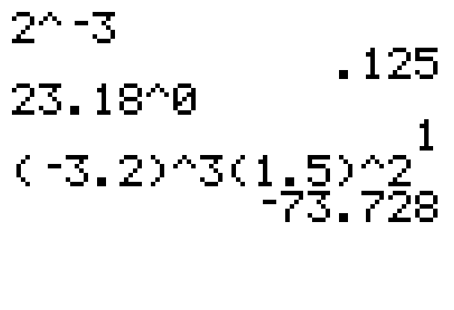


Example 8: Evaluating Expressions with Exponents
Use a graphing calculator to evaluate each expression.
Solution
The following solutions show how the caret key is used to indicate exponents. Be careful to use the negative sign key (and not the minus sign key) for negative numbers and negative exponents.

Slide 29
Practice Problems
Simplify each expression.
Use a graphing calculator to evaluate each expression.

Slide 30
Practice Problem Answers
2. 3.
4. 10 5. 6. 1
7. 26,873,856 8. 3375

