Slide 1
Section 5.2
Exponents and Scientific Notation

Slide 2
Objectives
Simplify powers of expressions by using the properties of integer exponents.
Write decimal numbers in scientific notation.
Operate with decimal numbers by using scientific notation.

Slide 3
Exponents
Summary of the Rules for Exponents
For any nonzero real number a and integers m and n:
1. The exponent 1:
2. The exponent 0:
3. The product rule:
4. The quotient rule:
5. Negative exponents:

Slide 4
Power Rule
Power Rule for Exponents
If a is a nonzero real number and m and n are integers, then
In words, the value of a power raised to a power can be found by multiplying the exponents and keeping the base.

Slide 5
Example 1: Power Rule for Exponents
Simplify each expression by using the power rule for exponents.
Solution
Solution

Slide 6
Example 1: Power Rule for Exponents (cont.)
Solution
Solution
Another approach, because we have a numerical base, would be

Slide 7
Example 1: Power Rule for Exponents (cont.)
We see that while the base and exponent may be different, the value is the same.

Slide 8
Rule for Power of a Product
Rule for Power of a Product
If a and b are nonzero real numbers and n is an integer then
In words, a power of a product is found by raising each factor to that power.

Slide 9
Example 2: Rule for Power of a Product
Simplify each expression by using the rule for power of a product.
Solution
Solution

Slide 10
Example 2: Rule for Power of a Product (cont.)
Solution
Solution
or, using the rule of negative exponents first and then the rule for the power of a product,

Slide 11
Example 2: Rule for Power of a Product (cont.)
Solution

Slide 12
Rule for Power of a Product
Notes
Special Note about Negative Numbers and Exponents
In an expression such as we know that −1 is understood to be the coefficient of That is,
The same is true for expressions with numbers such as
That is,

Slide 13
Rule for Power of a Product
Notes (cont.)
We see that the exponent refers to 7 and not to −7. For the exponent to refer to −7 as the base, −7 must be in parentheses as follows:
As another example,

Slide 14
Rule for Power of a Quotient
Rule for Power of a Quotient
If a and b are nonzero real numbers and n is an integer, then
In words, a power of a quotient (in fraction form) is found by raising both the numerator and the denominator to that power.

Slide 15
Example 3: Rule for the Power of a Quotient
Simplify each expression by using the rule for the power of a quotient.
Solution
Solution
Solution
Solution

Slide 16
Example 4: Applying Combinations of Rules for Exponents
Simplify each expression by using the appropriate rules for exponents.
Solution

Slide 17
Example 4: Applying Combinations of Rules for Exponents (cont.)
Solution
Method 1: Simplify inside the parentheses first.

Slide 18
Example 4: Applying Combinations of Rules for Exponents (cont.)
Method 2: Apply the power of a quotient rule first.
Note that the answer is the same even though the rules were applied in a different order.

Slide 19
Using Combinations of Rules for Exponents
Notes
In effect, there are two basic shortcuts with negative exponents and fractions:
1. Taking the reciprocal of a fraction changes the sign of any exponent in the fraction.
2. Moving any term from numerator to denominator or vice versa, changes the sign of the corresponding exponent.

Slide 20
Example 5: Two Approaches with Fractional Expressions and Negative Exponents
Simplify:
Solution
Method 1: Use the ideas of reciprocals first.

Slide 21
Example 5: Two Approaches with Fractional Expressions and Negative Exponents (cont.)
Method 2: Apply the power of a quotient rule first.

Slide 22
Example 6: A More Complex Example
This example involves the application of a variety of steps. Study it carefully and see if you can get the same result by following a different sequence of steps.
Simplify:
Solution

Slide 23
Example 6: A More Complex Example (cont.)

Slide 24
Using Combinations of Rules for Exponents
Summary of the Rules for Exponents
If a and b are nonzero real numbers and m and n are integers:
1. The exponent 1:
2. The exponent 0:
3. The product rule:
4. The quotient rule:
5. Negative exponents:

Slide 25
Using Combinations of Rules for Exponents
Summary of the Rules for Exponents (cont.)
6. Power rule:
7. Power of a product:
8. Power of a quotient:

Slide 26
Scientific Notation and Calculators
Scientific Notation
If N is a decimal number, then in scientific notation
and n is an integer.

Slide 27

Example 7: Decimals in Scientific Notation
Write the following decimal numbers in scientific notation.
a. 8,720,000
Solution
To check, move the decimal point 6 places to the right and get the original number:
8.72 is between 1 and 10

Slide 28
Example 7: Decimals in Scientific Notation (cont.)
b. 0.000000376
Solution
To check, move the decimal point 7 places to the left and get the original number:
3.76 is between 1 and 10

Slide 29
Example 8: Scientific Notation and Properties of Exponents
Simplify the following expressions by first writing the decimal numbers in scientific notation and then using the properties of exponents.
Solution

Slide 30
Example 8: Scientific Notation and Properties of Exponents (cont.)

Slide 31
Example 8: Scientific Notation and Properties of Exponents (cont.)
Solution

Slide 32
Example 8: Scientific Notation and Properties of Exponents (cont.)
c. Light travels approximately meters per second. How many meters per minute does light travel?
Solution
Since there are 60 seconds in one minute, multiply by 60.
Thus light travels meters per minute.

Slide 33

Example 9: Scientific Notation and Calculators
a. Use a graphing calculator to evaluate the expression
Leave the answer in scientific notation.
Note: You can press the key and select SCI on the first line to have all decimal calculations in scientific
notation.

Slide 34
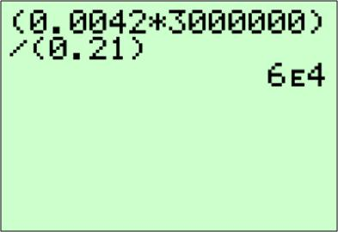
Example 9: Scientific Notation and Calculators (cont.)
Solution
With a TI-84 Plus calculator (set in scientific notation mode) the display should appear as shown below. Note that the E in the display indicates an exponent with base 10.

Slide 35
Example 9: Scientific Notation and Calculators (cont.)
b. A light-year is the distance light travels in one year. Use a graphing calculator to find the length of a light-year in scientific notation if light travels 186,000 miles per second.
Solution
60 sec = 1 minute
60 min = 1 hour
24 hr = 1 day
365 days = 1 year

Slide 36
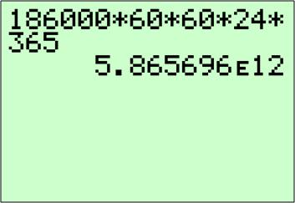
Example 9: Scientific Notation and Calculators (cont.)
Multiplication gives the following display on your
calculator.
Thus a light-year is 5,865,696,000,000 miles (5 trillion, 865 billion, 696 million miles).

Slide 37

Example 9: Scientific Notation and Calculators (cont.)
c. Use a calculator to evaluate the expression
Leave the answer in scientific notation.
Note: Remember, the caret key is used to indicate
an exponent.

Slide 38
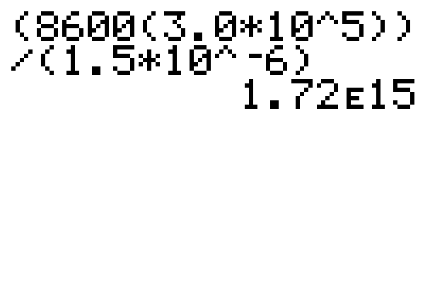
Example 9: Scientific Notation and Calculators (cont.)
Solution
With a graphing calculator (set in scientific notation mode) the display should appear as shown in the following figure.
Note: The numerator and denominator must be set in parentheses.

Slide 39
Practice Problems
Simplify each expression.
1. 2.
3. 4.
5. Write the number in scientific notation: 186,000 miles per second (speed of light in miles per second).

Slide 40
Practice Problem Answers
1. 2. 1 3.
4. 5.

