Slide 1
Section 6.7
Applications of Quadratic Equations

Slide 2
Objectives
Use quadratic equations to solve problems related to numbers, geometry, and consecutive integers.
Solve problems related to the Pythagorean theorem.

Slide 3
Application Problems
Attack Plan for Application Problems
1. Read the problem carefully at least twice.
2. Decide what is asked for and assign a variable or variable expression to the unknown quantities.
3. Organize a chart, table, or diagram relating all the information provided.
4. Form an equation. (A formula of some type may be necessary.)

Slide 4
Application Problems
Attack Plan for Application Problems (cont.)
5. Solve the equation.
6. Check your solution with the wording of the problem to be sure it makes sense.

Slide 5
Example 1: Applications of Quadratic Equations
a. One number is four more than another and the sum of their squares is 296. What are the numbers?
Solution Let x = smaller number.
Then x + 4 = larger number.
Add the squares.
Expand
Write the equation in standard form.
Factor out the GCF.
Factor the trinomial.

Slide 6
Example 1: Applications of Quadratic
Equations (cont.)
There are two sets of answers to the problem: 10 and 14 or −14 and −10.
Check

Slide 7
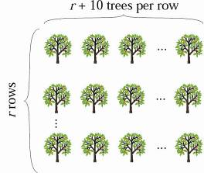
Example 1: Applications of Quadratic
Equations (cont.)
b. In an orange grove, there are 10 more trees in each row than there are rows. How many rows are there if there are 96 trees in the grove?
Solution Let r = number of rows.
Then r + 10 = number of trees per row.
Set up the equation and solve.

Slide 8
Example 1: Applications of Quadratic
Equations (cont.)
There are 6 rows in the grove (6 · 16 = 96 trees).
Note: While −16 is a solution to the equation, −16 does not fit the conditions of the problem and is discarded. You cannot have −16 rows.

Slide 9
Example 1: Applications of Quadratic
Equations (cont.)
c. A rectangle has an area of 135 square meters and perimeter of 48 meters. What are the dimensions of the rectangle?
Solution
The area of a rectangle is the product of its length and width (A = lw).
The perimeter of a rectangle is given by P = 2l + 2w.
Since the perimeter is 48 meters, then the length plus the width must be 24 meters (one-half of the perimeter).

Slide 10
Example 1: Applications of Quadratic
Equations (cont.)
Let w = width. Then 24 − w = length.
Set up the equation and solve.
The dimensions are 9 meters by 15 meters (9 ⋅ 15 = 135).
w
24 − w
Area = lw = length times width

Slide 11
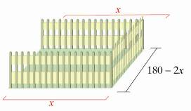
Example 1: Applications of Quadratic
Equations (cont.)
d. A man wants to build a fence on three sides of a rectangular-shaped lot he owns. If 180 feet of fencing is needed and the area of the lot is 4000 square feet, what are the dimensions of the lot?
Solution Let x = one of two equal sides.
Then 180 − 2x = third side.
Set up the equation and solve.

Slide 12
Example 1: Applications of Quadratic
Equations (cont.)
Third side
Thus there are two possible answers: the lot is 50 feet by 80 feet or the lot is 40 feet by 100 feet.

Slide 13
Consecutive Integers
Consecutive Integers
Integers are consecutive if each is 1 more than the previous integer. Three consecutive integers can be represented as n, n + 1, and n + 2.
For example: 5, 6, 7

Slide 14
Consecutive Integers
Consecutive Even Integers
Even integers are consecutive if each is 2 more than the previous even integer. Three consecutive even integers can be represented as n, n + 2, and n + 4, where n is an even integer.
For example: 24, 26, 28

Slide 15
Consecutive Integers
Consecutive Odd Integers
Odd integers are consecutive if each is 2 more than the
previous odd integer. Three consecutive odd integers
can be represented as n, n + 2, and n + 4, where n is an
odd integer.
For example: 41, 43, 45

Slide 16
Example 2: Consecutive Integers
a. Find two consecutive positive integers such that the sum of their squares is 265.
Solution Let n = first integer
n + 1 = next consecutive integer
Set up and solve the related equation.

Slide 17
Example 2: Consecutive Integers (cont.)
Consider the solution n = −12. The next consecutive integer, n + 1, is −11. While it is true that the sum of their squares is 265, we must remember that the problem calls for positive consecutive integers. Therefore, we can only consider positive solutions. Hence, the two integers are 11 and 12.

Slide 18
Example 2: Consecutive Integers (cont.)
b. Find three consecutive odd integers such that the product of the first and second is 68 more than the third.
Solution Let n = first odd integer
and n + 2 = second consecutive odd integer
and n + 4 = third consecutive odd integer.
Set up and solve the related equation.

Slide 19
Example 2: Consecutive Integers (cont.)
The three consecutive odd integers are −9, −7, and −5.
Note that 8, 10 and 12 are even and therefore cannot be considered a solution to the problem.

Slide 20
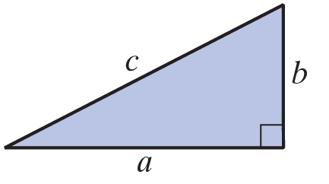
The Pythagorean Theorem
The Pythagorean Theorem
In a right triangle, if c is the length of the hypotenuse and a and b are the lengths of the legs, then

Slide 21
Example 3: The Pythagorean Theorem
A support wire is 25 feet long and stretches from a tree to a point on the ground. The point of attachment on the tree is 5 feet higher than the distance from the base of the tree to the point of attachment on the ground. How far up the tree is the point of attachment?
Solution
Let x = distance from base of tree to point of attachment on ground,
then x + 5 = height of point of attachment on tree.

Slide 22
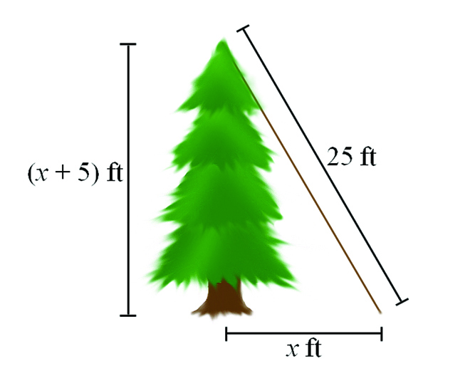
Example 3: The Pythagorean Theorem (cont.)
By the Pythagorean theorem, we have:

Slide 23
Example 3: The Pythagorean Theorem (cont.)
Because distance is positive, −20 is not a possible solution.
The solution is
x = 15
and x + 5 = 20.
Thus the point of attachment is 20 feet up the tree.

