Slide 1
Section 7.4
Solving Equations with Rational Expressions

Slide 2
Objectives
Solve proportions.
Solve other equations with rational expressions.

Slide 3
Proportions
Proportion
A proportion is an equation stating that two ratios are
equal. In symbols, is a proportion.

Slide 4
Example 1: Proportions
Solve the following proportions.
Solution
LCD = 6x
Note: x ≠ 0
Multiply both sides by the LCD, 6x.

Slide 5
Example 1: Proportions (cont.)
Check
Thus the solution is x = 9.

Slide 6
Example 1: Proportions (cont.)
Solution
LCD = x(x – 6)
Note: x ≠ 0, 6
Multiply both sides by the LCD, x(x – 6).

Slide 7
Example 1: Proportions (cont.)
Check
Thus the solution is x = 15.

Slide 8
Example 2: Application of Proportions
On an architect’s scale drawing of a home, inch
represents 10 feet. What length does a measure of inches represent?
Solution
Set up a proportion representing the information. In this example the numerators are the same type (inches) and the denominators are the same type (feet).

Slide 9
Example 2: Application of Proportions (cont.)

Slide 10
Example 2: Application of Proportions (cont.)
On this drawing, inches represent 50 feet.

Slide 11
Proportions
Notes
Any of the following four equations could have been used to solve the problem in Example 2:
Agree in type

Slide 12
Proportions
Notes (cont.)
Correspond:

Slide 13
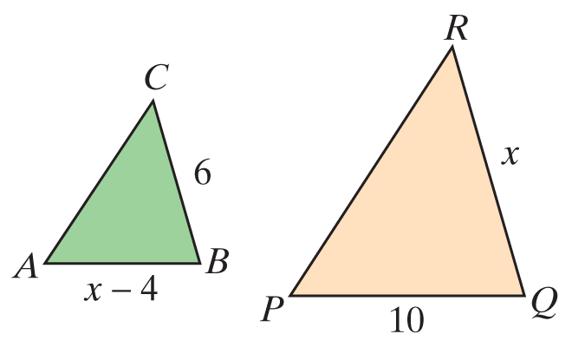
Example 3: Similar Triangles
In the figure shown, ΔABC ∼ ΔPQR. Find the lengths of the sides AB and QR.

Slide 14
Example 3: Similar Triangles (cont.)
Solution
Set up a proportion involving corresponding sides and solve for x.

Slide 15
Example 3: Similar Triangles (cont.)
Because the length of a side cannot be negative, the
only acceptable solution is x = 10. Thus
Substituting 10 for x gives

Slide 16
Solving Equations with Rational Expressions
To Solve an Equation Containing Rational Expressions
1. Find the LCD of the fractions.
2. Multiply both sides of the equation by this LCD and simplify.
3. Solve the resulting equation. (This equation will have only polynomials on both sides.)
4. Check each solution in the original equation. (Remember that no denominator can be 0 and any solution that gives a 0 denominator is to be discarded.)

Slide 17
Example 4: Solving Equations Involving Rational Expressions
State any restrictions on the variable, and then solve the equation.
Solution
First find the LCD of the fractions, and then multiply both sides of the equation by the LCD.

Slide 18
Example 4: Solving Equations Involving Rational Expressions (cont.)

Slide 19
Example 4: Solving Equations Involving Rational Expressions (cont.)
Since 6 and 2 are not restrictions, there are two solutions, x = 6 and x = 2.

Slide 20
Example 4: Solving Equations Involving Rational Expressions (cont.)
Solution
First find the LCD of the fractions and then multiply each term on both sides of the equation by the LCD.

Slide 21
Example 4: Solving Equations Involving Rational Expressions (cont.)

Slide 22
Example 4: Solving Equations Involving Rational Expressions (cont.)
The only solution is since 2 is a restricted value
(x ≠ 0, 2) and thus not a solution. No denominator can be 0.

Slide 23
Example 4: Solving Equations Involving Rational Expressions (cont.)
Solution
First find the LCD of the fractions and then multiply each term on both sides of the equation by the LCD.

Slide 24
Example 4: Solving Equations Involving Rational Expressions (cont.)
Note that 3 is one of the restrictions.

Slide 25
Example 4: Solving Equations Involving Rational Expressions (cont.)
There is no solution. The solution set is the empty set, ∅. The original equation is a contradiction.

Slide 26
Example 5: Solving a Formula for a Specified Variable
The formula S = 2π r² + 2π rh is used to find the surface area (S) of a right circular cylinder, where r is the radius of the cylinder and h is the height of the cylinder. Solve the formula for h.
Solution

Slide 27
Example 5: Solving a Formula for a Specified Variable (cont.)

Slide 28
Practice Problems
Solve each proportion. State any restrictions on the variable.
3. On a road map, each inch represents 50 miles. What distance is represented by 4.5 inches on the map?

Slide 29
Practice Problems (cont.)
Solve each equation. State any restrictions on the variable.
6. Solve the formula A = P + Pr for r.

Slide 30
Practice Problem Answers

