Slide 1
Section 7.6
Variation

Slide 2
Objectives
Solve problems related to direct variation.
Solve problems related to inverse variation.
Solve problems involving combined variation.

Slide 3
Direct Variation
Direct Variation
A variable quantity y varies directly as (or is directly proportional to) a variable x if there is a constant k such that
The constant k is called the constant of variation.

Slide 4
Example 1: Direct Variation
If y varies directly as x, and y = 6 when x = 2, find y if x = 6.
Solution
So y = 3x. Thus if x = 6, then y = 3 ⋅ 6 = 18.

Slide 5
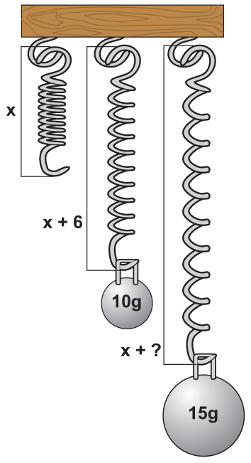
Example 2: Direct Variation
A spring will stretch a greater distance as more weight is placed on the end of the spring. The distance d the spring stretches varies directly as the weight w placed at the end of the spring.
This is a property of springs studied in physics and is known as Hooke’s Law. If a weight of 10 g stretches a certain spring
6 cm, how far will the spring stretch with a weight of 15 g? (Note: We assume that the weight is not so great as to break the spring.)

Slide 6
Example 2: Direct Variation (cont.)
Solution
Because the two variables are directly proportional, the relationship can be indicated with the formula
d = k · w
First, substitute the given information to find the value for k. (The value of k will depend on the particular spring. Springs made of different material or which are wound more tightly will have different values for k.)
where d = distance spring stretches in cm,
w = weight in g,
and k = constant of variation.

Slide 7
Example 2: Direct Variation (cont.)

Slide 8
Inverse Variation
Inverse Variation
A variable quantity y varies inversely as (or is inversely proportional to) a variable x if there is a constant k such that
The constant k is called the constant of variation.

Slide 9
Example 3: Inverse Variation
If y varies inversely as the cube of x, and y = −1 when x = 3, find y if x = −3.
Solution

Slide 10
Example 3: Inverse Variation (cont.)

Slide 11

Example 4: Inverse Variation
The gravitational force F between an object and the Earth is inversely proportional to the square of the distance d from the object to the center of the Earth. Hence we have the formula
(As the distance of an object from the Earth becomes larger, the gravitational force exerted by the Earth on the object becomes smaller.)

Slide 12
Example 4: Inverse Variation (cont.)
If an astronaut weighs 200 pounds on the surface of the Earth, what will he weigh 100 miles above the Earth? Assume that the radius of the Earth is 4000 miles.
Solution
We know F = 200 = 2 × 10² pounds
when d = 4000 = 4 × 10³ miles.
Use scientific notation to make values simpler to work with in the calculations.

Slide 13
Example 4: Inverse Variation (cont.)
When the astronaut is 100 miles above the Earth,
d = 4100 = 4.1 × 10³ miles. Then
That is, 100 miles above the Earth the astronaut will weigh about 190 pounds.

Slide 14
Example 5: Joint Variation
If z varies jointly as x² and y, and z = 18 when x = 2 and y = 4, what is z when x = 4 and y = 3?
Solution

Slide 15
Example 5: Joint Variation (cont.)
If x = 4 and y = 3, then

Slide 16
Example 6: More Variation
a. The distance an object falls varies directly as the square of the time it falls (until it hits the ground and assuming little or no air resistance). If an object fell 64 feet in two seconds, how far would it have fallen by the end of 3 seconds?
Solution

Slide 17
Example 6: More Variation (cont.)
The object would have fallen 144 feet in 3 seconds.

Slide 18
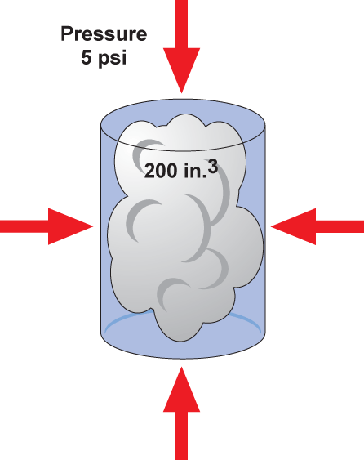
Example 6: More Variation (cont.)
b. The volume of a gas in a container varies inversely as the pressure on the gas. If a gas has a volume of 200 cubic inches under pressure of 5 pounds per square inch, what will be its volume if the pressure is increased to 8 pounds per square inch?

Slide 19
Example 6: More Variation (cont.)

Slide 20
Example 6: More Variation (cont.)
c. The safe load L of a wooden beam supported at both ends varies jointly as the width w and the square of the depth d and inversely as the length l. A 3 in. wide by 10 in. deep beam that is 8 ft long supports a load of 9600 lb safely. What is the safe load of a beam of the same material that is 4 in. wide, 9 in. deep, and 12 ft long?

Slide 21
Example 6: More Variation (cont.)

Slide 22
Example 6: More Variation (cont.)

Slide 23
Practice Problems
1. The length that a hanging spring stretches varies directly as the weight placed on the end of the spring. If a weight of 5 mg stretches a certain spring 3 cm, how far will the spring stretch with a weight of 6 mg?
2. The volume of propane in a container varies inversely to the pressure on the gas. If the propane has a volume of 200 in.³ under a pressure of 4 lb per in.², what will be its volume if the pressure is increased to 5 lb per in.²?

Slide 24
Practice Problem Answers

