Slide 1
Section 8.1
Systems of Linear Equations: Solutions by Graphing

Slide 2
Objectives
Determine if given points lie on both lines in a specified system of equations.
Estimate, by graphing, the coordinates of the intersection of a system of linear equations with one solution.
Use a graphing calculator to solve a system of linear equations.

Slide 3
Example 1: Solution of a System
Show that (2, 1) is a solution to the system
Solution
Substitute x = 2 and y = 1 into both equations.
In the first equation:

Slide 4
Example 1: Solution of a System (cont.)
In the second equation:
Because (2, 1) satisfies both equations, (2, 1) is a solution to the system.

Slide 5
Example 2: Not a Solution of a System
Show that (0, 4) is not a solution to the system
Solution
Substitute x = 0 and y = 4 into both equations.
In the first equation:

Slide 6
Example 2: Not a Solution of a System (cont.)
In the second equation:
Because (0, 4) does not satisfy both equations, (0, 4) is NOT a solution to the system.

Slide 7
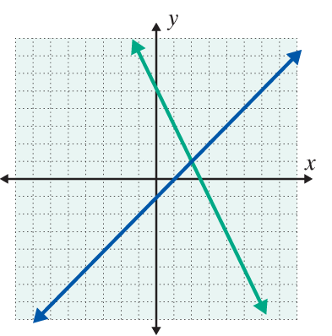
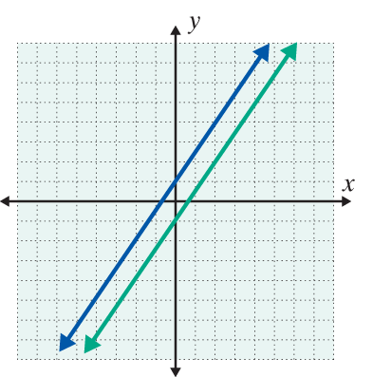
Solving Systems of Linear Equations by Graphing
System | Graph | Intersection | Classification
 |  | (2,1) (The lines intersect at one point.) | Consistent
 |  | No solution (The lines are parallel.) | Inconsistent

Slide 8
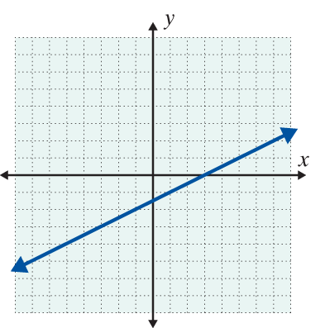
Solving Systems of Linear Equations by Graphing (cont.)
System | Graph | Intersection | Classification
 |  | Every ordered pair that satisfies x − 2y = 3. (The lines are the same line.) There is an infinite number of solutions: (3+2y, y), where y is any real number or where x is any real number | Dependent

Slide 9
Solutions by Graphing
To Solve a System of Linear Equations by Graphing
1. Graph both linear equations on the same set of axes.
2. Observe the point of intersection (if there is one).
a. If the slopes of the two lines are different, then the lines intersect in one and only one point. The system has a single point as its solution.
b. If the lines are distinct and have the same slope, then the lines are parallel. The system has no solution.

Slide 10
Solutions by Graphing
To Solve a System of Linear Equations by Graphing (cont.)
c. If the lines are the same line, then all the points on the line constitute the solution. There is an infinite number of solutions.
3. Check the solution (if there is one) in both of the original equations.

Slide 11
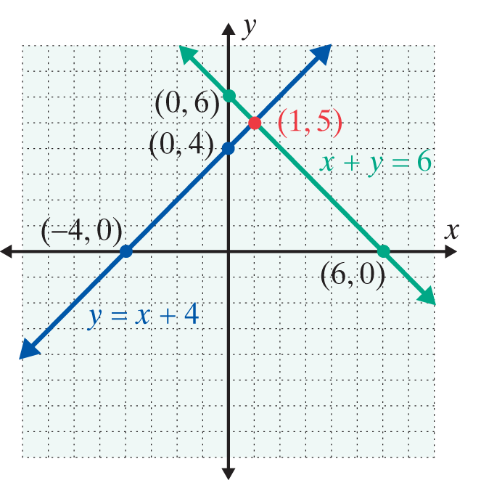
Example 3: A System With One Solution
Solve the following system of linear equations by
graphing:
Solution
The two lines intersect at
the point (1, 5). Thus the
solution to the system is
(1, 5) or x = 1 and y = 5.

Slide 12
Example 3: A System With One Solution (cont.)
Check
Substitution shows that (1, 5) satisfies both of the equations in the system.

Slide 13
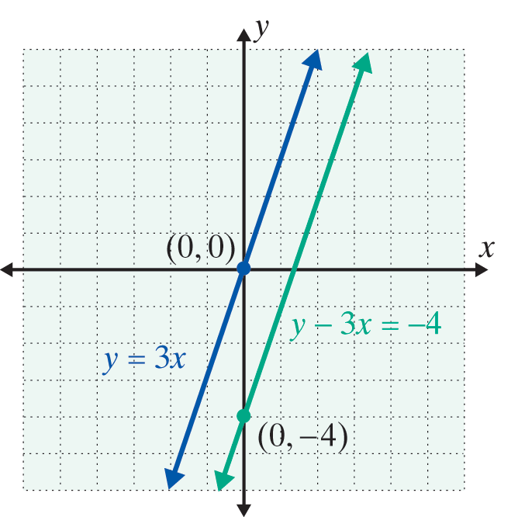
Example 4: A System With No Solution
Solve the following system of linear equations by
graphing:
Solution
The lines are parallel with the
same slope, 3, and there are
no points of intersection.
There is no solution to the
system.

Slide 14
Example 5: A System With Infinitely Many Solutions
Solve the following system of linear equations by
graphing:
Solution
All points that lie on one line also lie on the other line. For example, (4, 1) is a point on the line x + 2y = 6 since
4 + 2(1) = 6. The point (4, 1) is also on the line
since

Slide 15
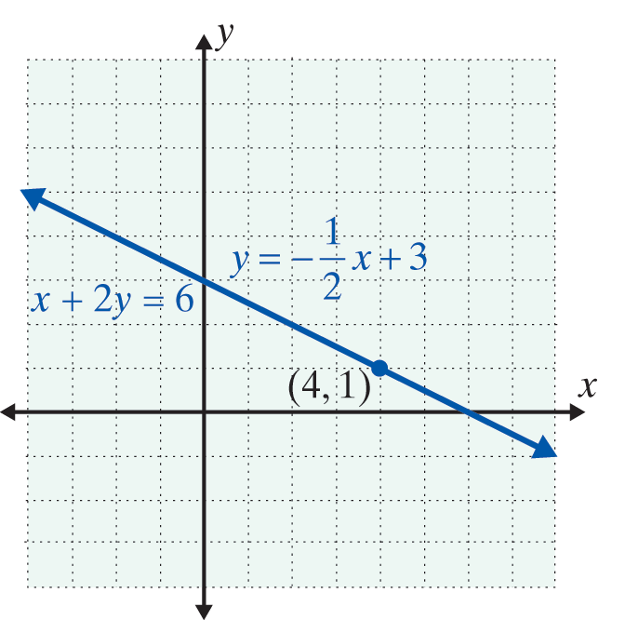
Example 5: A System With Infinitely Many Solutions (cont.)
Therefore, the solution can be stated as all of the points that satisfy the equation x + 2y = 6.
The solution is the set of all
points of the form
an infinite set of solutions. (Or, solving the first equation for x we have (6 – 2y, y) for all values of y.)

Slide 16
Example 6: A System That Requires Estimation
Solve the following system of linear equations by
graphing:
Solution
The two lines intersect at one point. However, we can
only estimate the point of intersection as In
this situation be aware that, although graphing gives a good “estimate,” finding exact solutions to the system is not likely.

Slide 17
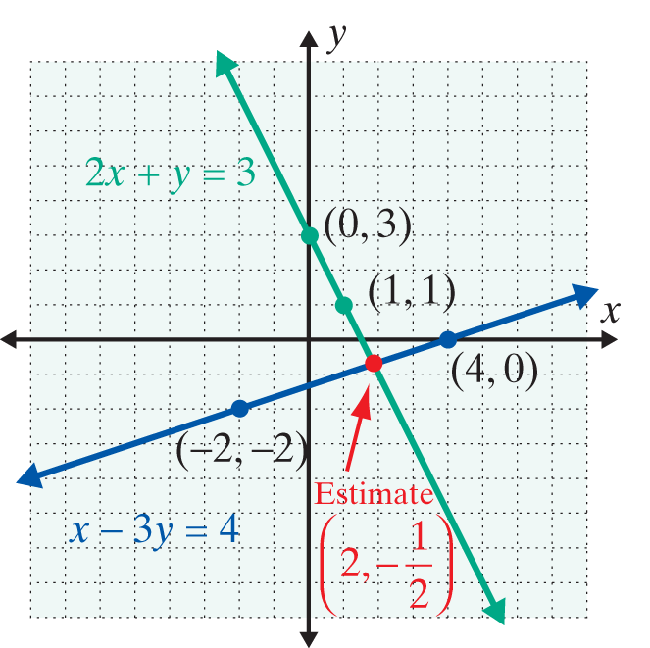
Example 6: A System That Requires Estimation (cont.)

Slide 18
Example 6: A System That Requires Estimation (cont.)
Thus checking shows that the estimated solution
does not satisfy either equation. The estimated point of intersection is just that—an estimate. The following discussion provides a technique based on using of a graphing calculator that would give the exact solution
as

Slide 19
Solutions by Graphing
Notes
1. To use the graphing method, graph the lines as accurately as you can.
2. Be sure to check your solution by substituting it back into both of the original equations. (Of course, fractional estimates may not check exactly.)

Slide 20
Example 7: Using a Graphing Calculator
Use a graphing calculator to solve the system
as follows:
Solution
Step 1: Solve each equation for y.
For this system

Slide 21


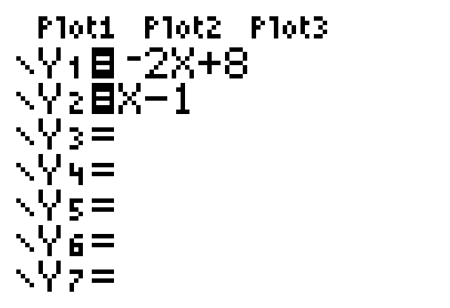
Example 7: Using a Graphing Calculator (cont.)
Step 2:
Press and enter the two expressions for y.
To get the variable X, press .
The display screen will appear as follows:

Slide 22




Example 7: Using a Graphing Calculator (cont.)
Step 3: Press .
(Both lines should appear. If not, you may need to adjust the .)
Step 4: Press and CALC. Select 5:intersect.
The cursor will appear on one of the lines. Use the right or left arrow to get near the point of intersection and press . Then move the up or down arrow to
get to the other line.

Slide 23
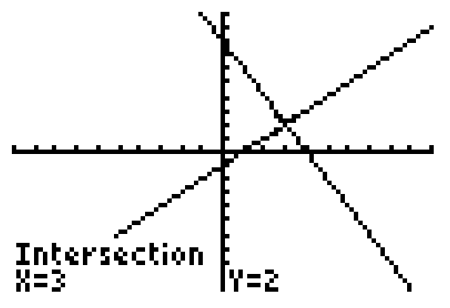
Example 7: Using a Graphing Calculator (cont.)
Now use the right or left arrow to move closer to the point of intersection on this line and press .
Follow the directions for Guess? by moving the cursor to the point of intersection and pressing .
Step 5: The answer x = 3 and y = 2 will appear at the bottom of the display screen.

Slide 24
Example 7: Using a Graphing Calculator (cont.)
Note: Step 4 may seem somewhat complicated, but TRY IT. It is fun and accurate! (Note: If the lines are parallel (an inconsistent system) the calculator will give an error message.)

Slide 25
Practice Problems
1. Determine which of the given points, if any, lie on both of the lines in the given system of equations by substituting each point into both equations.
a. (8, 0) b. (2, 3) c. (0, −1) d. (4, 2)

Slide 26
Practice Problems (cont.)
2. Show that the following system of equations is inconsistent by determining the slope of each line and the y-intercept. Explain your reasoning.
3. Solve the following system graphically.

Slide 27
Practice Problem Answers
1. b
2.
The lines do not intersect because they are parallel, they have the same slope, but different y-intercepts.
3. (x, 2x + 5)

