Slide 1
Section 8.5
Applications: Interest and Mixture

Slide 2
Objectives
Use systems of linear equations to solve the following types of applied problems:
interest, and
mixture.

Slide 3
Example 1: Interest
James has two investment accounts, one pays 6%
interest and the other pays 10% interest. He has $1000
more in the 10% account than he has in the 6%
account. Each year, the interest from the 10% account
is $260 more than the interest from the 6% account.
How much does he have in each account?
Solution
Careful reading indicates two types of information:
1. He has two accounts.
2. He earns two amounts of interest.

Slide 4
Example 1: Interest (cont.)
Let x = amount (principal) invested at 6%
y = amount (principal) invested at 10%,
then 0.06x = interest earned on first account
0.10y = interest earned on second account.
Now set up two equations.
y is larger than x by $1000.
Interest from the 10% account is $260 more than interest from the 6% account.

Slide 5
Example 1: Interest (cont.)
Because the first equation is already solved for y, we
use the substitution method and substitute for y in the
second equation.
Multiply by 100.
Amount at 6%.

Slide 6
Example 1: Interest (cont.)
Back substitute x = 4000 into one of the original
equations to find y.
James has $4000 invested at 6% and $5000 invested at 10%.
Amount at 10%.

Slide 7
Example 2: Interest
Lila has $7000 to invest. She decides to separate her funds into two accounts. One yields interest at the rate of 7% and the other at 12%. If she wants a total annual income from both accounts to be $690, how should she split the money? (Note: The higher interest account is considered more risky. Otherwise, she would put the entire $7000 into that account.)
Solution
Again, careful reading indicates two types of information:

Slide 8
Example 2: Interest (cont.)
1. She has two accounts.
2. She earns two amounts of interest.
Let x = amount (principal) invested at 7%
y = amount (principal) invested at 12%,
then 0.07x = interest earned on first account
0.12y = interest earned on second account.
Now set up two equations.
The sum of both accounts is $7000.
The total interest from both accounts is $690.

Slide 9
Example 2: Interest (cont.)
Both equations are in standard form. Solve by addition.
Multiply the first equation by −7 and the second by 100
to get opposite coefficients for x as follows:
Amount at 12%

Slide 10
Example 2: Interest (cont.)
Substitute y = 4000 into one of the original equations.
x + 4000 = 7000
x = 3000
She should invest $3000 at 7% and $4000 at 12%.
Amount at 7%

Slide 11
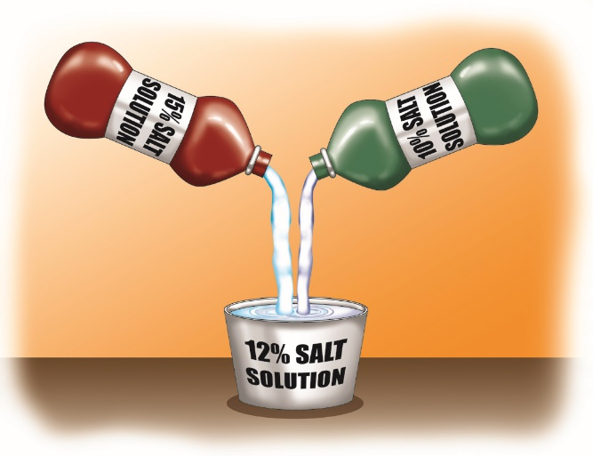
Example 3: Mixture
How many ounces each of a 10% salt solution and a
15% salt solution must be used to produce 50 ounces
of a 12% salt solution?
Solution Let x = amount of 10% solution
and y = amount of 15% solution.

Slide 12
Example 3: Mixture (cont.)
Amount of solution × Percent of salt = Amount of salt
10% solution | x | 0.10 | 0.10x
15% solution | y | 0.15 | 0.15y
12% solution | 50 | 0.12 | 0.12(50)
Then the system of linear equations is
The sum of the two amounts must be 50 ounces.
The sum of the amounts of salt from the two solutions equals the total amount of salt in the final solution.

Slide 13
Example 3: Mixture (cont.)
Multiplying the first equation by −10 and the second by
100 gives
Amount of 15%

Slide 14
Example 3: Mixture (cont.)
Substitute y = 20 into one of the original equations.
Use 30 ounces of the 10% solution and 20 ounces of the 15% solution.
Amount of 10%

Slide 15
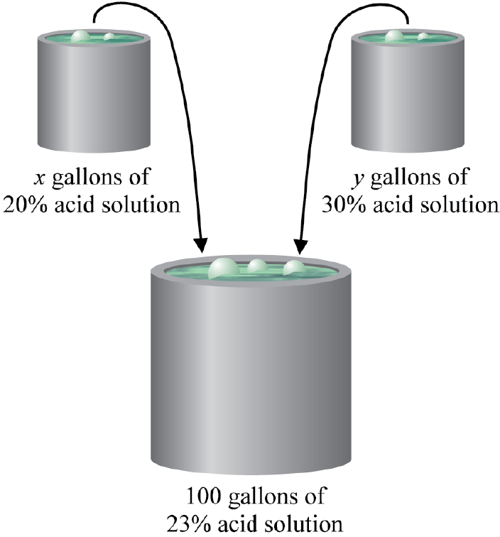
Example 4: Mixture
How many gallons of a 20% acid solution should be
mixed with a 30% acid solution to produce 100 gallons
of a 23% solution?
Solution
Let x = amount of 20% solution
and y = amount of 30% solution.

Slide 16
Example 4: Mixture (cont.)
Amount of solution × Percent of acid = Amount of acid
20% solution | x | 0.20 | 0.20x
30% solution | y | 0.30 | 0.30y
23% solution | 100 | 0.23 | 0.23(100)
Then the system of linear equations is
The sum of the two amounts must be 100 gallons.
The sum of the amounts of acid from the two solutions equals the total amount of acid in the final solution.

Slide 17
Example 4: Mixture (cont.)
Multiplying the first equation by −20 and the second by
100 gives,
Amount of 30%

Slide 18
Example 4: Mixture (cont.)
Substitute y = 30 into one of the original equations.
x + 30 = 100
x = 70
Seventy gallons of the 20% solution should be added to thirty gallons of the 30% solution. This will produce 100 gallons of a 23% solution.
Amount of 20%

