Slide 1
Section 9.1
Roots and Radicals

Slide 2
Objectives
Evaluate square roots.
Evaluate cube roots.
Use a calculator to evaluate square and cube roots.

Slide 3
Perfect Squares and Square Roots
Radical Terminology
The symbol is called a radical sign.
The number under the radical sign is called the radicand.
The complete expression, such as is called a radical or radical expression.

Slide 4
Perfect Squares and Square Roots
Square Root
If a is a nonnegative real number, then
is the principal square root of a,
and is the negative square root of a.

Slide 5
Perfect Squares and Square Roots
Note
Square roots of negative numbers are not real numbers. For example, is not a real number. There is no real number whose square is −4. Numbers of this type will be discussed in Section 9.7.

Slide 6
Example 1: Evaluating Square Roots
a. 64 has two square roots, one positive and one negative. The sign is understood to represent the positive square root (or the principal square root) and represents the negative square root. Therefore, we have
b. Because 11² = 121, we have

Slide 7
Example 1: Evaluating Square Roots (cont.)
c. Because 0² = 0,
d. is not a real number.

Slide 8
Example 2: Evaluating Square Roots

Slide 9
Example 3: Estimating Square Roots
A calculator will give accurate to four places. Check that this is a reasonable estimate.
Solution
Because 25 < 30 < 36, we have
The approximation 5.4772 is between 5 and 6 and is reasonable.
Another approach is to square as follows:
(5.4772)² = 29.99971984 which is close to 30.

Slide 10
Cube Roots
Cube Root
If a is a real number, then
is the cube root of a.

Slide 11
Cube Roots
Note
In the cube root expression the number 3 is called the index. In a square root expression such as the index is understood to be 2 and is not written. Expressions with square roots and cube roots (as well as other roots) are called radical expressions.

Slide 12
Example 4: Evaluating Cube Roots
a. Because
b. Because
c. Because
Note that the cube root of a negative number is a real number and is negative.

Slide 13

Example 5: Evaluating Radical Expressions with a Calculator
The following radical expressions are evaluated by using a TI-84 Plus graphing calculator. In each example the steps (or keys to press) are shown. The TI-84 Plus gives answers accurate up to nine decimal places. You may choose (through the key) to have answers accurate to fewer than nine places.
Solution
To find proceed as follows:

Slide 14






Example 5: Evaluating Radical Expressions with a Calculator (cont.)
Step 1: Press to get the square root
symbol . (Note: When the symbol
appears, it will appear with a left-hand parenthesis. You should press the right-hand parenthesis to close the square root operation.)
Step 2: Enter and the right-hand
parenthesis .
Step 3: Press .

Slide 15
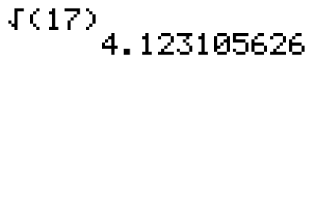
Example 5: Evaluating Radical Expressions with a Calculator (cont.)
The display will appear as follows:

Slide 16



Example 5: Evaluating Radical Expressions with a Calculator (cont.)
Note: This expression represents 3 times
Solution
To find proceed as follows:
Step 1: Enter .
Step 2: Press . (This gives the
symbol.)
Step 3: Enter and the right-hand
parenthesis .
Step 4: Press .

Slide 17
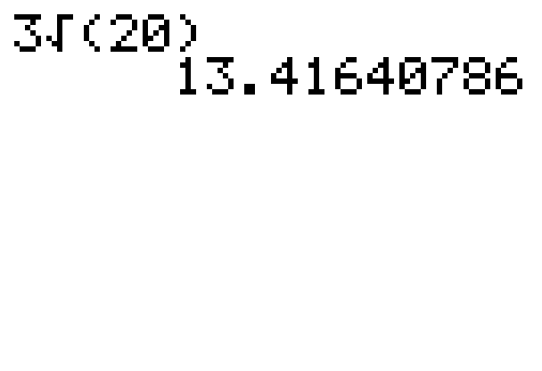
Example 5: Evaluating Radical Expressions with a Calculator (cont.)
The display will appear as follows:

Slide 18

Example 5: Evaluating Radical Expressions with a Calculator (cont.)
Note: The calculator is programmed to follow the rules for order of operations.
Solution
To find proceed as follows:
Step 1: Enter .
Step 2: Press the key.
Step 3: Enter .
Step 4: Press (This gives the symbol.)

Slide 19


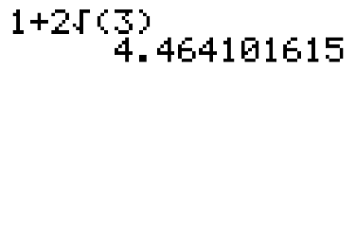
Example 5: Evaluating Radical Expressions with a Calculator (cont.)
Step 5: Enter and the right-hand parenthesis
Step 6: Press .
The display will appear as follows:

Slide 20
Practice Problems
Simplify the following square roots and cube roots.
Use your knowledge of square roots and cube roots to determine whether each number is rational, irrational, or nonreal.

Slide 21
Practice Problems (cont.)
Use your calculator to find the value (accurate to four decimal places) of each of the following radical expressions.

Slide 22
Practice Problem Answers
1. 7 2. 5 3. −5
4. 14 5. Rational 6. Rational
7. Nonreal 8. Irrational 9. 7.0711
10. −4.5830

