Slide 1
Section 9.3
Rational Exponents

Slide 2
Objectives
Understand the meaning of n^{th} root.
Translate expressions using radicals into expressions using rational exponents and translate expressions using rational exponents into expressions using radicals.
Simplify expressions using the properties of rational exponents.
Evaluate expressions of the form with a calculator.

Slide 3
Radical Notation
If n is a positive integer, then (assuming is a
real number).
The expression is called a radical.
The symbol is called a radical sign.
n is called the index.
a is called the radicand.
Note: If no index is given, it is understood to be 2. For
example,

Slide 4
Notes
Special Notes about the Index n:
For the expression to be a real number:
1. when a is nonnegative, n can be any index, and
2. when a is negative, n must be odd. (If a is negative and n is even, then is nonreal.)

Slide 5
Example 1: Evaluating Principal n^{th} Roots
Any even root of a
negative number is
nonreal.

Slide 6
Rational Exponents of the Form
Summary of the Rules for Exponents
For nonzero real numbers a and b and rational
numbers m and n,
The exponent 1: (a is any real number.)
The exponent 0:
The product rule:
The quotient rule:

Slide 7
Rational Exponents of the Form
Summary of the Rules for Exponents (cont.)
Negative exponents:
Power rule:
Power of a product:
Power of a quotient:

Slide 8
Rational Exponents of the Form
If n is a positive integer, m is any integer, and is a
real number, then
In radical notation:

Slide 9
Example 2: Conversion from Exponential Notation to Radical Notation
Assume that each variable represents a positive real
number. Each expression is changed to an equivalent
expression in either radical or exponential notation.
Note that the index, 3, is the denominator in the rational exponent.
Note that the coefficient, 3, is not affected by the exponent.
Note that −1 is the understood coefficient.

Slide 10
Example 2: Conversion from Exponential Notation to Radical Notation (cont.)
Note that the index, 6, is the denominator of the rational exponent.
Note that in a square root the index is understood to be 2.
Note that the coefficient, −1, is not affected
by the exponent. Also, we could write

Slide 11
Simplifying Expressions with Rational Exponents
Notes
Unless otherwise stated, we will assume, for the remainder of this chapter, that all variables represent positive real numbers.

Slide 12
Example 3: Simplifying Expressions with Rational Exponents
Each expression is simplified using one or more of the rules for exponents.
Find a common denominator and add the exponents.
Find a common denominator and subtract the exponents.

Slide 13
Example 3: Simplifying Expressions with Rational Exponents (cont.)
Multiply the exponents of y and reduce the fraction to
This is not a real number because
is not real.
The exponent can be reduced as long as the expression is real.

Slide 14
Example 3: Simplifying Expressions with Rational Exponents (cont.)
Study this example carefully.
Use the power rule four times.
Simplify exponents.
Use the properties of negative exponents.

Slide 15
Example 4: Simplifying Radical Notation by Changing to Exponential Notation
Simplify each expression by first changing it into an equivalent expression with rational exponents. Then rewrite the answer in simplified radical form.

Slide 16
Example 4: Simplifying Radical Notation by Changing to Exponential Notation (cont.)

Slide 17


Evaluating Roots with a TI-84 Plus Calculator (The key)
To Find the Value of with a TI-84 Plus Graphing Calculator
1. Enter the value of the base, a.
2. Press the caret key .
3. Enter the fractional exponent enclosed in
parentheses. (This exponent may be positive or
negative.)
4. Press .

Slide 18

Example 5: Evaluating Rational Exponents with a Calculator
Evaluate the following expressions using a TI-84 Plus graphing calculator.
Solution To find proceed as follows.
Step 1: Enter the base, 125.
Step 2: Press the caret key .
Step 3: Enter the exponent in parentheses,
Step 4: Press .

Slide 19
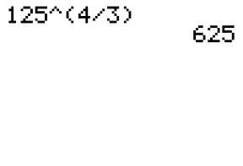
Example 5: Evaluating Rational Exponents with a Calculator (cont.)
The display should read as follows.

Slide 20
Example 5: Evaluating Rational Exponents with a Calculator (cont.)
Solution To find proceed as follows.
Step 1: Enter the base, 36.
Step 2: Press the caret key .
Step 3: Enter the exponent in parentheses,
Step 4: Press .

Slide 21
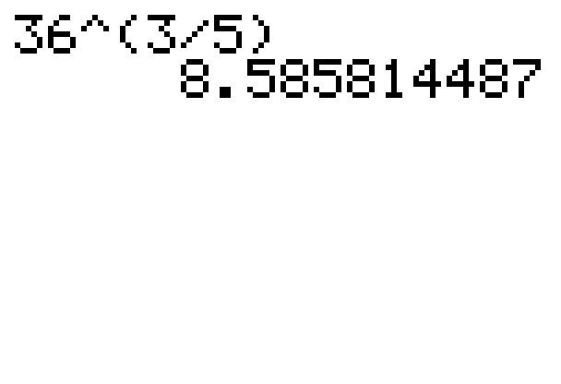
Example 5: Evaluating Rational Exponents with a Calculator (cont.)
The display should read as follows.

Slide 22
Practice Problems
Simplify each of the following expressions. Leave
the answers with rational exponents.

Slide 23
Practice Problem (cont.)
Simplify each expression by first changing to an equivalent expression with rational exponents. Rewrite the answer in simplified radical form.
Use a graphing calculator to find the following values accurate to 4 decimal places.

Slide 24
Practice Problem Answers
1. 16 2. 3. 4. 5. −3 6. 7.
8. 9. 2.6390 10. 0.3162

