Slide 1
Section 9.4
Operations with Radicals

Slide 2
Objectives
Perform arithmetic operations with radical expressions.
Rationalize the denominators of radicals.
Use a graphing calculator to evaluate radical expressions.

Slide 3
Example 1: Addition and Subtraction with Radicals
Perform the indicated operation and simplify, if possible. Assume that all variables are positive.
Solution

Slide 4
Example 1: Addition and Subtraction with Radicals (cont.)
Solution
Note that and are not like radicals. Therefore, the last expression is already fully simplified.

Slide 5
Example 1: Addition and Subtraction with Radicals (cont.)
Solution

Slide 6
Example 1: Addition and Subtraction with Radicals (cont.)
Solution

Slide 7
Example 2: Multiplication of Radicals
Multiply and simplify the following expressions.
Solution
Solution

Slide 8
Example 2: Multiplication of Radicals (cont.)

Slide 9
Example 2: Multiplication of Radicals (cont.)
Solution

Slide 10
Example 2: Multiplication of Radicals (cont.)
Solution

Slide 11
Rationalizing Denominators of Rational Expressions
To Rationalize a Denominator Containing a Square Root or a Cube Root
1. If the denominator contains a square root, multiply both the numerator and denominator by an expression that will give a denominator with no square roots.
2. If the denominator contains a cube root, multiply both the numerator and denominator by an expression that will give a denominator with no cube roots.

Slide 12
Example 3: Rationalizing the Denominator
Simplify each radical expression so that the denominator contains no radicals. Assume all variables represent positive numbers.
Solution Multiply the numerator and denominator by
because a perfect square.

Slide 13
Example 3: Rationalizing the Denominator (cont.)
Solution
Multiply the numerator and denominator by
because a perfect square expression.

Slide 14
Example 3: Rationalizing the Denominator (cont.)
Solution
Multiply the numerator and denominator by
because a perfect cube expression.

Slide 15
Rationalizing Denominators of Rational Expressions
To Rationalize a Denominator Containing a Sum or Difference Involving Square Roots
If the denominator of a fraction contains a sum or
difference involving a square root, rationalize the
denominator by multiplying both the numerator and
denominator by the conjugate of the denominator.
1. If the denominator is of the form a − b, multiply
both the numerator and denominator by a + b.

Slide 16
Rationalizing Denominators of Rational Expressions
To Rationalize a Denominator Containing a Sum or Difference Involving Square Roots (cont.)
2. If the denominator is of the form a + b, multiply
both the numerator and denominator by a − b.
The new denominator will be the difference of two
squares and therefore will not contain a radical term.

Slide 17
Example 4: Rationalizing a Denominator with a
Sum or Difference Involving a Square Root
Simplify each expression by rationalizing the denominator.
Solution
Multiply the numerator and denominator by

Slide 18
Example 4: Rationalizing a Denominator with a
Sum or Difference Involving a Square Root (cont.)
The denominator is the difference of two squares.
The denominator is a rational number. Note that the numerator is now irrational. However, this is generally preferred over having an irrational denominator.

Slide 19
Example 4: Rationalizing a Denominator with a
Sum or Difference Involving a Square Root (cont.)
Solution
Multiply the numerator and denominator by

Slide 20
Example 4: Rationalizing a Denominator with a
Sum or Difference Involving a Square Root (cont.)
Solution
Multiply the numerator and denominator by

Slide 21
Example 4: Rationalizing a Denominator with a
Sum or Difference Involving a Square Root (cont.)
Solution
Multiply the numerator and denominator by

Slide 22
Example 4: Rationalizing a Denominator with a
Sum or Difference Involving a Square Root (cont.)
Solution
Multiply the numerator and denominator by

Slide 23
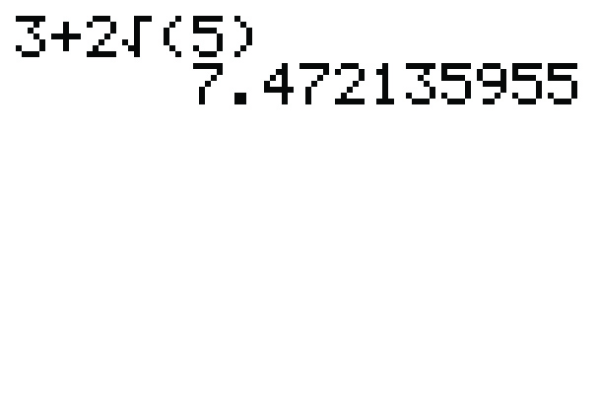
Example 5: Using a TI-84 Graphing Calculator to Evaluate Radical Expressions
Use a TI-84 Plus graphing calculator to evaluate each
expression. Round answers to 4 decimal places.
Solution The display should appear as follows.
Rounded to 4 decimal places.

Slide 24
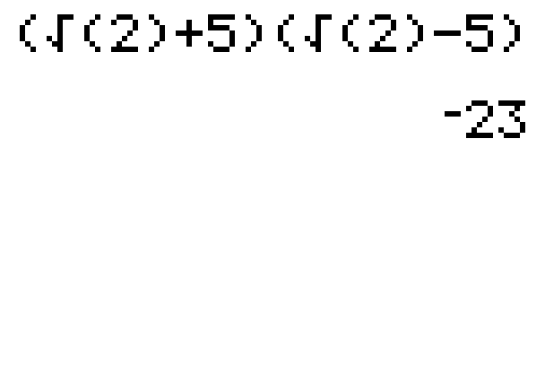
Example 5: Using a TI-84 Graphing Calculator to Evaluate Radical Expressions (cont.)
Solution The display should appear as follows.
Note that the right parenthesis on 2 must be included. Otherwise, the calculator will interpret the expression as
which is not intended.

Slide 25
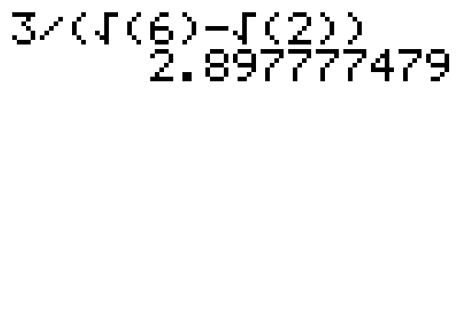
Example 5: Using a TI-84 Graphing Calculator to Evaluate Radical Expressions (cont.)
Solution The display should appear as follows.
Count the parentheses in pairs.
Rounded to 4 decimal places.

Slide 26
Practice Problems
Simplify each expression. Assume that all variables
represent positive numbers.

Slide 27
Practice Problem Answers

